Slide 1

MACHINE UNLEARNING USING PRUNING AND KNOWLEDGE DISTILLATION
First Review – Batch 81
Andrew Blaze - 211FA04255
Nikhil Sai – 211FA04251
Guidance – Dr. K. V. Krishna Kishore

Slide 2
Abstract
This presents a method for “unlearning” specific classes from a trained deep neural network without significantly degrading performance on the retained classes. Our approach combines iterative pruning and knowledge distillation, effectively forcing the model to forget selected classes while preserving its ability to classify the remaining classes.
We demonstrated this on multiple datasets (CIFAR-10, CIFAR-100, Fashion-MNIST, and CelebA), and show reduced membership-inference attack (MIA) success on the forgotten classes, thereby enhancing privacy.

Slide 3
Introduction
Data privacy regulations increasingly mandate the right to be forgotten, which entails removing or “unlearning” certain classes or subsets of training data from an already trained model.
Naively, one could retrain from scratch excluding the classes that must be forgotten; however, this is computationally expensive.
We propose an approach that merges global magnitude-based pruning and knowledge distillation (KD) to expunge information specific to designated classes while retaining most of the original model’s accuracy on the remaining classes.
In addition, we examine the privacy aspects via membership inference attacks (MIA), which test how easily an adversary can determine whether a particular sample belonged to the training set.
After unlearning, the MIA success rate on the forgotten classes drops significantly, demonstrating that the unlearned classes are effectively obfuscated.

Slide 4
Literature Review
Author(s) | Title | Year | Methods Used | Results | Demerits | Remarks
Lang Li, Xiaojun Ren, Hongyang Yan, Xiaozhang Liu, Zhenxin Zhang | Pseudo Unlearning via Sample Swapping with Hash | 2024 | Sample Swapping with Hash (SSH), Membership Inference Attack | Feasible pseudo unlearning scheme validated via MNIST, Fashion-MNIST, CIFAR10/100, SVHN datasets | Risk of dishonest unlearning, limited to specific evaluation metrics | Introduced pseudo unlearning and SSH method for machine unlearning verification.
Yuyuan Li, Chaochao Chen, Xiaolin Zheng, Yizhao Zhang, Biao Gong, Jun Wang, Linxun Chen | Selective and Collaborative Influence Function for Efficient Recommendation Unlearning | 2023 | Selective and Collaborative Influence Function (SCIF), Membership Inference Oracle (MIO) | Enhanced efficiency and completeness for recommendation unlearning using benchmark datasets | High complexity for large-scale systems | Proposed SCIF for efficient and collaborative unlearning in recommender systems.

Slide 5
Chunxiao Li, Haipeng Jiang, Jiankang Chen, Yu Zhao, Shuxuan Fu, Fangming Jing, Yu Guo | An Overview of Machine Unlearning | 2024 | Survey, Exact and Approximate Unlearning, Catastrophic Unlearning Analysis | Provided comprehensive definitions, challenges, and categorized algorithms for machine unlearning | Does not propose new methods; focused on summarizing existing approaches | Focused on challenges, frameworks, and potential future research in machine unlearning.
Ayush K. Tarun, Vikram S. Chundawat, Murari Mandal, Mohan Kankanhalli | Fast Yet Effective Machine Unlearning | 2024 | Error-Maximizing Noise, Impair-Repair Weight Manipulation | Achieved efficient unlearning for multi-class data while retaining model accuracy | Limited scalability for certain deep learning tasks | Introduced UNSIR framework; emphasized scalability and efficiency in deep learning unlearning.
Thanveer Shaik, Xiaohui Tao, Lin Li, Haoran Xie, Taotao Cai, Xiaofeng Zhu, Qing Li | FRAMU: Attention-Based Machine Unlearning Using Federated Reinforcement Learning | 2024 | Federated Reinforcement Learning, Attention Mechanisms | Improved adaptability and privacy preservation in federated learning environments | Complex implementation for multi-modality data | Focused on federated unlearning, privacy preservation, and adaptability in dynamic data landscapes.

Slide 6
Zhuo Ma, Yang Liu, Ximeng Liu, Jian Liu, Jianfeng Ma, Kui Ren | Learn to Forget: Machine Unlearning via Neuron Masking | 2023 | Neuron Masking, Forsaken Unlearning Method | Achieved >90% forgetting rate with <5% accuracy loss on average across datasets | Limited testing on real-world large-scale datasets | Introduced Forsaken for efficient neuron masking and forgetting in neural networks.
Chenghao Shao, Chang Li, Rencheng Song, Xiang Liu, Ruobing Qian, Xun Chen | Machine Unlearning for Seizure Prediction | 2024 | Knowledge Distillation, PCT-net for EEG Signals | Successfully unlearned patient-specific data while maintaining performance for other patients | Limited scope for non-EEG data applications | First study introducing machine unlearning into seizure prediction using EEG data.
Jie Xu, Zihan Wu, Cong Wang, Xiaohua Jia | Machine Unlearning: Solutions and Challenges | 2024 | Survey of Exact and Approximate Unlearning Approaches | Comprehensive analysis of strengths, limitations, and gaps in machine unlearning solutions | No new unlearning methods proposed; limited to taxonomy and overview | Serves as a roadmap for future research in machine unlearning.

Slide 7
Wangkun Xu, Fei Teng | Task-Aware Machine Unlearning and Its Application in Load Forecasting | 2024 | Influence Function, Task-aware Optimization | Balanced unlearning completeness with model performance for load forecasting | Complex optimization may limit scalability | First application of machine unlearning in load forecasting with task-aware optimization.
Vikram S. Chundawat, Ayush K. Tarun, Murari Mandal, Mohan Kankanhalli | Zero-Shot Machine Unlearning | 2023 | Error Minimizing-Maximizing Noise, Gated Knowledge Transfer | Demonstrated zero-shot unlearning for deep learning models without using training data | Performance highly dependent on noise generation effectiveness | Introduced zero-shot unlearning for scenarios without access to original training data.

Slide 8
Problem identification
With the increasing adoption of deep learning models in real-world applications, concerns regarding data privacy and compliance with regulations such as GDPR and the Right to Be Forgotten have driven the need for effective machine unlearning techniques. Existing approaches to machine unlearning face several key challenges:
Scalability and Complexity Issues: Large-scale deep learning models often require complex optimization procedures, making existing unlearning methods computationally expensive and difficult to scale.
Lack of Generalizability: Many studies focus on specific datasets or model architectures, limiting their applicability to diverse real-world scenarios, including multi-modality data.
Limited Real-World Testing: Most existing methods have not been extensively tested on large-scale datasets, reducing their practical effectiveness in real applications.
No New Unlearning Methods Proposed: Many works provide only a taxonomy or a summary of existing approaches rather than introducing new methodologies.

Slide 9
Objective
To address these challenges, we propose a novel machine unlearning framework that integrates iterative model pruning and knowledge distillation to achieve selective data forgetting in deep neural networks. Our approach is designed to:
Efficiently Remove Class-Specific Knowledge: By iteratively pruning model weights associated with the forgotten classes, we systematically erase learned representations while preserving general knowledge.
Retain Model Performance on Retained Data: Using knowledge distillation, we transfer important knowledge from the original model (teacher) to a pruned version (student), ensuring minimal performance degradation on the retained classes.
Enhance Scalability Across Multiple Architectures and Datasets: We evaluate our method on multiple benchmark datasets (CIFAR-10, CIFAR-100, Fashion MNIST, and Celeb A) using different model architectures (ResNet-18, WideResNet-28-10, VGG-16, and ViT).
Improve Practical Applicability: By designing an iterative unlearning framework that can be applied to diverse deep learning tasks, we contribute towards making machine unlearning more feasible for real-world deployments.

Slide 10
Methodology
In this work, we propose a novel machine unlearning framework that combines iterative model pruning and knowledge distillation (KD) to achieve selective data forgetting from deep neural networks.
Specifically, we aim to “forget” a subset of classes from a model previously trained on the CIFAR-10, CIFAR-100, Fashion MNIST, Celeb A datasets.
Our unlearning procedure consists of two main stages, iteratively performed:
1. Model Pruning: Reducing model weights to remove learned representations related to forgotten classes.
2. Knowledge Distillation: Retraining the pruned model (student) with knowledge transferred from the original model (teacher), selectively suppressing information about the forgotten classes.
Models used for these datasets are
CIFAR-10 : RESNET-18
CIFAR100 : WIDERESNET28_10
Fashion MNIST: VGG-16
Celeb A: Vit

Slide 11
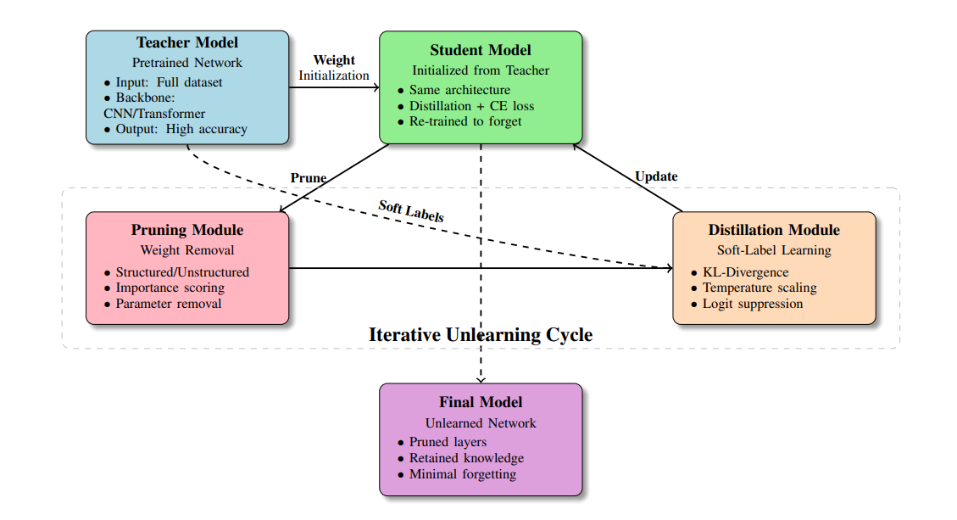
Architecture diagram

Slide 12
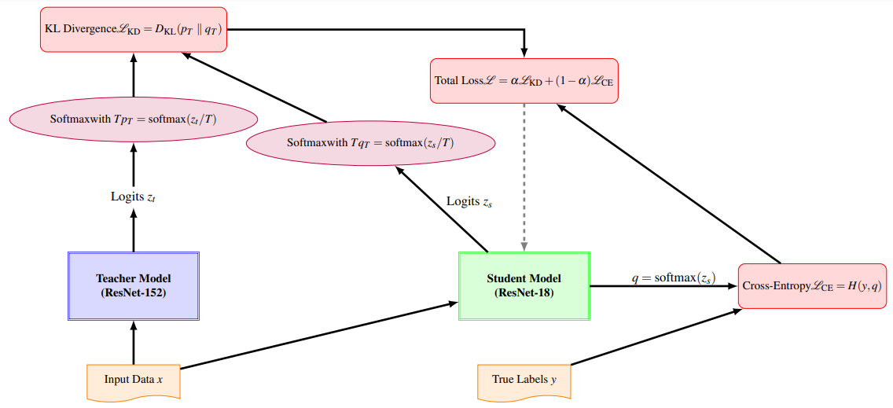
Knowledge Distillation Model diagram

Slide 13
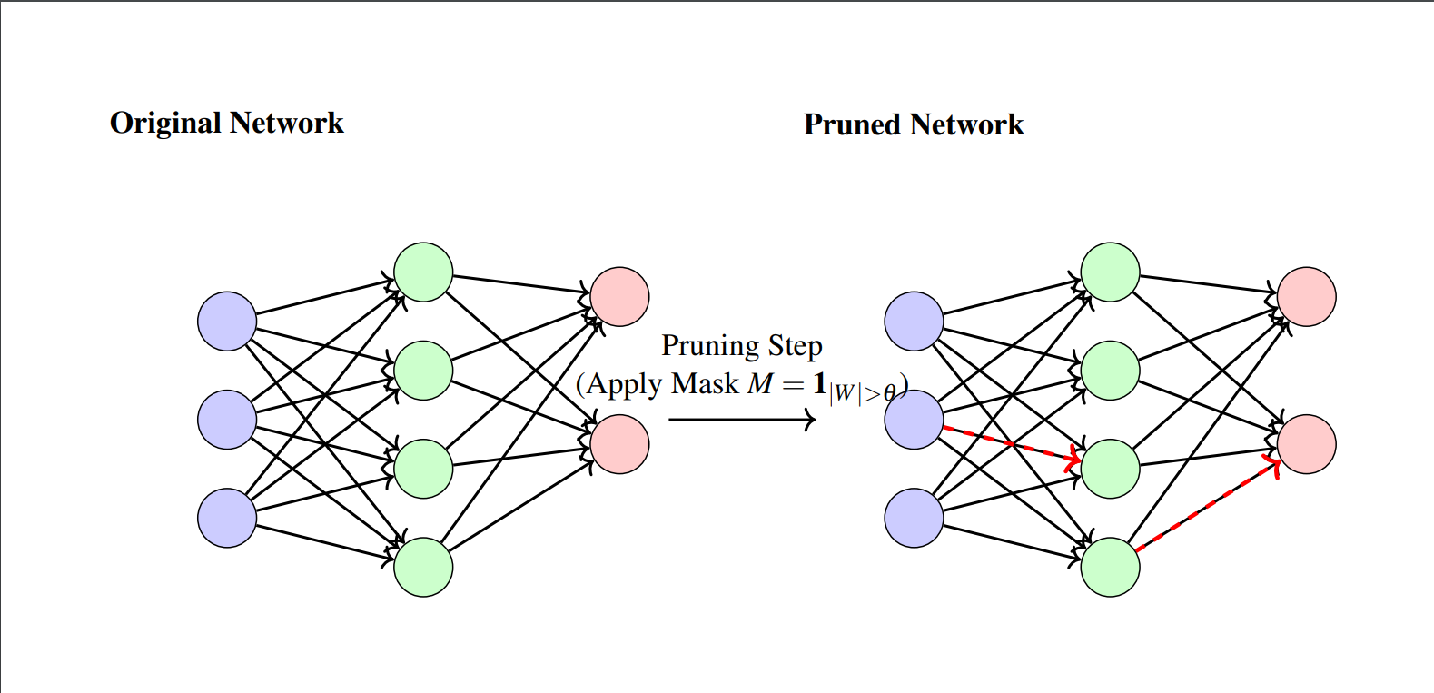
Pruning Model Diagram

Slide 14
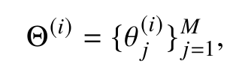
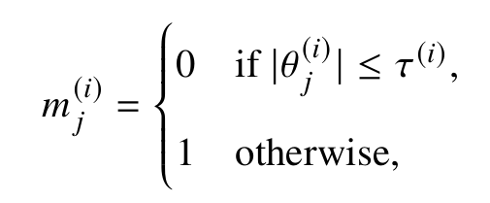
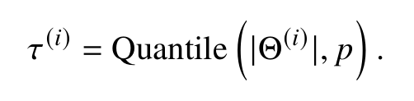
Model Pruning
Model pruning involves selectively removing a fraction of weights from the neural network to encourage forgetting of previously learned concepts. We utilize global magnitude-based pruning, defined as follows. Let the model parameters (weights) at iteration 𝑖 be denoted as:
where 𝑀 is the total number of parameters in the neural network. (1) We perform pruning by zeroing weights based on a global threshold. Specifically, we define a pruning mask:
where the pruning threshold 𝜏(𝑖) at iteration 𝑖 is computed by sorting all absolute parameter
values and determining the cutoff such that a fixed fraction 𝑝 (e.g., 𝑝 = 0.1) of parameters are
pruned at each iteration. Formally

Slide 15
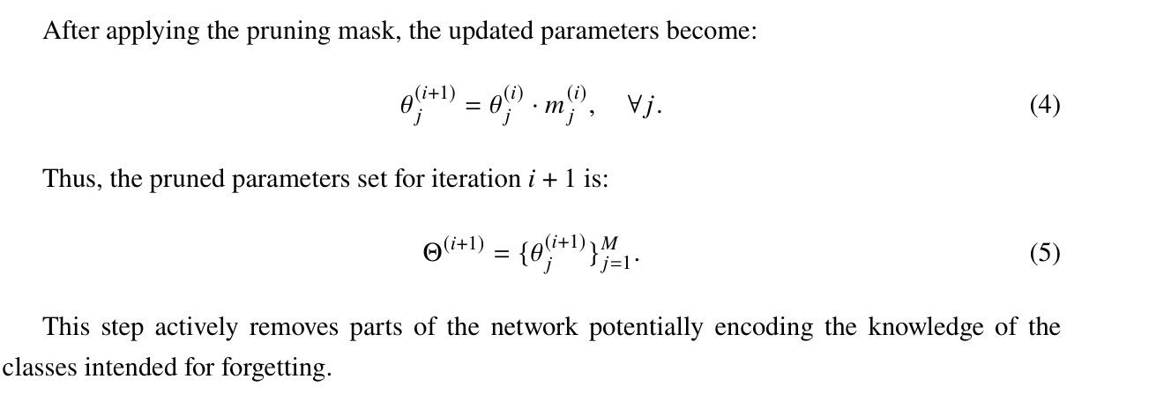
Model Pruning

Slide 16
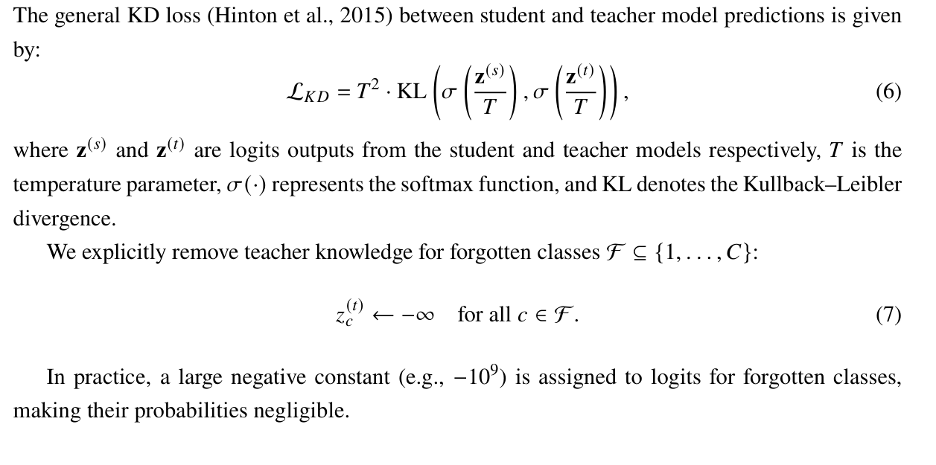
Knowledge Distillation for Unlearning
After pruning, the network undergoes retraining via a modified Knowledge Distillation (KD) approach. Unlike standard KD, our method explicitly suppresses the teacher model’s knowledge for the targeted (forgotten) classes, guiding the student model away from unwanted memories.

Slide 17
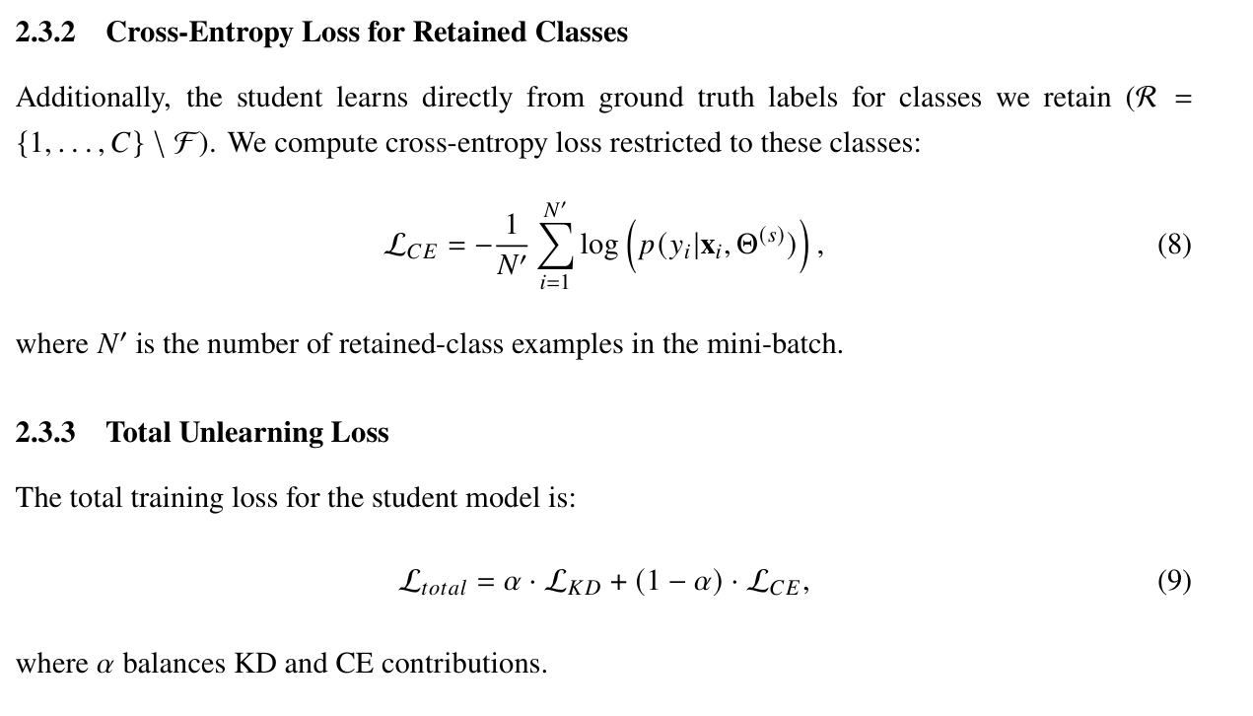
Knowledge Distillation for Unlearning

Slide 18
Iterative Prune-Distill Unlearning Procedure
We iteratively apply pruning and distillation for 𝐾 iterations. At iteration 𝑖:
1. Prune a fraction 𝑝 of weights.
2. Distill knowledge (suppressing forgotten classes) for 𝐸 epochs, optimizing L𝑡𝑜𝑡𝑎𝑙 .
This iterative approach selectively removes predictive power from forgotten classes while main-taining performance on retained classes.

Slide 19
Membership Inference Attack (MIA)
We evaluate the effectiveness of our unlearning method using a Membership Inference Attack(MIA).
MIA assesses the privacy leakage by distinguishing whether a particular data sample was included(member) or not (non-member) in the training set, based on model predictions.
Attack Formulation: We construct a binary classifier to predict membership status. Specifically, the attacker uses model confidence scores derived from predictions as attack features. For each sample, the attacker extracts the following features:

Slide 20
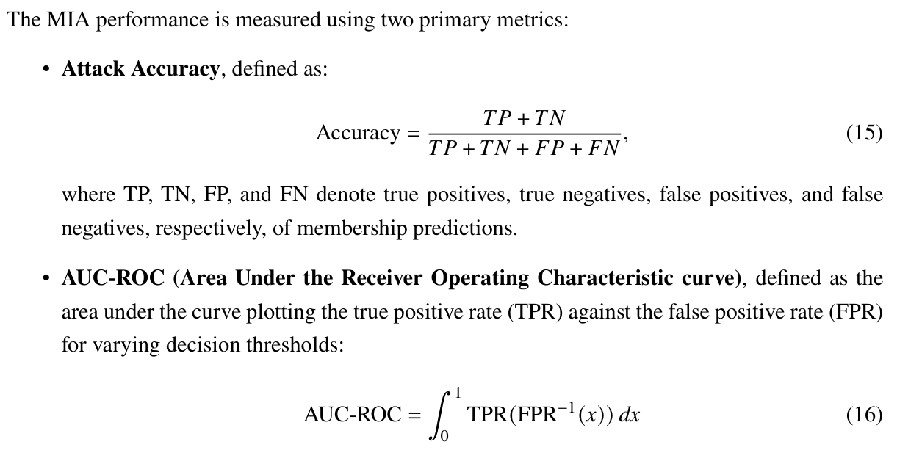
Attack Evaluation Metrics

Slide 21
Attack Evaluation Metrics
High attack accuracy or AUC-ROC indicates increased vulnerability of the model to membership inference, reflecting greater privacy risks. Conversely, lower values suggest improved privacy preservation due to effective unlearning.
Per-Class MIA Analysis: Additionally, we measure MIA performance separately for forgotten and retained classes, providing insights into whether forgotten classes indeed exhibit reduced vulnerability compared to retained classes after unlearning

Slide 22
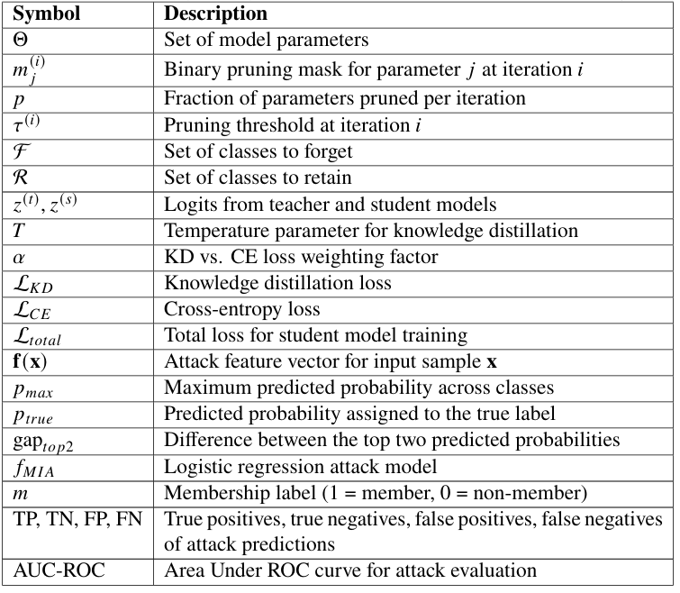
Summary of Key Variables & Parameters

Slide 23
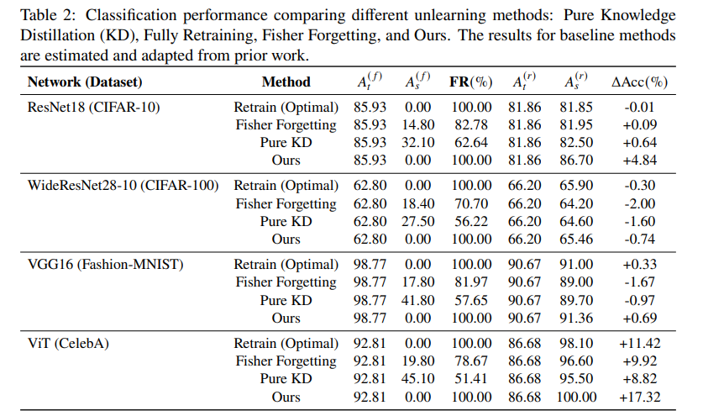
Results
We present the classification performance before and after unlearning in Table 2. Table 3 summarizes the results of the membership-inference attack (MIA), showing how effectively the forget operation reduces the MIA AUC in the forgotten classes.

Slide 24
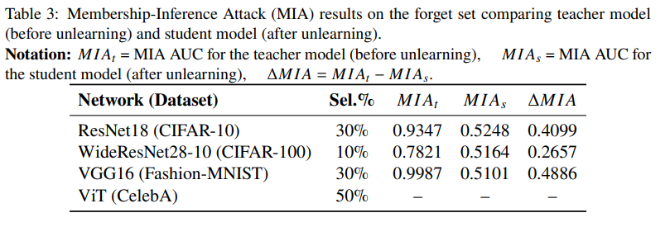

Slide 25
As shown in Table 2, our unlearning procedure drives the accuracy on the forgotten classes (𝑀(𝑠)) to 0%, achieving a 100% forgetting rate.
For example, for ResNet18 (CIFAR-10), 𝑀(𝑠)𝐵 = 85.93% and 𝑀(𝑠)𝐴 = 0.00%. In some cases, the retain-set accuracy (𝑀(𝑡)) even improves (e.g., +4.84% for ResNet18).
However, with WideResNet28-10 (CIFAR-100), there is a slight decrease (−0.74%) in retain-set accuracy.
From Table 3, the MIA AUC on the forgotten classes drops significantly after unlearning (e.g. from 0.9987 to 0.5101 for VGG16 on Fashion-MNIST), indicating stronger privacy preservation for the forgotten samples.

Slide 26
Thank You

