Slide 1

Bayesian CNNs For the detection of diabetic retinopathy
By andREW Thomas costa

Slide 2
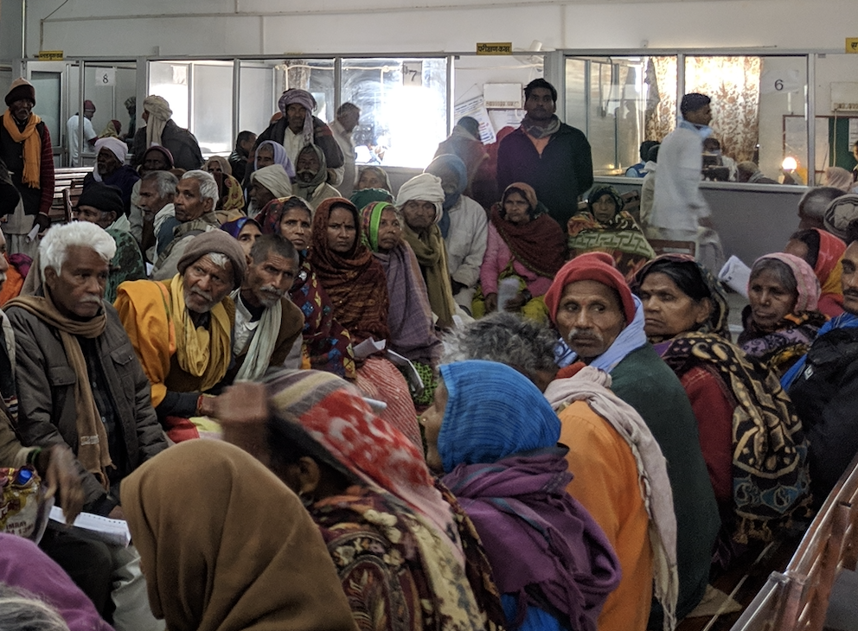
Abstract
Diabetic retinopathy is a disease formed in the eye and millions of working adults suffer from this disease.
Data set was a part of a competition hosted on Kaggle, APTOS 2019 Blindness Detection
This project investigated methods to:
Use a Convolutional Neural Networks (CNNs) on photographic data as a baseline model
Increase prediction accuracy using a Bayesian Convolutional Neural Networks (BCNNs) on the same data
The results show that:
Traditional CNN methods outperformed BCNNs, but only marginally
CNN (Accuracy/Loss): 97% Accuracy

Slide 3
Introduction
Convolutional Neural Networks have been widely applied to image data across academia and industry
Capture complex, non-linear relationships in a high-dimensional feature space (photographs)
Show strong performance
Wide-range of supporting libraries
Requires large amounts of data
Bayesian Convolutional Neural Networks are a more novel method
Allows more control over over-fitting → via posterior inference
Functions over a smaller sample

Slide 4

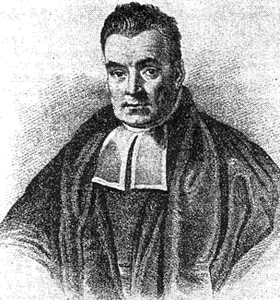
Bayes’ Theorem
What is Bayes’ Theorem?
H is a hypothesis of which one holds prior belief; D is data that might update one’s belief about H
Aleatoric Uncertainty → P(D|H) → Prior → uncertainty due to noise in data
Epistemic Uncertainty → P(H|D) → Posterior → uncertainty due to lack of data/change in
weights → train model, weights change
Joint Probability of D given H → P(D|H)P(H)

Slide 5
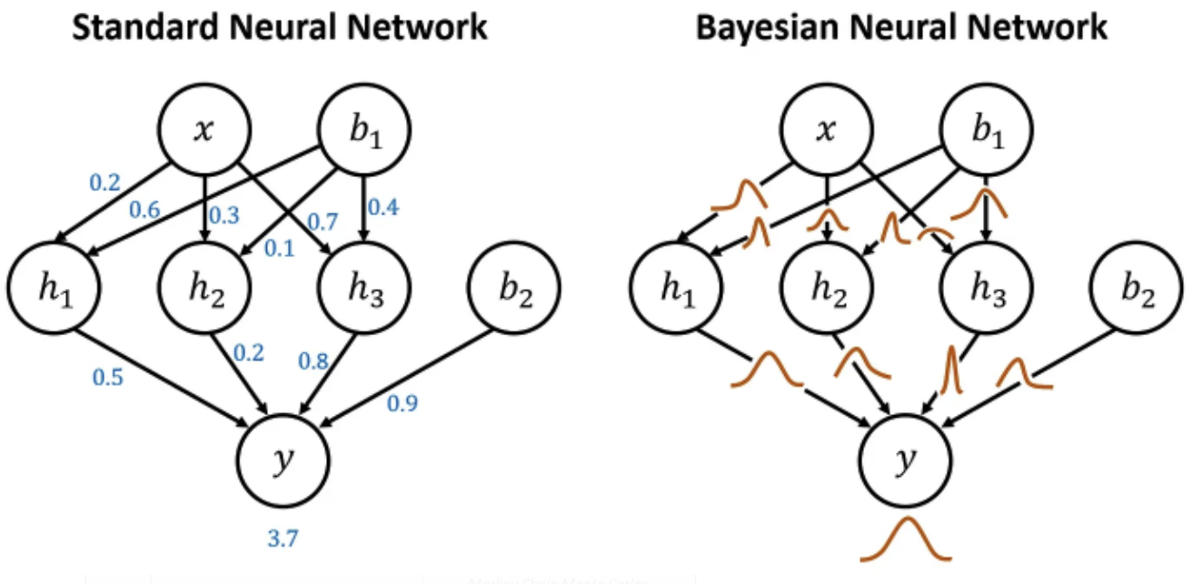
Bayesian Neural network
Bayesian Convolutional Neural Network (BCNN)
Def.: stochastic artificial neural network trained using
Bayesian inference
uses a probability distribution over the network
parameters (weights & biases)
Advantages:
More natural approach to uncertainty quantification
Distinguish between aleatoric and epistemic uncertainty
Integrates prior knowledge
Use Cases:
Computer vision
Astronomy
Medicine

Slide 6



Bayesian Neural network
Bayesian Neural Network – Workflow
Design Neural Network Architecture
Choose stochastic model → prior distribution (KL divergence, …etc) & prior confidence
Compute posterior distribution:
Marginal Distribution: prediction with uncertainty , where theta is the sampled models parameterisations
Classification model average prediction (measure of uncertainty):
Notes:
- Step 2. selection of stochastic model → equivalent to choosing a loss function in a point-estimate deep learning model
- Bayesian posterior for ANN is complex and using traditional methods for sampling is not tractable → use MCMC or variational inference
- large set of weights θi is sampled from the posterior and used to compute a series of possible outputs y_i ; corresponds to samples from marginal

Slide 7
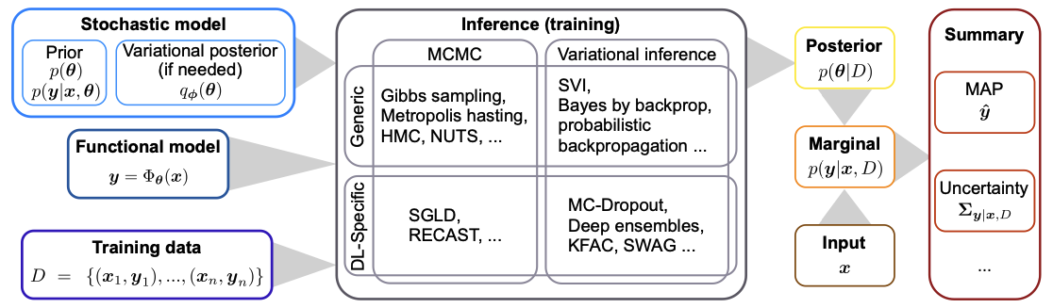
Bayesian Neural Network - workflow

Slide 8

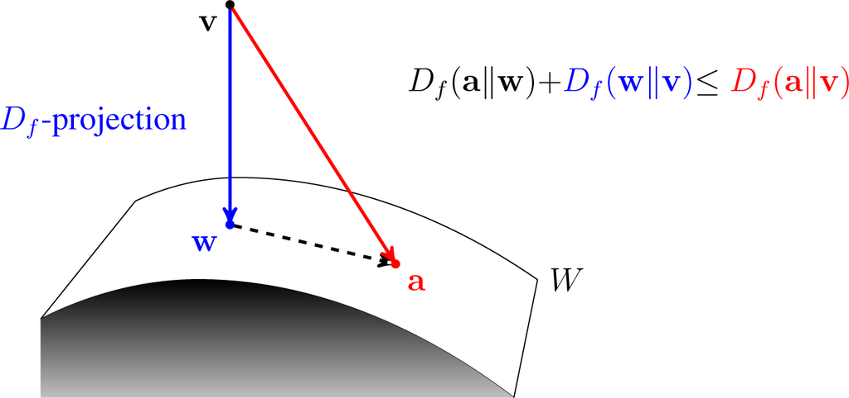
Variational Inference
Goal
Uses variational distribution Q(Z) to estimate the true posterior distribution over a set Z of unobserved variables
Purpose
Normalising constant for weights are intractable → can’t compute posterior distribution of network parameters
In approximating the following, the denominator is intractable as the search space for Z is combinatorially large
Derive lower bound for marginal likelihood
Evidence of Lower Bound (ELBO): maximising this → maximises P(X|Z) →
translates to picking model in variational family Q that better predicts the data value X
Q(Z)

Slide 9

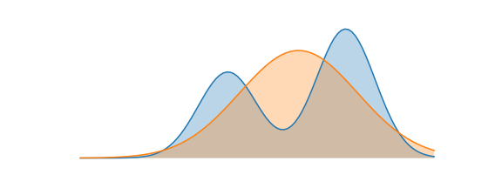


Kullback-Leibler Divergence
Most common type of VI method
It measures the divergence of Q from P i.e. difference in distributions between P and Q
Find best candidate distribution that minimizes the KL divergence
ELBO (Estimate Lower BOund) Method

Slide 10
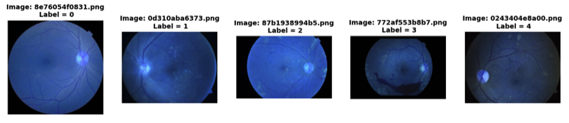
Exploratory Data Analysis
5 unique labels
Clinician has given a rating for the condition on a scale of 0 to 4
Images contain noise and different levels of light exposure
No Diabetic Retinopathy
Mild Diabetic Retinopathy
Moderate Diabetic Retinopathy
Severe Diabetic Retinopathy
Proliferative Diabetic Retinopathy

Slide 11
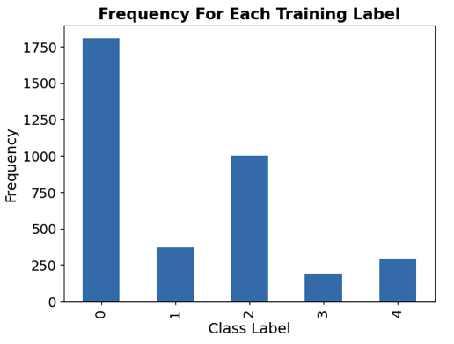
Exploratory Data Analysis contd.

Slide 12
Data preparation
1) Multi-label Approach
For a data point x of category k, the target vector is represented like
[1, 1, 1, 0, 0]
In which the first k elements are 1 and the rest are 0
For example, a label of 3 would be represented like [1, 1, 1, 1, 0], which also considers order of target vector
Advantage:
The targets instruct the network to adjust the weights to produce probability outputs as close as possible to target vector
Formulation of target vector is similar to the perceptron approach (Crammer & Singer, 2002) and related to cumulative probit model for ordinal regression (McCullagh, 1980) → output vector is a cumulative probability dist. on categories k
Notes:
If a data point x belongs
to category k, it is classified automatically into lower-
order categories (1, 2, ..., k − 1) as well. So the target
vector of x is t = (1,1,..,1,0,0,0), where ti (1 ≤ i ≤ k)
is set to 1 and other elements zeros. Thus, the goal
is to learn a function to map the input vector x to
a probability vector o = (o1,o2,...,ok,...oK), where
oi (i≤k) is close to 1 and oi (i≥k) is close to 0.
􏰀K oi is the estimate of number of categories (i.e. i=1
k) that x belongs to, instead of 1. The formulation of the target vector is similar to the perceptron ap- proach (Crammer & Singer, 2002). It is also related to the classical cumulative probit model for ordinal re- gression (McCullagh, 1980), in the sense that we can consider the output probability vector (o1,...ok,...oK) as a cumulative probability distribution on categories
K
􏰀K oi (1, ..., k, ..., K), i.e., i=1
is the proportion of categories that x belongs to, starting from category 1.

Slide 13
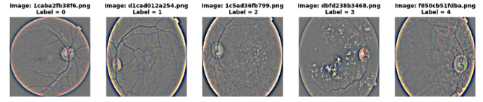
Data preparation
2) Cropping Images from Grey
This method converted the images from 3 colour channels → grey and resized them.
Labels for each class are singular, unlike the multi-label approach

Slide 14
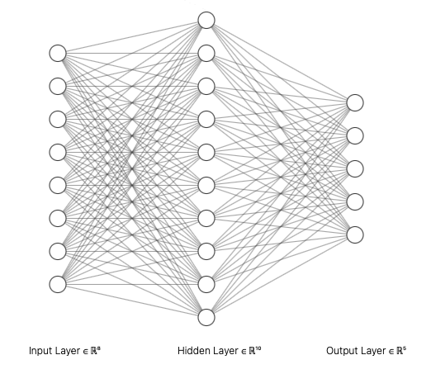
Methodology
CNN Baseline | Architecture
Convolutional Block | Kernel Size= 5x5, filters= 8, activation= 'relu’, kernel_regularizer = regularizers.l2(l = 0.01), padding='same'
Max Pooling | 6x6
Flatter Layer | -
Dense Layer | 5 units, sigmoid function
Loss function | Binary Crossentropy
Optimiser | Adam. Lr = 0.00005
Metrics | Accuracy

Slide 15
Methodology
BCNN Model | Architecture
Convolutional 2D Flip-out | Filters = 8, Kernel Size = 5x5, Strides = 1x1, Padding = same, Activation=ReLU, Kernel Divergence Function(q,p)
Max Pooling 2D | Pool Size = 6x6, Padding = same
Flatter Layer | -
Dense Flip-out | 5 units, Kernel Divergence Function
Loss function | Binary Crossentropy
Optimiser | Adam. Lr = 0.00005
Metrics | Accuracy
Convolutional 2D Flip-out:
Convolution kernel that assumes kernel is drawn from a distribution
Uses flip-out estimator that performs a Monte Carlo over the distribution integrating over the kernel and bias
q and p are the priors and posteriors that approximate KL divergence
Dense Flip-out:
Implements variational inference assuming kernel drawn from KL-distribution
Flip-out estimator

Slide 16
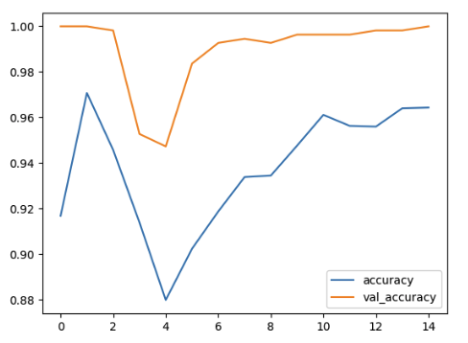
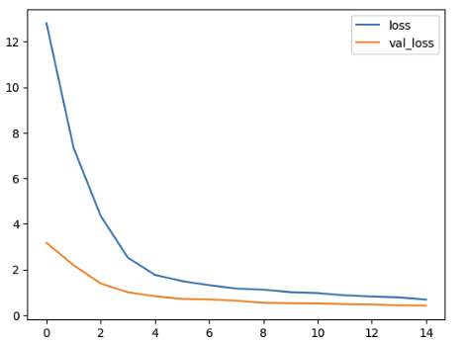
Results – Multilabel approach
Baseline Model

Slide 17
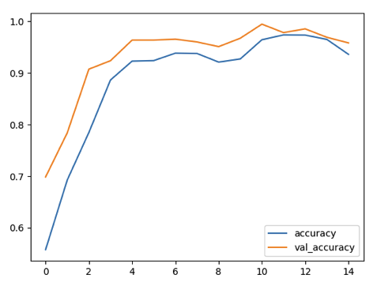
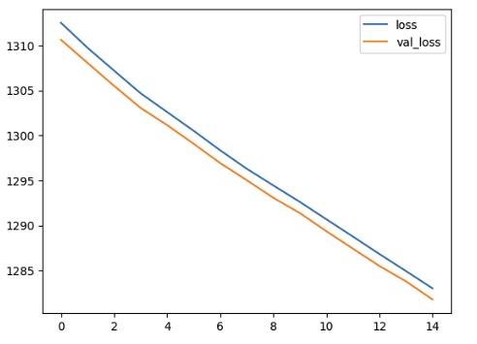
Results - Multilabel approach
Bayesian Convolutional Neural Network

