Slide 1
Hi
We’re Andrew and Liam Fletcher.

Slide 2

In the last 5 seconds …
… 2,200 reviews have been posted on Yelp

Slide 3
How many of those can you trust?

Slide 4

This is a question we hoped to help answer by tackling the bazaarvoice challenge.

Slide 5

Problem
Machine learning models are capable of generating sequences of text that seem authentic to humans.

Slide 6
Why is this a problem?
Reviews produce an average of 18% uplift in sales
63% of customers are more likely to make a purchase from a site which has user reviews
86% of people will hesitate to purchase from a business that has negative online reviews
Source: https://www.vendasta.com/blog/50-stats-you-need-to-know-about-online-reviews

Slide 7
Solution
A convolutional neural network built using Keras
Backed by a word2vec embedding layer

Slide 8

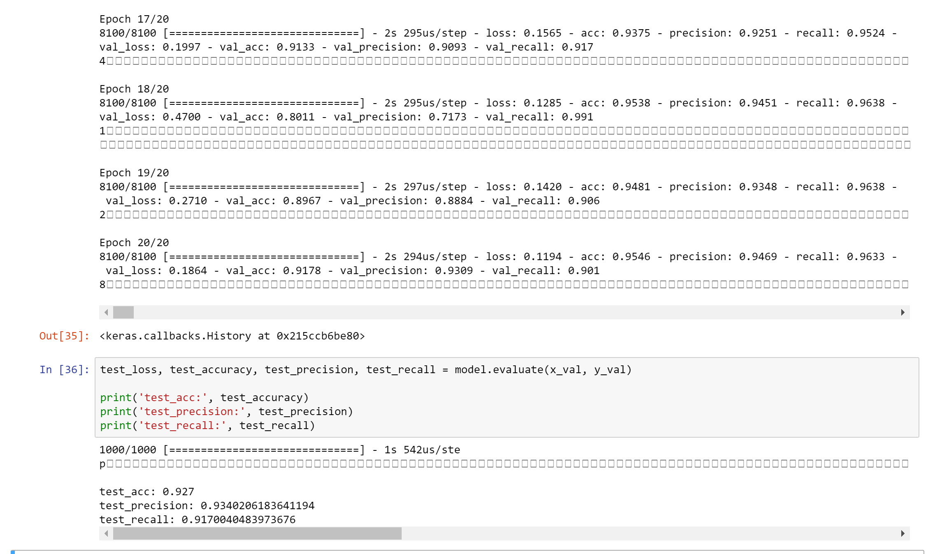
How effective is it?
On a test set:
>90% across accuracy, precision and recall
On the BV Test set:
91.8% accuracy

Slide 9
Application
Google Chrome Extension
Live highlighting of genuine and false reviews

Slide 10
Challenges we faced
Optimising model parameters
Unfamiliarity with Chrome Extensions
Hosting machine learning models

Slide 11
Is this AI for Good?
Customers can have more trust in online reviews using this application
Businesses can boost their sales. Provides a new channel for BV
Valuable data insight opportunities

Slide 12
Demo
Let’s see what we’ve made!

