Slide 1

A journey through the creation of Park Smart
Presented by Andrew and Liam Fletcher

Slide 2
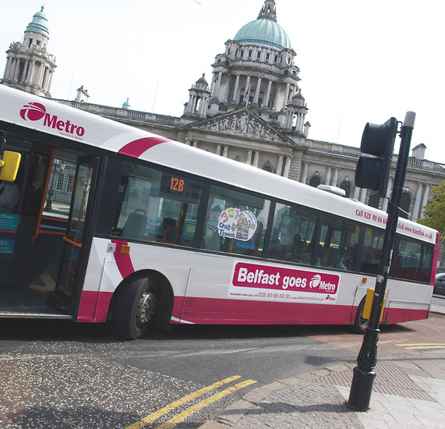
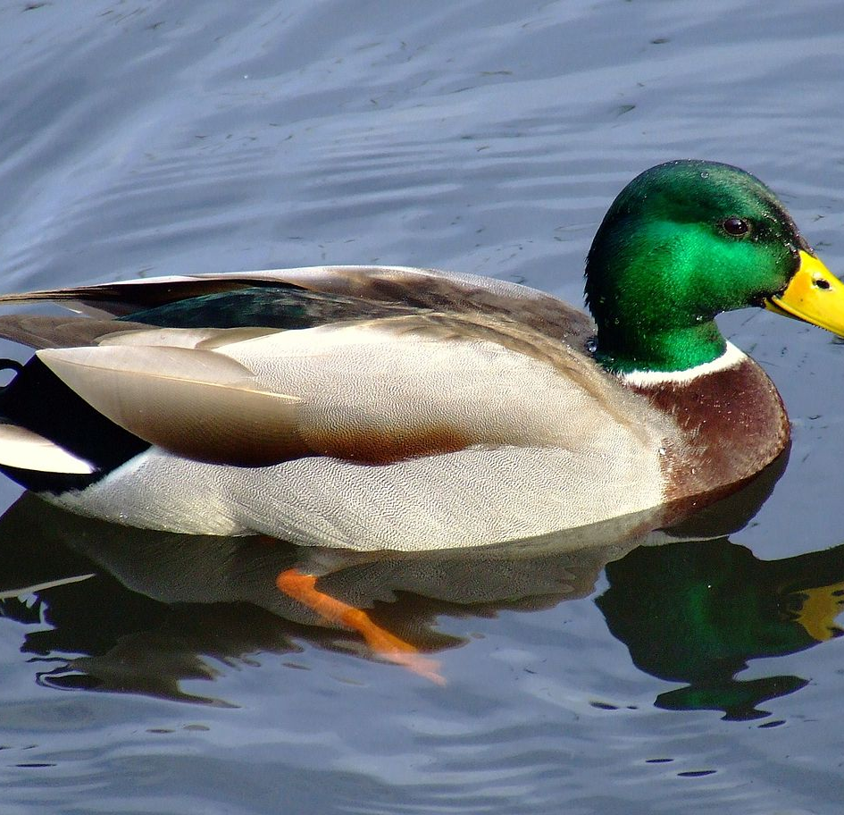
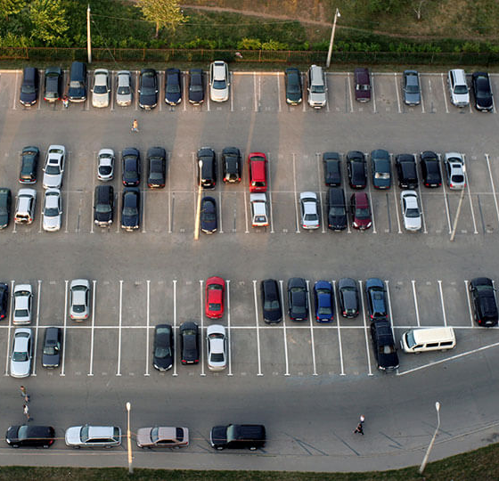
The Journey
Buses and ducks to smart parking. Our idea changed a lot in the first two days.

Slide 3

The idea
Make parking in Northern Ireland smarter
1
Contribute to Open Data NI
2
Learn how to make cool IOT stuff
3

Slide 4
The tech
Beacon Technology
Ionic Frontend
PHP Laravel Backend
And, of course, Open Data!

Slide 5

Innovation
Few examples of beacon technology used in parking
Contributing data back to Open Data NI and the TIMON Project
Enhancing the user experience when parking

Slide 6

Relevance to the TIMON Project
Helping drivers find a car park with space quickly and easily
Reducing congestion and pollution by reducing the number of cars circling towns and cities for parking
Providing more data to the Open Data NI and TIMON projects

Slide 7



Beneficiaries
Drivers
Motorbike riders
Electric car users
City councils
Vulnerable road users

Slide 8



Business model
Selling our all-in-one parking solution to councils and private car park providers
Targeting ticketed car parks initially
Low cost off-the-shelf commodity hardware

Slide 9
Demo
Time for a quick demo

Slide 10
Q&A
Any questions?

