Slide 1

PROPERTIES OF WAVES
This lesson will introduce you to varies properties of waves.
You will also learn about the universal wave equation, this equation applies to all waves

Slide 2

What are we going to cover today?
By the end of this lesson, you will be able to:
Define period and frequency of waves
Apply the wave equation to waves
Explain how waves reflect
Homework

Slide 3
PERIOD AND FREQUENCY
The time required for one complete oscillation is called the period, T, of a wave
period is a time, so the SI units for period are seconds (s)
the period is the time for one cycle of the wave
Notes:
Oscillation: movement of back and forth at a regular speed; regular variation in magnitude or position around a central point

Slide 4
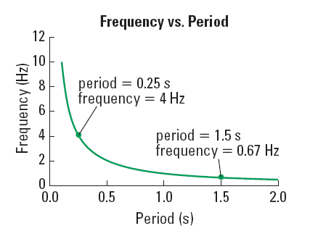
The number of oscillations that occur per second is called the frequency, f, of the wave
frequency is measured in Hertz, Hz
frequency is related to period by the following eqn:
Notes:
GRAPH: inverse relationship between T and f

Slide 5
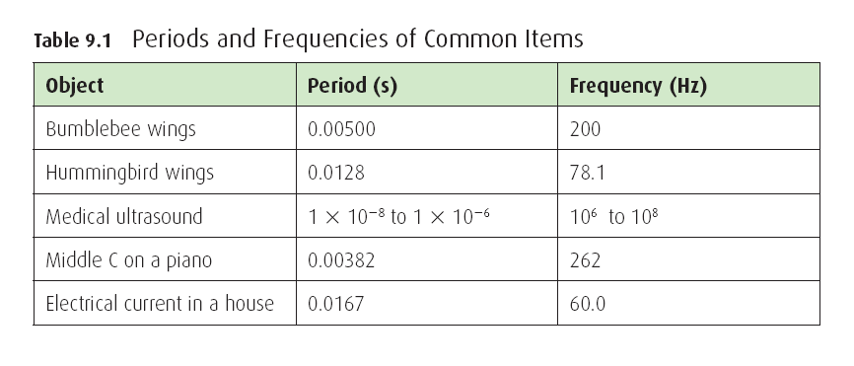
the freq of a wave will be exactly the same as the freq of the source creating the wave.
Notes:
Page 304 Table 9.1

Slide 6
Ex 1: You are at the beach and watching waves hit the
shore. Every 3.5 seconds a new wave arrives. What
are the period and freq of the waves?

Slide 7
THE UNIVERSAL WAVE EQUATION
the universal wave eqn applies to ALL waves
it tells us that the speed of a wave is proportional to both the frequency and wavelength

Slide 8
Ex 2: You generate a wave in a slinky with wavelength
1.2 m. Each wave takes .75 s to create. What is the
speed of the waves in the slinky ?

Slide 9
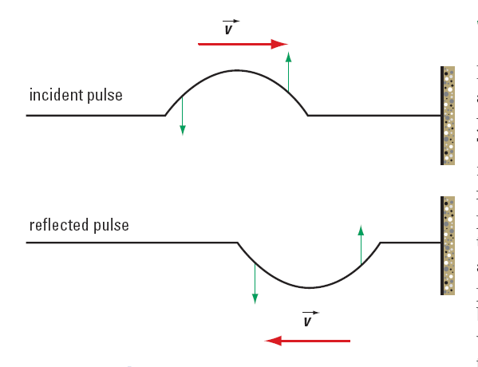
Wave REFLECTION
If a slinky is fixed at one end and a wave reflects off that fixed end, the reflected wave will invert.
fixed end

Slide 10
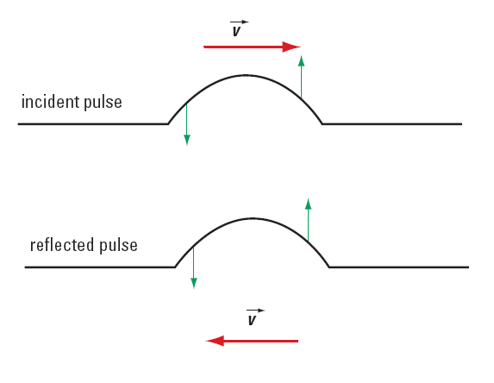
If a slinky is free to move at one end and a wave reflects off that free end, the reflected wave will not invert.
free end

Slide 11
HOMEWORK
Read pgs 303 – 306
Questions 1 – 3 pg 304 both sets
1 – 3 pg 305
1 – 3 pg 306
1 – 15 pg 308

