Slide 1
P
Write buffer
MRU
LRU
A B C E F S D P R T K
Min benefit
FTL
Flash memory
SSD

Slide 2
Now: T1
Cold queue
E
B
C
A
D
MRU
LRU
Future: T2
Cold queue
C
A
D
E
B
MRU
LRU

Slide 3
5
3
11
24
21
Hint
Priority
0.05
0.04
0.03
0.02
0.01
Cold queue
E
B
C
A
D

Slide 4

Write buffer
(RAM-Based)
Flash Chip 0
Flash Chip 1
Host
interface
Buffer manager
Flash
controller
Channel 0
processor
Channel 1
Flash Chip 0
Flash Chip 1
FTL
Channel N
SSD controller

Slide 5
B
Block | Benefit value
A | 0.1
B | 0.5
C | 0.45
D | 0.7
E | 0.3
F | 0.6
G | 0.5
A
C
D
E
G
Write buffer
duration
1
2
3
4
Block A duration=4
A

Slide 6
Host
Page cache
Hot queue
MRU
LRU
Demoting
Mean queue
MRU
LRU
Cold queue
MRU
LRU
Write buffer
FTL
Flash memory

Slide 7
Late queue
MRU
LRU
Demoting
Mean queue
MRU
LRU
Soon queue
MRU
LRU
Write buffer
FTL
Flash memory

Slide 8



Online
Architecture
Online
Predict duration label
Write buffer
Hint Queue

Slide 9
Duration value : d
Threshold:t
d<t
d>=t & d<5t
d>=5t
Cold->0
Mean->1
Hot->2

Slide 10




Architecture
Offline
Offline
Benefit function
Oracle
Write buffer simulator
AI training
Online
Predict duration label
Write buffer
Training model

Slide 11
Online
Architecture
Online
Predict duration label
Write buffer

Slide 12
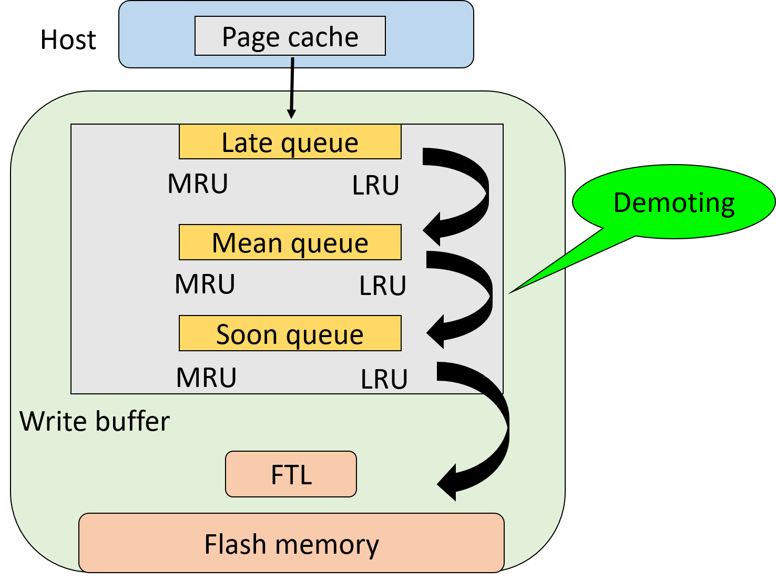
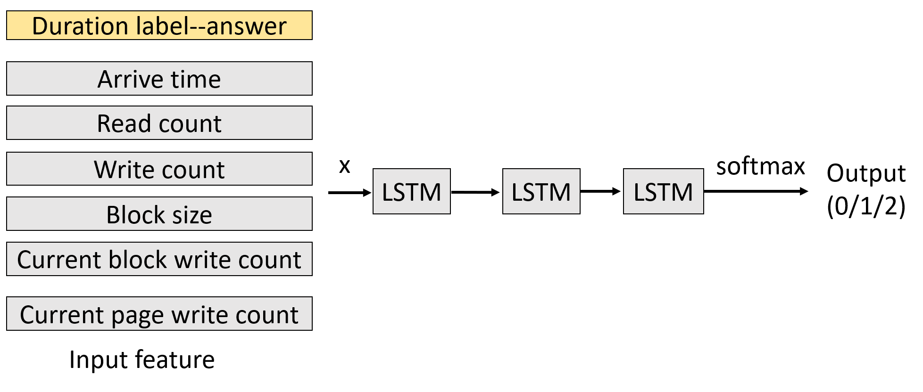
Online
Offline

Slide 13
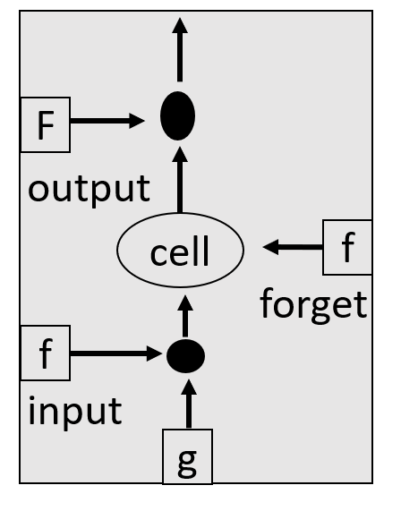
LSTM
f=activation function → sigmoid
O
f
O=f(Zo)*C’
Zo
C’=f(zf)*C+X
C
Zf
X
Zi
X=g *f(zi)
Z
Notes:
X-→當下狀態(初始值)是好還是壞…..，決定是否將資訊送進memory
Forget gate-→決定是否記住上次memory資訊
Output gate→決定是否輸出

Slide 14
LSTM
w1
w2
w3
w4
2
1
5
4
5
1
5
3
3
1
1
2
1
7
5
52
13
45
35
Input feature
Number of LSTM unit
w1
Input feature
w3
Input feature
2
5
3
1
7
5
5
5
1
1
7
5
w2
Input feature
w4
Input feature
1
1
1
1
7
5
4
3
2
1
7
5
Notes:
X-→當下狀態(初始值)是好還是壞…..，決定是否將資訊送進memory
Forget gate-→決定是否記住上次memory資訊
Output gate→決定是否輸出

Slide 15
Y1
Y2
Y3
Yn
Output
Memory
cell
Memory
cell
Memory
cell
Memory
cell
X1
X2
X3
Xn
Time 1
Time 2
Time 3
Time n

Slide 16
LSTM
Training
Duration label--answer
Arrive time
Read count
Write count
x
softmax
Output
(0/1/2)
LSTM
LSTM
LSTM
Block size
Current block write count
Current page write count
Input feature

Slide 17
Dirty ratio=40%
Clean page
41
40
32
74
26
66
58
95
84
1
Dirty page
Page Cache
MRU
LRU
41
40
74
66
Dirty page queue

Slide 18
Global time flag
Clean page
Dirty page
41
40
32
74
26
66
58
95
84
1
Page Cache
LRU
More than 30 second
MRU
1024 pages
1024 pages
1
1024 pages
2
First time
The second time
3
The third time
1024 pages
4
The fourth time

Slide 19
Write buffer
15
27
11
14
6
26
18
2
21
5
25
9
1
29
12
0
LB 3
LB 5
LB 1
LB 6
LB 2
LB 4
LB 0
LB 7
MRU
LRU

Slide 20
Write request
26
Write buffer
15
27
3
7
14
6
26
18
2
30
21
5
25
9
1
29
12
0
28
LB 3
LB 5
LB 1
LB 6
LB 2
LB 4
LB 0
LB 7
MRU
LRU
27
15
3
7
26
14
6
18
2
30
25
21
5
9
1
29
12
0
28
LB 6
LB 3
LB 5
LB 1
LB 2
LB 4
LB 0
LB 7
MRU
LRU

Slide 21
NAND flash memory
7
6
Page padding
5
4
圖 2-6 Page Padding

Slide 22

Request 1: read page 0,1,2,3
Request 2: write page 12,13,14,15
12
13
14
15
valid
CH 0
CH 1
CH 2
CH 3
CH 0
CH 1
CH 2
CH 3
invalid
0
1
2
3
0
1
2
3
free
4
5
6
7
20
21
22
23
8
9
10
11
PB 0
PB 1
PB 2
PB 3
PB 0
PB 1
PB 2
PB 3
GC time
12
13
14
15
24
25
26
27
28
29
30
31
32
33
34
35
PB 4
PB 5
PB 6
PB 7
PB 4
PB 5
PB 6
PB 7
Parallel read->response time

Slide 23
Request 1: read page 0,1,2,3
Request 2: write page 12,13,14,15
12
13
14
15
valid
CH 0
CH 1
CH 2
CH 3
CH 0
CH 1
CH 2
CH 3
invalid
0
0
4
8
20
free
1
1
5
9
21
2
2
6
10
22
3
3
7
11
23
PB 0
PB 1
PB 2
PB 3
PB 0
PB 1
PB 2
PB 3
GC time
12
24
28
40
13
25
29
41
14
26
30
42
15
27
31
43
PB 4
PB 5
PB 6
PB 7
PB 4
PB 5
PB 6
PB 7
No parallel->response time

Slide 24
CPU
Host
Write dirty page in three cases:
Replacement
Dirty amount
Dirty time
Page cache
AI model
Write buffer
Hint queue
FTL
Flash memory
SSD

Slide 25
Host
Page cache
Write dirty page in three cases:
Replacement
Dirty amount
Dirty time
Store dirty page
Hint queue
Write buffer
Flash memory
SSD
Notes:
Write buffer管理分成以physical block管理或是logical block管理，如果是以physical block管理……

Slide 26
 | 學長程式 | LPB | Blas | AI | AI+Hint
User2 | 0.076511 | 0.046969
Run1_ug15 | 0.072819 | 0 | 0.027175
Run1_Postmark_2475 | 0.063393 | 0.064210 | 0.058303 | 0.064292 | 0.066953
iozone
Iozone 2 | 0.014246 | 0 | 0 | 0.019151
Moodle | 0.052095 | 0.020689 | 0
Write Hit ratio

Slide 27
 | 學長程式 | LPB | Blas | AI | AI+Hint
User2 | 0.073461 | 0.031402
Run1_ug15 | 0.069325 | 0.000832 | 0.02175
Run1_Postmark_2475 | 0.062784 | 0.063958 | 0.057319 | 0.064087 | 0.066697
iozone
Iozone 2 | 0.015352 | 0.010390 | 0.008428 | 0.020685
Moodle | 0.030228 | 0.01129 | 0.003464
Total Hit ratio

Slide 28
 | 學長程式 | LPB | Blas | AI | AI+Hint
User2 | 0.126705 | 0.347556
Run1_ug15 | 0.444973 | 0.539642 | 0.569047
Run1_Postmark_2475 | 0.181492 | 0.478093 | 0.505316 | 0.19606 | 0.186695
iozone
Iozone 2 | 0.155912 | 0.302168 | 0.306793 | 0.167209
Moodle | 0.22802 | 0.232283 | 0.235524
Average response time

Slide 29
 | 學長程式 | LPB | Blas | AI | AI+Hint
User2 | 14570 | 10256
Run1_ug15 | 13397 | 10213 | 7494
Run1_Postmark_2475 | 38871 | 42136 | 16114 | 50644 | 47096
Iozone
Iozone 2 | 43280 | 45367 | 60223 | 46351
Moodle | 389 | 129 | 134
Kick block count

Slide 30
0
6
7
10
15
16
17
18
19
Write buffer
LB0
LB1
LB2
LB3
LB4
MRU
LRU
31
32
33
41
52
66
69
71
Flush memory
16
17
19
18

Slide 31
初始化first_enter_write_buffer為1,not_exist_lpn為-1
初始化array hint為0
將global_HQ中的lpn當成hint index，assing為1(存在即為1)
Write buffer
將當下node->overwrite_num初始化為0
將每個node的block_num當成special_used的index
而node本身存入special_used array中
將not_exist_lpn assign -2
Add_a_node
Y_add_Pg
Add_a_page
在demoting while loop中，若first_enter_write_buffer=1,就初始化每個block的overwrite_num
比對當下lpn在hint中是否為1，是就累加overwrite_num
Outside while
not_exist_lpn[lpn_num]:
-1:free space
-2:exist
Block_num:not_exist
Leave write buffer
Reset hint

