Slide 1
P
Write buffer
MRU
LRU
A B C E F S D P R T K
Min benefit
FTL
Flash memory
SSD

Slide 2

Write buffer
(RAM-Based)
Flash Chip 0
Flash Chip 1
Host
interface
Buffer manager
Flash
controller
Channel 0
processor
Channel 1
Flash Chip 0
Flash Chip 1
FTL
Channel N
SSD controller

Slide 3
B
Block | Benefit value
A | 0.1
B | 0.5
C | 0.45
D | 0.7
E | 0.3
F | 0.6
G | 0.5
A
C
D
E
G
Write buffer
duration
1
2
3
4
Block A duration=4
A

Slide 4
Host
Page cache
Late queue
MRU
LRU
Demoting
Mean queue
MRU
LRU
Soon queue
MRU
LRU
Write buffer
FTL
Flash memory

Slide 5
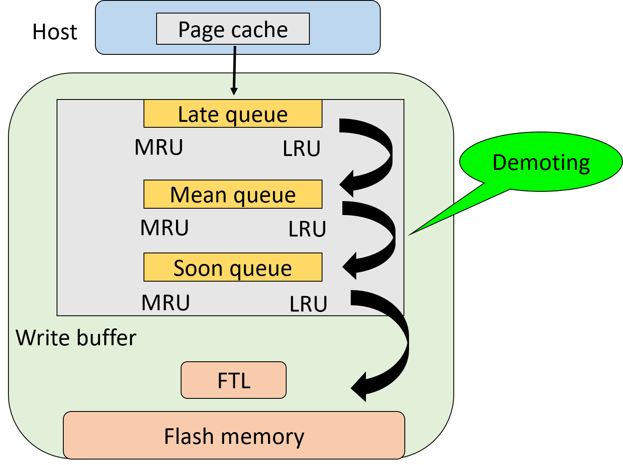
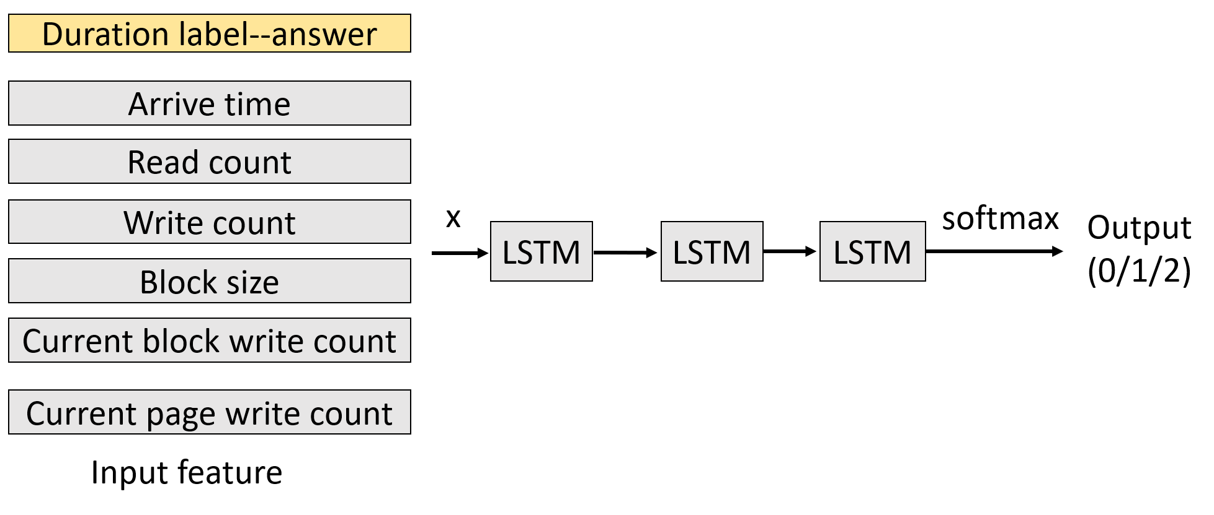
Online
Offline

Slide 6
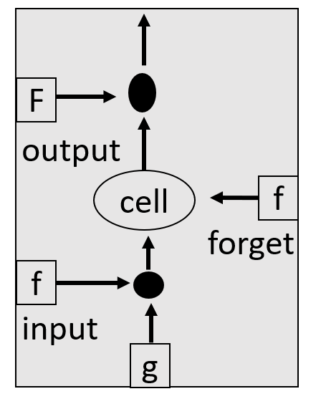
LSTM
f=activation function → sigmoid
O
f
O=f(Zo)*C’
Zo
C’=f(zf)*C+X
C
Zf
X
Zi
X=g *f(zi)
Z
Notes:
X-→當下狀態(初始值)是好還是壞…..，決定是否將資訊送進memory
Forget gate-→決定是否記住上次memory資訊
Output gate→決定是否輸出

Slide 7
LSTM
w1
w2
w3
w4
2
1
5
4
5
1
5
3
3
1
1
2
1
7
5
52
13
45
35
Input feature
Number of LSTM unit
w1
Input feature
w3
Input feature
2
5
3
1
7
5
5
5
1
1
7
5
w2
Input feature
w4
Input feature
1
1
1
1
7
5
4
3
2
1
7
5
Notes:
X-→當下狀態(初始值)是好還是壞…..，決定是否將資訊送進memory
Forget gate-→決定是否記住上次memory資訊
Output gate→決定是否輸出

Slide 8
LSTM
y1
Zi
y2
Zo
X
Zf
Y
Z
yn
Time 1
Time 2
Time 3

Slide 9
LSTM
Training
Duration label--answer
Arrive time
Read count
Write count
x
softmax
Output
(0/1/2)
LSTM
LSTM
LSTM
Block size
Current block write count
Current page write count
Input feature

Slide 10
Dirty ratio=40%
Clean page
41
40
32
74
26
66
58
95
84
1
Dirty page
Page Cache
MRU
LRU
41
40
74
66
Dirty page queue

Slide 11
Global time flag
Clean page
Dirty page
41
40
32
74
26
66
58
95
84
1
Page Cache
LRU
More than 30 second
MRU
1024 pages
1024 pages
1
1024 pages
2
First time
The second time
3
The third time
1024 pages
4
The fourth time

Slide 12
Write buffer
15
19
7
14
21
18
46
26
1
20
17
5
25
61
12
24
LB 3
LB 5
LB 1
LB 6
LB 2
LB 4
LB 0
LB 7
MRU
LRU
圖 2-4 FAB架構

Slide 13
Write request
70
Write buffer
15
19
7
7
14
21
18
46
26
70
1
20
17
5
25
69
12
24
68
LB 3
LB 5
LB 1
LB 6
LB 2
LB 4
LB 0
LB 7
MRU
LRU
7
15
19
7
70
14
21
18
46
26
69
1
20
17
5
25
68
12
24
LB 7
LB 3
LB 5
LB 1
LB 6
LB 2
LB 4
LB 0
MRU
LRU
圖 2-5 BPLRU架構

Slide 14
NAND flash memory
7
6
Page padding
5
4
圖 2-6 Page Padding

Slide 15

Request 1: read page 0,1,2,3
Request 2: write page 12,13,14,15
12
13
14
15
valid
CH 0
CH 1
CH 2
CH 3
CH 0
CH 1
CH 2
CH 3
invalid
0
1
2
3
0
1
2
3
free
4
5
6
7
20
21
22
23
8
9
10
11
PB 0
PB 1
PB 2
PB 3
PB 0
PB 1
PB 2
PB 3
GC time
12
13
14
15
24
25
26
27
28
29
30
31
32
33
34
35
PB 4
PB 5
PB 6
PB 7
PB 4
PB 5
PB 6
PB 7
Parallel read->response time

Slide 16
Request 1: read page 0,1,2,3
Request 2: write page 12,13,14,15
12
13
14
15
valid
CH 0
CH 1
CH 2
CH 3
CH 0
CH 1
CH 2
CH 3
invalid
0
0
4
8
20
free
1
1
5
9
21
2
2
6
10
22
3
3
7
11
23
PB 0
PB 1
PB 2
PB 3
PB 0
PB 1
PB 2
PB 3
GC time
12
24
28
40
13
25
29
41
14
26
30
42
15
27
31
43
PB 4
PB 5
PB 6
PB 7
PB 4
PB 5
PB 6
PB 7
No parallel->response time
圖 2-9 Block Striping

Slide 17
CPU
Host
Write dirty page in three cases:
Replacement
Dirty amount
Dirty time
Page cache
AI model
Write buffer
Hint queue
FTL
Page striping
Block striping
Flash memory
SSD

Slide 18
 | 學長程式 | LPB | Blas | AI | AI+Hint
User2 | 0.076511 | 0.046969
Run1_ug15 | 0.072819 | 0 | 0.027175
Run1_Postmark_2475 | 0.063393 | 0.064210 | 0.058303 | 0.064292 | 0.066953
iozone
Iozone 2 | 0.014246 | 0 | 0 | 0.019151
Moodle | 0.052095 | 0.020689 | 0
Write Hit ratio

Slide 19
 | 學長程式 | LPB | Blas | AI | AI+Hint
User2 | 0.073461 | 0.031402
Run1_ug15 | 0.069325 | 0.000832 | 0.02175
Run1_Postmark_2475 | 0.062784 | 0.063958 | 0.057319 | 0.064087 | 0.066697
iozone
Iozone 2 | 0.015352 | 0.010390 | 0.008428 | 0.020685
Moodle | 0.030228 | 0.01129 | 0.003464
Total Hit ratio

Slide 20
 | 學長程式 | LPB | Blas | AI | AI+Hint
User2 | 0.126705 | 0.347556
Run1_ug15 | 0.444973 | 0.539642 | 0.569047
Run1_Postmark_2475 | 0.181492 | 0.478093 | 0.505316 | 0.19606 | 0.186695
iozone
Iozone 2 | 0.155912 | 0.302168 | 0.306793 | 0.167209
Moodle | 0.22802 | 0.232283 | 0.235524
Average response time

Slide 21
 | 學長程式 | LPB | Blas | AI | AI+Hint
User2 | 14570 | 10256
Run1_ug15 | 13397 | 10213 | 7494
Run1_Postmark_2475 | 38871 | 42136 | 16114 | 50644 | 47096
Iozone
Iozone 2 | 43280 | 45367 | 60223 | 46351
Moodle | 389 | 129 | 134
Kick block count

