Slide 1
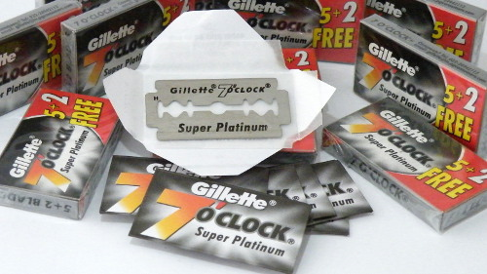
Project Blades
Andrew Abraham
Marketing Predictive Analysis

Slide 2
Introduction
Objective:
To provide insights to the marketing department of Gillette on brand expansion and customers acquisition in its least performing markets.
Data used:
Customer data (Level: PanID, StoreID, Week, UPC)
Store data (Level: StoreID, Week, UPC)
Customer Information (Level: PanID)
Store Information (Level: StoreID)
Product Information (Level: UPC)

Slide 3
Analysis 1: Descriptive
Objective:
To find top performing brands in the market.
To find top products of Gillette.
To find best and least performing markets of Gillette.

Slide 4
Top Performing Brands
Gillette(P&G) leads the market with 70% share which is more than 4 times the share of the second-best company.
Energizer Holdings comes second with 15% share.
All the rest have less than 10% of shares.

Slide 5
Top Products of Gillette and Energizer
Gillette Mach 3 is the leading product of P&G and constitutes to 34% of total revenue.
For Energizer Holdings, Schick Slim Twin contributes the most with 37% of total revenue.

Slide 6
Top and bottom markets of Gillette
The average coverage of the bottom five markets of Gillette is around 63%, i.e. 7% lower than Gillette’s overall market share

Slide 7
Recommendations
Invest in continuous marketing and sustaining brand image of the top 3 products of Gillette (Mach 3, Sensor Excel, Sensor) as they contribute to more than 50% of the total revenue with 34%, 11% and 10% of shares respectively
Invest in marketing and customer acquisition in the weaker markets to enhance market dominance and raising it in par with the top markets

Slide 8
Analysis 2: Effect of Display and Features
Objective:
To gauge the effect of product featuring and product display on sales in the low performing markets.
Methodology:
A fixed effect model was executed controlling product and time effects.
Predicted variable is product sales.
Independent variables were weighted product variant price, display sizes and feature sizes.
Estimation method is ‘FixedTwo’ regression.
A random effects model was initially run but was rejected after testing for equality of coefficient estimates by the Hausman test.

Slide 9

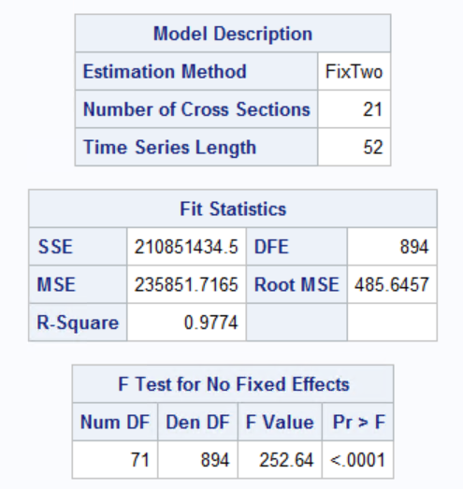
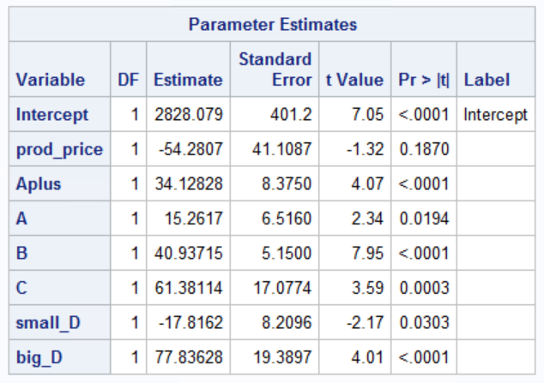
Results of Fixed Effects Model
All coefficient estimates are found to be significant at a confidence level of 95%
Setting up a big display is associated with a $78 increment in sales per week than without any display, controlling all other factors
All sizes of the features were associated with a positive increment in sales, controlling all other factors
The largest of the increments is contributed by the smallest feature size as compared to the larger sizes and when compared with no feature at all

Slide 10
Recommendations
Frequent displays of the popular and flagship products should be set up at stores in the low performing markets to boost sales
Products should be advertised with multiple small sized features as compared to larger sizes, especially if the larger features are twice as expensive as the smaller ones

Slide 11
Analysis 3: Customer Brand Preference
Objective:
To discern patterns within customer demographics and spending patterns to understand factors affecting the choice preference between Gillette and its competitors.
Methodology:
All the required data was gathered onto one central table from various sources. The variables were then checked for correlation and some that were irrelevant for the analysis were then dropped.
Independent variables taken comprised number of units purchased, outlet type, dollars spent, combined pre-tax income, family size, household race, male occupation type, female age group and marital status.
A column for the dependant variable was formed – ‘Brand’. Products of brand Gillette contained the value ‘Gillette’ and all other brands were labelled as ‘Others’.
A logistic regression was designed and modelled to predict choice preference.

Slide 12
Results
The significant variables from the above model are units purchased, outlet type, dollars spent, family size, female age group and male occupation type
An additional dollar spent by customer is associated with a 57.4% increase in the odds ratio of choosing the brand Gillette as compared to other brands
A unit increase in the quantity purchased by the customer is associated with a 92% decrement in the odds ratio of choosing the brand Gillette as compared to other brands
The odds ratio of customer purchasing a Gillette brand from a grocery store decreases by 39% as compared to customers purchasing it from a drug store

Slide 13
Recommendations
Market popular and flagship products to Gillette users as they have more affinity to purchase more expensive blades.
Provide discounts and launch marketing campaigns more in grocery stores than drug stores as customer conversion is lower at grocery stores.
The below customer segments are most susceptible to Gillette products and should be targeted with more offers for high end products to increase sales
Households with at least 6 people
Customers who are in profession of administration, sales, operations and clerks
Women with age more than 55

Slide 14
Analysis 4: Customer Segmentation
Objective:
To segment the customers into similar groups based on monetary value of total purchases, frequency of purchases and recency of purchases
Methodology:
The panel data was merged with Product category data and filtered for the brand Gillette
Recency was difference between the last date on dataset and last date of the customer’s transaction
Frequency was total number of weeks the customer had made a purchase
Monetary was total amount spent by the customer on Gillette products
Created RFM scores of each customer through rank method
Standardized the R, F, M variables and segmented the customers into 3 clusters

Slide 15
Results of Segmentation
Cluster 1 – Least Desirable
[Low R, F and M]
Females are graduate from a technical school
Cluster 2 – Average
[High R, Low F, Medium M]
Customers are single
Cluster 3 – Most Desirable
[High R, F and M]
Males have either operative or craftsman jobs
Males are high school graduates
Males and Females in the age group of 25-34
Females are craftswomen or homemaker
Families have children in age of 6-11
Males with medium income and Professional or Technical occupation
Females with age between 25-34 and with age 65 or more
Females are college graduates
Females have clerical jobs
Gillette Mach and Gillette Venus are favored products
Females are in the age group of 45-54
Females have cleared high school
Females are in Food and Health services
Customers are divorced
Gillette Sensor excel, Gillette Custom plus, Gillette Daisy, Gillette Atra, Gillette Good news are favored

Slide 16
Recommendations
Cluster 1 and 2 comprise of customers who score low on recency and frequency, and should be targeted with bundled packs with less expensive products at a discounted rate.
Customers in cluster 3 comprise of high value customers and should be targeted with discounts on the high-end products and loyalty programs.

Slide 17
Analysis 5: Cross brand & Cross Product Price Elasticity
Objective:
To gauge the effect of competitor brands and products on Gillette sales by measuring the cross-brand price elasticity and the cross-product price elasticity.
Methodology:
For cross brand, a regression model was run to measure the overall Gillette sales considering the weighted Gillette brand price and the weighted Schick brand price.
For cross product, a regression model was run to measure the overall Gillette sales considering the weighted Gillette product price and the weighted Schick product price

Slide 18
Results
Output models for both cross product and cross brand had insignificant coefficients at a 95% confidence level
Thus, we conclude that Gillette has positioned itself such that price fluctuations in competitor brand price and competitor product price have no effect on Gillette sales

Slide 19
Thank You!

