Slide 1
EE-577B Project - Phase 2
Gold Variable-Width Processor
Andrew Adam
Harsh Bhardwaj

Slide 2
Agenda
Overview of design
Division of work
Processor Pipeline
Register File
Stalling
Forwarding
Branches
ALU
Shifters
Multipliers
Testing & Synthesis
Q & A

Slide 3
Overview
Four-stage variable-width processor
Flow
Design → RTL → Testing → Synthesis
Division of work
Andrew
Logical & Shift instructions
Memory instructions
Register File
Program Counter
Harsh
Arithmetic instructions
Branch instructions
Perl compiler script
Both
Pipeline structure and components
ALU
3

Slide 4
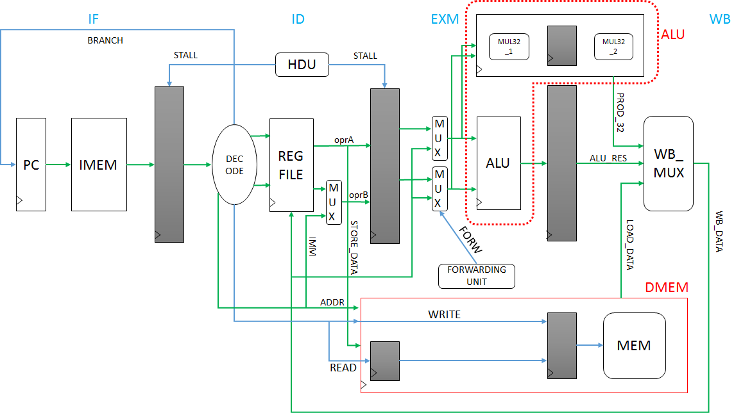
High-level Block Diagram
Data
Control

Slide 5

Processor Pipeline - Register File
Tradeoff between 1-D [width*depth] vs 2-D reg file [width][depth]
Key Features:
Internally forward if write address = read address
Participation fields used in reg file
1) Ex stage calculation assumes all fields participate
2) Reg file - get value of current reg file
3) Calculate what to write back based on new write data, current reg, and PPP
Each instruction therefore takes 1 cycle for execution (2 cycles for multiply)

Slide 6
Processor Pipeline - Stalling
Store Instruction
Branch Instruction
Multiply Instruction
Notes:
Store Instruction - If store is in ID stage and instruction currently in pipeline with matching register, stall
Branch Instruction - Stall if branch reg file address is being modified in EX stage
Multiply Instruction - Stall for 32-bit multiply instruction that uses 2 cycles

Slide 7
Processor Pipeline - Forwarding
Forward according to PPP value when:
Write back stage destination register file = EX stage stage destination register file
Register write is enabled in both EX and WB stages
Applies for both R-type and Load instructions
When stalling - forward only on 1st clock cycle of stall

Slide 8
Processor Pipeline - Branches
ID stages includes a comparator
Determines if the register file address read is zero or not zero
The result of this ID branch signal is used to load the PC if stall if not active
If current branch in ID stage is successful, tag the instruction in IF stage to be flushed

Slide 9
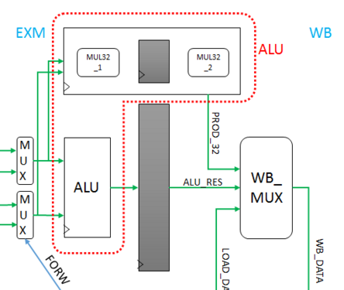
ALU
Logical Operations
AND, OR, XOR, NOT, MOV
Arithmetic Operations
ADD, SUB
Multiplication
Shift Operations
Rotate
Logical Shift
Arithmetic Shift
WW field determines operand widths
Not considered for logical operations
Two-cycles for 32-bit multiplication
One-cycle operation for all other instructions

Slide 10
ALU - Shifters
Logical Shifting
Left- and right-shift
Eight 8-bit shifters
Four 16-bit shifters
Two 32-bit shifters
One 64-bit shifter
Arithmetic Shifting
Only right-shift
Shift amount - Immediate or register-value
Rotation
Coding style for arithmetic-shifting
$signed
Type-cast function
Sign-extension
Synthesizable
“>>>”
Verilog arithmetic right-shift operator
result = $signed(oprA) >>> oprB[58:63];
Notes:
Verilog – by default treats operands as unsigned

Slide 11
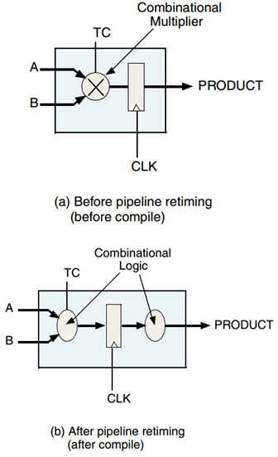
ALU - Multipliers
8-bit Multipliers
Four 8x8 multipliers
Byte multiplication
16-bit Multipliers
Two 16x16 multipliers
Halfword multiplication
32-bit Multiplier
Word multiplication
One 2-stage pipelined DesignWare multiplier instance
DW02_mult_2_stage
Implementation - Booth-recoded Wallace-tree
Even and Odd multiplication
Square Operations
Fig. - DW02_mult_2_stage block diagram
(source - Synopsys DesignWare document library)

Slide 12
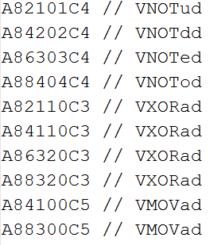
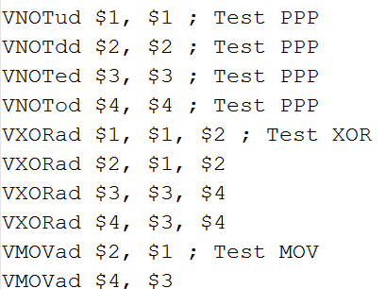
Testing & Synthesis
Test methodology
Write assembly code
Perl script to convert to binary IMEM fill
Observe waveforms and DMEM dump file
Separate test-benches for register-file, ALU
Test-cases
ALU operations
Load and Store
Branches
Stalling, Forwarding...
Synthesis
Meets 4 ns clock-period requirement
2.4 ns cycle time possible too!
report_resources command

Slide 13
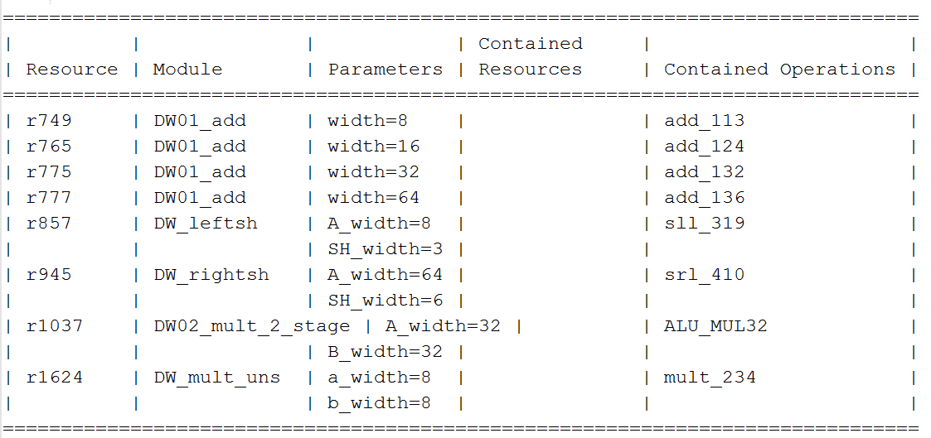
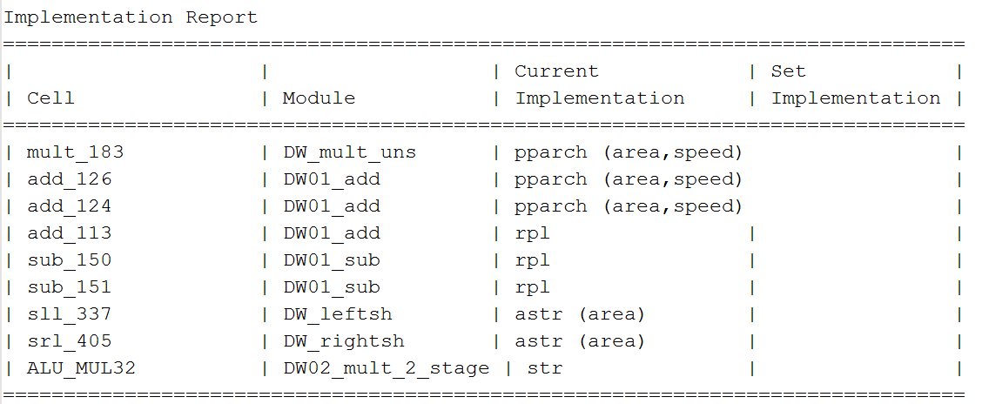
Testing & Synthesis - contd.

Slide 14
Q & A

Slide 15
Instruction Formats
R-type
M-type
6-bits | 5-bits | 5-bits | 5-bits | 5-bits |  | 6-bits
101010 | rD | rA | rB | PPP | WW | Function_code
0 5 | 6 10 | 11 15 | 16 20 | 21 23 | 24 25 | 26 31
6-bits | 5-bits | 5-bits | 5-bits | 5-bits |  | 6-bits
101010 | rD | rA | 00000 | PPP | WW | Function_code
0 5 | 6 10 | 11 15 | 16 20 | 21 23 | 24 25 | 26 31
6-bits | 5-bits | 5-bits | 16-bits
 | rD | 00000 | Immediate_Address
0 5 | 6 10 | 11 15 | 16 31

Slide 16
WW value | Operand Width | Assembly Mnemonic
00 | 8 | b
01 | 16 | h
10 | 32 | w
11 | 64 | d
WW | Width | Subfield indices within a 64-bit register for different operand widths |  |  |  |  |  |  |  | Data-operands
 |  | MSB |  |  |  |  |  |  | LSB
00 | 8 | 0 | 1 | 2 | 3 | 4 | 5 | 6 | 7 | 8
01 | 16 | 0 |  | 1 |  | 2 |  | 3 |  | 4
10 | 32 | 0 |  |  |  | 1 |  |  |  | 2
11 | 64 | 0 |  |  |  |  |  |  |  | 1

Slide 17
PPP value | Participation Definition | Assembly Mnemonic
000 | All subfields participate | a
001 | Upper 32-bit participate | u
010 | Lower 32-bits participate | d
011 | Subfields with even index participate | e
100 | Subfields with odd index participate | o
101 | Reserved | None
110 | Reserved | None
111 | Reserved | None
Subfield indices within a 64-bit register for different operand widths
MSB |  |  |  |  |  |  | LSB
0 | 1 | 2 | 3 | 4 | 5 | 6 | 7
0 | 1 | 2 | 3 | 4 | 5 | 6 | 7
0 | 1 | 2 | 3 | 4 | 5 | 6 | 7
0 | 1 | 2 | 3 | 4 | 5 | 6 | 7
0 | 1 | 2 | 3 | 4 | 5 | 6 | 7

Slide 18
Sr. No. | Instruction | Format | Encoding
 |  |  | 6bits | 5bits | 5bits | 5bits | 5bits | 6bits
1 | VAND | R | 101010 | rD | rA | rB | PPPWW | 000001
2 | VOR | R | 101010 | rD | rA | rB | PPPWW | 000010
3 | VXOR | R | 101010 | rD | rA | rB | PPPWW | 000011
4 | VNOT | R | 101010 | rD | rA | 00000 | PPPWW | 000100
5 | VMOV | R | 101010 | rD | rA | 00000 | PPPWW | 000101
6 | VADD | R | 101010 | rD | rA | rB | PPPWW | 000110
7 | VSUB | R | 101010 | rD | rA | rB | PPPWW | 000111
8 | VMULEU | R | 101010 | rD | rA | rB | PPPWW | 001000
9 | VMULOU | R | 101010 | rD | rA | rB | PPPWW | 001001
10 | VSQEU | R | 101010 | rD | rA | 00000 | PPPWW | 001010
11 | VSQOU | R | 101010 | rD | rA | 00000 | PPPWW | 001011
12 | VRTTH | R | 101010 | rD | rA | 00000 | PPPWW | 001100
13 | VSLL | R | 101010 | rD | rA | rB | PPPWW | 001101
14 | VSLLI | R | 101010 | rD | rA | shift_amount | PPPWW | 001110
15 | VSRL | R | 101010 | rD | rA | rB | PPPWW | 001111
16 | VSRLI | R | 101010 | rD | rA | shift_amount | PPPWW | 010000
17 | VSRA | R | 101010 | rD | rA | rB | PPPWW | 010001
18 | VSRAI | R | 101010 | rD | rA | shift_amount | PPPWW | 010010
19 | VLD | M | 100000 | rD | 00000 | Immediate Address
20 | VSD | M | 100001 | rA | 00000 | Immediate Address
21 | VBEZ | R | 100010 | rD | 00000 | Immediate Address
22 | VBNEZ | R | 100011 | rD | 00000 | Immediate Address
23 | VNOP | R | 111100 | 00000 | 00000 | 00000 | 00000 | 000000

