Slide 1
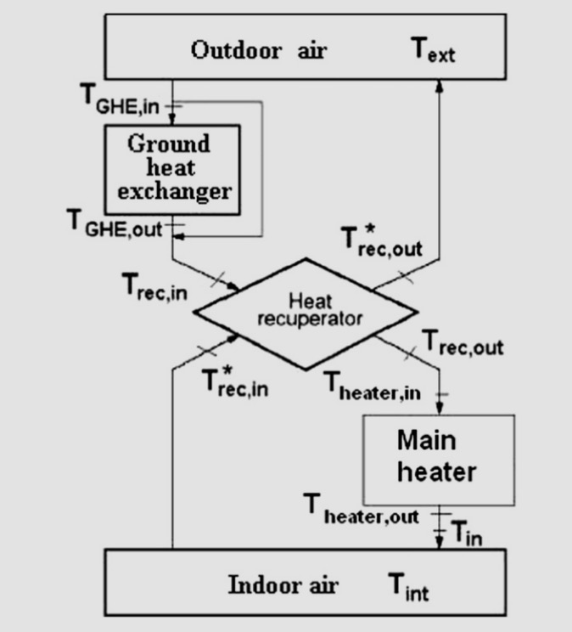
Time-Dependent Simulation of a Large Passively Heated Building
Analyzed the thermal performance of a large office building in Romania during the cold season against European standards
A passive system was implemented that made use of light through windows and ground heat exchanger
Made use of temperature and solar data in a transient analysis
Andrew Alferman June 6, 2017

Slide 2
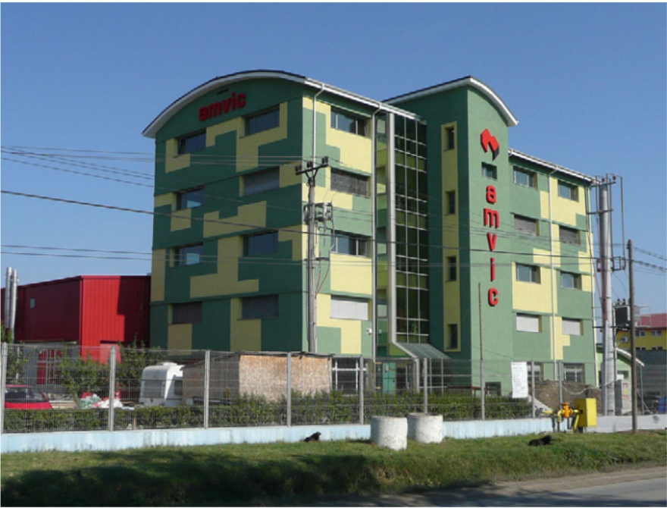
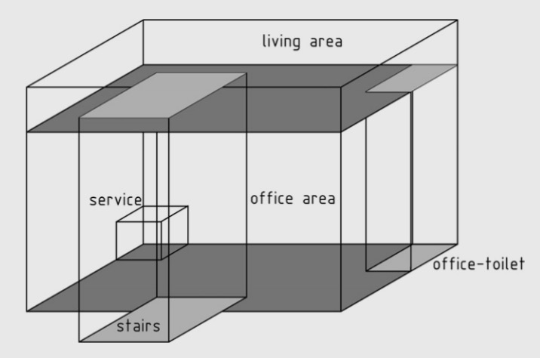
Important Takeaways
Simulation/analysis similar to techniques learned in class
Yearly thermal load of 6.7 kWh/m², better than standard of 15 kWh/m²
Ground heat exchanger provided the most heat to the building, η_{GHE} = 16.9%
Transient analysis demonstrated that the system is sufficient to meet demands

Slide 3
Ideas for Future Development
Extend analysis to hot season to determine cooling requirements
Factor in impact of wind or other weather conditions on building
Determine if existing heating/cooling capabilities support growth in heat load (computers) or use of more efficient lighting and other heat sources
Works Cited:
Badescu, V., Laaser, N., Crutescu, R., Crutescu, M., Dobrovicescu, A., & Tsatsaronis, G. (2011). Modeling , validation and time-dependent simulation of the first large passive building in Romania. Renewable Energy, 36(1), 142–157. https://doi.org/10.1016/j.renene.2010.06.015

