Slide 1


Differential Equations
Brannan
Copyright © 2010 by John Wiley & Sons, Inc.
All rights reserved.
Chapter 04: Second Order Linear
Equations

Slide 2
Chapter 4 Second Order Linear
Equations
In Chapter 3 we discussed systems of two first order equations, with primary emphasis on homogeneous linear equations with constant coefficients.
In this chapter we will begin to consider second order linear equations, both homogeneous and nonhomogeneous.
Since second order equations can always be transformed into a system of two first order equations, this may seem redundant. However, second order equations naturally arise in many areas of application, and it is important to be able to deal with them directly. One cannot go very far in the development of fluid mechanics, heat conduction, wave motion, or electromagnetic phenomena without encountering second order linear differential equations.

Slide 3
Chapter 4 - Second Order Linear Equations
4.1 Definitions and Examples
4.2 Theory of Second Order Linear Homogeneous Equations
4.3 Linear Homogeneous Equations with Constant Coefficients
4.4 Mechanical and Electrical Vibrations
4.5 Nonhomogeneous Equations; Method of Undetermined Coefficients
4.6 Forced Vibrations, Frequency Response, and Resonance
4.7 Variation of Parameters

Slide 4
4.1 Definitions and Examples
A second order differential equation is an equation involving the independent variable
t, and an unknown function or dependent variable y = y(t) along with its first and second
derivatives. We will assume that it is always possible to solve for the second derivative so
that the equation has the form
y'' = f (t, y, y'),
A solution of it on an interval I is a function y = φ(t), twice continuously differentiable on I, such that φ''(t) = f (t, φ(t), φ'(t)) for all values of t ∈ I.

Slide 5
Definitions and Examples (Ctd.)
An initial value problem for a second order equation on an interval I consists of y'' = f (t, y, y'), together with two initial conditions y(t₀) = y₀, y'(t₀) = y₁, prescribed at a point t0 ∈ I, where y₀ and y₁ are any given numbers.
Thus y = φ(t) is a solution of the initial value problem on I if, in addition to satisfying y'' = f (t, y, y') on I, φ(t₀) = y₀ and φ'(t₀) = y₁.

Slide 6
Linear Equations
The differential equation y'' = f (t, y, y') is said to be linear if it can be written in the standard form
y'' + p(t) y' + q(t)y = g(t), (A)
where the coefficient of y'' is equal to 1. The coefficients p, q, and g can be arbitrary functions of the independent variable t, but y, y', and y'' can appear in no other way except as designated by the form of Eq. (A).
Equation (A) is said to be homogeneous if the term g(t) is zero for all t. Otherwise the equation is nonhomogeneous, and the term g(t) is referred to as the nonhomogeneous term.

Slide 7
Linear Equations
A slightly more general form of a linear second order equation is
P(t)y'' + Q(t)y' + R(t)y = G(t).
This Equation is said to be a constant coefficient equation if P, Q, and R are constants. In this case, Eq. reduces to
ay'' + by' + cy = g(t)
where a = 0, b, and c are given constants and we have replaced G(t) by g(t).
Otherwise Eq. has variable coefficients.

Slide 8
Dynamical System Formulation
As in 3.2, y'' = f (t, y, y') can be converted to a system of first order equations of dimension two by introducing the state variables x₁ = y and x₂ = y'. Then
x'₁ = x₂, x₂= f (t, x₁, x₂),
Initial conditions for the system are x₁(t₀) = y₀, x₂(t₀) = y₁,
When we refer to the state variables for y'' = f (t, y, y'), we mean both y and y, although other choices for state variables may be used. In addition, when we refer to the dynamical system equivalent to y'' = f (t, y, y'), we mean the system of first order equations above expressed in terms of the state variables.
Just as in Chapter 3, the evolution of the system state in time is graphically represented as a continuous trajectory, or orbit, through the phase plane or state space.

Slide 9
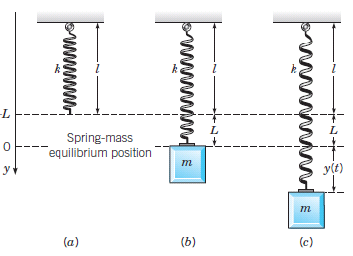
Application 1 - The Spring-Mass System

Slide 10
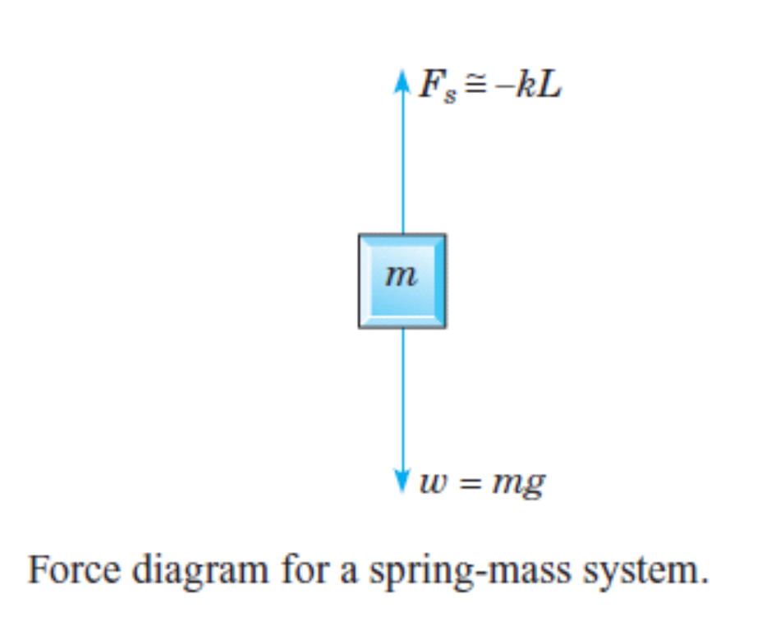
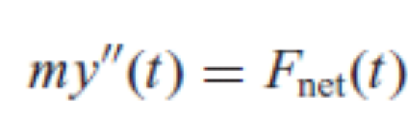
The Spring-Mass System
Hooke’s law. F_{s} (Δy) = −k Δy.
k is spring constant or stiffness of the spring.

Slide 11
Four forces to get F_{net}
1. Gravitational Force. The weight w = mg of the mass always acts downward.
2. Spring Force. The spring force Fs is assumed to be proportional to the total elongation y = L + y following Hooke’s law, (see Figure c above), F_{s} = −k(L + y).
3. Damping Force. The damping or resistive force F_{d} always acts in the direction opposite to the direction of motion of the mass.
4. External Forces or Inputs. An applied external force F(t) is directed downward or upward as F(t) is positive or negative.

Slide 12
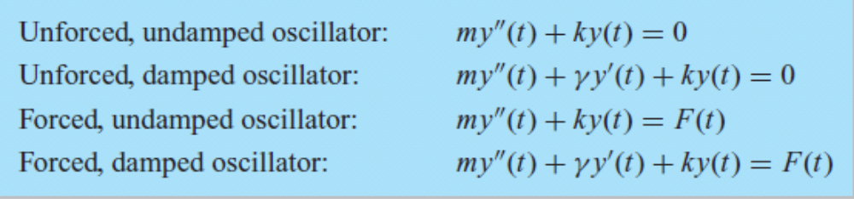
The equation of motion of the mass
It is a second order linear equation with constant coefficients,
my''(t) + γ y'(t) + ky(t) = F(t),
where the constants m, γ , and k are positive.
Four Interesting cases:

Slide 13
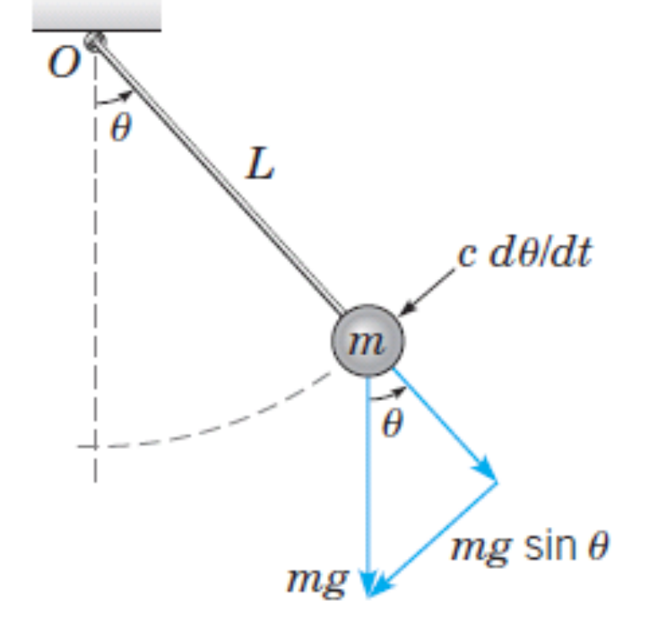
Application 2 - The Linearized Pendulum
Consider the configuration shown in Figure in which a mass m is attached to one end of a rigid, but weightless, rod of length L.

Slide 14
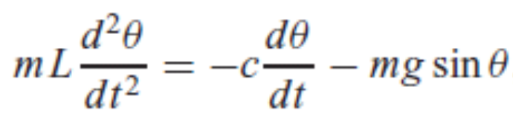

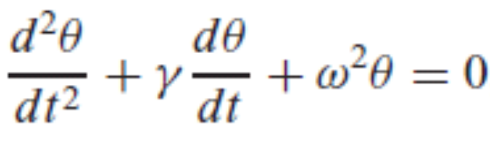
The Linearized Pendulum
The differential equation that describes the motion of the pendulum is derived by applying Newton’s second law ma = F_{net} along the line tangent to the path of motion,
or
where γ = c/mL and ω2 = g/L. Due to the presence of the term sin θ, Eq. cannot be written in the form of a linear equation. Thus Eq. is nonlinear.
It can be linearized to
for small θ.

Slide 15
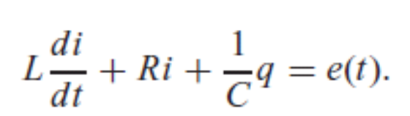
Application 3 - The Series RLC Circuit
A third example of a second order linear differential equation with constant coefficients is a model of flow of electric current in the simple series circuit.
The current i, measured in amperes, is a function of time t. The resistance R (ohms), the capacitance C (farads), and the inductance L (henrys) are all positive and are assumed to be known constants. The impressed voltage e (volts) is a given function of time. Another physical quantity that enters the discussion is the total charge q (coulombs) on the capacitor at time t. The relation between charge q and current i is
i = dq/dt.
By Kirchhoff’s law,

Slide 16
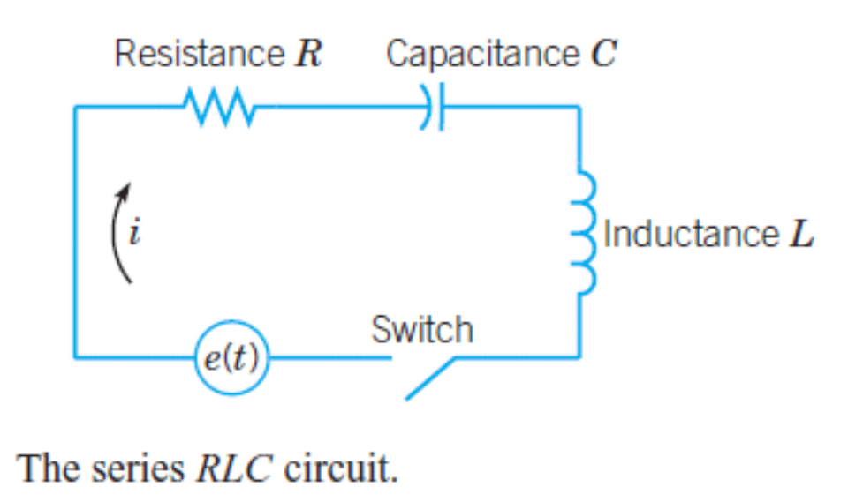


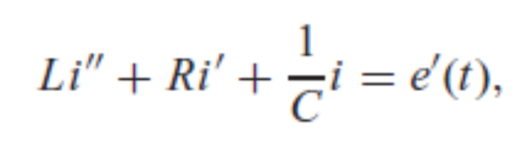


The Series RLC Circuit

Slide 17
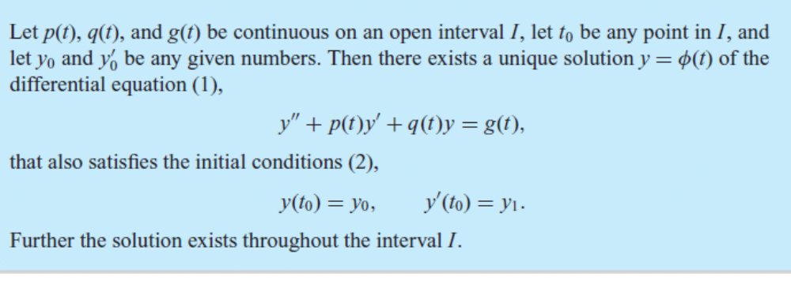
4.2 Theory of Second Order Linear
Homogeneous Equations
THEOREM 4.2.1- Existence and Uniqueness of Solutions

Slide 18
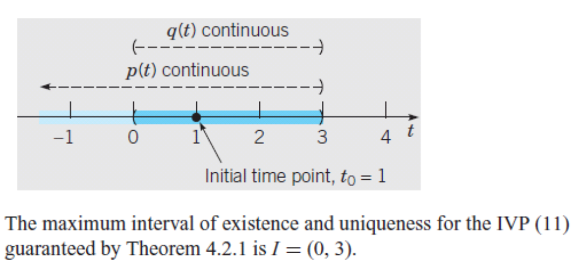
Example
Find the longest interval in which the solution of the initial value problem (IVP)
(t² − 3t)y'' + ty' − (t + 3)y = 0,
y(1) = 2, y' (1) = 1
is certain to exist.
Ans:

Slide 19
Linear Operators and the Principle of Superposition for Linear Homogeneous Equations
In an expression such as dy/dt + p(t)y, each of the two operations, differentiation and multiplication by a function, map y into another function. Each operation is an example of an operator or transformation.
Let D to indicate the operation of differentiation, (Dy)(t) = dy/dt(t), and p to indicate the operation of multiplication, ( py)(t) = p(t)y(t). Both of the operators D and p have the special property that they are linear operators.
We can define the second order differential operator L by L = D² + pD + q =d²/dt²+ pd/dt + q.

Slide 20
THEOREM 4.2.2 - Linearity of the differential operator L.
Let L[ y] = y'' + py' + qy, where p and q are continuous functions on an interval I. If y₁ and y₂ are any twice continuously differentiable functions on I, and c₁ and c₂ are any constants, then
L[c₁y₁ + c₂y₂] = c₁L[y₁] + c₂L[y₂].
Principle of superposition for linear homogeneous equations - If L is linear and y₁ and y₂ are solutions of the homogeneous equation L[y]=0, then c₁y₁ + c₂y₂ is also a solution of L[y]=0 for any pair of constants c₁ and c₂ .

Slide 21
COROLLARY 4.2.3
Let L[ y] = y'' + py' + qy, where p and q are continuous functions on an interval I. If y₁ and y₂ are two solutions of L[y] = 0, then the linear combination y = c₁ y₁(t) + c₂ y₂(t) is also a solution for any values of the constants c₁ and c₂.
THEOREM 4.2.4
Let K[x] = x' − P(t)x, where the entries of P are continuous functions on an interval I. If x₁ and x₂ are continuously differentiable vector functions on I, and c₁ and c₂ are any constants, then K[c₁x₁ + c₂x₂] = c₁K[x₁] + c₂K[x₂].

Slide 22
COROLLARY 4.2.5
Let K[x] = x' − P(t)x, where the entries of P are continuous functions on an interval I. If x₁ and x₂ are two solutions of K[x] = 0, and c₁ and c₂ are any constants, then the linear combination x=c₁x₁(t)+ c₂x₂(t) is also a solution.
THEOREM 4.2.6
If x₁ and x₂ are two solutions of x' = P(t)x, that their Wronskian is not zero on I. Then x₁ and x₂ form a fundamental set of solutions and the general solution is x=c₁x₁ + c₂x₂. If there is a given initial condition x(t₀) = x₀, then this condition determines the constants c₁ and c₂ uniquely.

Slide 23
THEOREM 4.2.7
Let y₁ and y₂ be two solutions of y'' + p(t)y' + q(t)y = 0, and assume that their Wronskian, defined by
W[y₁, y₂](t) = y₁(t) y'₂(t) − y'₁(t)y₂(t),
is not zero on I. Then y₁ and y₂ form a fundamental set of solutions, and the general solution is given by
y = c₁y₁(t) + c₂y₂(t),
where c₁ and c₂ are arbitrary constants. If there are given initial conditions y(t₀) = y₀ and y'(t₀) = y₁, then these conditions determine c₁ and c₂ uniquely.

Slide 24
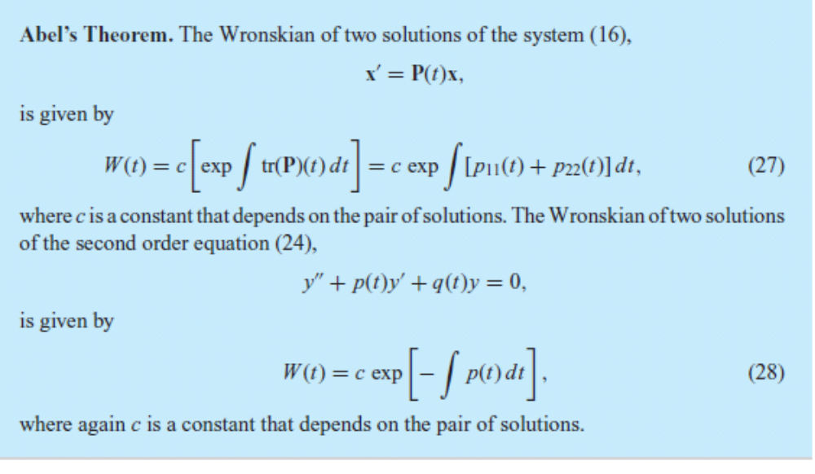
Abel’s Equation for the Wronskian
THEOREM 4.2.8

Slide 25
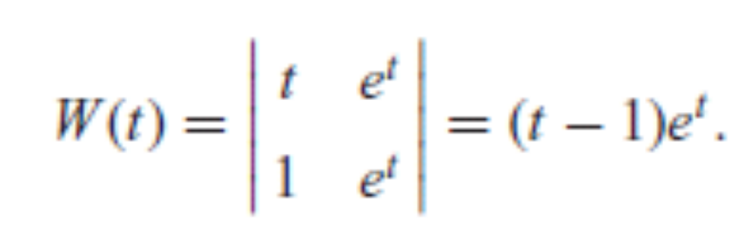
Example
Find the Wronskian of any pair of solutions of (1 − t)y'' + ty' − y = 0.
Answer Rewrite the equation in standard form and use theorem 4.2.8.
Verify that y₁(t) = t and y₂(t) = e^{t} are two solutions of Eq. by substituting these two functions into the differential equation. The Wronskian of these two solutions is

Slide 26
COROLLARY 4.2.9
If x₁(t) and x₂(t) are two solutions of the system x = P(t)x, and all entries of P(t) are continuous on an open interval I, then the Wronskian W[x₁, x₂](t) is either never zero or always zero in I.
If y₁(t) and y₂(t) are two solutions of the second order equation y'' + p(t)y' + q(t)y = 0, where p and q are continuous on an open interval I, then the Wronskian W[y₁, y₂](t) is either never zero or always zero in I.

Slide 27

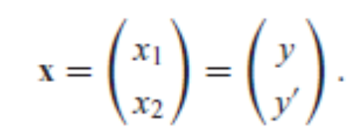
4.3 Linear Homogeneous Equations with Constant Coefficients
We study ay'' + by' + cy = 0 (Eq. (1)), where a≠0, b, and c are given real numbers.
Using the state variables x₁ = y and x₂ = y', this equation converts to
(Eq. (2)) where
Assume x = e^{λt}v and substitute to get the Characteristic Equation, Z(λ) = aλ² + bλ + c = 0, of ay'' + by' + cy = 0. Z(λ) = aλ2 + bλ + c is called the characteristic polynomial.

Slide 28
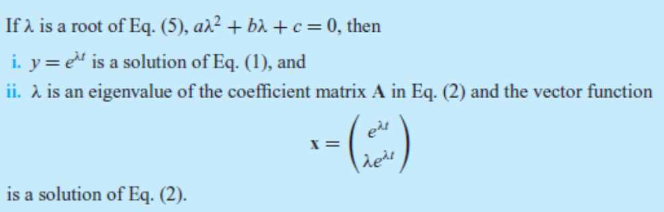
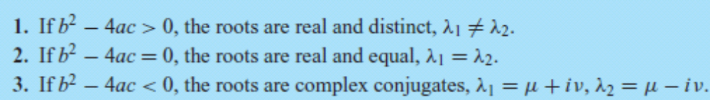
THEOREM 4.3.1
There will be three forms of the general solution of Eq. (2).

Slide 29
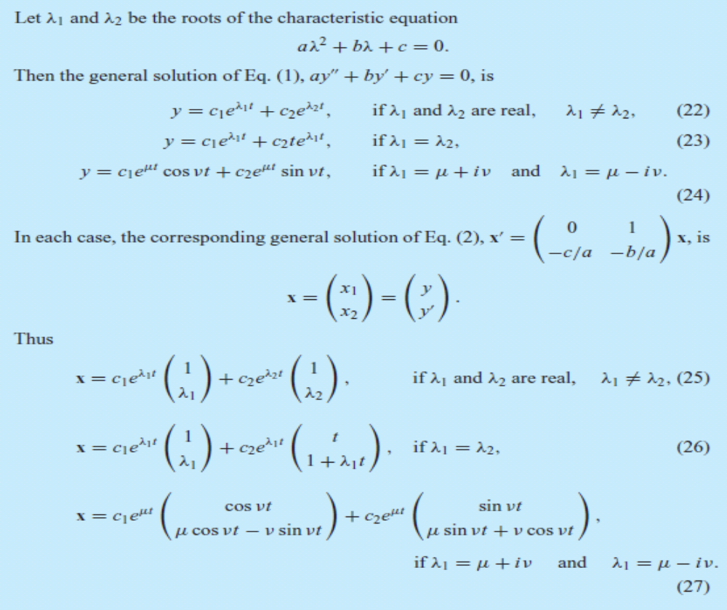
THEOREM 4.3.2

Slide 30
Example
Find general solution for the differential equation: y'' + 5y' + 6y = 0
Answer:
λ² + 5λ + 6 = (λ + 2)(λ + 3) = 0,
λ₁ = −2, λ₂ = −3
From Eq. (22) in Theorem 4.3.2,
y = c₁e^{−2t} + c₂e^{−3t}.

Slide 31
Initial Value Problems and Phase Portraits
The origin is an asymptotically stable node if the roots are real and negative. If the roots are real and positive, the origin is an unstable node.
If the roots are real and of opposite sign, the origin is a saddle point and unstable.
If the roots are complex with nonzero imaginary part, the origin is an asymptotically stable spiral point (trajectories spiral in) if the real part is negative. If the real part is positive, the origin is an unstable spiral point (trajectories spiral out).
If the real part of a pair of complex roots is zero, the origin is a center (trajectories are closed curves) and is stable, but not asymptotically stable.
The direction of rotation for spiral points and centers for Eq. (2) is always clockwise. To see this, we note that in order to have roots with a nonzero imaginary part, it is necessary that b² −4ac<0, or ac>b²/4 ≥ 0. Thus a and c must have the same sign. The direction field vector for Eq. (2) at the point (1, 0) is 0i − (c/a) j. Since the second component is negative, the direction of rotation must be clockwise.

Slide 32
Example
Question: Find the solution of the initial value problem
y'' + 5y' + 6y = 0, y(0) = 2, y(0) = 3.
Formulate the differential equation as a dynamical system, discuss the corresponding phase portrait, and draw the trajectory associated with the solution of the initial value problem.
Answer: Generel solution is y = c₁e^{−2t} + c₂e^{−3t}. Substitute the initial conditions to get y = 9e^{−2t} − 7e^{−3t}.

Slide 33
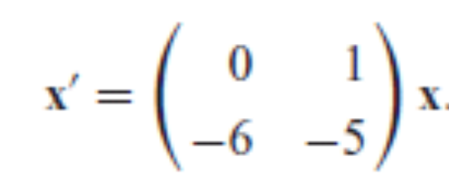
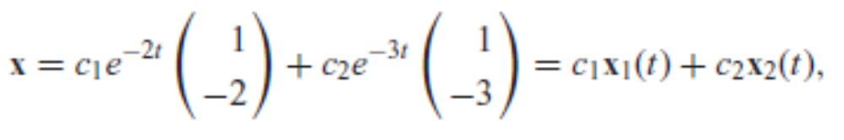
Example (Ctd.)
The dynamical system corresponding to the state vector x = x₁i + x₂j = yi + y'j is
From Theorem 4.3.2 the general solution is

Slide 34
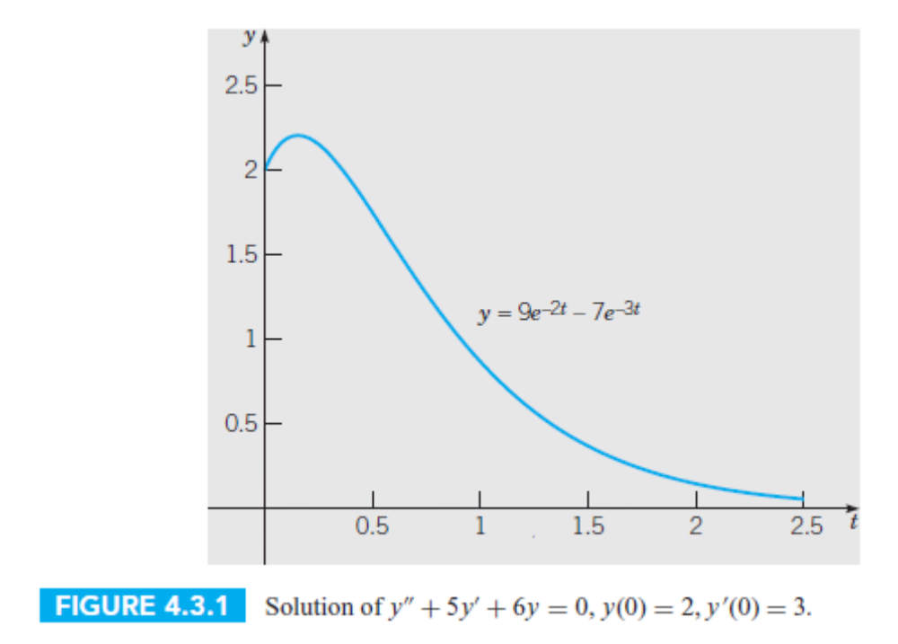
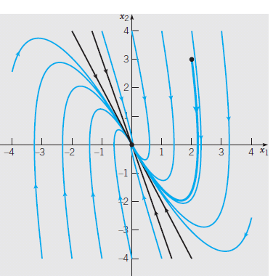
Solution and Phase portrait for the dynamical system

Slide 35
4.4 Mechanical and Electrical Vibrations
Undamped Free Vibrations
Recall that the equation of motion for the damped spring-mass system with external forcing is
my'' + γ y' + ky = F(t)
with initial conditions, y(0) = y₀, y(0) = v₀, that specify initial position y₀ and initial velocity v₀ provide a complete formulation of the vibration problem.
If there is no external force, then F(t) = 0. Assume that there is no damping, so γ = 0.
We get my'' + ky = 0. If we divide by m, it becomes
y'' + ω²₀ y = 0,
where ω²₀ = k/m.

Slide 36
Undamped Free Vibrations
The characteristic equation for diff. eq. is
λ² + ω²₀ = 0, and the corresponding characteristic roots are λ=±ω₀. It follows that the general solutionis
y = A cos ω₀t + B sin ω₀t.
Via the initial conditions to determine the integration constants A and B in terms of initial position and velocity,
A = y₀ and B = v₀/ ω₀.
We can write y in the phase amplitude form
y = R cos(ω₀t − δ).

Slide 37
Undamped Free Vibrations
The period of the motion isT = 2π/ω₀= 2π(m/k)^{1/2}.
The circular frequency ω₀ =√(k/m), measured in radians per unit time, is called the natural frequency of the vibration.
The maximum displacement R of the mass from equilibrium is the amplitude of the motion.
The dimensionless parameter δ is called the phase, or phase angle, and measures the displacement of the wave from its normal position corresponding to δ = 0.

Slide 38
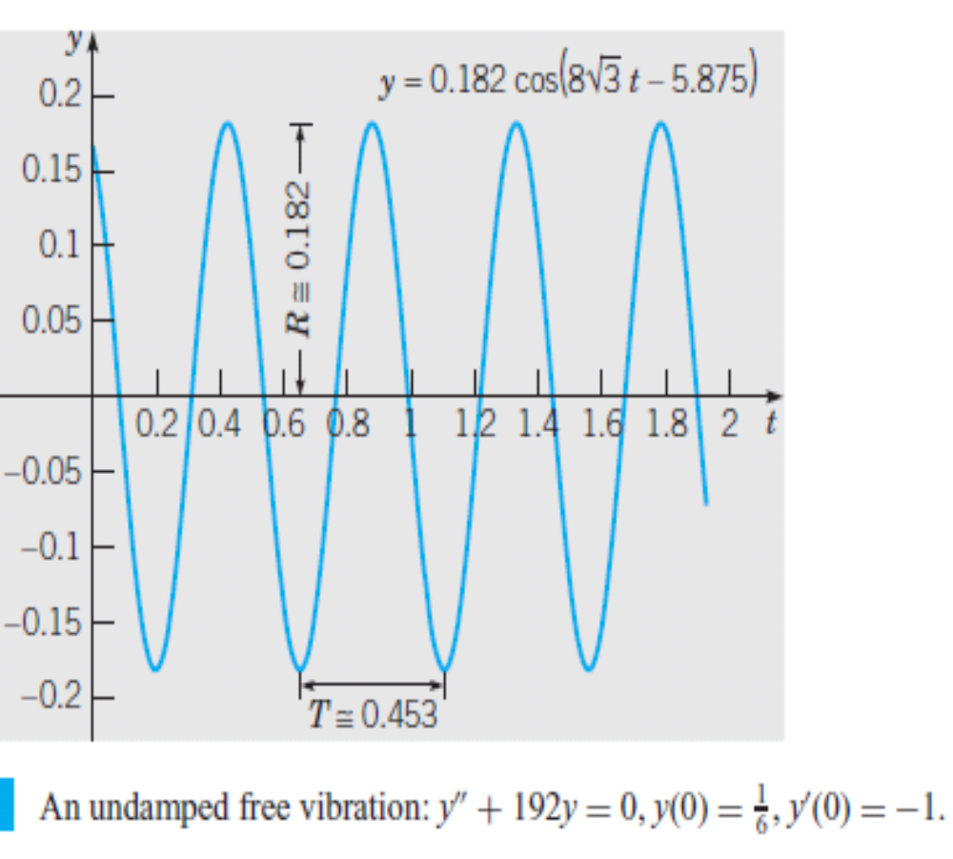
Example
Suppose that a mass weighing 10 lb stretches a spring 2 in. If the mass is displaced an additional 2 in and is then set in motion with an initial upward velocity of 1 ft/s, determine the position of the mass at any later time. Also determine the period, amplitude, and phase of the motion.

Slide 39
Damped Free Vibrations
If we include the effect of damping, the differential equation governing the motion of the mass is my''+γy'+ky=0.
The roots of the corresponding characteristic equation, mλ²+γλ+k=0 leads to 3 cases.
1. Underdamped Harmonic Motion (γ²−4km < 0).
The roots are μ ±iν with μ = −γ/2m < 0 and ν = (4km − γ²)^{1/2}/2m> 0 and general solution is y = e^{−γt/2m}(A cos νt + B sin νt).
2. CriticallyDampedHarmonic Motion (γ²−4km =0).
In this case, λ₁=−γ/2m<0 is a repeated root and the general solution is y = (A + Bt)e^{−γt/2m}

Slide 40
Damped Free Vibrations
3. Overdamped Harmonic Motion (γ²−4km > 0).
In this case, the values of λ₁ and λ₂ are real, distinct, and negative, and the general solution is y = Ae^{λ1t} + Be^{λ2t}.
The most important case is the first one, which occurs when the damping is small. If we let A = R cos δ and B = R sin δ, then we obtain
y = Re^{−γ t/2m} cos(νt − δ).
ν is called the quasi-frequency and T_{d} = 2π/ν is called the quasi-period.

Slide 41
Example
The motion of a certain spring-mass system is governed by the differential equation
y'' + 0.125y' + y = 0,
where y is measured in feet and t in seconds. If y(0) = 2 and y'(0) = 0, determine the position of the mass at any time. Find the quasi-frequency and the quasi-period, as well as the time at which the mass first passes through its equilibrium position. Find the time τ such that |y(t)| < 0.1 for all t > τ. Draw the orbit of the initial value problem in phase space.

Slide 42
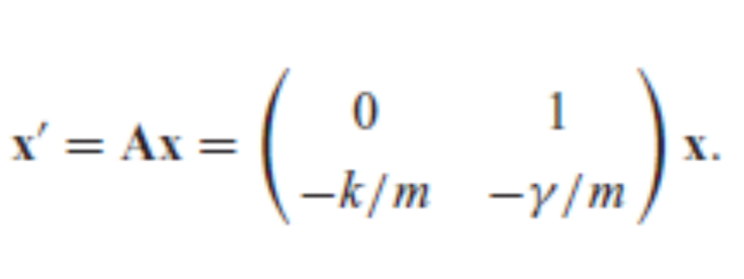
Phase Portraits for Harmonic Oscillators
The differences in the behavior of solutions of undamped and damped harmonic oscillators, illustrated by plots of displacement versus time, are completed by looking at their corresponding phase portraits. If we convert my''+γy'+ky=0 to a first order system where x = x1i +x2j = yi + yj, we obtain

Slide 43
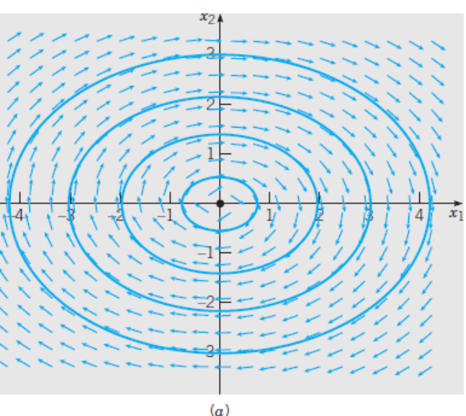
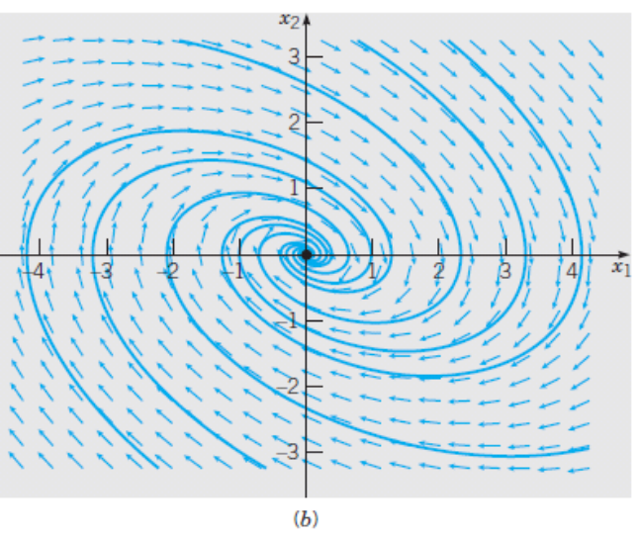
Phase Portraits for Harmonic Oscillators
Since the eigenvalues of A are the roots of the characteristic equation, we know that the origin of the phase plane is a center, and therefore stable, for the undamped system in which γ = 0. In the underdamped case, 0 < γ² < 4km, the origin is a spiral sink. Direction fields and phase portraits for these two cases are shown in Figures below.
(a) For an undamped harmonic oscillator.
(b) a damped harmonic oscillator that is underdamped.

Slide 44
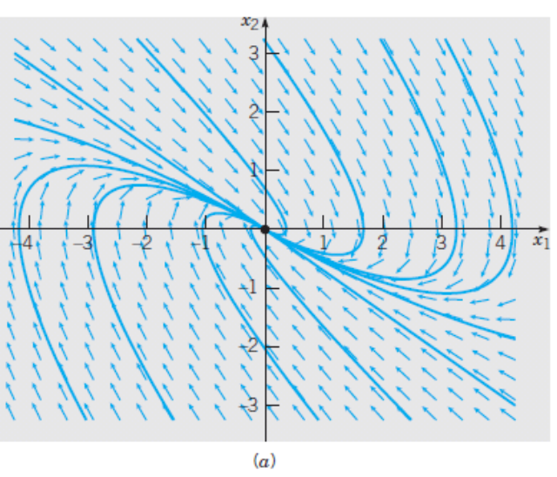
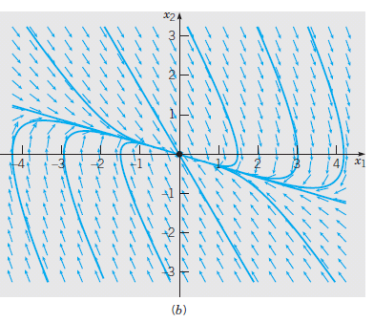
Direction field and phase portraits
If γ₂ = 4km, the matrix A has a negative, real, and repeated eigenvalue; if γ² > 4km, the eigenvalues of A are real, negative, and unequal. Thus the origin of the phase plane in both the critically damped and overdamped cases is a nodal sink. Direction fields and phase portraits for these two cases are shown in Figure.
(a) a critically damped harmonic oscillator.
(b) an overdamped harmonic oscillator.

Slide 45
4.5 Nonhomogeneous Equations;
Method of Undetermined Coefficients
THEOREM 4.5.1
If Y₁ and Y₂ are two solutions of the nonhomogeneous equation L[ y] = y'' + p(t)y' + q(t)y = g(t), then their difference Y₁−Y₂ is a solution of the corresponding homogeneous equation L[ y] = y'' + p(t)y' + q(t)y = 0. If, in addition, y₁ and y₂ are a fundamental set of solutions of L[ y] = y'' + p(t)y' + q(t)y = 0, then Y₁(t) − Y₂(t) = c₁ y₁(t) + c₂ y₂(t), where c₁ and c₂ are certain constants.

Slide 46
THEOREM 4.5.2
The general solution of the nonhomogeneous equation L[ y] = y'' + p(t)y' + q(t)y = g(t) can be written in the form
y = φ(t) = c₁y₁(t)+c₂ y₂(t)+Y(t),
where y₁ and y₂ are a fundamental set of solutions of the corresponding homogeneous equation, c₁ and c₂ are arbitrary constants, and Y is some specific solution of the nonhomogeneous equation L[ y] = y'' + p(t)y' + q(t)y = g(t).

Slide 47
General Solution Strategy
Theorem 4.5.2 states that to solve the nonhomogeneous equation, we must do three things:
1. Find the general solution c₁y₁(t)+c₂ y₂(t) of the corresponding homogeneous equation. This solution is frequently called the complementary solution and may be denoted by y_{c}(t).
2. Find some single solution Y(t) of the nonhomogeneous equation. Often this solution is referred to as a particular solution.
3. Add together the functions found in the two preceding steps.

Slide 48
A special method of finding a particular solution
Method of Undetermined Coefficients
1. If the nonhomogeneous term g(t) is an exponential function e^{αt} , then assume that Y(t) is proportional to the same exponential function.
2. If g(t) is sin βt or cos βt, then assume that Y(t) is a linear combination of sin βt and cos βt.
3. If g(t) is a polynomial, then assume that Y(t) is a polynomial of like degree.
The same principle extends to the case where g(t) is a product of any two, or all three, of these types of functions.

Slide 49
Examples
1. Find a particular solution of
y'' − 3y' − 4y = 3e^{2t}.
Ans: Let Y (t) = Ae^{2t} and find A by substitutiing in to the equation. Then A=−12. Thus a particular solution is
Y(t) = −½e^{2t} .
2. Find a particular solution of
y'' − 3y' − 4y = 2 sin t.
Ans: Y (t) = A sin t + B cos t. Get A and B.
Y (t) = − 5/17 sin t + 3/17 cos t.

Slide 50
Superposition Principle for Nonhomogeneous Equations
Suppose that g(t) is the sum of two terms, g(t) = g₁(t) + g₂(t), and suppose that Y₁ and Y₂ are solutions of the equations
a y'' + b y' + cy = g₁(t) and
a y'' + b y' + cy = g₂(t), respectively.
Then Y₁ + Y₂ is a solution of the equation a y'' + b y' + cy = g(t).

Slide 51
Example
Find a particular solution of
y'' −3y' −4y = 3e^{2t} + 2 sin t − 8e^{t} cos 2t.
Answer: Get particular solutions to each after Splitting up the right side of to three equations
y'' −3y' −4y = 3e^{2t}
y'' −3y' −4y = 2 sin t and
y'' −3y' −4y = − 8e^{t} cos 2t.
Add those solutions to get a particular solution to the problem
Y (t) = −1/2e^{2t} + 3/17 cos t − 5/17 sin t + 10/13 e^{t} cos 2t + 2/13 e^{t} sin 2t.

Slide 52
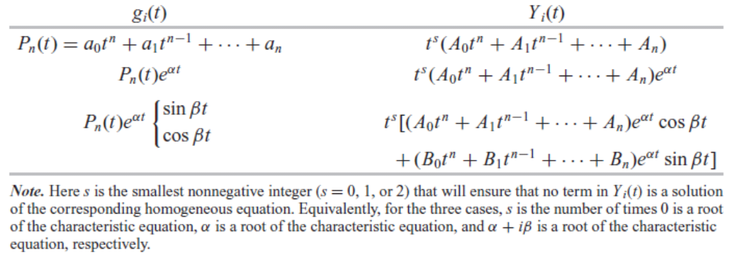
The particular solution Yi(t) of ay'' +by' + cy = g_{i}(t).

Slide 53
4.6 Forced Vibrations, Frequency
Response, and Resonance
Forced Vibrations with Damping
Recall that the equation of motion for the damped spring-mass system with external forcing is
my'' + γ y' + ky = F(t)
where m, γ, and k are the mass, damping coefficient, and spring constant, respectively.
Dividing through Eq. by m puts it in the form
y'' + 2δy' + ω²₀ y = f (t),
where δ = γ/(2m), ω²₀= k/m, and f (t) = F(t)/m.

Slide 54
Example
Find the general solution of
y'' + 2δy' + ω²₀ y = Ae^{iωt}
The general solution of Eq. is of the form
y = y_{c}(t) + Y (t)
y_{c}(t)= c₁y₁(t)+c₂ y₂(t) is the general solution of the homogeneous equation and the constants c₁ and c₂ depend on initial conditions. Since y_{c}(t)→0 as t→∞, it is called the transient solution.
The remaining term in solution, Y(t) = G(iω)Ae^{iωt} , or in the real case corresponding to the input f (t) = A cos ωt, Y_{Re}(t) = ReY(t) does not die out as t increases but persists indefinitely, or as long as the external force is applied. It represents a steady oscillation with the same frequency as the external force and is called the steady-state solution, the steady-state response, the steady-state output, or the forced response.

Slide 55
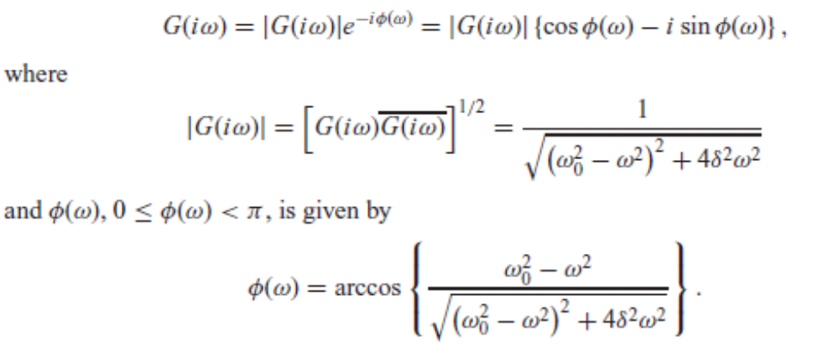
The Frequency Response Function
It is convenient to represent G(iω) in complex exponential form. The function G(iω) is called the frequency response of the system. The absolute value of the frequency response, |G(iω)|, is called the gain of the frequency response and the angleφ(ω) is called the phase of the frequency response.

Slide 56
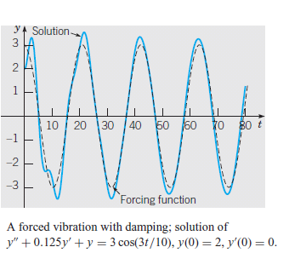
Example
Consider the initial value problem
y''+0.125y'+y=3cos ωt, y(0)=2, y'(0) = 0.
Show plots of the solution for different values of the forcing frequency ω, and compare them with corresponding plots of the forcing function.

Slide 57
Forced Vibrations without Damping
We now assume that δ = γ/2m = 0 to get the equation of motion of an undamped forced oscillator y + ω²₀y = A cos ωt, where we have assumed that
f(t) = A cos ωt. The form of the general solution of Eq. is different, depending on whether the forcing frequency ω is different from or equal to the
natural frequency ω₀ =√(k/m_ of the unforced system. First consider the case ω ≠ ω₀ ; then the general solution of Eq. is
y = c₁cos ω₀t + c₂sin ω₀t + (A/(ω²₀−ω²))cos ωt.
The constants c₁ and c₂ are determined by the initial conditions. The resulting motion is, in general, the sum of two periodic motions of different frequencies (ω₀ and ω) and amplitudes.

Slide 58
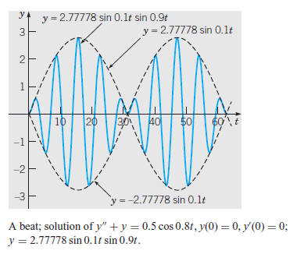
Example
Solve the initial value problem
y'' +y = 0.5 cos 0.8t, y(0) = 0, y'(0) = 0, and plot the solution.
In this case, ω₀ = 1, ω = 0.8, and A = 0.5, so from the solution of the given problem is
y = 2.77778 sin 0.1t sin 0.9t.
A graph of this solution is shown in Figure.

Slide 59
4.7 Variation of Parameters
We describe another method for finding a particular solution of a nonhomogeneous equation. The method, known as variation of parameters or variation of constants, is due to Lagrange and complements the method of undetermined coefficients rather well.
The main advantage of variation of parameters is that it is a general method; in principle at least, it can be applied to any linear nonhomogeneous equation or system. It requires no detailed assumptions about the form of the solution.

Slide 60
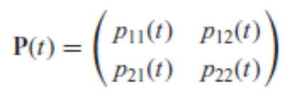
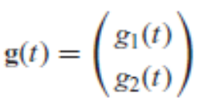
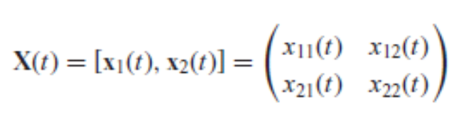
Variation of Parameters for Linear First Order Systems of Dimension 2
THEOREM 4.7.1
Assume that the entries of the matrices
and
are continuous on an open interval I and that x₁ and x₂ are a fundamental set of solutions of the homogeneous equation x' = P(t)x corresponding to the nonhomogeneous equation (1) x' = P(t)x + g(t).
Then a particular solution is x_{p}(t) = X(t)∫X⁻¹(t)g(t) dt, where the fundamental matrix X(t) is defined by
Moreover the general solution is
x(t) = c₁x₁(t) + c₂x₂(t) + x_{p}(t).

Slide 61
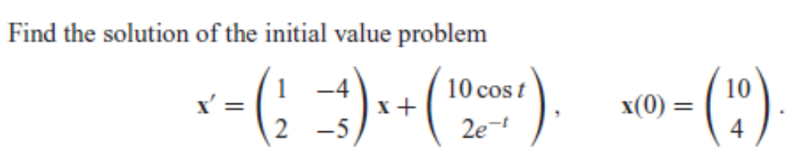


Example
Answer: The general solution of the nonhomogeneous equation
The solution of the initial value problem

Slide 62
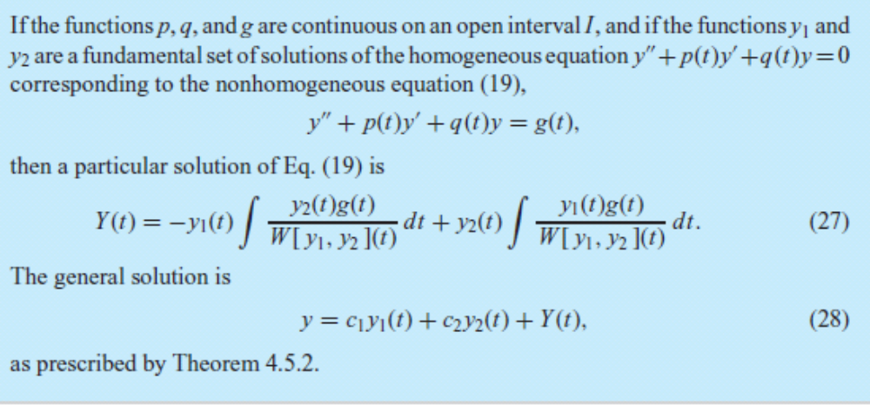
Variation of Parameters for Linear Second Order Equations

Slide 63
Example
Find a particular solution of
y'' + 4y = 3 csc t.
Answer
A particular solution is
y = 3 sin t + 3/2ln |csc t − cot t| sin 2t
The general solution is
y = 3 sin t + 3/2 ln |csc t − cot t| sin 2t + c₁cos 2t + c₂sin 2t.

Slide 64
Chapter Summary - Section 4.1
Many simple vibrating systems are modeled by second order linear equations. Mathematical descriptions of spring-mass systems and series RLC circuits lead directly to such equations. Using a technique known as linearization, second order linear equations are often used as approximate models of nonlinear second order systems that operate near an equilibrium point. An example of this is the pendulum undergoing small oscillations about its downward-hanging equilibrium state.

Slide 65
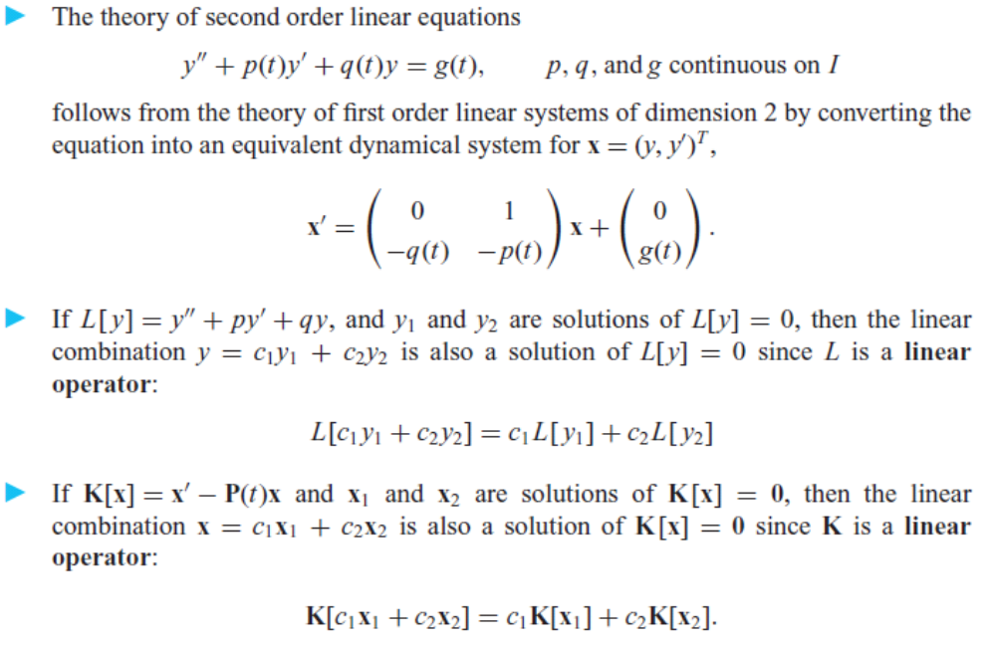
Section 4.2

Slide 66
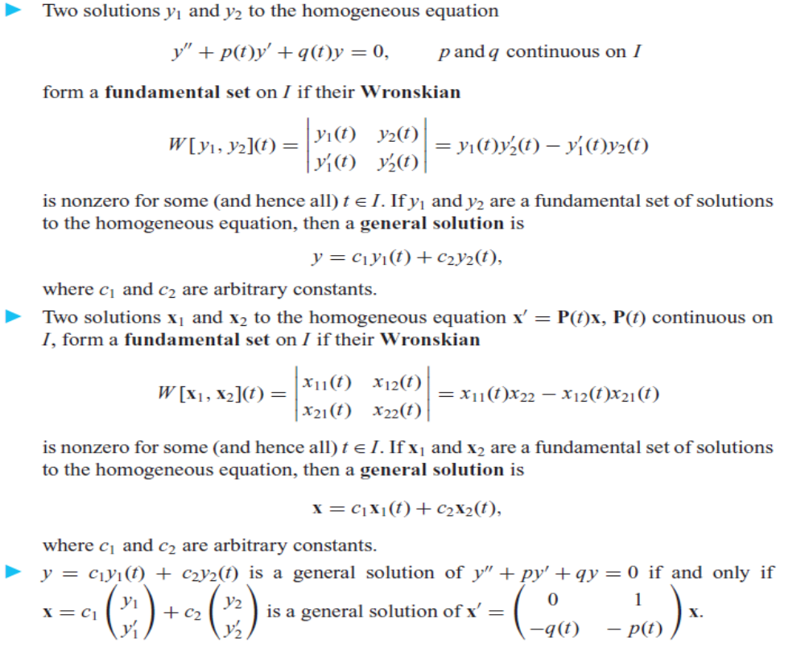

Slide 67
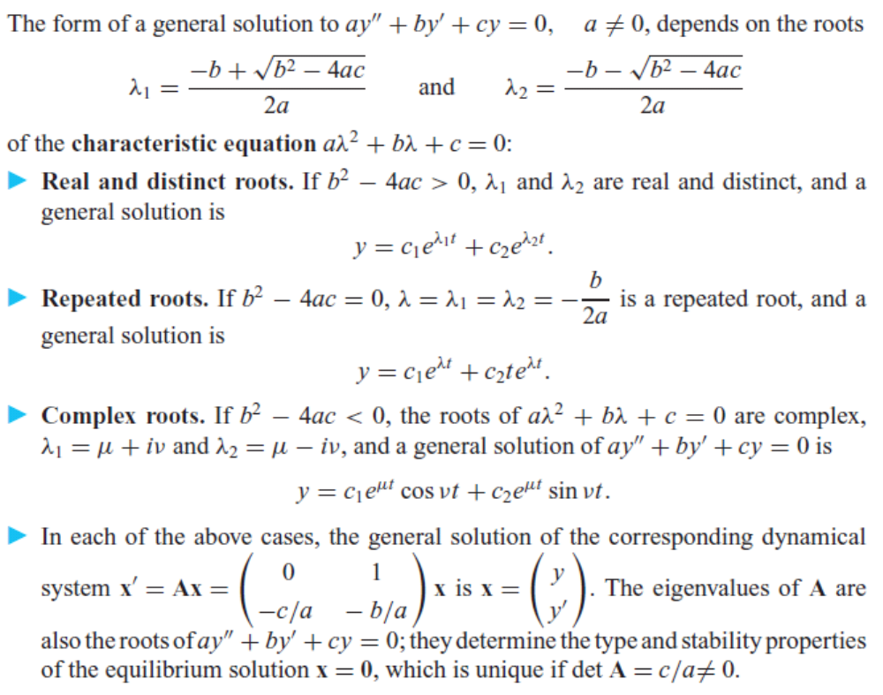
Section 4.3 Constant Coefficient Equations

Slide 68
Section 4.4
The solution of the undamped spring-mass system my'' + ky = 0 can be expressed using phase-amplitude notation as y = R cos (ω₀t − φ).
For the damped spring-mass system my'' + γ y' + ky = 0, the motion is overdamped if γ² − 4mk > 0, critically damped if γ² − 4mk = 0, and underdamped if γ² − 4mk < 0.

Slide 69
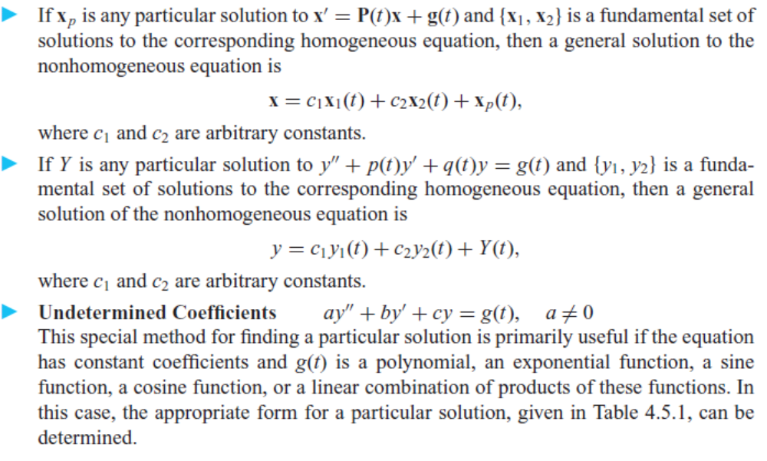
Section 4.5

Slide 70
