Slide 1

Introduction to MATLAB
ME373 Winter 2009

Slide 2
Introduction
What is MATLAB?
  high-performance language for technical computing
  computation, visualization, and programming
purpose
  essential skills for programming in MATLAB.
In this presentation
  MATLAB environment
  Matrices
  Programming
  Exercises

Slide 3
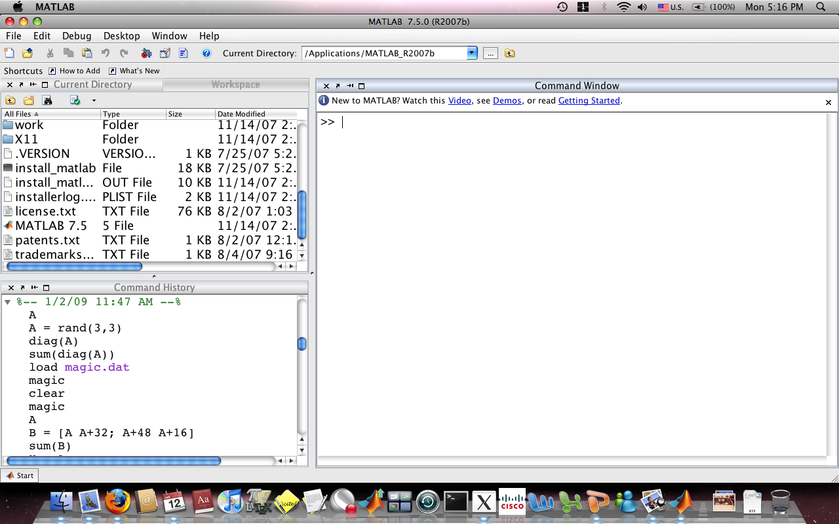
MATLAB Environment
Current directory
Command window
Command history

Slide 4

Getting started
Getting started
Demos
Video

Slide 5
Variables
Every variable is a Matrix.
Scalar: 1 x 1
  a = 5 or a = [5]
Arrays: 1 x n or n x 1
  b = [ 3.6, 4.8, 2.5 ] or b = [ 3.6 4.8 2.5 ]
  c = [ 9; 4 ; 5 ]
Matrix (general) : m x n
  r = [1, 5, 8 ; 3, 7, 6] or [1 5 8 ; 3 7 6]
Case sensitive x is not X
Spaces or commas separate elements of a row
Semicolons separate columns

Slide 6
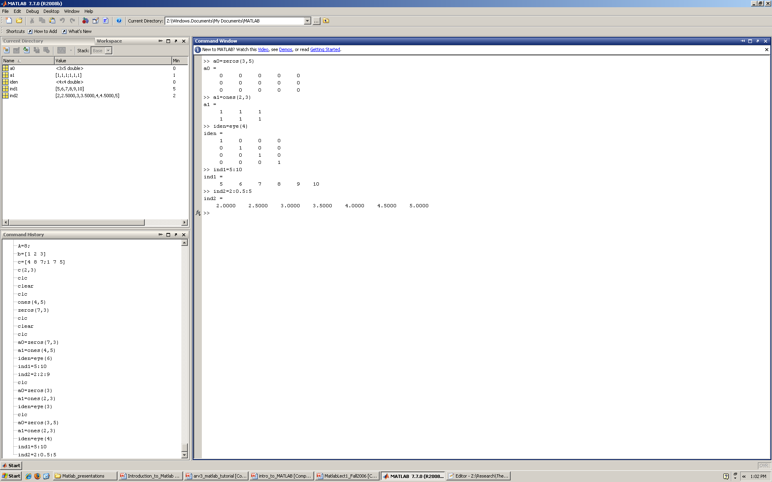
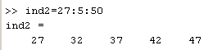
Constructing Matrices (Built-in function)
Zeros matrix
  zeros(m,n)
Ones matrix
  ones(m,n)
Identity matrix
  eye(n)
Range
  m:n or m:i:n

Slide 7
Indexing Matrices
>> A = [1 2 4 5;6 3 8 2] [1 2 4 5
6 3 8 2]
>> size(A)
Ans 2 4 A is a 2 x 4 matrix
>> A(2,1)
Ans 6
Note: The colon operator can be used to index a range of elements
>> A(1,1:3)
Ans 1 2 4
>> A(:,1)
Ans 1
6

Slide 8
Matrix Operations
Transpose
  A’
Invert
  Inv(A)
Matrix arithmetic operators
  +, -, *,^
Element wise arithmetic oper.
  .* , ./, .^
Functions
  sin(A), cos(A), exp(A), etc.
Right matrix divide (/)
  A*inv(B) ➔ A/B
Left matrix divide (\)
  inv(A)*B ➔ A\B

Slide 9
who - whos
who lists all of the variables in your matlab workspace
whos lists the variables and describes their matrix size

Slide 10
Saving your Work
To save data to a *.mat file:
    Typing ‘save filename’ at the >> prompt and the file ‘filename.mat’ will be saved to the working directory
    Select Save from the file pull down menu
To reload a *.mat file
1. Type ‘load filename’ at the >> prompt to load ‘filename.mat’
(ensure the filename is located in the current working directory)
2. Select Open from the file pull down menu and manually find the datafile

Slide 11



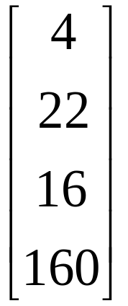



Exercise
Construct the following matrices
use whos to confirm the size
Save your matrices, clear the workspace and open the saved data.
Change the elements in the circle to -1:
A =
B =
E = a 5 x 9 matrix of 1’s
C =
D =

Slide 12
Variables
Every variable is a MATRIX.
Scalars: 1 x 1 a = 1;
Arrays: 1 x n x = [1:100];
Matrices: m x n M = [1:2:100 ; 1:50]
Commands:
size, who, whos, clear, clear x,
variable ans keeps the latest calculation.

Slide 13
Output Format
Changes the way numbers are displayed.
format short pi = 3.1416
format short e pi = 3.1416e+00
format long pi = 3.141592653589793
format long e pi = 3.141592653589793e+00
etc.
calculate sin(pi) examples

Slide 14
MATLAB editor
Text editor
MATLAB language features highlighted in different colors:
  Comments are green
  Variables and numbers, black
  Character strings, magenta
  Incomplete char strings, red
  Keywords, blue
type edit filename.m in the command line to open the editor.

Slide 15
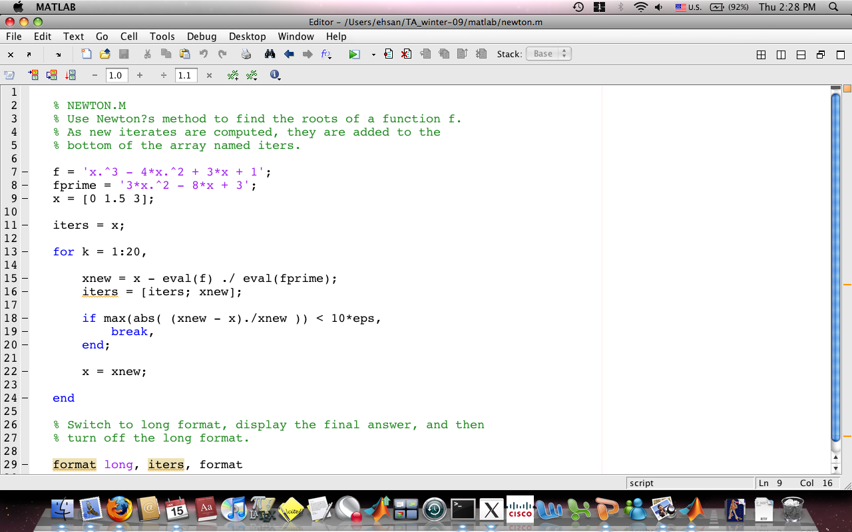
Editor

Slide 16
Programming
M files:
- script sequence of commands
ex: sin_sc, matrix1
- functions executable from the command line
function [y, z] = function_name(a, b)
ex: stats, my_plot2d
(cubic_poly…)

Slide 17
Flow Control
conditional control
  if
  switch and case
Loops
  for
  while
  continue
  break
Termination
  return

Slide 18
Conditional control if , else if, else
Basic form | Example
if expression(s), statements, elseif expressions, statements, else, statements, end; | if ( A > 2 ) disp('A is greater than 2.'); elseif ( A < 2 ) disp('A is less than 2.') else disp('A must be 2.') end
switch and case is another option for conditional control.

Slide 19
Relational and logical operators
Relational operators:
Operator | Description
< | Less than
<= | Less than or equal
> | Greater than
>= | Greater than or equal
== | Equal to
~= | Not equal to
Logical operators:
& (logical and)
| (logical or)
~ (logical not)

Slide 20
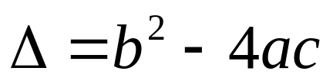
Exercise: Roots of ax²+bx+c=0
write a function to solve for roots of a qaudratic polynomial
function [x1,x2] = quad_roots(a,b,c)
% calculate delta
% if delta greater than zero
% x1 = (-b+sqrt(delta))/2a
% x2 = (-b-sqrt(delta))/2a
% if delta less than zero
% x1 = (-b)/(2*a) + sqrt(delta)/2a*i
% x2 = (-b)/(2*a) - sqrt(delta)/2a*i
% if delta equal zero
…..

Slide 21
Loop control - for
Basic form | Example
for variable = expression, statement, end; | for n = 1:10, a(n) = n*n, end;

Slide 22
Exercise – Matrix operations
write two different programs for matrix addition and multiplication.
(you can check the results with the built-in operations)
function [C] = add_matrix(A,B)
% get size of matrices…
[m1,n1] = size(A);
[m2,n2] = size(B);
% check if sizes match for addition…
% outer loop over rows i = 1:m1 …
% inner loop over columns j = 1:n1 …
C(i,j) = A(i,j) + B(i,j)

Slide 23
Exercise – contd.
function [C] = mult_matrix(A,B)
% get size of matrices…
[m1,n1] = size(A);
[m2,n2] = size(B);
% check if sizes match for addition…
% outer loop over rows i = 1:m1 …
% inner loop over columns j = 1:n2 …
C(i,j) = 0;
% inner loop over columns of A and rows of B, k = 1:n1
C(i,j) = C(i,j) + A(i,k) * B(k,j);
% end loop over k
% end loop over j
% end loop over i

Slide 24

Thank you
Use MATLAB help and demos to explore it in more detail.

Slide 25
Exercises
matrix operations: addition, multiplication
iterative problem (Newton’s method)
ODE solution: particle motion, mass – spring, etc.

