Slide 1
EAR 99 – Non-Proprietary
Turbulent Flame Speed of Large Hydrocarbon Fuels
David Blunck, Oregon State University
Acknowledgments: Aaron Fillo (funding from NSF), Jonathan Bonebrake, Nathan Schorn,
2016 Year-End Meeting
Rolls-Royce, Indianapolis, IN
Dec. 14-16, 2016

Slide 2
S_{T} Task
How do turbulent flame speed measurements relate to LBO?
LBO depends on S_{T}
S_{T} measurements provide insight into stability….
without the complications of complex fluid mechanics and two-phase flows
Objectives
Identify fuel sensitivity of turbulent flame speeds at atmospheric and sub-atmospheric conditions
Measure boundary conditions

Slide 3
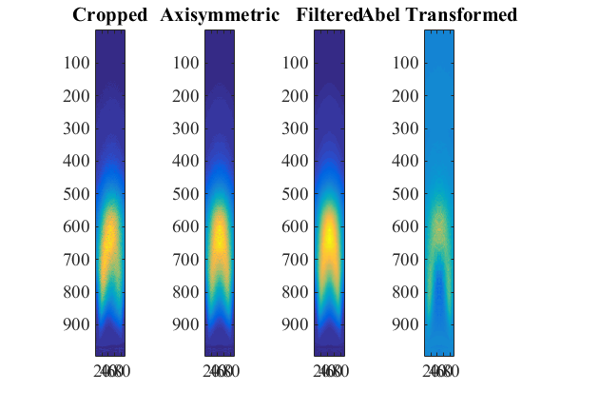
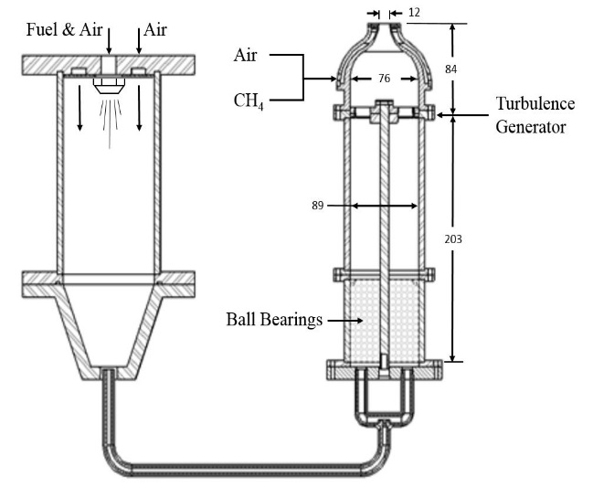
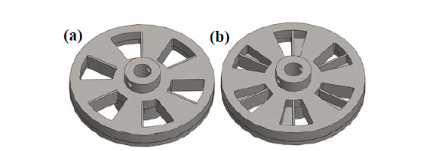
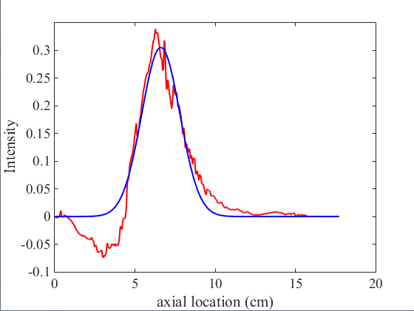


Experimental Approach
$$\overline{A}$$
Axi-symmetric
Abel Transform
H
Raw
Filtered
ICCD
$$S_{T,GC}=\frac{\dot{m}}{ρ_{u}{\left\langle \overline{A}\right\rangle }_{c}}$$
R
(a) Low turbulence intensity(TI) (~13%)
(b) High turbulence intensity (TI) (~19%)
200 nm ≤ λ ≤ 800 nm ICCD data
- Abel Transform centerline
- Progress Fit (c)
Burner schematic [Fillo]
Flow velocity and turbulence intensity (m/s)
Turbulence Generator
Re | U | u'_{rms} (a) | u'_{rms} (b)
5000 | 13.7 | 1.8 | 2.6
7500 | 20.6 | 2.7 | 3.9
10000 | 27.5 | 3.6 | 5.2
H
Preheat Temperature: 470 K
Designs from Georgia Tech and AFRL gratefully acknowledged

Slide 4
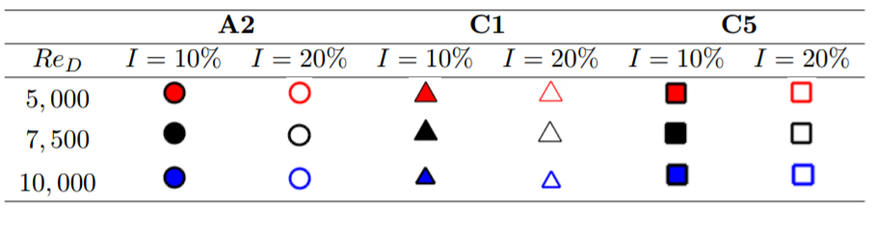
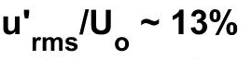
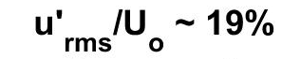
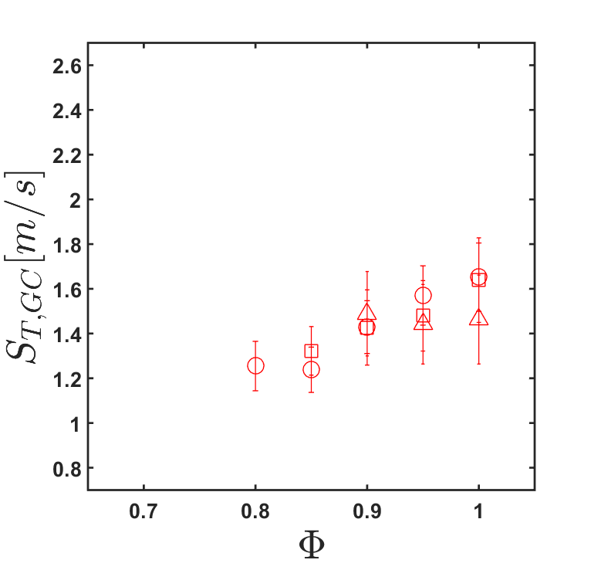
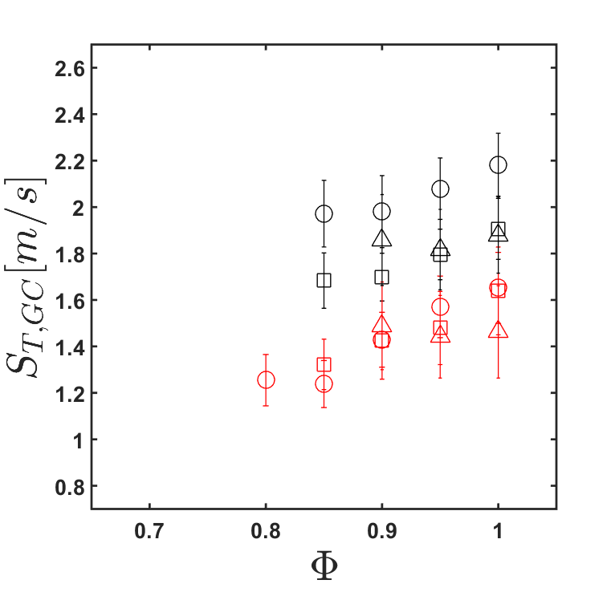
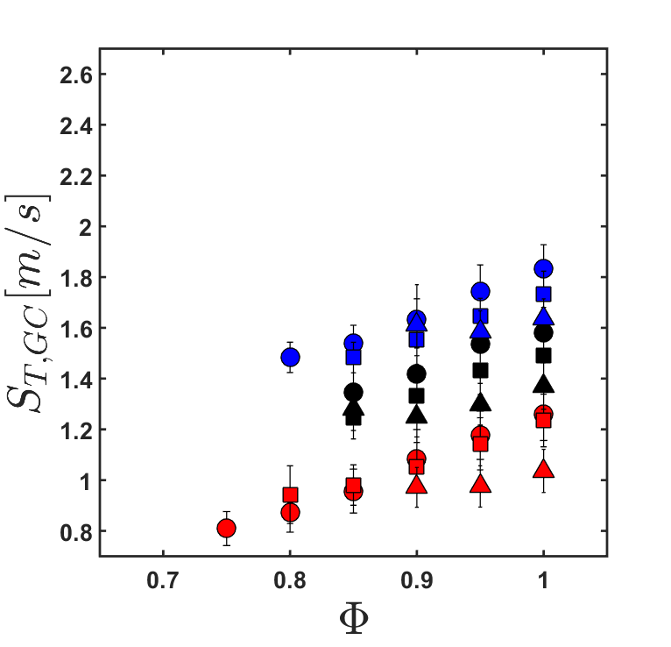
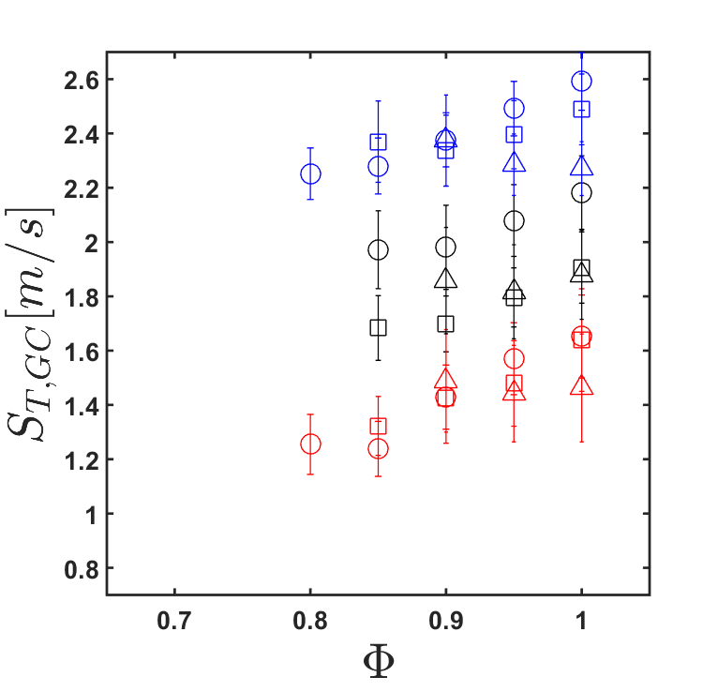
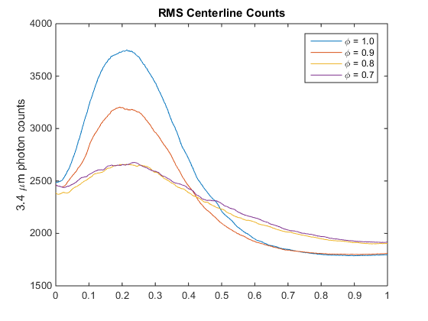
S_{T} at Atmospheric Conditions
A2, C5
Relationship to LBO
C1
A2
Lower flame speeds and reduced stability for C1 make flames more prone to blowoff
Similar flame speeds for C5 and A2 tend to support similar LBO conditions
C1, C5
RMS IR: Re = 5000
Indicates fuel is breaking through the flame front for lower Φ
C5, A2
Φ =1
C1
Φ =0.9
Φ =0.8, 0.7

Slide 5
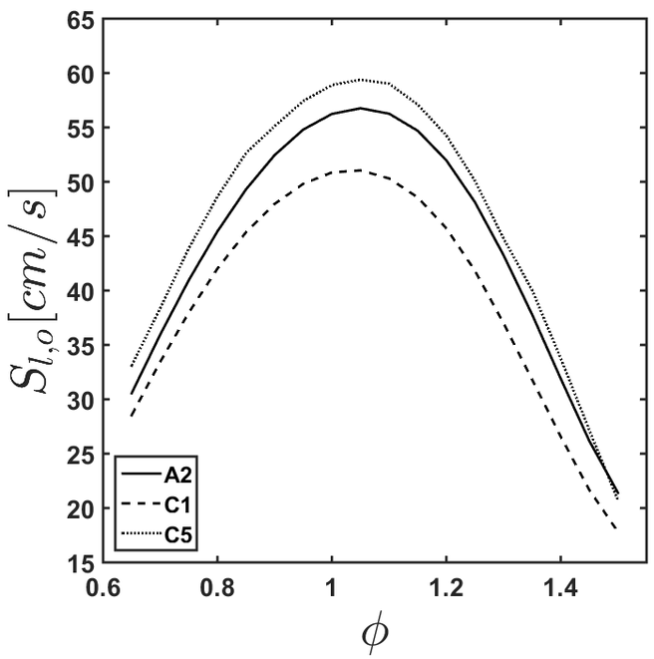
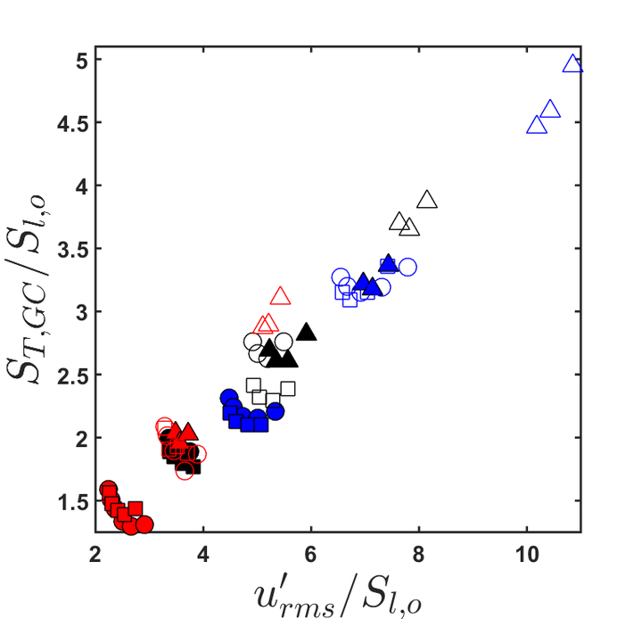
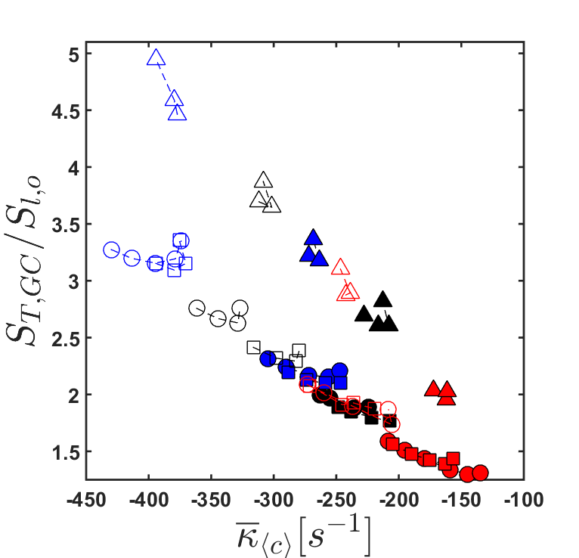
Sensitivities of C1
Upstretched laminar flame speeds at 400K
Sensitivity to global stretch
Sensitivity to velocity fluctuations
The slower flame speed for C1 will make more sensitive to blowoff
Greater sensitivity of C1 to flame stretch makes flame less stable
Similar stretch sensitives and flame speeds for C5 and A2 suggest both would have similar blowoff

Slide 6
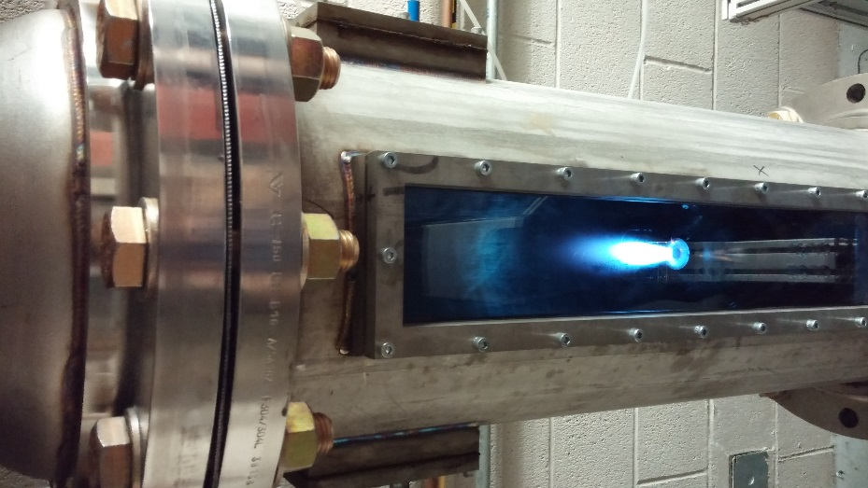
Pressure Sensitivity of S_{T}
Re = 7,500
0.6 atm
1 atm
Different sensitives of S_{T} to pressure for the fuels indicate that blowoff characteristics may change
Flame in pressure vessel

Slide 7
Future Work
Complete test matrix of subatmospheric data collection
Collect measurements of S_{T} for surrogates and fuel blends
Complete measurements of turbulence conditions and identify stability thresholds

