Slide 1

Bank Marketing Campaign
Andrew Truong
Msba

Slide 2
Table of Content
Business Background and Objective
Data Cleaning
Data Preparation
Descriptive Analytics
Customer Propensity
Recommendation

Slide 3
Business Background Information and Objective
A Portuguese Bank Institution performed a direct marketing campaign from May 2008 to November 2010.
Term deposit, also known as Certificate of Deposit, type of account where customers deposit money for specific duration with fixed interest and restricted access.
Objective: To identify the characteristics and types of clients that will open a term deposit account with the bank and determine the effective marketing approach for future campaigns.

Slide 4
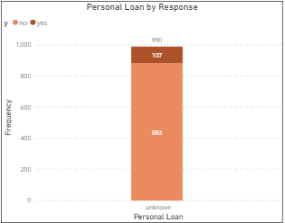
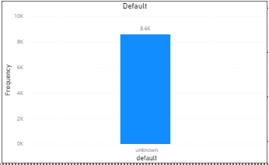
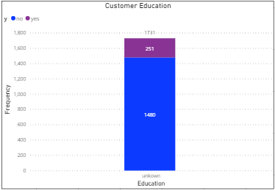
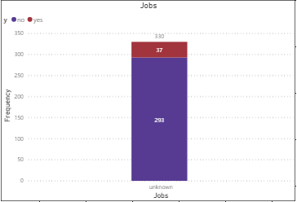
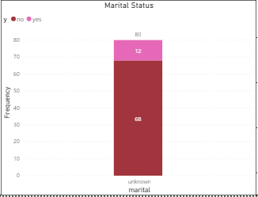
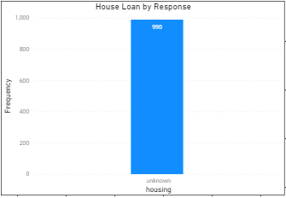
Data Cleaning
Initial dataset had 41,189 records with 21 independent variables or predictors.
There 10 numerical variables and 11 categorical variables.
6 variables had missing values categorized as “unknown”: education, jobs, marital, housing, loan and default.
Removed all missing values for all variables except default.
Removed 5 variables socioeconomic factors
After cleaning, data set had 38,245 records and 15 variables.

Slide 5
Data Preparation
Variable Name | Description
age | Age of customer (numeric)
jobs | Type of jobs (categorical: blue-collar, white-collar, pink-collar, entrepreneur/self, retired, unemployed, student)
marital | Marital Status (categorical: divorced, married, single)
educations | Type of education customer earned (categorical: primary, secondary, tertiary)
housing | Has Housing Loan (categorical: no, yes)
loan | Has Personal Loan (categorical: no, yes)
contact | Contact communication type from this campaign (categorical: cellular, telephone)
Season | Last contact season of year (categorical: Spring, Summer, Fall, Winter)
day of week | Last contact day of week (categorical: mon, tue, wed, thu, fri)
duration | Last contact duration, in seconds (numeric)
Campaign | Number of contacts performed during this campaign and for this customer (numeric)
pdays | Number of days passed by after customer last contact from previous campaign (numeric)
previous | Number of contacts performed before this campaign (numeric)
poutcome | Outcome of previous campaign (categorical: failure, nonexistent, success)
y | Response of the clients to opening an term deposit or not (categorical: yes, no)
Performed correlation matrix and removed previous and poutcome because high correlation with the Season variable.
Combined categories in jobs, education, and months:
Jobs- Blue-collar (Blue-collar & technician), White-collar (admin & management), Pink-collar (housemaid & service), Entrepreneur/Self (Entrepreneur & Self employed)
Education- Tertiary (university, professional course), Secondary (High school), Primary (Basic 4yr, 6yr & 9yr)
Season- Spring (March-May), Summer(June-August), Fall(Sept-Nov), Winter(Dec)

Slide 6
Descriptive Analytics: Customer’s Demographics

Slide 7
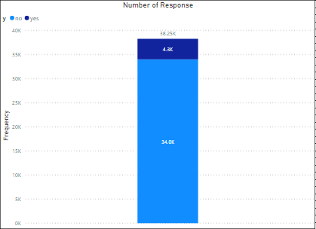
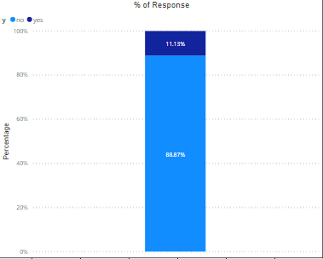
The overall campaign of this data had a conversion rate of 11.13% which is about 4,300 clients that open
an account. The percentage is still a little low and that’s why we are doing this project!

Slide 8
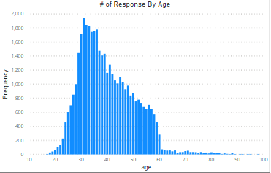
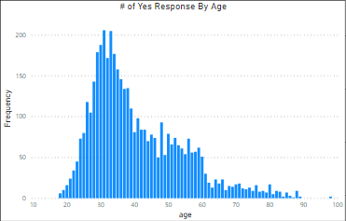
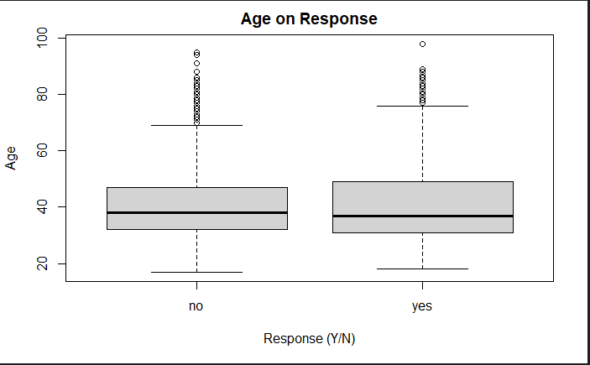
The 5th percentile is at age 26 and 95th percentile is at 58 which is where 90% of clients are at.
Mean: 40.02, Median: 38, Std: 10.42, Min: 17, Max: 98, skewness: .78

Slide 9
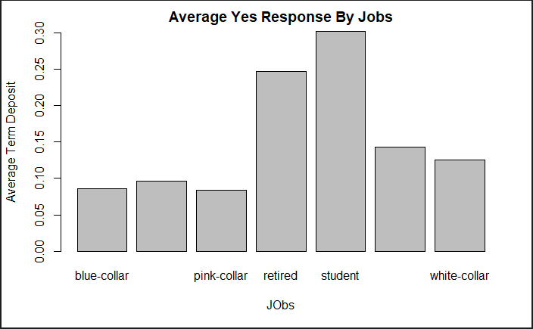
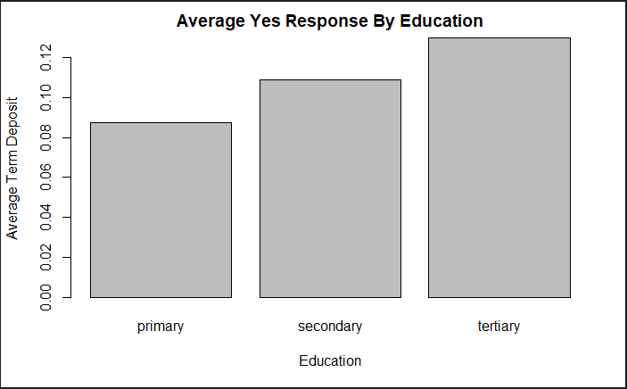
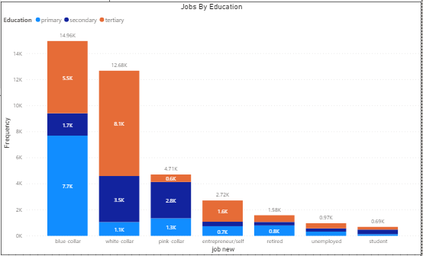
68.31% of the clients have at least a secondary education.
Clients that are not working to have a higher positive response.
Number of clients with primary education are higher than secondary education, but secondary education have a higher rate of term deposits opened.

Slide 10
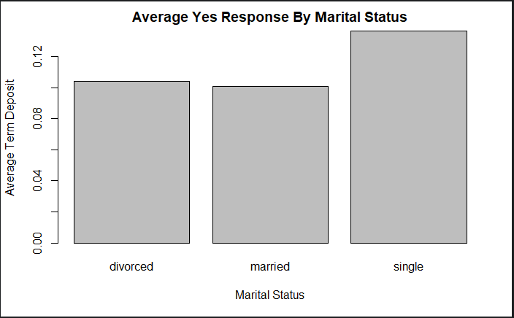
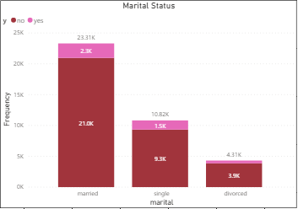
60.62% of the clients for this campaign were married.
54.87% the clients that opened an account were married.
Despite large number married clients, single and divorced had higher average term deposits.

Slide 11
Descriptive Analytics: Customer’s Behavior

Slide 12
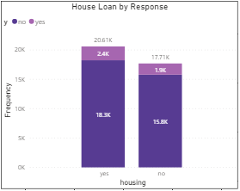
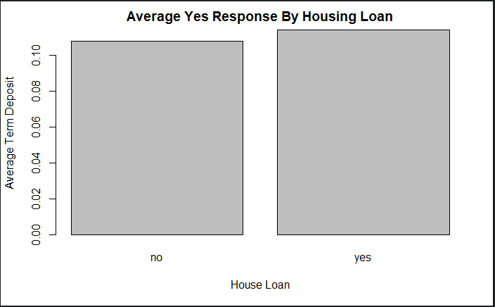
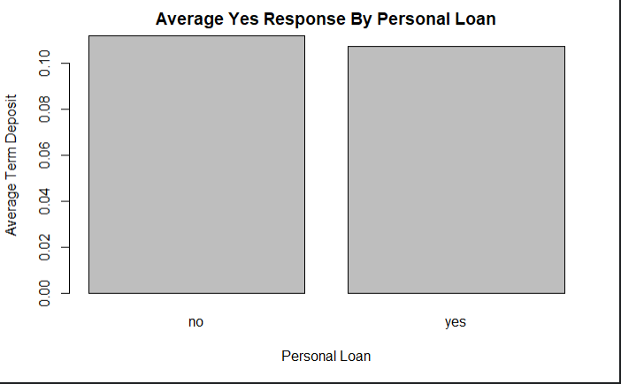
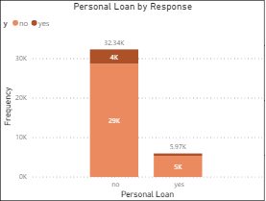
53.81% of clients who were part of the campaign have house loans.
55.17% of clients that opened
an account had house loans.
84.42% of clients don’t have
a personal loan.
85.02% of clients that opened an
an account did not have personal
loans.

Slide 13
Descriptive Analytics: Campaign

Slide 14
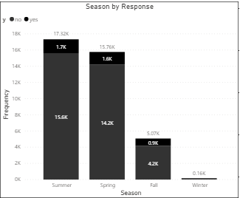
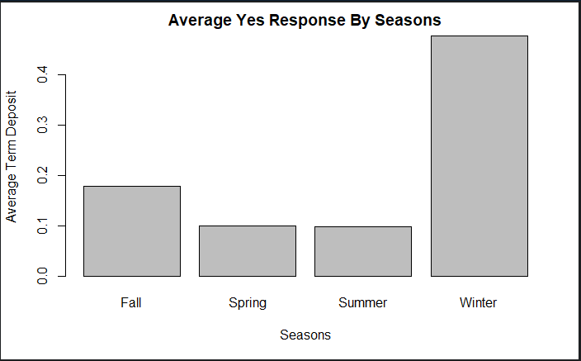
Clients that were last contacted during Spring and Summer encompassed 86.35% of
the total clients in this campaign. It seems like more clients opening a term deposit during the
colder seasons than hotter seasons.

Slide 15
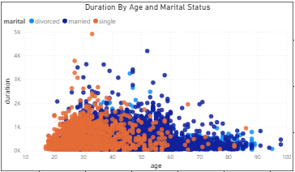
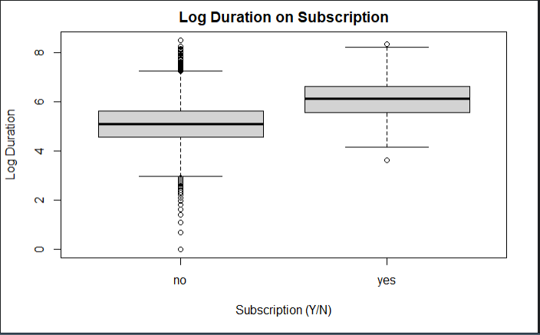
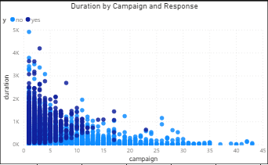
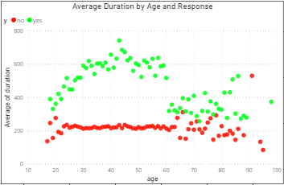
Average of duration of clients opening an account is above 300 seconds until the age of 60.
As clients get older, the less duration of the contact needed to have clients open account average around 300 seconds.
As the number of times clients are contacted, the duration decreases.

Slide 16
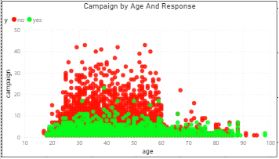
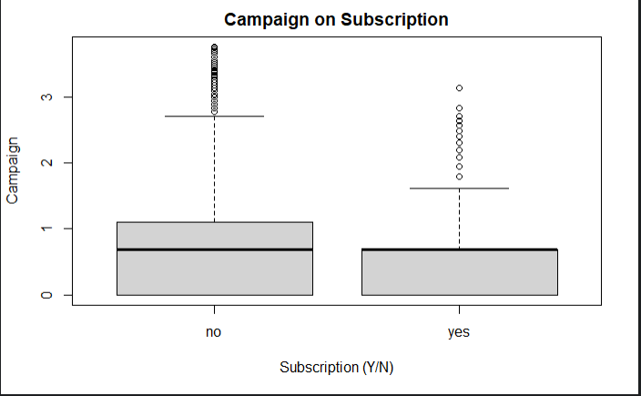
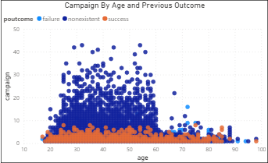
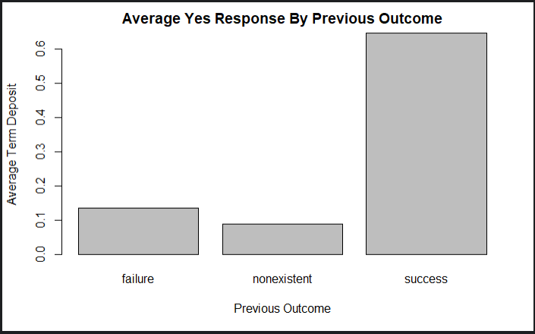

Slide 17
Customer Propensity

Slide 18
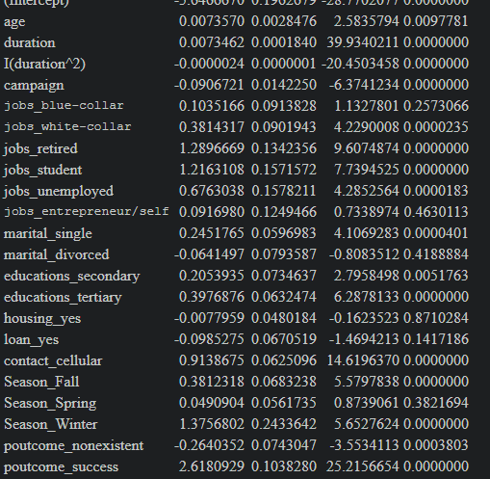
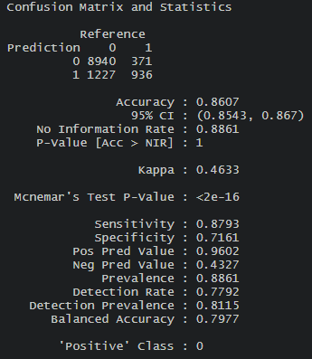
Customer Propensity: Logistic Regression
This model was the best model out of 10 other models created.
It had the high specificity rate of 71.61% and it measures how accurate it detects clients opening term deposits.
Highest(Positive) Coefficient: Season_Winter, jobs_retired, jobs_student, contact_cellular, poutcome_success
Lowest Coefficient: campaign, loan_yes, poutcome_nonexistent

Slide 19
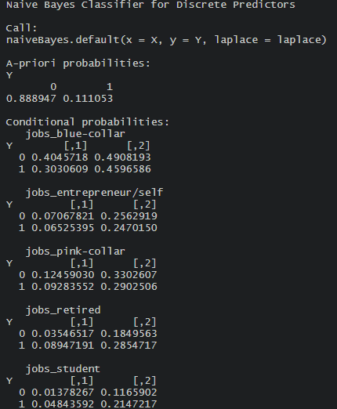
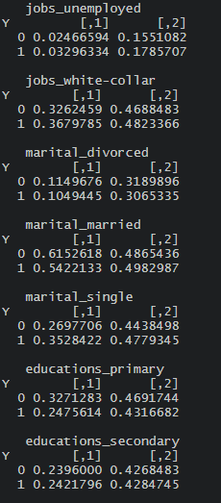
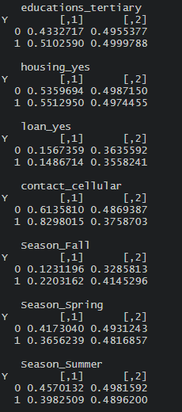
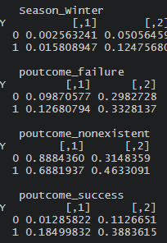
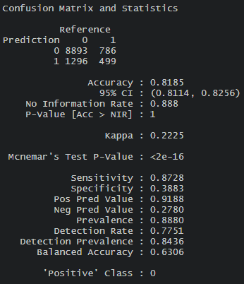
Customer Propensity: Naïve Bayes Classifier
This model was the best model with 2 other models created.
It had the high specificity rate of 38.83% and it measures how accurate it detects clients opening term deposits.
Categories that have higher probability of opening term deposit than not opening: jobs_retired, jobs_student, jobs_unemployed, jobs_white-collar, marital_single, educations_secondary, educations_tertiary, housing_yes, contact_cellular, Season_Fall, Season_Winter, poutcome_failure, poutcoe_success

Slide 20
Recommendations
For future telemarketing campaigns, these are the traits of clients that will likely open an account and who the marketing department should market towards:
Retired – most likely have money saved up for retirement and would not use all
Student- could have money from scholarships or loans that can be put in an account
Unemployed- would want to find another way to make some money while find a job
Previous opened an account- if they have opened one before will most likely open another one through experience
Single- would not spend as much compared to married who have to expenses for two people
Previous have not been part of any campaigns (poutcome_nonexistent)- still recommend if need to expand client pool
Secondary Education or higher- have more knowledge of methods of making more money
An effective marketing campaign approach:
Retrieve and contact clients mostly through their cellular phone since more people have money throughout the years
Focus campaign primarily during the Fall and Winter because tend to spend less on traveling compared to Spring and Summer
Market for longer duration which shows that clients are getting more information of account and show of interest
Do not continue effort and time if client does not open account by the 10th time

