Slide 1

Uber Database
Andrew Arrigo

Slide 2
Table of Contents
Table of contents…………………………………….. 2
Executive Summary………….……………………… 3
E/R Diagram……………………………………………. 4
Tables……………………………………………………... 5-20
Views………………………………………………………. 21-22
Reports…………………………………………………… 23-24
Stored Procedure……………………………………. 25
Security…………………………………………………… 26-27
Implementation Notes………………............... 28
Known Problems/Future Enhancements…. 29

Slide 3
Executive Summary
Within the past several years, the world of transportation has been taken over drastically by Uber. Uber is a transportation company that allows for people to become a driver, passenger (customer), or both driver/passenger. As Uber’s customer and driver rate has significantly increased, the need for a well designed database is crucial.
The database created will show how passenger information is stored in the database in comparison to driver information.

Slide 4
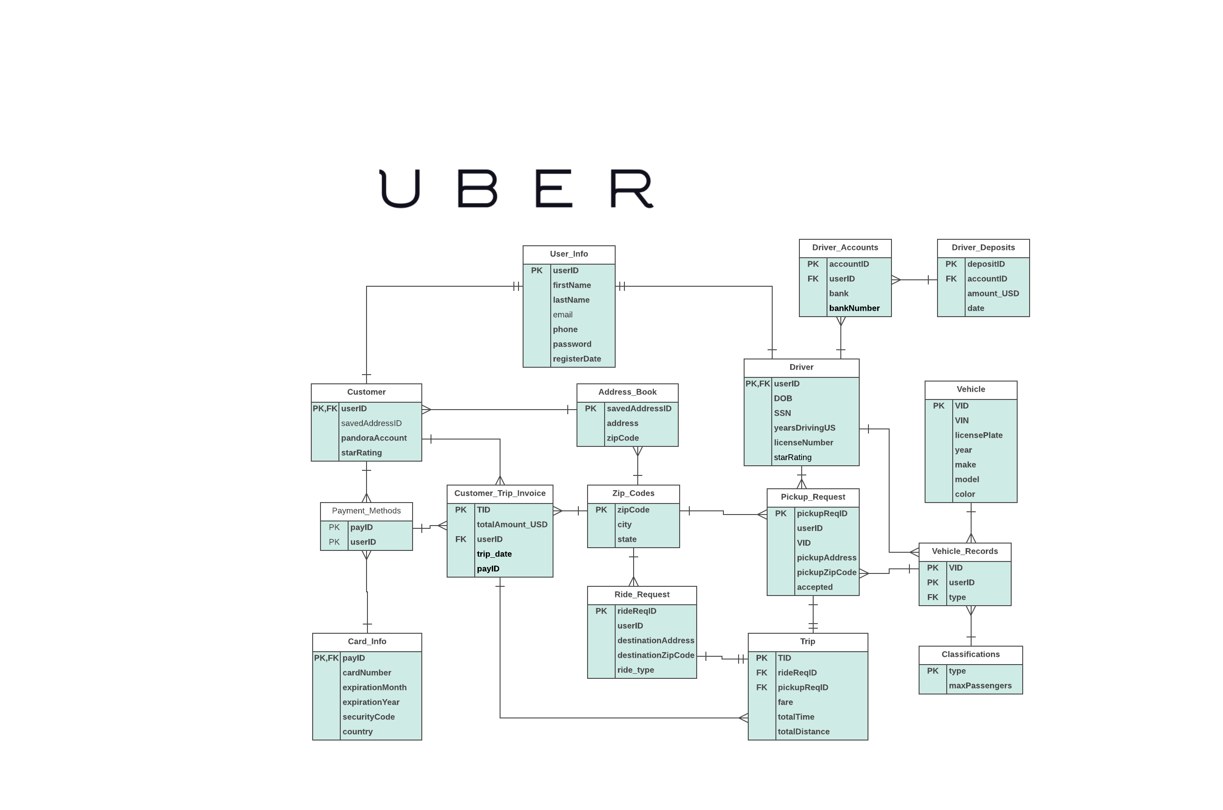
E/R Diagram

Slide 5
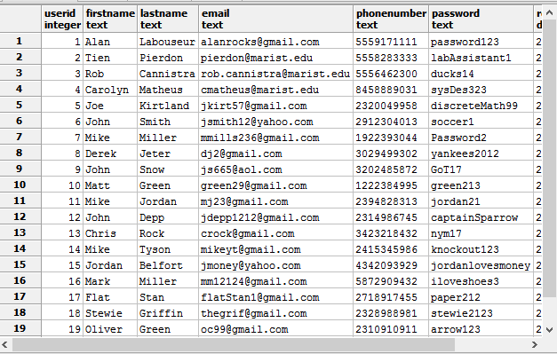
User_Info Table
Functional Dependencies: userID → firstName, lastName, email, phoneNumber, password, registerDate
Displays account information about users signed up with Uber accounts
CREATE TABLE User_Info(
userID int NOT NULL,
firstName text NOT NULL,
lastName text NOT NULL,
email text NOT NULL,
phoneNumber text NOT NULL,
password text NOT NULL,
registerDate date NOT NULL,
PRIMARY KEY (userID)
)
;

Slide 6
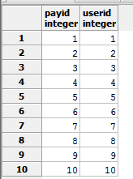
Payment_Methods Table
Functional Dependencies: payID, userID →
Displays users payID that coincides with each userID
CREATE TABLE Payment_Methods(
payID int NOT NULL,
userID int NOT NULL,
PRIMARY KEY (payID)
)
;

Slide 7
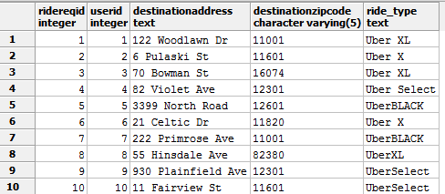
Ride_Request Table
Displays information of what ride type is requested, and destination information such as address and zip code
CREATE TABLE Ride_Request(
rideReqID int NOT NULL,
userID int NOT NULL,
destinationAddress text NOT NULL,
destinationZipCode varchar(5) NOT NULL,
ride_type text NOT NULL,
PRIMARY KEY (rideReqID)
)
;
Functional Dependencies: rideReqID → userID, destinationAddress, destinationZipCode, ride_type

Slide 8
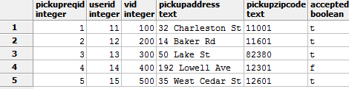
Pickup_Request Table
Display pick up request information and such as the vehicle linked to the pickup, the pickup address and if the payment is accepted
CREATE TABLE Pickup_Request(
pickupReqID int NOT NULL,
userID int NOT NULL references Driver(userID),
VID int NOT NULL,
pickupAddress text NOT NULL,
pickupZipCode text NOT NULL,
accepted Boolean DEFAULT TRUE,
PRIMARY KEY (pickupReqID)
)
;
Functional Dependencies: pickupReqID → userID, VID, pickupAddress, pickupZipCode, accepted

Slide 9
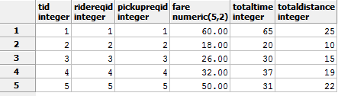
Trip Table
Displays fare price and distance of trip between locations
CREATE TABLE Trip(
TID int NOT NULL,
rideReqID int NOT NULL references Ride_Request(rideReqID),
pickupReqID int NOT NULL references Pickup_Request(pickupReqID),
fare decimal (5,2),
totalTime int NOT NULL,
totalDistance int NOT NULL,
PRIMARY KEY (TID)
)
;
Functional Dependencies: TID → rideReqID, pickupReqID, fare, totalTime, totalDistance,

Slide 10
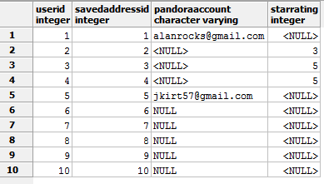
Customer Table
Keeps track of individual users userID’s, their saved addresses as savedAddressID, pandora account information (if available), and star rating
CREATE TABLE Customer(
userID int NOT NULL references User_Info(userID),
savedAddressID int NOT NULL,
pandoraAccount varchar,
starRating int,
PRIMARY KEY (userID)
)
;
Functional Dependencies:
userID → savedAddressID, pandoraAccount, starRating

Slide 11
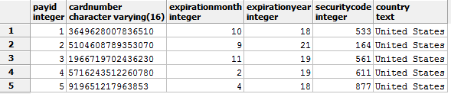
Card_Info Table
Keeps track of users credit card information
CREATE TABLE Card_Info(
payID int NOT NULL references Payment_Methods(payID),
cardNumber varchar(16) NOT NULL,
expirationMonth int NOT NULL,
expirationYear int NOT NULL,
securityCode int NOT NULL,
country text NOT NULL,
PRIMARY KEY (payID)
)
;
Functional Dependencies:
payID → cardNumber, expirationMonth, expirationYear, securityCode, country

Slide 12
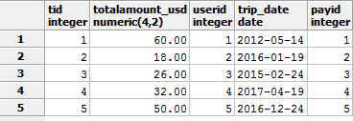
Customer_Trip_Invoice Table
Displays the price of each trip associated with each user by TID, userID, payID
CREATE TABLE Customer_Trip_Invoice(
TID int NOT NULL,
totalAmount_USD decimal (4,2) NOT NULL,
userID int NOT NULL,
trip_date date NOT NULL,
payID int NOT NULL,
PRIMARY KEY (TID)
)
;
Functional Dependencies: TID → totalAmount_USD, userID, trip_date, payID

Slide 13
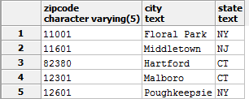
Zip_Codes Table
Functional Dependencies: zipCode → city, state
Displays zip code information from addresses
CREATE TABLE Zip_Codes(
zipCode varchar(5) NOT NULL,
city text NOT NULL,
state text NOT NULL,
PRIMARY KEY (zipCode)
)
;

Slide 14
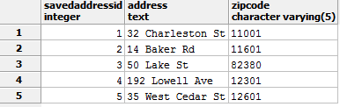
Address_Book Table
Displays the saved location of the users original address entered when first signing up for an account
CREATE TABLE Address_Book(
savedAddressID int NOT NULL,
address text NOT NULL,
zipCode varchar(5) references Zip_Codes(zipCode) NOT NULL,
PRIMARY KEY (savedAddressID)
)
;
Functional Dependencies: savedAddressID → address, zipCode

Slide 15

Driver_Accounts Table
Functional Dependencies: accountID→ userID, bank, bankNumber
Displays bank information of drivers
CREATE TABLE Driver_Accounts(
accountID int NOT NULL,
userID int NOT NULL,
bank text NOT NULL,
bankNumber varchar(10),
PRIMARY KEY (accountID)
)
;

Slide 16
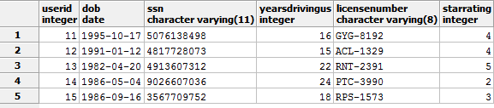
Driver Table
Functional Dependencies: userID → DOB, SSN, yearsDrivingUS, licenseNumber, starRating
Displays personal information for all drivers
CREATE TABLE Driver(
userID int NOT NULL,
DOB date NOT NULL,
SSN varchar(11),
yearsDrivingUS int NOT NULL,
licenseNumber varchar(8) NOT NULL,
starRating int,
PRIMARY KEY (userID)
)
;

Slide 17

Driver_Deposits Table
Functional Dependencies: depositID → accountID, amount_USD, date
Displays the amount drivers make and the date it is made on
CREATE TABLE Driver_Deposits(
depositID int NOT NULL,
accountID int NOT NULL,
amount_USD decimal (5,2) NOT NULL,
date date NOT NULL,
PRIMARY KEY (depositID)
)
;

Slide 18
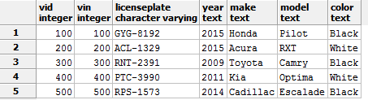
Vehicle Table
Displays information relating to drivers vehicles
CREATE TABLE Vehicle(
VID int NOT NULL,
VIN int NOT NULL,
licensePlate varchar NOT NULL,
year text NOT NULL,
make text NOT NULL,
model text NOT NULL,
color text NOT NULL,
PRIMARY KEY (VID)
)
;
Functional Dependencies: VID → VIN, licensePlate, year, make, model, color

Slide 19
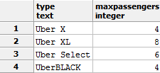
Classifications Table
Displays maximum amount of passengers for each Uber type
CREATE TABLE Classifications(
type text NOT NULL,
maxPassengers int NOT NULL,
PRIMARY KEY (type)
)
;
Functional Dependencies: type →maxPassengers

Slide 20
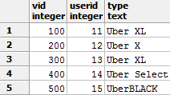
Vehicle_Records Table
Displays Uber car type according to the VID and the appropriate userID
CREATE TABLE Vehicle_Records(
VID int NOT NULL,
userID int NOT NULL references Driver(userID),
type text NOT NULL references Classifications(type),
PRIMARY KEY (VID)
)
;
Functional Dependencies: VID → userID, type

Slide 21
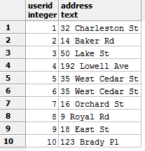
Views
Creates view that simply displays users userID from customers table to their saved address in the address_book table
CREATE VIEW showAddress
AS SELECT Customer.userID, Address_Book.address
FROM Customer, Address_Book
WHERE customer.savedAddressID = address_book.savedAddressID;

Slide 22
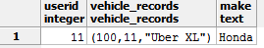
Views
Creates View of information of the driver with a userID that correlates to a to the vehicle make of a Honda and its vehicle type
CREATE VIEW DriverInfo
AS SELECT Driver.userID, Vehicle_records, Vehicle.make
FROM Driver,Vehicle_Records, Vehicle
WHERE Driver.userID = vehicle_records.userID
AND vehicle_records.vid = vehicle.vid
AND vehicle.make= 'Honda';

Slide 23
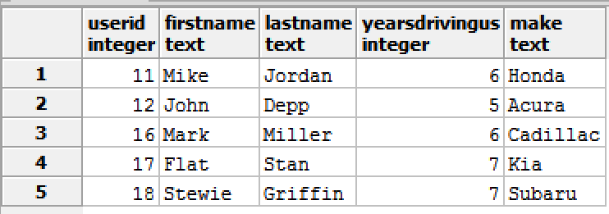
Report
Joins tables user_info, driver, vehicle_records, and vehicle tables and displays userID, firstname, lastname yearsdrivingus and the make of the car each driver drives
SELECT u.userID, u.firstName, u.lastName, d.yearsDrivingUS, v.make
FROM user_info u inner join driver d on u.userID = d.userID
inner join vehicle_records vr on d.userID = vr.userID
inner join vehicle v on vr.vid = v.vid
WHERE d.yearsdrivingus > 4;

Slide 24
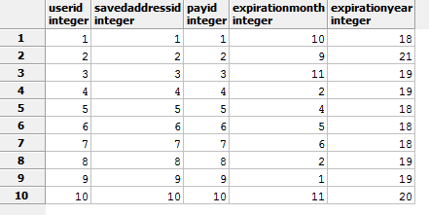
Report
Joins customer table on payment_methods table on card_info table to show userID, savedAddressID, payID, expirationMonth, expirationYear
SELECT c.userID , c.savedAddressID, p.payID, ci.expirationMonth, ci.expirationYear
FROM Customer c inner join payment_methods p on c.userID = p.userID
inner join Card_Info ci on p.payID = ci.payID

Slide 25
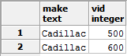
Stored Procedure
Creates trigger to direct you to vehicles with VID’s according to the make being Cadillac
CREATE OR REPLACE FUNCTION carTypeFor(text, refcursor) RETURNS refcursor AS
$$
DECLARE
type text :=$1;
resultset refcursor :=$2;
BEGIN OPEN resultset for
select make, vid
from Vehicle
where vehicle.make = 'Cadillac';
return resultset;
end;
$$
language plpgsql;
select carTypeFor ('Cadillac', 'results');
Fetch all from results;

Slide 26
Security
For security reasons, the best way to implement measures on a system this large is to use hashed passwords, making it difficult for intruders. Uber’s network administrators would also grant access for drivers to accept or deny rides if they are in the area. Passengers are limited to changing basic profile information, payment information and can book rides, but do not have access to personal information of drivers. Network administrators are granted access to the whole system.

Slide 27
Security
Create role admin;
Create role driver;
Create role passenger;
-- Admin
Grant all on all tables in schema public to admin
-- Passenger
Grant insert, update on Card_Info to passenger
Grant insert, update on User_Info to passenger
--Driver
Grant insert, update on Driver_Accounts to driver
Grant insert, update on vehicle to driver
Grant insert, update on Pickup_Request to driver
Grant insert, update on Ride_Request to driver

Slide 28
Implementation Notes
If users were given the opportunity to pay with different payment methods, more tables should be created to differentiate account types
This separation of payment information would reduce the amount of users entered in each table or encourage more users to join as there is a greater amount of payment options

Slide 29
Known Problems
Drivers may own more than one car thus adding more VID’s and vehicle information which adds redundancy in linking VID’s to userID’s
Passengers are unaware of how many years the driver has been driving in the U.S.
Future Enhancements
In depth profile view of driver
Passengers should be able to pay cash upon arrival of driver instead of set up a credit account
Show what drivers in the area are already driving passengers

