Slide 1

Andre Warsaw

Slide 2
D
A
B
C
Purpose
Current Method
ABS team currently observes their buying patterns through two observations including store size and store performance. For my project I have included two variables named “storesizecat” which includes their ranking of store sizes and “storetiercat” which includes their financial performance rankings based on ABS preset parameters.
Inventory Manager
Used machine learning models to help with creating an inventory manager tool. The tool is provided in an R Studio quarto document, where the customer only needs to upload the most recent csv file and update chunks in areas that are noted then run every chunk to receive a new csv file which provides a list of items each store should hold based on available SKU counts for each individual store, priority and parameters I have set for each tier of store.
Variable Engineering and Modeling
I created a new variable named “priority” by observing items in their dataset and separated items by three different tiers. High Priority items are the top 25% performing items globally, Medium priority the middle 50%, and low priority the lowest 25% performing items globally. The items are observed on a yearly basis. I then used priority as the main variable to create a formula for a machine learning model to help with predicting how items would perform in future years based on current performance.
Final Remarks
As I have reached the end of this project there are some things I noticed I could have done to improve the final product if given more time to refine it.
To help the Montgomery County Alcohol and Beverage Services team with optimizing their method of observing buying patterns between all 27 locations. The final goal is to help ABS save money by using research and analysis to determine best practices for future operations.

Slide 3
A
B
C
D
Current Method
ABS team currently observes their buying patterns through two observations including store size and store performance. For my project I have included two variables named “storesizecat” which includes their ranking of store sizes and “storetiercat” which includes their financial performance rankings based on ABS preset parameters.
Variable Engineering and Modeling
I created a new variable named “priority” by observing items in their dataset and separated items by three different tiers. High Priority items are the top 25% performing items globally, Medium priority the middle 50%, and low priority the lowest 25% performing items globally. The items are observed on a yearly basis. I then used priority as the main variable to create a formula for a machine learning model to help with predicting how items would perform in future years based on current performance.
Inventory Manager
Used machine learning models to help with creating an inventory manager tool. The tool is provided in an R Studio quarto document, where the customer only needs to upload the most recent csv file and update chunks in areas that are noted then run every chunk to receive a new csv file which provides a list of items each store should hold based on available SKU counts for each individual store, priority and parameters I have set for each tier of store.
Final Remarks
As I have reached the end of this project there are some things I noticed I could have done to improve the final product if given more time to refine it.

Slide 4
D
A
B
C
Based on ABS’ current method, I chose to observe their classification categories in the provided data set:
Classification Dept -> Classification Type -> Classification Category
Current Method
ABS team currently observes their buying patterns through two observations including store size and store performance. For my project I have included two variables named “storesizecat” which includes their ranking of store sizes and “storetiercat” which includes their financial performance rankings based on ABS preset parameters.
Inventory Manager
Used machine learning models to help with creating an inventory manager tool. The tool is provided in an R Studio quarto document, where the customer only needs to upload the most recent csv file and update chunks in areas that are noted then run every chunk to receive a new csv file which provides a list of items each store should hold based on available SKU counts for each individual store, priority and parameters I have set for each tier of store.
Variable Engineering and Modeling
I created a new variable named “priority” by observing items in their dataset and separated items by three different tiers. High Priority items are the top 25% performing items globally, Medium priority the middle 50%, and low priority the lowest 25% performing items globally. The items are observed on a yearly basis. I then used priority as the main variable to create a formula for a machine learning model to help with predicting how items would perform in future years based on current performance.
Final Remarks
As I have reached the end of this project there are some things I noticed I could have done to improve the final product if given more time to refine it.
Based on my observations I noticed that there were little to no variation in inventory performance between all 27 locations

Slide 5
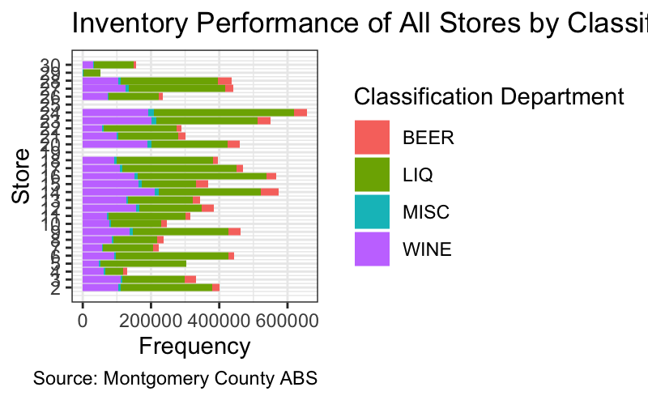
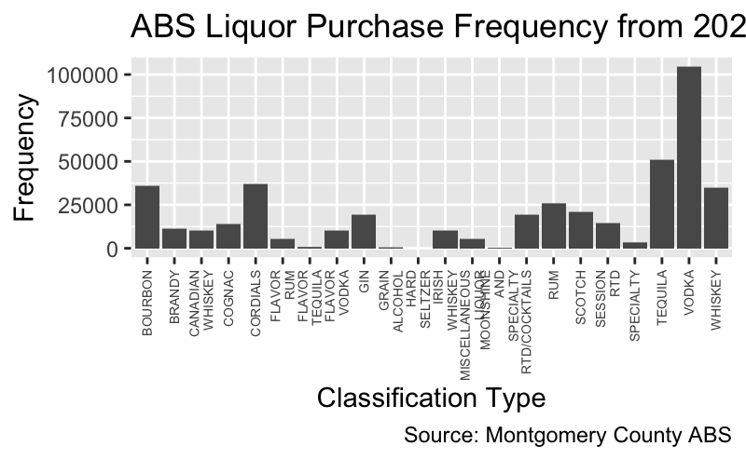
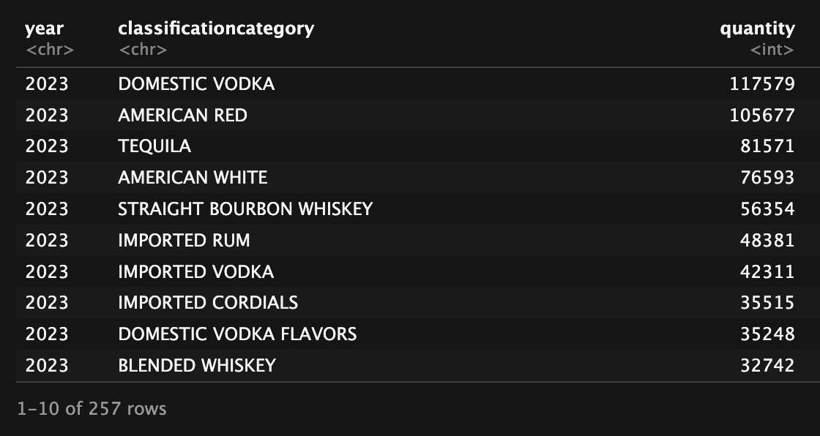
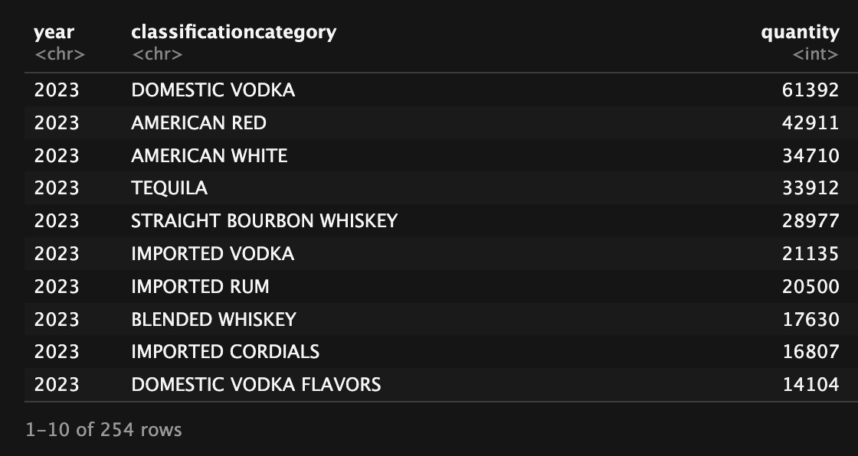
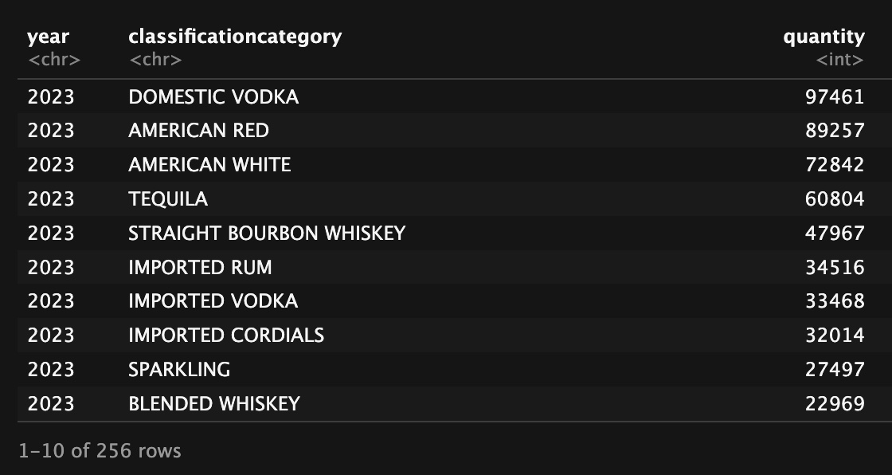
D
A
B
C
Current Method
ABS team currently observes their buying patterns through two observations including store size and store performance. For my project I have included two variables named “storesizecat” which includes their ranking of store sizes and “storetiercat” which includes their financial performance rankings based on ABS preset parameters.
Inventory Manager
Used machine learning models to help with creating an inventory manager tool. The tool is provided in an R Studio quarto document, where the customer only needs to upload the most recent csv file and update chunks in areas that are noted then run every chunk to receive a new csv file which provides a list of items each store should hold based on available SKU counts for each individual store, priority and parameters I have set for each tier of store.
Variable Engineering and Modeling
I created a new variable named “priority” by observing items in their dataset and separated items by three different tiers. High Priority items are the top 25% performing items globally, Medium priority the middle 50%, and low priority the lowest 25% performing items globally. The items are observed on a yearly basis. I then used priority as the main variable to create a formula for a machine learning model to help with predicting how items would perform in future years based on current performance.
Final Remarks
As I have reached the end of this project there are some things I noticed I could have done to improve the final product if given more time to refine it.
Tier 1 Stores
Tier 2 Stores
Tier 3 Stores

Slide 6
D
C
B
Goal: Use machine learning models to help with predicting the priority of an item for the following year
Inventory Manager
Used machine learning models to help with creating an inventory manager tool. The tool is provided in an R Studio quarto document, where the customer only needs to upload the most recent csv file and update chunks in areas that are noted then run every chunk to receive a new csv file which provides a list of items each store should hold based on available SKU counts for each individual store, priority and parameters I have set for each tier of store.
Formula Used:
next_priority ~ total_netamount + total_lineqty + avg_cost + n_transactions + storetiercat + storesizecat + year
Final Remarks
As I have reached the end of this project there are some things I noticed I could have done to improve the final product if given more time to refine it.
Variable Engineering and Modeling
I created a new variable named “priority” by observing items in their dataset and separated items by three different tiers. High Priority items are the top 25% performing items globally, Medium priority the middle 50%, and low priority the lowest 25% performing items globally. The items are observed on a yearly basis. I then used priority as the main variable to create a formula for a machine learning model to help with predicting how items would perform in future years based on current performance.
Models Used:
Multinomial
Linear Discriminate Analysis
Decision Tree
Random Forest
K Nearest Neighbors
Artificial Neural Networks

Slide 7
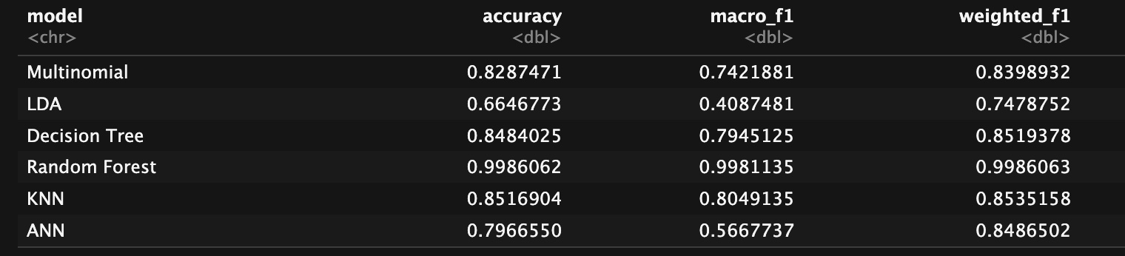
D
C
B
Random Forest Model was the best choice for the data set by a landslide with a high accuracy score of 99.86% and F1 Score of 0.998 (out of 1)
Inventory Manager
Used machine learning models to help with creating an inventory manager tool. The tool is provided in an R Studio quarto document, where the customer only needs to upload the most recent csv file and update chunks in areas that are noted then run every chunk to receive a new csv file which provides a list of items each store should hold based on available SKU counts for each individual store, priority and parameters I have set for each tier of store.
Final Remarks
As I have reached the end of this project there are some things I noticed I could have done to improve the final product if given more time to refine it.
Variable Engineering and Modeling
I created a new variable named “priority” by observing items in their dataset and separated items by three different tiers. High Priority items are the top 25% performing items globally, Medium priority the middle 50%, and low priority the lowest 25% performing items globally. The items are observed on a yearly basis. I then used priority as the main variable to create a formula for a machine learning model to help with predicting how items would perform in future years based on current performance.
To give a basic explanation on what a Random Forest Model does:
A random forest is a method that makes predictions by combining many simple decision trees. Each tree looks at different pieces of the data and makes its own guess. The model then puts all the guesses together and chooses the answer that most trees agree on. By using many trees instead of just one, the random forest gives more stable and accurate results, even when the data is messy or unclear.

Slide 8
Inventory Parameters
Tier 1 stores should be at minimum 55% high priority items, 30% medium priority items, and 15% low priority items
Tier 2 stores should be at minimum 75% high priority items, 20% medium priority items, and 5% low priority items
Tier 3 stores should be at minimum 85% high priority items, 15% medium priority items, and 0% low priority items
D
C
Inventory Manager
Used machine learning models to help with creating an inventory manager tool. The tool is provided in an R Studio quarto document, where the customer only needs to upload the most recent csv file and update chunks in areas that are noted then run every chunk to receive a new csv file which provides a list of items each store should hold based on available SKU counts for each individual store, priority and parameters I have set for each tier of store.
Final Remarks
As I have reached the end of this project there are some things I noticed I could have done to improve the final product if given more time to refine it.
Final CSV file provided the following:
Store Information (Store, Store tier, SKU count)
Item Information (Item ID, Priority)
Predictive Information (Recommended number of priority per store, fill rates and percentages per priority)
Quotas (pass/fail for low, medium, and high and if store passes quota overall)

Slide 9
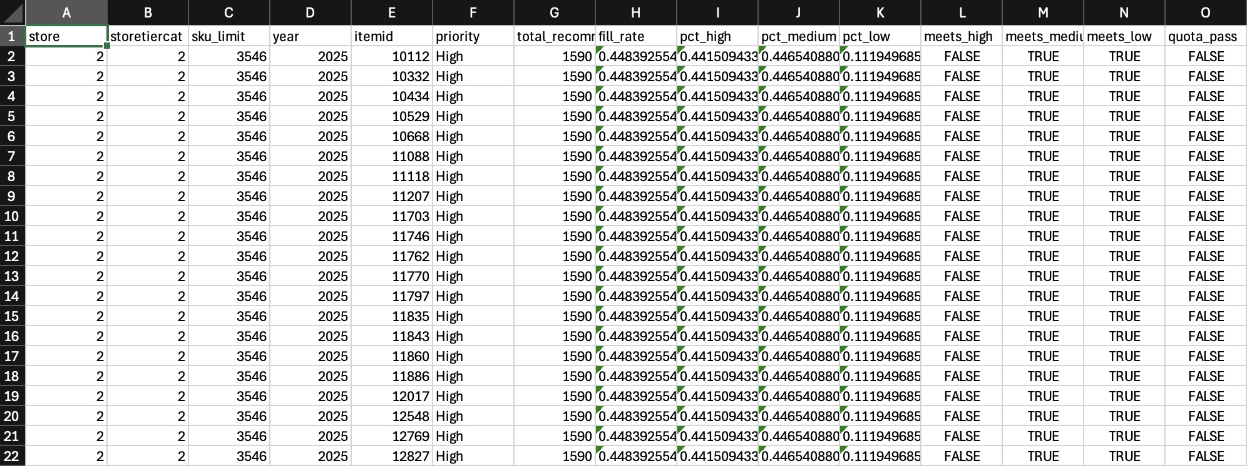
D
C
Sample of Final Output
Inventory Manager
Used machine learning models to help with creating an inventory manager tool. The tool is provided in an R Studio quarto document, where the customer only needs to upload the most recent csv file and update chunks in areas that are noted then run every chunk to receive a new csv file which provides a list of items each store should hold based on available SKU counts for each individual store, priority and parameters I have set for each tier of store.
Final Remarks
As I have reached the end of this project there are some things I noticed I could have done to improve the final product if given more time to refine it.

Slide 10
I realized that my current ranking system for the priority of items is flawed. This becomes more apparent when creating a quota that the high priority items will never be able to fulfill for any store due to the limitations of the quantity. To resolve this, I would:
Change the definition of high priority items by changing it from the top 25% performing items organization wide to either top 33%, top 40%, or even consider letting a random forest model help with predicting the priority of items based on performance (which personally I'd recommend the most).
Re calibrate the quotas I have created for all store tiers so that the amount of high priority items offer a more realistic percentage for each, making it more possible to fulfill.
D
Additional adjustments I would make include:
Include the quantity of an item I would recommend to each individual store, using the random forest model to assist with predicting the best amount based on SKU limitations
Adjust the method that the model observes the data from a yearly perspective to a monthly perspective to get a more accurate perspective on inventory fulfillment.
Possibly even make it so that the random forest model would produce a new recommended list before every inventory fulfillment cycle so that each individual store could determine what it would need in their inventory based on inventory performance.
Final Remarks
As I have reached the end of this project there are some things I noticed I could have done to improve the final product if given more time to refine it.

Slide 11
Acknowledgments
ABS team for keeping me on track and assisting me every week with understanding the data set they have provided and stopping me from going the wrong direction with my research whenever it was needed
Data Montgomery team for helping with organizing meetings, and all communication and also helping with finding supplementary data even if we never ended up using it
Prof. Lori Perine for advising me on how to move forward with my machine learning models
My fellow teammate Arash as his research also helped sharpen my approach

Slide 12
Link to Research
https://github.com/wasraw/DATA-205

