Slide 1
Vehicle Crash Fatalities
An Analysis of Fatalities by Vehicle Type and the Relationship to Vehicle Sales from 1994-2015
Andrew Auxier, Data Analysis January 2025, Capstone Project

Slide 2
Questions to be analyzed
Which type of vehicle, when crashed, most often results in a fatality?
Is there a correlation between the number of vehicles sold of a given type and the number of fatal crashes that type of vehicle is involved in?

Slide 3
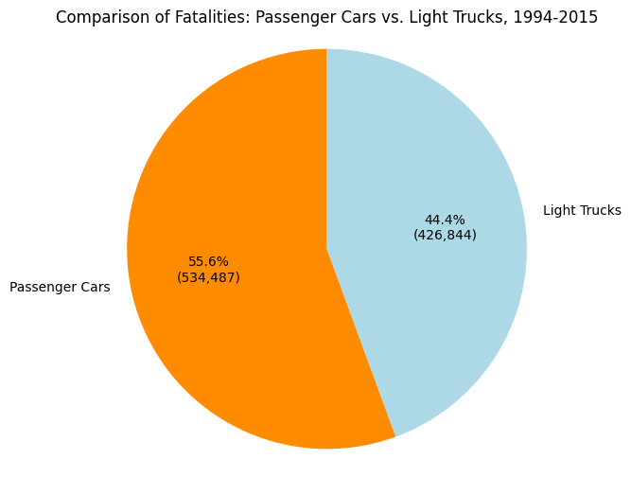
Fatalities by Vehicle Type
For the given time period, the data revealed that more passenger cars were involved in fatal crashes than light trucks.

Slide 4
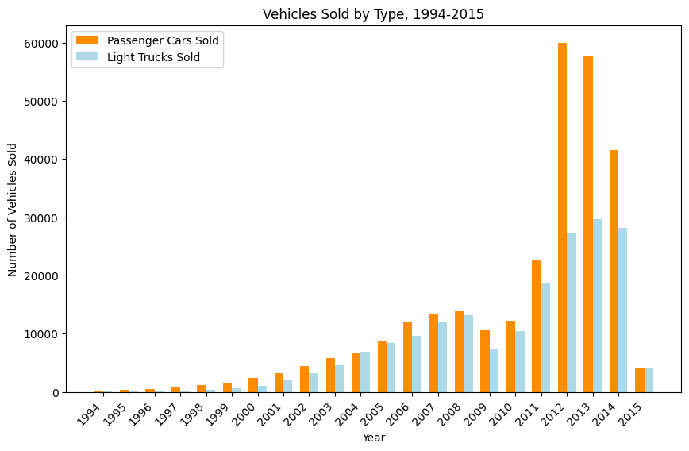
Number of Vehicles Sold by Type
The data showed:
For the time period, the two types of vehicles sales rose steadily until around 2009 (the Great Recession).
After the recession, sales for both types of vehicles continued to rise, but passenger car sales rose disproportionately higher (a lot more cars on the road than trucks).

Slide 5
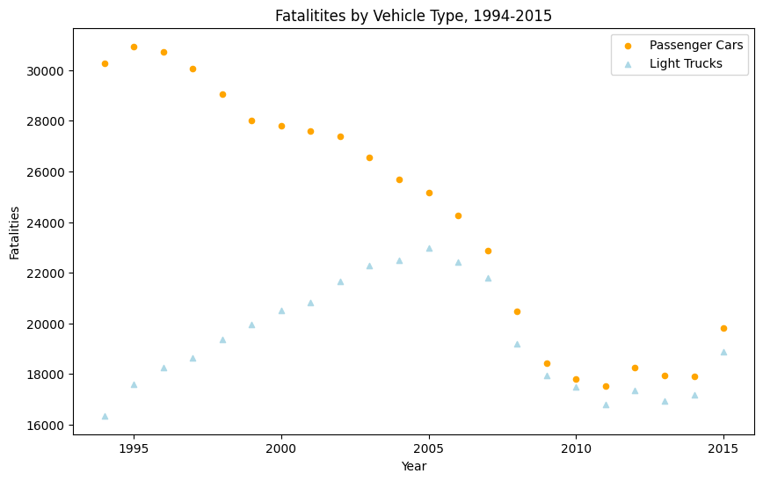
Comparing Vehicles Sold to Fatalities by Vehicle Type
As vehicle sales increased (especially passenger cars), fatalities decreased.
The data shows that initially, passenger car fatalities were significantly higher than truck fatalities. But with time, the two seemed began to trend higher, although passenger cars still experienced higher fatalities

Slide 6
Conclusions
From 1994 thru approximately 2007, there was a marked difference in that passenger cars were involved at significantly higher rates of fatal crashes than passenger trucks.
However, for the period of 2008 thru 2015, the rates of fatal crashes by vehicle were much more closely aligned, though passenger car fatalities still appeared to remain slightly higher.
Vehicle sales climbed modestly from 1994 until around the time of “Great Recession.” At that time, sales slumped, as one might expect. Surprisingly after that period, vehicle sales (and especially passenger cars) skyrocketed.

Slide 7
Limitations
The vehicle sales dataset had nearly 11,000 null (missing) values for certain parameters. However, the entire dataset contained nearly 600,000 rows of data. The null values represented about 1% of the entire dataset. Therefore, those null values were dropped from the dataset for analysis as it was presumed that they wouldn’t make any appreciable difference.
The NHTSA makes available fatalities data for vehicle types beyond light trucks and passenger cars, to include large trucks, motorcycles, buses, and others. However, the sales data only included passenger cars and light trucks (i.e. Ford F-150s or Chevy 1500-series). Other vehicle types were not included. As such, only the passenger car and light truck data were utilized from the fatalities dataset to better mesh with the vehicle sales dataset.

Slide 8
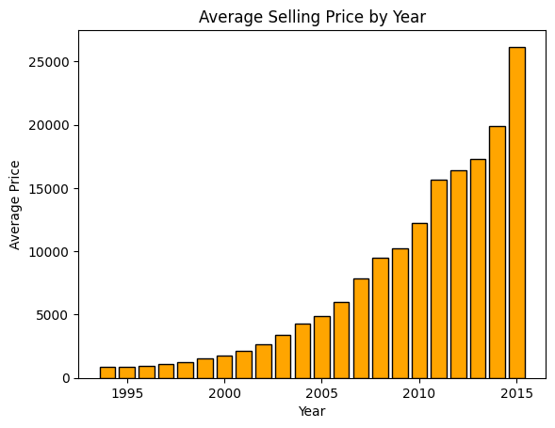
Bonus Visualization
You’ve already seen this one, but…
Not only did sales skyrocket, but so did prices for all vehicle types during the period.
This has nothing to do with the capstone analysis, it’s just interesting. The conclusion from this slide? We like our vehicles so much that we’re willing to pay!

