Slide 1
Web Search Engine for Trine

Slide 2
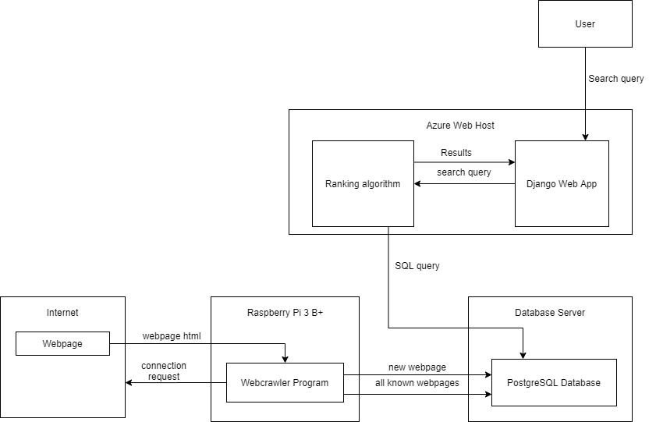
Design

Slide 3
Parts list
Raspberry Pi 3 B+ with case (2x) - $35 each
Network Cables (3x) - $5 each
Domain - $12-15
Server – $250-500
Azure - $50 per month (high end estimate)

Slide 4
Risks
Inability to host website ( Resolved )
Azure Web App
Speed vs accuracy dilemma
Ranking on host (primary design): slower, accurate
Ranking on crawlers (secondary design): faster, less accurate

Slide 5
Separation Plan
One person takes the hardware
Everyone can remote access the hardware
Testing can be done on personal devices
Azure Web application is hosted by Microsoft's servers

Slide 6
Gantt Chart

