Slide 1

Robodactyl ESCAPE
Andrew Berls
Billy Galarpe
Bryce Filler

Slide 2

Vision

Slide 3
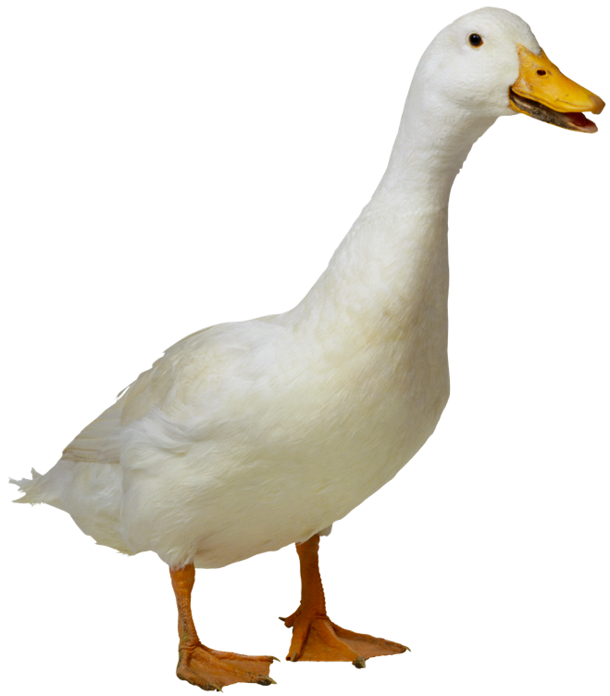
GOALS easy to Play, tough to beat
Accessibility
Entertainment
Personal goals: learn to write elegant and well-formed JavaScript

