Slide 1

Robodactyl ESCAPE
Andrew Berls
Billy Galarpe
Bryce Filler

Slide 2

Vision

Slide 3
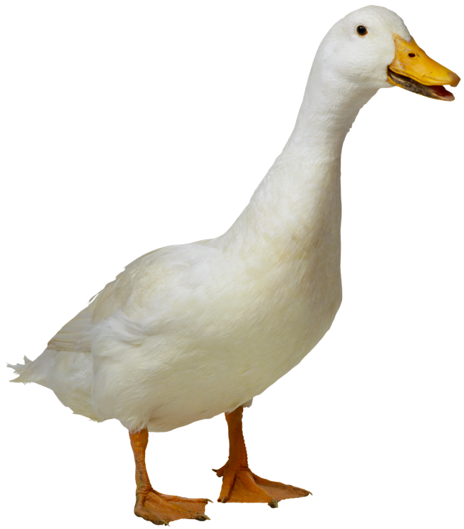
GOALS easy to Play, tough to beat
Accessibility
Entertainment
Personal goals: learn to write elegant and well-formed JavaScript

Slide 4
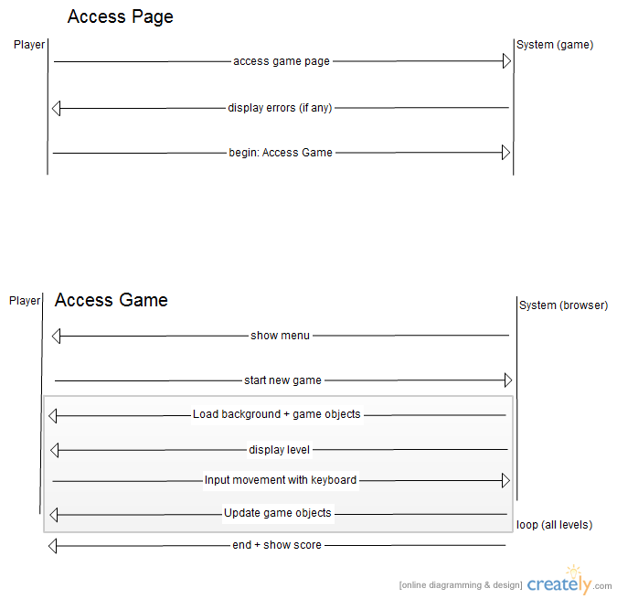

Slide 5
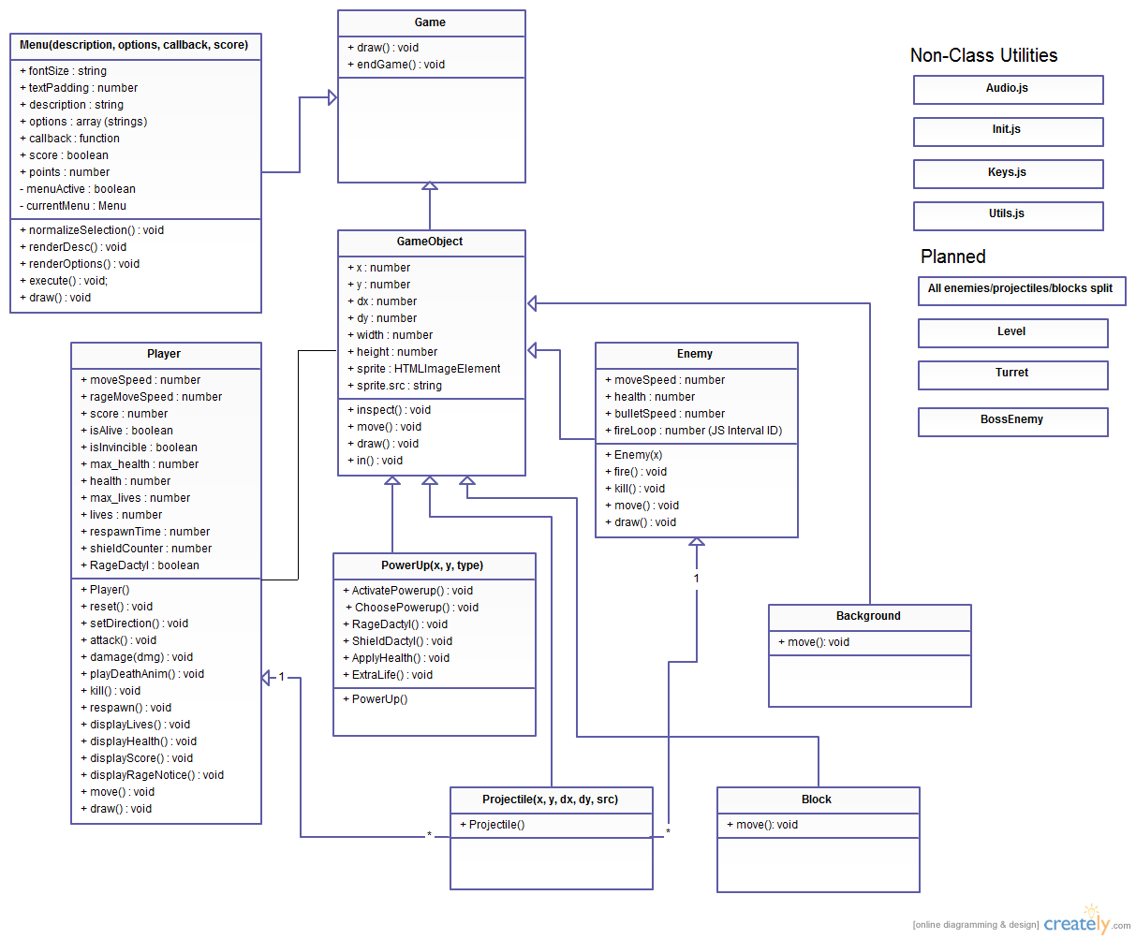

Slide 6
Level One
http://cs.ucsb.edu/~andrewberls

Slide 7
THE FUTURE
More levels
More enemies
More power-ups
MORE DESTRUCTION

