Slide 1
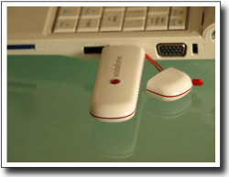
An open community for mobile application developers
Vodafone Mobile Connect – for Linux
Nicholas Herriot & Kevin Scarr
Nov 2008

Slide 2
VMC Background
VMC started as a joint project with the local Spanish Government and Vodafone to supply an Open Source application to run on Linux to help with mobile broadband connectivity.
In 2007 Vodafone ES removed funding for the project, it was later picked up with Vodafone Group Marketing and R&D as a tactical solution for the Asus 701 being sold in other Op-Co's. The Software was hosted on the new Betavine portal dedicated to the developer community and cutting edge applications.
In 2008 R&D took the decision into supporting the growing community and decided to build dedicated Linux packages for Linux Netbooks.
By late 2008 the Linux Driver section of Betavine supported 3 Linux Netbooks and 3 different Linux distributions with over 400,000 downloads.
Group Marketing are continuing to fund plug-in development for Vodafone USB dongles, and partial support of the Community, while Group R&D (UK & Spain) continue to invest resources for development / testing / hosting / community engagement / support.
Currently the Software has plugins for over 40 devices – uses components and packages from the OS community – is written in Python a scripting and compilable GPL language – takes its main lead from feedback provided by the community.
The Betavine Connect software is currently the world lead in mobile connectivity software for Linux in terms of Google importance.

Slide 3



Technology
VMC uses standard Open Source components where possible
VMC
SMS,
Contacts,
SIM details
Mysqlite db
Setup connection
Device insertion
removal
Python plugin scripts
Huawei E172
Options z150
D-Bus
UI Widgets
ZTE K3520
wvdial
Plugable components
Ericsson md..
HSO
CHAT
Linux OS

Slide 4
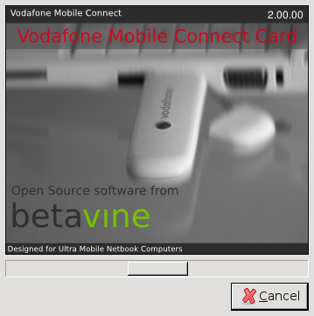
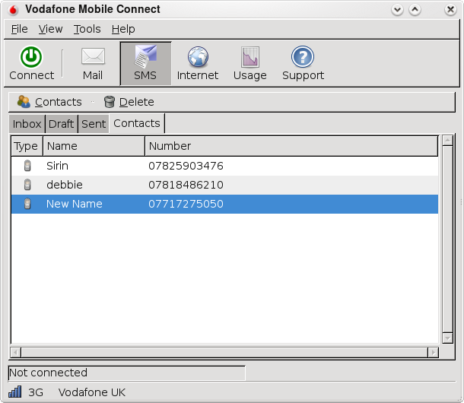
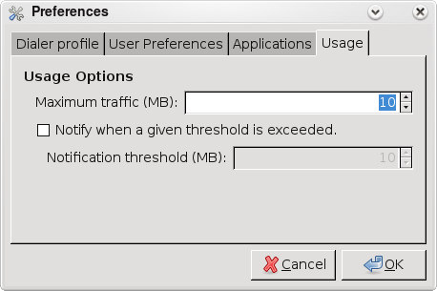
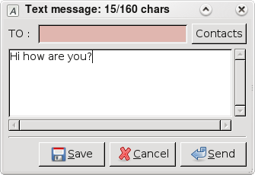
Advantages
Device 'differences' can be accommodated with a Python script within the plugins directory. No re-compile is needed. This lowers the level which Open Source developers, contributes and OEM's have to understand to build in compatibility.
All components used are GPL or such like, hence '0' licence costs.
VMC is not just a modem connection manager. It allows:
- users to send receive SMS;
  - control contacts from a SIM,
  - view/set data usage statistic.

Slide 5
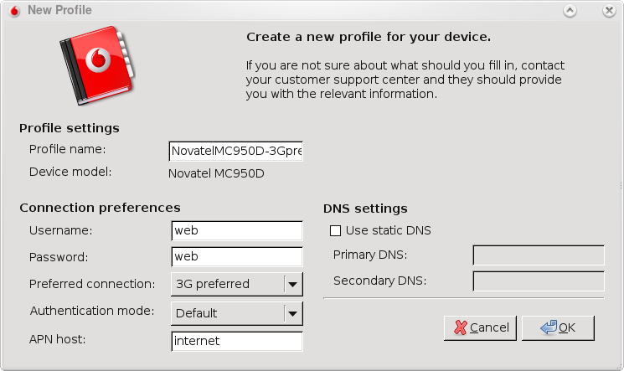
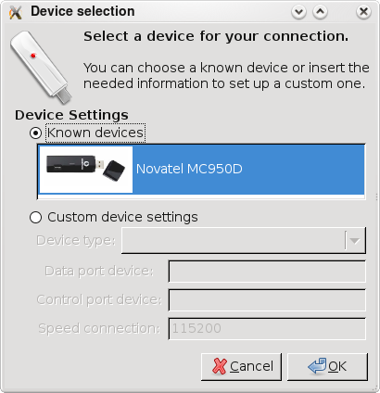
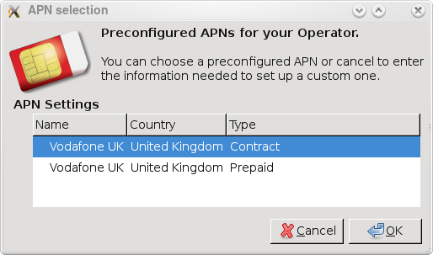
Configuration Options
VMC also allows easy setup of several OEM USB Dongles, taking care of the many differences and non-standard / proprietary configuration problems observed in cards;
Allows easy setup and configuration of APN's for our mobile broadband customers;
Integration with new services like PAYT
broadband as they come on line.

Slide 6
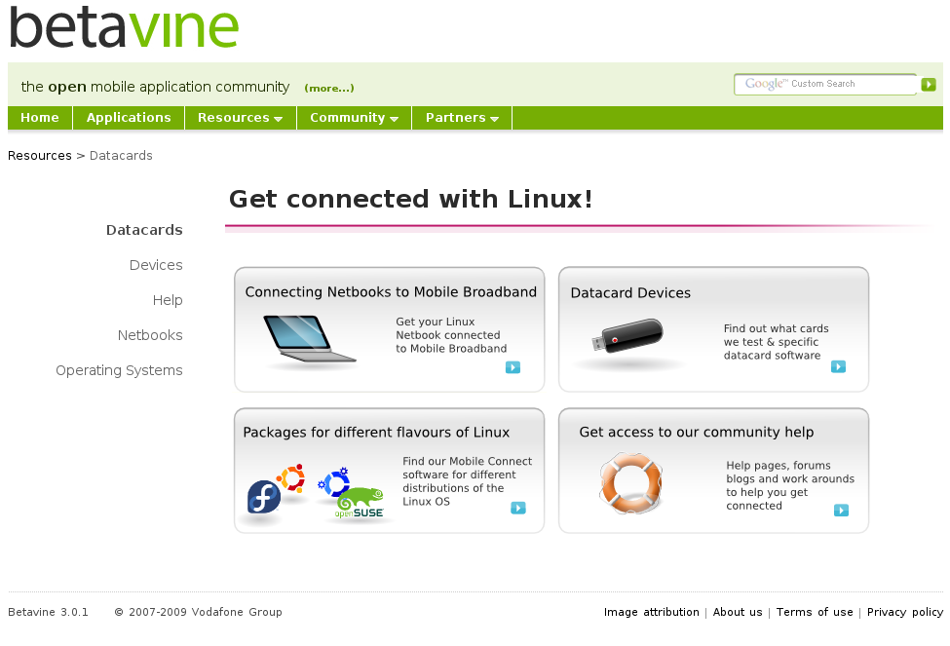
Support / Community / Hosting
VMC has been hosted on Betavine since 2007. A community of:
  - developers
  - Linux enthusiasts
  - computer literate users and
  general users now actively participate in:
  - download
  - trial
  - test
  - submit views
  - offer suggestion and tips
  - contribute content
  - fixes and help.

Slide 7
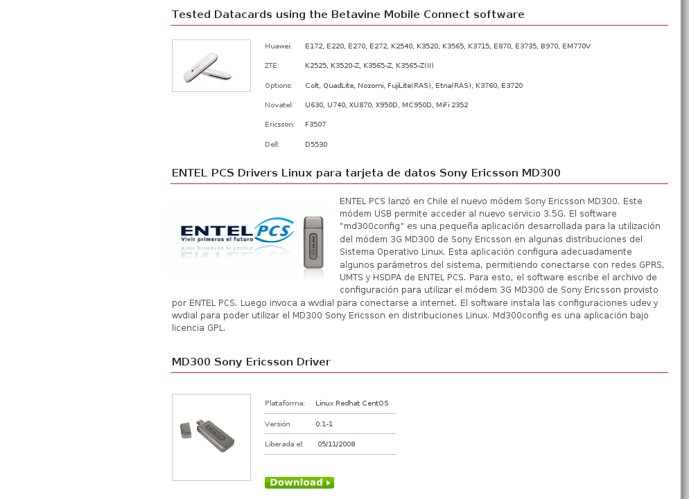
Partner Networks
Betavine and VMC's success has allowed us to work with partner networks such as Entel due to the visibility it's obtained.
Betavine currently host a Linux app designed to connect 'Entel' subscribers using the Ericsson MD-300 USB Modem – This in turn has
allowed us to collaborate with Entel on
ways to split features / resources across
a common Modem Driver.
  -Background-
  Steady growth in download counts from our
  repositories shows higher downloads
  for countries such as Brazil, Hungary,
  Romania and Indonesia than even
  United States. We suspect that Linux is a
  far more popular operating system in
  emerging markets.

Slide 8
Future Trends and New Features
Proposals are to continue supporting new Linux Netbooks from OEM's.
Language support provided by the community and partner networks.
Funding of developer API's for messaging (SMS and MMS) pushed through Betavine.
Incorporation of other Operator APN's, MMSC and SMSC settings.
Full integration with an OS Linux Network Manager.
Integration with Wader and support from an OS developer house like Warp.
Engagement with a Linux Distributor such as Canonical to submit the App into a main line Linux repository.
Development of USSD API.
Re-skinning UI, and building of a better messaging interface.
Development or sponsorship/prize for SMS integration with IM app's like Pidgeon.
Development of tighter integration with ZIP and SIM Contacts integration.
Development of drivers to work with Mobile devices as modems out the box.
Integration with MID's / Change UI to use clutter.
Tight integration with Betavine – show data usage – logging – network – signal strength for users with account on Betavine for their card.

Slide 9
Future Trends and New Features
In the short term we believe there will be a continuing need for this type of application as emerging markets continue to experiment with Linux devices.
There will be less need for a connect/disconnect type application as this becomes a 'default' behaviour by the OS and more manufacturers build driver support into the Linux Kernel Further to this, many devices will have an inbuilt datacard, meaning the onus will be on the OEM and OS to make the card work. Never the less this does not negate the usefulness on devices such as Netbooks or larger form factor machines.
We think integration with SMS and IM will be taken up by the community, it could be an enabler to encourage SMS usage from IM.
Having a presence in this area keeps Vodafone as an 'enabler' for connectivity of devices to mobile networks. Pushing our brand across all Linux machines and all mobile operators could be reason enough to continue.
The project has allowed Betavine to gain an insight into problems with installing, finding and downloading applications on MID's and Netbooks for Linux. In medium to long term we could build and push a betavine market place app that allows easy installation of app's provided by Betavine to MID's and Netbooks. This would leverage the work done with Bondi, pushing Widgets to Netbooks and MID's.

Slide 10


An open community for mobile application developers
Thank You!
www.betavine.net
betavine.mobi
forge.betavine.net

