Slide 1
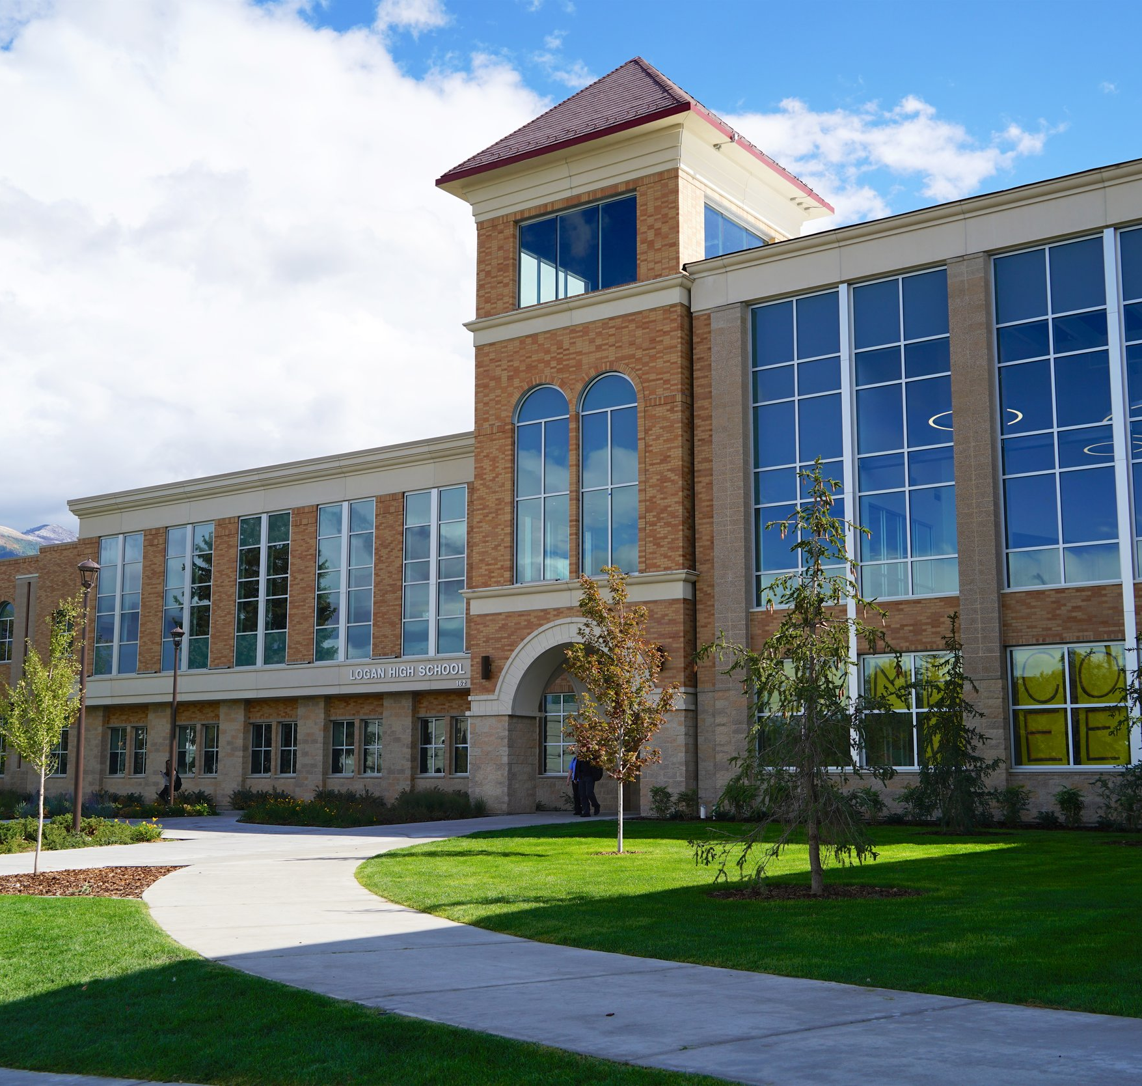
THE DEPARTMENT OF EDUCATION QUALITY SURVEY AND ITS EFFICACY
Andrew Bowen, Glen Dale Davis, Shoshana Farber, Joshua Forster, Charles Ugiagbe

Slide 2
Agenda
Abstract
Introduction
Literature Review
Methodology
Experimentation and Results
Conclusion
References

Slide 3
Abstract
TBS

Slide 4
Introduction
NYC School Survey – collects data on NYC Public Schools and provides standardized ratings of various elements of “school quality”
The question – does the NYC School Quality Review Survey accurately reflect educational outcomes or could these outcomes be better predicted by proxy variables related to the student body?
Primary measure of success – 4-year college persistence rate (percentage of students from a specific public school who completed college)

