Slide 1
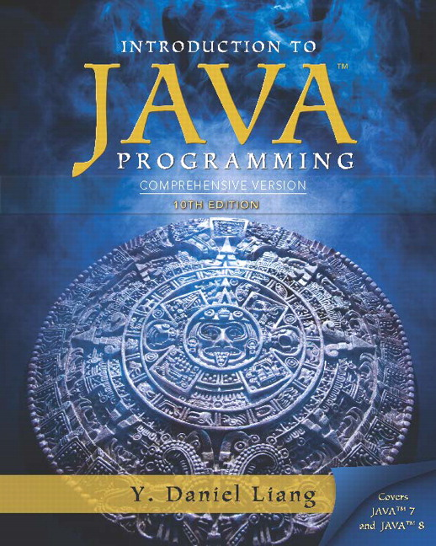
Introduction to Java Programming Comprehensive Version
Tenth Edition
Chapter 1
Introduction to Computers, Programs, and Java
Slides in the presentation contain hyperlinks. J A W S users should be able to get a list of links by using INSERT+F7
Copyright © 2015 Pearson Education, Inc. All Rights Reserved
Notes:
If this PowerPoint presentation contains mathematical equations, you may need to check that your computer has the following installed:
1) MathType Plugin
2) Math Player (free versions available)
3) NVDA Reader (free versions available)

Slide 2
Learning Objectives (1 of 2)
1.1 To understand computer basics, programs, and operating systems (§§1.2-1.4).
1.2 To describe the relationship between Java and the World Wide Web (§1.5).
1.3 To understand the meaning of Java language specification, A P I, J D K, and I D E (§1.6).
1.4 To write a simple Java program (§1.7).
1.5 To display output on the console (§1.7).
1.6 To explain the basic syntax of a Java program (§1.7).

Slide 3
Learning Objectives (2 of 2)
1.7 To create, compile, and run Java programs (§1.8).
1.8 To use sound Java programming style and document programs properly (§1.9).
1.9 To explain the differences between syntax errors, runtime errors, and logic errors (§1.10).
1.10 To develop Java programs using NetBeans (§1.11).
1.11 To develop Java programs using Eclipse (§1.12).

Slide 4
What is a Computer?
A computer consists of a C P U, memory, hard disk, floppy disk, monitor, printer, and communication devices.

Slide 5
C P U
The central processing unit (C P U) is the brain of a computer. It retrieves instructions from memory and executes them. The C P U speed is measured in megahertz (M H z), with 1 megahertz equaling 1 million pulses per second. The speed of the C P U has been improved continuously. If you buy a P C now, you can get an Intel Pentium 4 Processor at 3 gigahertz (1 gigahertz is 1000 megahertz).

Slide 6
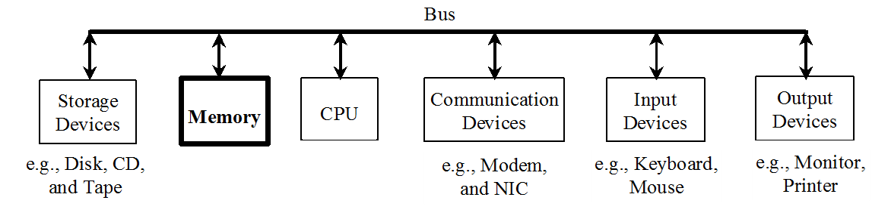
Memory
Memory is to store data and program instructions for C P U to execute. A memory unit is an ordered sequence of bytes, each holds eight bits. A program and its data must be brought to memory before they can be executed. A memory byte is never empty, but its initial content may be meaningless to your program. The current content of a memory byte is lost whenever new information is placed in it.

Slide 7
How Data is Stored?
Data of various kinds, such as numbers, characters, and strings, are encoded as a series of bits (zeros and ones). Computers use zeros and ones because digital devices have two stable states, which are referred to as zero and one by convention. The programmers need not to be concerned about the encoding and decoding of data, which is performed automatically by the system based on the encoding scheme. The encoding scheme varies. For example, character ‘J’ is represented by 01001010 in one byte. A small number such as three can be stored in a single byte. If computer needs to store a large number that cannot fit into a single byte, it uses a number of adjacent bytes. No two data can share or split a same byte. A byte is the minimum storage unit.

Slide 8
Storage Devices
Memory is volatile, because information is lost when the power is off. Programs and data are permanently stored on storage devices and are moved to memory when the computer actually uses them. There are three main types of storage devices:Disk drives (hard disks and floppy disks), C D drives (C D-R and C D-R W), and Tape drives.

Slide 9
Output Devices: Monitor
The monitor displays information (text and graphics). The resolution and dot pitch determine the quality of the display.

Slide 10
Monitor Resolution and Dot Pitch
resolution
The screen resolution specifies the number of pixels in horizontal and vertical dimensions of the display device. Pixels (short for “picture elements”) are tiny dots that form an image on the screen. A common resolution for a 17-inch screen, for example, is 1,024 pixels wide and 768 pixels high. The resolution can be set manually. The higher the resolution, the sharper and clearer the image is.
dot pitch
The dot pitch is the amount of space between pixels, measured in millimeters. The smaller the dot pitch, the sharper the display.

Slide 11
Communication Devices
A regular modem uses a phone line and can transfer data in a speed up to 56,000 bps (bits per second). A D S L (digital subscriber line) also uses a phone line and can transfer data in a speed 20 times faster than a regular modem. A cable modem uses the T V cable line maintained by the cable company. A cable modem is as fast as a D S L. Network interface card (N I C) is a device to connect a computer to a local area network (L A N). The L A N is commonly used in business, universities, and government organizations. A typical type of N I C, called 10BaseT, can transfer data at 10 m b p s (million bits per second).

Slide 12
Programs
Computer programs, known as software, are instructions to the computer.
You tell a computer what to do through programs. Without programs, a computer is an empty machine. Computers do not understand human languages, so you need to use computer languages to communicate with them.
Programs are written using programming languages.

Slide 13
Programming Languages (1 of 3)
Machine Language
Machine language is a set of primitive instructions built into every computer. The instructions are in the form of binary code, so you have to enter binary codes for various instructions. Program with native machine language is a tedious process. Moreover the programs are highly difficult to read and modify. For example, to add two numbers, you might write an instruction in binary like this:
1101101010011010

Slide 14
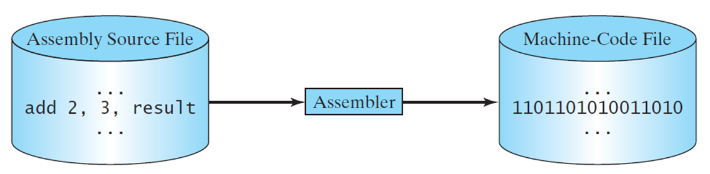
Programming Languages (2 of 3)
Assembly languages
Assembly languages were developed to make programming easy. Since the computer cannot understand assembly language, however, a program called assembler is used to convert assembly language programs into machine code. For example, to add two numbers, you might write an instruction in assembly code like this:
A D D F3 R1, R2, R3

Slide 15
Programming Languages (3 of 3)
High-level language
The high-level languages are English-like and easy to learn and program. For example, the following is a high-level language statement that computes the area of a circle with radius 5:

Slide 16
Popular High-Level Languages (1 of 2)
Language | Description
Ada | Named for Ada Lovelace, who worked on mechanical general-purpose computers. The Ada language was developed for the Department of Defense and is used mainly in defense projects.
Basic | Beginner’s All-purpose Symbolic Instruction Code. It was designed to be learned and used easily by beginners.
C | Developed at Bell Laboratories. C combines the power of an assembly language with the ease of use and portability of a high-level language.
C++ | C++ is an object-oriented language, based on C.
C# | Pronounced “C Sharp.” It is a hybrid of Java and C++ and was developed by Microsoft.

Slide 17
Popular High-Level Languages (2 of 2)
Language | Description
Cobol | Common Business Oriented Language. Used for business applications.
Fortran | Formula Translation. Popular for scientific and mathematical applications.
Java | Developed by Sun Microsystems, now part of Oracle. It is widely used for developing platform-independent Internet applications.
Pascal | Named for Blaise Pascal, who pioneered calculating machines in the seventeenth century. It is a simple, structured, general-purpose language primarily for teaching programming.
Python | A simple general-purpose scripting language good for writing short programs.
Visual Basic | Visual Basic was developed by Microsoft and it enables the programmers to rapidly develop graphical user interfaces.

Slide 18
Interpreting/Compiling Source Code
A program written in a high-level language is called a source program or source code. Because a computer cannot understand a source program, a source program must be translated into machine code for execution. The translation can be done using another programming tool called an interpreter or a compiler.

Slide 19
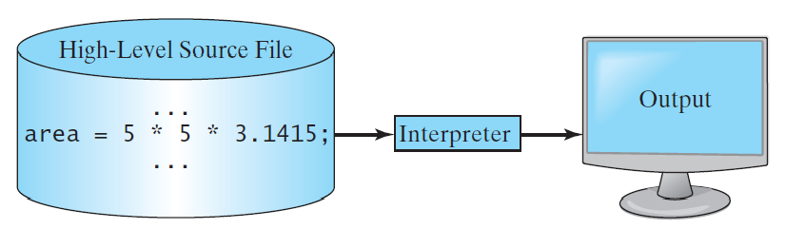
Interpreting Source Code
An interpreter reads one statement from the source code, translates it to the machine code or virtual machine code, and then executes it right away, as shown in the following figure. Note that a statement from the source code may be translated into several machine instructions.

Slide 20
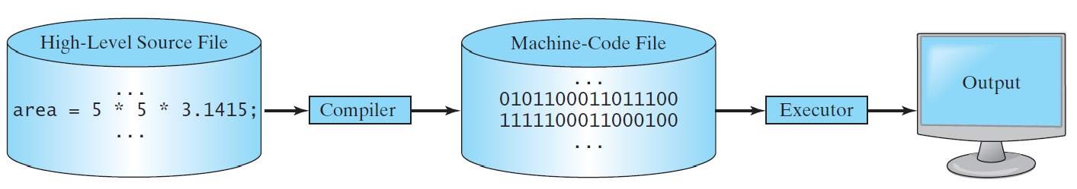
Compiling Source Code
A compiler translates the entire source code into a machine-code file, and the machine-code file is then executed, as shown in the following figure.

Slide 21
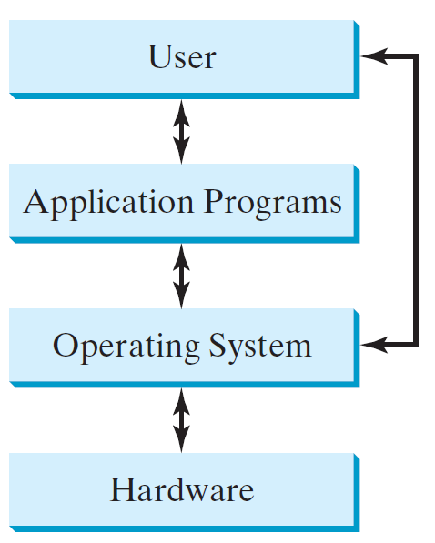
Operating Systems
The operating system (O S) is a program that manages and controls a computer’s activities. The popular operating systems for general-purpose computers are Microsoft Windows, Mac O S, and Linux. Application programs, such as a Web browser or a word processor, cannot run unless an operating system is installed and running on the computer.

Slide 22
Why Java?
The answer is that Java enables users to develop and deploy applications on the Internet for servers, desktop computers, and small hand-held devices. The future of computing is being profoundly influenced by the Internet, and Java promises to remain a big part of that future. Java is the Internet programming language.
Java is a general purpose programming language.
Java is the Internet programming language.

Slide 23
Java, Web, and Beyond
Java can be used to develop standalone applications.
Java can be used to develop applications running from a browser.
Java can also be used to develop applications for hand-held devices.
Java can be used to develop applications for Web servers.

Slide 24
Java’s History
James Gosling and Sun Microsystems
Oak
Java, May 20, 1995, Sun World
HotJava
The first Java-enabled Web browser
Early History Website:
Java History

Slide 25
Characteristics of Java (1 of 13)
Java Is Simple
Java Is Object-Oriented
Java Is Distributed
Java Is Interpreted
Java Is Robust
Java Is Secure
Java Is Architecture-Neutral

Slide 26
Characteristics of Java (2 of 13)
Java Is Portable
Java's Performance
Java Is Multithreaded
Java Is Dynamic
Java Characteristics

Slide 27
Characteristics of Java (3 of 13)
Java Is Simple
Java is partially modeled on C++, but greatly simplified and improved. Some people refer to Java as “C++--” because it is like C++ but with more functionality and fewer negative aspects.

Slide 28
Characteristics of Java (4 of 13)
Java Is Object-Oriented
Java is inherently object-oriented. Although many object-oriented languages began strictly as procedural languages, Java was designed from the start to be object-oriented. Object-oriented programming (O O P) is a popular programming approach that is replacing traditional procedural programming techniques.
One of the central issues in software development is how to reuse code. Object-oriented programming provides great flexibility, modularity, clarity, and reusability through encapsulation, inheritance, and polymorphism.

Slide 29
Characteristics of Java (5 of 13)
Java Is Distributed
Distributed computing involves several computers working together on a network. Java is designed to make distributed computing easy. Since networking capability is inherently integrated into Java, writing network programs is like sending and receiving data to and from a file.

Slide 30
Characteristics of Java (6 of 13)
Java Is Interpreted
You need an interpreter to run Java programs. The programs are compiled into the Java Virtual Machine code called bytecode. The bytecode is machine-independent and can run on any machine that has a Java interpreter, which is part of the Java Virtual Machine (J V M).

Slide 31
Characteristics of Java (7 of 13)
Java Is Robust
Java compilers can detect many problems that would first show up at execution time in other languages.
Java has eliminated certain types of error-prone programming constructs found in other languages.
Java has a runtime exception-handling feature to provide programming support for robustness.

Slide 32
Characteristics of Java (8 of 13)
Java Is Secure
Java implements several security mechanisms to protect your system against harm caused by stray programs.

Slide 33
Characteristics of Java (9 of 13)
Java Is Architecture-Neutral
Write once, run anywhere
With a Java Virtual Machine (J V M), you can write one program that will run on any platform.

Slide 34
Characteristics of Java (10 of 13)
Java Is Portable
Because Java is architecture neutral, Java programs are portable. They can be run on any platform without being recompiled.

Slide 35
Characteristics of Java (11 of 13)
Java's Performance
Java’s performance Because Java is architecture neutral, Java programs are portable. They can be run on any platform without being recompiled.

Slide 36
Characteristics of Java (12 of 13)
Java Is Multithreaded
Multithread programming is smoothly integrated in Java, whereas in other languages you have to call procedures specific to the operating system to enable multithreading.

Slide 37
Characteristics of Java (13 of 13)
Java Is Dynamic
Java was designed to adapt to an evolving environment. New code can be loaded on the fly without recompilation. There is no need for developers to create, and for users to install, major new software versions. New features can be incorporated transparently as needed.

Slide 38
J D K Versions
J D K 1.02 (1995)
J D K 1.1 (1996)
J D K 1.2 (1998)
J D K 1.3 (2000)
J D K 1.4 (2002)
J D K 1.5 (2004) a. k. a. J D K 5 or Java 5
J D K 1.6 (2006) a. k. a. J D K 6 or Java 6
J D K 1.7 (2011) a. k. a. J D K 7 or Java 7
J D K 1.8 (2014) a. k. a. J D K 8 or Java 8

Slide 39
J D K Editions
Java Standard Edition (J 2 S E)
J 2 S E can be used to develop client-side standalone applications or applets.
Java Enterprise Edition (J 2 E E)
J 2 E E can be used to develop server-side applications such as Java servlets, Java ServerPages, and Java ServerFaces.
Java Micro Edition (J 2 M E).
J 2 M E can be used to develop applications for mobile devices such as cell phones.
This book uses J 2 S E to introduce Java programming.

Slide 40
Popular Java I D E s
NetBeans
Eclipse

Slide 41
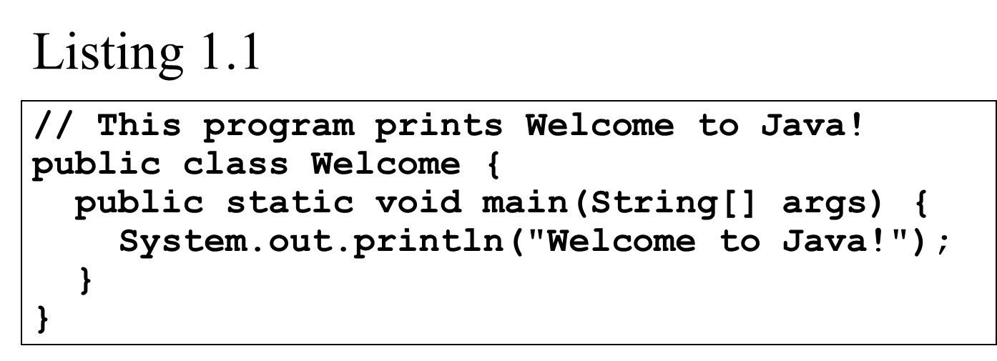
A Simple Java Program
Note: Clicking the green button displays the source code with interactive animation. You can also run the code in a browser. Internet connection is needed for this button.
Welcome
Run
Note: Clicking the blue button runs the code from Windows. If you cannot run the buttons, see www.cs.armstrong.edu/liang/javaslidenote.doc.

Slide 42
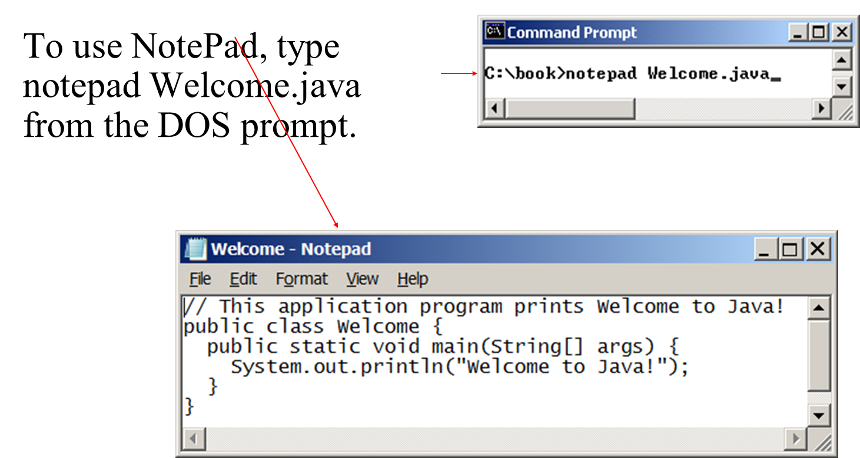
Creating and Editing Using NotePad

Slide 43
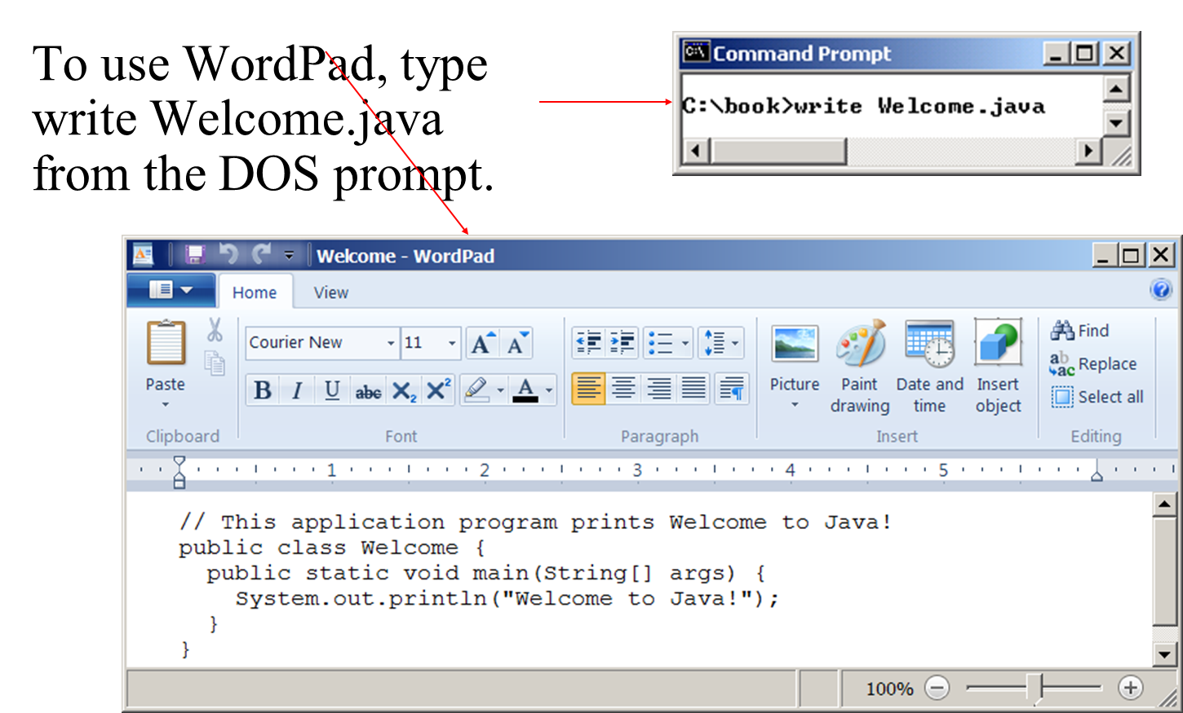
Creating and Editing Using WordPad

Slide 44
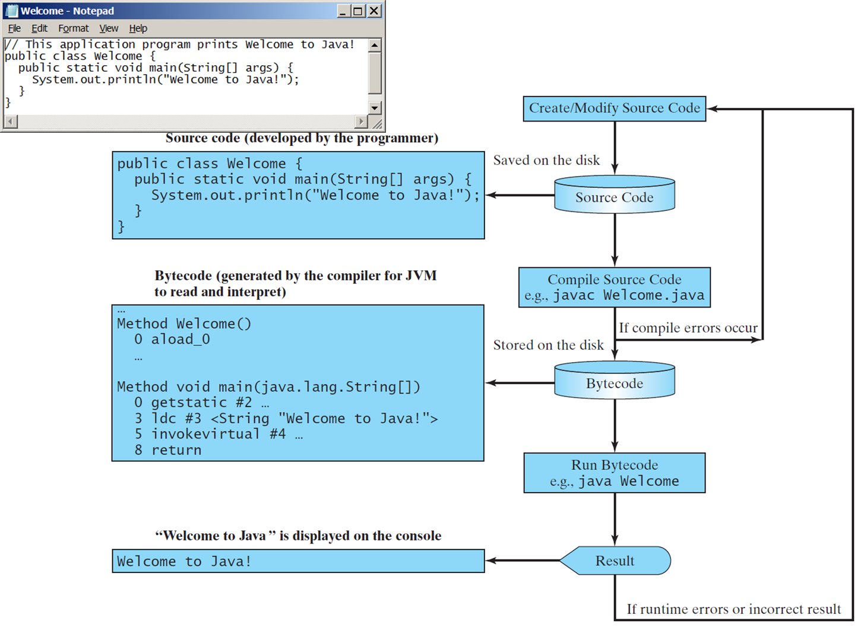
Creating, Compiling, and Running Programs

Slide 45
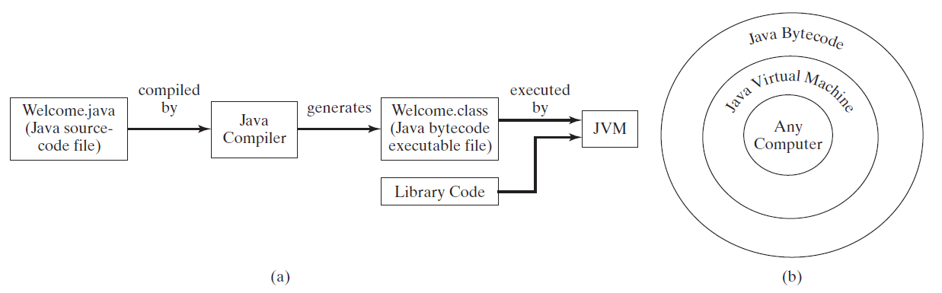
Compiling Java Source Code
You can port a source program to any machine with appropriate compilers. The source program must be recompiled, however, because the object program can only run on a specific machine. Nowadays computers are networked to work together. Java was designed to run object programs on any platform. With Java, you write the program once, and compile the source program into a special type of object code, known as bytecode. The bytecode can then run on any computer with a Java Virtual Machine, as shown below. Java Virtual Machine is a software that interprets Java bytecode.

Slide 46
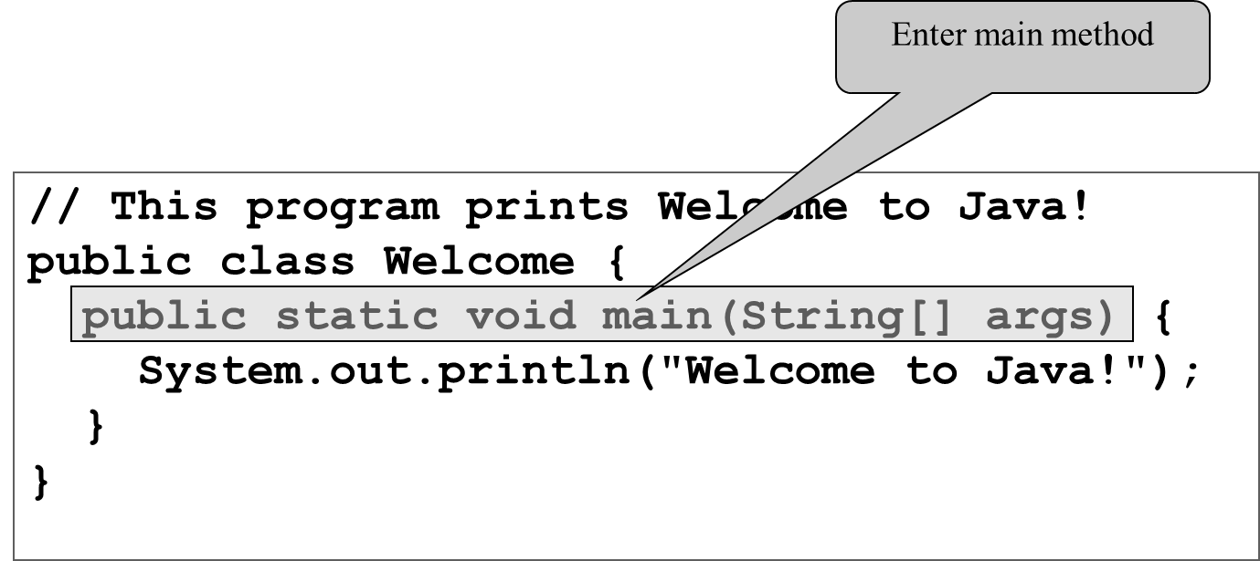
Trace a Program Execution (1 of 3)

Slide 47
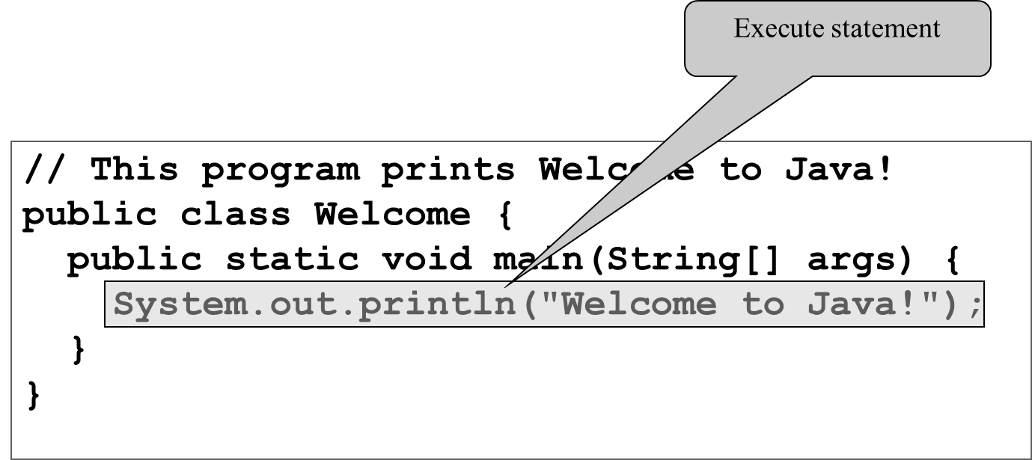
Trace a Program Execution (2 of 3)

Slide 48
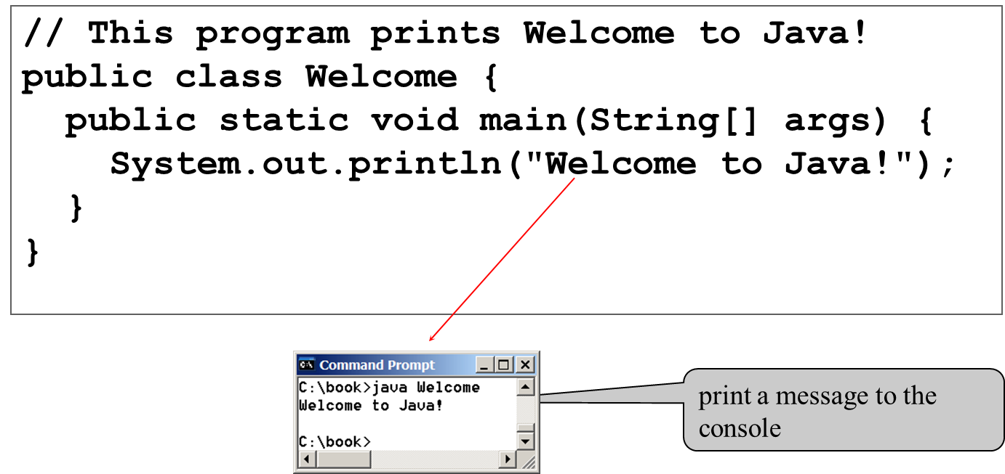
Trace a Program Execution (3 of 3)

Slide 49
Two More Simple Examples
WelcomeWithThreeMessages
Run
ComputeExpression
Run

Slide 50
Supplements on the Companion Website
See Supplement I.B for installing and configuring J D K
See Supplement I.C for compiling and running Java from the command window for details
armstrong

Slide 51
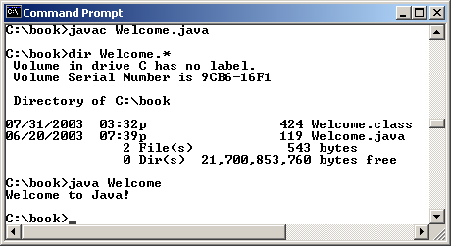
Compiling and Running Java from the Command Window
Set path to J D K bin directory
set path=c:\Program Files\java\jdk1.8.0\bin
Set classpath to include the current directory
set classpath=.
Compile
javac Welcome.java
Run
java Welcome

Slide 52
Compiling and Running Java from TextPad
See Supplement II.A on the Website for details

Slide 53
Anatomy of a Java Program
Class name
Main method
Statements
Statement terminator
Reserved words
Comments
Blocks

Slide 54
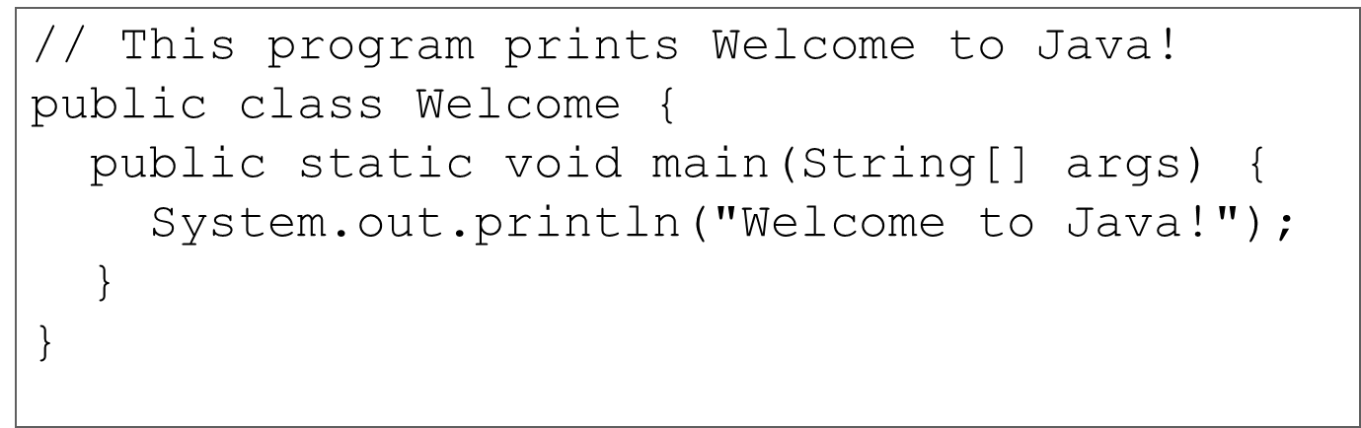
Class Name
Every Java program must have at least one class. Each class has a name. By convention, class names start with an uppercase letter. In this example, the class name is Welcome.

Slide 55
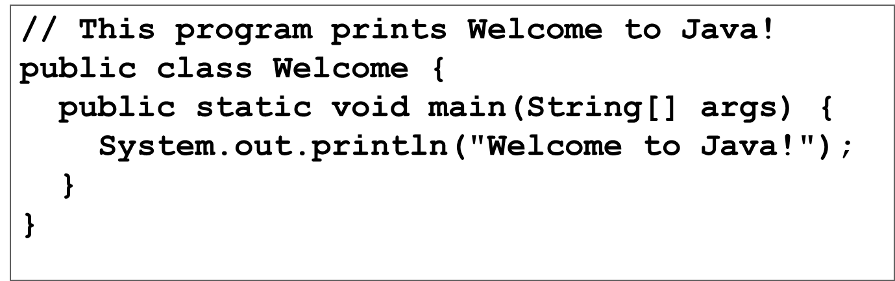
Main Method
Line 2 defines the main method. In order to run a class, the class must contain a method named main. The program is executed from the main method.

Slide 56
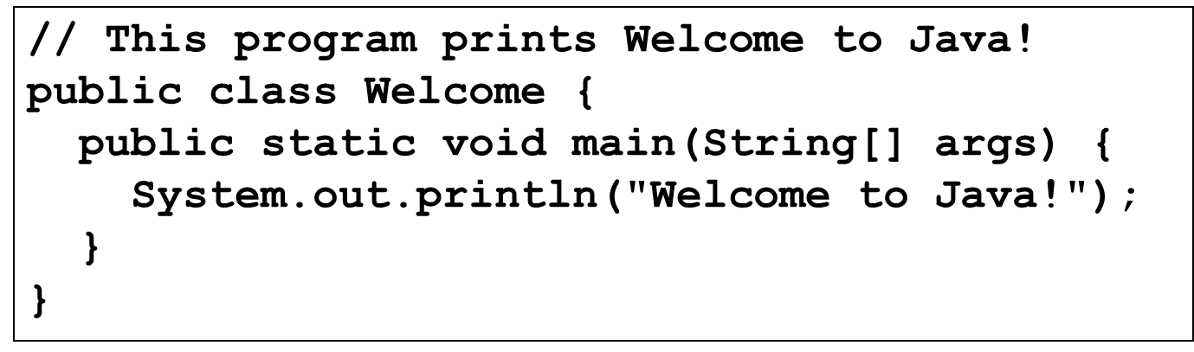
Statement
A statement represents an action or a sequence of actions. The statement System.out.println("Welcome to Java!") in the program in Listing 1.1 is a statement to display the greeting "Welcome to Java!“.

Slide 57
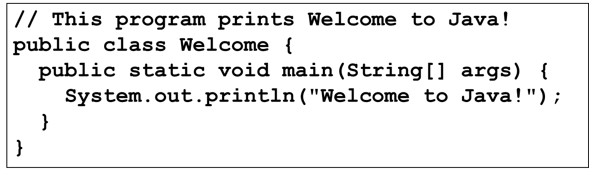
Statement Terminator
Every statement in Java ends with a semicolon (;).

Slide 58
Reserved words
Reserved words or keywords are words that have a specific meaning to the compiler and cannot be used for other purposes in the program. For example, when the compiler sees the word class, it understands that the word after class is the name for the class.

Slide 59
Blocks
A pair of braces in a program forms a block that groups components of a program.

Slide 60
Special Symbols
Character | Name | Description
{} | Opening and closing braces | Denotes a block to enclose statements.
() | Opening and closing parentheses | Used with methods.
[] | Opening and closing brackets | Denotes an array.
// | Double slashes | Precedes a comment line.
" " | Opening and closing quotation marks | Enclosing a string (i.e., sequence of characters).
; | Semicolon | Marks the end of a statement.

Slide 61
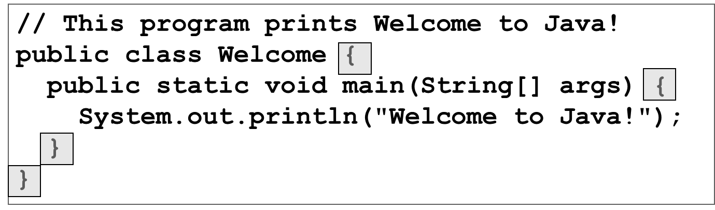
{ … }

Slide 62
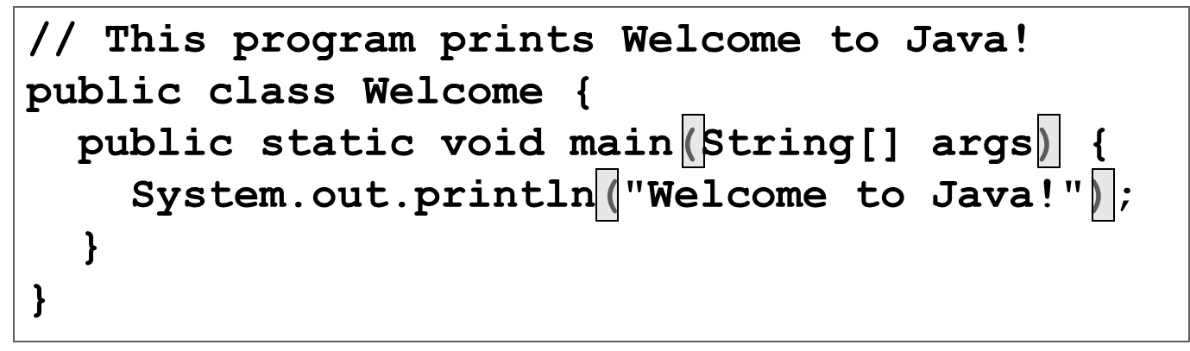
( … )

Slide 63
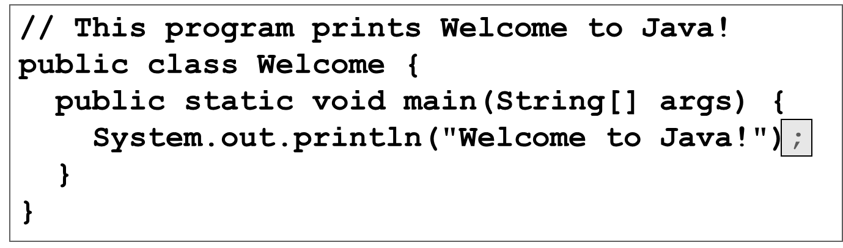
;semicolon

Slide 64
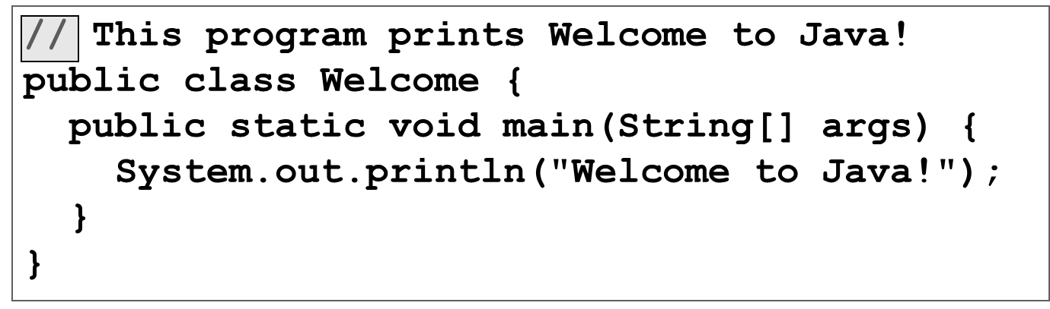
// …

Slide 65
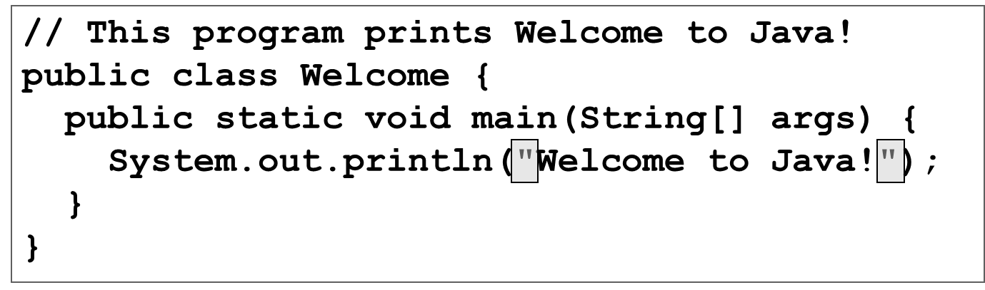
" … "

Slide 66
Programming Style and Documentation
Appropriate Comments
Naming Conventions
Proper Indentation and Spacing Lines
Block Styles

Slide 67
Appropriate Comments
Include a summary at the beginning of the program to explain what the program does, its key features, its supporting data structures, and any unique techniques it uses.
Include your name, class section, instructor, date, and a brief description at the beginning of the program.

Slide 68
Naming Conventions
Choose meaningful and descriptive names.
Class names:
Capitalize the first letter of each word in the name. For example, the class name ComputeExpression.

Slide 69
Proper Indentation and Spacing
Indentation
Indent two spaces.
Spacing
Use blank line to separate segments of the code.

Slide 70
Block Styles
Use end-of-line style for braces.

Slide 71
Programming Errors
Syntax Errors
Detected by the compiler
Runtime Errors
Causes the program to abort
Logic Errors
Produces incorrect result

Slide 72
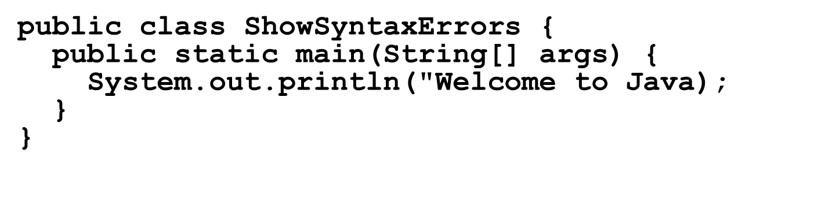
Syntax Errors
ShowSyntaxErrors
Run

Slide 73
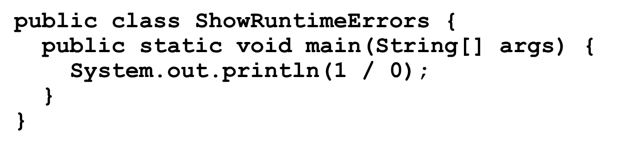
Runtime Errors
ShowSyntaxErrors
Run

Slide 74
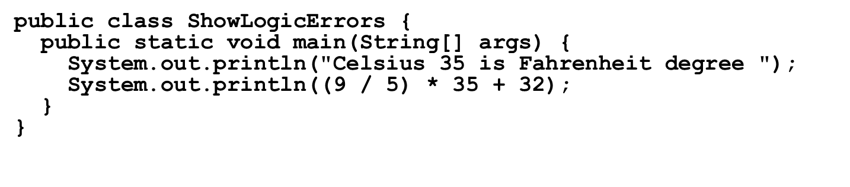
Logic Errors
ShowSyntaxErrors
Run

Slide 75
Compiling and Running Java from NetBeans
See Supplement I.D on the Website for details

Slide 76
Compiling and Running Java from Eclipse
See Supplement II.D on the Website for details

Slide 77
Displaying Text in a Message Dialog Box
you can use the showMessageDialog method in the JOptionPane class. JOptionPane is one of the many predefined classes in the Java system, which can be reused rather than “reinventing the wheel.”
WelcomeInMessageDialogBox
Run

Slide 78
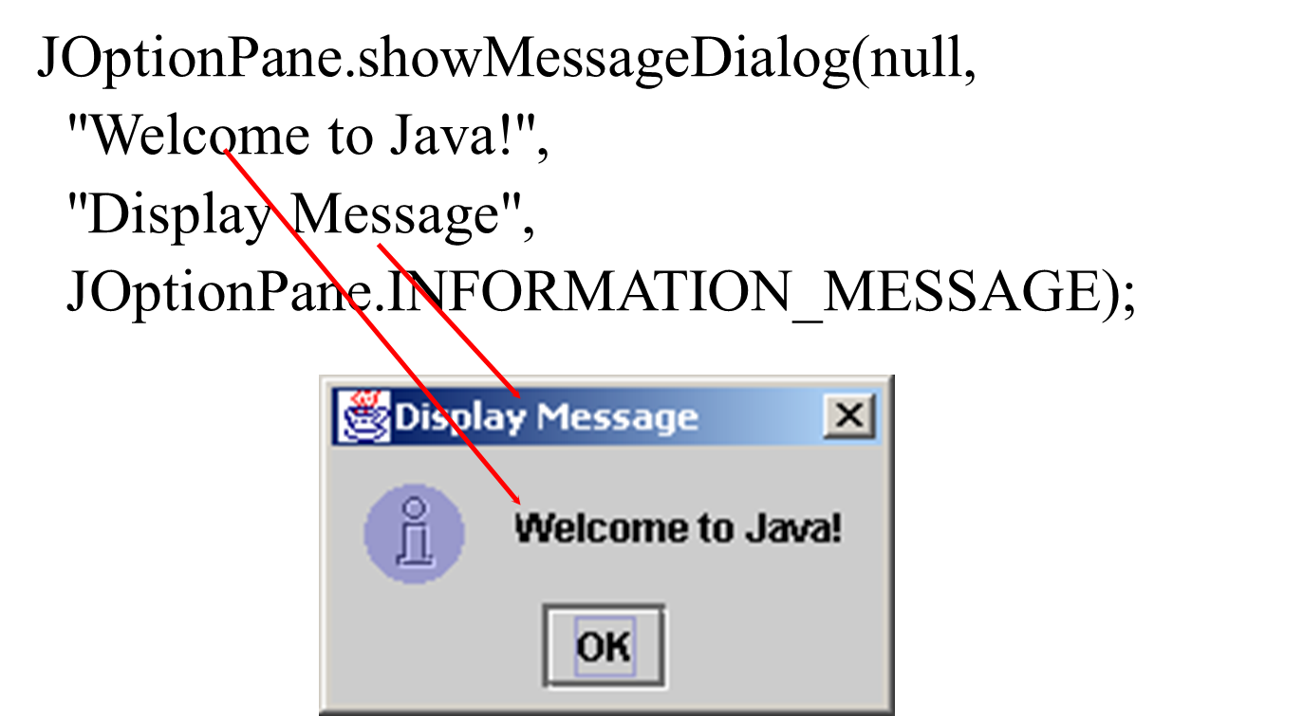
The showMessageDialog Method

Slide 79
Two Ways to Invoke the Method
There are several ways to use the showMessageDialog method. For the time being, all you need to know are two ways to invoke it.
One is to use a statement as shown in the example:
JOptionPane.showMessageDialog(null, x,
y, JOptionPane.INFORMATION_MESSAGE);
where x is a string for the text to be displayed, and y is a string for the title of the message dialog box.
The other is to use a statement like this:
JOptionPane.showMessageDialog(null, x);
where x is a string for the text to be displayed.

Slide 80
Implicit Import and Explicit Import
java.util.* ; // Implicit import
java.util.JOptionPane; // Explicit Import
No performance difference

Slide 81
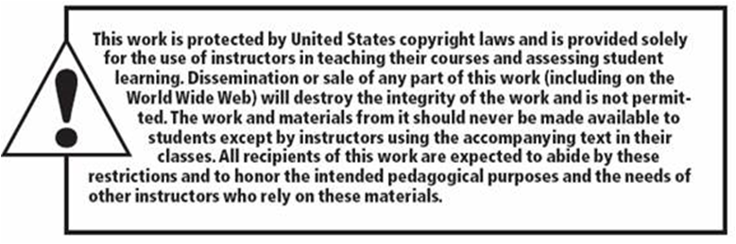
Copyright

