Slide 1
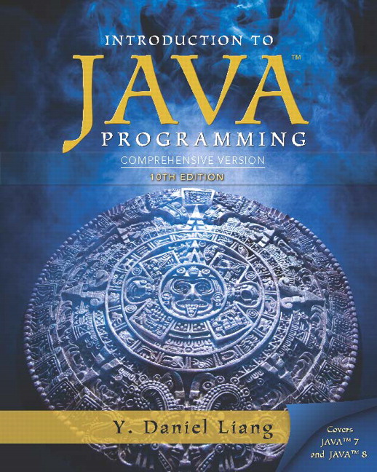
Introduction to Java Programming Comprehensive Version
Tenth Edition
Chapter 2
Elementary Programming
Slides in the presentation contain hyperlinks. J A W S users should be able to get a list of links by using INSERT+F7
Copyright © 2015 Pearson Education, Inc. All Rights Reserved
Notes:
If this PowerPoint presentation contains mathematical equations, you may need to check that your computer has the following installed:
1) MathType Plugin
2) Math Player (free versions available)
3) NVDA Reader (free versions available)

Slide 2
Motivations
In the preceding chapter, you learned how to create, compile, and run a Java program. Starting from this chapter, you will learn how to solve practical problems programmatically. Through these problems, you will learn Java primitive data types and related subjects, such as variables, constants, data types, operators, expressions, and input and output.

Slide 3
Learning Objectives (1 of 3)
2.1 To write Java programs to perform simple computations (§2.2).
2.2 To obtain input from the console using the Scanner class (§2.3).
2.3 To use identifiers to name variables, constants, methods, and classes (§2.4).
2.4 To use variables to store data (§§2.5-2.6).
2.5 To program with assignment statements and assignment expressions (§2.6).
2.6 To use constants to store permanent data (§2.7).
2.7 To name classes, methods, variables, and constants by following their naming conventions (§2.8).

Slide 4
Learning Objectives (2 of 3)
2.8 To explore Java numeric primitive data types: byte, short, int, long, float, and double (§2.9.1).
2.9 To read a byte, short, int, long, float, or double value from the keyboard (§2.9.2).
2.10 To perform operations using operators +, -, *, /, and % (§2.9.3).
2.11 To perform exponent operations using Math.pow(a, b) (§2.9.4).
2.12 To write integer literals, floating-point literals, and literals in scientific notation (§2.10).
2.13 To write and evaluate numeric expressions (§2.11).
2.14 To obtain the current system time using System.currentTimeMillis() (§2.12).

Slide 5
Learning Objectives (3 of 3)
2.15 To use augmented assignment operators (§2.13).
2.16 To distinguish between postincrement and preincrement and between postdecrement and predecrement (§2.14).
2.17 To cast the value of one type to another type (§2.15).
2.18 To describe the software development process and apply it to develop the loan payment program (§2.16).
2.19 To write a program that converts a large amount of money into smaller units (§2.17).
2.20 To avoid common errors and pitfalls in elementary programming (§2.18).

Slide 6
Introducing Programming with an Example
Listing 2.1 Computing the Area of a Circle
This program computes the area of the circle.
ComputeArea
Note: Clicking the green button displays the source code with interactive animation. You can also run the code in a browser. Internet connection is needed for this button.
Run
Note: Clicking the blue button runs the code from Windows. If you cannot run the buttons, see
IMPORTANT NOTE: If you cannot run the buttons, see www.cs.armstrong.edu/liang/javaslidenote.doc.

Slide 7
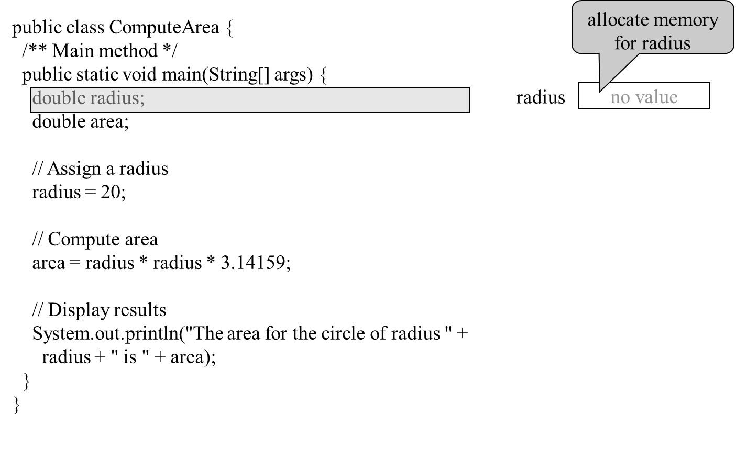
Trace a Program Execution (1 of 5)

Slide 8
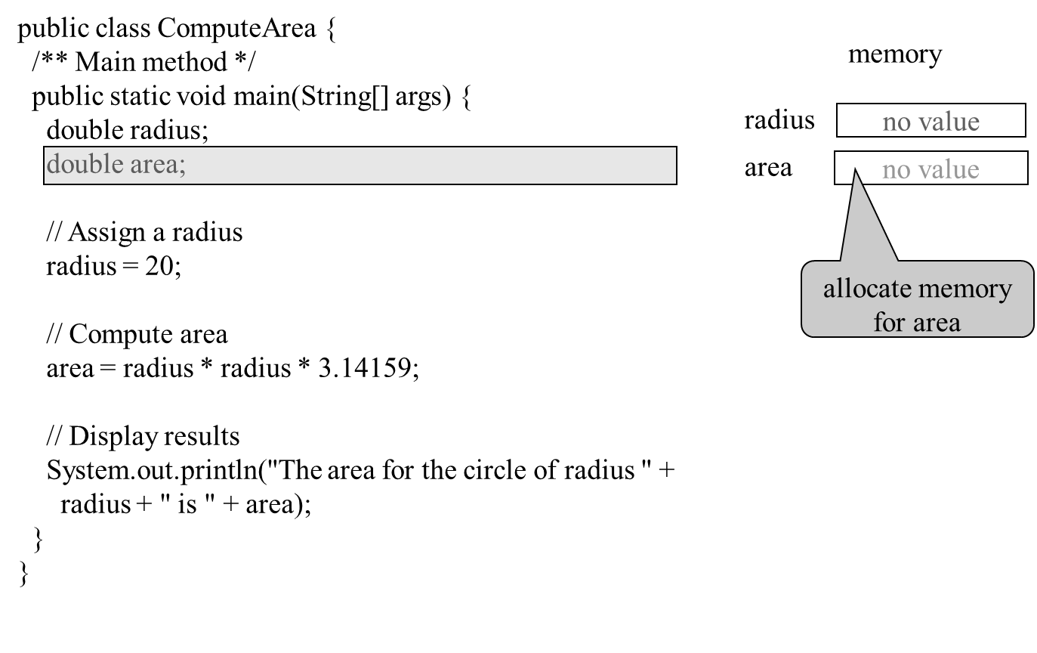
Trace a Program Execution (2 of 5)

Slide 9
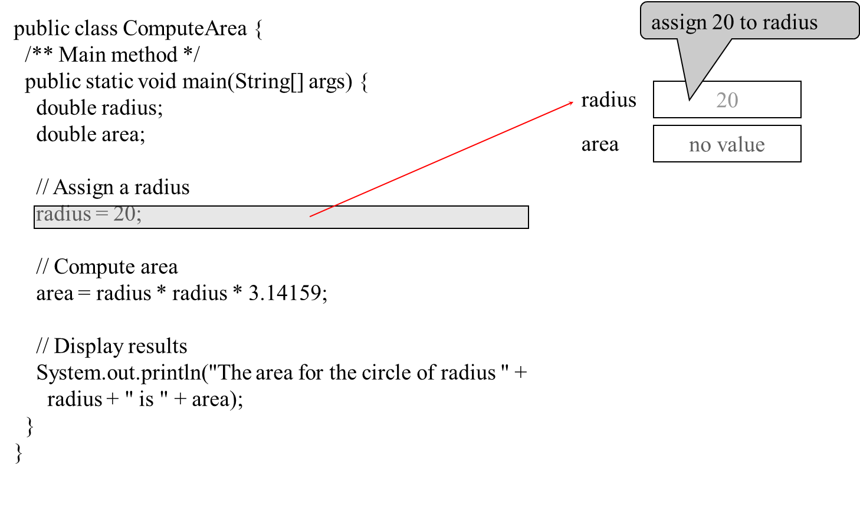
Trace a Program Execution (3 of 5)

Slide 10
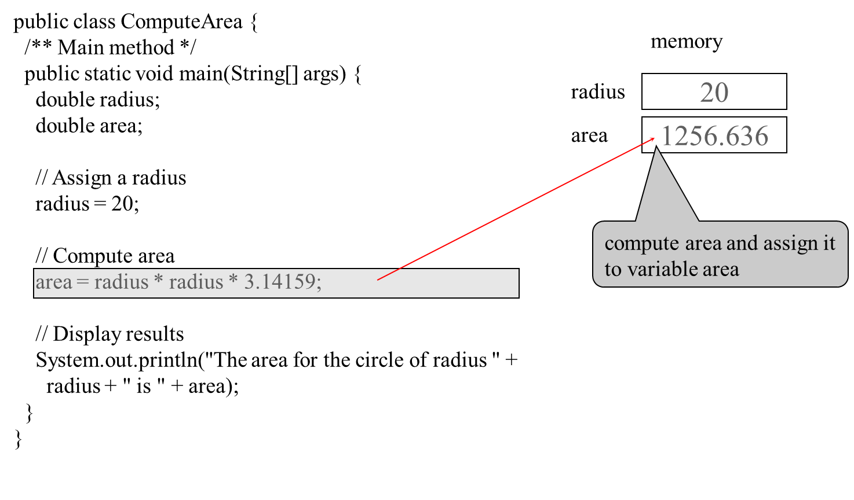
Trace a Program Execution (4 of 5)

Slide 11
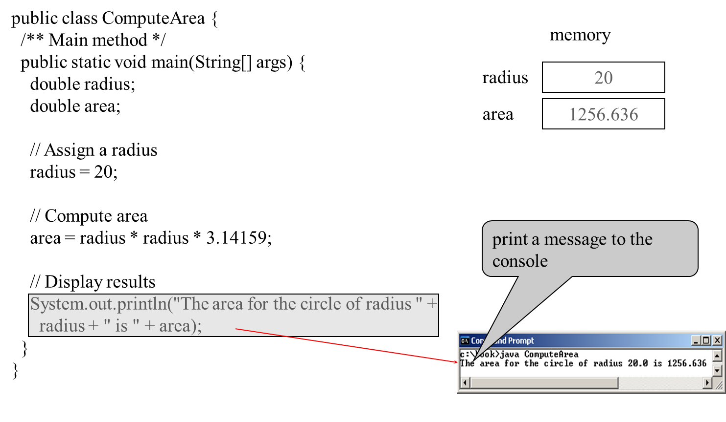
Trace a Program Execution (5 of 5)

Slide 12
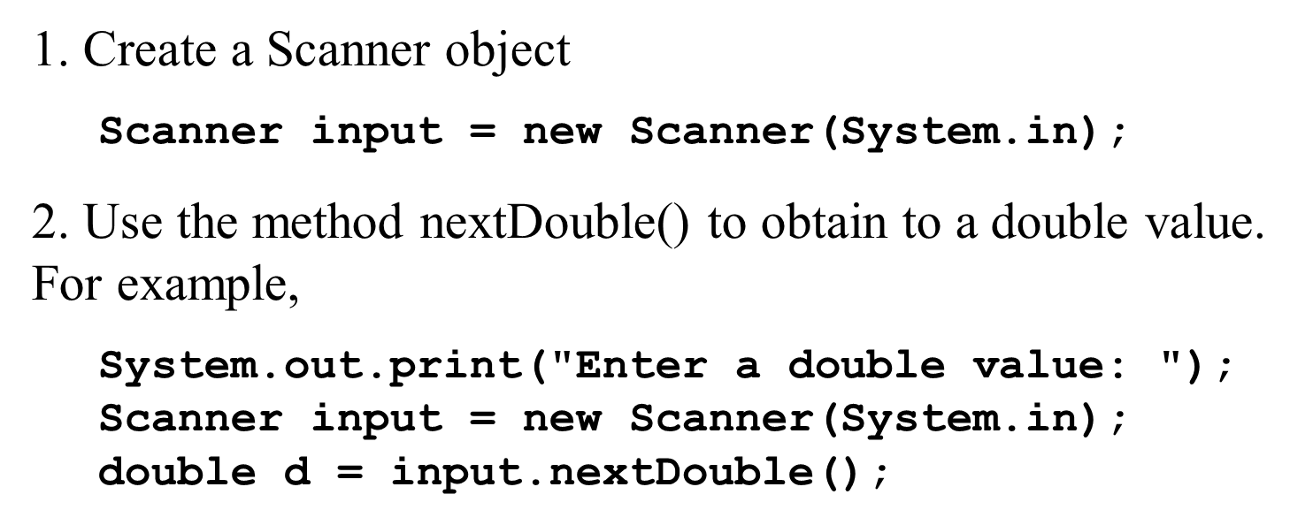
Reading Input from the Console
ComputeAreaWithConsoleInput
Run
ComputeAverage
Run

Slide 13
Identifiers
An identifier is a sequence of characters that consist of letters, digits, underscores (_), and dollar signs ($).
An identifier must start with a letter, an underscore (_), or a dollar sign ($). It cannot start with a digit.
An identifier cannot be a reserved word. (See Appendix A, “Java Keywords,” for a list of reserved words).
An identifier cannot be true, false, or null.
An identifier can be of any length.

Slide 14
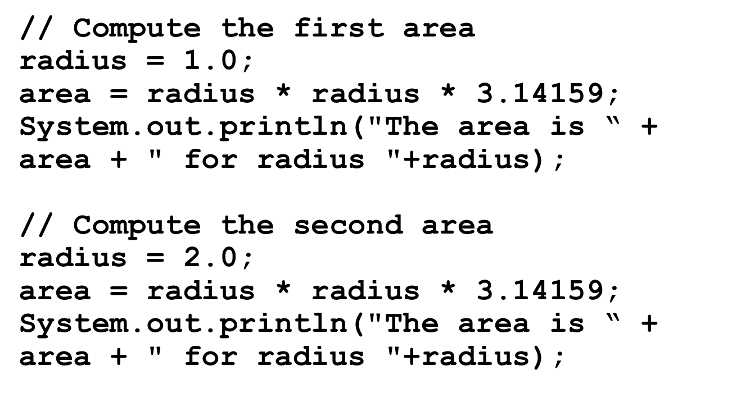
Variables

Slide 15
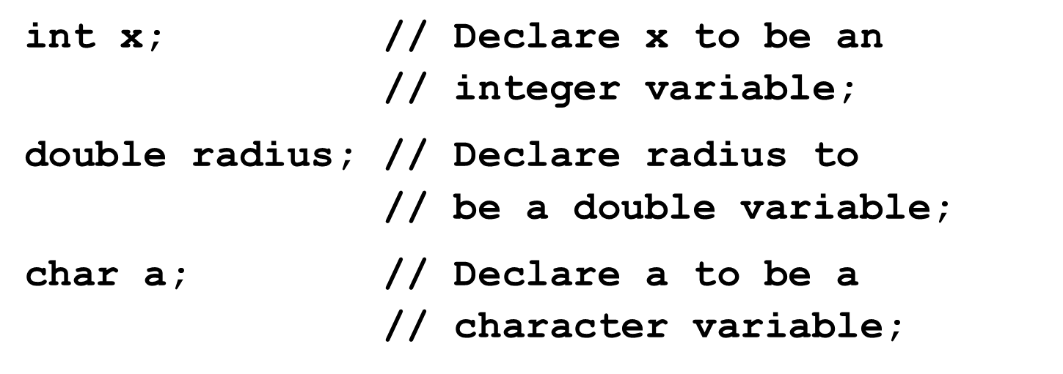
Declaring Variables

Slide 16
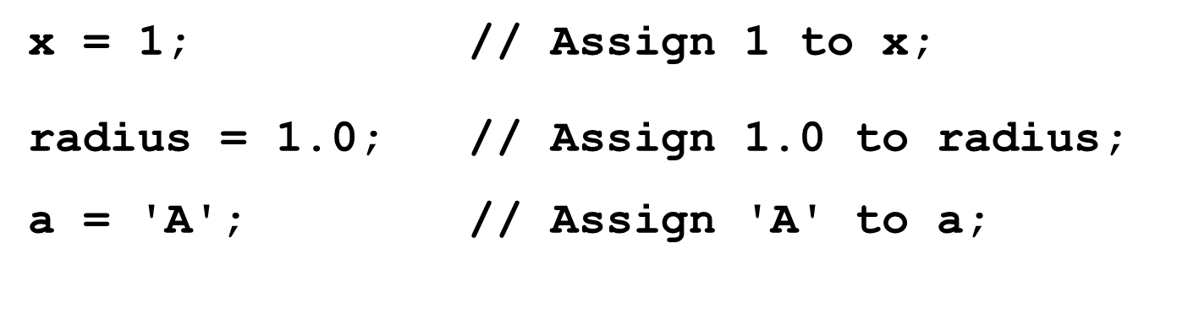
Assignment Statements

Slide 17
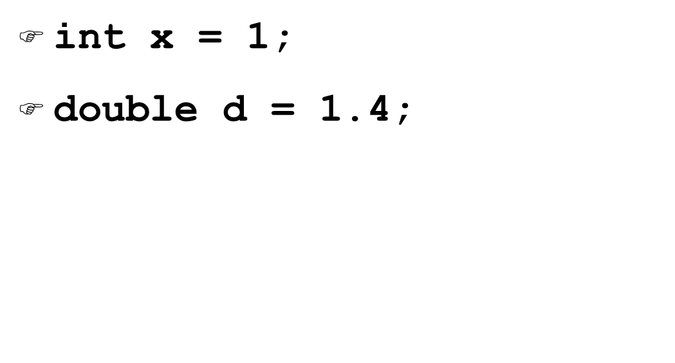
Declaring and Initializing in One Step

Slide 18
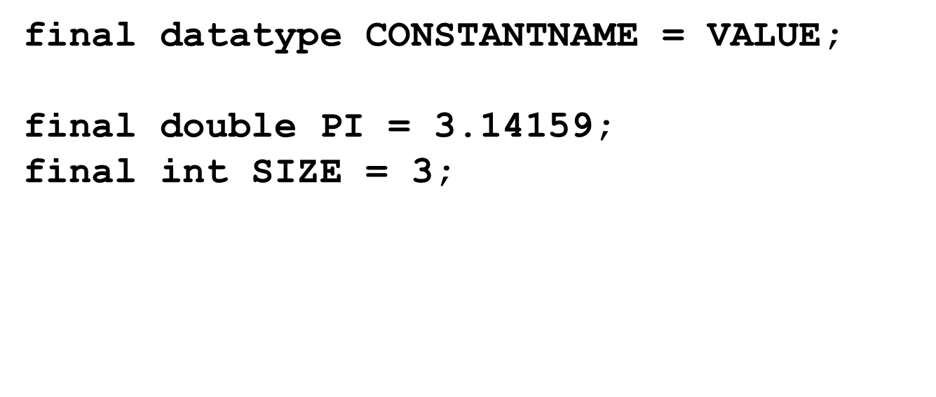
Named Constants

Slide 19
Naming Conventions
Choose meaningful and descriptive names.
Variables and method names:
Use lowercase. If the name consists of several words, concatenate all in one, use lowercase for the first word, and capitalize the first letter of each subsequent word in the name. For example, the variables radius and area, and the method computeArea.

Slide 20
Naming Conventions, cont.
Class names:
Capitalize the first letter of each word in the name. For example, the class name ComputeArea.
Constants:
Capitalize all letters in constants, and use underscores to connect words. For example, the constant P I and MAX_VALUE

Slide 21
Numerical Data Types (1 of 2)
Name | Range | Storage Size
byte | -27 to 27 - 1 (-128 to 127) | 8-bit signed
short | 215 to 215 - 1 (-32768 to 32767) | 16-bit signed
int | -231 to 231 - 1 (-2147483648 to 2147483647) | 32-bit signed
long | -263 to 263 - 1(i.e., -9223372036854775808 to 9223372036854775807) | 64-bit signed

Slide 22
Numerical Data Types (2 of 2)
Name | Range | Storage Size
float | Negative range: -3.4028235E+38 to -1.4E-45 Positive range: 1.4E-45 to 3.4028235E+38 | 32-bit IEEE 754
double | Negative range:-1.7976931348623157E+308 to -4.9E-324 Positive range: 4.9E-324 to 1.7976931348623157E+308 | 64-bit IEEE 754

Slide 23
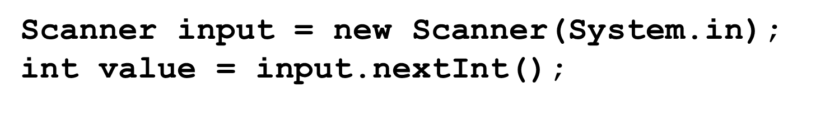
Reading Numbers from the Keyboard (1 of 2)

Slide 24
Reading Numbers from the Keyboard (2 of 2)
Method | Description
nextByte() | reads an integer of the byte type.
nextShort() | reads an integer of the short type.
nextInt() | reads an integer of the int type.
nextLong() | reads an integer of the long type.
nextFloat() | reads a number of the float type.
nextDouble() | reads a number of the double type.

Slide 25
Numeric Operators
Name | Meaning | Example | Result
+ | Addition | 34 + 1 | 35
- | Subtraction | 34.0 - 0.1 | 33.9
* | Multiplication | 300 * 30 | 9000
/ | Division | 1.0 / 2.0 | 0.5
% | Remainder | 20 % 3 | 2

Slide 26
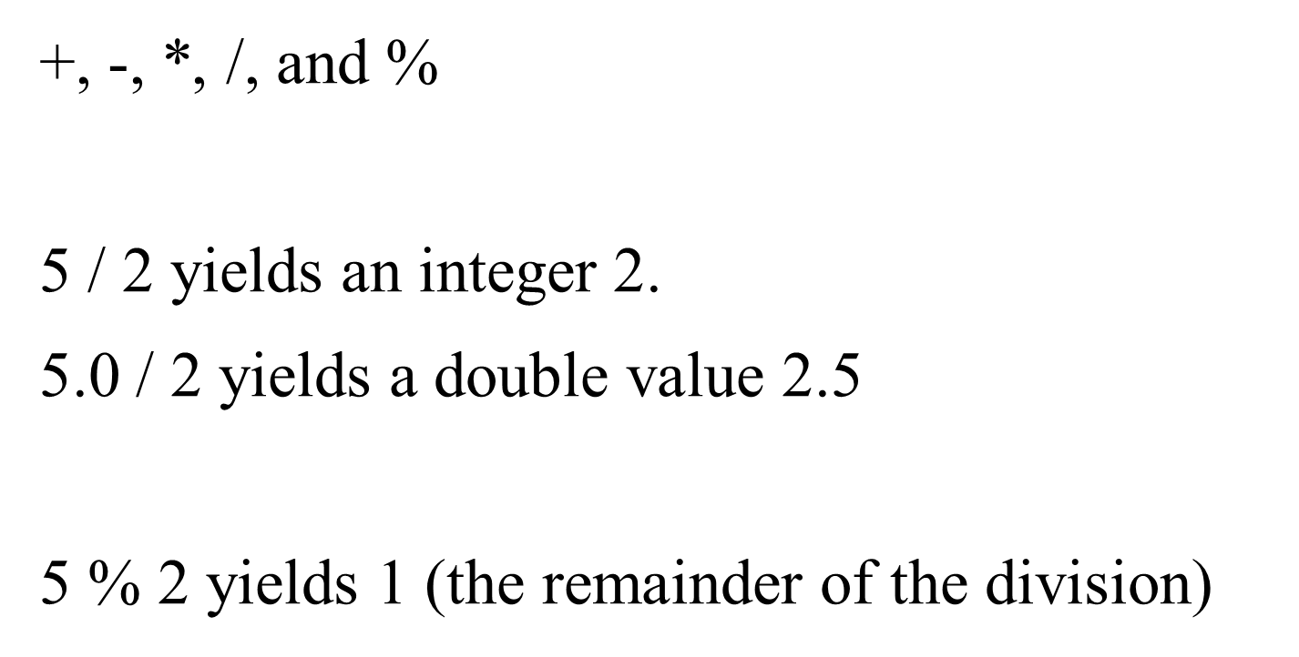
Integer Division

Slide 27
Remainder Operator
Remainder is very useful in programming. For example, an even number % 2 is always 0 and an odd number % 2 is always 1. So you can use this property to determine whether a number is even or odd. Suppose today is Saturday and you and your friends are going to meet in 10 days. What day is in 10 days? You can find that day is Tuesday using the following expression:

Slide 28
Problem: Displaying Time
Write a program that obtains minutes and remaining seconds from seconds.
DisplayTime
Run

Slide 29
Note
Calculations involving floating-point numbers are approximated because these numbers are not stored with complete accuracy. For example,
System.out.println(1.0 - 0.1 - 0.1 - 0.1 - 0.1 - 0.1);
displays 0.5000000000000001, not 0.5, and
System.out.println(1.0 - 0.9);
displays 0.09999999999999998, not 0.1. Integers are stored precisely. Therefore, calculations with integers yield a precise integer result.

Slide 30
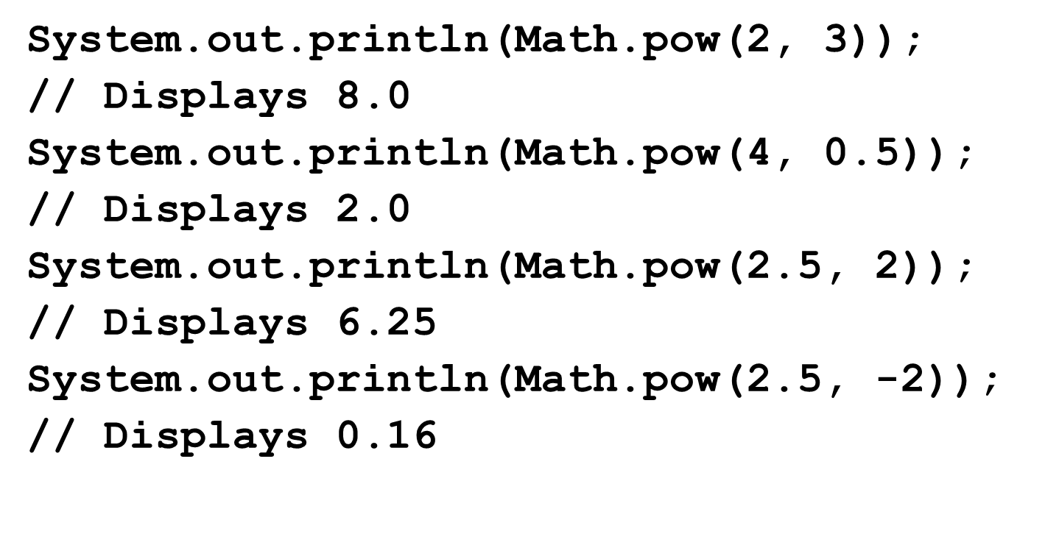
Exponent Operations

Slide 31
Number Literals
A literal is a constant value that appears directly in the program. For example, 34, 1,000,000, and 5.0 are literals in the following statements:
int i = 34;
long x = 1000000;
double d = 5.0;

Slide 32
Integer Literals
An integer literal can be assigned to an integer variable as long as it can fit into the variable. A compilation error would occur if the literal were too large for the variable to hold. For example, the statement byte b=1000 would cause a compilation error, because 1000 cannot be stored in a variable of the byte type.
An integer literal is assumed to be of the int type, whose value is between
(-2147483648) to
(2147483647).
To denote an integer literal of the long type, append it with the letter L or l. L is preferred because l (lowercase L) can easily be confused with 1 (the digit one).

Slide 33
Floating-Point Literals
Floating-point literals are written with a decimal point. By default, a floating-point literal is treated as a double type value. For example, 5.0 is considered a double value, not a float value. You can make a number a float by appending the letter f or F, and make a number a double by appending the letter d or D. For example, you can use 100.2f or 100.2F for a float number, and 100.2d or 100.2D for a double number.

Slide 34
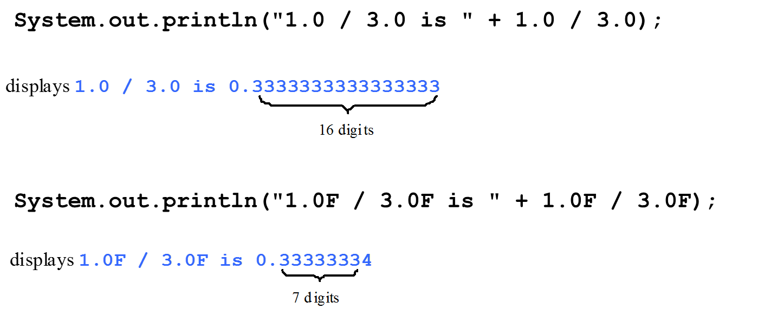
double versus float
The double type values are more accurate than the float type values. For example,

Slide 35
Scientific Notation
Floating-point literals can also be specified in scientific notation, for example, 1.23456e+2, same as 1.23456e2, is equivalent to 123.456, and 1.23456e-2 is equivalent to 0.0123456. E (or e) represents an exponent and it can be either in lowercase or uppercase.

Slide 36
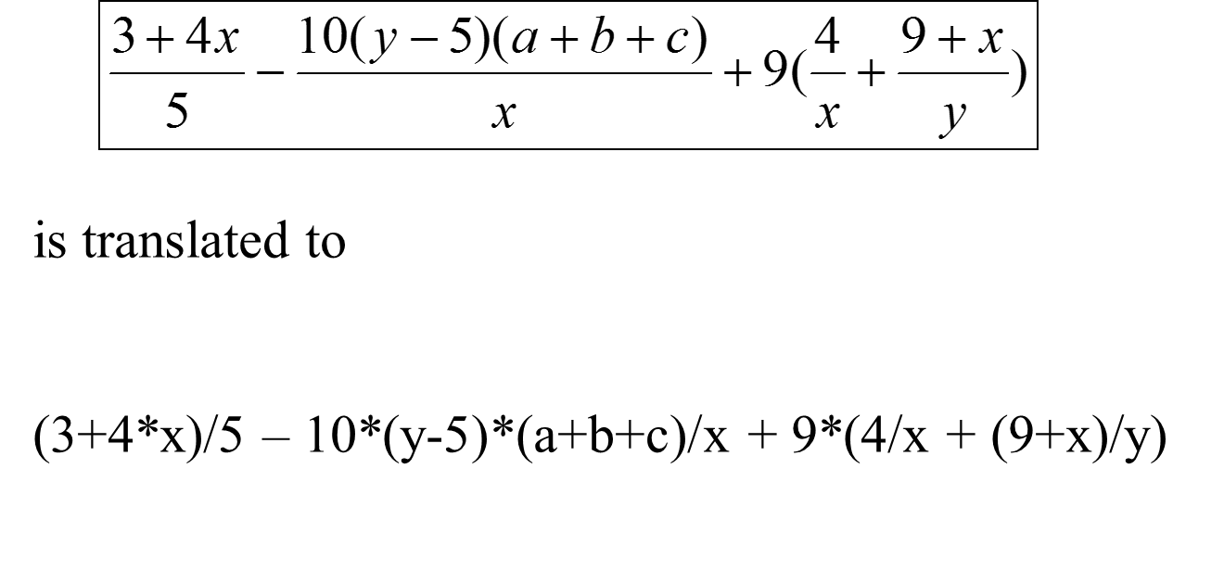
Arithmetic Expressions

Slide 37
How to Evaluate an Expression
Though Java has its own way to evaluate an expression behind the scene, the result of a Java expression and its corresponding arithmetic expression are the same. Therefore, you can safely apply the arithmetic rule for evaluating a Java expression.

Slide 38
Problem: Converting Temperatures
Write a program that converts a Fahrenheit degree to Celsius using the formula:
Note: you have to write
FahrenheitToCelsius
Run

Slide 39
Problem: Displaying Current Time
Write a program that displays current time in G M T in the format hour:minute:second such as 1:45:19.
The currentTimeMillis method in the System class returns the current time in milliseconds since the midnight, January 1, 1970 G M T. (1970 was the year when the Unix operating system was formally introduced.) You can use this method to obtain the current time, and then compute the current second, minute, and hour as follows.
ShowCurrentTime
Run

Slide 40
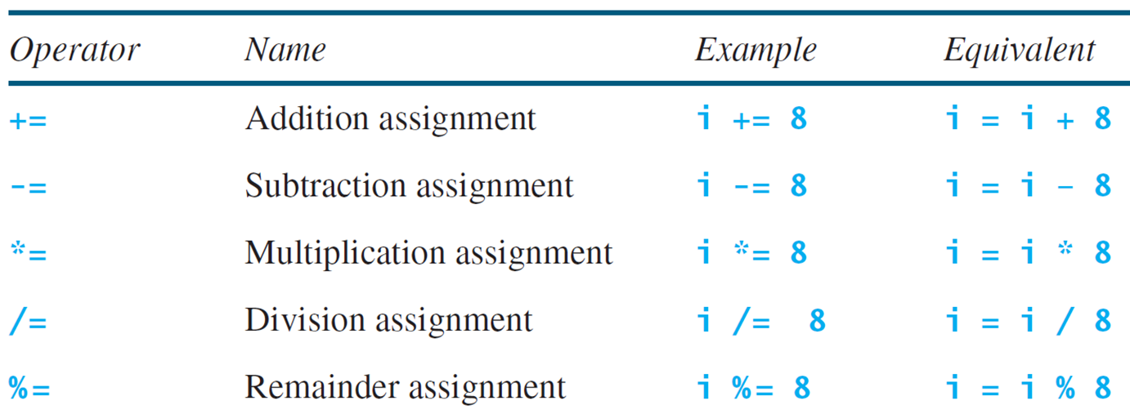
Augmented Assignment Operators

Slide 41
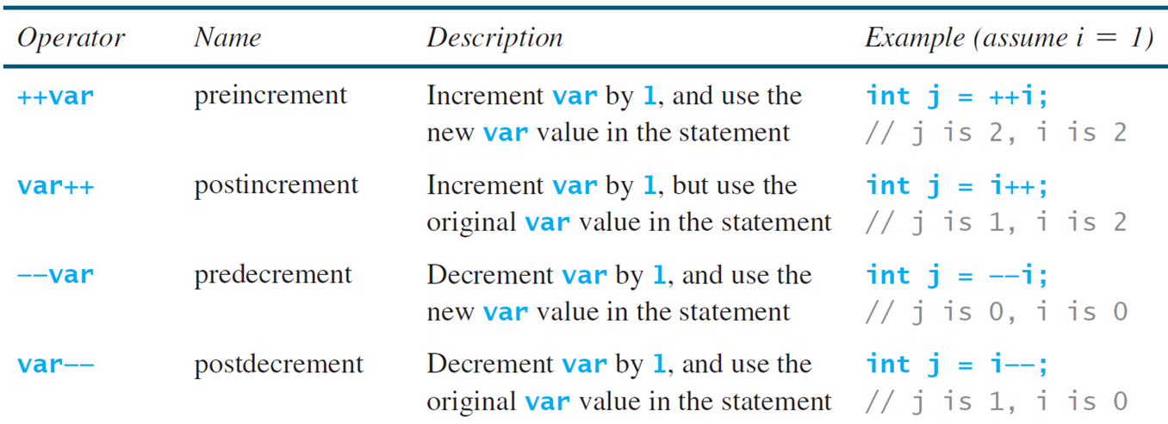
Increment and Decrement Operators

Slide 42
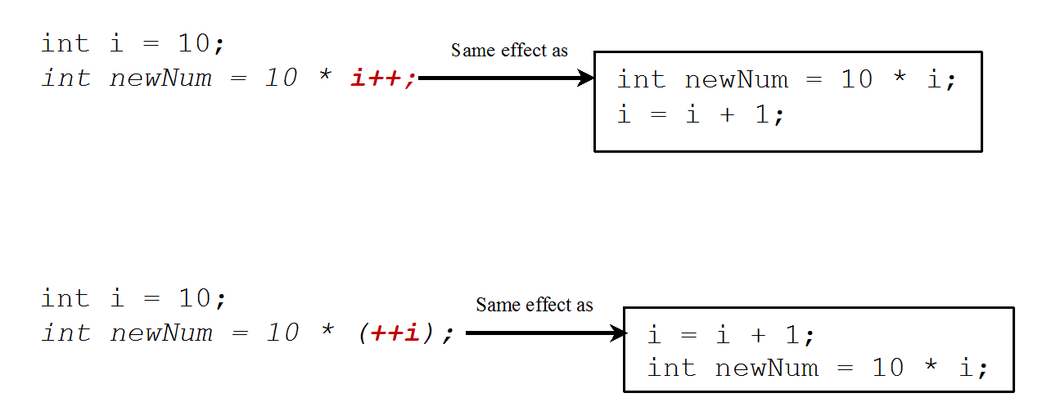
Increment and Decrement Operators, cont. (1 of 2)

Slide 43
Increment and Decrement Operators, cont. (2 of 2)
Using increment and decrement operators makes expressions short, but it also makes them complex and difficult to read. Avoid using these operators in expressions that modify multiple variables, or the same variable for multiple times such as this: int k = ++i + i.

Slide 44
Assignment Expressions and Assignment Statements
Prior to Java 2, all the expressions can be used as statements. Since Java 2, only the following types of expressions can be statements:
variable op= expression; // Where op is +, -, *, /, or %
++variable;
variable++;
--variable;
Variable--;

Slide 45
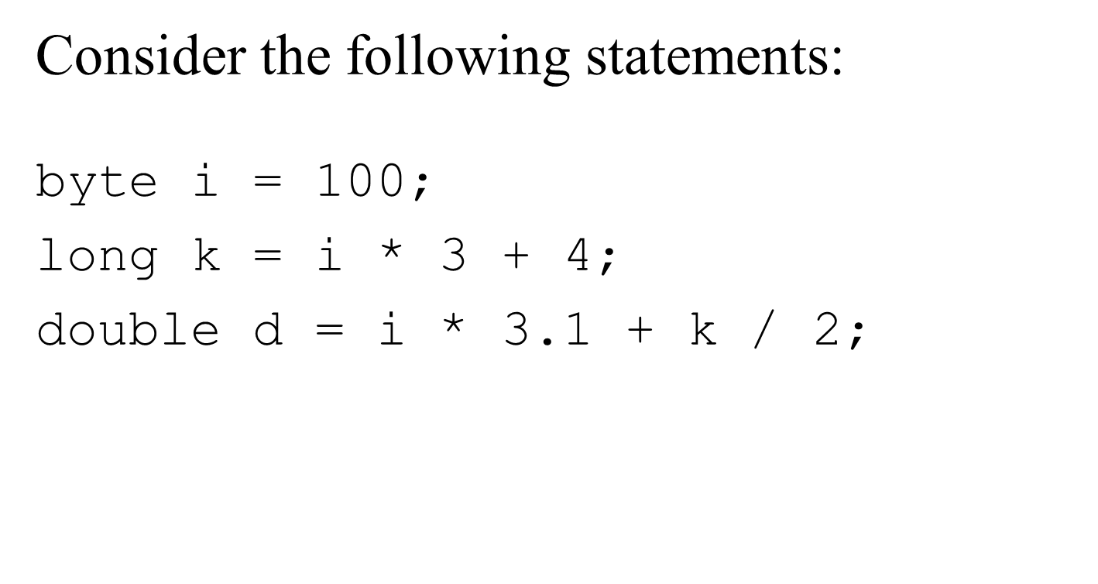
Numeric Type Conversion

Slide 46
Conversion Rules
When performing a binary operation involving two operands of different types, Java automatically converts the operand based on the following rules:
If one of the operands is double, the other is converted into double.
Otherwise, if one of the operands is float, the other is converted into float.
Otherwise, if one of the operands is long, the other is converted into long.
Otherwise, both operands are converted into int.

Slide 47
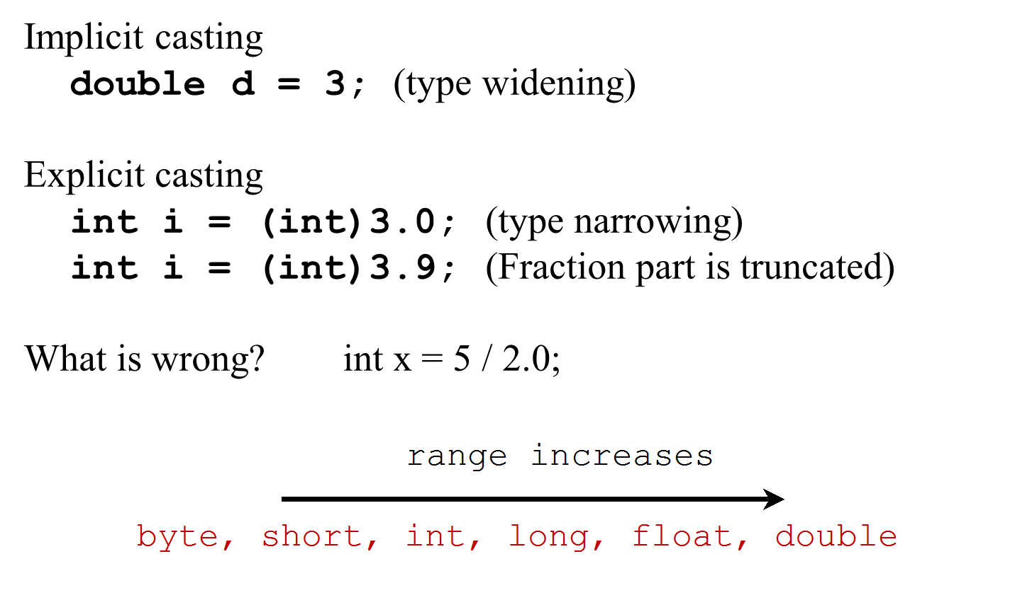
Type Casting

Slide 48
Problem: Keeping Two Digits After Decimal Points
Write a program that displays the sales tax with two digits after the decimal point.
SalesTax
Run

Slide 49
Casting in an Augmented Expression
In Java, an augmented expression of the form x1 op= x2 is
implemented as
where T is the type for
x1. Therefore, the following code is correct.
int sum = 0;
sum += 4.5; // sum becomes 4 after this statement
sum += 4.5 is equivalent to

Slide 50
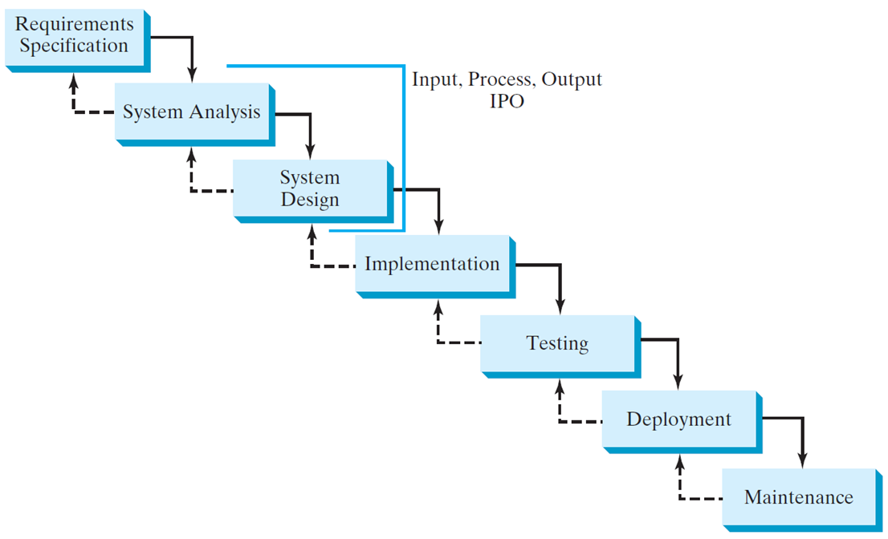
Software Development Process

Slide 51
Requirement Specification
A formal process that seeks to understand the problem and document in detail what the software system needs to do. This phase involves close interaction between users and designers.
Most of the examples in this book are simple, and their requirements are clearly stated. In the real world, however, problems are not well defined. You need to study a problem carefully to identify its requirements.

Slide 52
System Analysis
Seeks to analyze the business process in terms of data flow, and to identify the system’s input and output.
Part of the analysis entails modeling the system’s behavior. The model is intended to capture the essential elements of the system and to define services to the system.

Slide 53
System Design
The process of designing the system’s components.
This phase involves the use of many levels of abstraction to decompose the problem into manageable components, identify classes and interfaces, and establish relationships among the classes and interfaces.

Slide 54
I P O
The essence of system analysis and design is input, process, and output. This is called I P O.

Slide 55
Implementation
The process of translating the system design into programs. Separate programs are written for each component and put to work together.
This phase requires the use of a programming language like Java. The implementation involves coding, testing, and debugging.

Slide 56
Testing
Ensures that the code meets the requirements specification and weeds out bugs.
An independent team of software engineers not involved in the design and implementation of the project usually conducts such testing.

Slide 57
Deployment
Deployment makes the project available for use.
For a Java program, this means installing it on a desktop or on the Web.

Slide 58
Maintenance
Maintenance is concerned with changing and improving the product.
A software product must continue to perform and improve in a changing environment. This requires periodic upgrades of the product to fix newly discovered bugs and incorporate changes.

Slide 59
Problem: Computing Loan Payments
This program lets the user enter the interest rate, number of years, and loan amount, and computes monthly payment and total payment.
ComputeLoan
Run

Slide 60
Problem: Monetary Units
This program lets the user enter the amount in decimal representing dollars and cents and output a report listing the monetary equivalent in single dollars, quarters, dimes, nickels, and pennies. Your program should report maximum number of dollars, then the maximum number of quarters, and so on, in this order.
ComputeChange
Run

Slide 61
Common Errors and Pitfalls
Common Error 1: Undeclared/Uninitialized Variables and Unused Variables
Common Error 2: Integer Overflow
Common Error 3: Round-off Errors
Common Error 4: Unintended Integer Division
Common Error 5: Redundant Input Objects
Common Pitfall 1: Redundant Input Objects

Slide 62
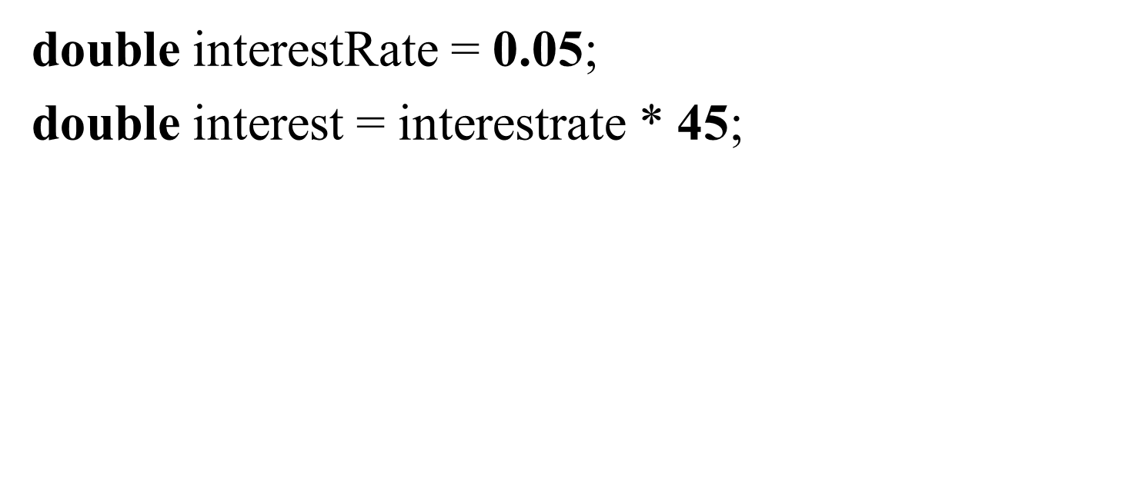
Common Error 1: Undeclared/Uninitialized Variables and Unused Variables

Slide 63
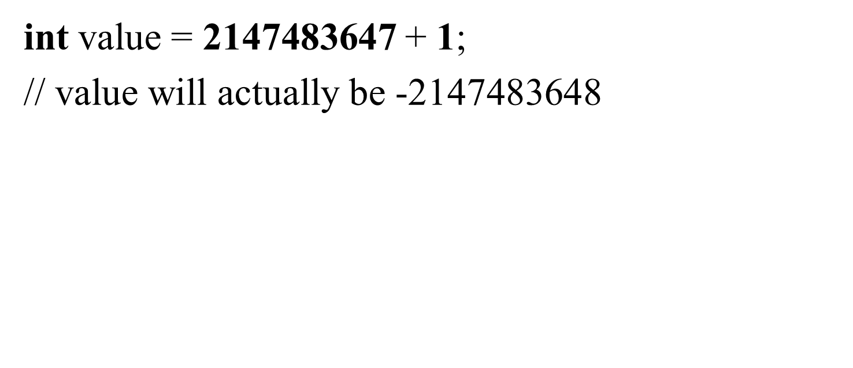
Common Error 2: Integer Overflow

Slide 64
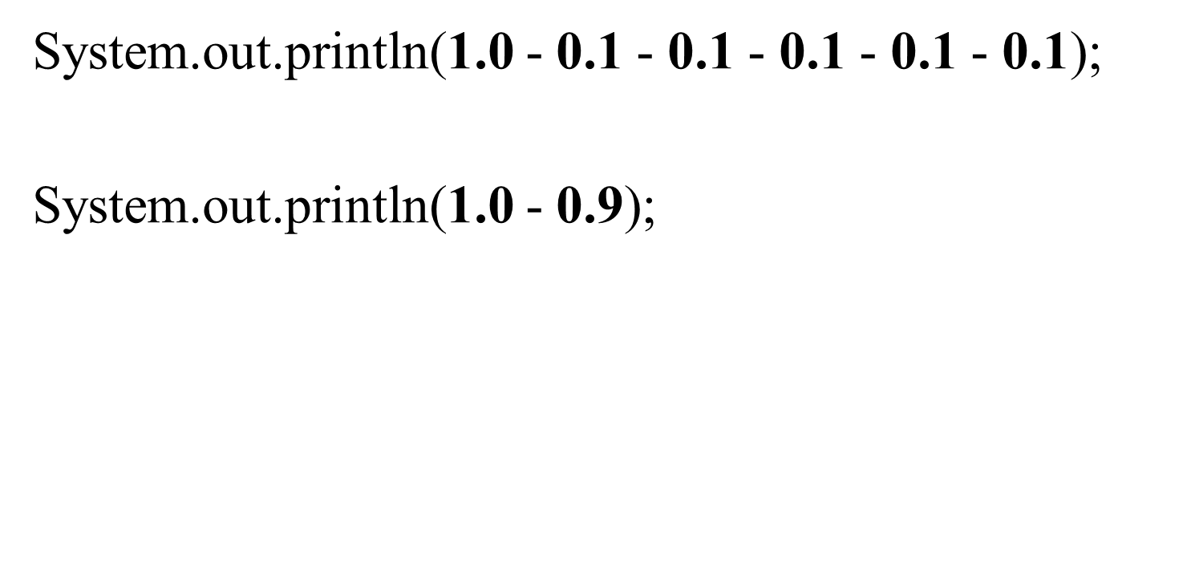
Common Error 3: Round-off Errors

Slide 65
Common Error 4: Unintended Integer Division

Slide 66
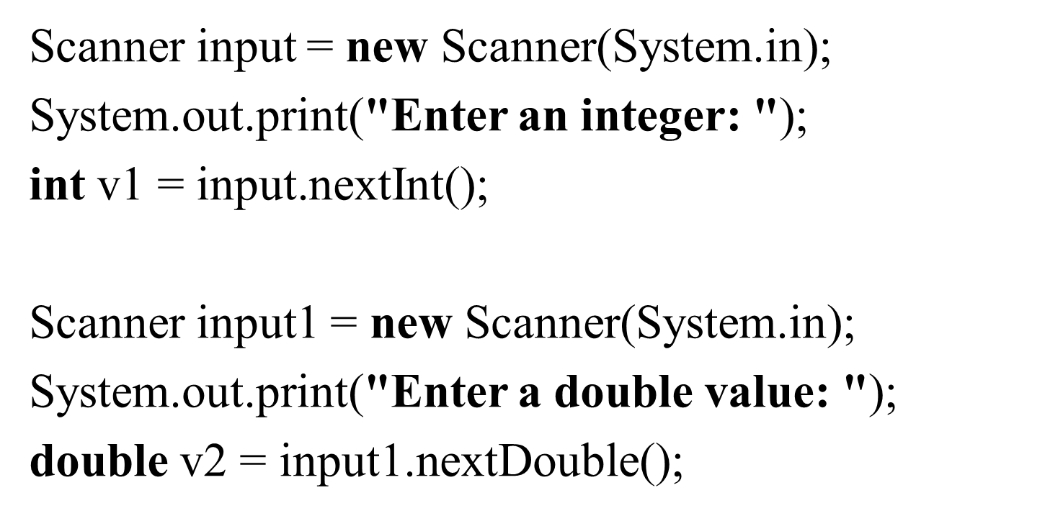
Common Pitfall 1: Redundant Input Objects

Slide 67
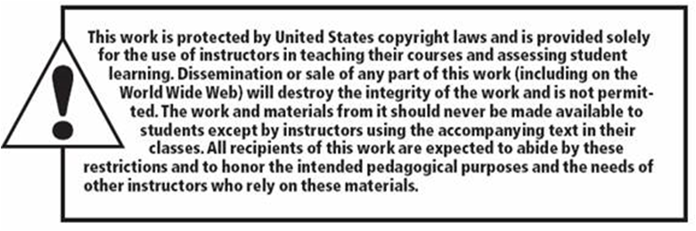
Copyright

