Slide 1
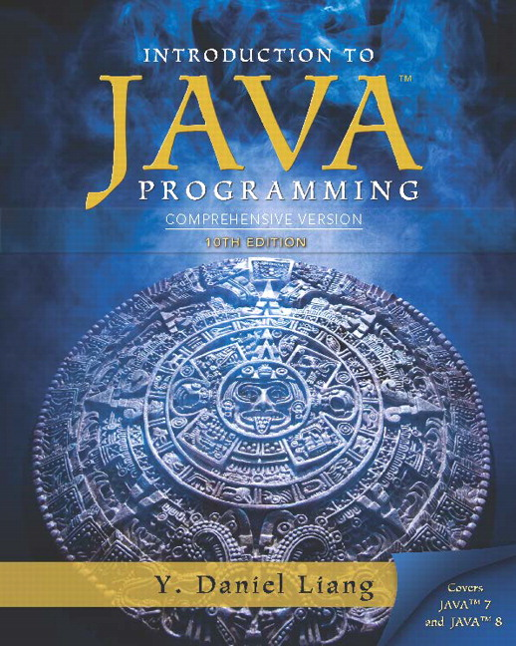
Introduction to Java Programming Comprehensive Version
Tenth Edition
Chapter 3
Selections
Slides in the presentation contain hyperlinks. J A W S users should be able to get a list of links by using INSERT+F7
Copyright © 2015 Pearson Education, Inc. All Rights Reserved
Notes:
If this PowerPoint presentation contains mathematical equations, you may need to check that your computer has the following installed:
1) MathType Plugin
2) Math Player (free versions available)
3) NVDA Reader (free versions available)

Slide 2
Motivations
If you assigned a negative value for radius in Listing 2.2, ComputeAreaWithConsoleInput.java, the program would print an invalid result. If the radius is negative, you don't want the program to compute the area. How can you deal with this situation?

Slide 3
Learning Objectives (1 of 3)
3.1 To declare boolean variables and write Boolean expressions using relational operators (§3.2).
3.2 To implement selection control using one-way if statements (§3.3).
3.3 To implement selection control using two-way if-else statements (§3.4).
3.4 To implement selection control using nested if and multi-way if statements (§3.5).
3.5 To avoid common errors and pitfalls in if statements (§3.6).

Slide 4
Learning Objectives (2 of 3)
3.6 To generate random numbers using the Math.random() method (§3.7).
3.7 To program using selection statements for a variety of examples (SubtractionQuiz, B M I, ComputeTax) (§§3.7-3.9).
3.8 To combine conditions using logical operators (&&, ||, and !) (§3.10).
3.9 To program using selection statements with combined conditions (LeapYear, Lottery) (§§3.11-3.12).
3.10 To implement selection control using switch statements (§3.13).

Slide 5
Learning Objectives (3 of 3)
3.11 To write expressions using the conditional expression (§3.14).
3.12 To examine the rules governing operator precedence and associativity (§3.15).
3.13 To apply common techniques to debug errors (§3.16).

Slide 6
The boolean Type and Operators
Often in a program you need to compare two values, such as whether i is greater than j. Java provides six comparison operators (also known as relational operators) that can be used to compare two values. The result of the comparison is a Boolean value: true or false.
boolean b = (1 > 2);

Slide 7
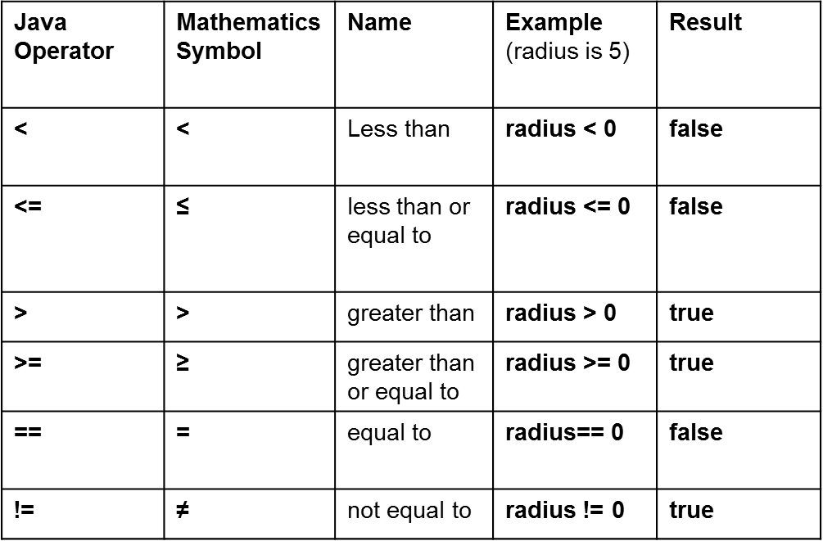
Relational Operators

Slide 8
Problem: A Simple Math Learning Tool
This example creates a program to let a first grader practice additions. The program randomly generates two single-digit integers number1 and number2 and displays a question such as “What is 7 + 9?” to the student. After the student types the answer, the program displays a message to indicate whether the answer is true or false.
IMPORTANT NOTE: If you cannot run the buttons, see www.cs.armstrong.edu/liang/javaslidenote.doc.
AdditionQuiz
Run

Slide 9
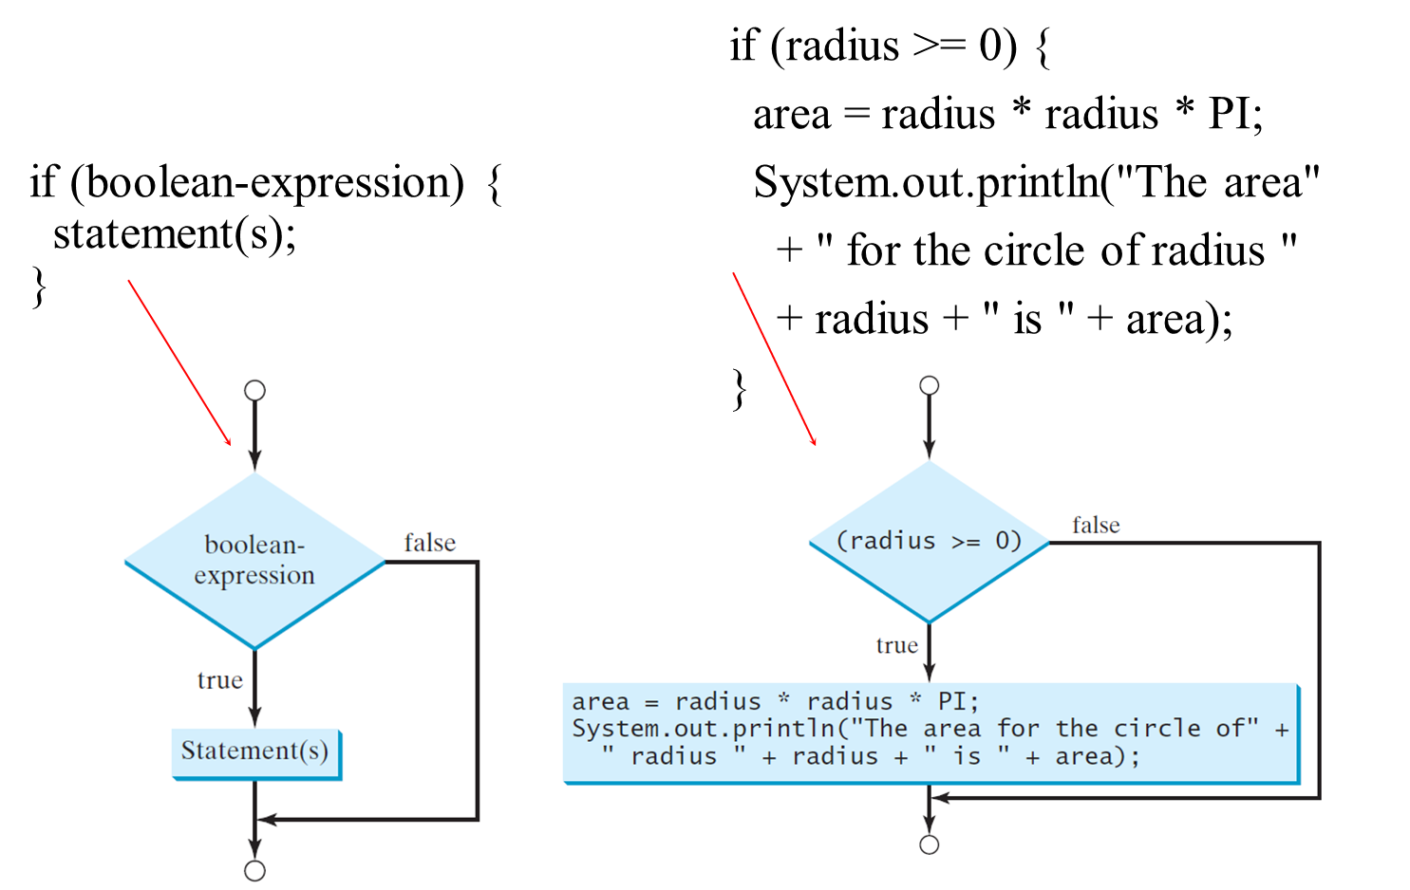
One-way if Statements

Slide 10
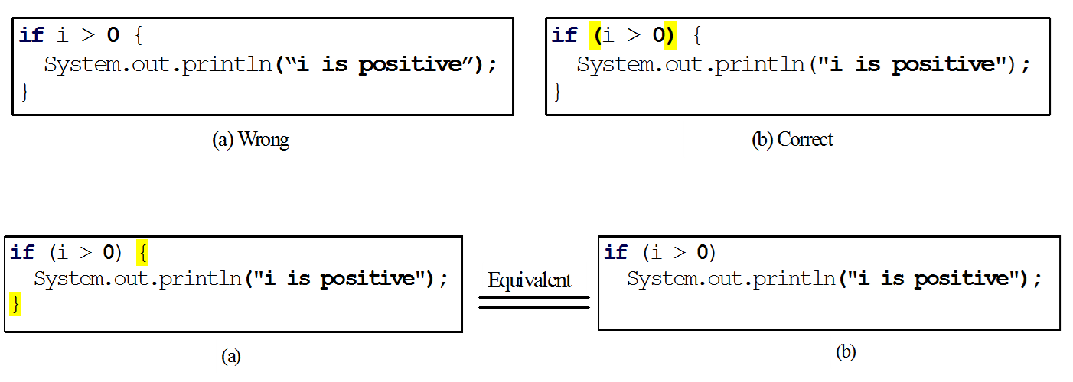
Note

Slide 11
Simple if Demo
Write a program that prompts the user to enter an integer. If the number is a multiple of 5, print HiFive. If the number is divisible by 2, print HiEven.
SimpleIfDemo
Run

Slide 12
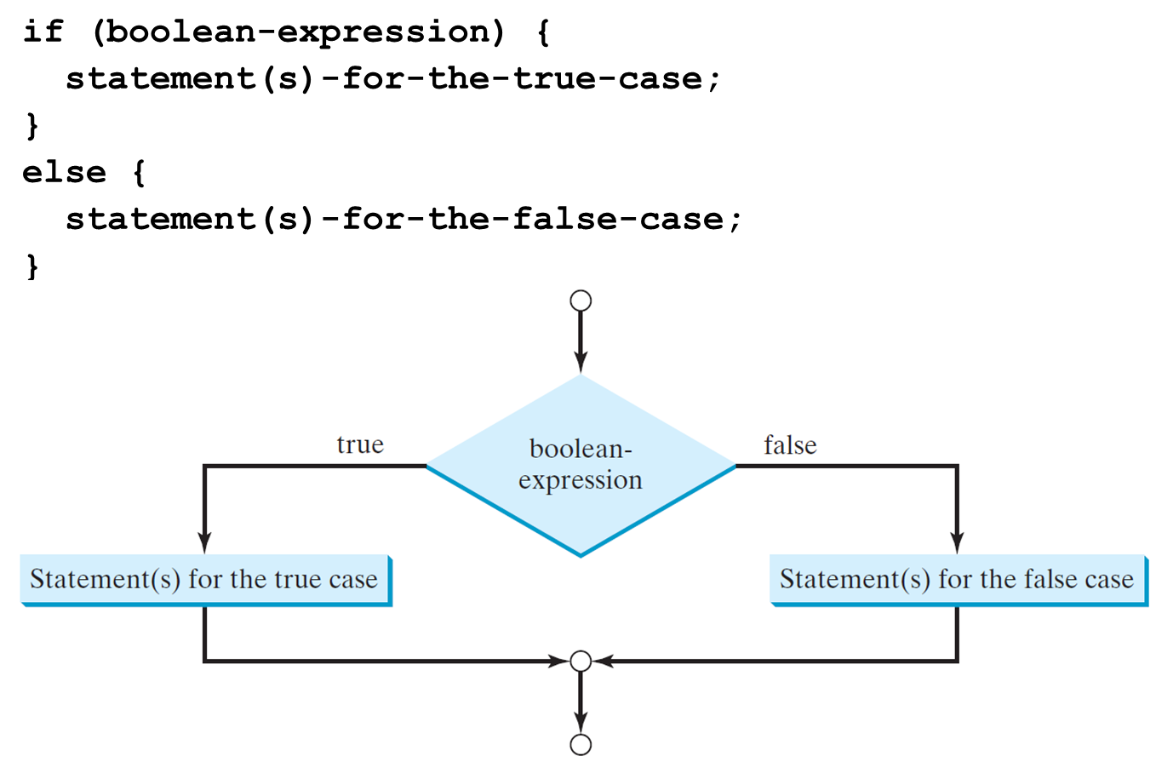
The Two-way if Statement

Slide 13
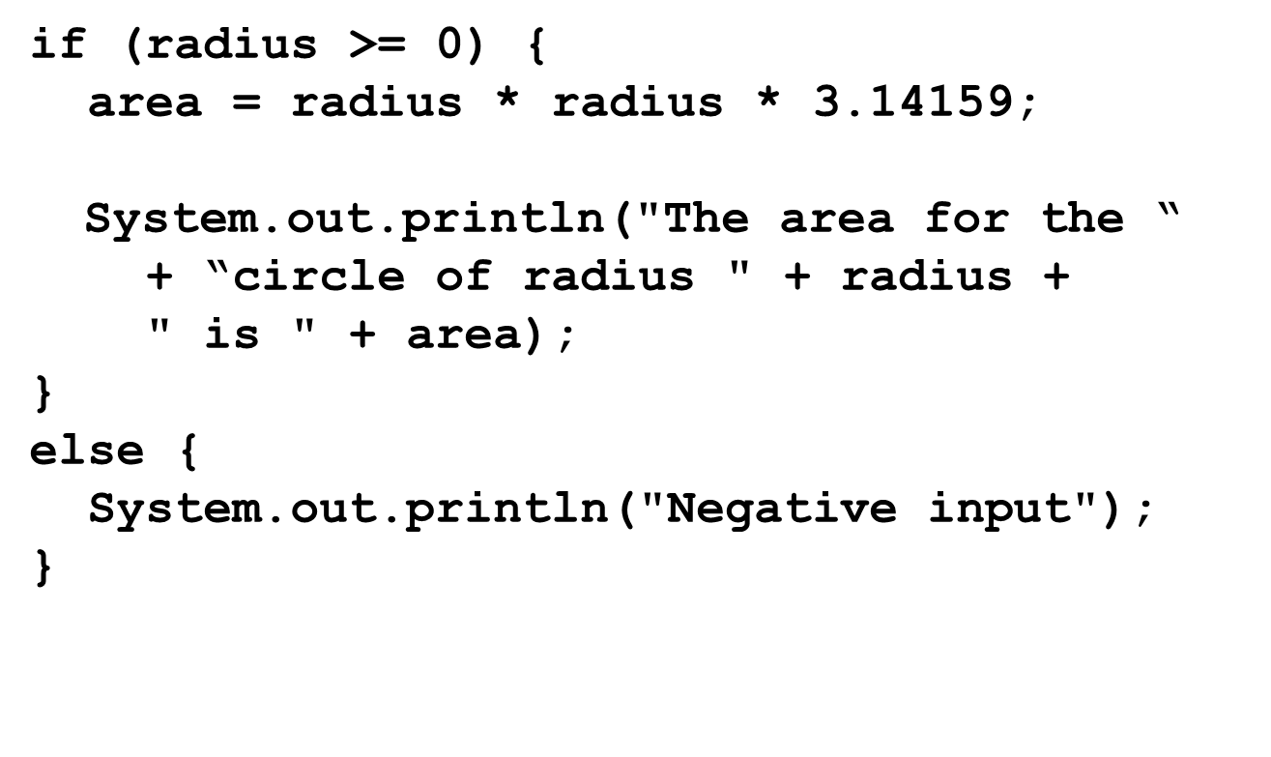
if-else Example

Slide 14
Multiple Alternative if Statements

Slide 15
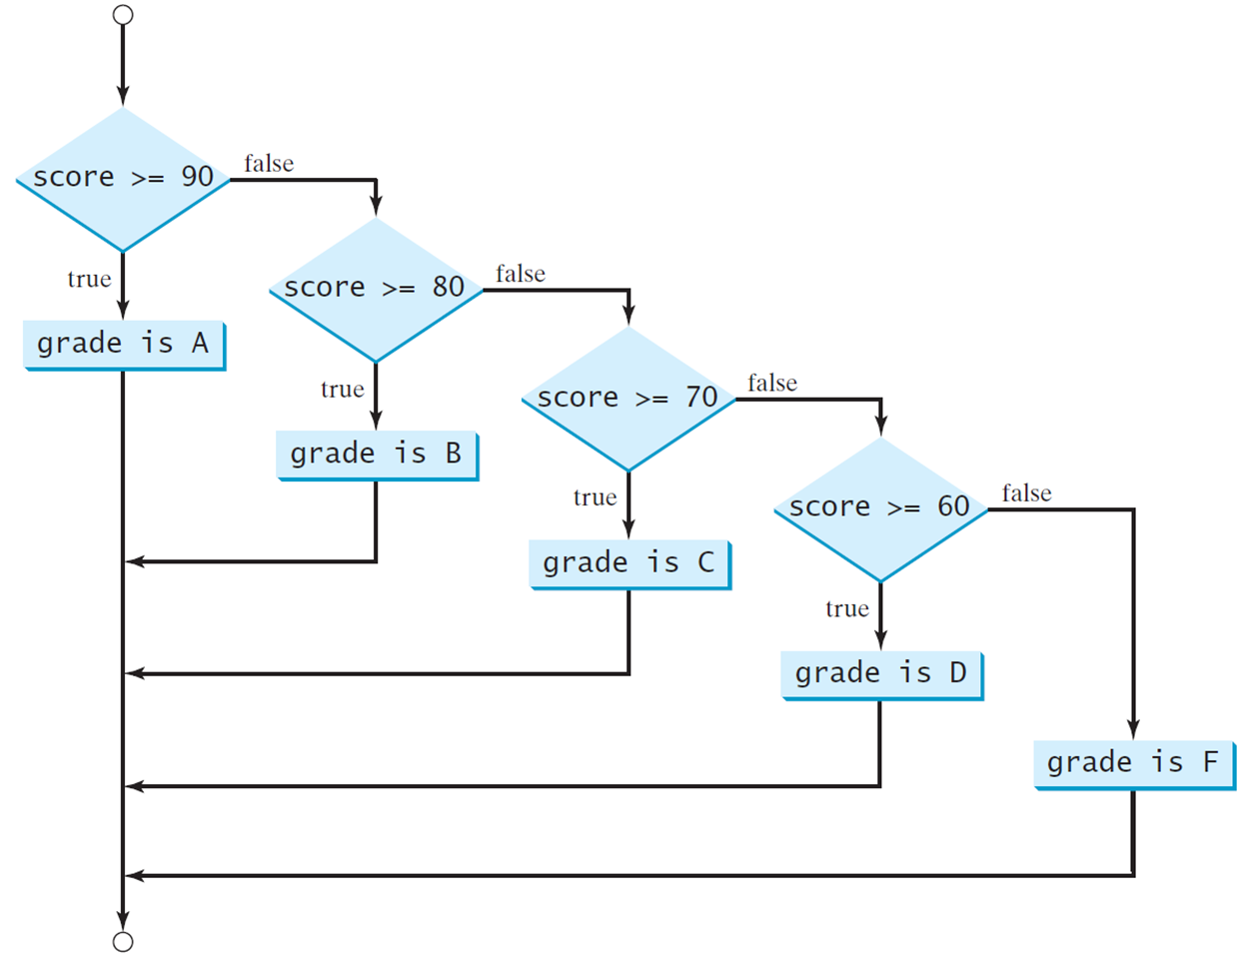
Multi-Way if-else Statements

Slide 16
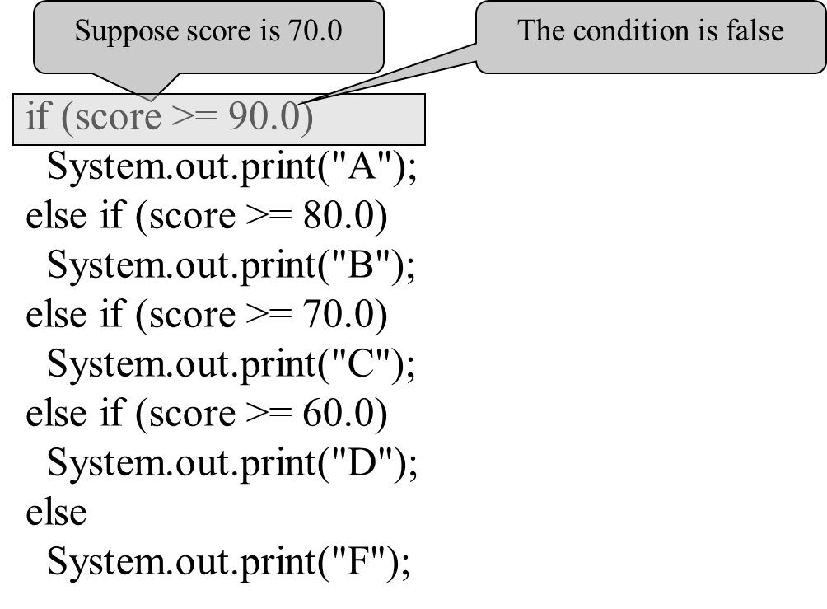
Trace if-else statement (1 of 5)

Slide 17
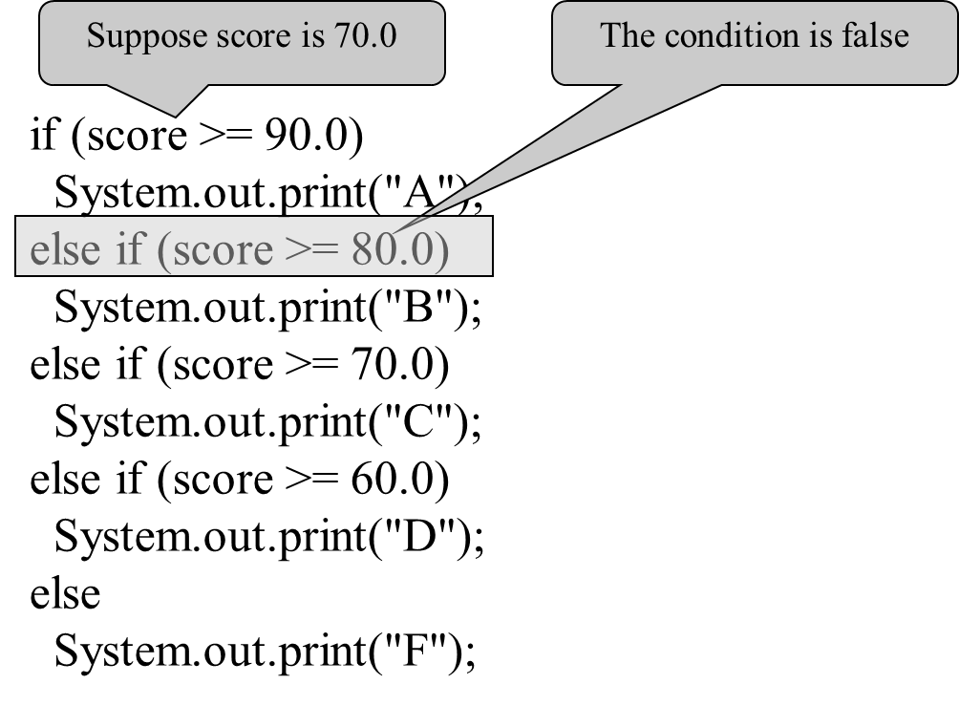
Trace if-else statement (2 of 5)

Slide 18
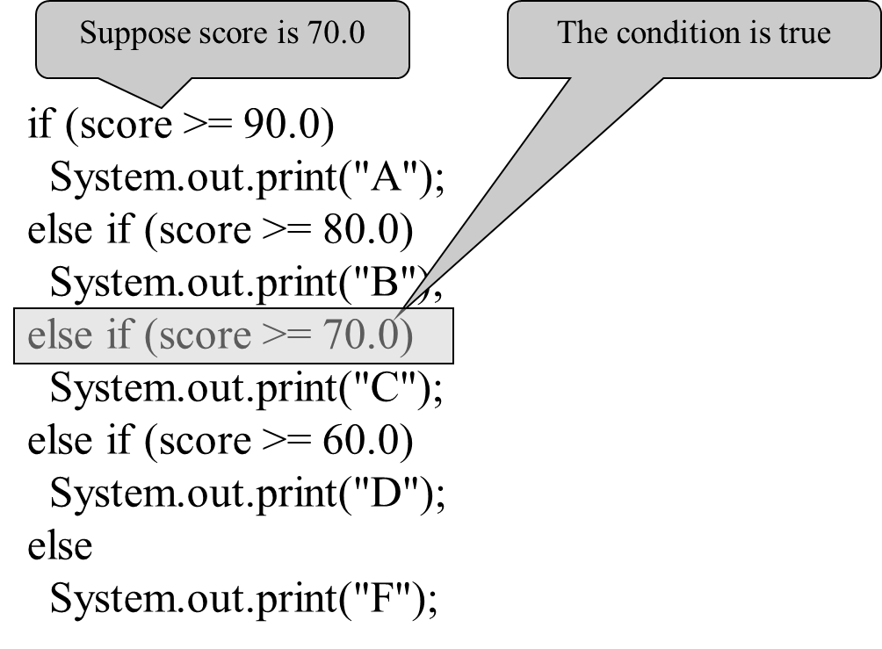
Trace if-else statement (3 of 5)

Slide 19
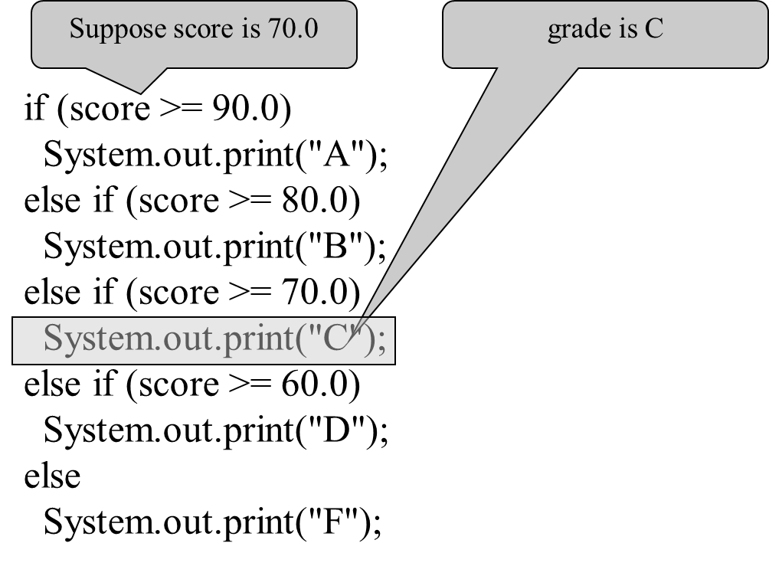
Trace if-else statement (4 of 5)

Slide 20
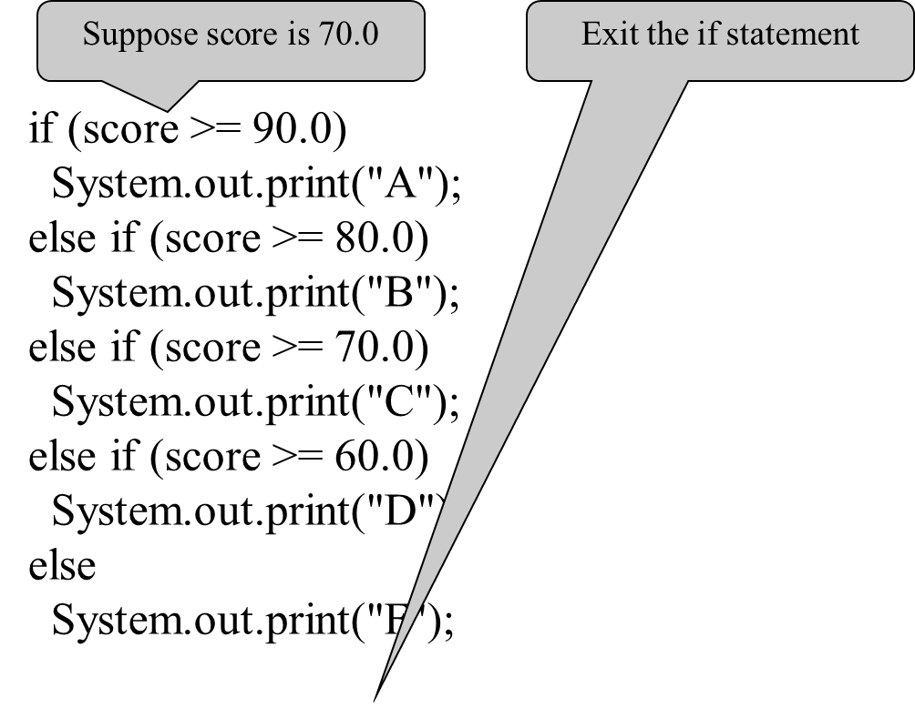
Trace if-else statement (5 of 5)

Slide 21
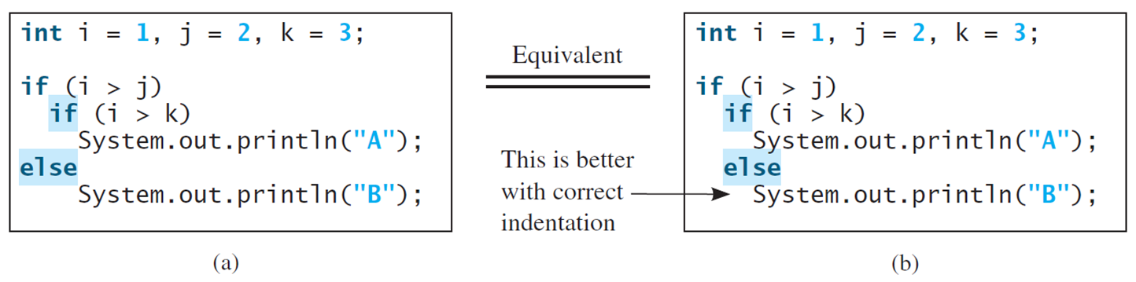
Note (1 of 2)
The else clause matches the most recent if clause in the same block.

Slide 22
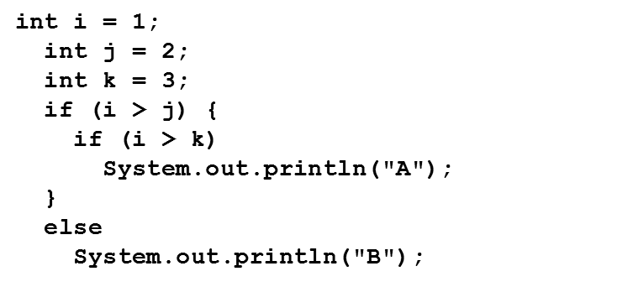
Note (2 of 2)
Nothing is printed from the preceding statement. To force the else clause to match the first if clause, you must add a pair of braces:
This statement prints B.

Slide 23
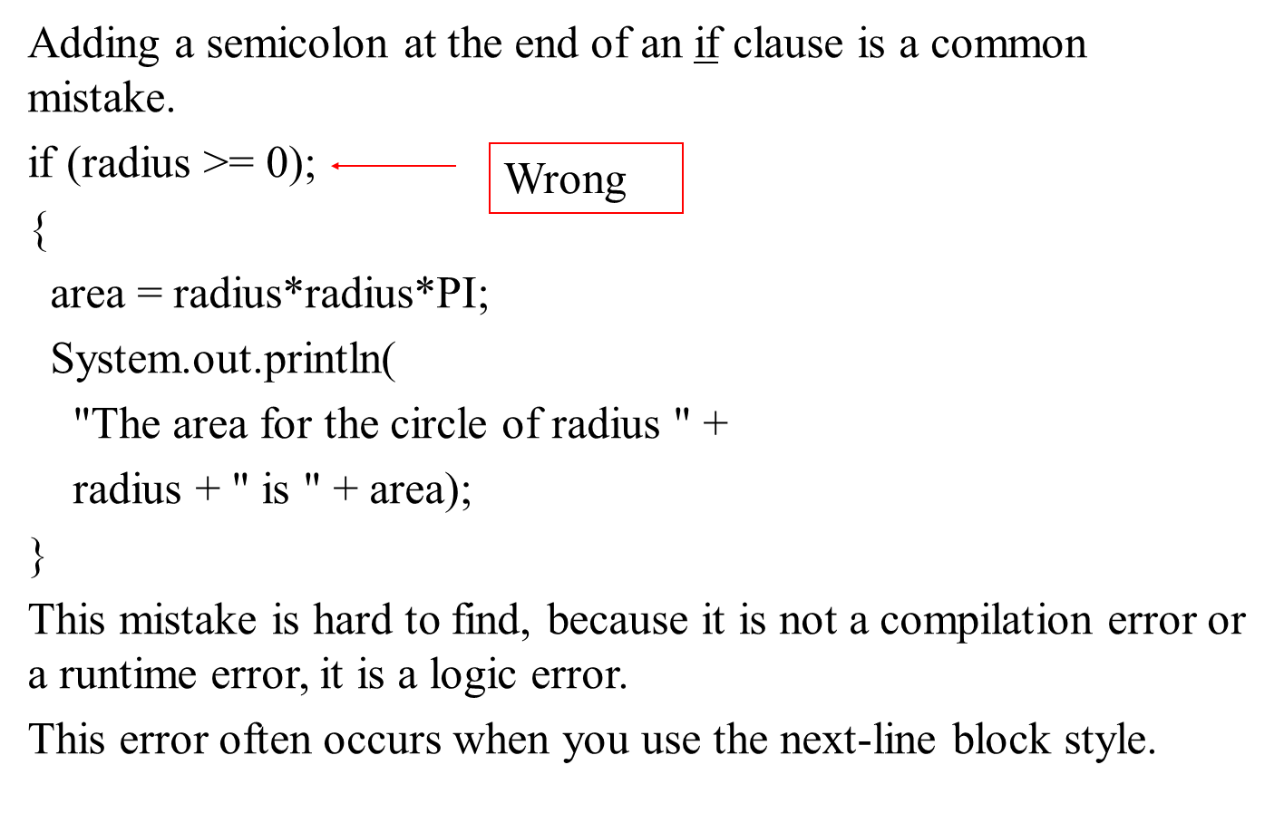
Common Errors

Slide 24
T I P

Slide 25
Caution

Slide 26
Problem: An Improved Math Learning Tool
This example creates a program to teach a first grade child how to learn subtractions. The program randomly generates two single-digit integers number1 and number2 with number1 >= number2 and displays a question such as “What is 9 - 2?” to the student. After the student types the answer, the program displays whether the answer is correct.
SubtractionQuiz
Run

Slide 27
Problem: Body Mass Index
Body Mass Index (B M I) is a measure of health on weight. It can be calculated by taking your weight in kilograms and dividing by the square of your height in meters. The interpretation of B M I for people 16 years or older is as follows:
ComputeAndInterpretBMI
Run

Slide 28
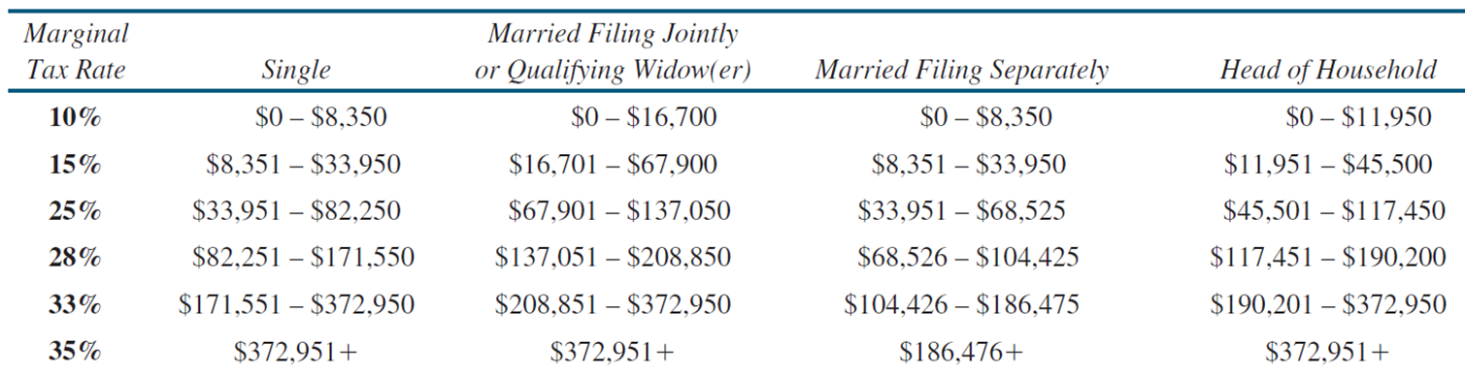
Problem: Computing Taxes (1 of 2)
The U S federal personal income tax is calculated based on the filing status and taxable income. There are four filing statuses: single filers, married filing jointly, married filing separately, and head of household. The tax rates for 2009 are shown below.

Slide 29
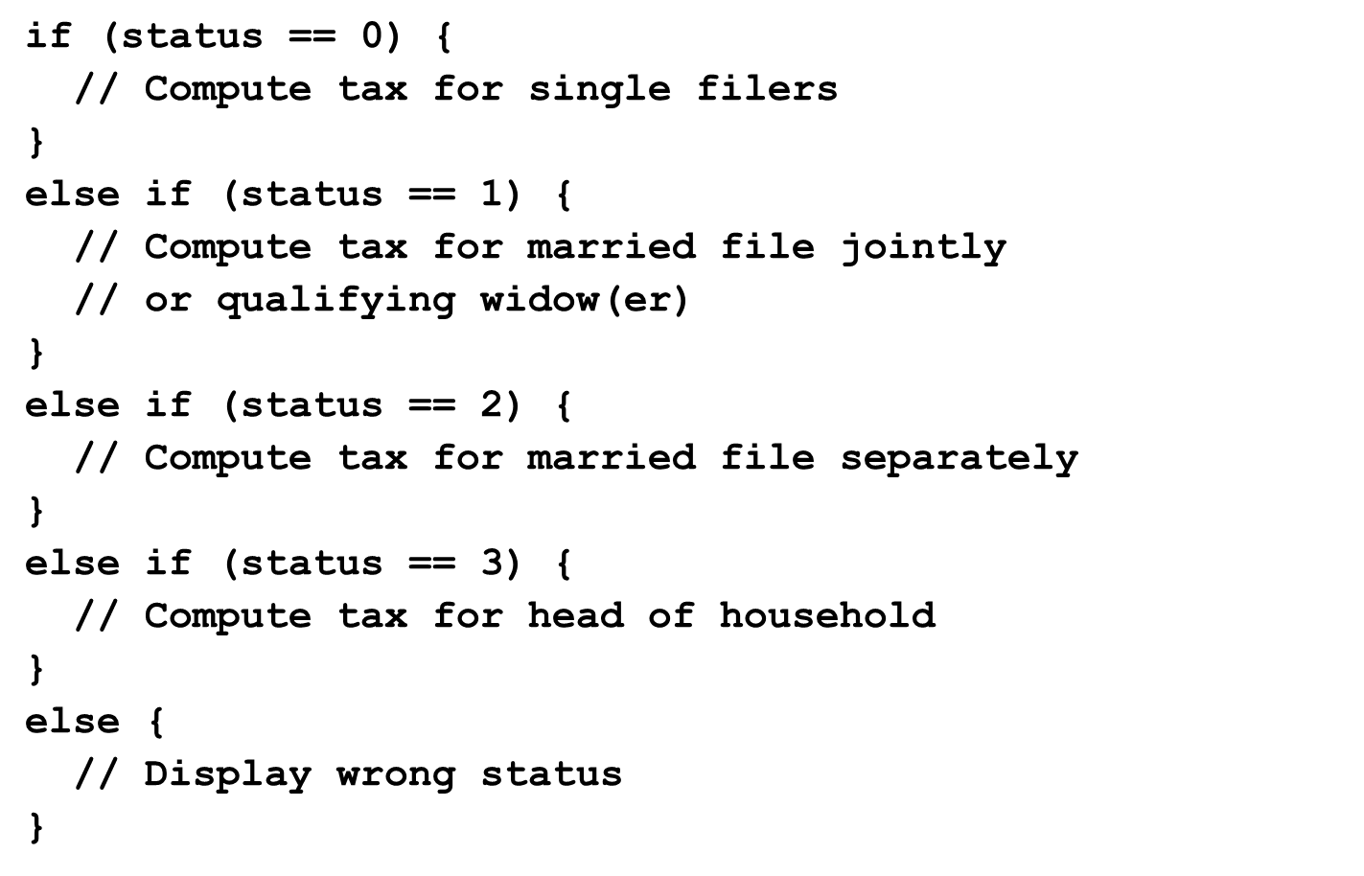
Problem: Computing Taxes (2 of 2)
ComputeTax
Run

Slide 30
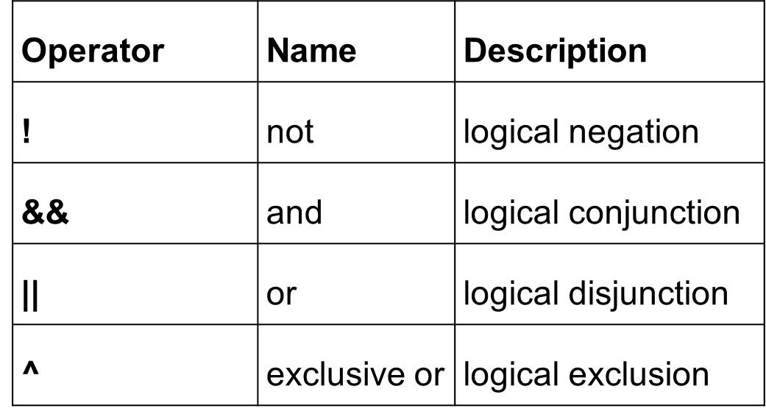
Logical Operators

Slide 31
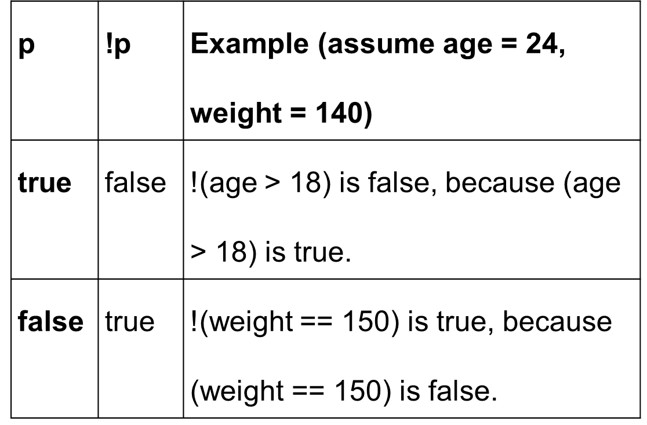
Truth Table for Operator !

Slide 32
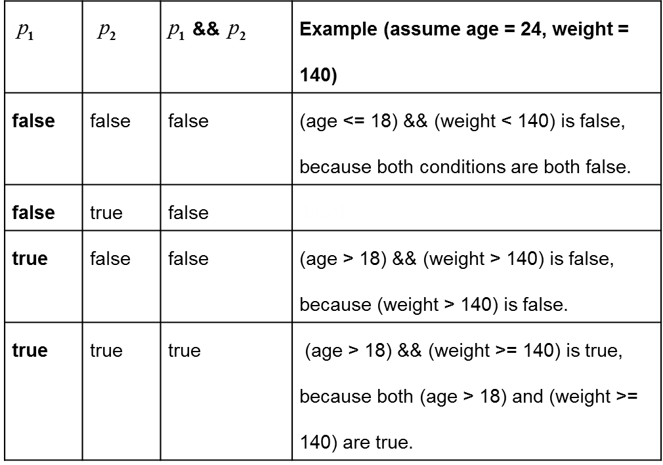
Truth Table for Operator &&

Slide 33
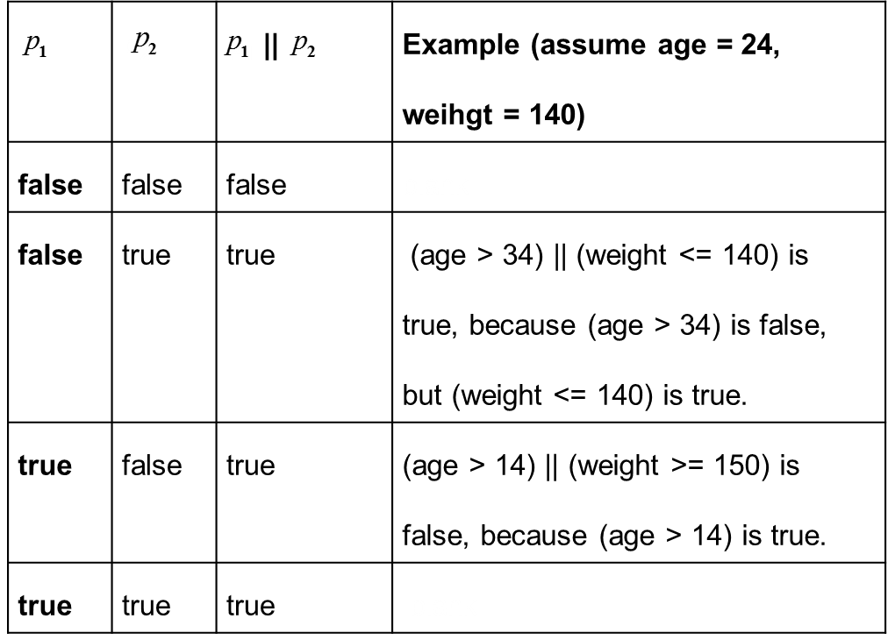
Truth Table for Operator ||

Slide 34
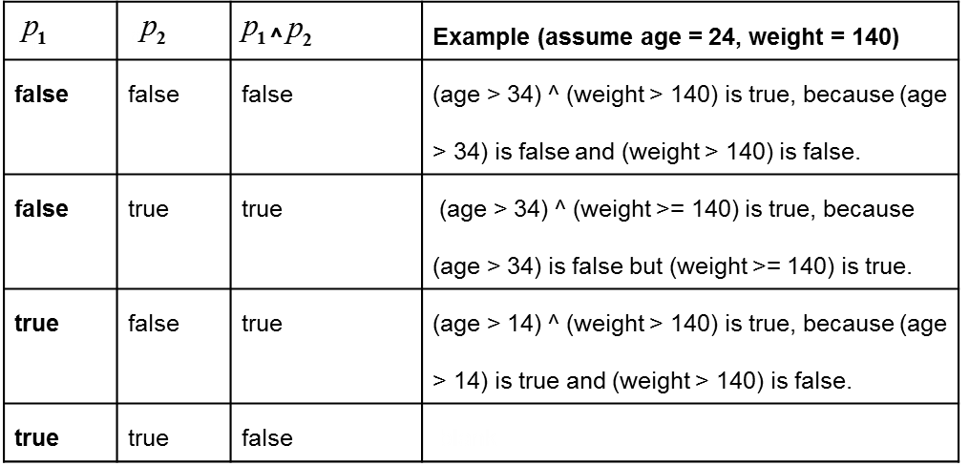
Truth Table for Operator ^

Slide 35
Examples (1 of 2)
Here is a program that checks whether a number is divisible by 2 and 3, whether a number is divisible by 2 or 3, and whether a number is divisible by 2 or 3 but not both:
TestBooleanOperators
Run

Slide 36
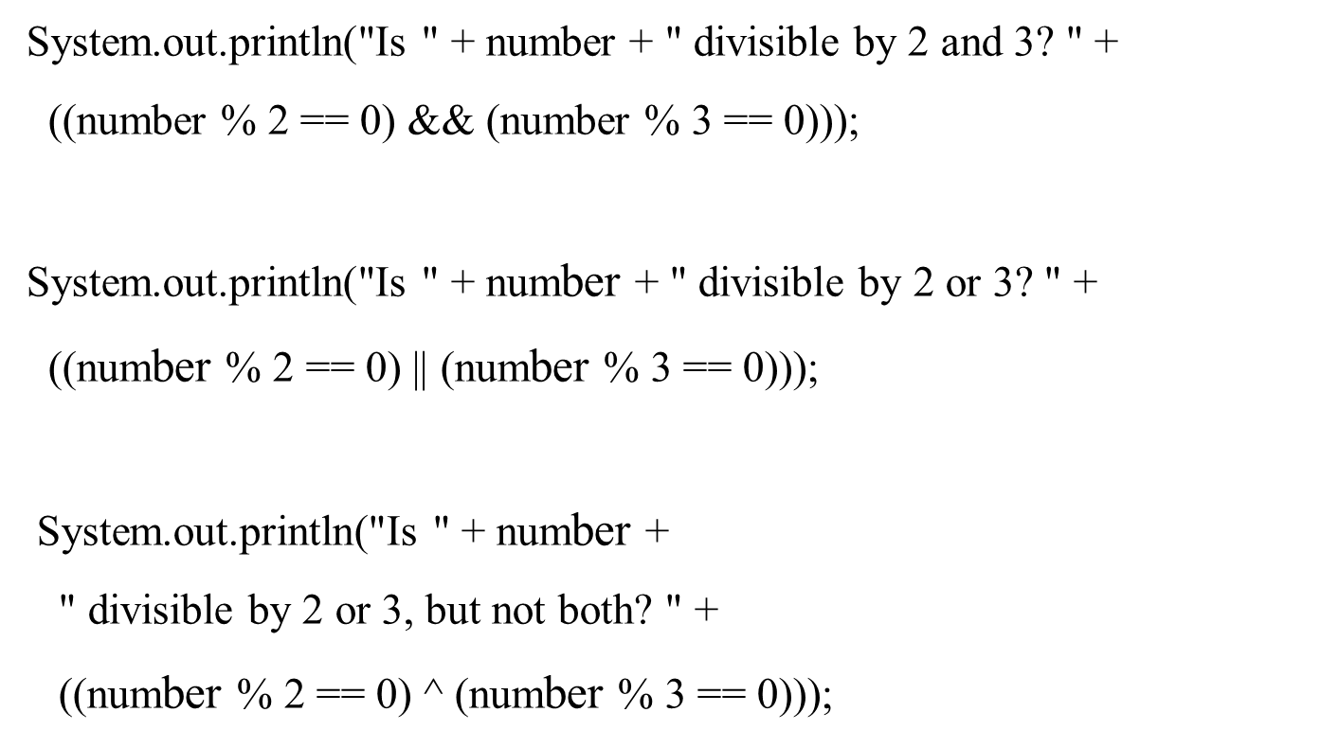
Examples (2 of 2)
TestBooleanOperators
Run

Slide 37
The & and | Operators (1 of 2)
Supplement III.B, “The & and | Operators”

Slide 38
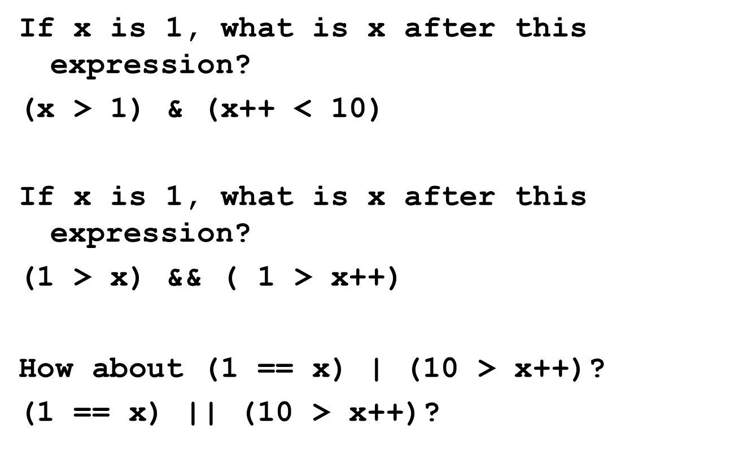
The & and | Operators (2 of 2)

Slide 39
Problem: Determining Leap Year?
This program first prompts the user to enter a year as an int value and checks if it is a leap year.
A year is a leap year if it is divisible by 4 but not by 100, or it is divisible by 400.
LeapYear
Run

Slide 40
Problem: Lottery
Write a program that randomly generates a lottery of a two-digit number, prompts the user to enter a two-digit number, and determines whether the user wins according to the following rule:
If the user input matches the lottery in exact order, the award is $10,000.
If the user input matches the lottery, the award is $3,000.
If one digit in the user input matches a digit in the lottery, the award is $1,000.
Lottery
Run

Slide 41
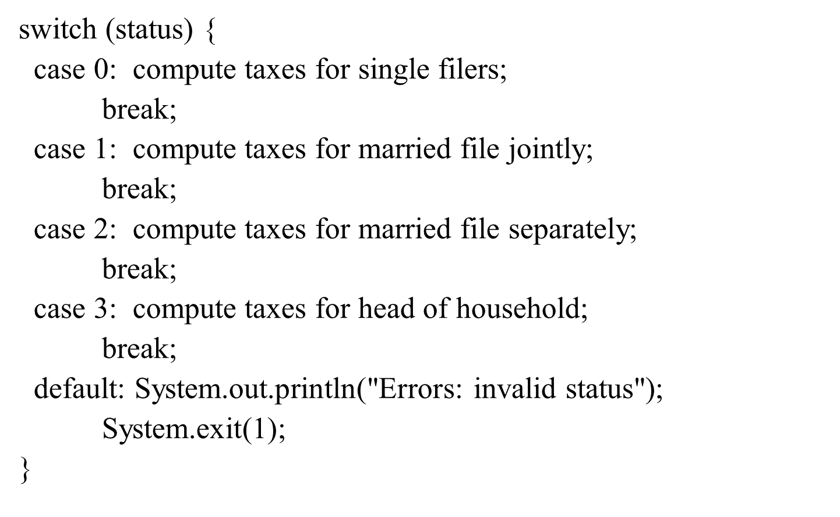
switch Statements

Slide 42
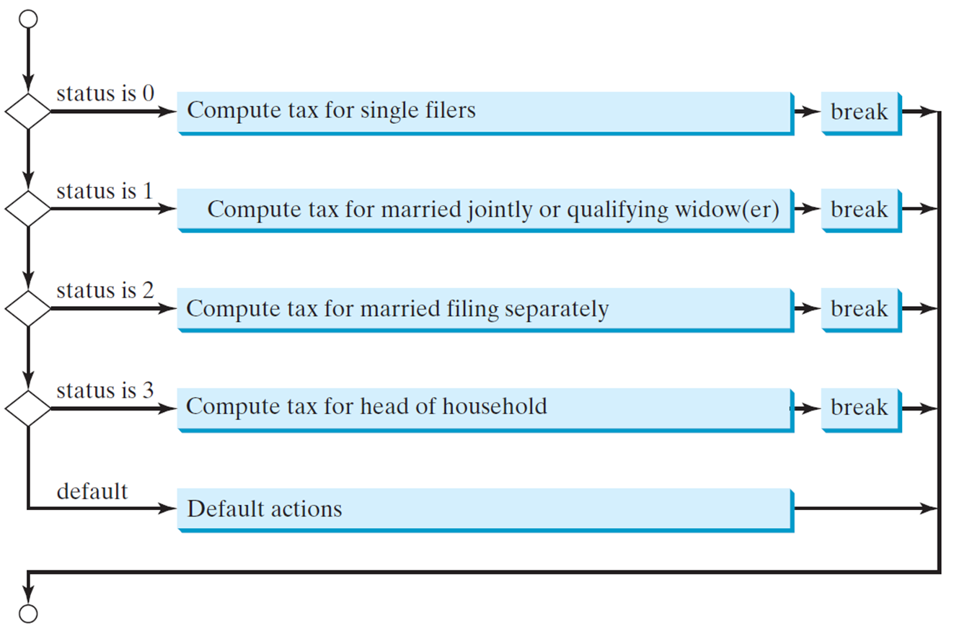
switch Statement Flow Chart

Slide 43
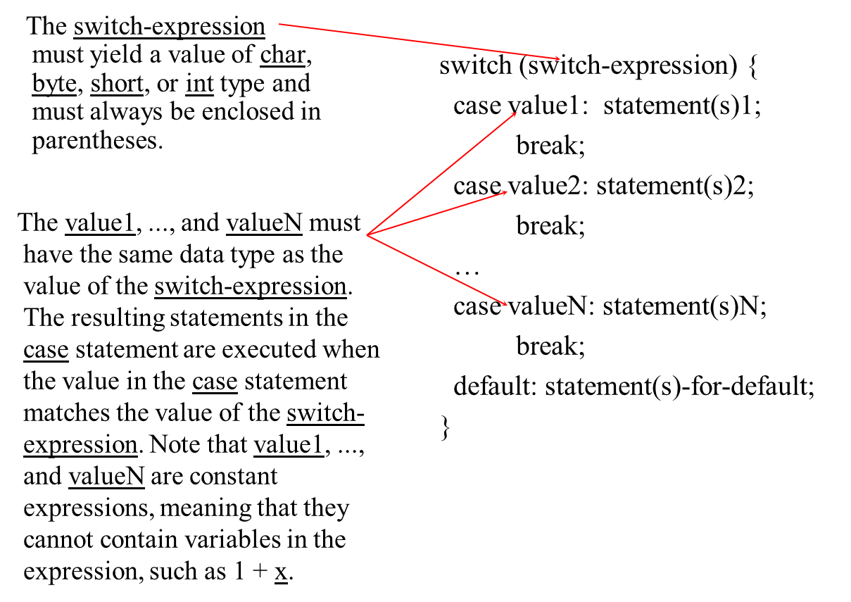
switch Statement Rules (1 of 2)

Slide 44
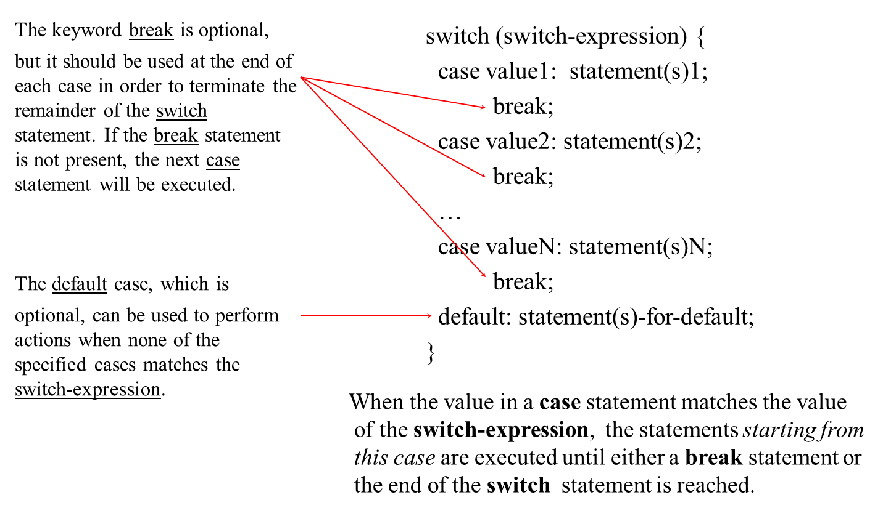
switch Statement Rules (2 of 2)

Slide 45
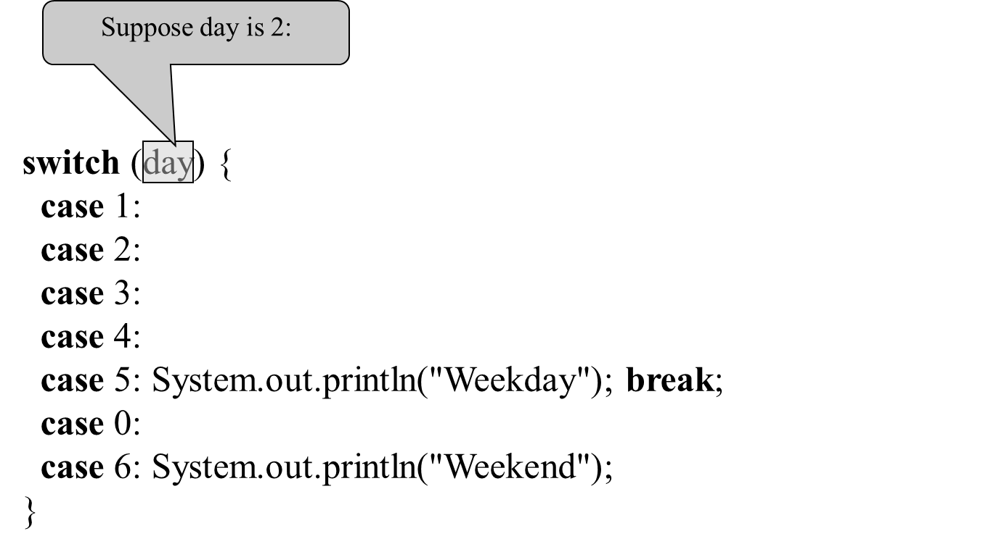
Trace switch statement (1 of 7)

Slide 46
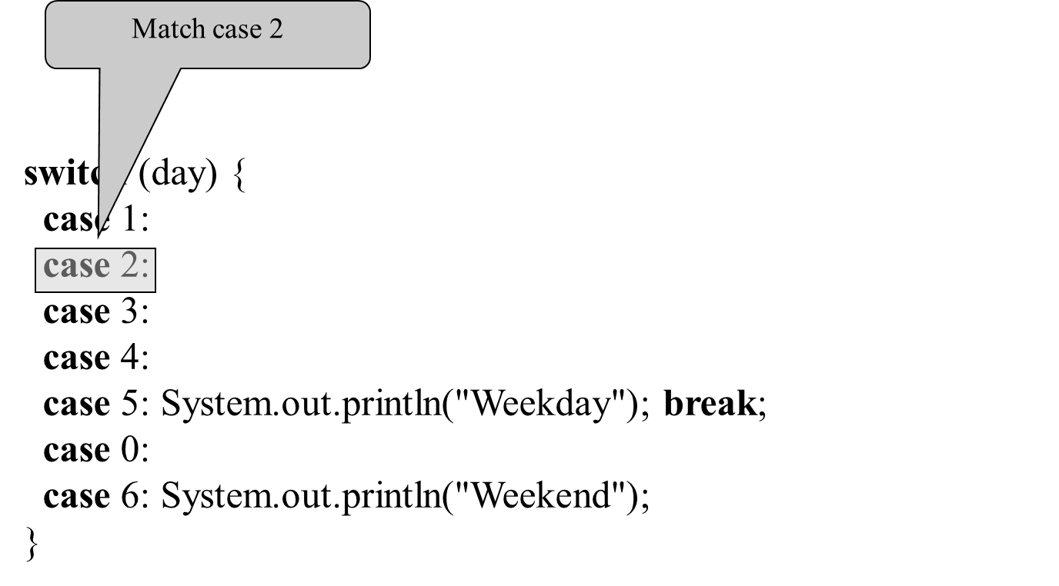
Trace switch statement (2 of 7)

Slide 47
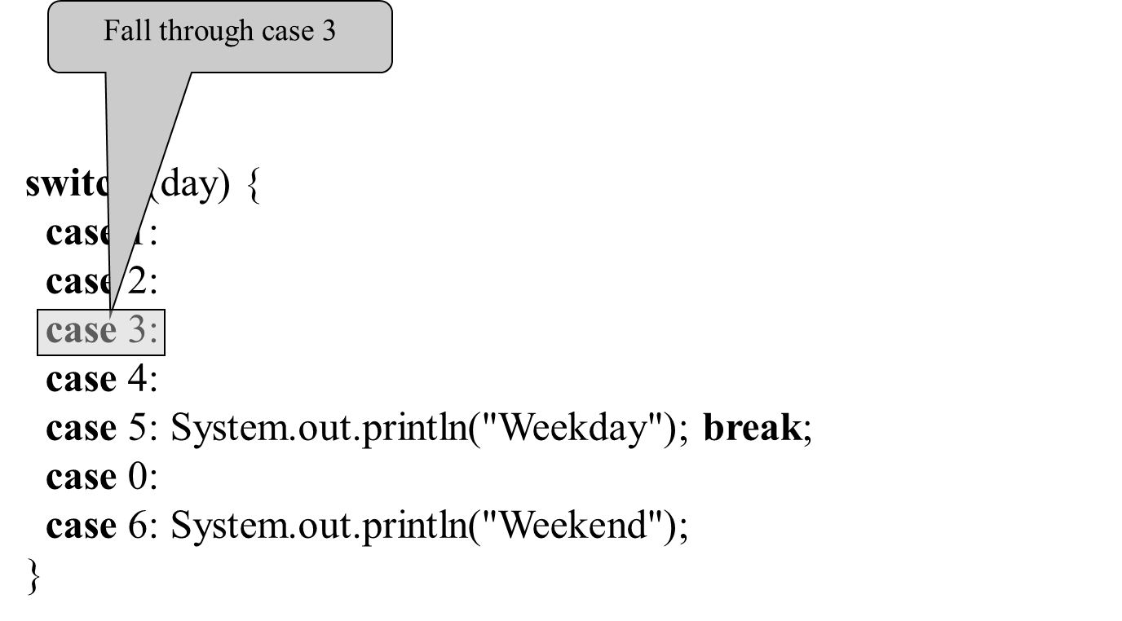
Trace switch statement (3 of 7)

Slide 48
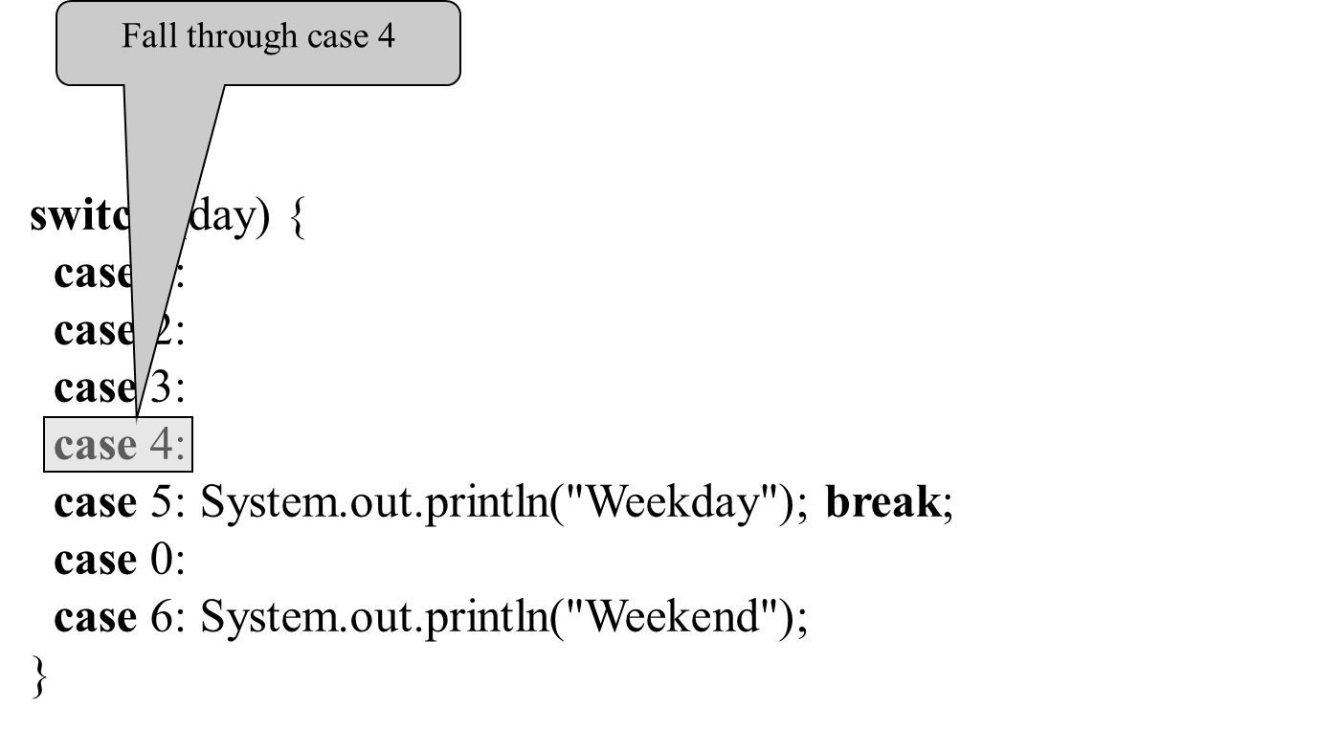
Trace switch statement (4 of 7)

Slide 49
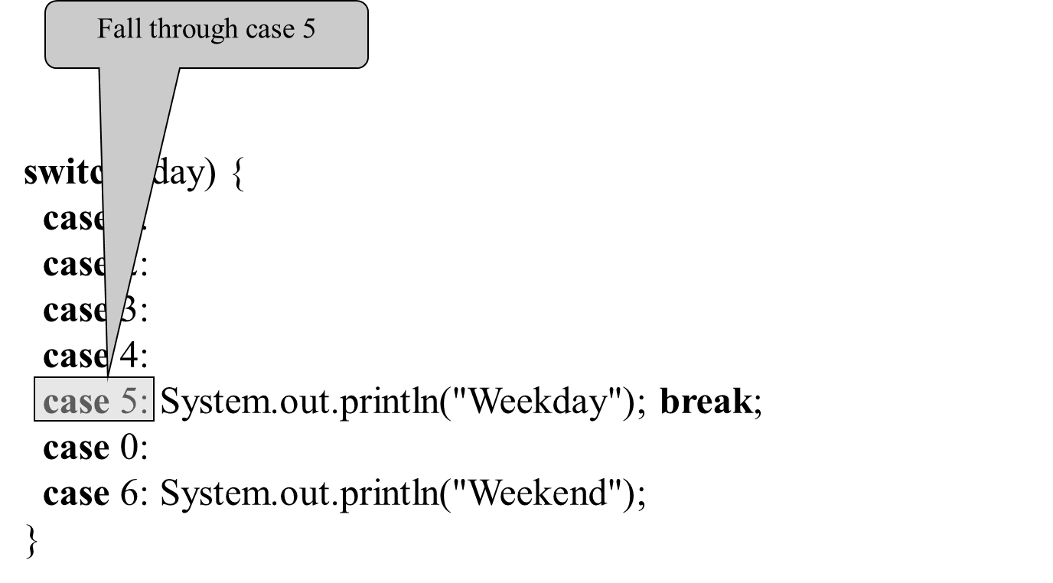
Trace switch statement (5 of 7)

Slide 50
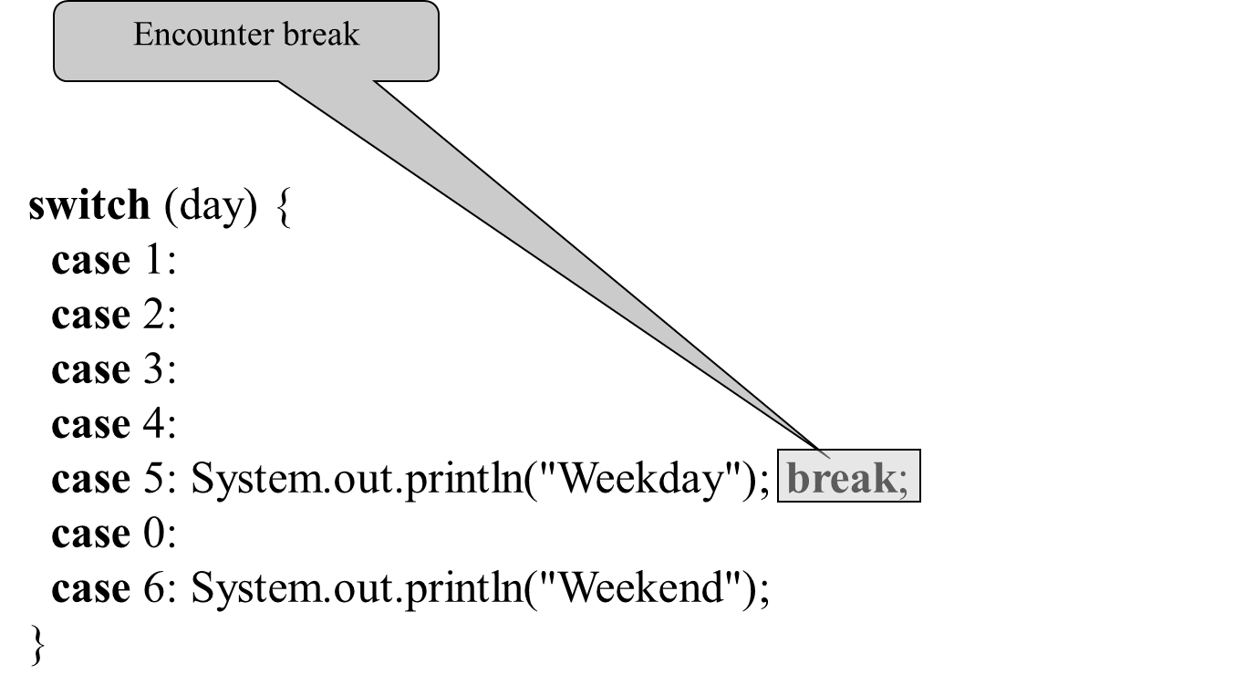
Trace switch statement (6 of 7)

Slide 51
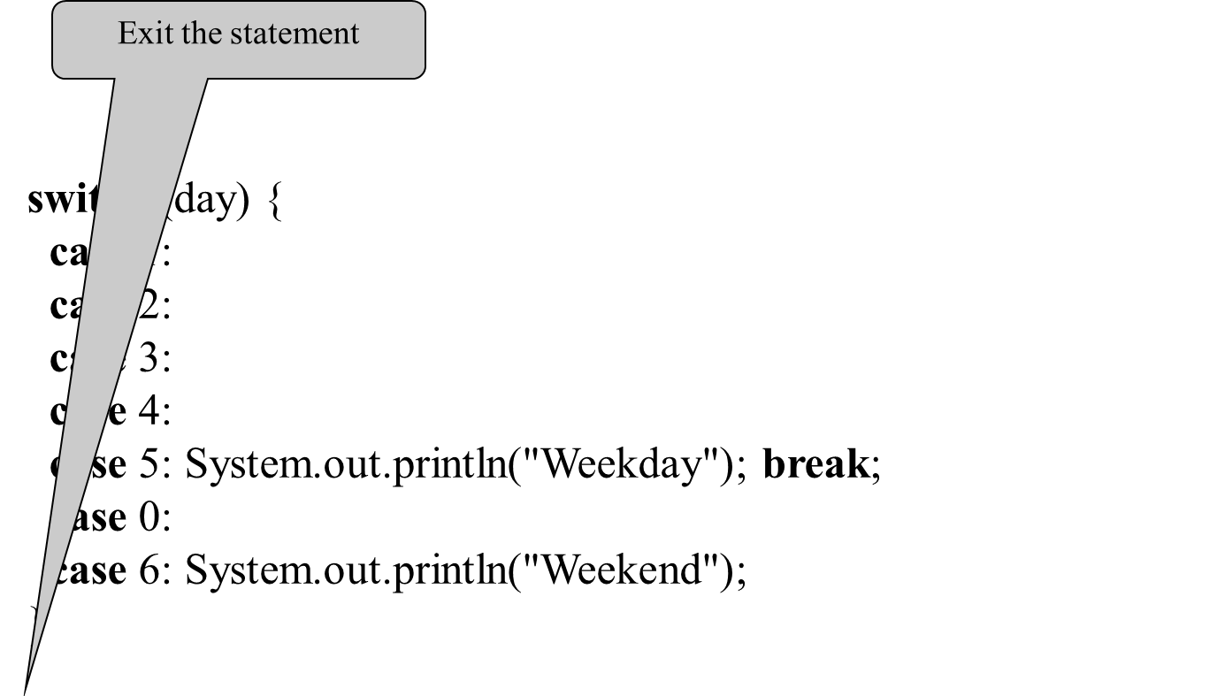
Trace switch statement (7 of 7)

Slide 52
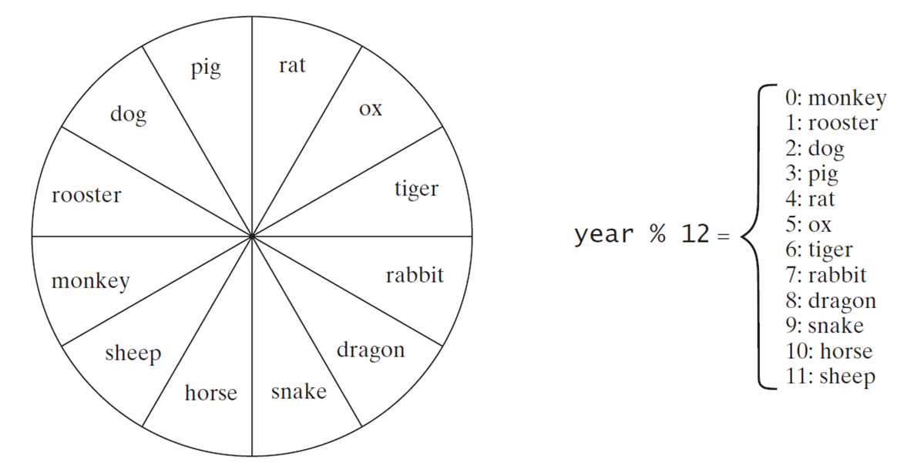
Problem: Chinese Zodiac
Write a program that prompts the user to enter a year and displays the animal for the year.
ChineseZodiac
Run

Slide 53
Conditional Expressions
if (x > 0)
y = 1
else
y = -1;
is equivalent to
y = (x > 0) ? 1 : -1;
(boolean-expression) ? expression1 : expression2
Ternary operator
Binary operator
Unary operator

Slide 54
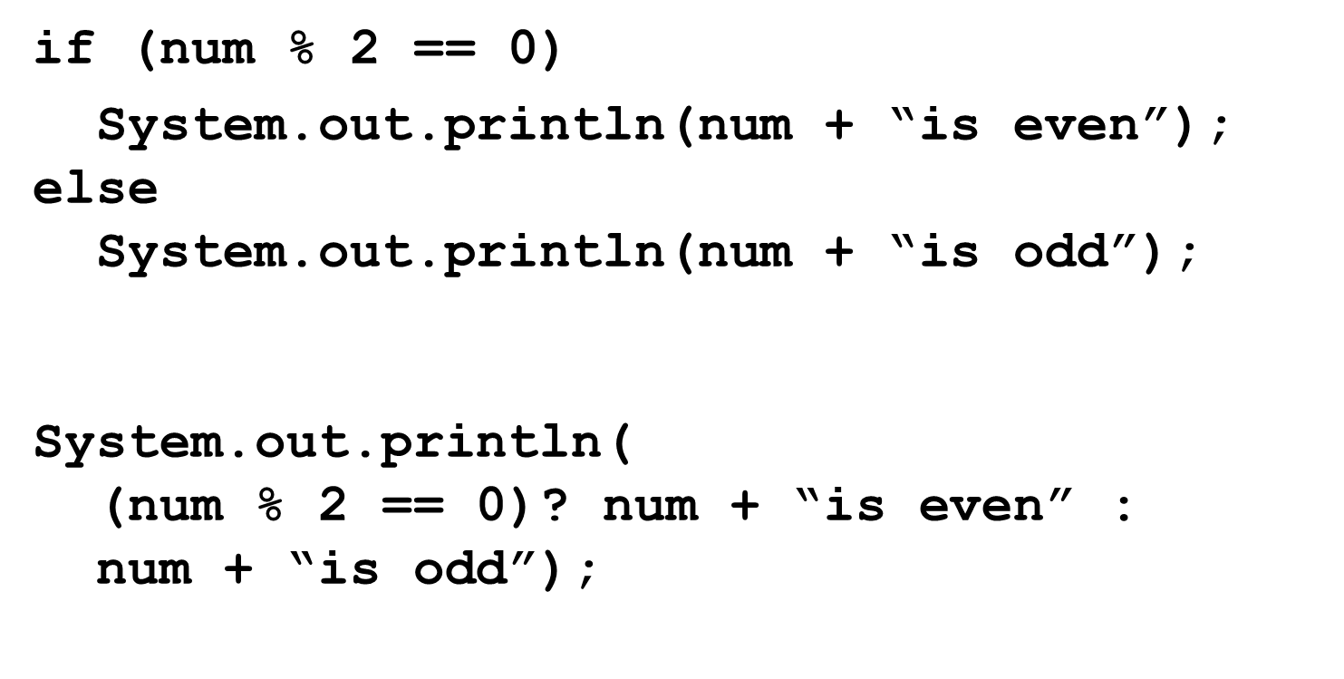
Conditional Operator (1 of 2)

Slide 55

Conditional Operator (2 of 2)

Slide 56
Operator Precedence (1 of 2)
var++, var--
+, - (Unary plus and minus), ++var,--var
(type) Casting
Not
*, /, % (Multiplication, division, and remainder)
+, - (Binary addition and subtraction)
<, <=, >, >= (Relational operators)

Slide 57
Operator Precedence (2 of 2)
(Equality)
(Exclusive OR)
(Conditional AND) Short-circuit AND
(Conditional OR) Short-circuit OR
(Assignment operator)

Slide 58
Operator Precedence and Associativity
The expression in the parentheses is evaluated first. (Parentheses can be nested, in which case the expression in the inner parentheses is executed first.) When evaluating an expression without parentheses, the operators are applied according to the precedence rule and the associativity rule.
If operators with the same precedence are next to each other, their associativity determines the order of evaluation. All binary operators except assignment operators are left-associative.

Slide 59
Operator Associativity
When two operators with the same precedence are evaluated, the associativity of the operators determines the order of evaluation. All binary operators except assignment operators are left-associative.
Assignment operators are right-associative. Therefore, the expression

Slide 60
Example
Applying the operator precedence and associativity rule,
the expression
is evaluated as
follows:

Slide 61
Operand Evaluation Order
Supplement III.A, “Advanced discussions on how an expression is evaluated in the J V M.”

Slide 62
Debugging
Logic errors are called bugs. The process of finding and correcting errors is called debugging. A common approach to debugging is to use a combination of methods to narrow down to the part of the program where the bug is located. You can hand-trace the program (i.e., catch errors by reading the program), or you can insert print statements in order to show the values of the variables or the execution flow of the program. This approach might work for a short, simple program. But for a large, complex program, the most effective approach for debugging is to use a debugger utility.

Slide 63
Debugger
Debugger is a program that facilitates debugging. You can use a debugger to
Execute a single statement at a time.
Trace into or stepping over a method.
Set breakpoints.
Display variables.
Display call stack.
Modify variables.

Slide 64
Debugging in NetBeans
Supplement II.E, Learning Java Effectively with NetBeans

Slide 65
Debugging in Eclipse
Supplement II.G, Learning Java Effectively with Eclipse

Slide 66
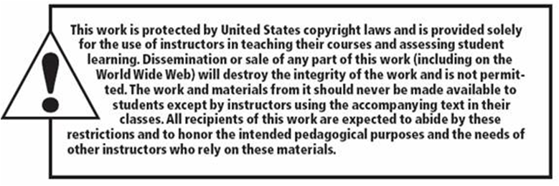
Copyright

