Slide 1
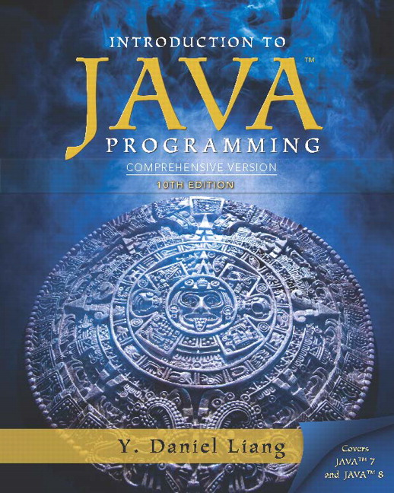
Introduction to Java Programming Comprehensive Version
Tenth Edition
Chapter 4
Mathematical Functions, Characters, and Strings
Slides in the presentation contain hyperlinks. J A W S users should be able to get a list of links by using INSERT+F7
Copyright © 2015 Pearson Education, Inc. All Rights Reserved
Notes:
If this PowerPoint presentation contains mathematical equations, you may need to check that your computer has the following installed:
1) MathType Plugin
2) Math Player (free versions available)
3) NVDA Reader (free versions available)

Slide 2
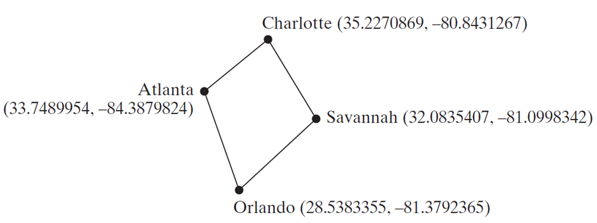
Motivations
Suppose you need to estimate the area enclosed by four cities, given the G P S locations (latitude and longitude) of these cities, as shown in the following diagram. How would you write a program to solve this problem? You will be able to write such a program after completing this chapter.

Slide 3
Learning Objectives (1 of 3)
4.1 To solve mathematics problems by using the methods in the Math class (§4.2).
4.2 To represent characters using the char type (§4.3).
4.3 To encode characters using A S C I I and Unicode (§4.3.1).
4.4 To represent special characters using the escape sequences (§4.4.2).
4.5 To cast a numeric value to a character and cast a character to an integer (§4.3.3).
4.6 To compare and test characters using the static methods in the Character class (§4.3.4).

Slide 4
Learning Objectives (2 of 3)
4.7 To introduce objects and instance methods (§4.4).
4.8 To represent strings using the String objects (§4.4).
4.9 To return the string length using the length() method (§4.4.1).
4.10 To return a character in the string using the charAt(i) method (§4.4.2).
4.11 To use the + operator to concatenate strings (§4.4.3).
4.12 To read strings from the console (§4.4.4).
4.13 To read a character from the console (§4.4.5).
4.14 To compare strings using the equals method and the compareTo methods (§4.4.6).

Slide 5
Learning Objectives (3 of 3)
4.15 To obtain substrings (§4.4.7).
4.16 To find a character or a substring in a string using the indexOf method (§4.4.8).
4.17 To program using characters and strings (GuessBirthday) (§4.5.1).
4.18 To convert a hexadecimal character to a decimal value (HexDigit2Dec) (§4.5.2).
4.19 To revise the lottery program using strings (LotteryUsingStrings) (§4.5.3).
4.20 To format output using the System.out.printf method (§4.6).

Slide 6
Mathematical Functions
Java provides many useful methods in the Math class for performing common mathematical functions.

Slide 7
The Math Class
Class constants:
P I
E
Class methods:
Trigonometric Methods
Exponent Methods
Rounding Methods
min, max, abs, and random Methods

Slide 8
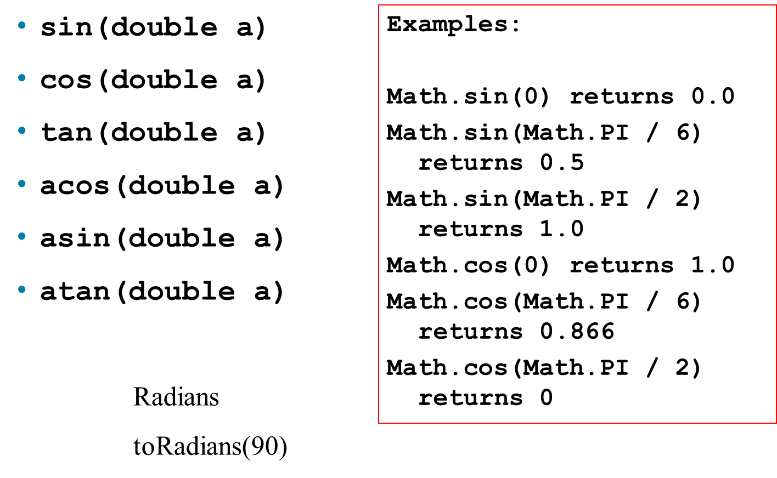
Trigonometric Methods

Slide 9
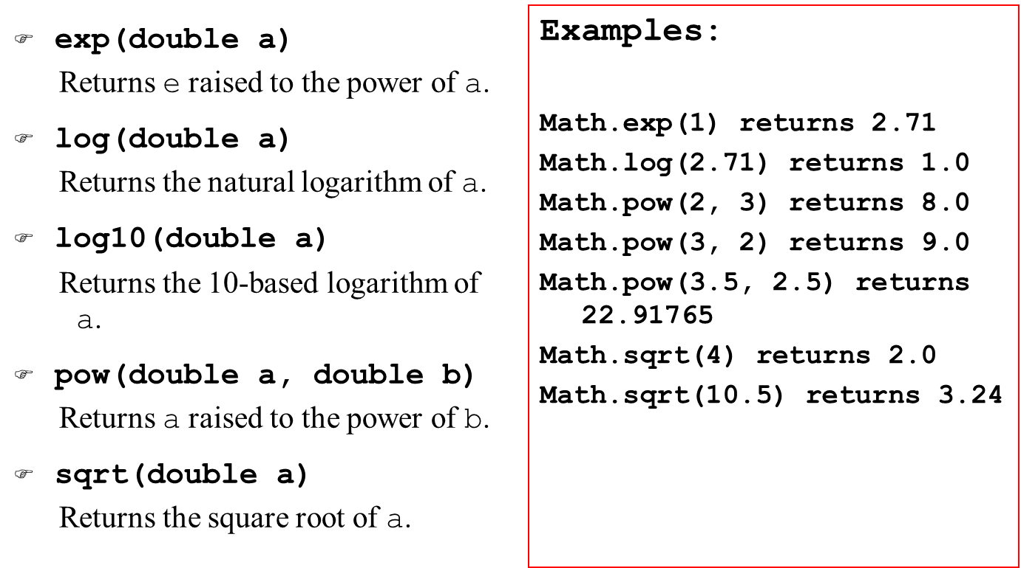
Exponent Methods

Slide 10
Rounding Methods
double ceil(double x)
x rounded up to its nearest integer. This integer is returned as a double value.
double floor(double x)
x is rounded down to its nearest integer. This integer is returned as a double value.
double rint(double x)
x is rounded to its nearest integer. If x is equally close to two integers, the even one is returned as a double.
int round(float x)
Return (int)Math.floor(x+0.5).
long round(double x)
Return (long)Math.floor(x+0.5).

Slide 11
Rounding Methods Examples (1 of 2)
Math.ceil(2.1) returns 3.0
Math.ceil(2.0) returns 2.0
Math.ceil(-2.0) returns -2.0
Math.ceil(-2.1) returns -2.0
Math.floor(2.1) returns 2.0
Math.floor(2.0) returns 2.0
Math.floor(-2.0) returns -2.0
Math.floor(-2.1) returns -3.0
Math.rint(2.1) returns 2.0
Math.rint(2.0) returns 2.0A

Slide 12
Rounding Methods Examples (2 of 2)
Math.rint(-2.0) returns -2.0
Math.rint(-2.1) returns -2.0
Math.rint(2.5) returns 2.0
Math.rint(-2.5) returns -2.0
Math.round(2.6f) returns 3
Math.round(2.0) returns 2
Math.round(-2.0f) returns -2
Math.round(-2.6) returns -3

Slide 13
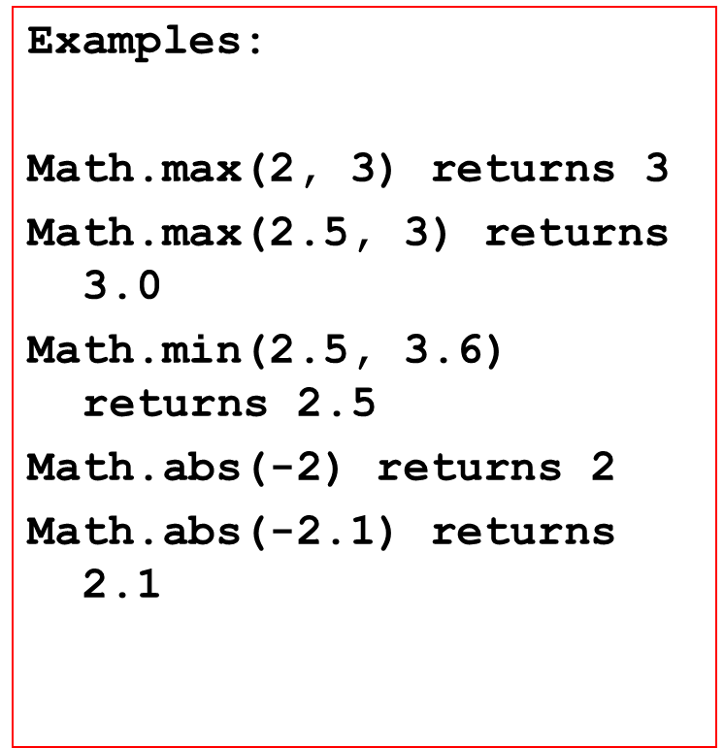
min, max, and abs
max(a, b)and min(a, b)
Returns the maximum or minimum of two parameters.
abs(a)
Returns the absolute value of the parameter.
random()
Returns a random double value in the range [0.0, 1.0).

Slide 14
The random Method
Generates a random double value greater than or equal to 0.0 and less than
Examples:
In general,

Slide 15
Case Study: Computing Angles of a Triangle
Write a program that prompts the user to enter the x- and y-coordinates of the three corner points in a triangle and then displays the triangle’s angles.
IMPORTANT NOTE: If you cannot run the buttons, see Java Slide Note Document.
ComputeAngles
Run

Slide 16
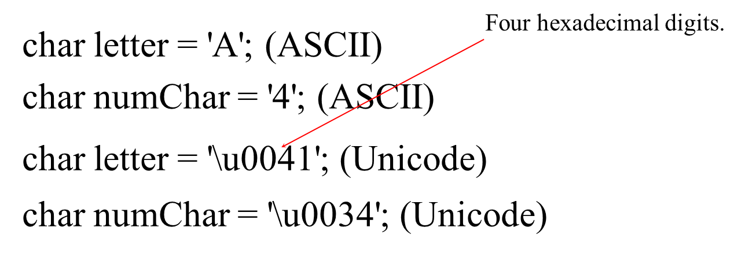
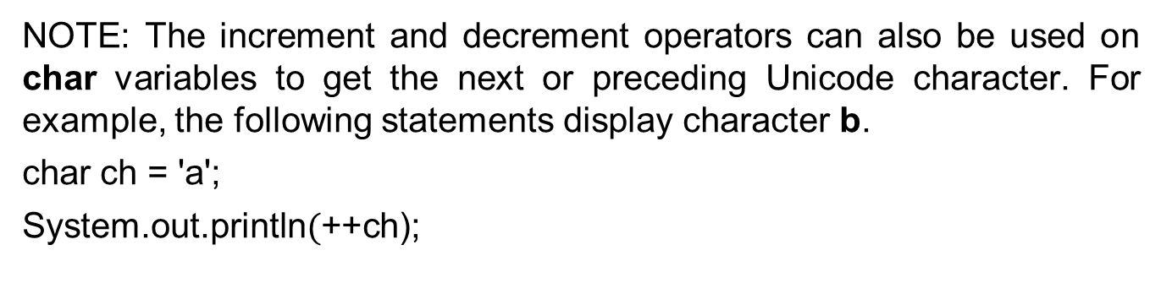
Character Data Type
NOTE: The increment and decrement operators can also be used on char variables to get the next or preceding Unicode character. For example, the following statements display character b.
char ch = 'a';
System.out.println$($++ch);

Slide 17
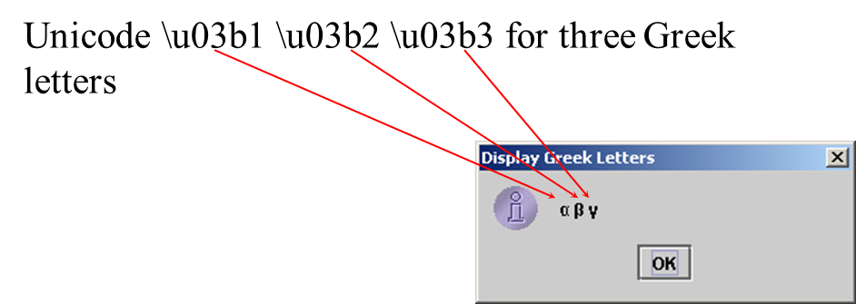
Unicode Format
Java characters use Unicode, a 16-bit encoding scheme established by the Unicode Consortium to support the interchange, processing, and display of written texts in the world’s diverse languages. Unicode takes two bytes, preceded by \u, expressed in four hexadecimal numbers that run from ‘\u0000’ to ‘\uFFFF’. So, Unicode can represent 65535 + 1 characters.

Slide 18
A S C I I Code for Commonly Used Characters
Characters | Code Value in Decimal | Unicode Value
'0' to '9' | 48 to 57 | \u0030 to \u0039
'A' to 'Z' | 65 to 90 | \u0041 to \u005A
'a' to 'z' | 97 to 122 | \u0061 to \u007A

Slide 19
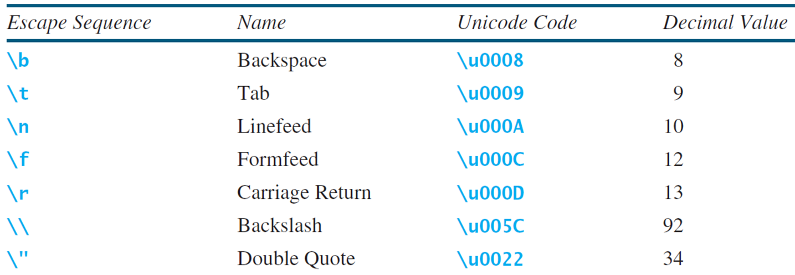
Escape Sequences for Special Characters

Slide 20
Appendix B: A S C I I Character Set (1 of 2)
A S C I I Character Set is a subset of the Unicode from \u0000 to \u007f

Slide 21
Appendix B: A S C I I Character Set (2 of 2)
A S C I I Character Set is a subset of the Unicode from \u0000 to \u007f

Slide 22
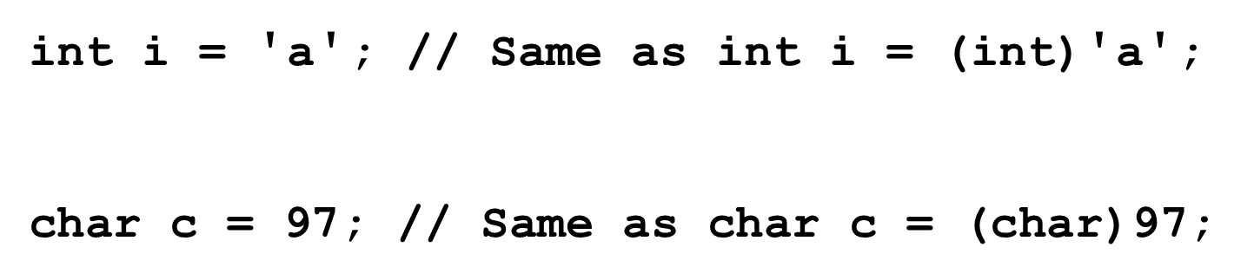
Casting between char and Numeric Types

Slide 23
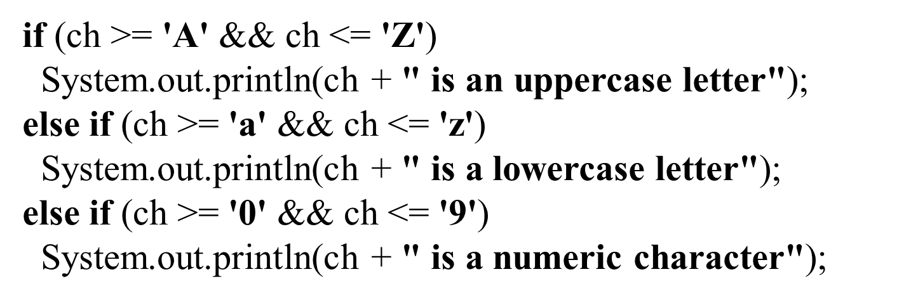
Comparing and Testing Characters

Slide 24
Methods in the Character Class
Method | Description
isDigit(ch) | Returns true if the specified character is a digit.
isLetter(ch) | Returns true if the specified character is a letter.
isLetterOfDigit(ch) | Returns true if the specified character is a letter or digit.
isLowerCase(ch) | Returns true if the specified character is a lowercase letter.
isUpperCase(ch) | Returns true if the specified character is an uppercase letter.
toLowerCase(ch) | Returns the lowercase of the specified character.
toUpperCase(ch) | Returns the uppercase of the specified character.

Slide 25
The String Type
The char type only represents one character. To represent a string of characters, use the data type called String. For example,
String message = "Welcome to Java";
String is actually a predefined class in the Java library just like the System class and Scanner class. The String type is not a primitive type. It is known as a reference type. Any Java class can be used as a reference type for a variable. Reference data types will be thoroughly discussed in Chapter 9, “Objects and Classes.” For the time being, you just need to know how to declare a String variable, how to assign a string to the variable, how to concatenate strings, and to perform simple operations for strings.

Slide 26
Simple Methods for String Objects (1 of 2)
Method | Description
length() | Returns the number of characters in this string.
charAt(index) | Returns the character at the specified index from this string.
concat(s1) | Returns a new string that concatenates this string with string s1.
toUpperCase() | Returns a new string with all letters in uppercase.
toLowerCase() | Returns a new string with all letters in lowercase.
trim() | Returns a new string with whitespace characters trimmed on both sides.

Slide 27
Simple Methods for String Objects (2 of 2)
Strings are objects in Java. The methods in the preceding table can only be invoked from a specific string instance. For this reason, these methods are called instance methods. A non-instance method is called a static method. A static method can be invoked without using an object. All the methods defined in the Math class are static methods. They are not tied to a specific object instance. The syntax to invoke an instance method is
referenceVariable.methodName(arguments).

Slide 28
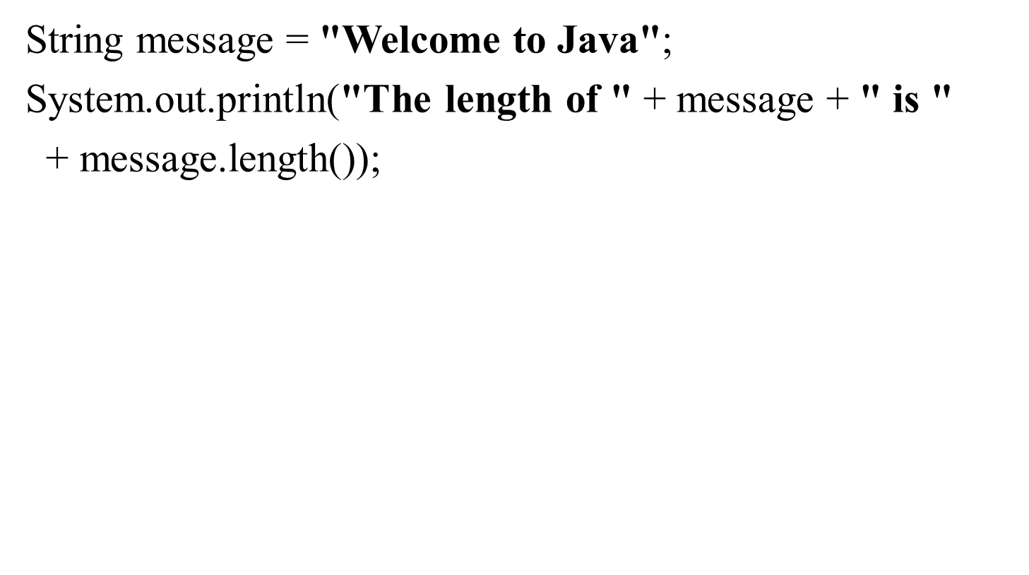
Getting String Length

Slide 29
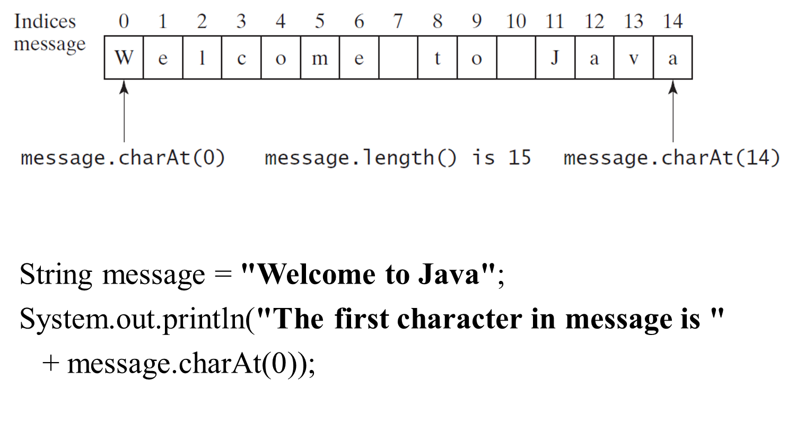
Getting Characters from a String

Slide 30
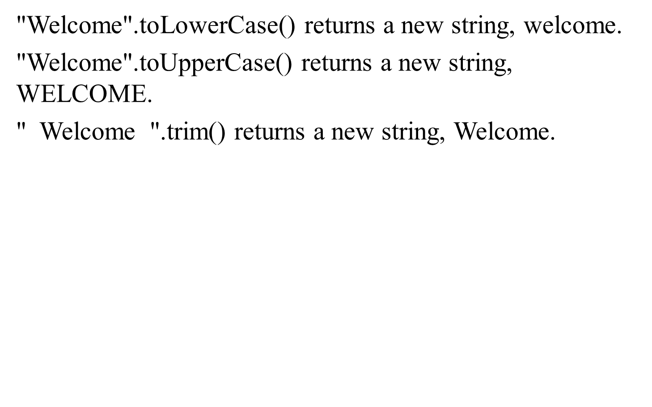
Converting Strings

Slide 31
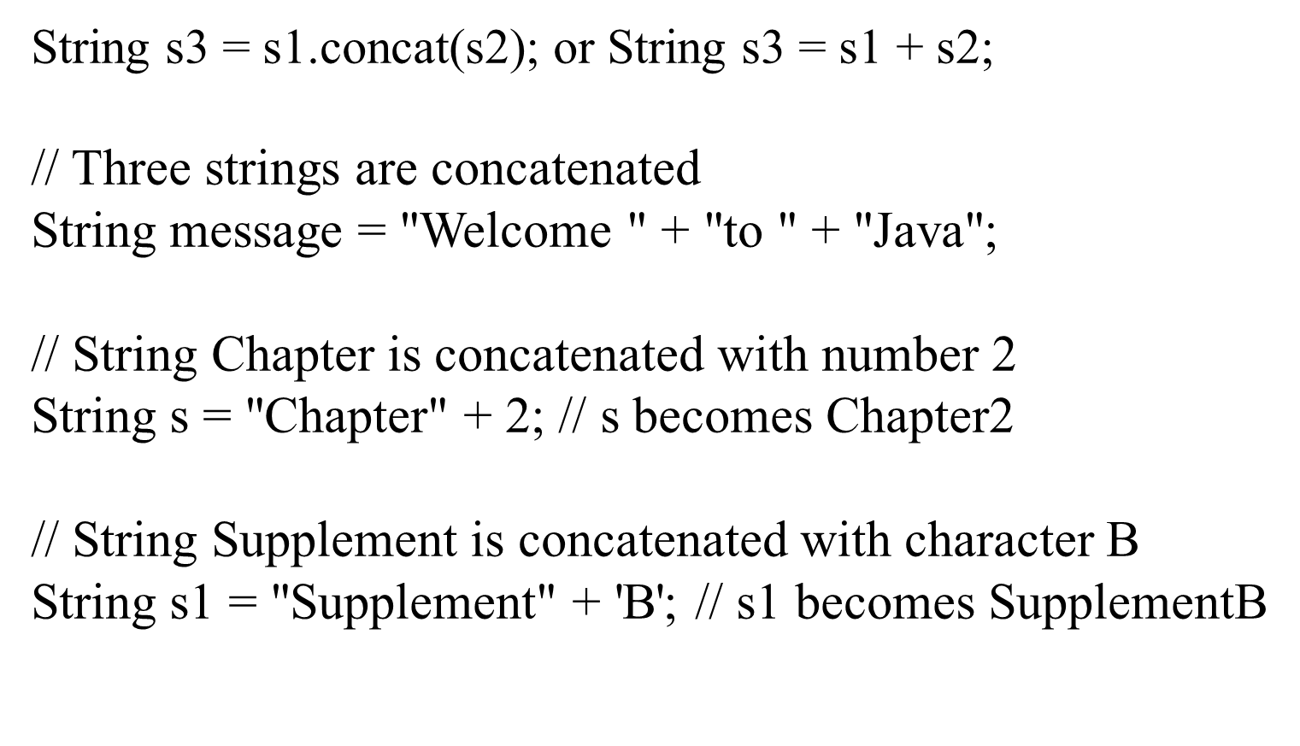
String Concatenation

Slide 32
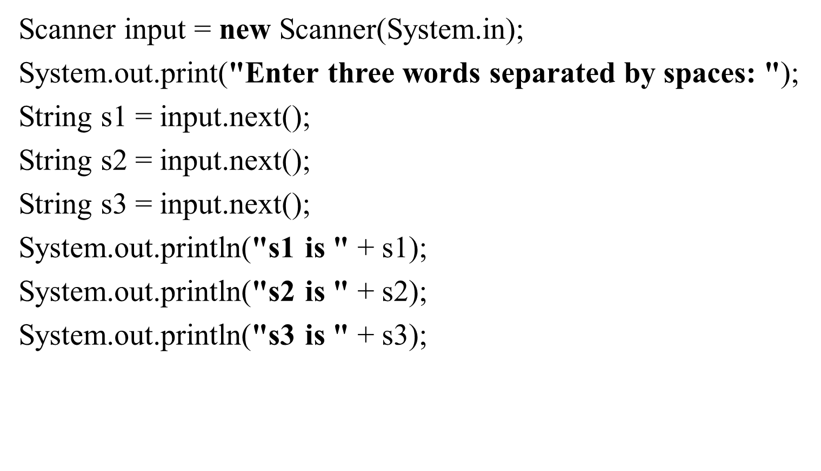
Reading a String from the Console

Slide 33
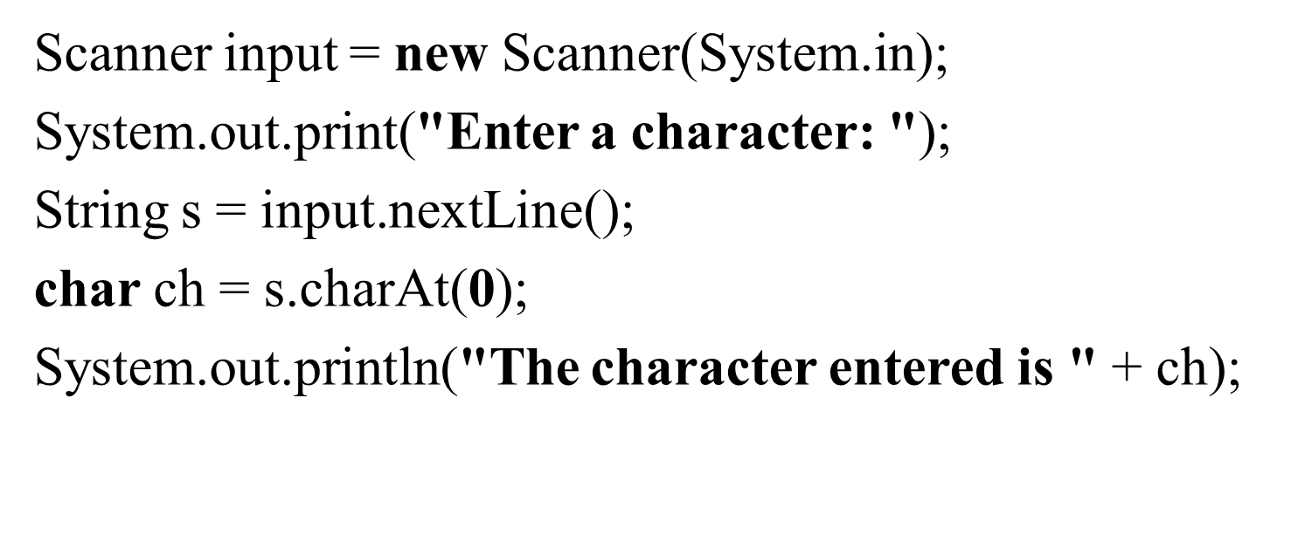
Reading a Character from the Console

Slide 34
Comparing Strings
Method | Description
equals(s1) | Returns true if this string is equal to string s1.
equalsIgnoreCase(s1) | Returns true if this string is equal to string s1; it is case insensitive.
compareTo(s1) | Returns an integer greater than 0, equal to 0, or less than 0 to indicate whether this string is greater than, equal to, or less than s1.
compareToIgnoreCase(s1) | Same as compareTo except that the comparison is case insensitive.
startsWith(prefix) | Returns true if this string starts with the specified prefix.
endsWith(suffix) | Returns true if this string ends with the specified suffix.
OrderTwoCities
Run

Slide 35
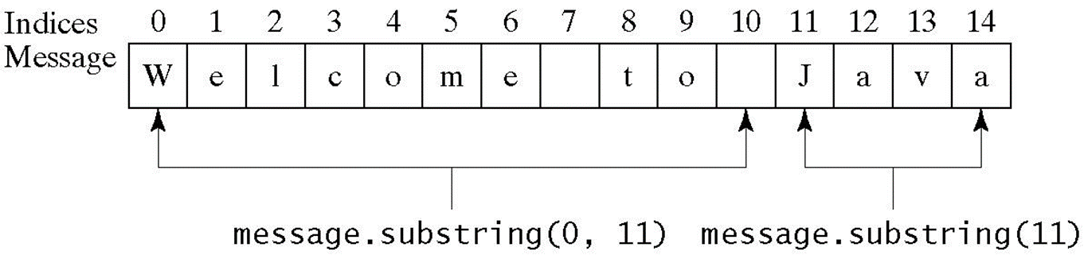
Obtaining Substrings
Method | Description
substring(beginIndex) | Returns this string’s substring that begins with the character at the specified beginIndex and extends to the end of the string, as shown in Figure 4.2.
substring(beginIndex, endIndex) | Returns this string’s substring that begins at the specified beginIndex and extends to the character at index endIndex – 1, as shown in Figure 9.6. Note that the character at endIndex is not part of the substring.

Slide 36
Finding a Character or a Substring in a String (1 of 3)
Method | Description
indexOf(ch) | Returns the index of the first occurrence of ch in the string. Returns -1 if not matched.
indexOf(ch, fromIndex) | Returns the index of the first occurrence of ch after fromIndex in the string. Returns -1 if not matched.
indexOf(s) | Returns the index of the first occurrence of string s in this string. Returns -1 if not matched.
indexOf(s, fromIndex) | Returns the index of the first occurrence of string s in this string after fromIndex. Returns -1 if not matched.

Slide 37
Finding a Character or a Substring in a String (2 of 3)
Method | Description
lastIndexOf(ch) | Returns the index of the last occurrence of ch in the string. Returns -1 if not matched.
lastindexOf(ch, fromIndex) | Returns the index of the last occurrence of ch before fromIndex in this string. Returns -1 if not matched.
lastIndexOf(s) | Returns the index of the first occurrence of string s in this string. Returns -1 if not matched.
indexOf(s, fromIndex) | Returns the index of the last occurrence of string s before fromIndex. Returns -1 if not matched.

Slide 38
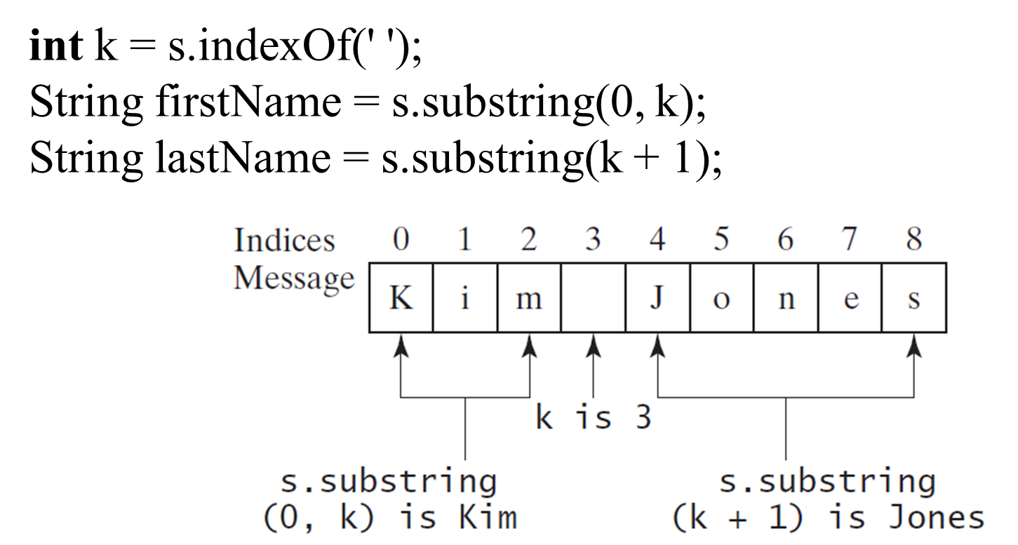
Finding a Character or a Substring in a String (3 of 3)

Slide 39
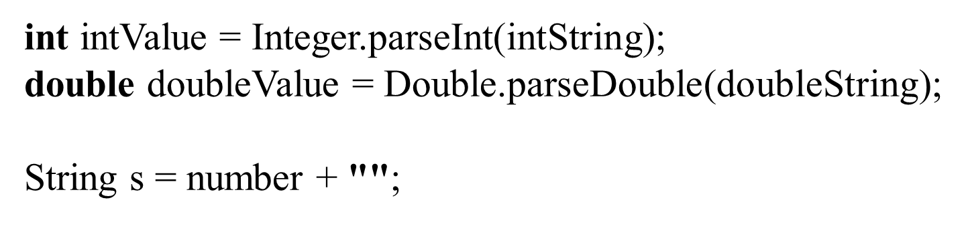
Conversion between Strings and Numbers

Slide 40
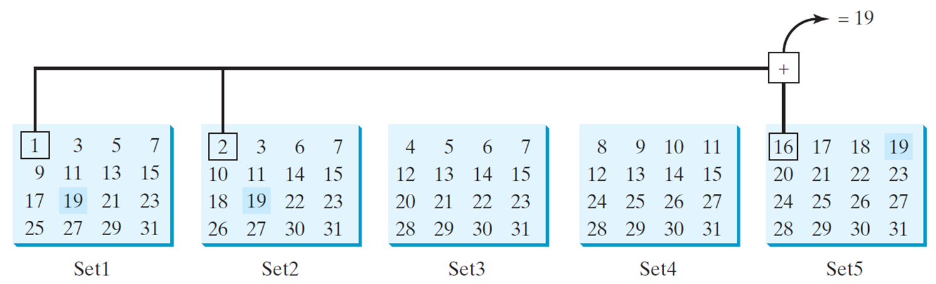
Problem: Guessing Birthday
The program can guess your birth date. Run to see how it works.
GuessBirthday
Run

Slide 41
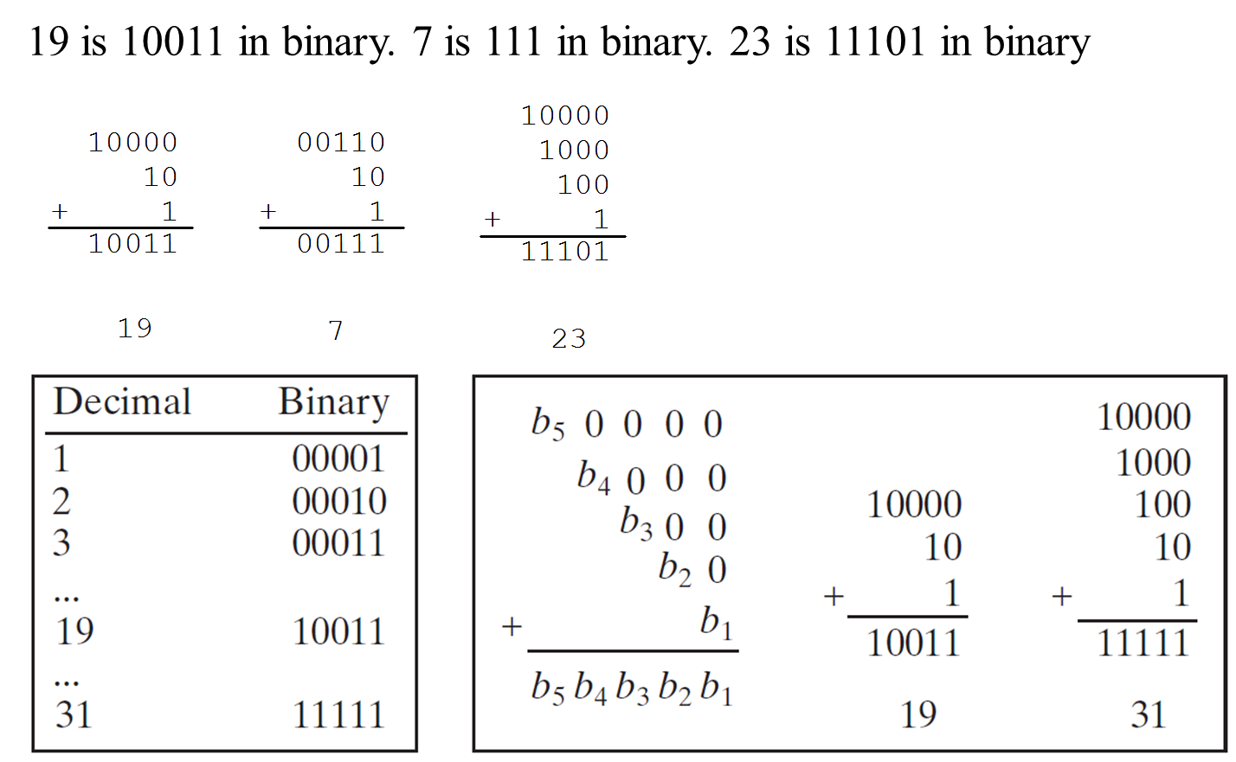
Mathematics Basis for the Game

Slide 42
Case Study: Converting a Hexadecimal Digit to a Decimal Value
Write a program that converts a hexadecimal digit into a decimal value.
HexDigit2Dec
Run

Slide 43
Case Study: Revising the Lottery Program Using Strings
A problem can be solved using many different approaches. This section rewrites the lottery program in Listing 3.7 using strings. Using strings simplifies this program.
LotteryUsingStrings
Run

Slide 44
Formatting Output
Use the printf statement.
System.out.printf(format, items);
Where format is a string that may consist of substrings and format specifiers. A format specifier specifies how an item should be displayed. An item may be a numeric value, character, boolean value, or a string. Each specifier begins with a percent sign.

Slide 45
Frequently-Used Specifiers
Specifier | Output | Example
%b | a boolean value | true or false
%c | a character | 'a'
%d | a decimal integer | 200
%f | a floating-point number | 45.460000
%e | a number in standard scientific notation | 4.556000e+01
%s | a string | "Java is cool"

Slide 46
FormatDemo
The example gives a program that uses printf to display a table.
FormatDemo
Run

Slide 47

Copyright

