Slide 1
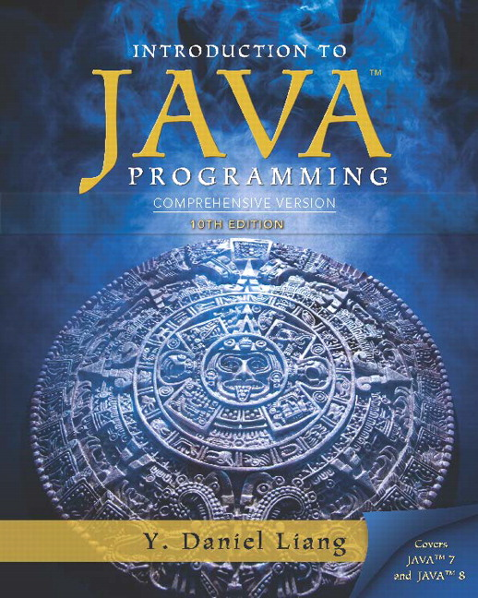
Introduction to Java Programming Comprehensive Version
Tenth Edition
Chapter 5
Loops
Slides in the presentation contain hyperlinks. J A W S users should be able to get a list of links by using INSERT+F7
Copyright © 2015 Pearson Education, Inc. All Rights Reserved
Notes:
If this PowerPoint presentation contains mathematical equations, you may need to check that your computer has the following installed:
1) MathType Plugin
2) Math Player (free versions available)
3) NVDA Reader (free versions available)

Slide 2
Motivations
Suppose that you need to print a string (e.g., “Welcome to Java!”) a hundred times. It would be tedious to have to write the following statement a hundred times:
System.out.println(“Welcome to Java!”);
So, how do you solve this problem?

Slide 3
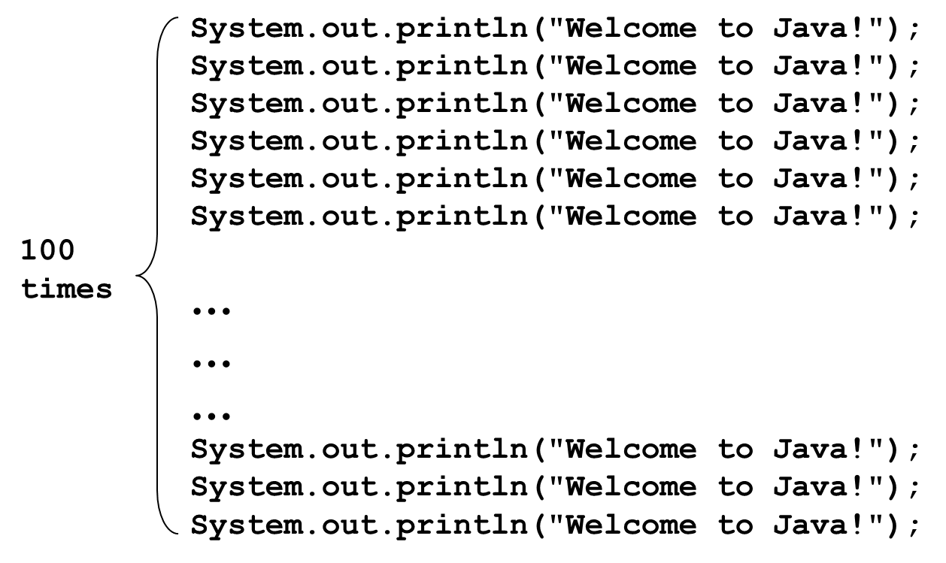
Opening Problem
Problem:

Slide 4
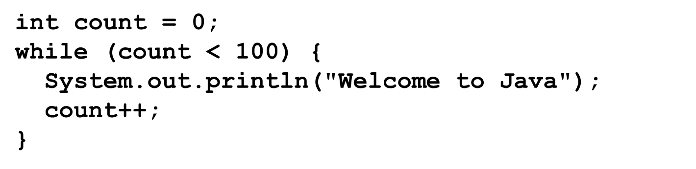
Introducing while Loops

Slide 5
Learning Objectives (1 of 2)
1.1 To write programs for executing statements repeatedly using a while loop (§5.2).
1.2 To follow the loop design strategy to develop loops (§§5.2.1-5.2.3).
1.3 To control a loop with a sentinel value (§5.2.4).
1.4 To obtain large input from a file using input redirection rather than typing from the keyboard (§5.2.5).
1.5 To write loops using do-while statements (§5.3).
1.6 To write loops using for statements (§5.4).

Slide 6
Learning Objectives (2 of 2)
1.7 To discover the similarities and differences of three types of loop statements (§5.5).
1.8 To write nested loops (§5.6).
1.9 To learn the techniques for minimizing numerical errors (§5.7).
2.0 To learn loops from a variety of examples (G C D, FutureTuition, Dec2Hex) (§5.8).
2.1 To implement program control with break and continue (§5.9).
2.2 To write a program that displays prime numbers (§5.11).

Slide 7
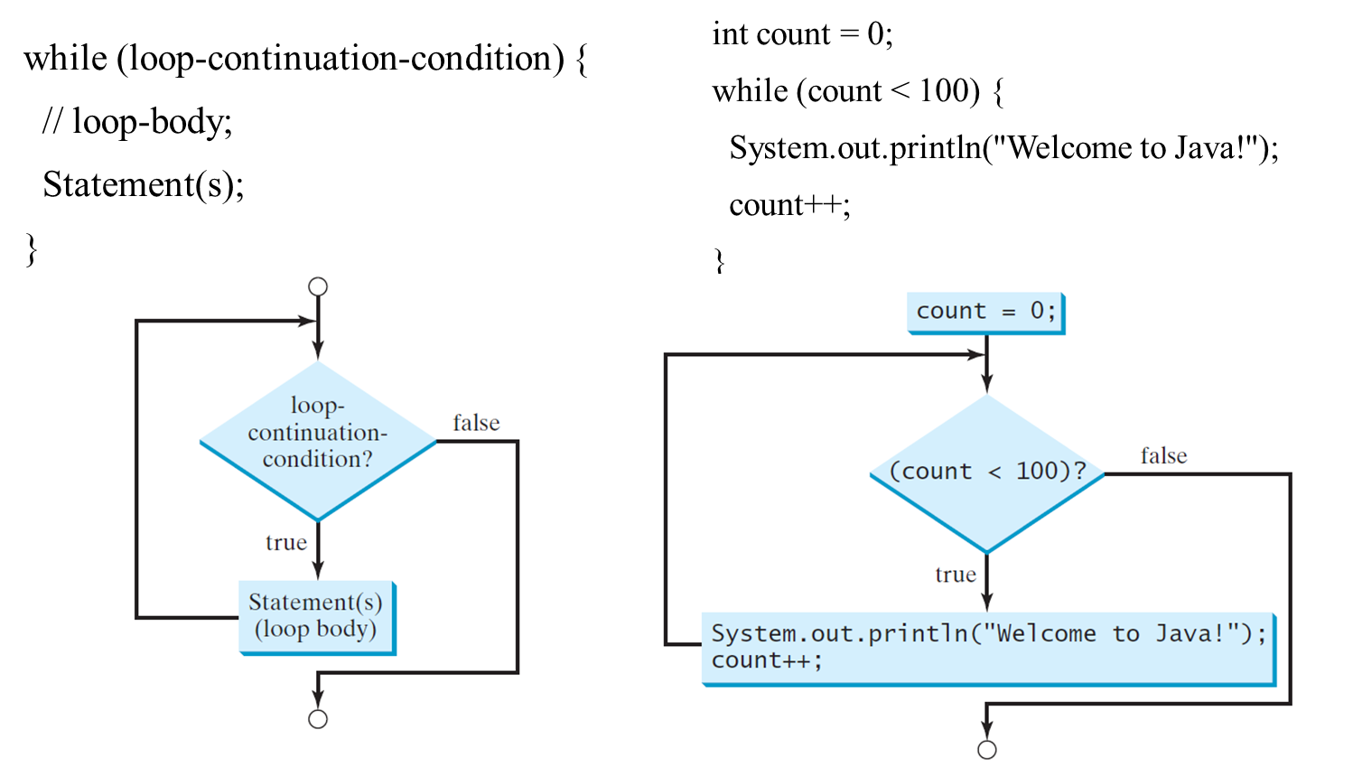
while Loop Flow Chart

Slide 8
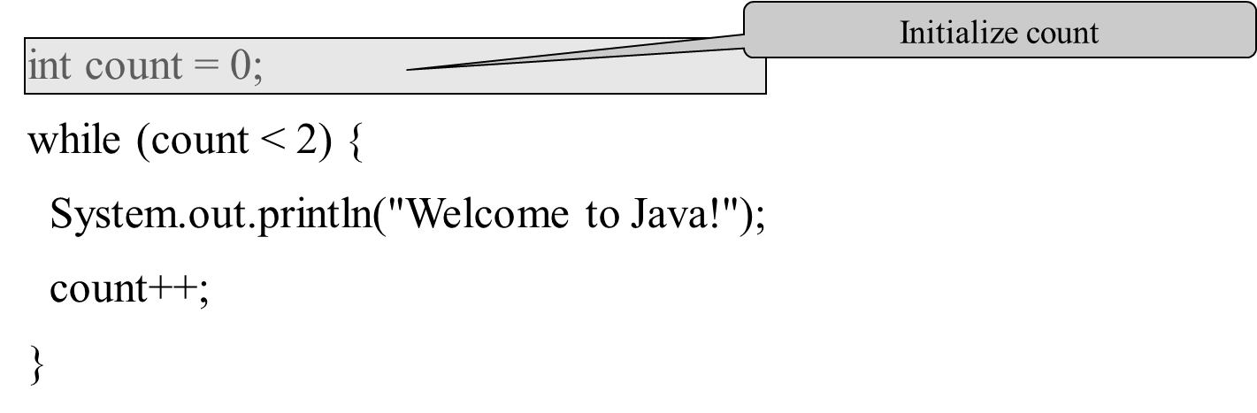
Trace while Loop (1 of 9)

Slide 9
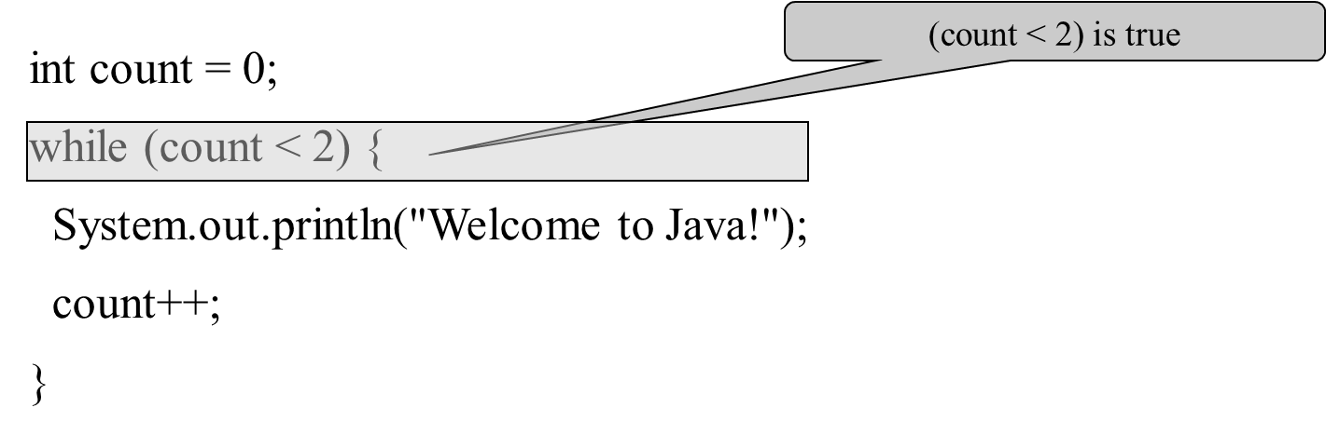
Trace while Loop (2 of 9)

Slide 10
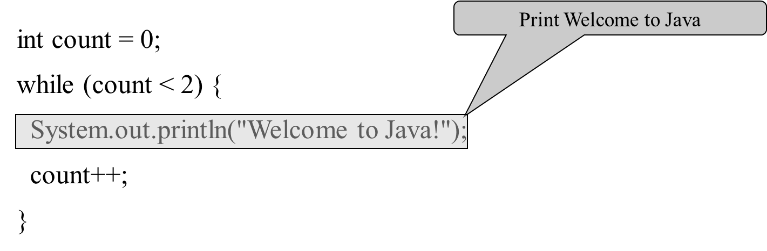
Trace while Loop (3 of 9)

Slide 11
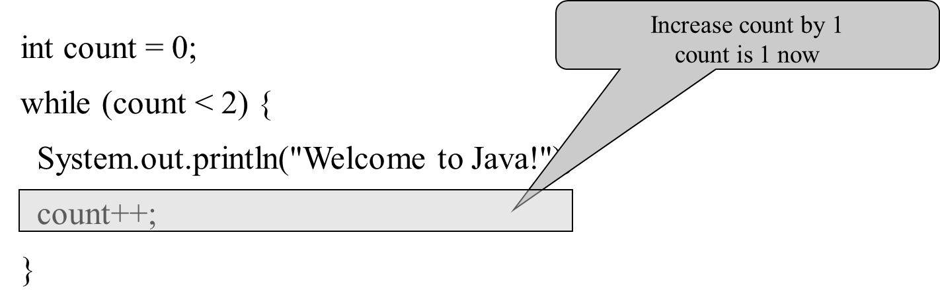
Trace while Loop (4 of 9)

Slide 12
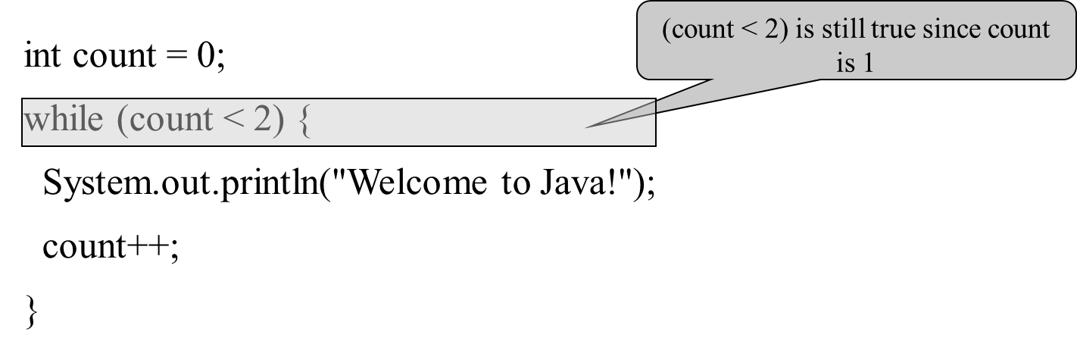
Trace while Loop (5 of 9)

Slide 13
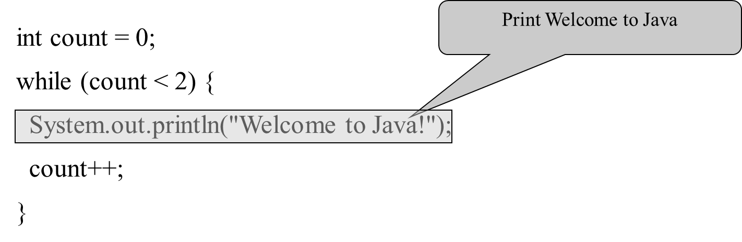
Trace while Loop (6 of 9)

Slide 14
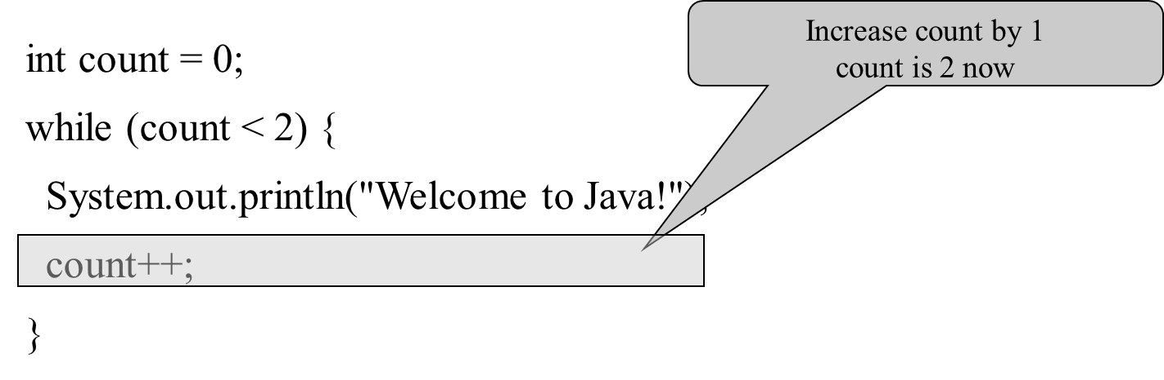
Trace while Loop (7 of 9)

Slide 15
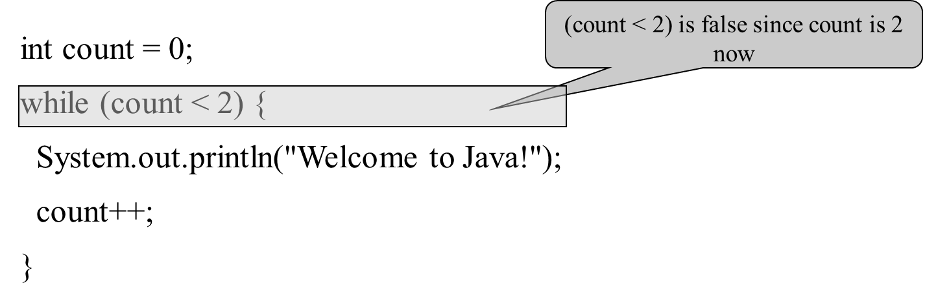
Trace while Loop (8 of 9)

Slide 16
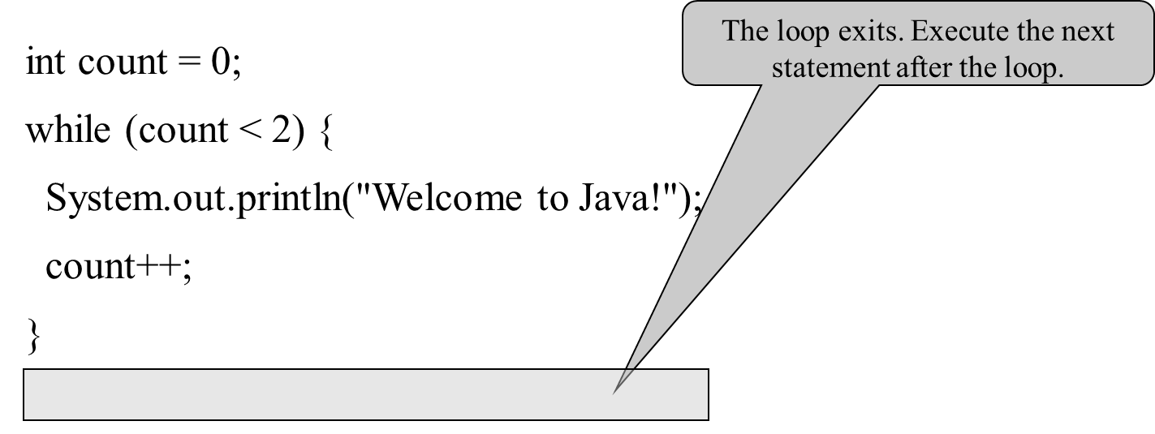
Trace while Loop (9 of 9)

Slide 17
Problem: Repeat Addition Until Correct
Recall that Listing 3.1 AdditionQuiz.java gives a program that prompts the user to enter an answer for a question on addition of two single digits. Using a loop, you can now rewrite the program to let the user enter a new answer until it is correct.
IMPORTANT NOTE: If you cannot run the buttons, see Java Slide Note Document.
RepeatAdditionQuiz
Run

Slide 18
Problem: Guessing Numbers
Write a program that randomly generates an integer between 0 and 100, inclusive. The program prompts the user to enter a number continuously until the number matches the randomly generated number. For each user input, the program tells the user whether the input is too low or too high, so the user can choose the next input intelligently. Here is a sample run:
GuessNumberOneTime
Run
GuessNumber
Run

Slide 19
Problem: An Advanced Math Learning Tool
The Math subtraction learning tool program generates just one question for each run. You can use a loop to generate questions repeatedly. This example gives a program that generates five questions and reports the number of the correct answers after a student answers all five questions.
SubtractionQuizLoop
Run

Slide 20
Ending a Loop with a Sentinel Value
Often the number of times a loop is executed is not predetermined. You may use an input value to signify the end of the loop. Such a value is known as a sentinel value.
Write a program that reads and calculates the sum of an unspecified number of integers. The input 0 signifies the end of the input.
SentinelValue
Run

Slide 21
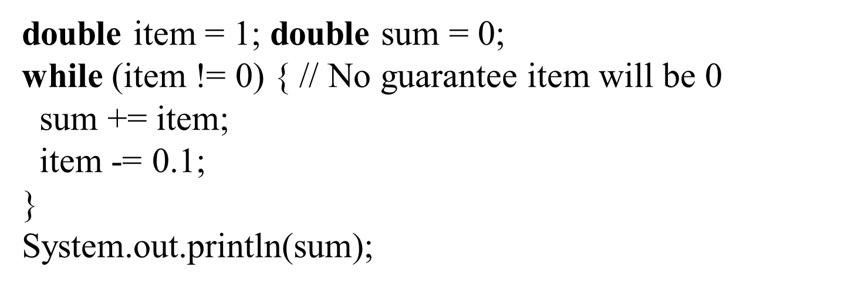
Caution
Don’t use floating-point values for equality checking in a loop control. Since floating-point values are approximations for some values, using them could result in imprecise counter values and inaccurate results. Consider the following code for computing 1 + 0.9 + 0.8 + ... + 0.1:

Slide 22
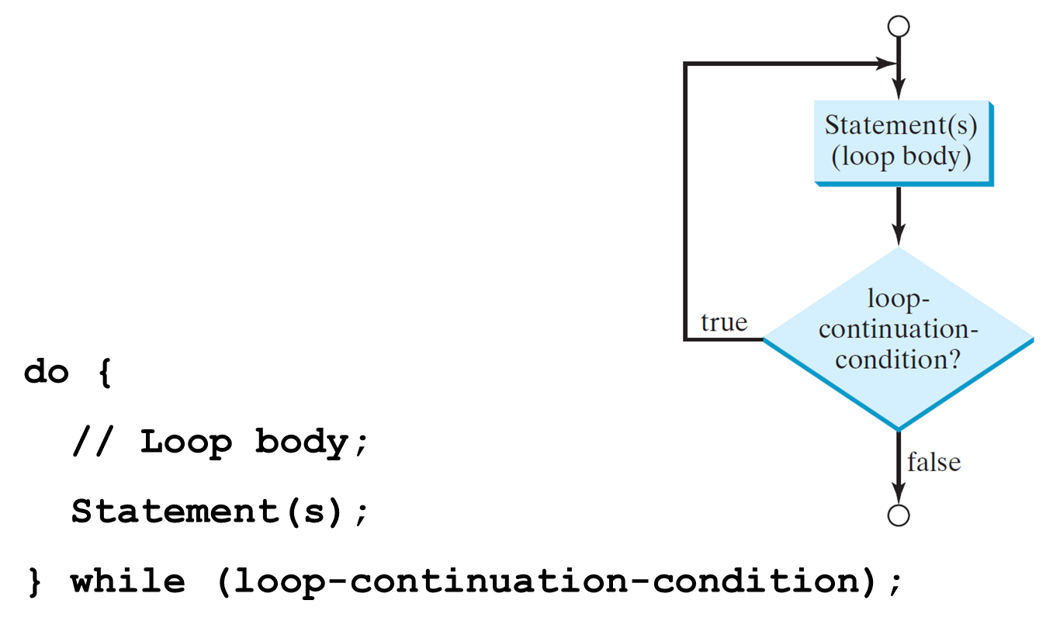
do-while Loop

Slide 23
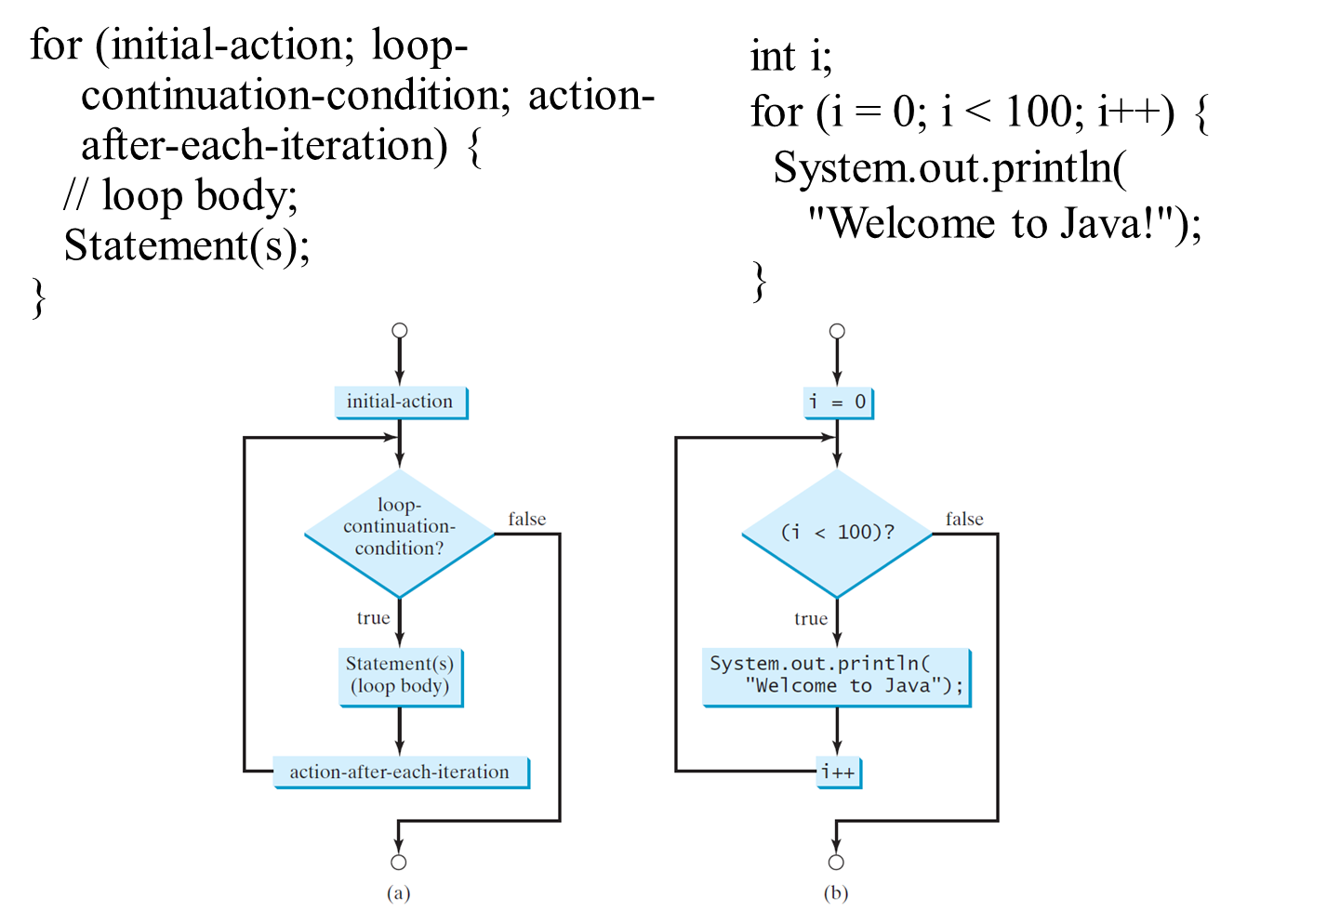
for Loops

Slide 24
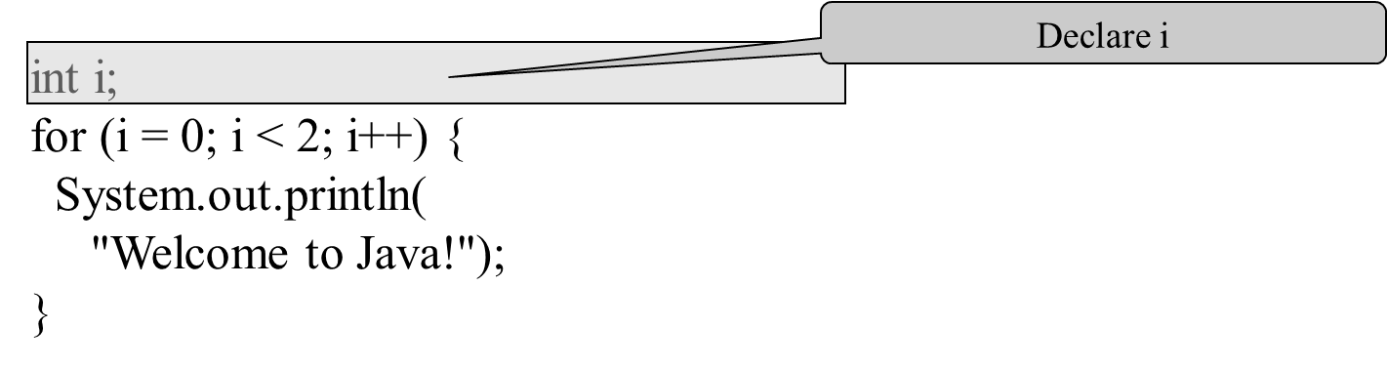
Trace for Loop (1 of 10)

Slide 25
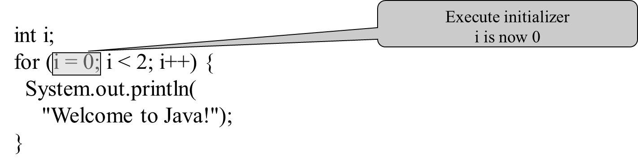
Trace for Loop (2 of 10)

Slide 26
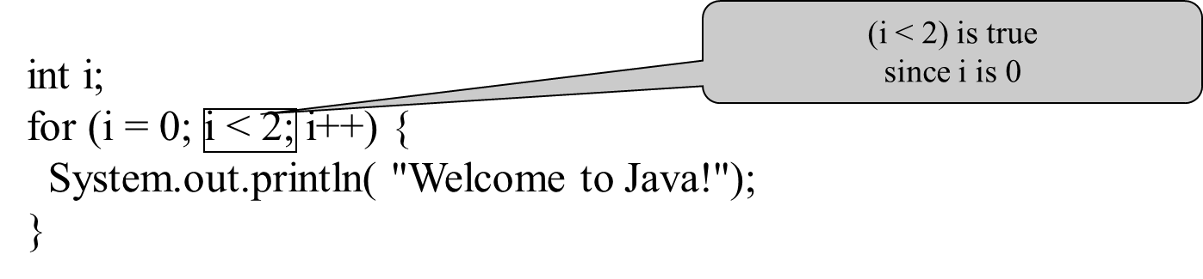
Trace for Loop (3 of 10)

Slide 27
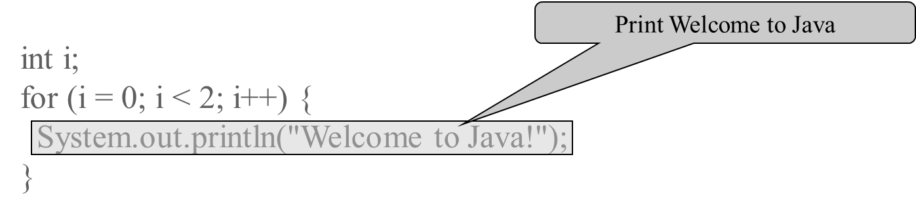
Trace for Loop (4 of 10)

Slide 28
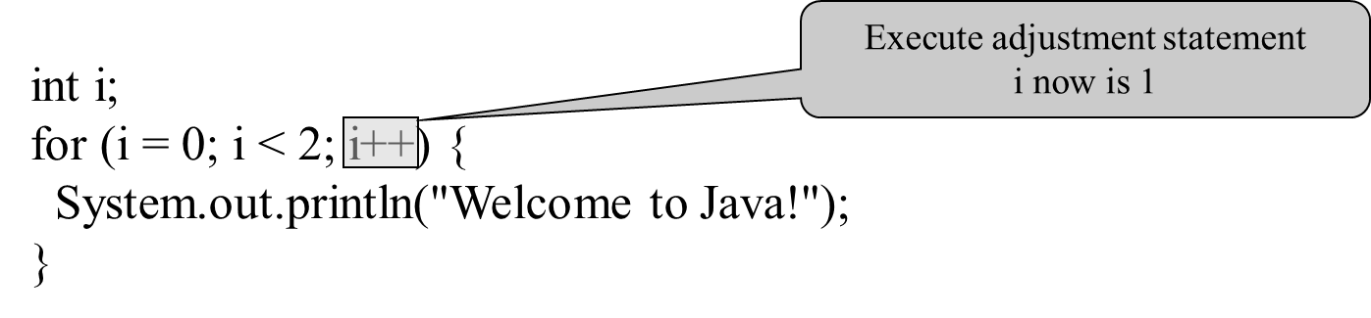
Trace for Loop (5 of 10)

Slide 29
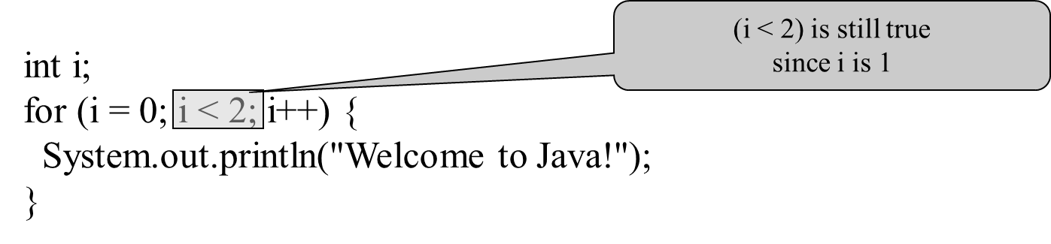
Trace for Loop (6 of 10)

Slide 30
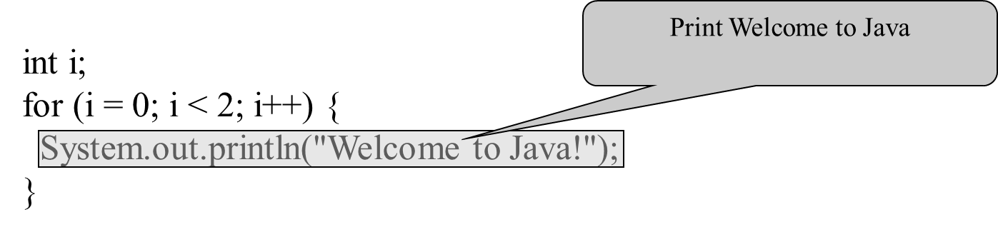
Trace for Loop (7 of 10)

Slide 31

Trace for Loop (8 of 10)

Slide 32
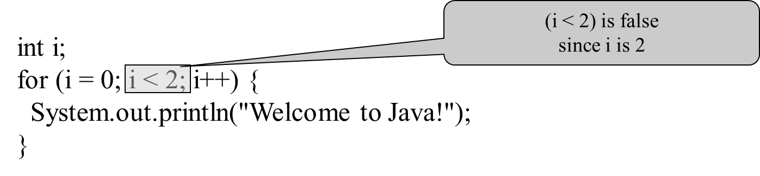
Trace for Loop (9 of 10)

Slide 33
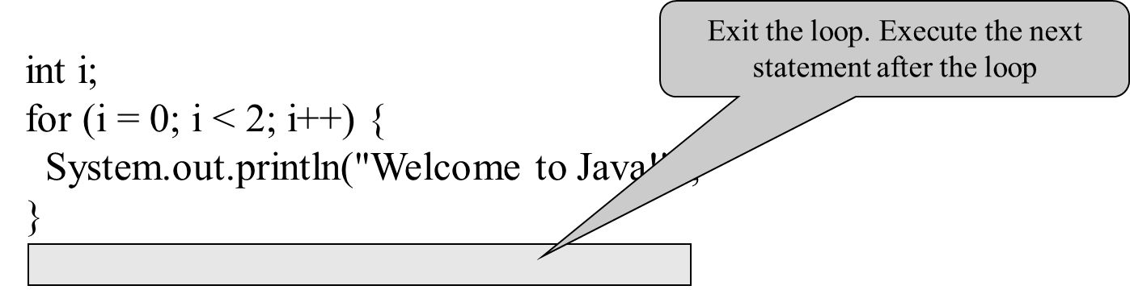
Trace for Loop (10 of 10)

Slide 34
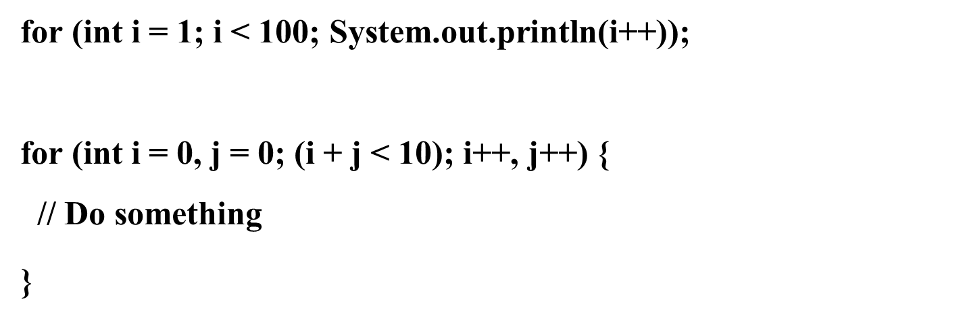
Note (1 of 2)
The initial-action in a for loop can be a list of zero or more comma-separated expressions. The action-after-each-iteration in a for loop can be a list of zero or more comma-separated statements. Therefore, the following two for loops are correct. They are rarely used in practice, however.

Slide 35
Note (2 of 2)
If the loop-continuation-condition in a for loop is omitted, it is implicitly true. Thus the statement given below in (a), which is an infinite loop, is correct. Nevertheless, it is better to use the equivalent loop in (b) to avoid confusion:

Slide 36
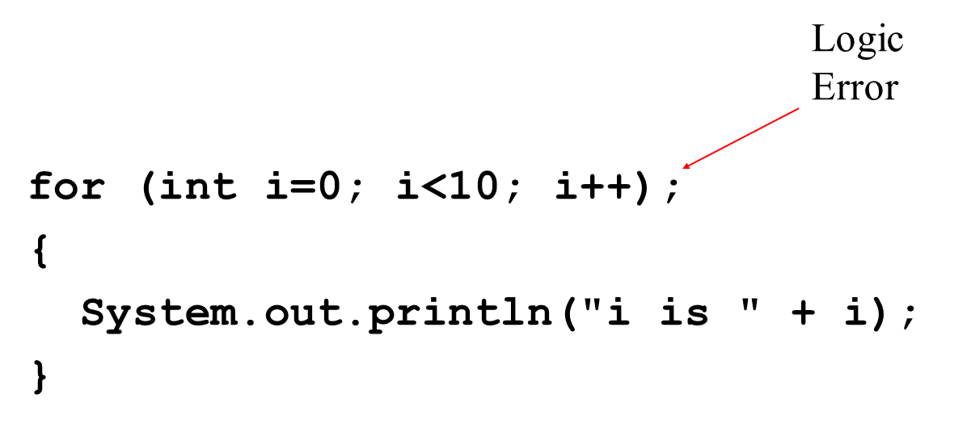
Caution (1 of 2)
Adding a semicolon at the end of the for clause before the loop body is a common mistake, as shown below:

Slide 37
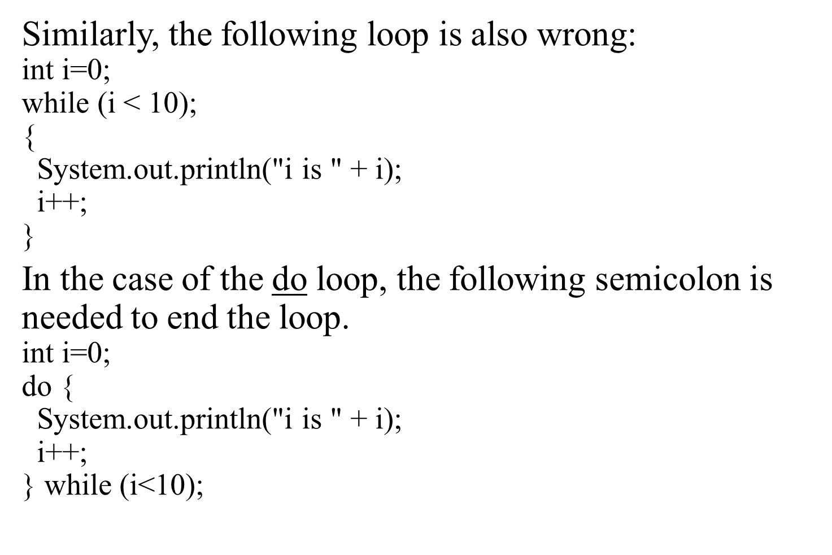
Caution (2 of 2)

Slide 38
Which Loop to Use?
The three forms of loop statements, while, do-while, and for, are expressively equivalent; that is, you can write a loop in any of these three forms. For example, a while loop in (a) in the following figure can always be converted into the following for loop in (b):
A for loop in (a) in the following figure can generally be converted into the following while loop in (b) except in certain special cases (see Review Question 3.19 for one of them):

Slide 39
Recommendations
Use the one that is most intuitive and comfortable for you. In general, a for loop may be used if the number of repetitions is known, as, for example, when you need to print a message 100 times. A while loop may be used if the number of repetitions is not known, as in the case of reading the numbers until the input is 0. A do-while loop can be used to replace a while loop if the loop body has to be executed before testing the continuation condition.

Slide 40
Nested Loops
Problem: Write a program that uses nested for loops to print a multiplication table.
MultiplicationTable
Run

Slide 41
Minimizing Numerical Errors
Numeric errors involving floating-point numbers are inevitable. This section discusses how to minimize such errors through an example.
Here is an example that sums a series that starts with 0.01 and ends with 1.0. The numbers in the series will increment by 0.01, as follows: 0.01 + 0.02 + 0.03 and so on.
TestSum
Run

Slide 42
Problem: Finding the Greatest Common Divisor
Problem: Write a program that prompts the user to enter two positive integers and finds their greatest common divisor.
Solution: Suppose you enter two integers 4 and 2, their greatest common divisor is 2. Suppose you enter two integers 16 and 24, their greatest common divisor is 8. So, how do you find the greatest common divisor? Let the two input integers be n1 and n2. You know number 1 is a common divisor, but it may not be the greatest commons divisor. So you can check whether k (for k = 2, 3, 4, and so on) is a common divisor for n1 and n2, until k is greater than n1 or n2.
GreatestCommonDivisor
Run

Slide 43
Problem: Predicting the Future Tuition
Problem: Suppose that the tuition for a university is $10,000 this year and tuition increases 7% every year. In how many years will the tuition be doubled?
FutureTuition
Run

Slide 44
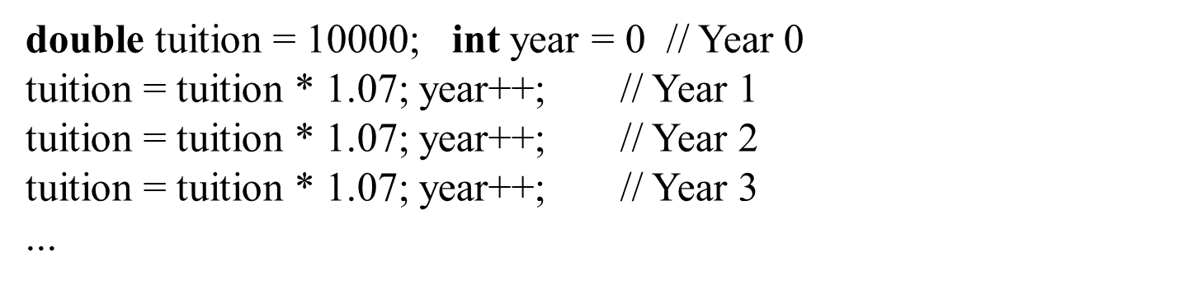
Problem: Predicating the Future Tuition

Slide 45
Case Study: Converting Decimals to Hexadecimals
Hexadecimals are often used in computer systems programming (see Appendix F for an introduction to number systems). How do you convert a decimal number to a hexadecimal number? To convert a decimal number d to a hexadecimal number is to find the hexadecimal digits
such that
These hexadecimal digits can be found by successively dividing d by 16 until the quotient is 0. The remainders are
Dec2Hex
Run

Slide 46
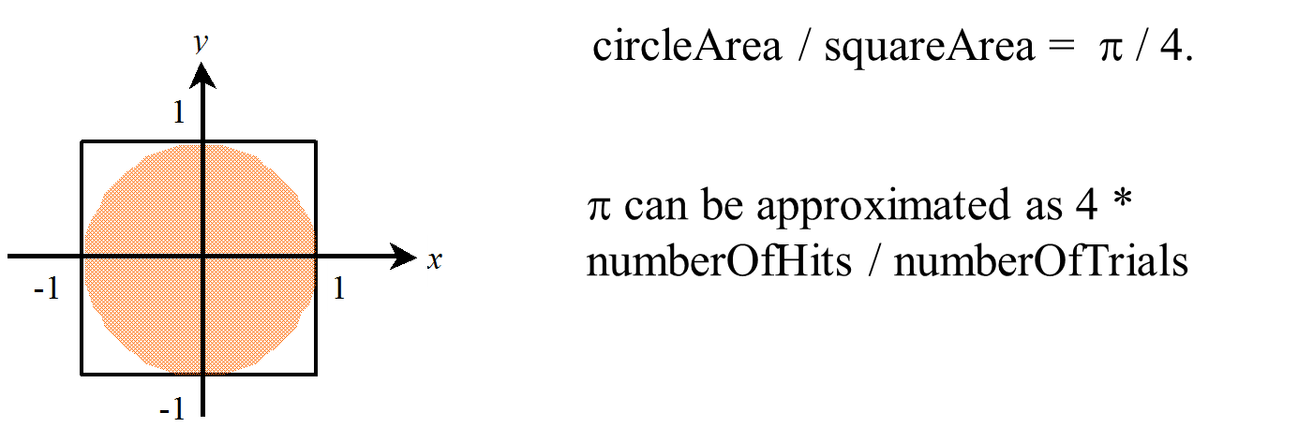
Problem: Monte Carlo Simulation
The Monte Carlo simulation refers to a technique that uses random numbers and probability to solve problems. This method has a wide range of applications in computational mathematics, physics, chemistry, and finance. This section gives an example of using the Monto Carlo simulation for estimating
MonteCarloSimulation
Run

Slide 47
Using break and continue
Examples for using the break and continue keywords:
TestBreak.java
TestBreak
Run
TestContinue.java
TestContinue
Run

Slide 48
break

Slide 49
continue

Slide 50
Guessing Number Problem Revisited
Here is a program for guessing a number. You can rewrite it using a break statement.
GuessNumberUsingBreak
Run

Slide 51
Problem: Checking Palindrome
A string is a palindrome if it reads the same forward and backward. The words “mom,” “dad,” and “noon,” for instance, are all palindromes.
The problem is to write a program that prompts the user to enter a string and reports whether the string is a palindrome. One solution is to check whether the first character in the string is the same as the last character. If so, check whether the second character is the same as the second-to-last character. This process continues until a mismatch is found or all the characters in the string are checked, except for the middle character if the string has an odd number of characters.
Palindrome
Run

Slide 52
Problem: Displaying Prime Numbers
Problem: Write a program that displays the first 50 prime numbers in five lines, each of which contains 10 numbers. An integer greater than 1 is prime if its only positive divisor is 1 or itself. For example, 2, 3, 5, and 7 are prime numbers, but 4, 6, 8, and 9 are not.
Solution: The problem can be broken into the following tasks:
For number = 2, 3, 4, 5, 6, ..., test whether the number is prime.
Determine whether a given number is prime.
Count the prime numbers.
Print each prime number, and print 10 numbers per line.
PrimeNumber
Run

Slide 53
Debugging Loops in I D E Tools
Supplements II.C, II.E, and II.G.

Slide 54
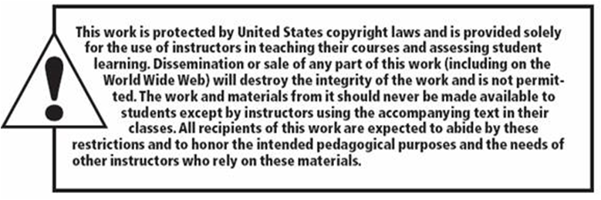
Copyright

