Slide 1
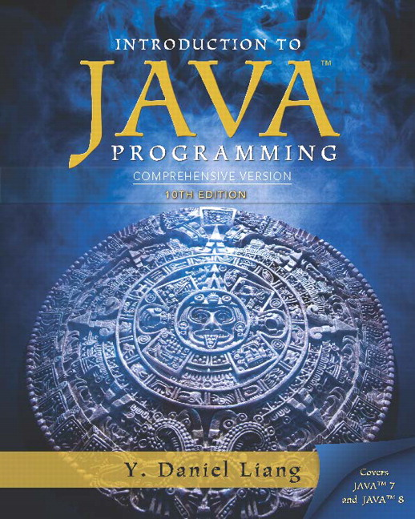
Introduction to Java Programming Comprehensive Version
Tenth Edition
Chapter 6
Methods
Copyright © 2015 Pearson Education, Inc. All Rights Reserved
Notes:
If this PowerPoint presentation contains mathematical equations, you may need to check that your computer has the following installed:
1) MathType Plugin
2) Math Player (free versions available)
3) NVDA Reader (free versions available)

Slide 2
Opening Problem
Find the sum of integers from 1 to 10, from 20 to 30, and from 35 to 45, respectively.

Slide 3
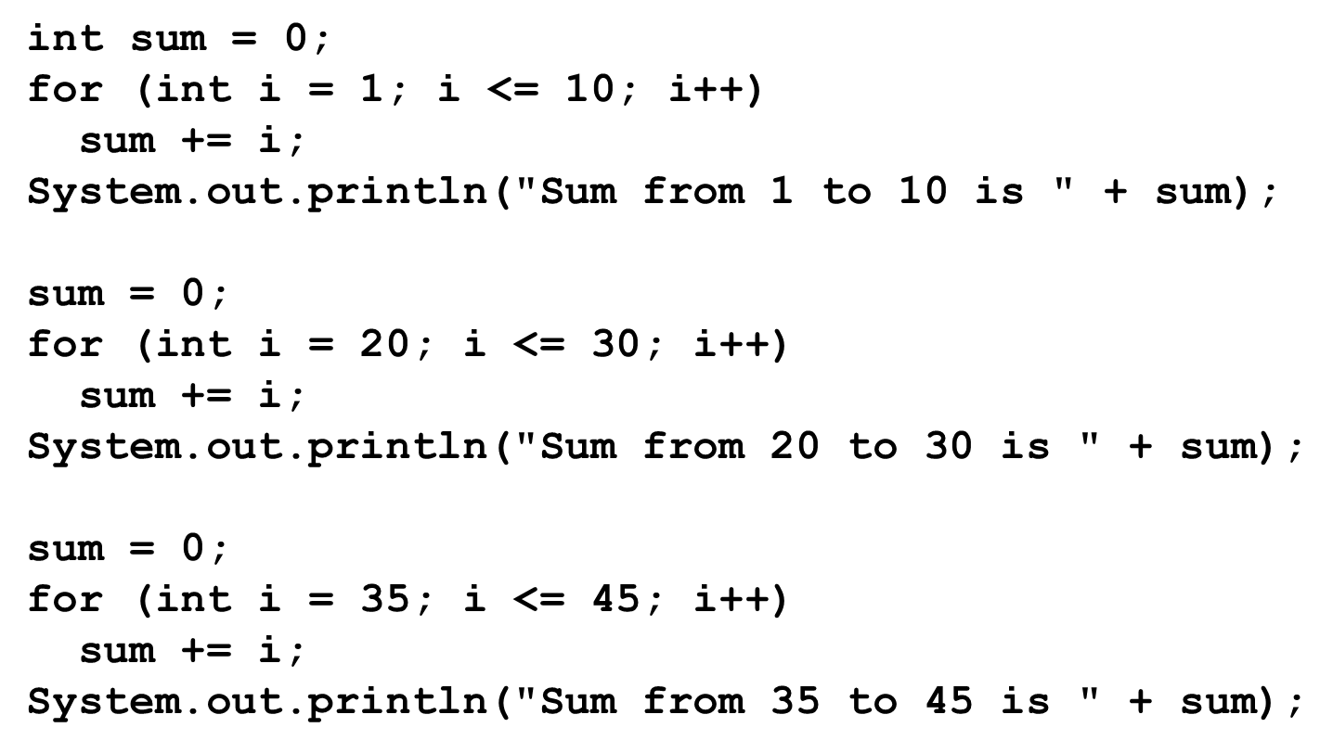
Problem (1 of 2)

Slide 4
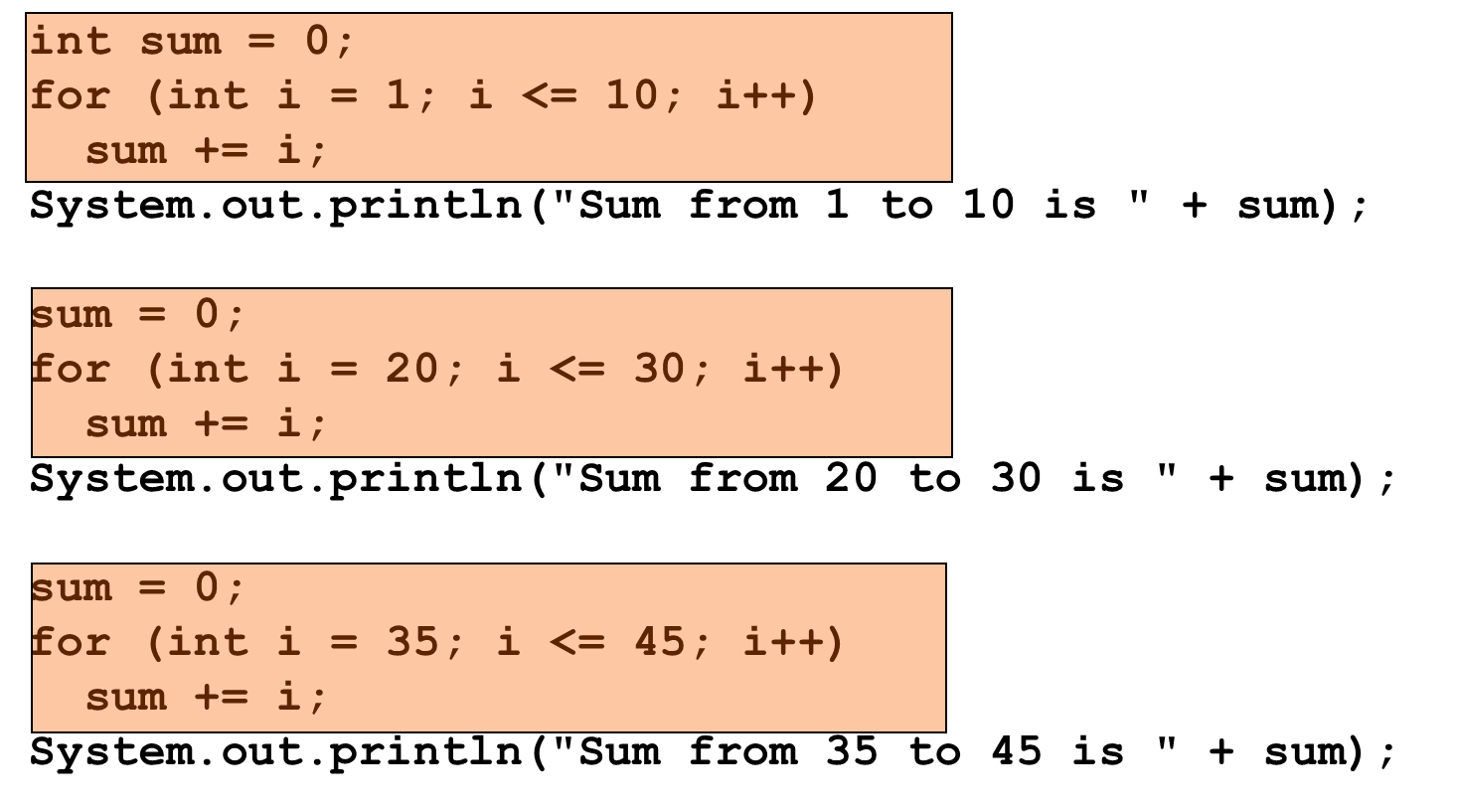
Problem (2 of 2)

Slide 5
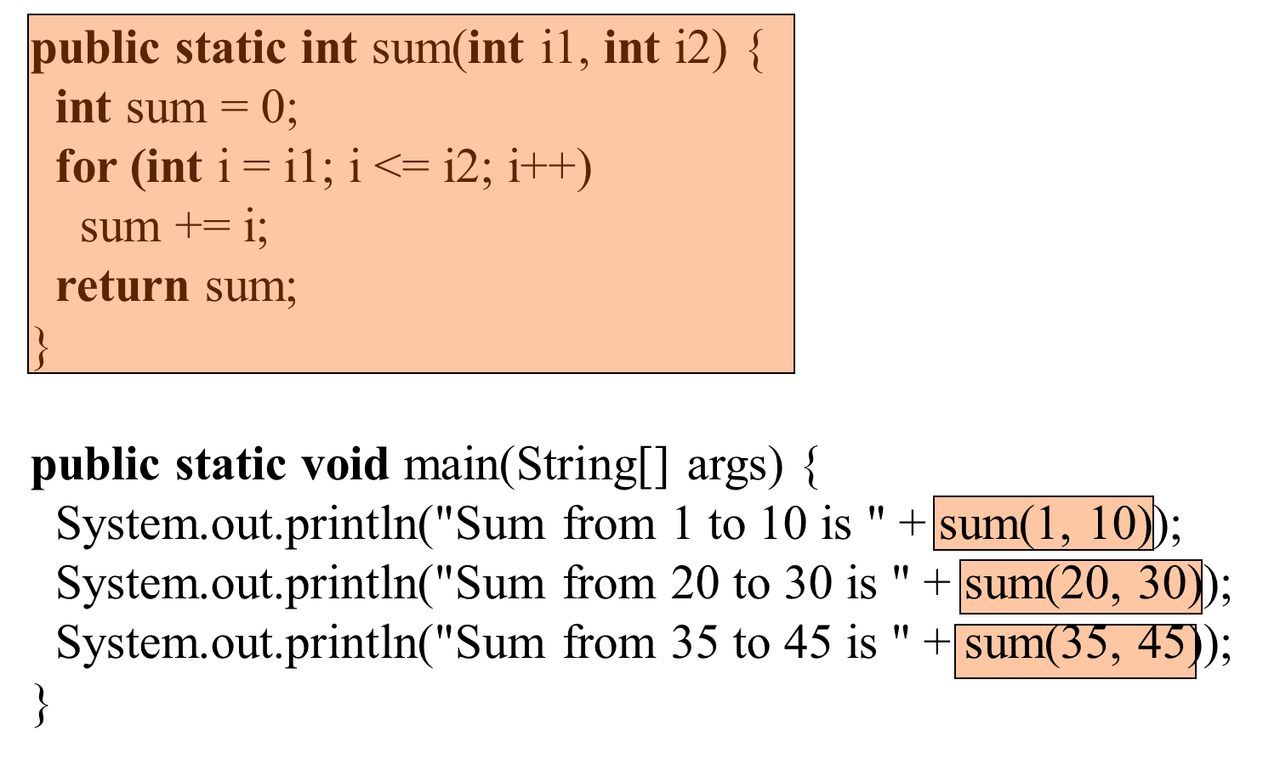
Solution

Slide 6
Objectives (1 of 2)
6.1 To define methods with formal parameters (§6.1).
6.2 To invoke methods with actual parameters (i.e., arguments) (§6.2).
6.3 To define methods with a return value (§6.3).
6.4 To define methods without a return value (§6.4).
6.5 To pass arguments by value (§6.5).
6.6 To develop reusable code that is modular, easy to read, easy to debug, and easy to maintain (§6.6).

Slide 7
Objectives (2 of 2)
6.7 To write a method that converts hexadecimals to decimals (§6.7).
6.8 To use method overloading and understand ambiguous overloading (§6.8).
6.9 To determine the scope of variables (§6.9).
6.10 To apply the concept of method abstraction in software development (§6.10).
6.11 To design and implement methods using stepwise refinement (§6.10).

Slide 8
Defining Methods (1 of 2)
A method is a collection of statements that are grouped together to perform an operation.

Slide 9
Defining Methods (2 of 2)
A method is a collection of statements that are grouped together to perform an operation.

Slide 10
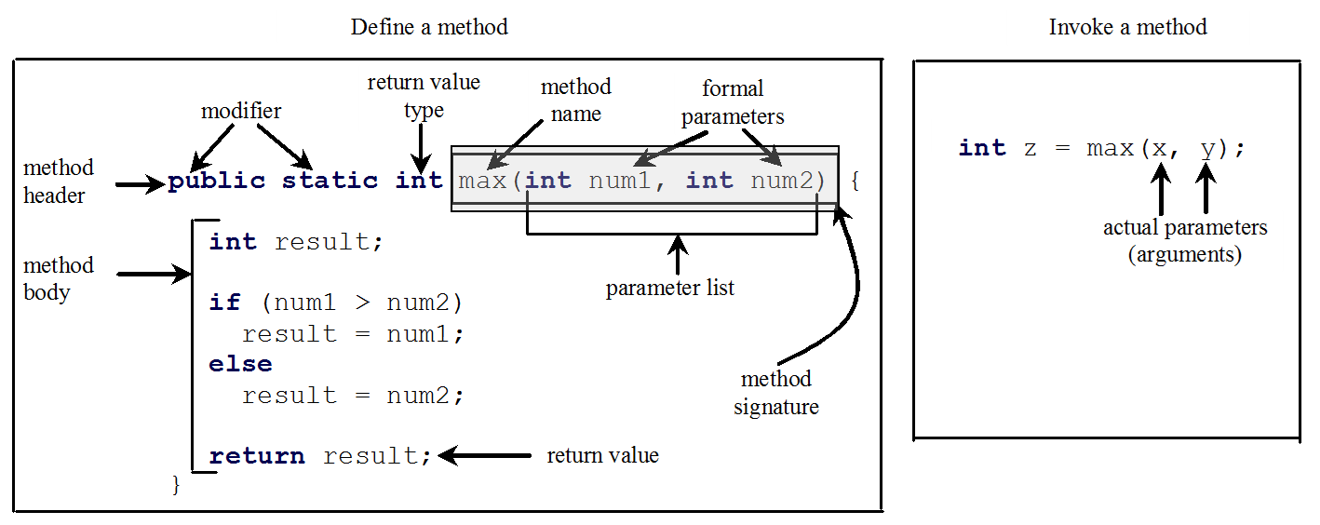
Method Signature
Method signature is the combination of the method name and the parameter list.

Slide 11
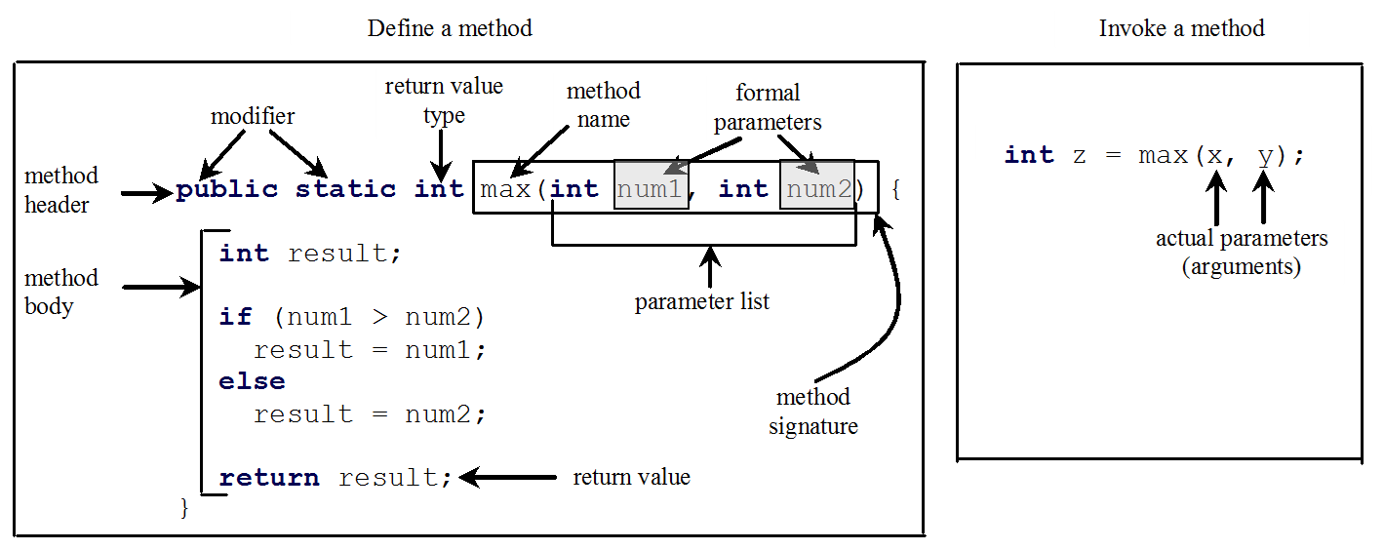
Formal Parameters
The variables defined in the method header are known as formal parameters.

Slide 12
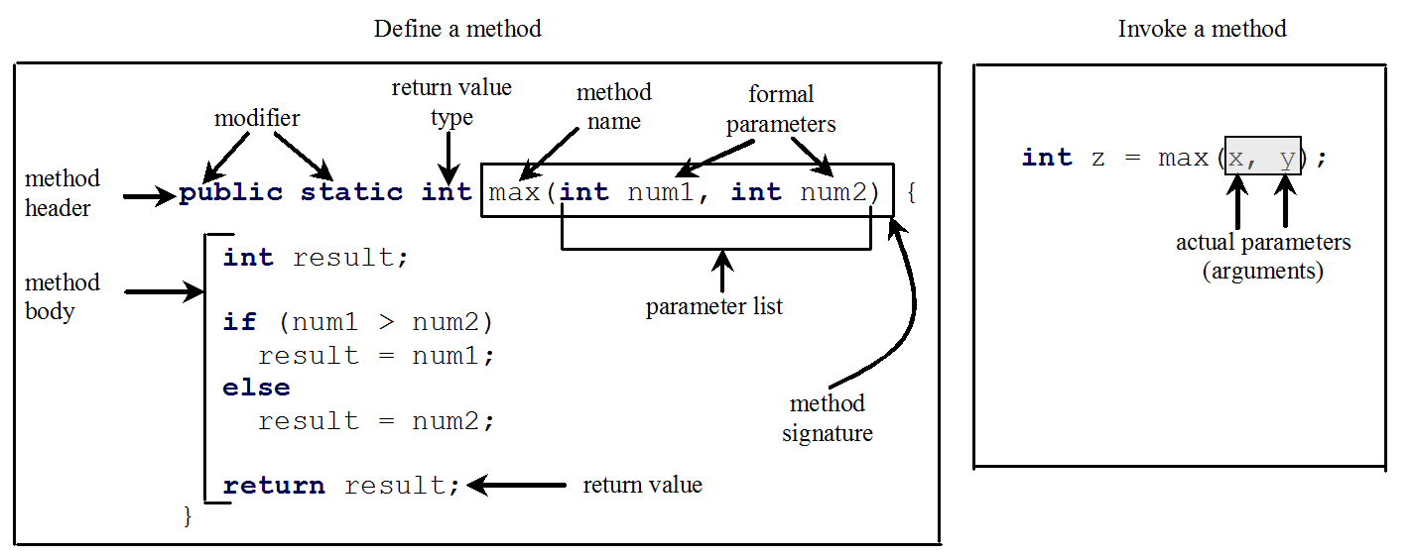
Actual Parameters
When a method is invoked, you pass a value to the parameter. This value is referred to as actual parameter or argument.

Slide 13
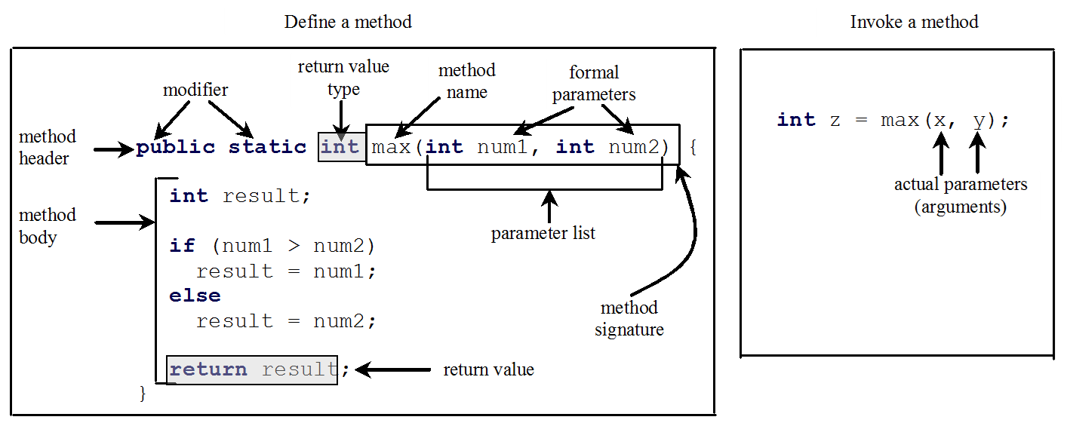
Return Value Type
A method may return a value. The returnValueType is the data type of the value the method returns. If the method does not return a value, the returnValueType is the keyword void. For example, the returnValueType in the main method is void.

Slide 14
Calling Methods (1 of 2)
Testing the max method
This program demonstrates calling a method max to return the largest of the int values
TestMax
Run

Slide 15
Calling Methods (2 of 2)

Slide 16
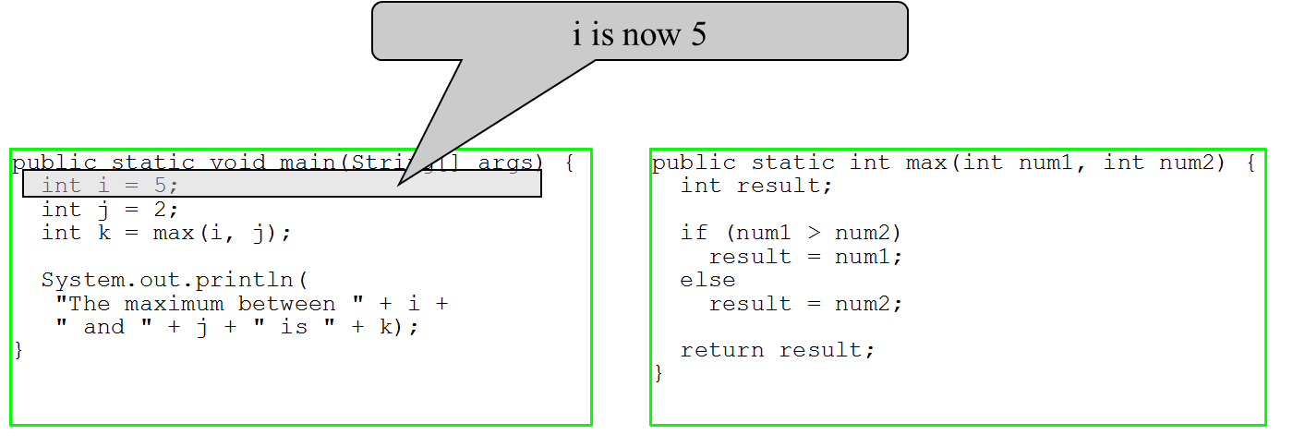
Trace Method Invocation (1 of 10)

Slide 17
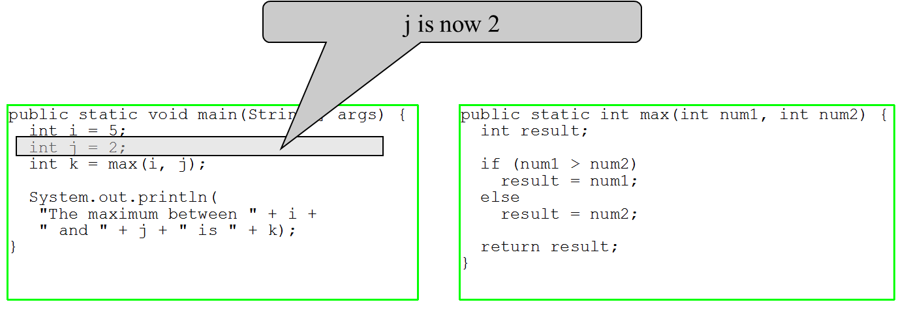
Trace Method Invocation (2 of 10)

Slide 18
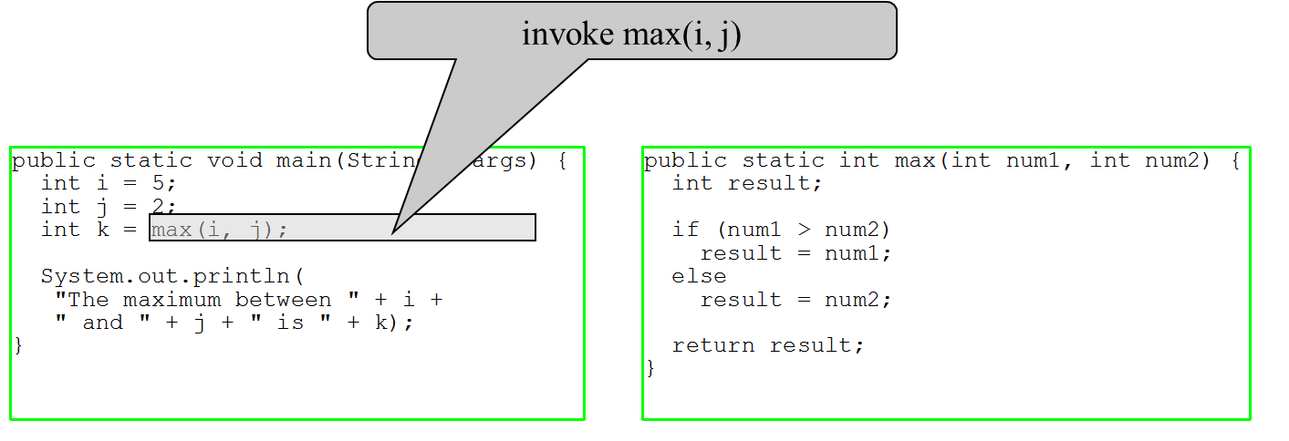
Trace Method Invocation (3 of 10)

Slide 19
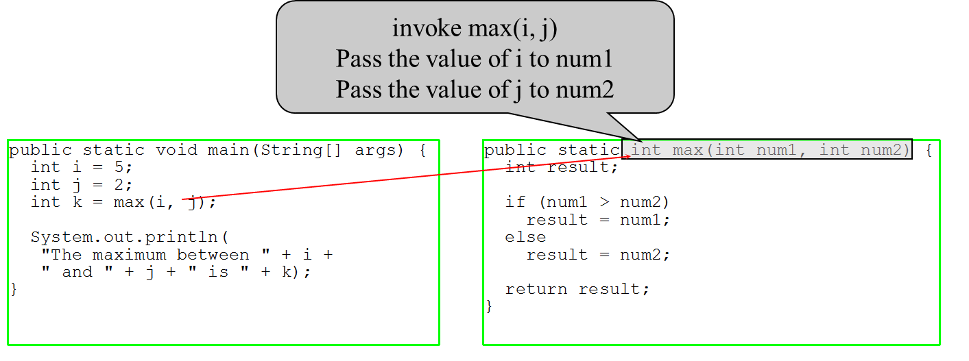
Trace Method Invocation (4 of 10)

Slide 20
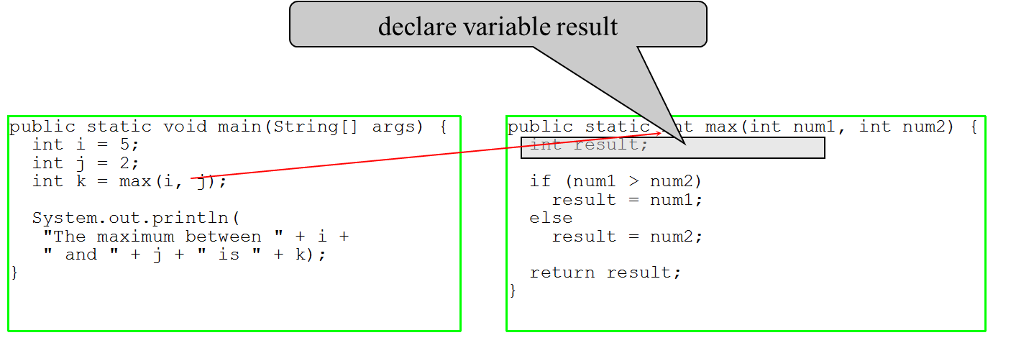
Trace Method Invocation (5 of 10)

Slide 21
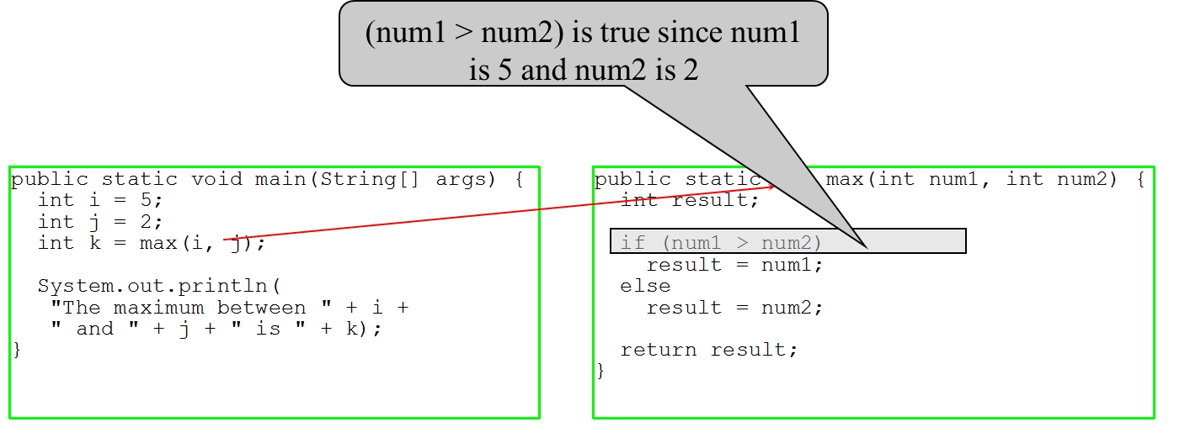
Trace Method Invocation (6 of 10)

Slide 22

Trace Method Invocation (7 of 10)

Slide 23
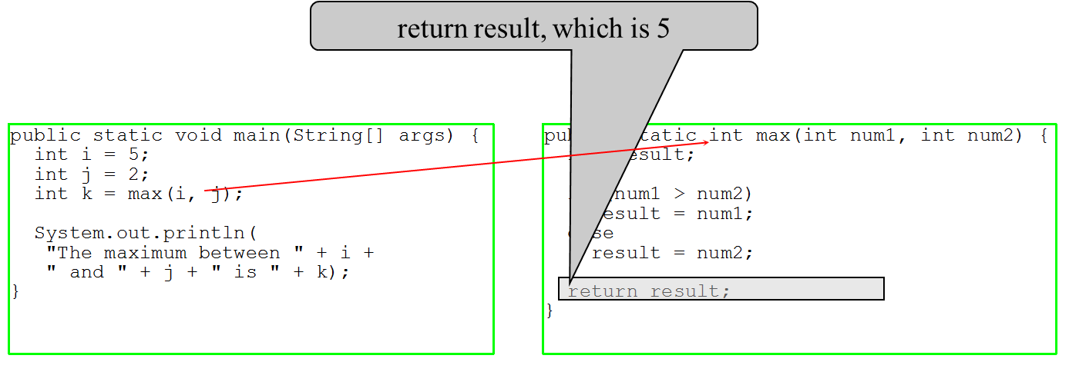
Trace Method Invocation (8 of 10)

Slide 24
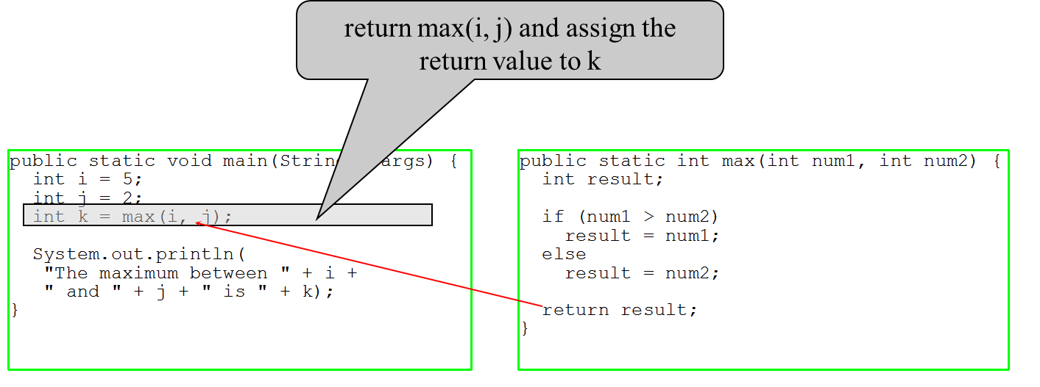
Trace Method Invocation (9 of 10)

Slide 25
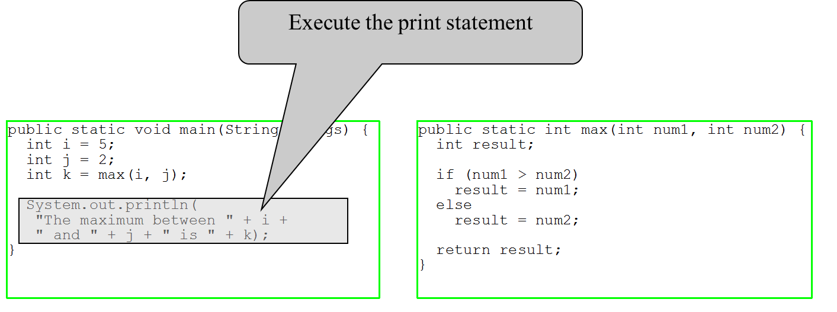
Trace Method Invocation (10 of 10)

Slide 26
Caution
A return statement is required for a value-returning method. The method shown below in (a) is logically correct, but it has a compilation error because the Java compiler thinks it possible that this method does not return any value.
To fix this problem, delete if (n < 0) in (a), so that the compiler will see a return statement to be reached regardless of how the if statement is evaluated.

Slide 27
Reuse Methods from Other Classes
Note: One of the benefits of methods is for reuse. The max method can be invoked from any class besides TestMax. If you create a new class Test, you can invoke the max method using ClassName.methodName (e.g., TestMax.max).

Slide 28
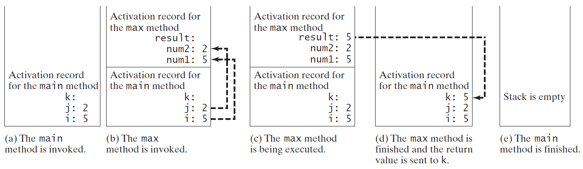
Call Stacks

Slide 29
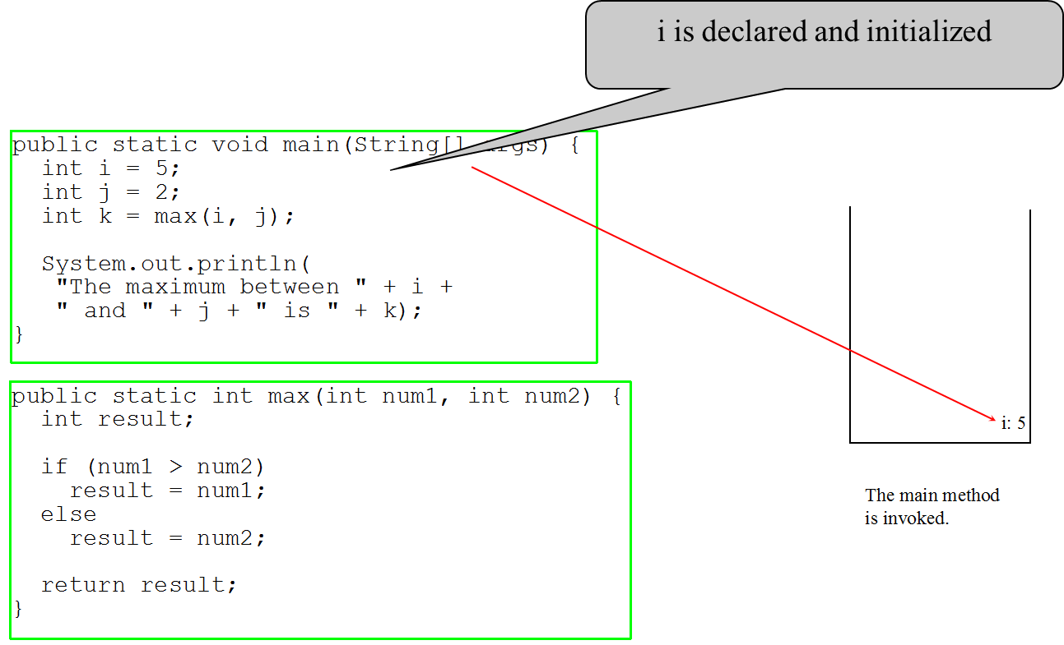
Trace Call Stack (1 of 10)

Slide 30
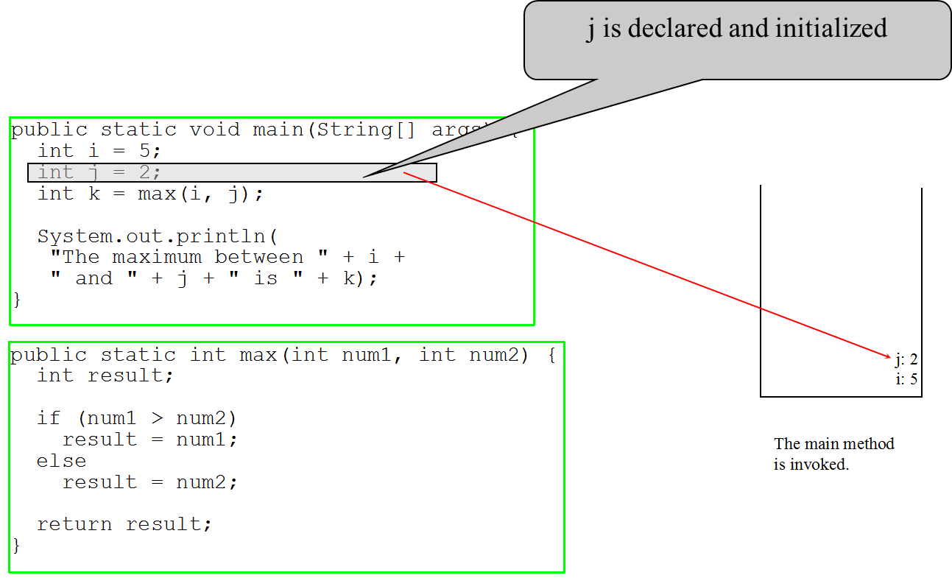
Trace Call Stack (2 of 10)

Slide 31
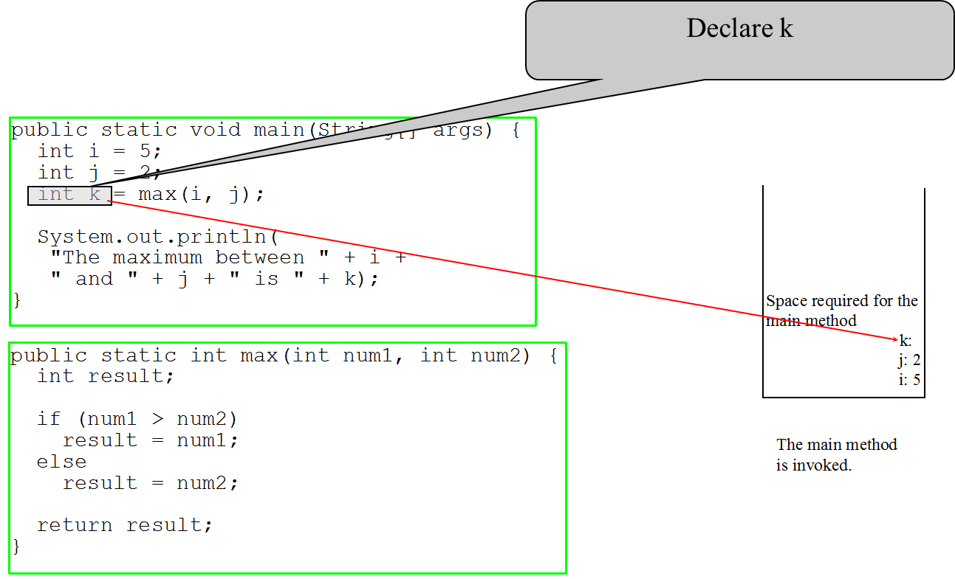
Trace Call Stack (3 of 10)

Slide 32
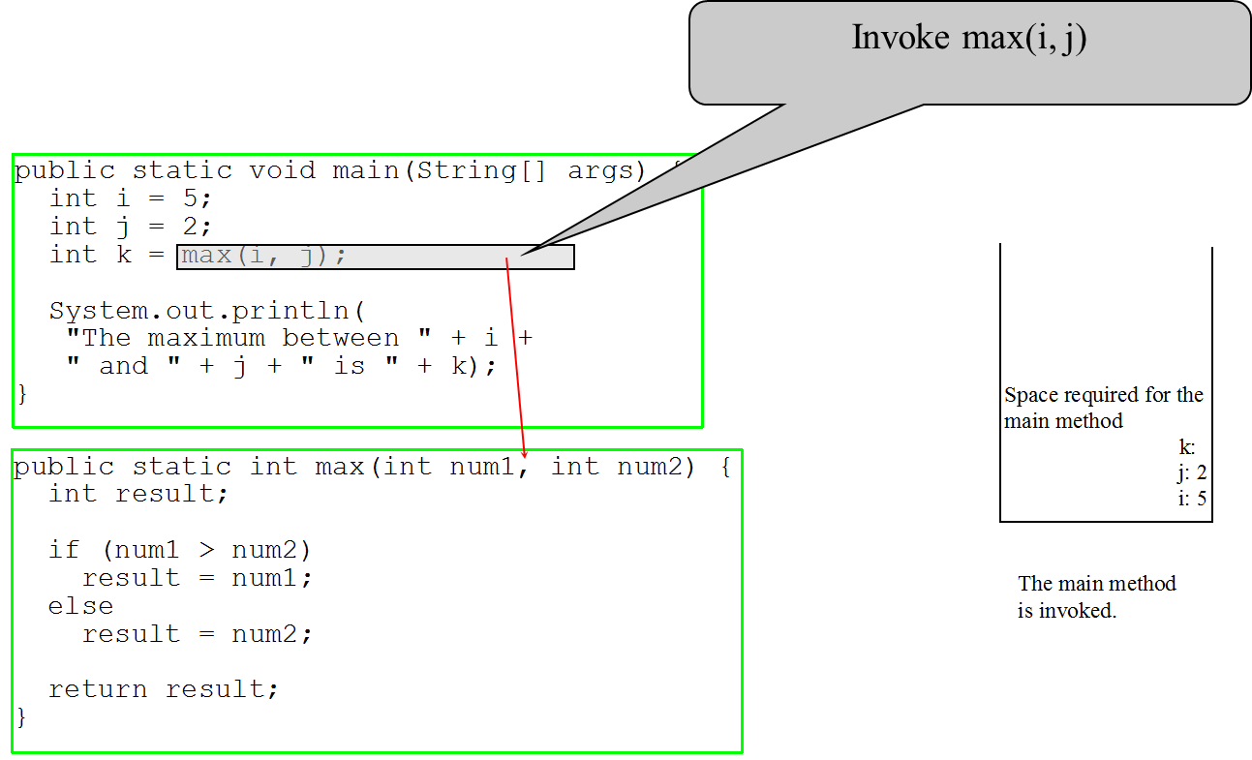
Trace Call Stack (4 of 10)

Slide 33
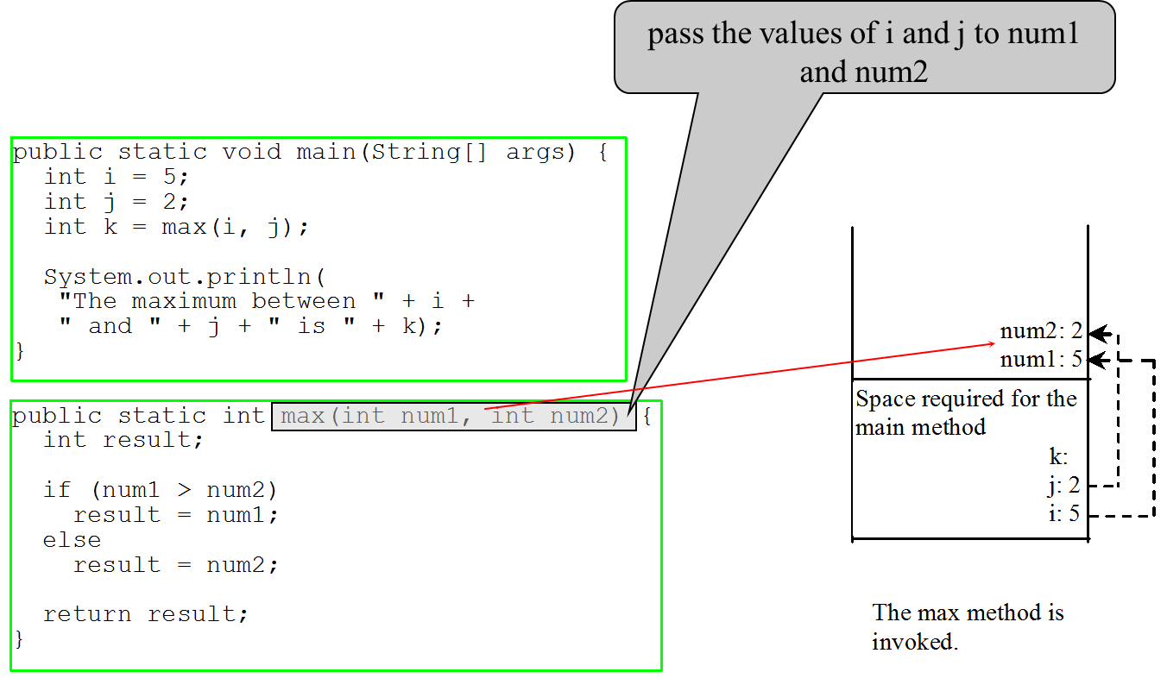
Trace Call Stack (5 of 10)

Slide 34
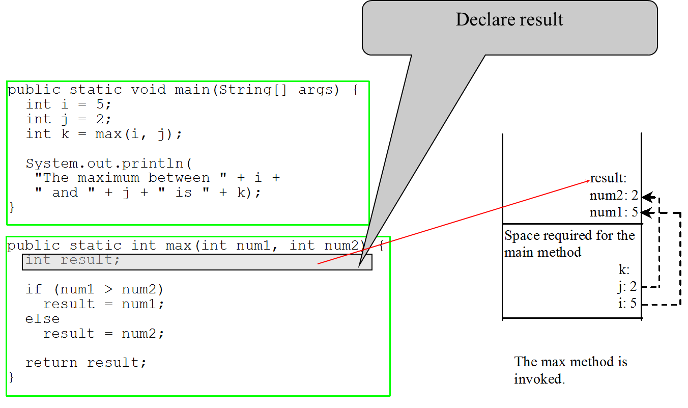
Trace Call Stack (6 of 10)

Slide 35
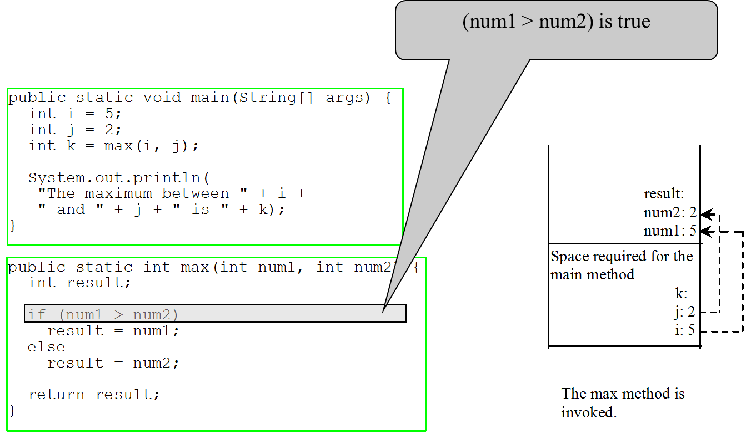
Trace Call Stack (7 of 10)

Slide 36
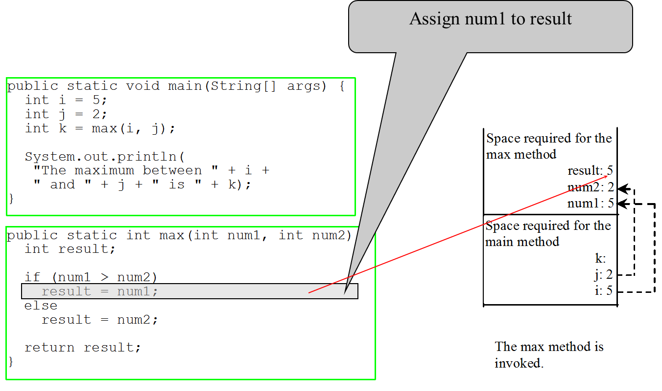
Trace Call Stack (8 of 10)

Slide 37
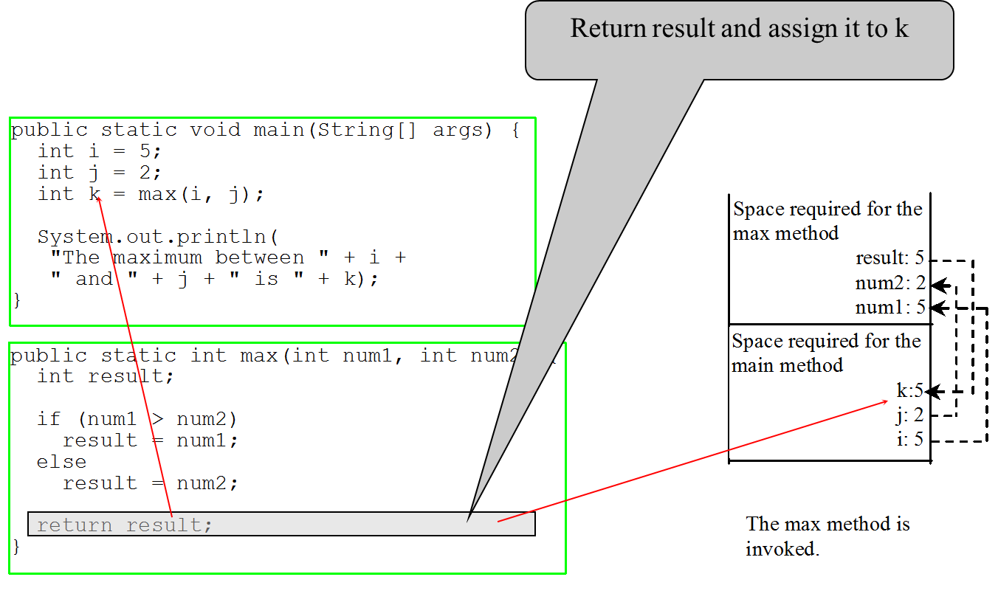
Trace Call Stack (9 of 10)

Slide 38
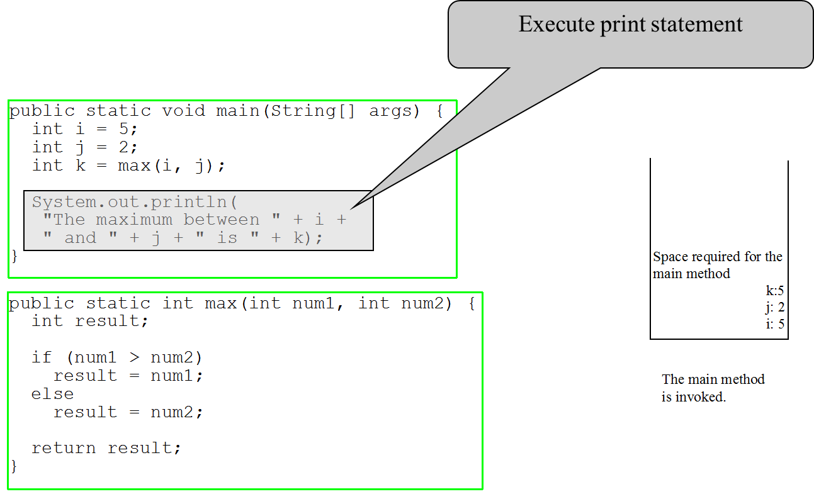
Trace Call Stack (10 of 10)

Slide 39
Void Method Example
This type of method does not return a value. The method performs some actions.
TestVoidMethod
Run
TestReturnGradeMethod
Run

Slide 40
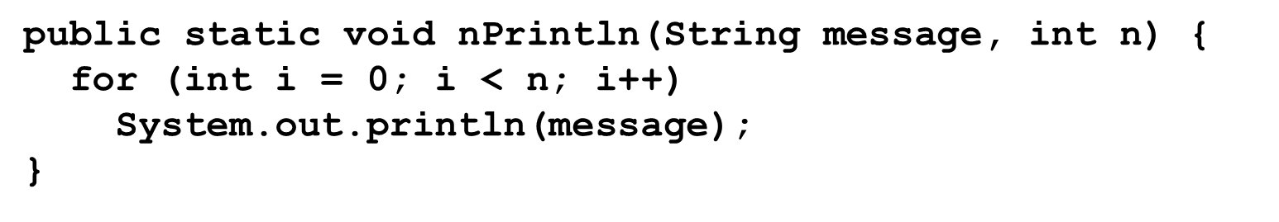
Passing Parameters
Suppose you invoke the method using
nPrintln(“Welcome to Java”, 5);
What is the output?
Suppose you invoke the method using
nPrintln(“Computer Science”, 15);
What is the output?
Can you invoke the method using
nPrintln(15, “Computer Science”);

Slide 41
Pass by Value (1 of 3)
This program demonstrates passing values to the methods.
Increment
Run

Slide 42
Pass by Value (2 of 3)
Testing Pass by value
This program demonstrates passing values to the methods.
TestPassByValue
Run

Slide 43
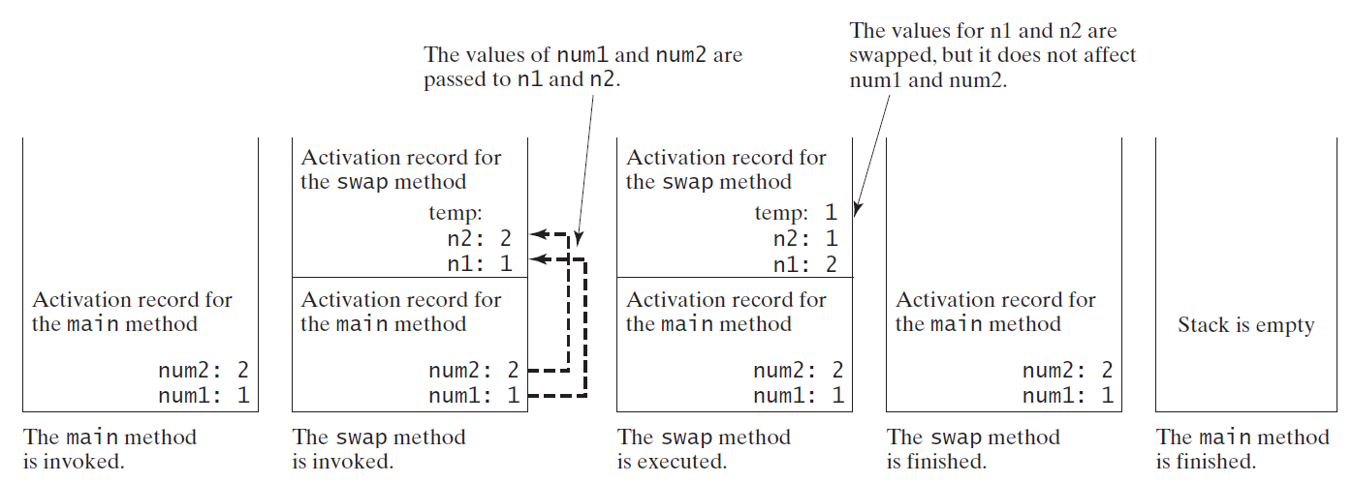
Pass by Value (3 of 3)

Slide 44
Modularizing Code
Methods can be used to reduce redundant coding and enable code reuse. Methods can also be used to modularize code and improve the quality of the program.
GreatestCommonDivisorMethod
Run
PrimeNumberMethod
Run

Slide 45
Case Study: Converting Hexadecimals to Decimals
Write a method that converts a hexadecimal number into a decimal number.
Hex2Dec
Run

Slide 46
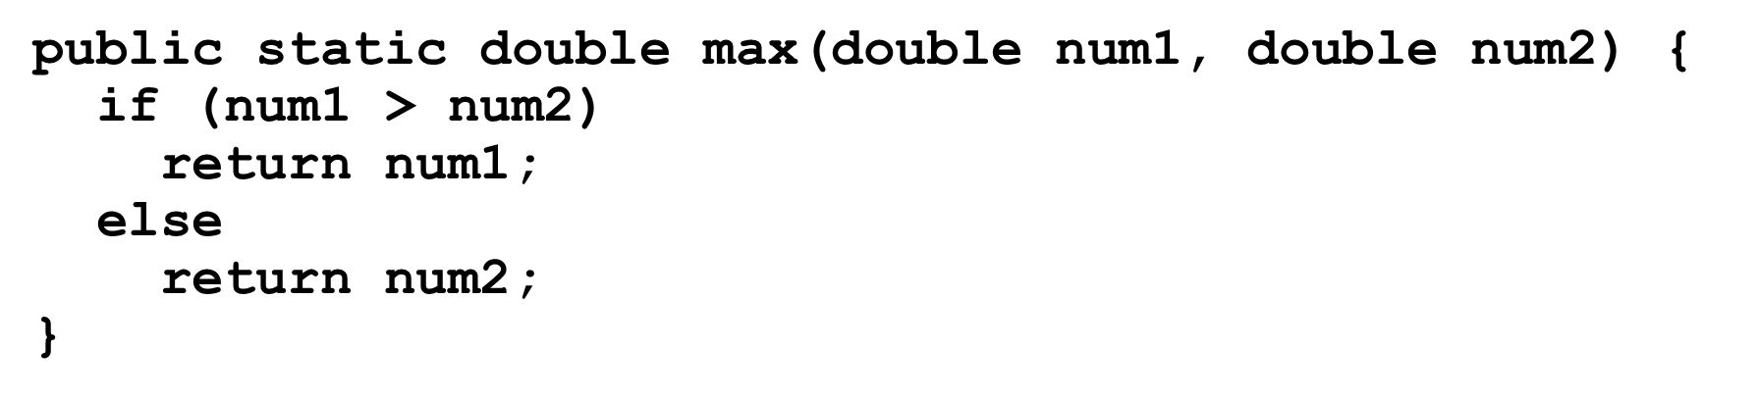
Overloading Methods
Overloading the max Method
TestMethodOverloading
Run

Slide 47
Ambiguous Invocation (1 of 2)
Sometimes there may be two or more possible matches for an invocation of a method, but the compiler cannot determine the most specific match. This is referred to as ambiguous invocation. Ambiguous invocation is a compile error.

Slide 48
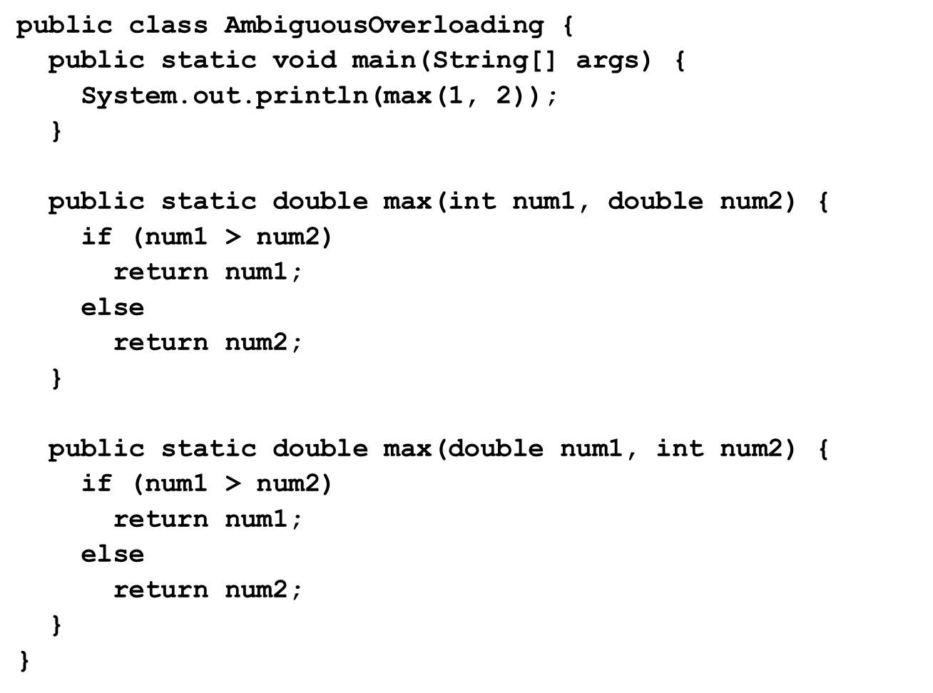
Ambiguous Invocation (2 of 2)

Slide 49
Scope of Local Variables (1 of 6)
A local variable: a variable defined inside a method.
Scope: the part of the program where the variable can be referenced.
The scope of a local variable starts from its declaration and continues to the end of the block that contains the variable. A local variable must be declared before it can be used.

Slide 50
Scope of Local Variables (2 of 6)
You can declare a local variable with the same name multiple times in different non-nesting blocks in a method, but you cannot declare a local variable twice in nested blocks.

Slide 51
Scope of Local Variables (3 of 6)
A variable declared in the initial action part of a for loop header has its scope in the entire loop. But a variable declared inside a for loop body has its scope limited in the loop body from its declaration and to the end of the block that contains the variable.

Slide 52
Scope of Local Variables (4 of 6)

Slide 53
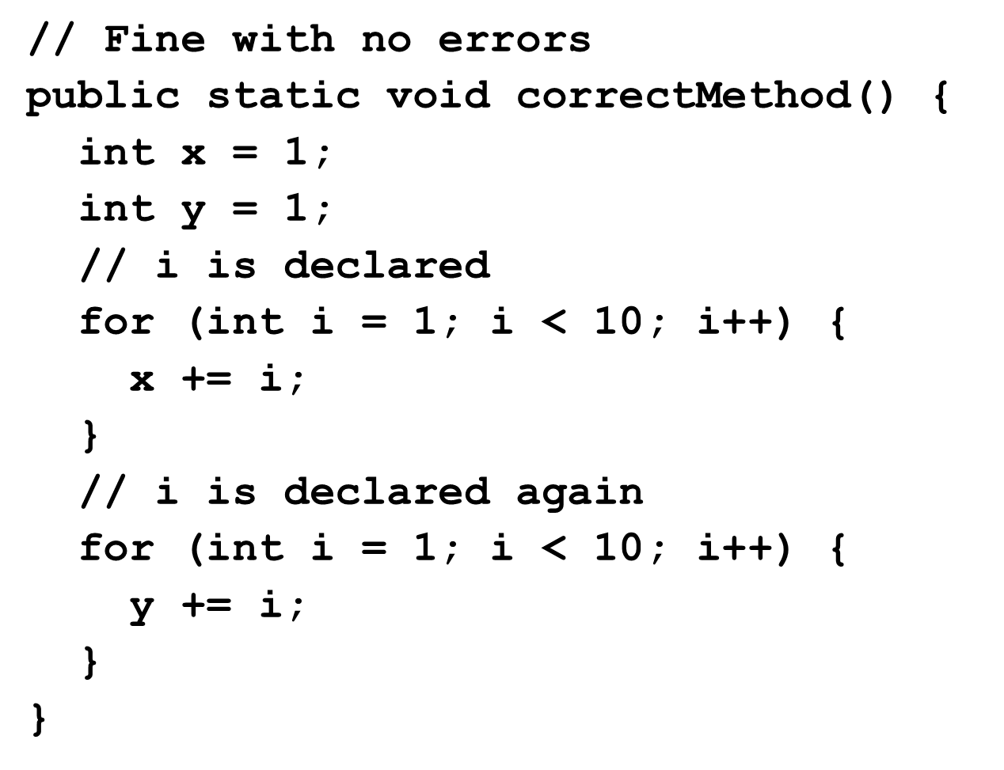
Scope of Local Variables (5 of 6)

Slide 54
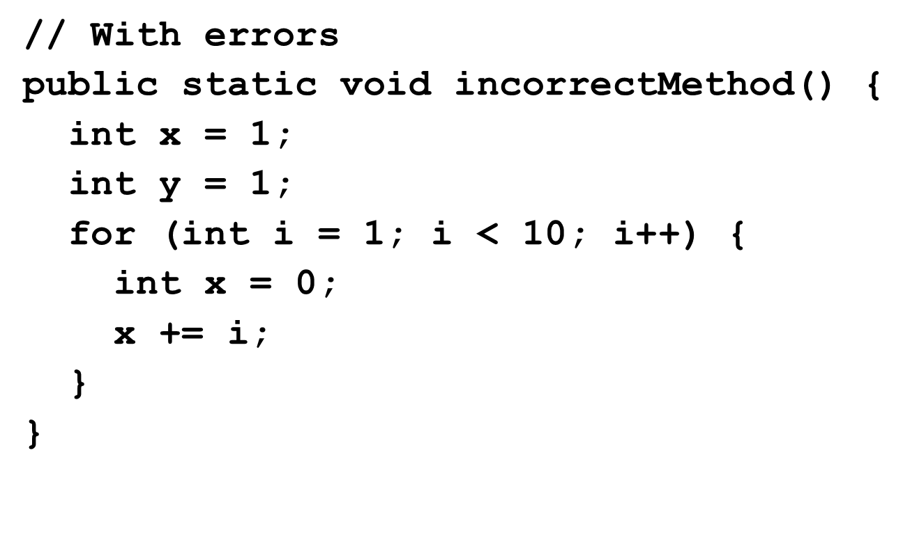
Scope of Local Variables (6 of 6)

Slide 55
Method Abstraction
You can think of the method body as a black box that contains the detailed implementation for the method.

Slide 56
Benefits of Methods
Write a method once and reuse it anywhere.
Information hiding. Hide the implementation from the user.
Reduce complexity.

Slide 57
Case Study: Generating Random Characters (1 of 5)
Computer programs process numerical data and characters. You have seen many examples that involve numerical data. It is also important to understand characters and how to process them.
As introduced in Section 2.9, each character has a unique Unicode between 0 and FFFF in hexadecimal (65535 in decimal). To generate a random character is to generate a random integer between 0 and 65535 using the following expression:

Slide 58
Case Study: Generating Random Characters (2 of 5)
Now let us consider how to generate a random lowercase letter. The Unicode for lowercase letters are consecutive integers starting from the Unicode for ‘a’, then for ‘b’, ‘c’, ..., and ‘z’. The Unicode for ‘a’ is

Slide 59
Case Study: Generating Random Characters (3 of 5)
Now let us consider how to generate a random lowercase letter. The Unicode for lowercase letters are consecutive integers starting from the Unicode for ‘a’, then for ‘b’, ‘c’, ..., and ‘z’. The Unicode for ‘a’ is

Slide 60
Case Study: Generating Random Characters (4 of 5)
As discussed in Chapter 2., all numeric operators can be applied to the char operands. The char operand is cast into a number if the other operand is a number or a character. So, the preceding expression can be simplified as follows:

Slide 61
Case Study: Generating Random Characters (5 of 5)
To generalize the foregoing discussion, a random character between any two characters ch1 and ch2 with ch1 < ch2 can be generated as follows:

Slide 62
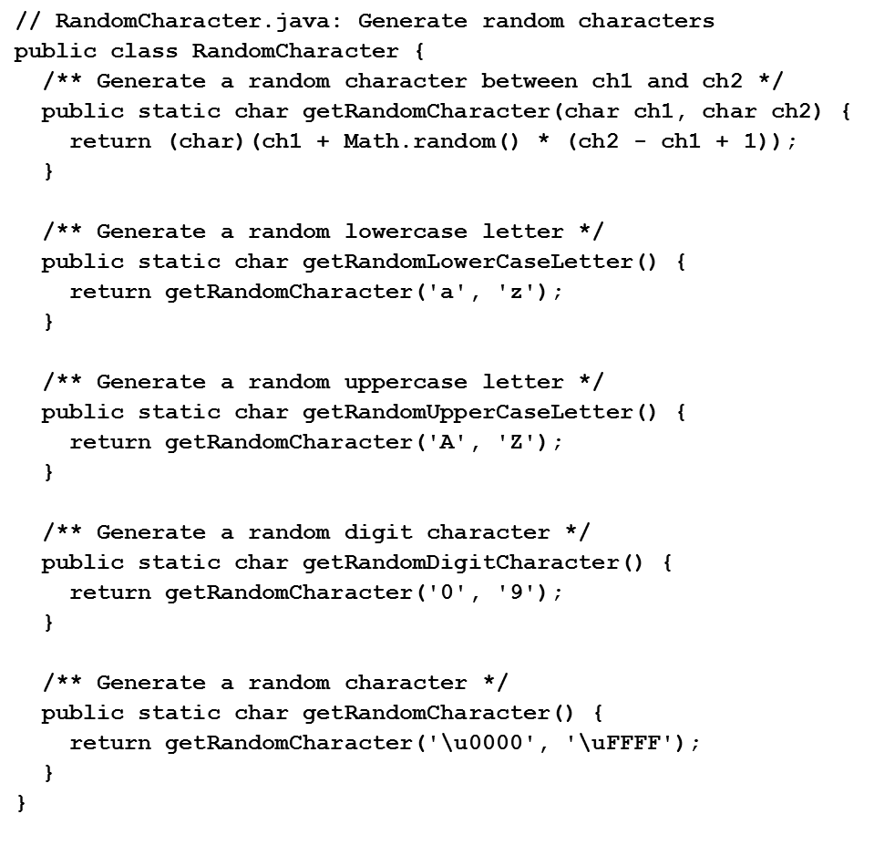
The RandomCharacter Class
RandomCharacter
TestRandomCharacter
Run

Slide 63
Stepwise Refinement (Optional)
The concept of method abstraction can be applied to the process of developing programs. When writing a large program, you can use the “divide and conquer” strategy, also known as stepwise refinement, to decompose it into sub problems. The sub problems can be further decomposed into smaller, more manageable problems.

Slide 64
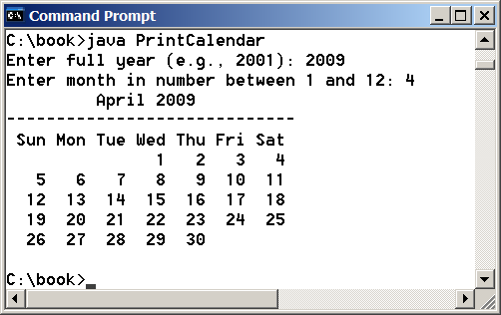
PrintCalender Case Study
Let us use the PrintCalendar example to demonstrate the stepwise refinement approach.
PrintCalndar
Run

Slide 65

Design Diagram (1 of 7)

Slide 66
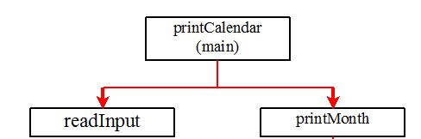
Design Diagram (2 of 7)

Slide 67
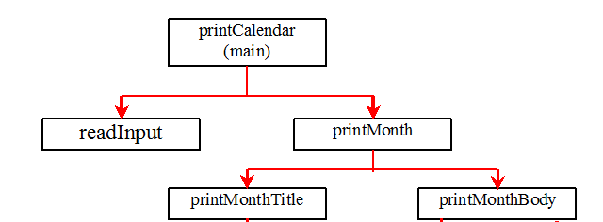
Design Diagram (3 of 7)

Slide 68
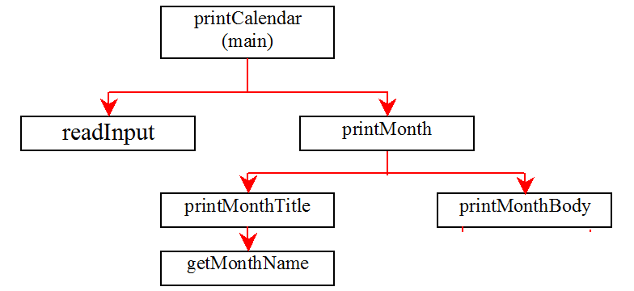
Design Diagram (4 of 7)

Slide 69
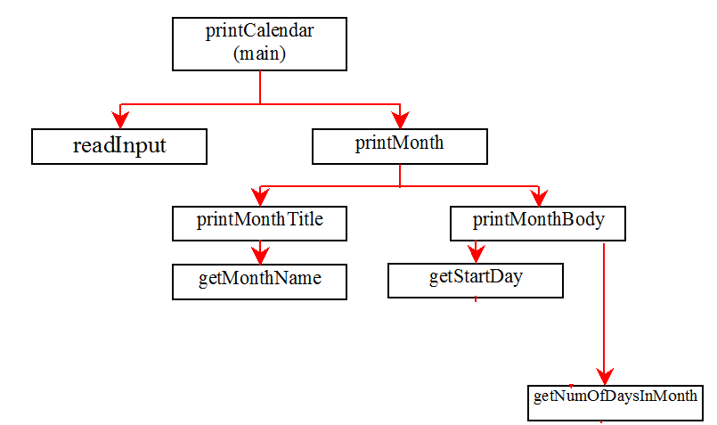
Design Diagram (5 of 7)

Slide 70
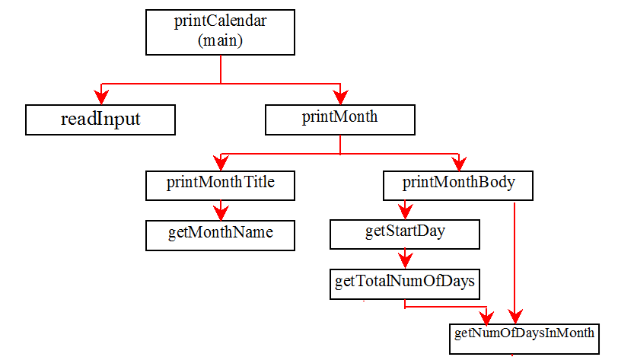
Design Diagram (6 of 7)

Slide 71
Design Diagram (7 of 7)

Slide 72
Implementation: Top-Down
Top-down approach is to implement one method in the structure chart at a time from the top to the bottom. Stubs can be used for the methods waiting to be implemented. A stub is a simple but incomplete version of a method. The use of stubs enables you to test invoking the method from a caller. Implement the main method first and then use a stub for the printMonth method. For example, let printMonth display the year and the month in the stub. Thus, your program may begin like this:
A Skeleton for printCalendar

Slide 73
Implementation: Bottom-Up
Bottom-up approach is to implement one method in the structure chart at a time from the bottom to the top. For each method implemented, write a test program to test it. Both top-down and bottom-up methods are fine. Both approaches implement the methods incrementally and help to isolate programming errors and makes debugging easy. Sometimes, they can be used together.

Slide 74
Benefits of Stepwise Refinement
Simpler Program
Reusing Methods
Easier Developing, Debugging, and Testing
Better Facilitating Teamwork

Slide 75
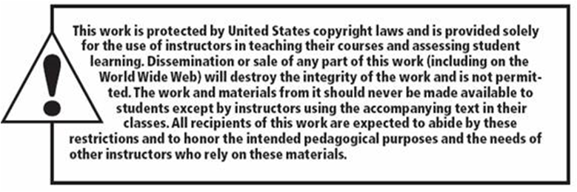
Copyright

