Slide 1
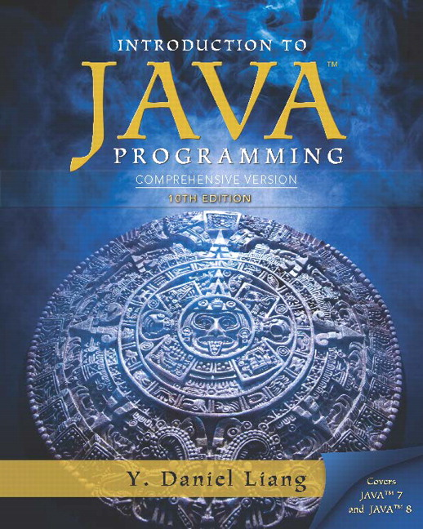
Introduction to Java Programming Comprehensive Version
Tenth Edition
Chapter 8
Multidimensional Arrays
Slides in the presentation contain hyperlinks. J A W S users should be able to get a list of links by using INSERT+F7
Copyright © 2015 Pearson Education, Inc. All Rights Reserved
Notes:
If this PowerPoint presentation contains mathematical equations, you may need to check that your computer has the following installed:
1) MathType Plugin
2) Math Player (free versions available)
3) NVDA Reader (free versions available)

Slide 2
Motivations (1 of 2)
Thus far, you have used one-dimensional arrays to model linear collections of elements. You can use a two-dimensional array to represent a matrix or a table. For example, the following table that describes the distances between the cities can be represented using a two-dimensional array.

Slide 3
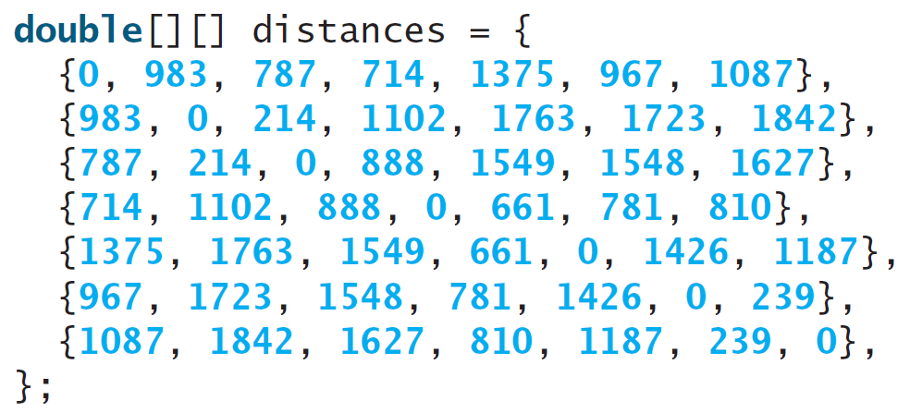
Motivations (2 of 2)

Slide 4
Objectives (1 of 2)
8.1 To give examples of representing data using two-dimensional arrays (§8.1).
8.2 To declare variables for two-dimensional arrays, create arrays, and access array elements in a two-dimensional array using row and column indexes (§8.2).
8.3 To program common operations for two-dimensional arrays (displaying arrays, summing all elements, finding the minimum and maximum elements, and random shuffling) (§8.3).

Slide 5
Objectives (2 of 2)
8.4 To pass two-dimensional arrays to methods (§8.4).
8.5 To write a program for grading multiple-choice questions using two-dimensional arrays (§8.5).
8.6 To solve the closest-pair problem using two-dimensional arrays (§8.6).
8.7 To check a Sudoku solution using two-dimensional arrays (§8.7).
8.8 To use multidimensional arrays (§8.8).

Slide 6
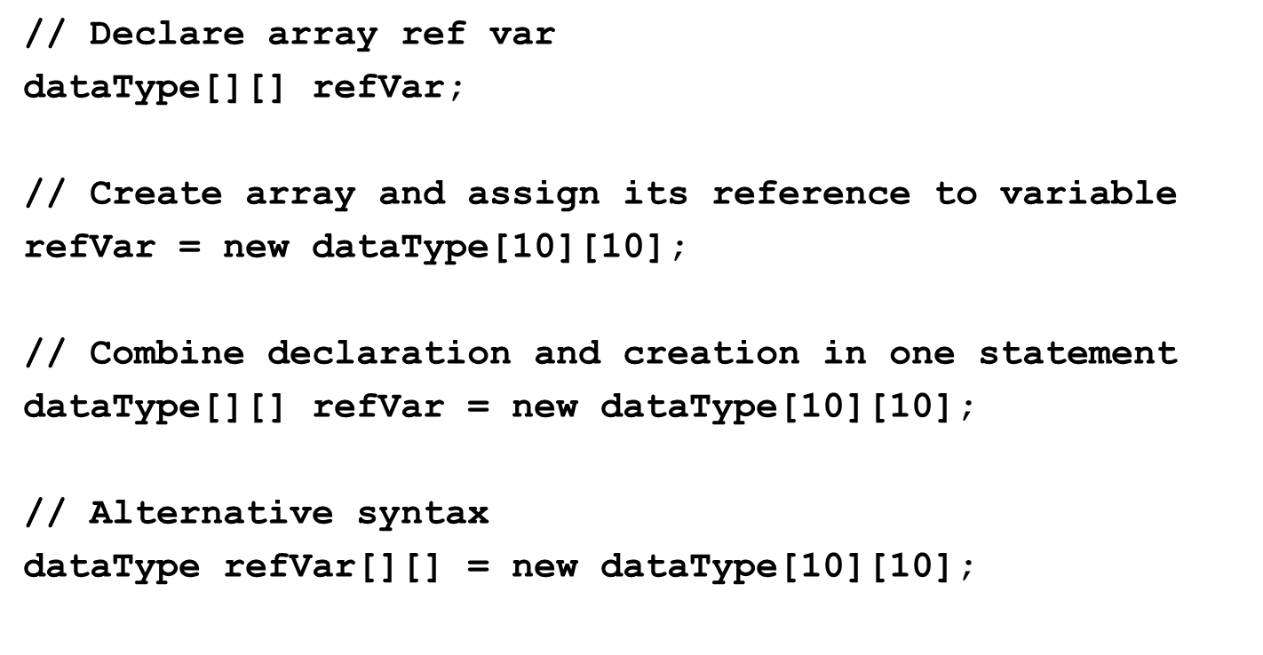
Declare/Create Two-dimensional Arrays

Slide 7
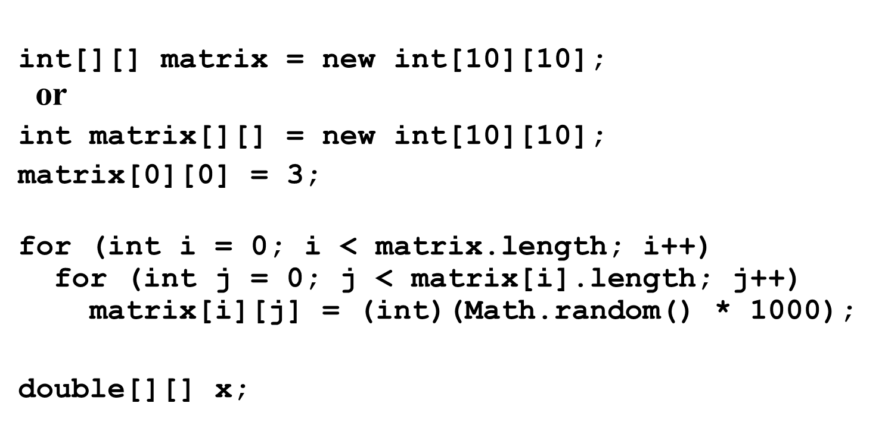
Declaring Variables of Two-dimensional Arrays and Creating Two-dimensional Arrays

Slide 8
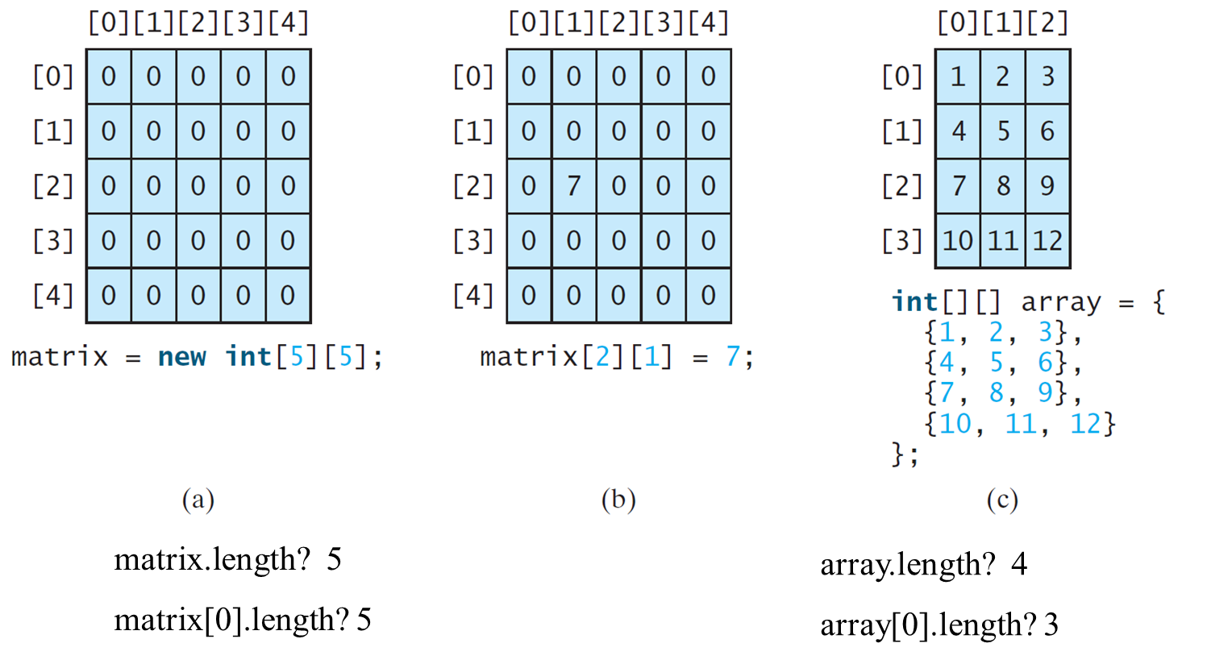
Two-dimensional Array Illustration

Slide 9
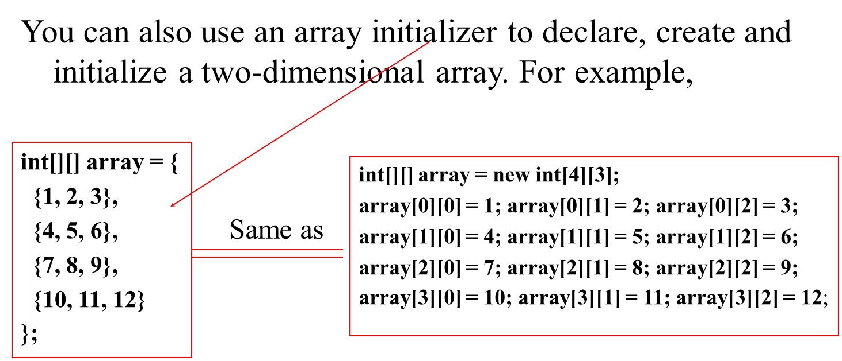
Declaring, Creating, and Initializing Using Shorthand Notations

Slide 10
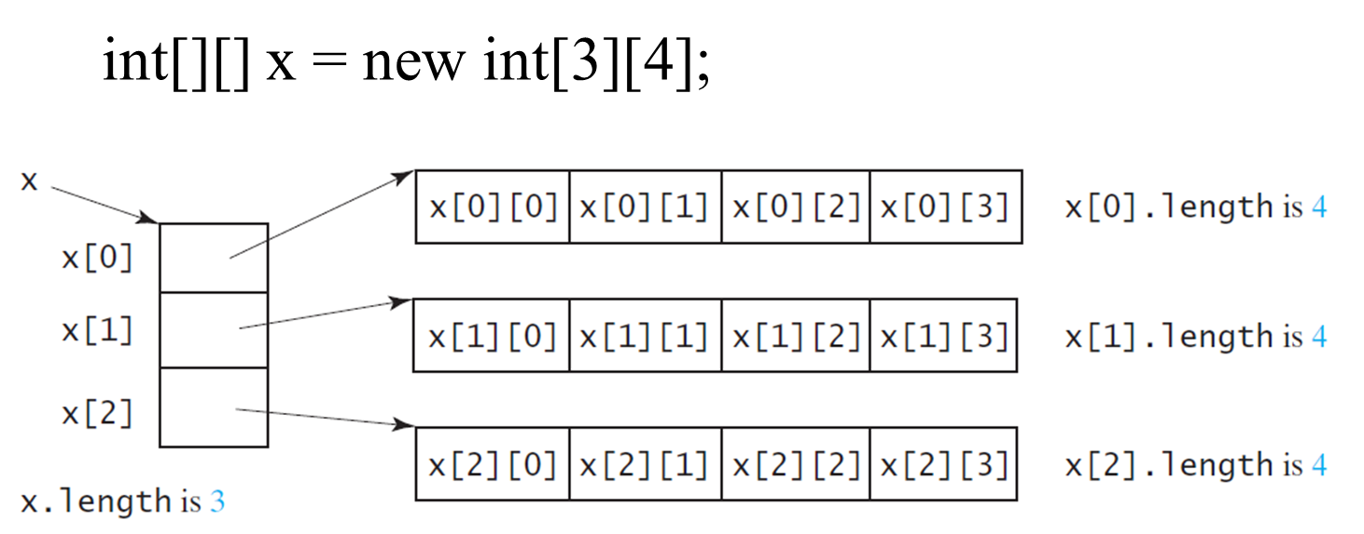
Lengths of Two-dimensional Arrays (1 of 2)

Slide 11
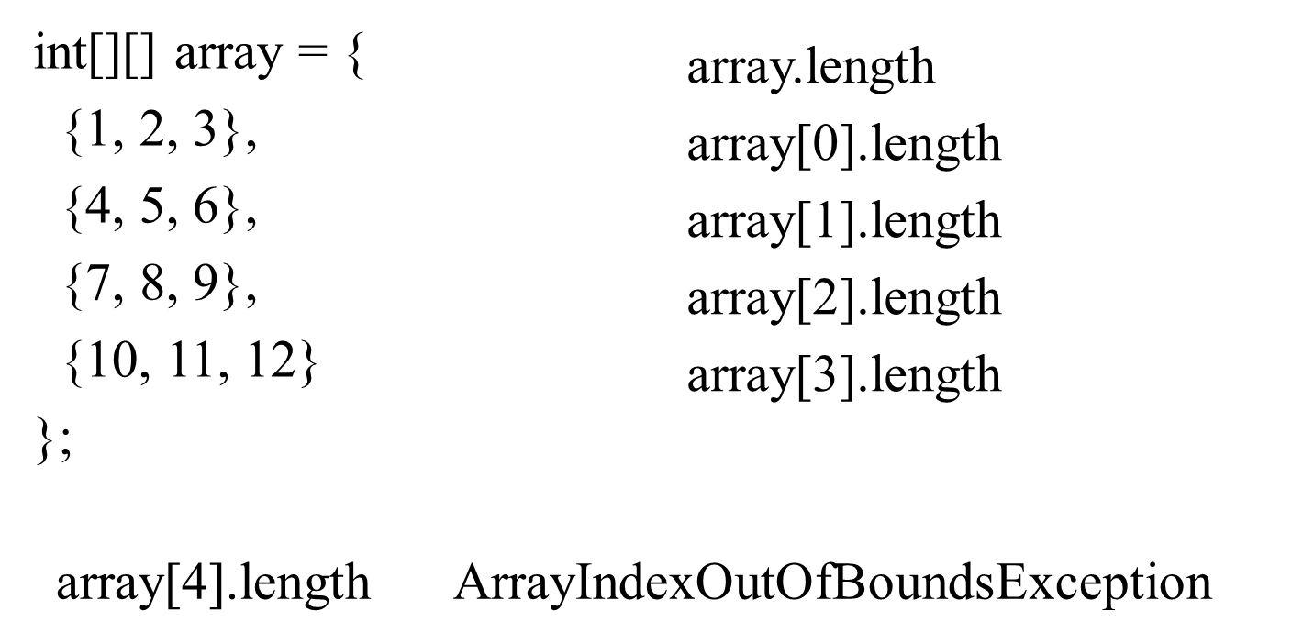
Lengths of Two-dimensional Arrays (2 of 2)

Slide 12
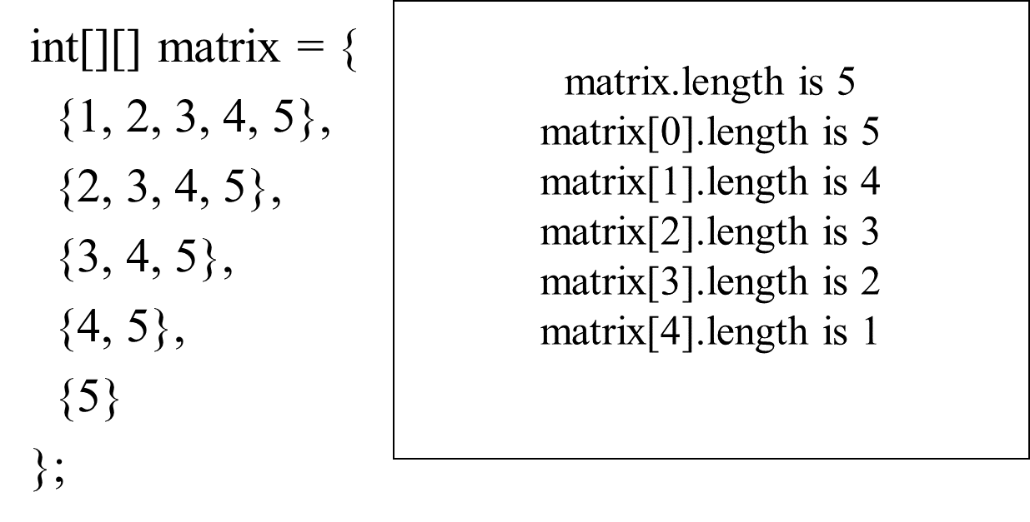
Ragged Arrays (1 of 2)
Each row in a two-dimensional array is itself an array. So, the rows can have different lengths. Such an array is known as a ragged array. For example,

Slide 13
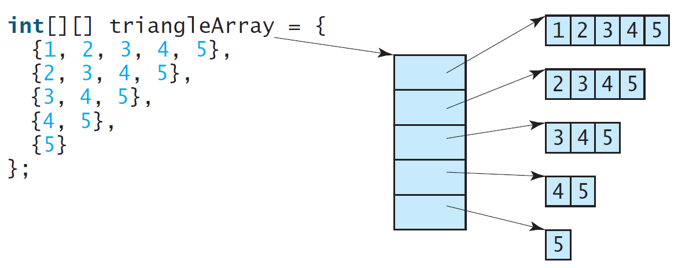
Ragged Arrays (2 of 2)

Slide 14
Processing Two-Dimensional Arrays
See the examples in the text.
(Initializing arrays with input values)
(Printing arrays)
(Summing all elements)
(Summing all elements by column)
(Which row has the largest sum)
(Finding the smallest index of the largest element)
(Random shuffling)

Slide 15
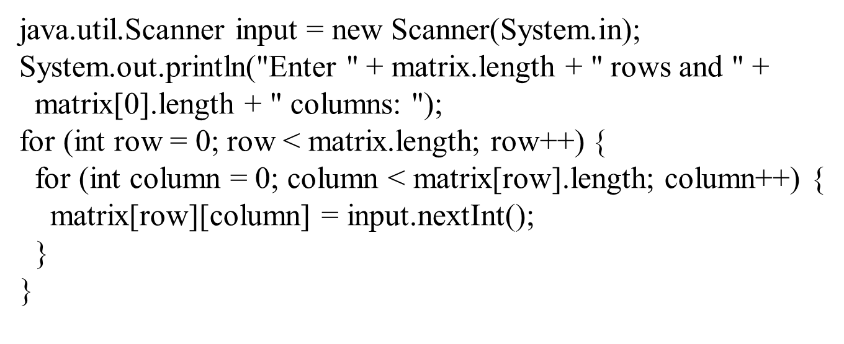
Initializing arrays with input values

Slide 16
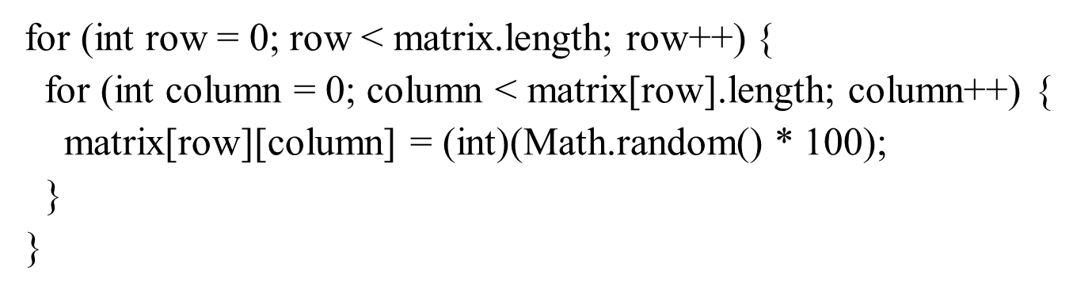
Initializing arrays with random values

Slide 17
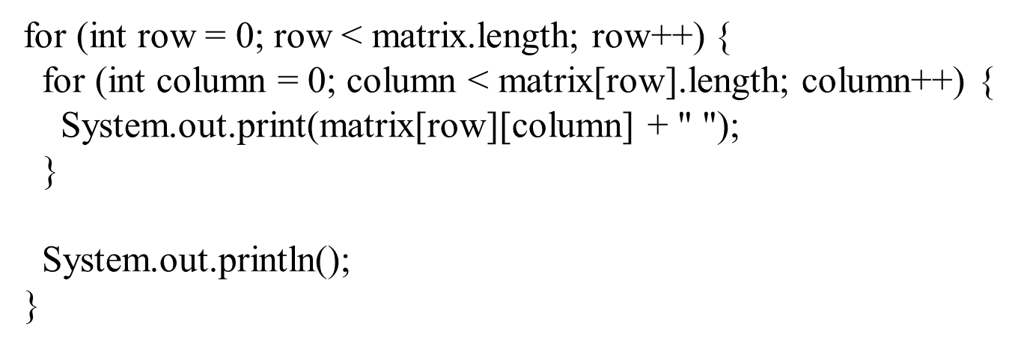
Printing arrays

Slide 18
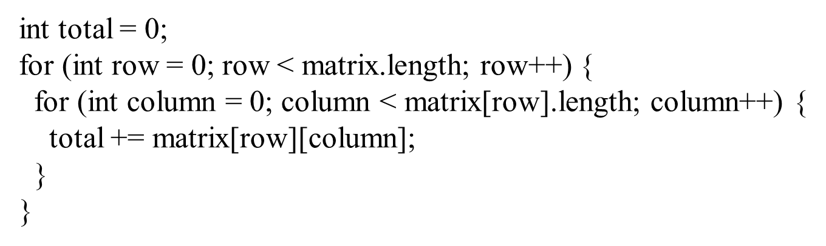
Summing all elements

Slide 19
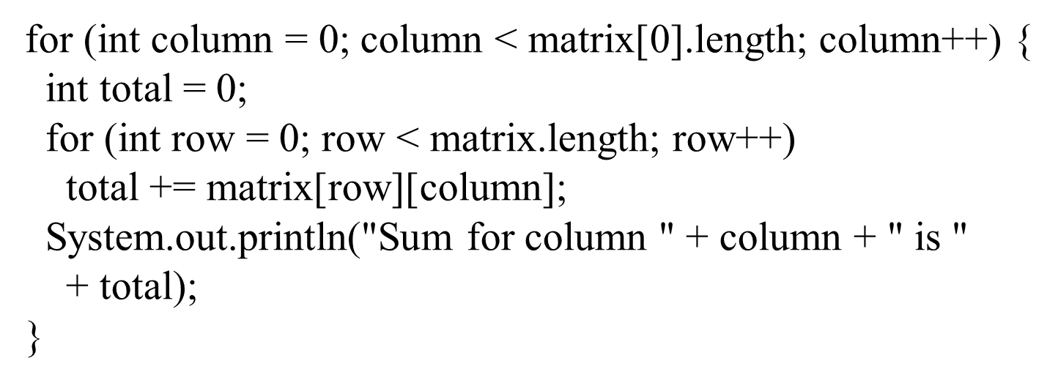
Summing elements by column

Slide 20
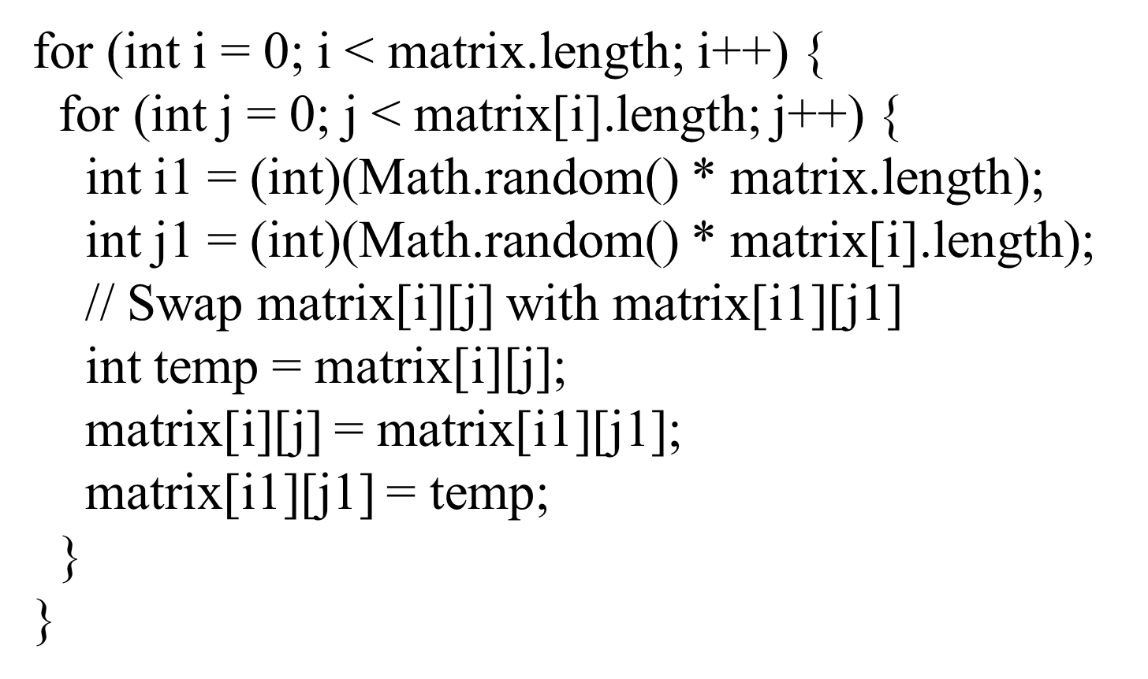
Random shuffling

Slide 21
Passing Tow-Dimensional Arrays to Methods
PassTwoDimensionalArray
Run

Slide 22
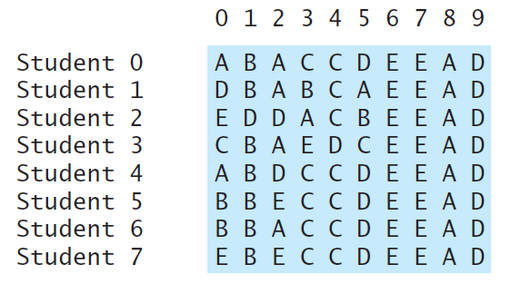
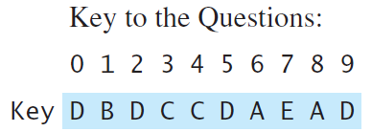
Problem: Grading Multiple-Choice Test
Students’ answer
Objective: write a program that grades multiple-choice test.
PassTwoDimensionalArray
Run

Slide 23
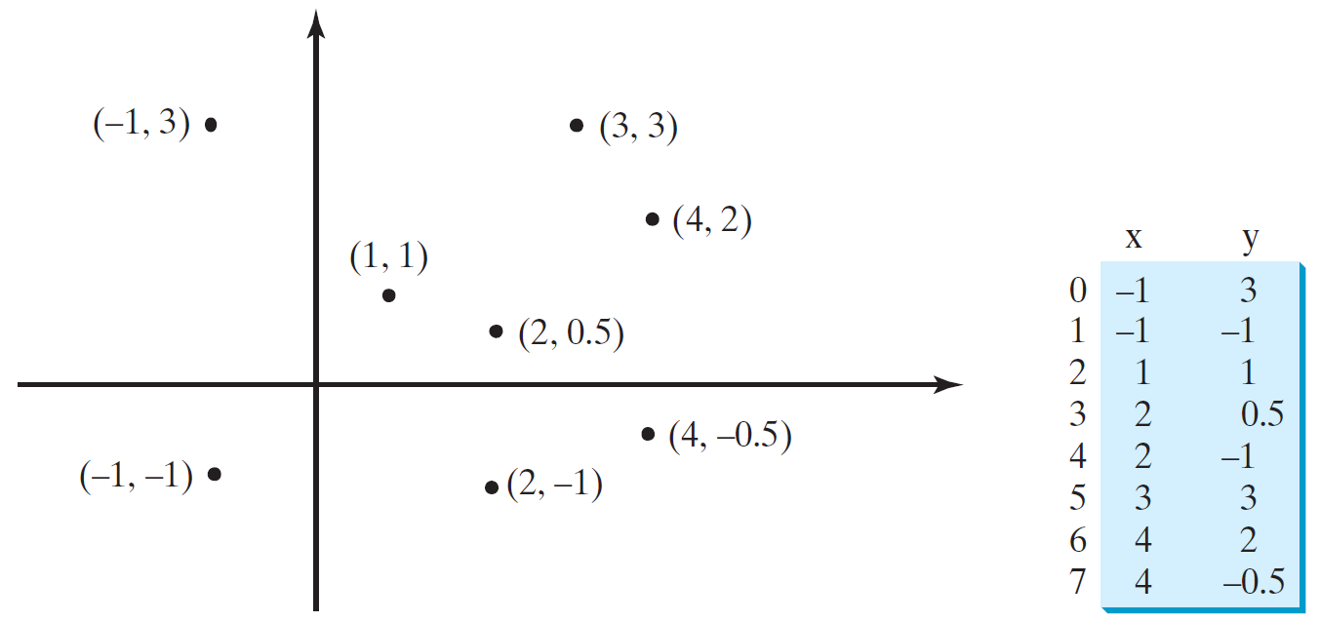
Problem: Finding Two Points Nearest to Each Other
Click here to play Closest Pair of Points
PassTwoDimensionalArray
Run

Slide 24
What is Sudoku?
Click here to play Sudoku game

Slide 25
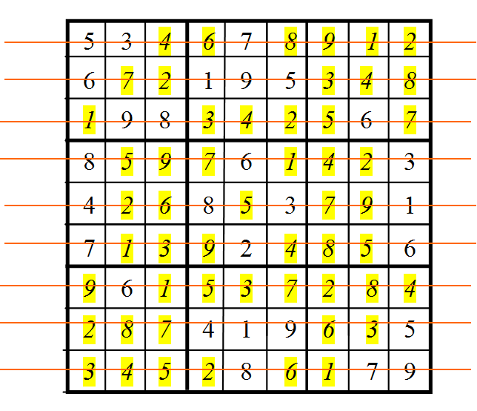
Every Row Contains the Numbers 1 to 9

Slide 26
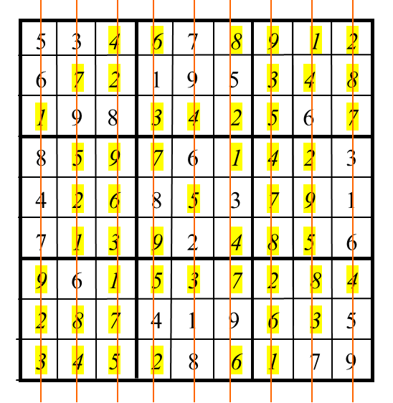
Every Column Contains the Numbers 1 to 9

Slide 27
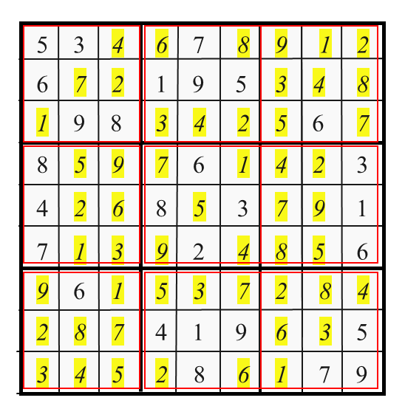
Every 3×3 box contains the numbers 1 to 9

Slide 28
Checking Whether a Solution is Correct
PassTwoDimensionalArray
Run

Slide 29
Multidimensional Arrays (1 of 2)
Occasionally, you will need to represent n-dimensional data structures. In Java, you can create n-dimensional arrays for any integer n.
The way to declare two-dimensional array variables and create two-dimensional arrays can be generalized to declare n-dimensional array variables and create n-dimensional arrays for n >= 3.

Slide 30
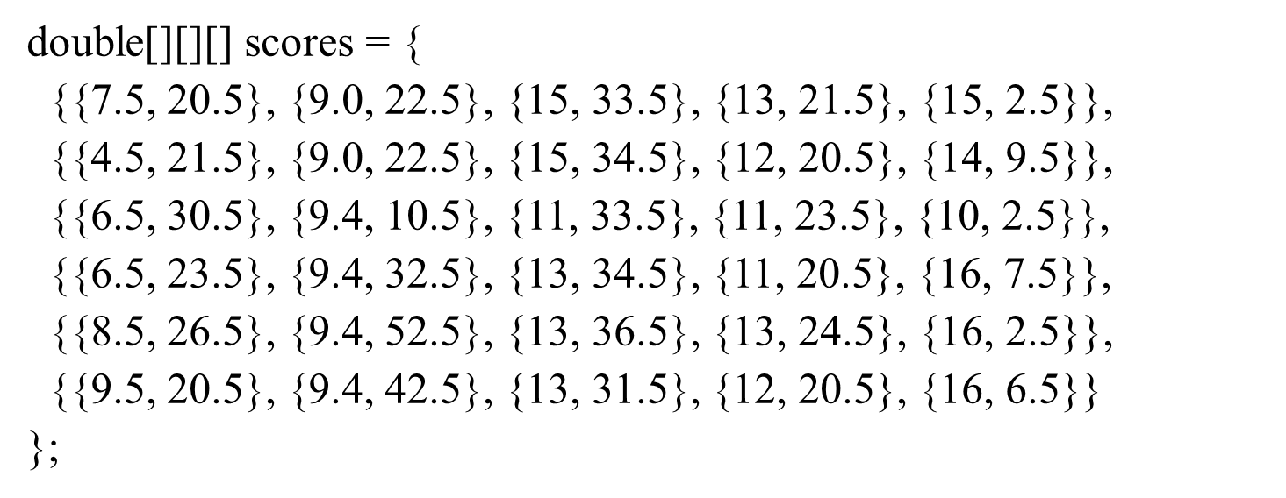
Multidimensional Arrays (2 of 2)

Slide 31
Problem: Calculating Total Scores
Objective: write a program that calculates the total score for students in a class. Suppose the scores are stored in a three-dimensional array named scores. The first index in scores refers to a student, the second refers to an exam, and the third refers to the part of the exam. Suppose there are 7 students, 5 exams, and each exam has two parts--the multiple-choice part and the programming part. So,
represents the
score on the multiple-choice part for the i’s student on the j’s exam. Your program displays the total score for each student.
TotalScore
Run

Slide 32
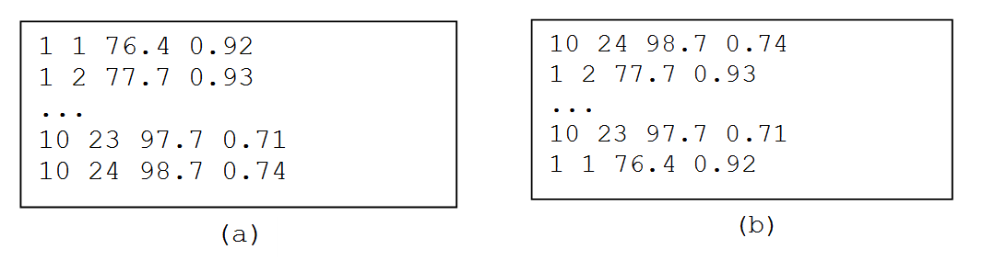
Problem: Weather Information
Suppose a meteorology station records the temperature and humidity at each hour of every day and stores the data for the past ten days in a text file named weather.txt. Each line of the file consists of four numbers that indicate the day, hour, temperature, and humidity. Your task is to write a program that calculates the average daily temperature and humidity for the 10 days.
Weather
Run

Slide 33
Problem: Guessing Birthday
Listing 4.3, GuessBirthday.java, gives a program that guesses a birthday. The program can be simplified by storing the numbers in five sets in a three-dimensional array, and it prompts the user for the answers using a loop.
GuessBirthdayUsingArray
Run

Slide 34
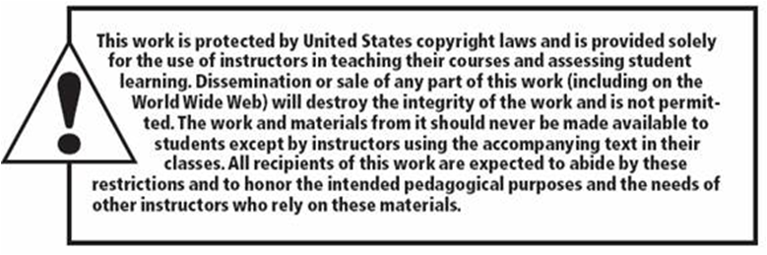
Copyright

