Slide 1
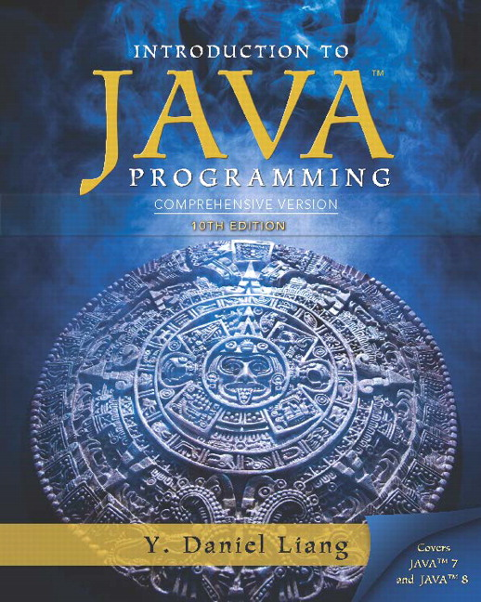
Introduction to Java Programming Comprehensive Version
Tenth Edition
Chapter 9
Objects and Classes
Copyright © 2015 Pearson Education, Inc. All Rights Reserved
Notes:
If this PowerPoint presentation contains mathematical equations, you may need to check that your computer has the following installed:
1) MathType Plugin
2) Math Player (free versions available)
3) NVDA Reader (free versions available)

Slide 2

Motivations
After learning the preceding chapters, you are capable of solving many programming problems using selections, loops, methods, and arrays. However, these Java features are not sufficient for developing graphical user interfaces and large scale software systems. Suppose you want to develop a graphical user interface as shown below. How do you program it?

Slide 3
Objectives (1 of 3)
9.1 To describe objects and classes, and use classes to model objects (§9.2).
9.2 To use U M L graphical notation to describe classes and objects (§9.2).
9.3 To demonstrate how to define classes and create objects (§9.3).
9.4 To create objects using constructors (§9.4).
9.5 To access objects via object reference variables (§9.5).
9.6 To define a reference variable using a reference type (§9.5.1).
9.7 To access an object’s data and methods using the object member access operator (.) (§9.5.2).

Slide 4
Objectives (2 of 3)
9.8 To define data fields of reference types and assign default values for an object’s data fields (§9.5.3).
9.9 To distinguish between object reference variables and primitive data type variables (§9.5.4).
9.10 To use the Java library classes Date, Random, and Point2D (§9.6).
9.11 To distinguish between instance and static variables and methods (§9.7).
9.12 To define private data fields with appropriate get and set methods (§9.8).

Slide 5
Objectives (3 of 3)
9.13 To encapsulate data fields to make classes easy to maintain (§9.9).
9.14 To develop methods with object arguments and differentiate between primitive-type arguments and object-type arguments (§9.10).
9.15 To store and process objects in arrays (§9.11).
9.16 To create immutable objects from immutable classes to protect the contents of objects (§9.12).
9.17 To determine the scope of variables in the context of a class (§9.13).
9.18 To use the keyword this to refer to the calling object itself (§9.14).

Slide 6
O O Programming Concepts
Object-oriented programming (O O P) involves programming using objects. An object represents an entity in the real world that can be distinctly identified. For example, a student, a desk, a circle, a button, and even a loan can all be viewed as objects. An object has a unique identity, state, and behaviors. The state of an object consists of a set of data fields (also known as properties) with their current values. The behavior of an object is defined by a set of methods.

Slide 7
Objects
An object has both a state and behavior. The state defines the object, and the behavior defines what the object does.

Slide 8
Classes (1 of 2)
Classes are constructs that define objects of the same type. A Java class uses variables to define data fields and methods to define behaviors. Additionally, a class provides a special type of methods, known as constructors, which are invoked to construct objects from the class.

Slide 9
Classes (2 of 2)

Slide 10
Example: Defining Classes and Creating Objects (1 of 2)
Objective: Demonstrate creating objects, accessing data, and using methods.
TestSimpleCircle
Run

Slide 11
Example: Defining Classes and Creating Objects (2 of 2)
TV
TestTV
Run

Slide 12
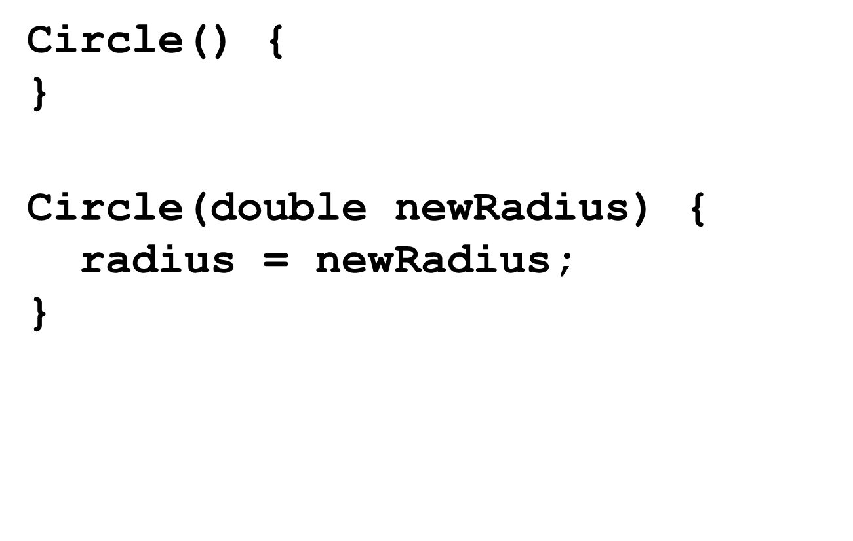
Constructors (1 of 2)
Constructors are a special kind of methods that are invoked to construct objects.

Slide 13
Constructors (2 of 2)
A constructor with no parameters is referred to as a no-arg constructor.
Constructors must have the same name as the class itself.
Constructors do not have a return type-not even void.
Constructors are invoked using the new operator when an object is created. Constructors play the role of initializing objects.

Slide 14
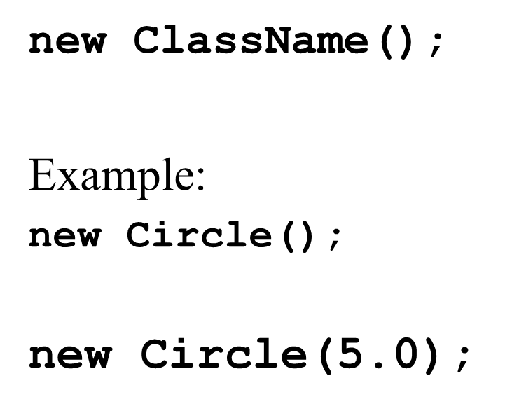
Creating Objects Using Constructors

Slide 15
Default Constructor
A class may be defined without constructors. In this case, a no-arg constructor with an empty body is implicitly defined in the class. This constructor, called a default constructor, is provided automatically only if no constructors are explicitly defined in the class.

Slide 16
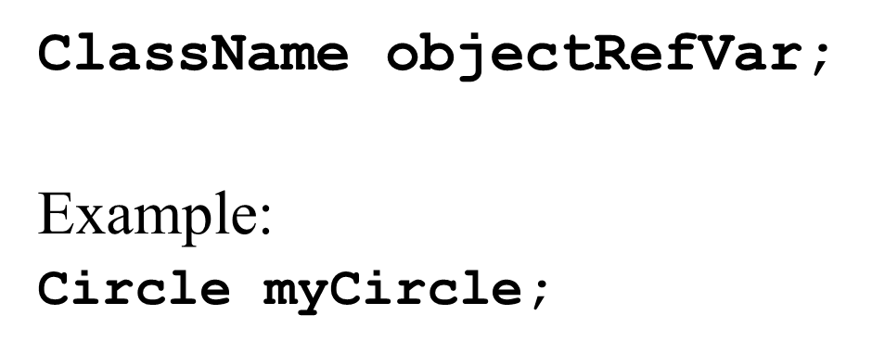
Declaring Object Reference Variables
To reference an object, assign the object to a reference variable.
To declare a reference variable, use the syntax:

Slide 17
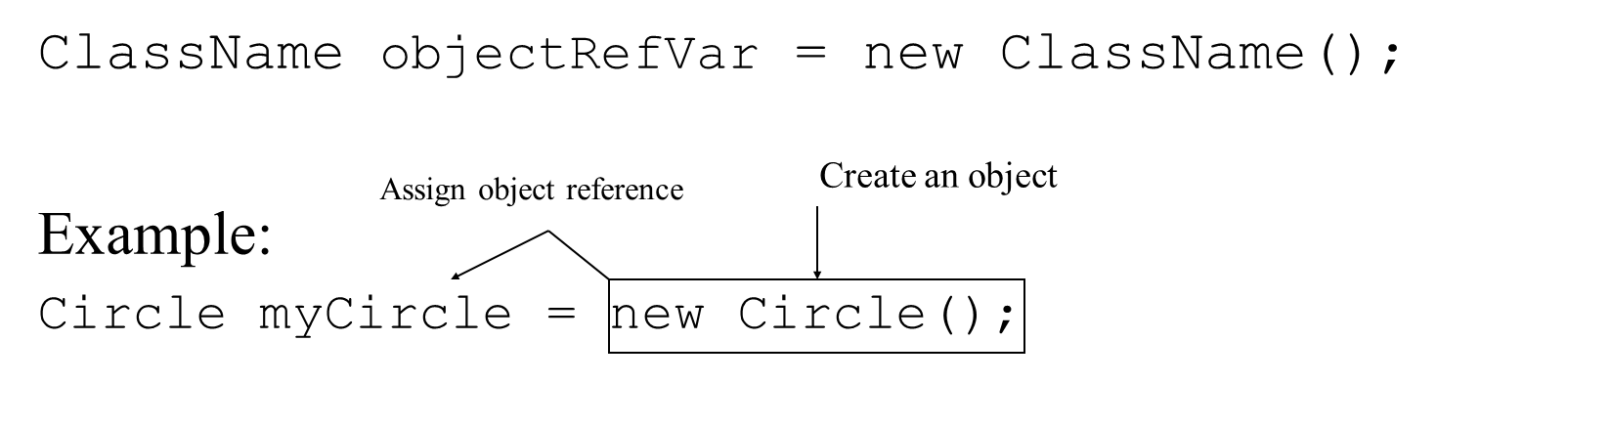
Declaring/Creating Objects in a Single Step

Slide 18
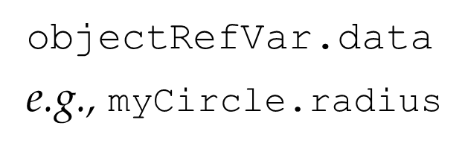
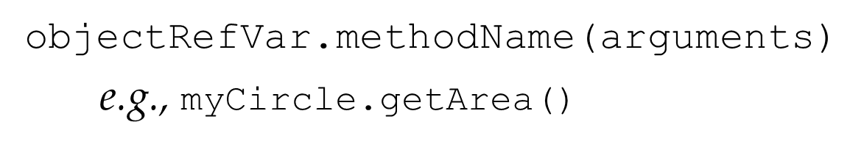
Accessing Object’s Members
Referencing the object’s data:
Invoking the object’s method:

Slide 19
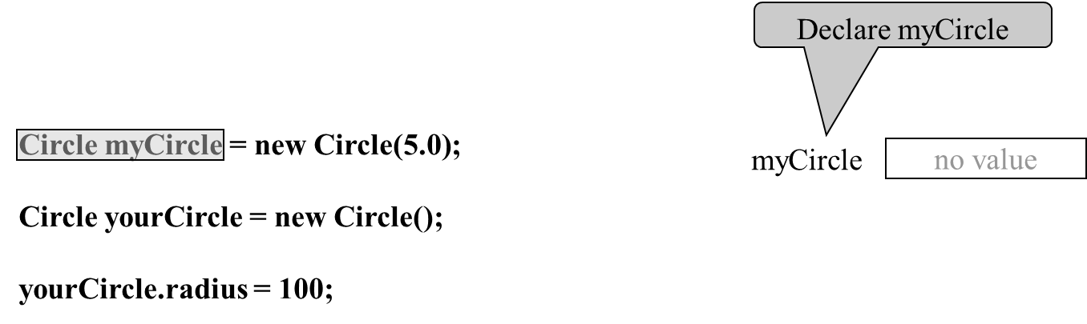
Trace Code (1 of 7)

Slide 20
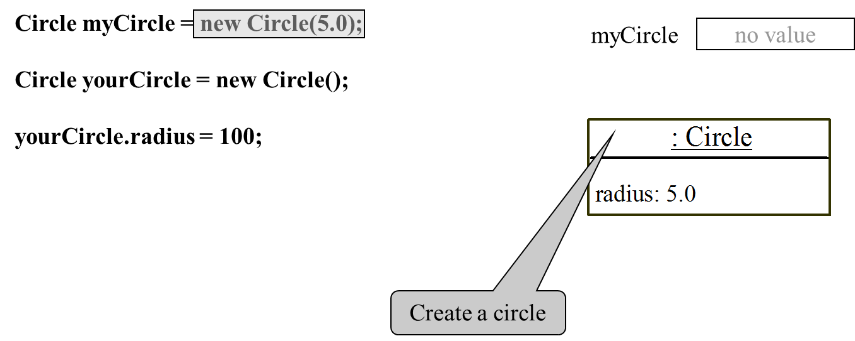
Trace Code (2 of 7)

Slide 21
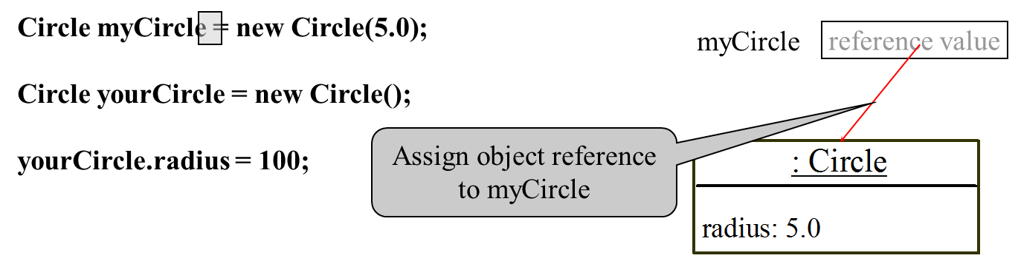
Trace Code (3 of 7)

Slide 22
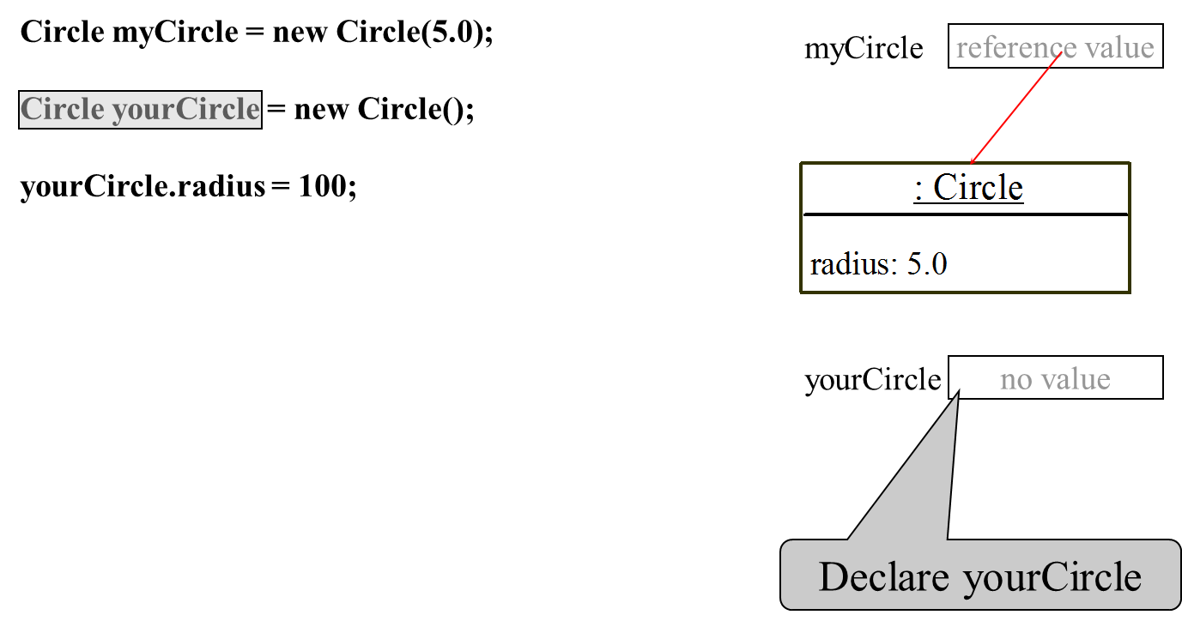
Trace Code (4 of 7)

Slide 23
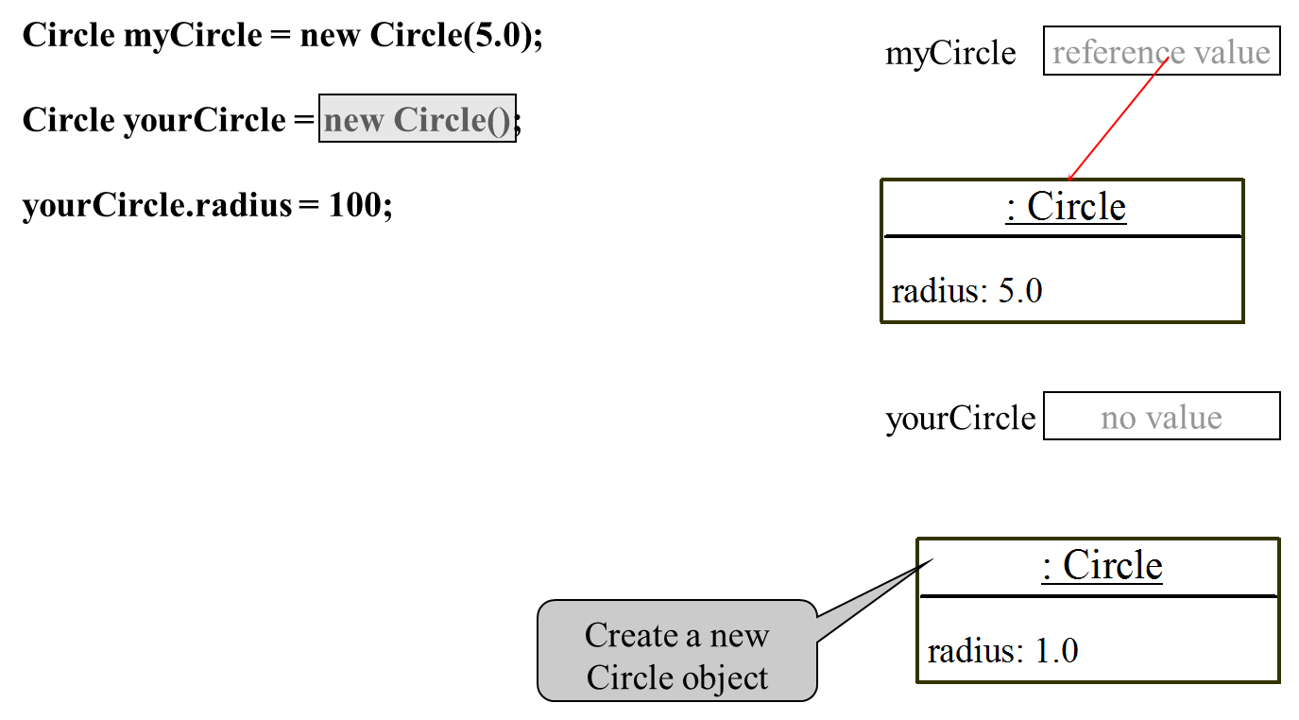
Trace Code (5 of 7)

Slide 24
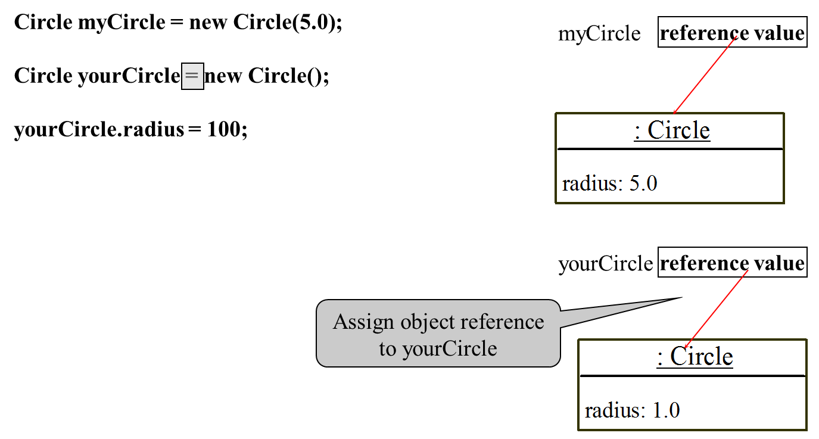
Trace Code (6 of 7)

Slide 25
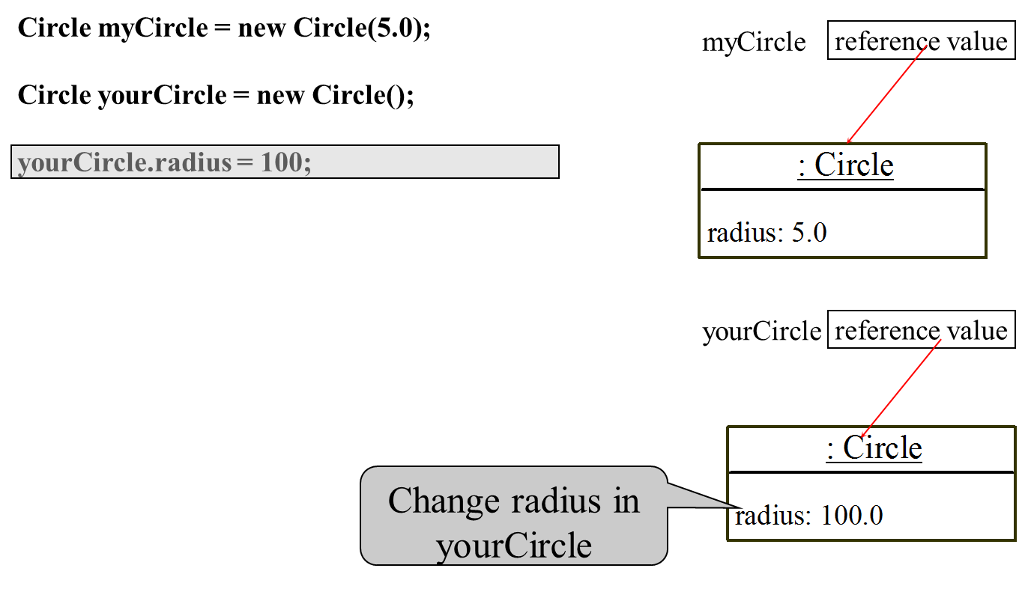
Trace Code (7 of 7)

Slide 26
Caution
Recall that you use
to invoke a method in the Math class. Can you invoke getArea() using SimpleCircle.getArea()? The answer is no. All the methods used before this chapter are static methods, which are defined using the static keyword. However, getArea() is non-static. It must be invoked from an object using
More explanations will be given in the section on “Static Variables, Constants, and Methods.”

Slide 27
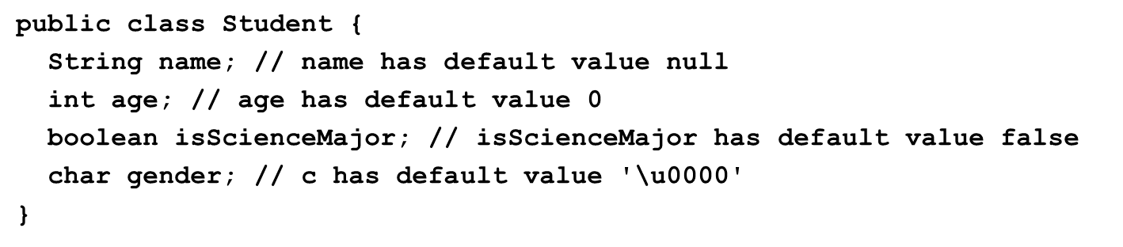
Reference Data Fields
The data fields can be of reference types. For example, the following Student class contains a data field name of the String type.

Slide 28
The Null Value
If a data field of a reference type does not reference any object, the data field holds a special literal value, null.

Slide 29
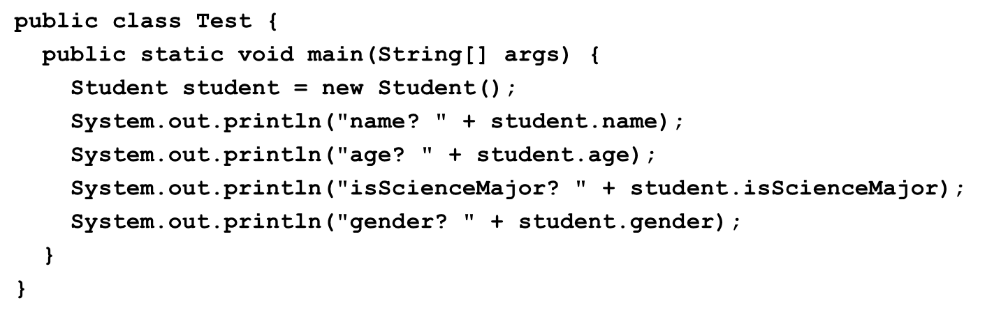
Default Value for a Data Field
The default value of a data field is null for a reference type, 0 for a numeric type, false for a boolean type, and ‘\u0000’ for a char type. However, Java assigns no default value to a local variable inside a method.

Slide 30
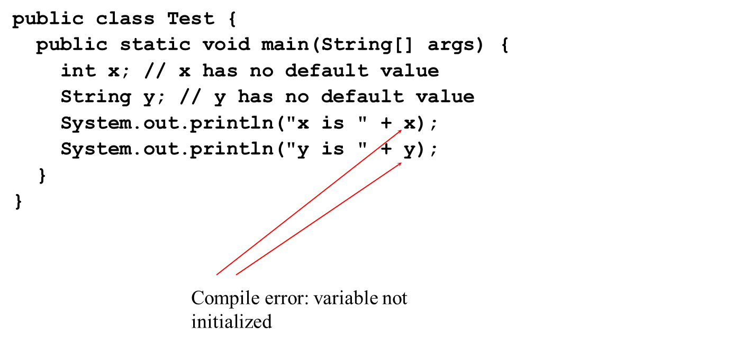
Example (1 of 2)
Java assigns no default value to a local variable inside a method.

Slide 31
Differences between Variables of Primitive Data Types and Object Types

Slide 32
Copying Variables of Primitive Data Types and Object Types

Slide 33
Garbage Collection (1 of 2)
As shown in the previous figure, after the assignment statement c1 = c2, c1 points to the same object referenced by c2. The object previously referenced by c1 is no longer referenced. This object is known as garbage. Garbage is automatically collected by J V M.

Slide 34
Garbage Collection (2 of 2)
T I P: If you know that an object is no longer needed, you can explicitly assign null to a reference variable for the object. The J V M will automatically collect the space if the object is not referenced by any variable.

Slide 35
The Date Class
Java provides a system-independent encapsulation of date and time in the java.util.Date class. You can use the Date class to create an instance for the current date and time and use its toString method to return the date and time as a string.

Slide 36
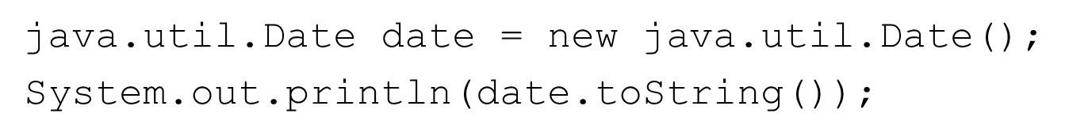
The Date Class Example
For example, the following code
displays a string like Sun Mar 09 13:50:19 EST 2003.

Slide 37
The Random Class
You have used Math.random() to obtain a random double value between 0.0 and 1.0 (excluding 1.0). A more useful random number generator is provided in the java.util.Random class.

Slide 38
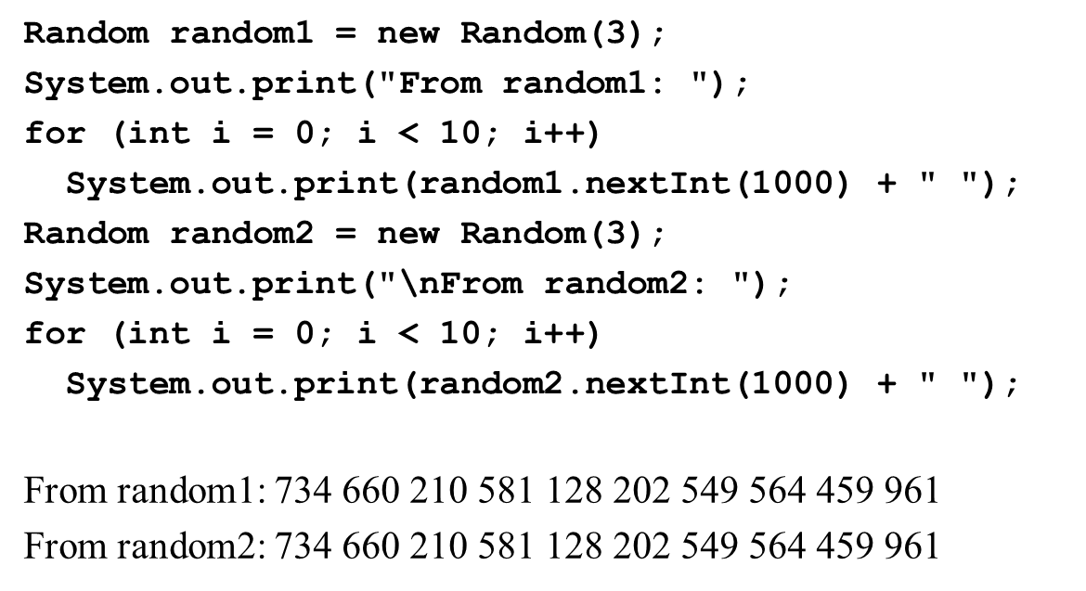
The Random Class Example
If two Random objects have the same seed, they will generate identical sequences of numbers. For example, the following code creates two Random objects with the same seed 3.

Slide 39
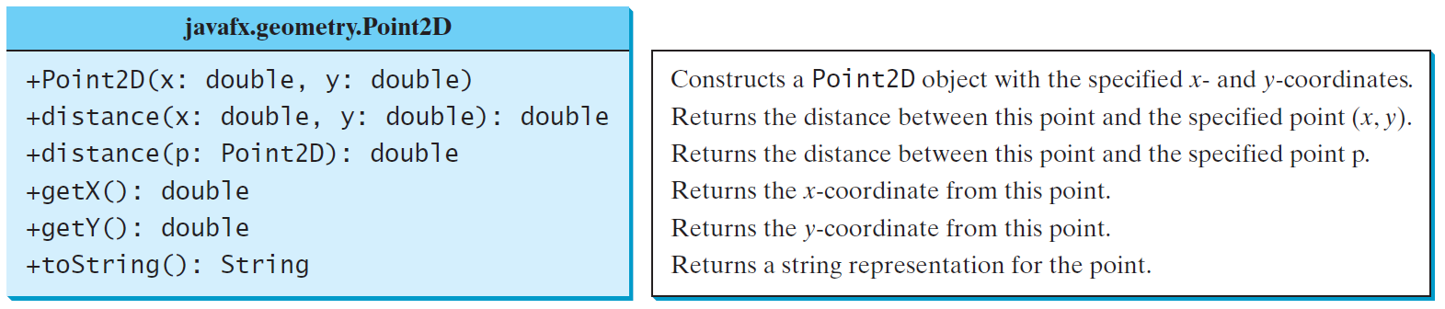
The Point2D Class
Java API has a convenient Point2D class in the javafx.geometry package for representing a point in a two-dimensional plane.
TestPoint2D
Run

Slide 40
Instance Variables, and Methods
Instance variables belong to a specific instance.
Instance methods are invoked by an instance of the class.

Slide 41
Static Variables, Constants, and Methods (1 of 3)
Static variables are shared by all the instances of the class.
Static methods are not tied to a specific object.
Static constants are final variables shared by all the instances of the class.

Slide 42
Static Variables, Constants, and Methods (2 of 3)
To declare static variables, constants, and methods, use the static modifier.

Slide 43
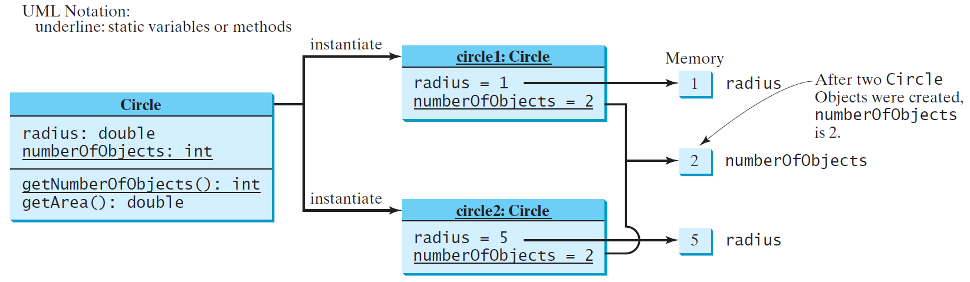
Static Variables, Constants, and Methods (3 of 3)

Slide 44
Example of Using Instance and Class Variables and Method
Objective: Demonstrate the roles of instance and class variables and their uses. This example adds a class variable numberOfObjects to track the number of Circle objects created.
CircleWithStaticMembers
TestCircleWithStaticMembers
Run

Slide 45
Visibility Modifiers and Accessor/Mutator Methods (1 of 3)
By default, the class, variable, or method can be accessed by any class in the same package.
public
The class, data, or method is visible to any class in any package.
private
The data or methods can be accessed only by the declaring class.
The get and set methods are used to read and modify private properties.

Slide 46
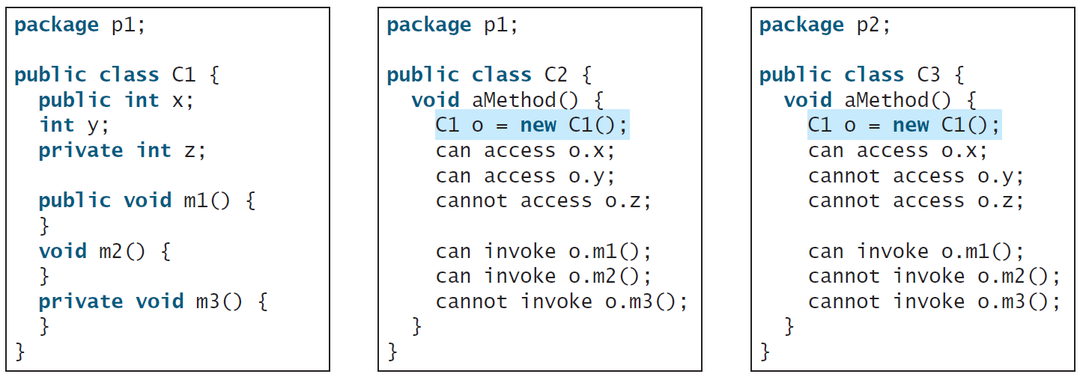
Visibility Modifiers and Accessor/Mutator Methods (2 of 3)
The private modifier restricts access to within a class, the default modifier restricts access to within a package, and the public modifier enables unrestricted access.

Slide 47
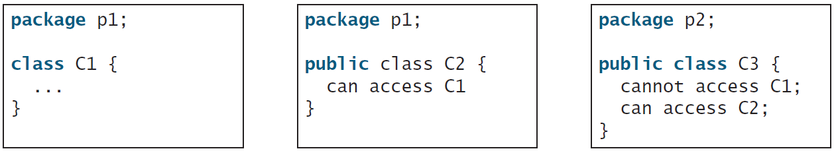
Visibility Modifiers and Accessor/Mutator Methods (3 of 3)
The default modifier on a class restricts access to within a package, and the public modifier enables unrestricted access.

Slide 48
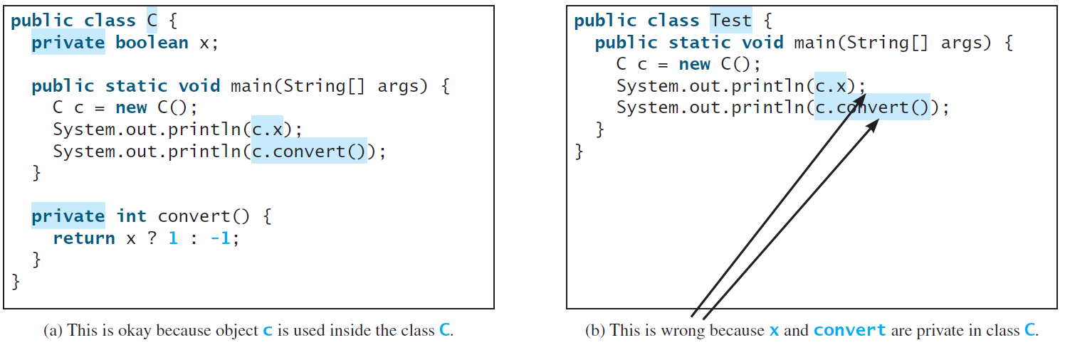
Note
An object cannot access its private members, as shown in (b). It is OK, however, if the object is declared in its own class, as shown in (a).

Slide 49
Why Data Fields Should Be private?
To protect data.
To make code easy to maintain.

Slide 50
Example of Data Field Encapsulation
CircleWithPrivateDataFields
TestCircleWithPrivateDataFields
Run

Slide 51
Passing Objects to Methods (1 of 2)
Passing by value for primitive type value (the value is passed to the parameter)
Passing by value for reference type value (the value is the reference to the object)
TestPassObject
Run

Slide 52
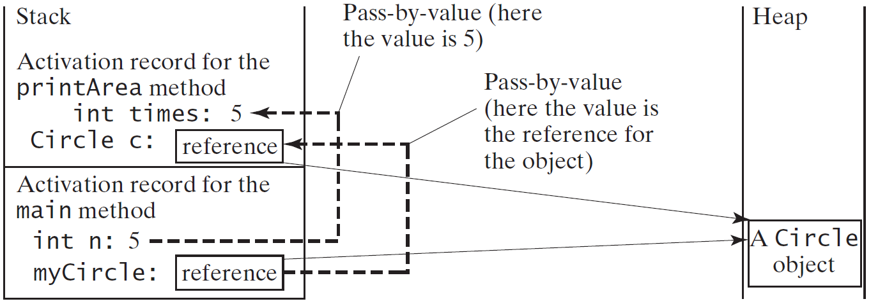
Passing Objects to Methods (2 of 2)

Slide 53
Array of Objects (1 of 3)
An array of objects is actually an array of reference variables. So invoking circleArray[1].getArea() involves two levels of referencing as shown in the next figure. circleArray references to the entire array. circleArray[1] references to a Circle object.

Slide 54

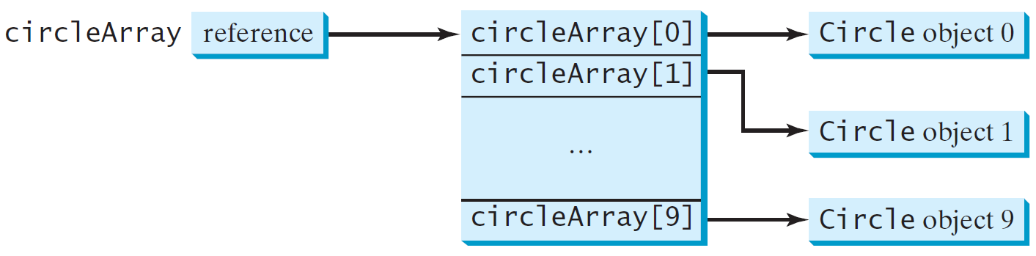
Passing Objects to Methods (2 of 3)

Slide 55
Array of Objects (3 of 3)
Summarizing the areas of the circles
TotalArea
Run

Slide 56
Immutable Objects and Classes
If the contents of an object cannot be changed once the object is created, the object is called an immutable object and its class is called an immutable class. If you delete the set method in the Circle class in Listing 8.10, the class would be immutable because radius is private and cannot be changed without a set method.
A class with all private data fields and without mutators is not necessarily immutable. For example, the following class Student has all private data fields and no mutators, but it is mutable.

Slide 57
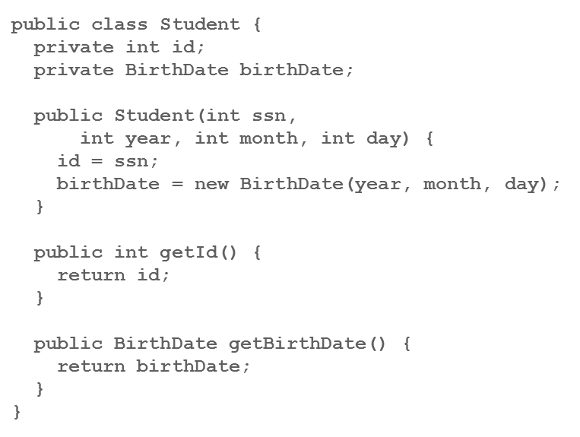
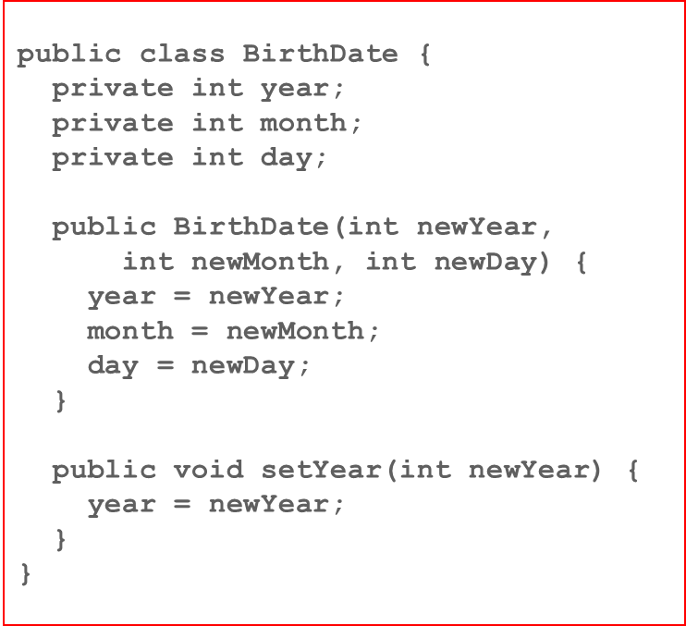
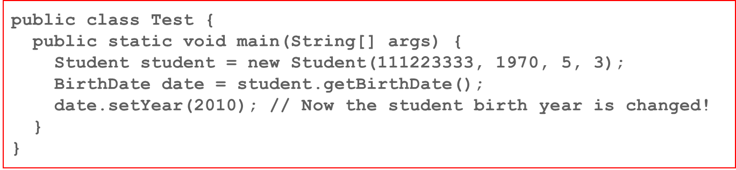
Example (2 of 2)

Slide 58
What Class is Immutable?
For a class to be immutable, it must mark all data fields private and provide no mutator methods and no accessor methods that would return a reference to a mutable data field object.

Slide 59
Scope of Variables
The scope of instance and static variables is the entire class. They can be declared anywhere inside a class.
The scope of a local variable starts from its declaration and continues to the end of the block that contains the variable. A local variable must be initialized explicitly before it can be used.

Slide 60
The this Keyword
The this keyword is the name of a reference that refers to an object itself. One common use of the this keyword is reference a class’s hidden data fields.
Another common use of the this keyword to enable a constructor to invoke another constructor of the same class.

Slide 61
Reference the Hidden Data Fields

Slide 62
Calling Overloaded Constructor

Slide 63
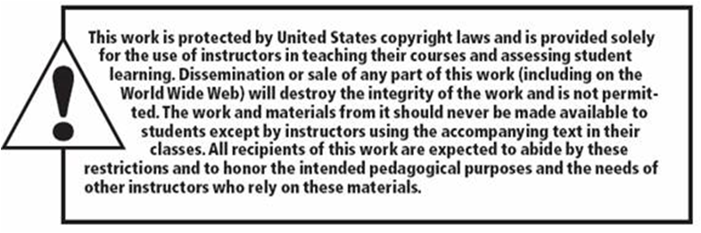
Copyright

