Slide 1
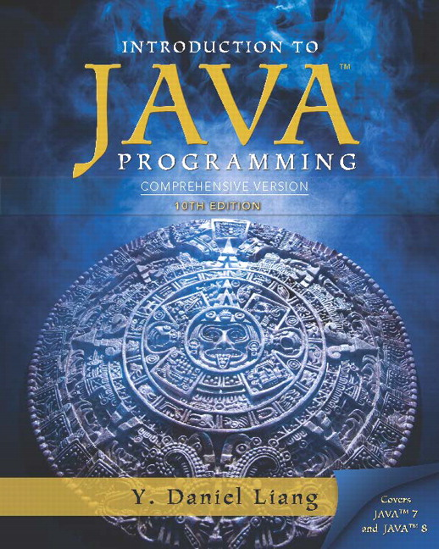
Introduction to Java Programming Comprehensive Version
Tenth Edition
Chapter 10
Thinking in Objects
Copyright © 2015 Pearson Education, Inc. All Rights Reserved
Notes:
If this PowerPoint presentation contains mathematical equations, you may need to check that your computer has the following installed:
1) MathType Plugin
2) Math Player (free versions available)
3) NVDA Reader (free versions available)

Slide 2
Motivations
You see the advantages of object-oriented programming from the preceding chapter. This chapter will demonstrate how to solve problems using the object-oriented paradigm.

Slide 3
Objectives (1 of 2)
10.1 To apply class abstraction to develop software (§10.2).
10.2 To explore the differences between the procedural paradigm and object-oriented paradigm (§10.3).
10.3 To discover the relationships between classes (§10.4).
10.4 To design programs using the object-oriented paradigm (§§10.5-10.6).
10.5 To create objects for primitive values using the wrapper classes (Byte, Short, Integer, Long, Float, Double, Character, and Boolean) (§10.7).

Slide 4
Objectives (2 of 2)
10.6 To simplify programming using automatic conversion between primitive types and wrapper class types (§10.8).
10.7 To use the BigInteger and BigDecimal classes for computing very large numbers with arbitrary precisions (§10.9).
10.8 To use the String class to process immutable strings (§10.10).
10.9 To use the StringBuilder and StringBuffer classes to process mutable strings (§10.11).

Slide 5
Class Abstraction and Encapsulation
Class abstraction means to separate class implementation from the use of the class. The creator of the class provides a description of the class and let the user know how the class can be used. The user of the class does not need to know how the class is implemented. The detail of implementation is encapsulated and hidden from the user.

Slide 6
Designing the Loan Class
Loan
TestLoanClass
Run

Slide 7
Object-Oriented Thinking
Chapters 1-8 introduced fundamental programming techniques for problem solving using loops, methods, and arrays. The studies of these techniques lay a solid foundation for object-oriented programming. Classes provide more flexibility and modularity for building reusable software. This section improves the solution for a problem introduced in Chapter 3 using the object-oriented approach. From the improvements, you will gain the insight on the differences between the procedural programming and object-oriented programming and see the benefits of developing reusable code using objects and classes.

Slide 8
The B M I Class
BMI
UseBMIClass
Run

Slide 9
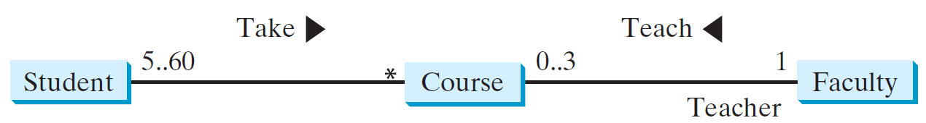
Class Relationships
Association
Aggregation
Composition
Inheritance (Chapter 13)
Association: is a general binary relationship that describes an activity between two classes.

Slide 10
Object Composition
Composition is actually a special case of the aggregation relationship. Aggregation models has-a relationships and represents an ownership relationship between two objects. The owner object is called an aggregating object and its class an aggregating class. The subject object is called an aggregated object and its class an aggregated class.

Slide 11
Class Representation
An aggregation relationship is usually represented as a data field in the aggregating class. For example, the relationship in Figure 10.6 can be represented as follows:

Slide 12
Aggregation or Composition
Since aggregation and composition relationships are represented using classes in similar ways, many texts don’t differentiate them and call both compositions.

Slide 13
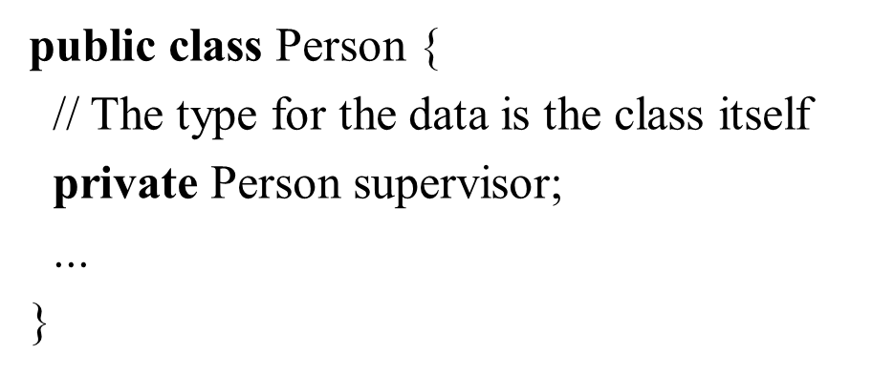
Aggregation Between Same Class (1 of 2)
Aggregation may exist between objects of the same class. For example, a person may have a supervisor.

Slide 14
Aggregation Between Same Class (2 of 2)
What happens if a person has several supervisors?

Slide 15
Example: The Course Class
Course
TestCourse
Run

Slide 16
Example: The StackOfIntegers Class
TestStackOfIntegers
Run

Slide 17
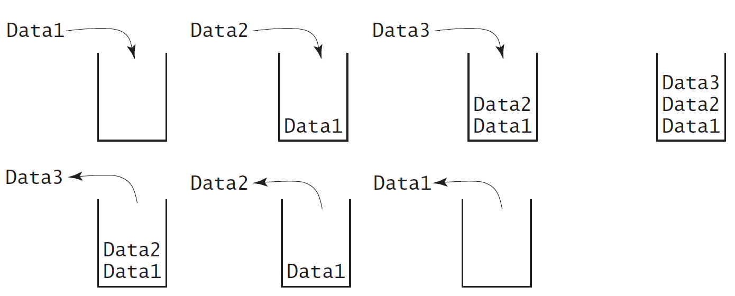
Designing the StackOfIntegers Class

Slide 18
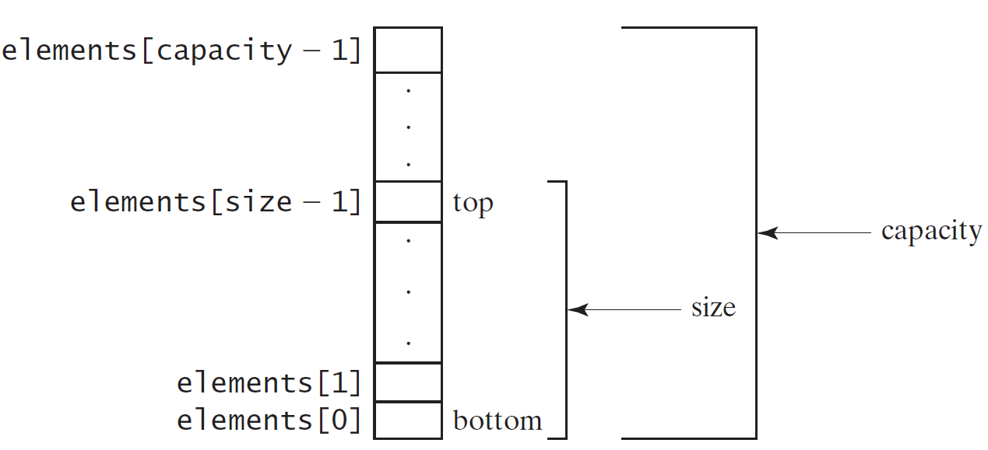
Implementing StackOfIntegers Class
StackOfIntegers

Slide 19
Wrapper Classes
Boolean
Character
Short
Byte
Integer
Long
Float
Double
Note: (1) The wrapper classes do not have no-arg constructors. (2) The instances of all wrapper classes are immutable, i.e., their internal values cannot be changed once the objects are created.

Slide 20
The Integer and Double Classes

Slide 21
The Integer Class and the Double Class
Constructors
Class Constants MAX_VALUE, MIN_VALUE
Conversion Methods

Slide 22
Numeric Wrapper Class Constructors
You can construct a wrapper object either from a primitive data type value or from a string representing the numeric value. The constructors for Integer and Double are:
public Integer(int value)
public Integer(String s)
public Double(double value)
public Double(String s)

Slide 23
Numeric Wrapper Class Constants
Each numerical wrapper class has the constants MAX_VALUE and MIN_VALUE. MAX_VALUE represents the maximum value of the corresponding primitive data type. For Byte, Short, Integer, and Long, MIN_VALUE represents the minimum byte, short, int, and long values. For Float and Double, MIN_VALUE represents the minimum positive float and double values. The following statements display the maximum integer (2,147,483,647), the minimum positive float (1.4E-45), and the maximum double floating-point number (1.79769313486231570e+308d).

Slide 24
Conversion Methods
Each numeric wrapper class implements the abstract methods doubleValue, floatValue, intValue, longValue, and shortValue, which are defined in the Number class. These methods “convert” objects into primitive type values.

Slide 25
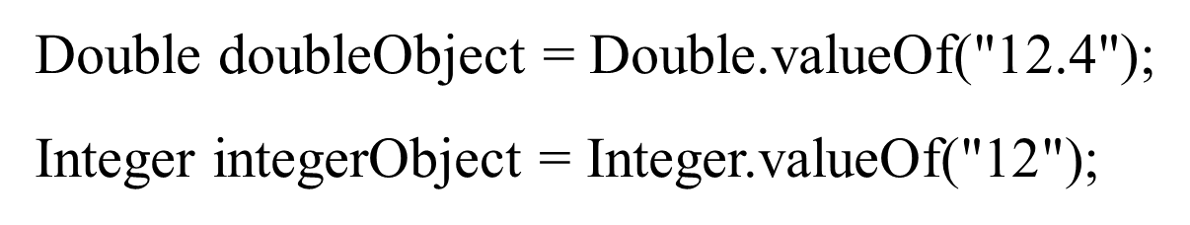
The Static valueOf Methods
The numeric wrapper classes have a useful class method, valueOf(String s). This method creates a new object initialized to the value represented by the specified string. For example:

Slide 26
The Methods for Parsing Strings into Numbers
You have used the parseInt method in the Integer class to parse a numeric string into an int value and the parseDouble method in the Double class to parse a numeric string into a double value. Each numeric wrapper class has two overloaded parsing methods to parse a numeric string into an appropriate numeric value.

Slide 27
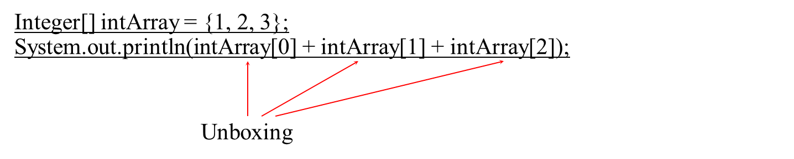
Automatic Conversion Between Primitive Types and Wrapper Class Types
JDK 1.5 allows primitive type and wrapper classes to be converted automatically. For example, the following statement in (a) can be simplified as in (b):

Slide 28
BigInteger and BigDecimal (1 of 2)
If you need to compute with very large integers or high precision floating-point values, you can use the BigInteger and BigDecimal classes in the java.math package. Both are immutable. Both extend the Number class and implement the Comparable interface.

Slide 29
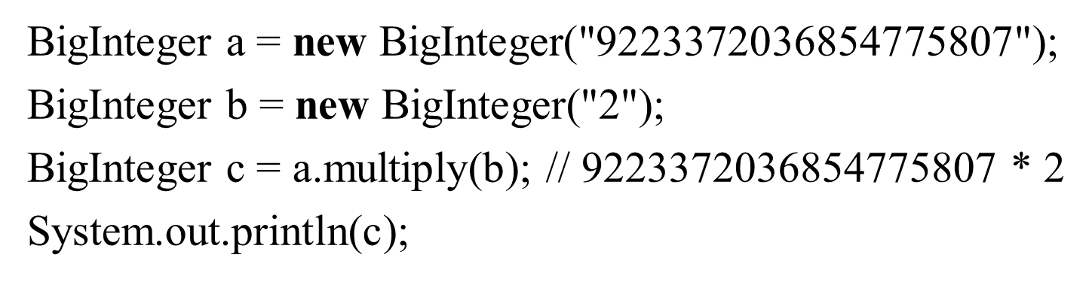
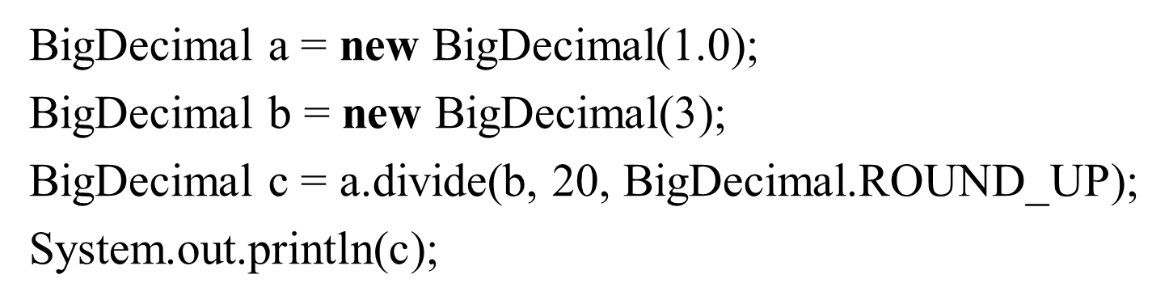
BigInteger and BigDecimal (2 of 2)
LargeFactorial
Run

Slide 30
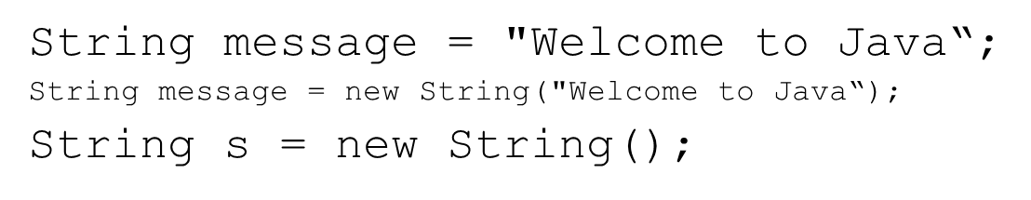
The String Class (1 of 2)
Constructing a String:
Obtaining String length and Retrieving Individual Characters in a string
String Concatenation (concat)
Substrings (substring(index), substring(start, end))

Slide 31
The String Class (2 of 2)
Comparisons (equals, compareTo)
String Conversions
Finding a Character or a Substring in a String
Conversions between Strings and Arrays
Converting Characters and Numeric Values to Strings

Slide 32
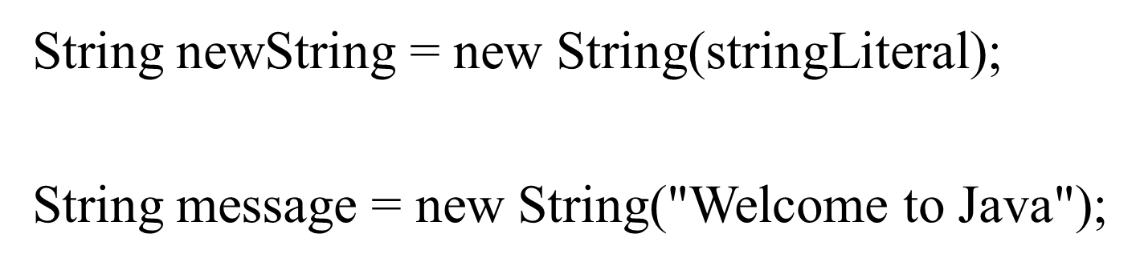
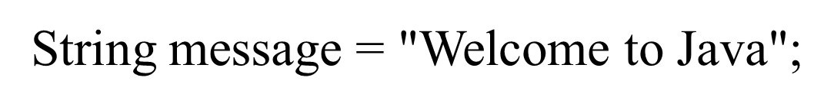
Constructing Strings
Since strings are used frequently, Java provides a shorthand initializer for creating a string:

Slide 33
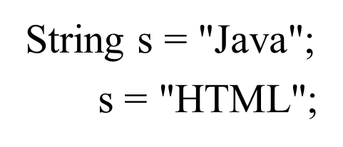
Strings Are Immutable
A String object is immutable; its contents cannot be changed. Does the following code change the contents of the string?

Slide 34
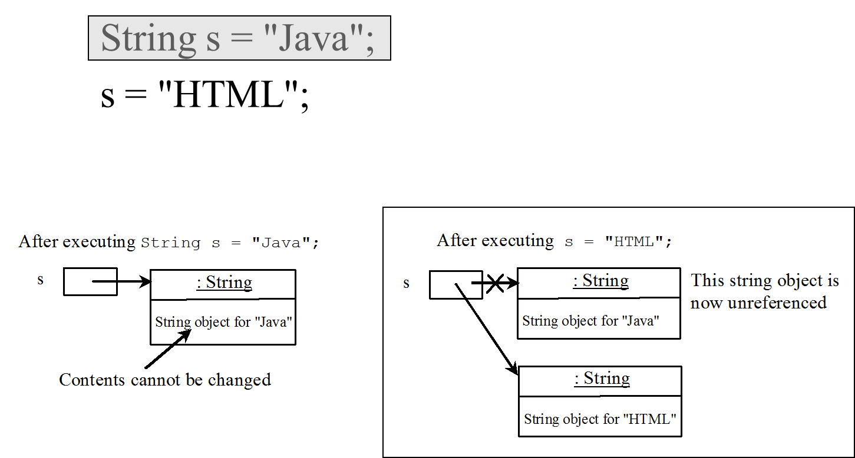
Trace Code (1 of 5)

Slide 35
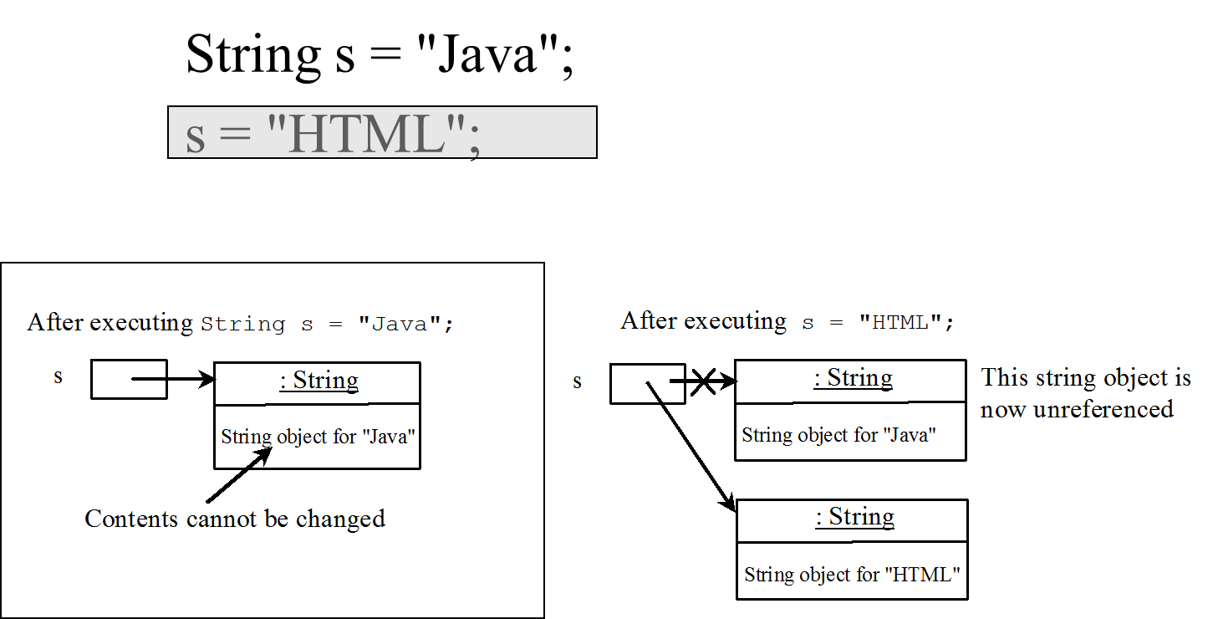
Trace Code (2 of 5)

Slide 36
Interned Strings
Since strings are immutable and are frequently used, to improve efficiency and save memory, the J V M uses a unique instance for string literals with the same character sequence. Such an instance is called interned. For example, the following statements:

Slide 37
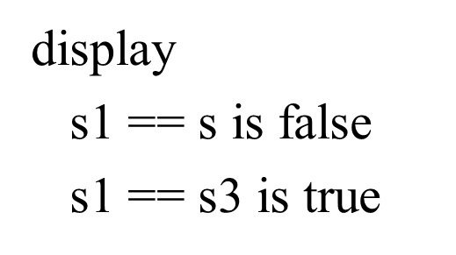
Examples of Interned Strings
A new object is created if you use the new operator.
If you use the string initializer, no new object is created if the interned object is already created.

Slide 38
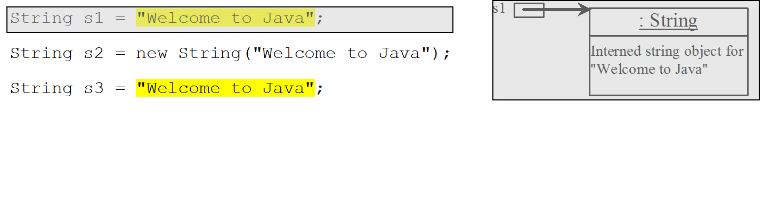
Trace Code (3 of 5)

Slide 39
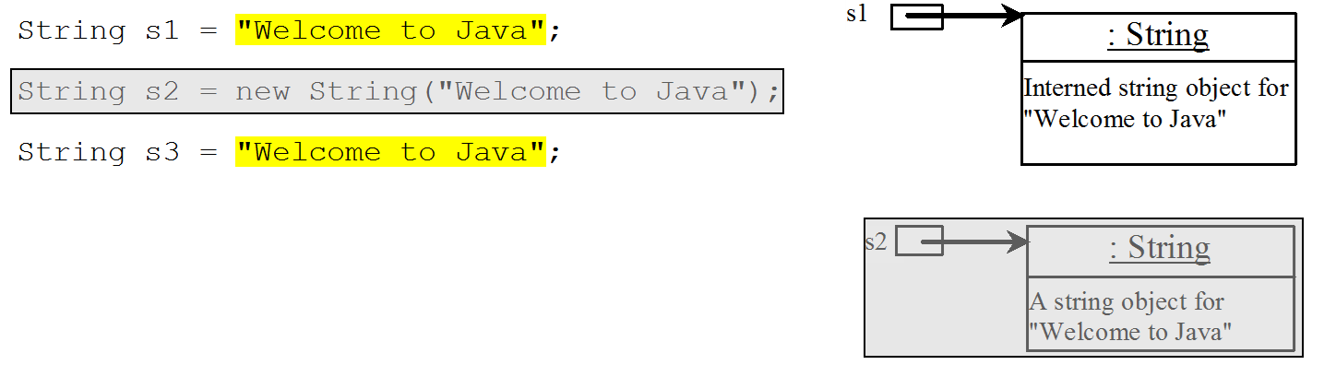
Trace Code (4 of 5)

Slide 40
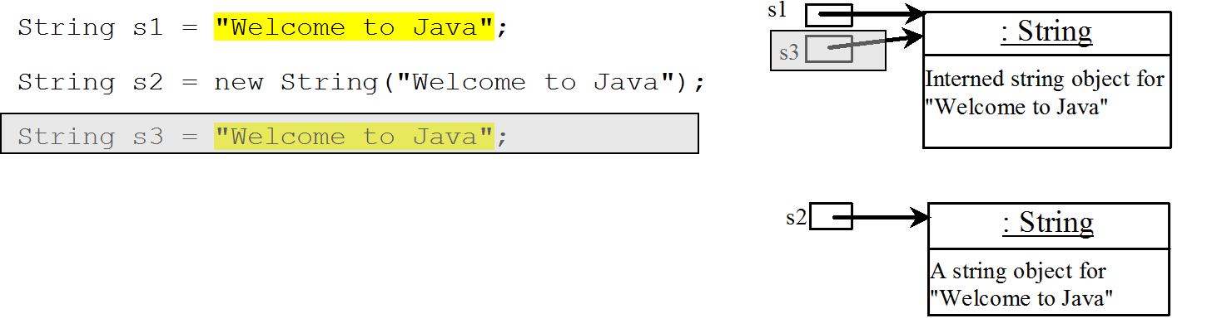
Trace Code (5 of 5)

Slide 41
Replacing and Splitting Strings (1 of 2)

Slide 42
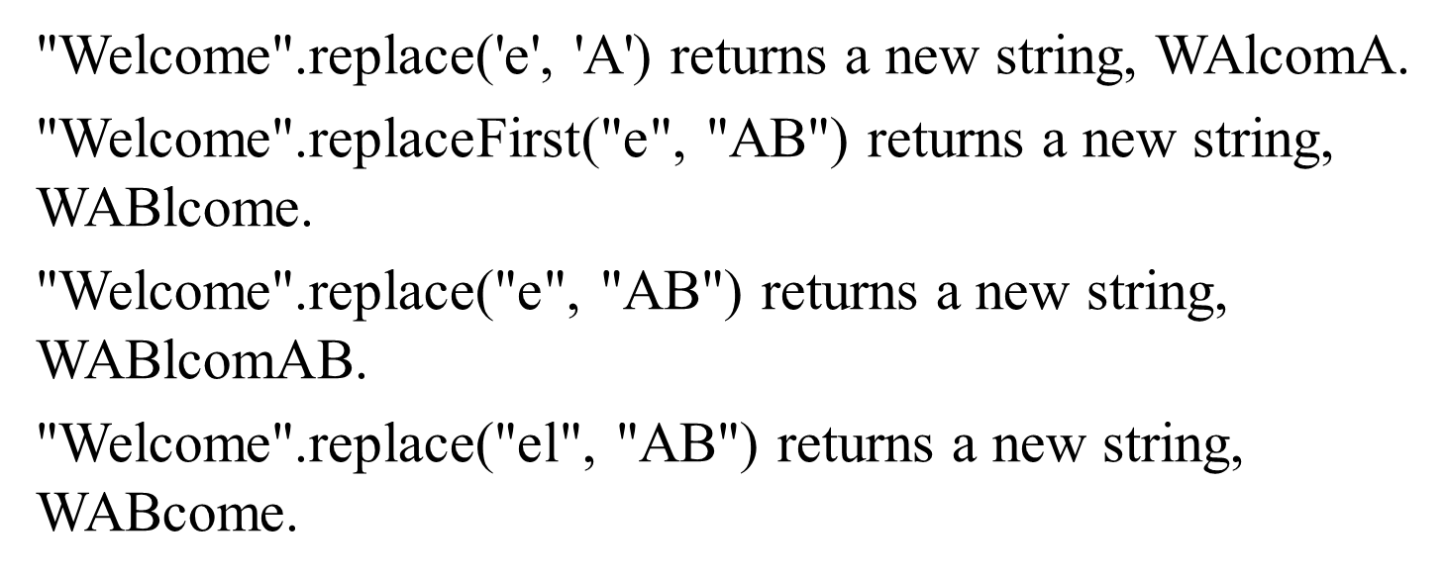
Examples (1 of 2)

Slide 43
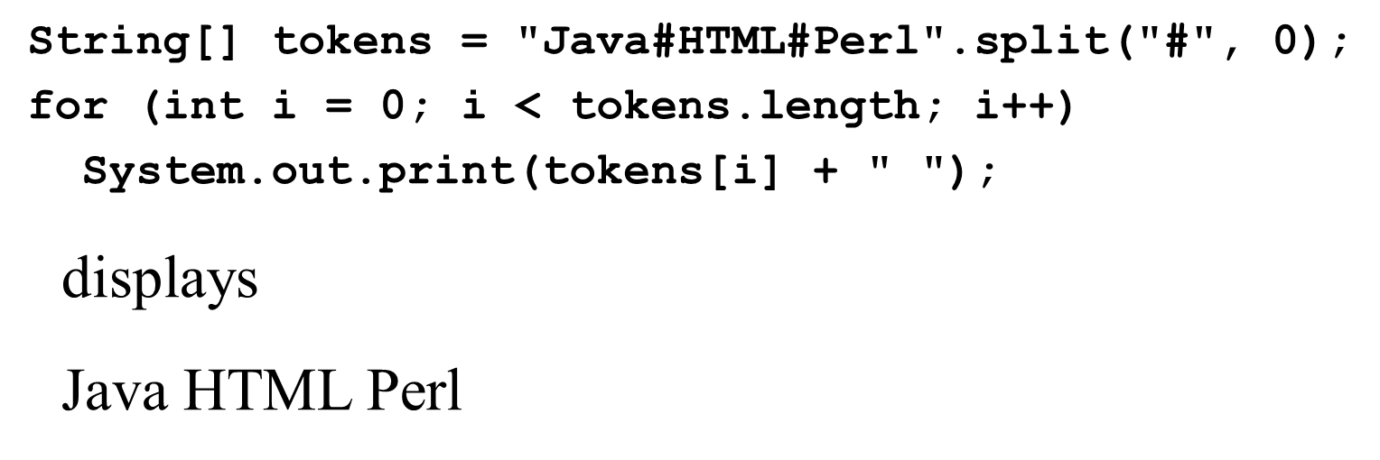
Splitting a String

Slide 44
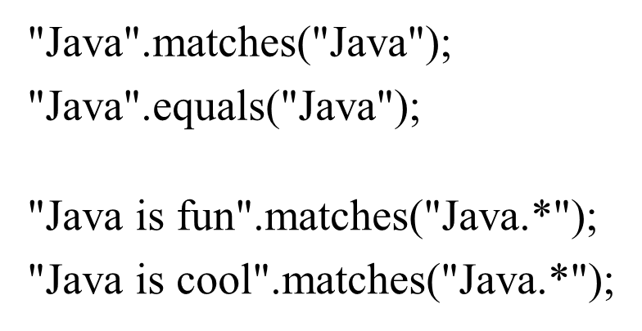
Matching, Replacing and Splitting by Patterns (1 of 3)
You can match, replace, or split a string by specifying a pattern. This is an extremely useful and powerful feature, commonly known as regular expression. Regular expression is complex to beginning students. For this reason, two simple patterns are used in this section. Please refer to Supplement III.F, “Regular Expressions,” for further studies.

Slide 45
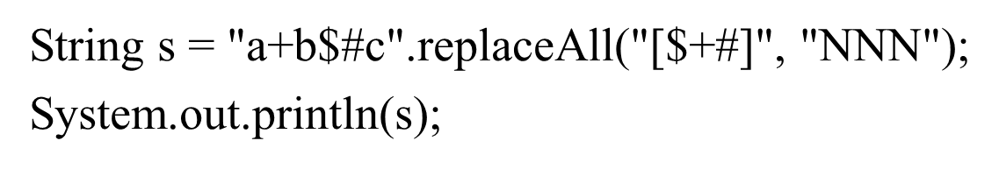
Matching, Replacing and Splitting by Patterns (2 of 3)
The replaceAll, replaceFirst, and split methods can be used with a regular expression. For example, the following statement returns a new string that replaces $, +, or # in “a+b$#c” by the string N N N.
Here the regular expression [$+#] specifies a pattern that matches $, +, or #. So, the output is aNNNbNNNNNNc.

Slide 46
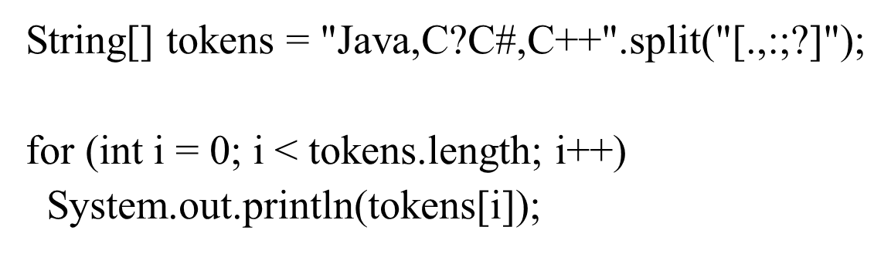
Matching, Replacing and Splitting by Patterns (3 of 3)
The following statement splits the string into an array of strings delimited by some punctuation marks.

Slide 47
Convert Character and Numbers to Strings
The String class provides several static valueOf methods for converting a character, an array of characters, and numeric values to strings. These methods have the same name valueOf with different argument types char, char[], double, long, int, and float. For example, to convert a double value to a string, use String.valueOf(5.44). The return value is string consists of characters ‘5’, ‘.’, ‘4’, and ‘4’.

Slide 48
StringBuilder and StringBuffer
The StringBuilder/StringBuffer class is an alternative to the String class. In general, a StringBuilder/StringBuffer can be used wherever a string is used. StringBuilder/StringBuffer is more flexible than String. You can add, insert, or append new contents into a string buffer, whereas the value of a String object is fixed once the string is created.

Slide 49
StringBuilder Constructors

Slide 50
Modifying Strings in the Builder

Slide 51
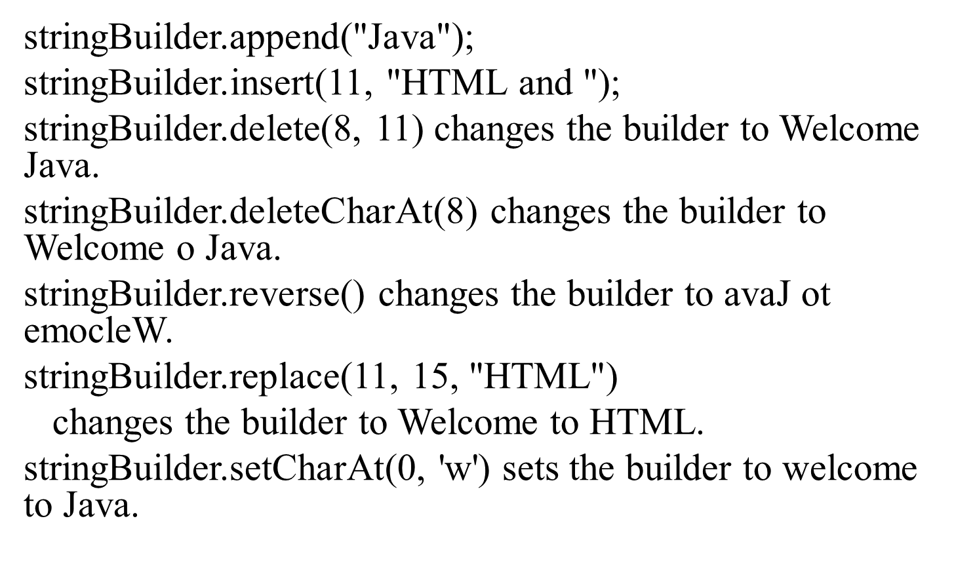
Examples for Modifying Strings in the Builder

Slide 52
The toString, capacity, length, setLength, and charAt Methods

Slide 53
Problem: Checking Palindromes Ignoring Non-alphanumeric Characters
This example gives a program that counts the number of occurrence of each letter in a string. Assume the letters are not case-sensitive.
PalindromeIgnoreNonAlphanumeric
Run

Slide 54
Regular Expressions
A regular expression (abbreviated regex) is a string that describes a pattern for matching a set of strings. Regular expression is a powerful tool for string manipulations. You can use regular expressions for matching, replacing, and splitting strings.

Slide 55
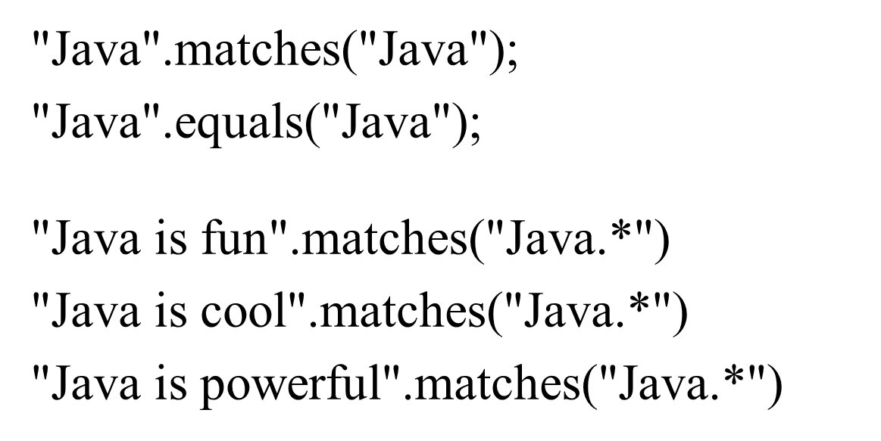
Matching Strings

Slide 56
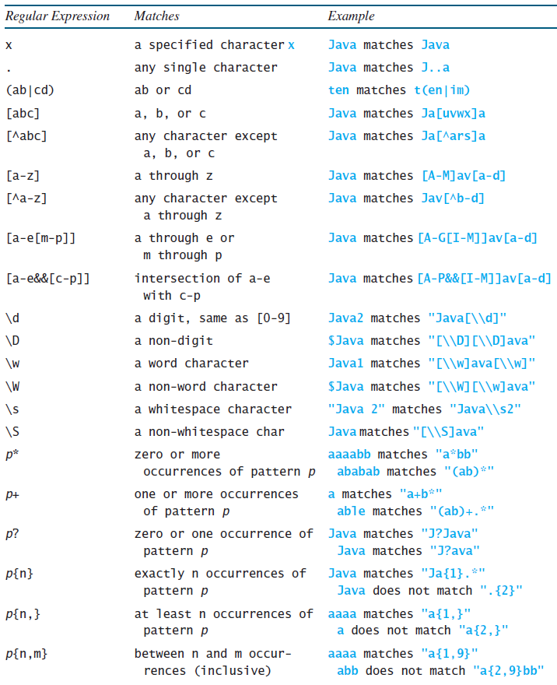
Regular Expression Syntax

Slide 57
Replacing and Splitting Strings (2 of 2)

Slide 58
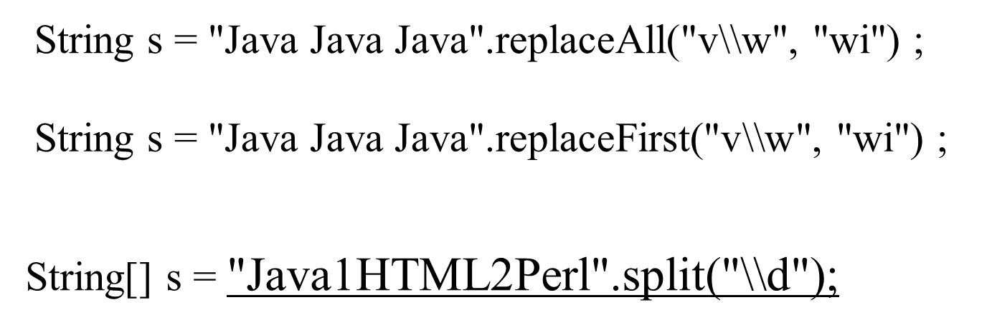
Examples (2 of 2)

Slide 59

Copyright

