Slide 1
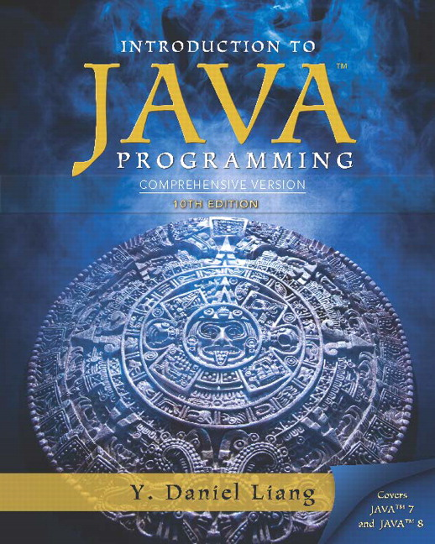
Introduction to Java Programming Comprehensive Version
Tenth Edition
Chapter 11
Inheritance and Polymorphism
Copyright © 2015 Pearson Education, Inc. All Rights Reserved
Notes:
If this PowerPoint presentation contains mathematical equations, you may need to check that your computer has the following installed:
1) MathType Plugin
2) Math Player (free versions available)
3) NVDA Reader (free versions available)

Slide 2
Motivations
Suppose you will define classes to model circles, rectangles, and triangles. These classes have many common features. What is the best way to design these classes so to avoid redundancy? The answer is to use inheritance.

Slide 3
Learning Objectives (1 of 2)
11.1 To define a subclass from a superclass through inheritance (§11.2).
11.2 To invoke the superclass’s constructors and methods using the super keyword (§11.3).
11.3 To override instance methods in the subclass (§11.4).
11.4 To distinguish differences between overriding and overloading (§11.5).
11.5 To explore the toString() method in the Object class (§11.6).
11.6 To discover polymorphism and dynamic binding (§§11.7–11.8).

Slide 4
Learning Objectives (2 of 2)
11.7 To describe casting and explain why explicit downcasting is necessary (§11.9).
11.8 To explore the equals method in the Object class (§11.10).
11.9 To store, retrieve, and manipulate objects in an ArrayList (§11.11).
11.10 To implement a Stack class using ArrayList (§11.12).
11.11 To enable data and methods in a superclass accessible from subclasses using the protected visibility modifier (§11.13).
11.12 To prevent class extending and method overriding using the final modifier (§11.14).

Slide 5
Superclasses and Subclasses
GeometricObject
CircleFromSimpleGeometricObject
RectangleFromSimpleGeometricObject
TestCircleRectangle
Run

Slide 6
Are Superclass’s Constructor Inherited?
No. They are not inherited.
They are invoked explicitly or implicitly.
Explicitly using the super keyword.
A constructor is used to construct an instance of a class. Unlike properties and methods, a superclass’s constructors are not inherited in the subclass. They can only be invoked from the subclasses’ constructors, using the keyword super. If the keyword super is not explicitly used, the superclass’s no-arg constructor is automatically invoked.

Slide 7
Superclass’s Constructor Is Always Invoked
A constructor may invoke an overloaded constructor or its superclass’s constructor. If none of them is invoked explicitly, the compiler puts super() as the first statement in the constructor. For example,

Slide 8
Using the Keyword super
The keyword super refers to the superclass of the class in which super appears. This keyword can be used in two ways:
To call a superclass constructor
To call a superclass method

Slide 9
Caution
You must use the keyword super to call the superclass constructor. Invoking a superclass constructor’s name in a subclass causes a syntax error. Java requires that the statement that uses the keyword super appear first in the constructor.

Slide 10
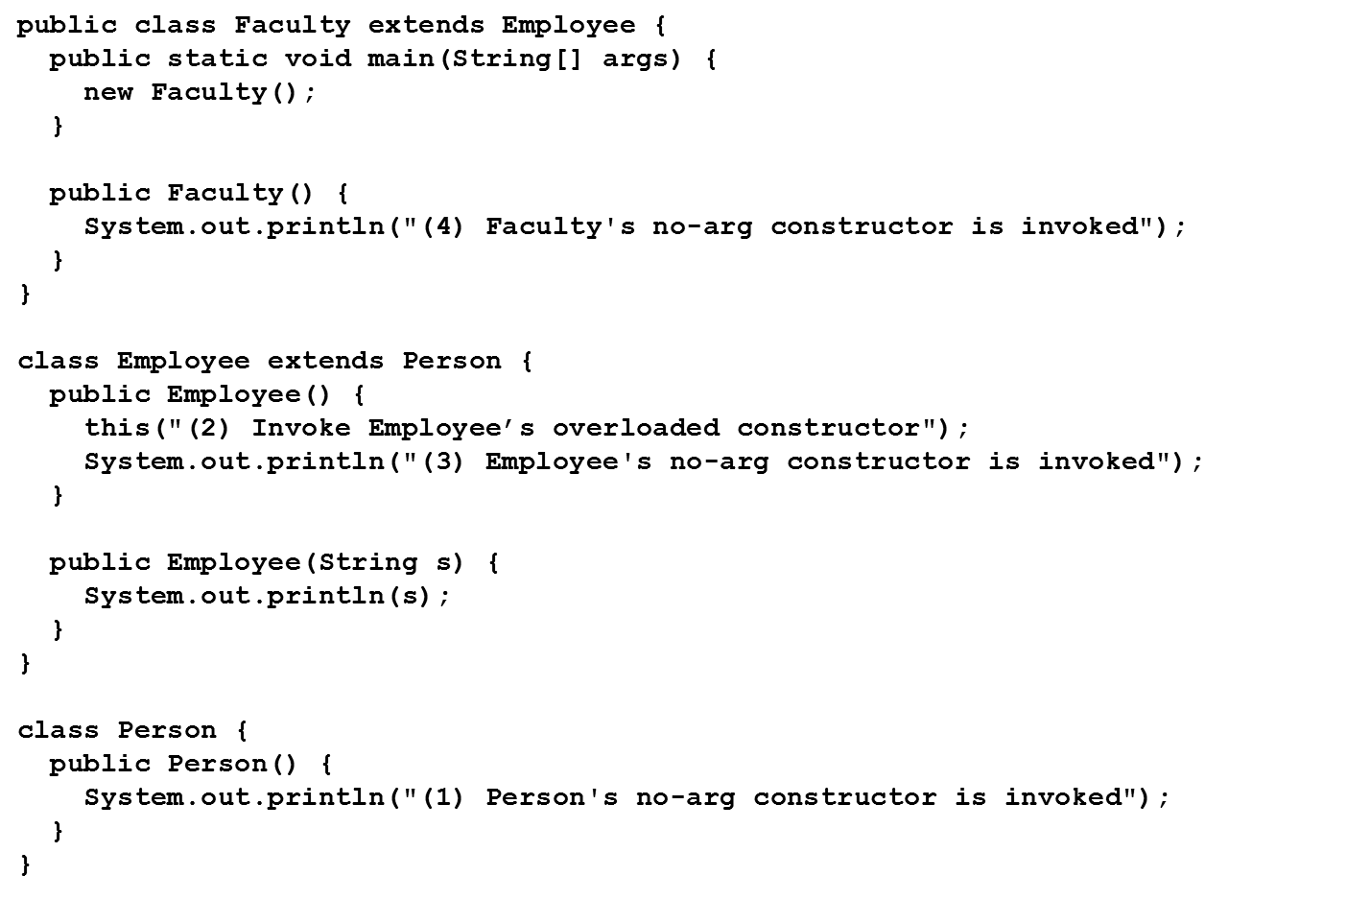
Constructor Chaining
Constructing an instance of a class invokes all the superclasses’ constructors along the inheritance chain. This is known as constructor chaining.

Slide 11
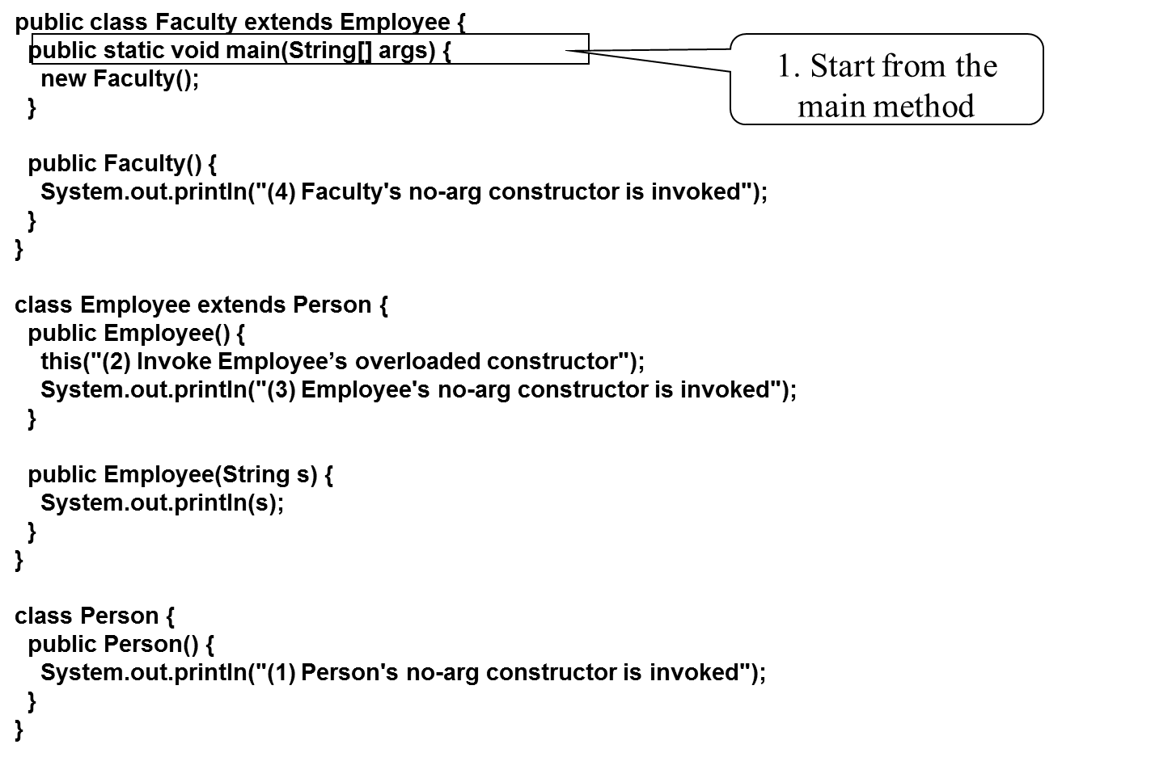
Trace Execution (1 of 9)

Slide 12
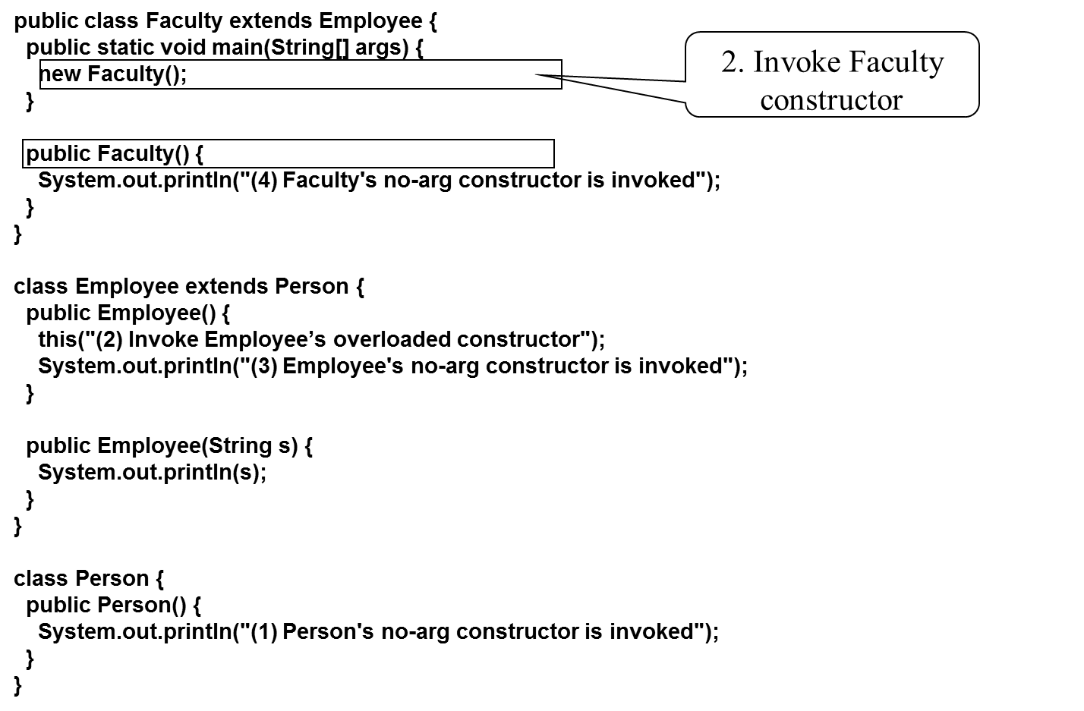
Trace Execution (2 of 9)

Slide 13
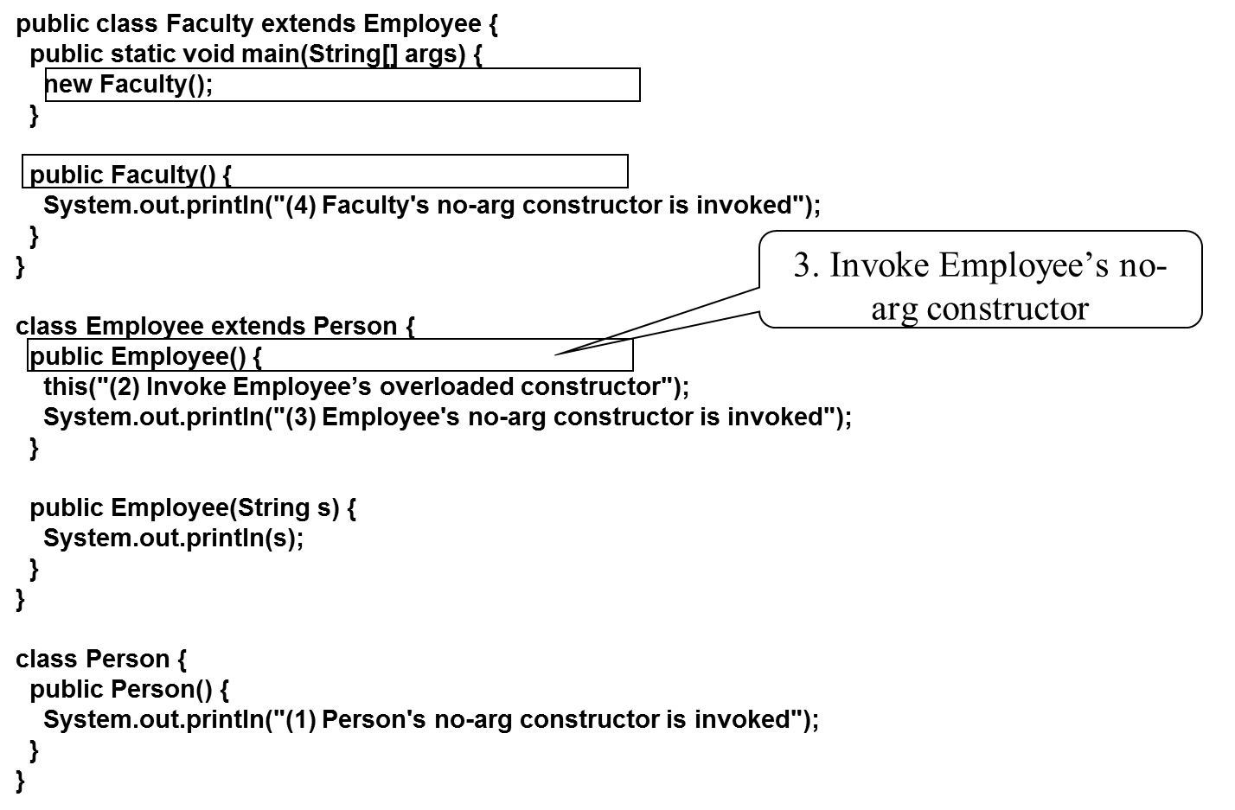
Trace Execution (3 of 9)

Slide 14
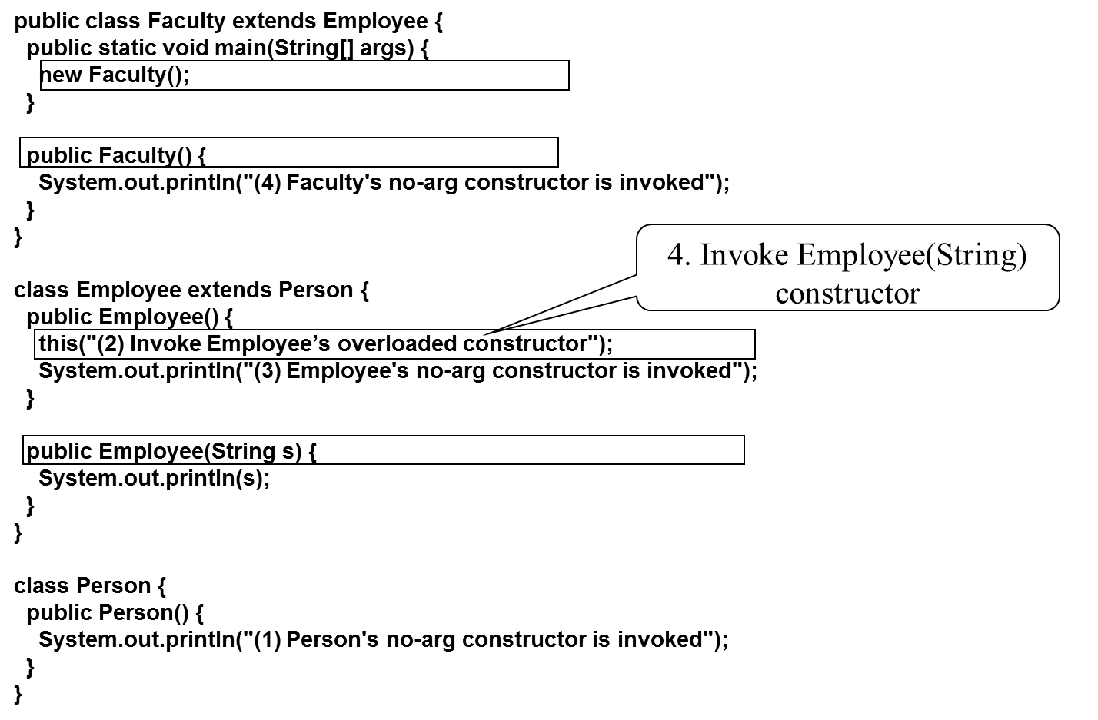
Trace Execution (4 of 9)

Slide 15
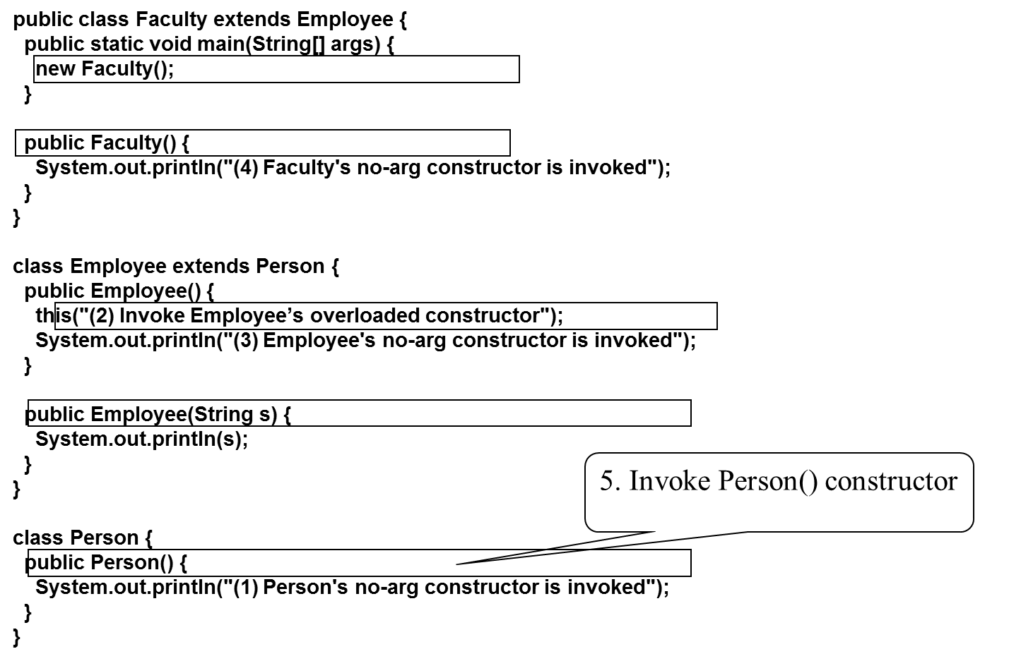
Trace Execution (5 of 9)

Slide 16
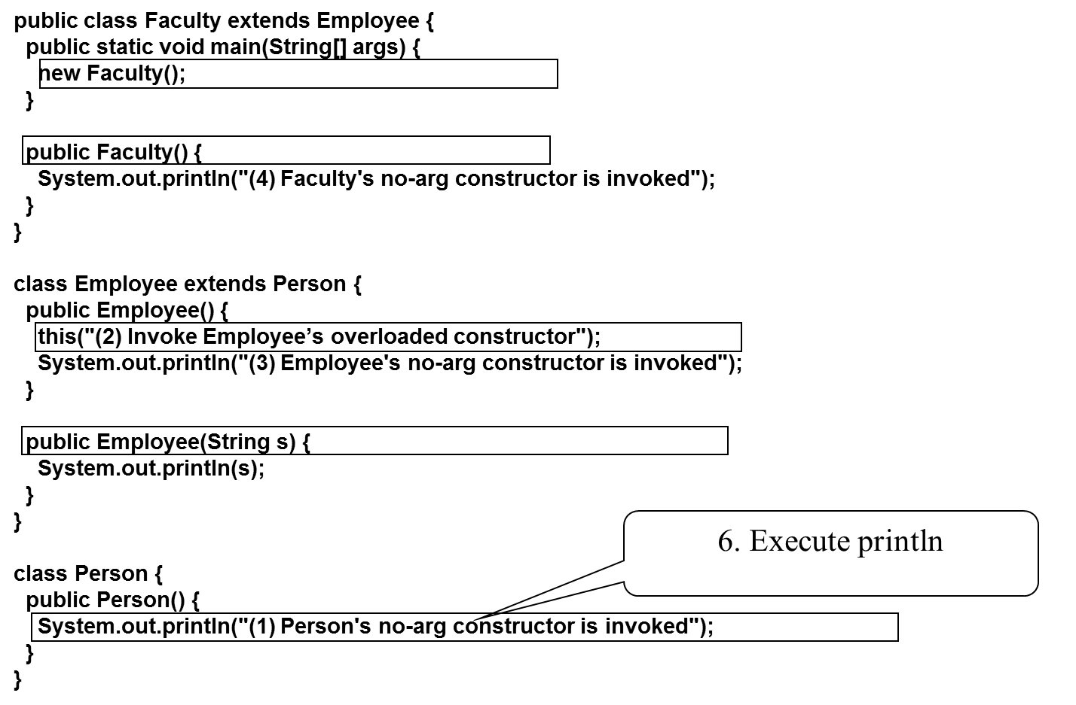
Trace Execution (6 of 9)

Slide 17
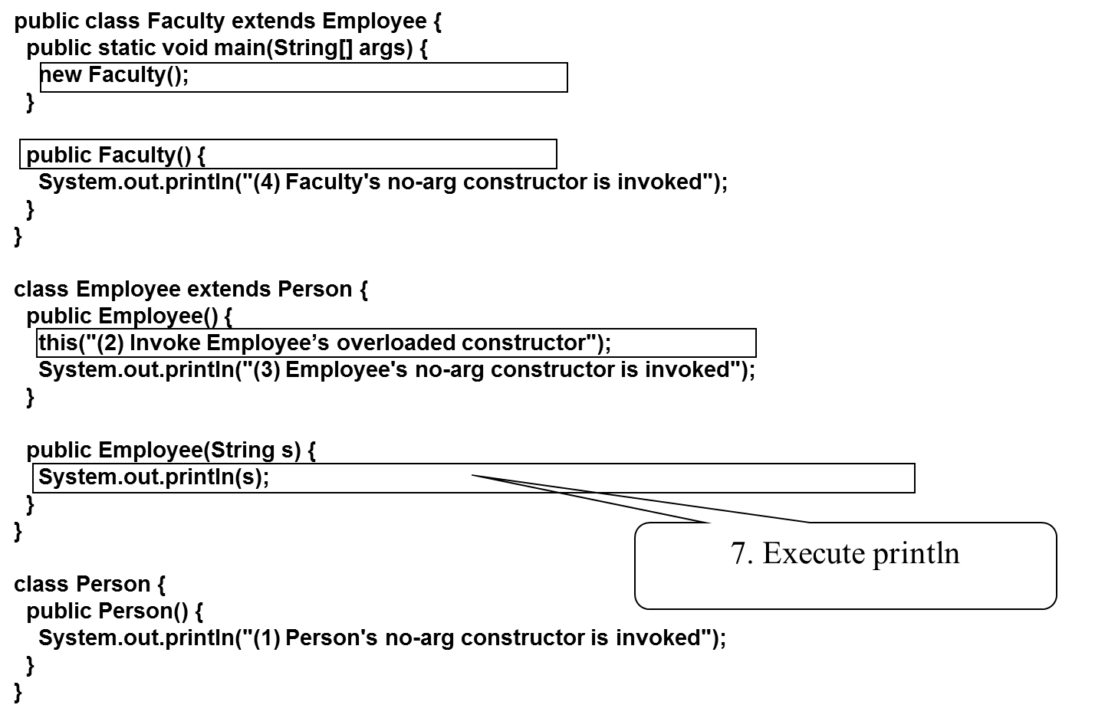
Trace Execution (7 of 9)

Slide 18
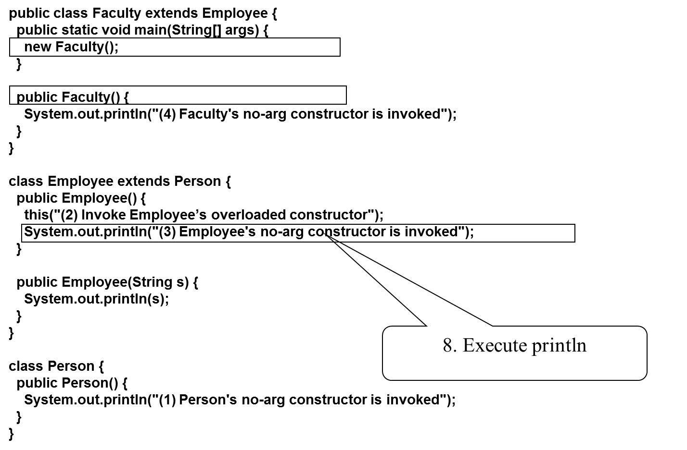
Trace Execution (8 of 9)

Slide 19
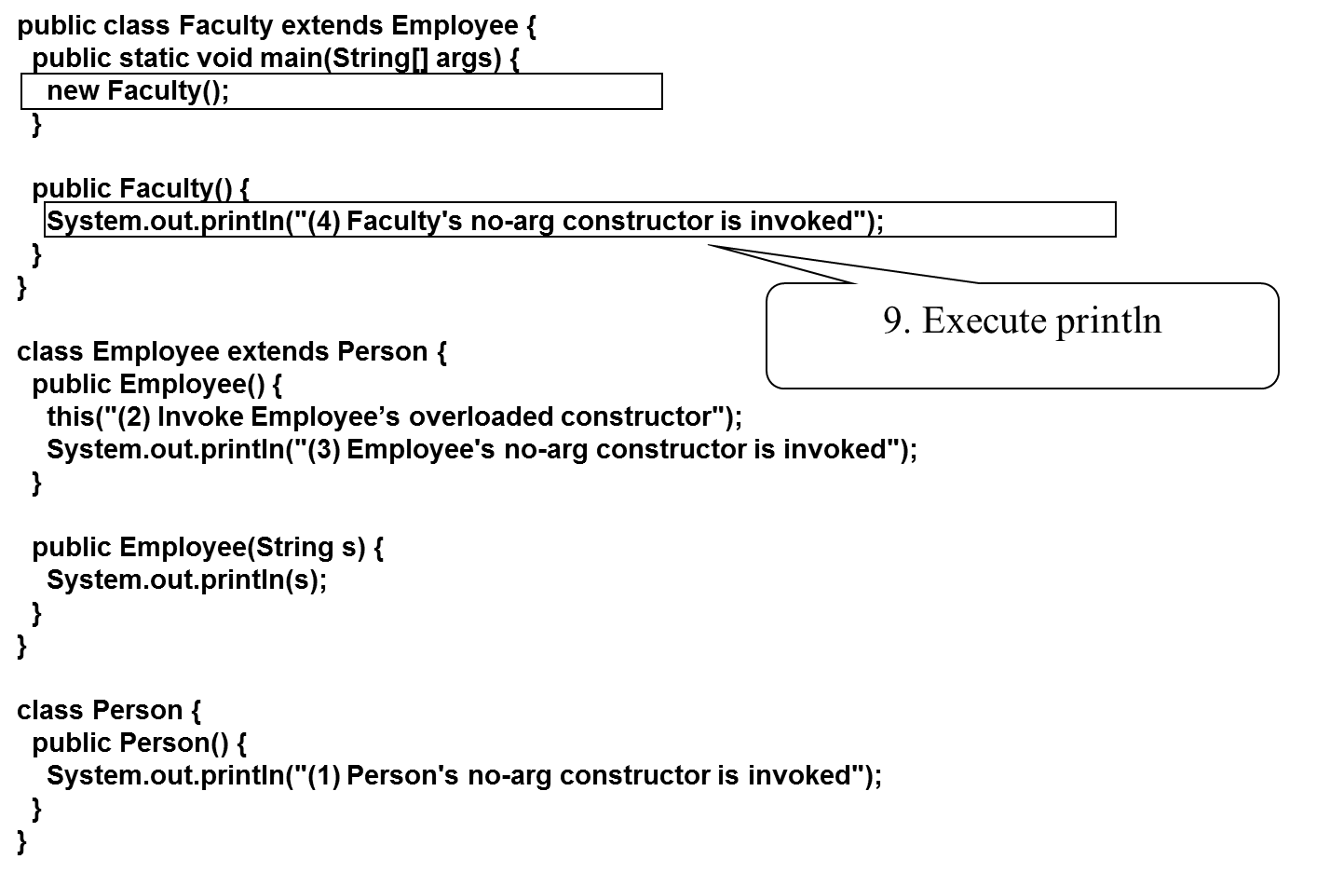
Trace Execution (9 of 9)

Slide 20

Example on the Impact of a Superclass without no-arg Constructor
Find out the errors in the program:

Slide 21
Defining a Subclass
A subclass inherits from a superclass. You can also:
Add new properties
Add new methods
Override the methods of the superclass

Slide 22
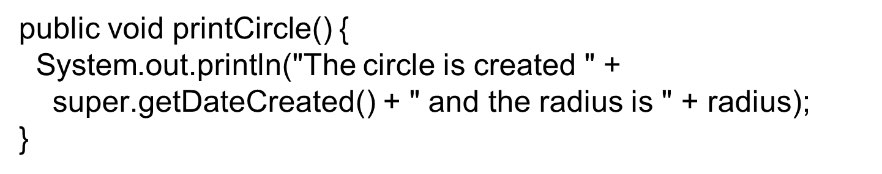
Calling Superclass Methods
You could rewrite the printCircle() method in the Circle class as follows:

Slide 23
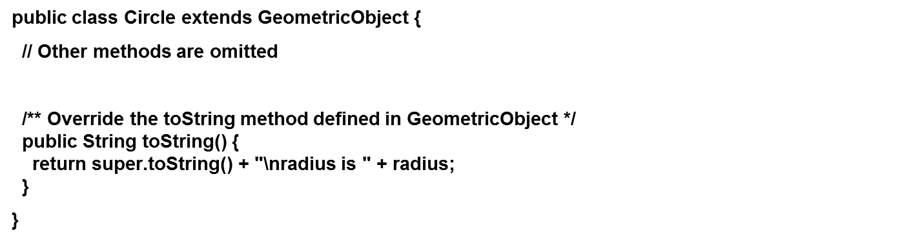
Overriding Methods in the Superclass
A subclass inherits methods from a superclass. Sometimes it is necessary for the subclass to modify the implementation of a method defined in the superclass. This is referred to as method overriding.

Slide 24
Note (1 of 2)
An instance method can be overridden only if it is accessible. Thus a private method cannot be overridden, because it is not accessible outside its own class. If a method defined in a subclass is private in its superclass, the two methods are completely unrelated.

Slide 25
Note (2 of 2)
Like an instance method, a static method can be inherited. However, a static method cannot be overridden. If a static method defined in the superclass is redefined in a subclass, the method defined in the superclass is hidden.

Slide 26
Overriding versus Overloading

Slide 27
The Object Class and Its Methods
Every class in Java is descended from the java.lang.Object class. If no inheritance is specified when a class is defined, the superclass of the class is Object.

Slide 28

The toString() method in Object
The toString() method returns a string representation of the object. The default implementation returns a string consisting of a class name of which the object is an instance, the at sign (@), and a number representing this object.
The code displays something like Loan@15037e5. This message is not very helpful or informative. Usually you should override the toString method so that it returns a digestible string representation of the object.

Slide 29
Polymorphism
Polymorphism means that a variable of a supertype can refer to a subtype object.
A class defines a type. A type defined by a subclass is called a subtype, and a type defined by its superclass is called a supertype. Therefore, you can say that Circle is a subtype of GeometricObject and GeometricObject is a supertype for Circle.
PolymorphismDemo
Run

Slide 30
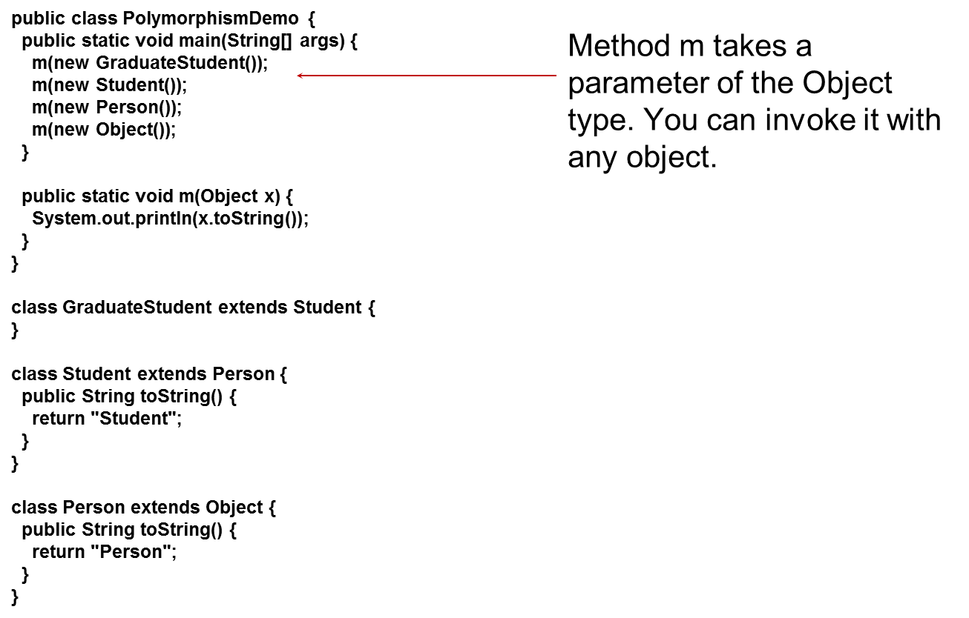
Polymorphism, Dynamic Binding and Generic Programming (1 of 2)
DynamicBindingDemo
Run

Slide 31
Polymorphism, Dynamic Binding and Generic Programming (2 of 2)
An object of a subtype can be used wherever its supertype value is required. This feature is known as polymorphism.
When the method m(Object x) is executed, the argument x’s toString method is invoked. x may be an instance of GraduateStudent, Student, Person, or Object. Classes GraduateStudent, Student, Person, and Object have their own implementation of the toString method. Which implementation is used will be determined dynamically by the Java Virtual Machine at runtime. This capability is known as dynamic binding.

Slide 32
Dynamic Binding
Dynamic binding works as follows: Suppose an object o is an instance of classes
where
is a subclass of
is a
subclass of
is a subclass of
That is,
is the most
general class, and
is the most specific class. In Java,
is the
Object class. If o invokes a method p, the JVM searches the implementation for the method p in
in this order,
until it is found. Once an implementation is found, the search stops and the first-found implementation is invoked.

Slide 33
Method Matching versus Binding
Matching a method signature and binding a method implementation are two issues. The compiler finds a matching method according to parameter type, number of parameters, and order of the parameters at compilation time. A method may be implemented in several subclasses. The Java Virtual Machine dynamically binds the implementation of the method at runtime.

Slide 34
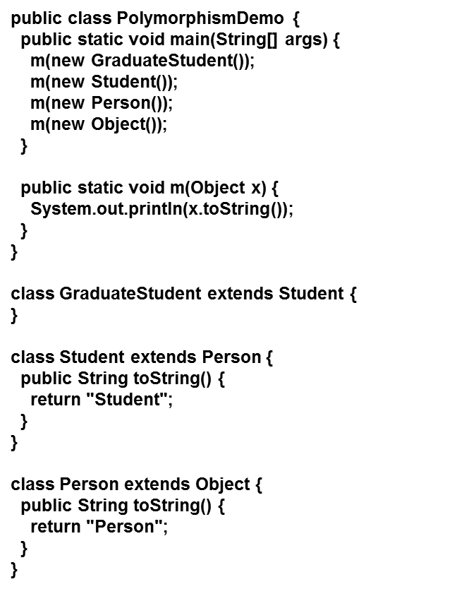
Generic Programming
Polymorphism allows methods to be used generically for a wide range of object arguments. This is known as generic programming. If a method’s parameter type is a superclass (e.g., Object), you may pass an object to this method of any of the parameter’s subclasses (e.g., Student or String). When an object (e.g., a Student object or a String object) is used in the method, the particular implementation of the method of the object that is invoked (e.g., toString) is determined dynamically.

Slide 35
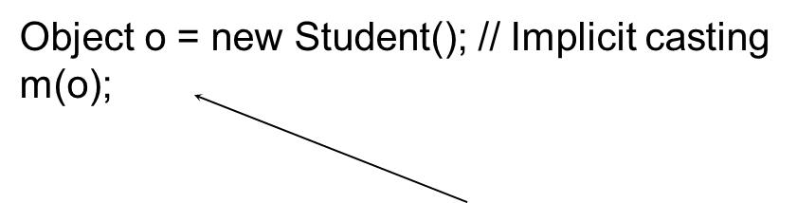
Casting Objects
You have already used the casting operator to convert variables of one primitive type to another. Casting can also be used to convert an object of one class type to another within an inheritance hierarchy. In the preceding section, the statement
m(new Student());
assigns the object new Student() to a parameter of the Object type. This statement is equivalent to:
The statement Object o = new Student(), known as implicit casting, is legal because an instance of Student is automatically an instance of Object.

Slide 36
Why Casting Is Necessary?
Suppose you want to assign the object reference o to a variable of the Student type using the following statement:
Student b = o;
A compile error would occur. Why does the statement Object o = new Student() work and the statement Student b = o doesn’t? This is because a Student object is always an instance of Object, but an Object is not necessarily an instance of Student. Even though you can see that o is really a Student object, the compiler is not so clever to know it. To tell the compiler that o is a Student object, use an explicit casting. The syntax is similar to the one used for casting among primitive data types. Enclose the target object type in parentheses and place it before the object to be cast, as follows:
Student b = (Student)o; // Explicit casting

Slide 37
Casting from Superclass to Subclass
Explicit casting must be used when casting an object from a superclass to a subclass. This type of casting may not always succeed.
Apple x = (Apple)fruit;
Orange x = (Orange)fruit;

Slide 38
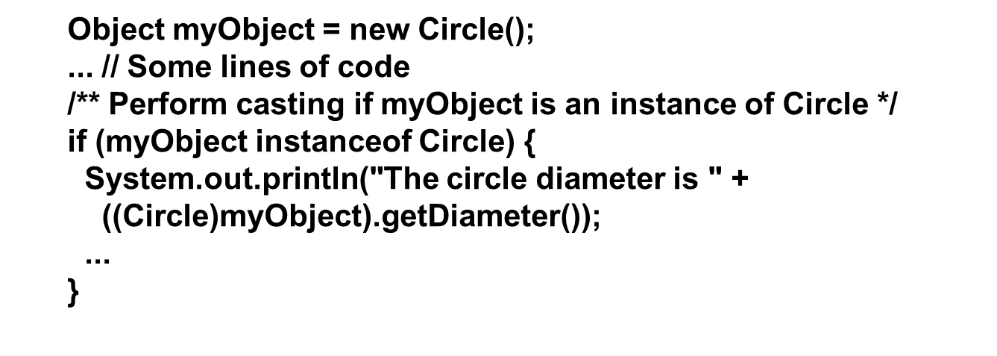
The instanceof Operator
Use the instanceof operator to test whether an object is an instance of a class:

Slide 39
Tip
To help understand casting, you may also consider the analogy of fruit, apple, and orange with the Fruit class as the superclass for Apple and Orange. An apple is a fruit, so you can always safely assign an instance of Apple to a variable for Fruit. However, a fruit is not necessarily an apple, so you have to use explicit casting to assign an instance of Fruit to a variable of Apple.

Slide 40
Example: Demonstrating Polymorphism and Casting
This example creates two geometric objects: a circle, and a rectangle, invokes the displayGeometricObject method to display the objects. The displayGeometricObject displays the area and diameter if the object is a circle, and displays area if the object is a rectangle.
CastingDemo
Run

Slide 41

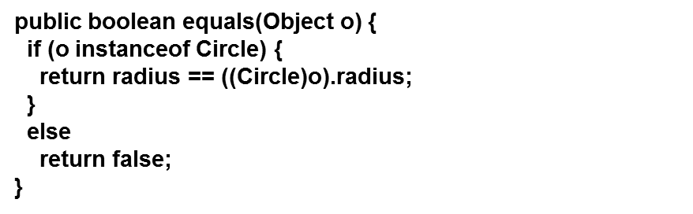
The equals Method
The equals()method compares the contents of two objects. The default implementation of the equals method in the Object class is as follows:
For example, the equals method is overridden in the Circle class.

Slide 42
Note
The == comparison operator is used for comparing two primitive data type values or for determining whether two objects have the same references. The equals method is intended to test whether two objects have the same contents, provided that the method is modified in the defining class of the objects. The == operator is stronger than the equals method, in that the == operator checks whether the two reference variables refer to the same object.

Slide 43
The ArrayList Class
You can create an array to store objects. But the array’s size is fixed once the array is created. Java provides the ArrayList class that can be used to store an unlimited number of objects.

Slide 44
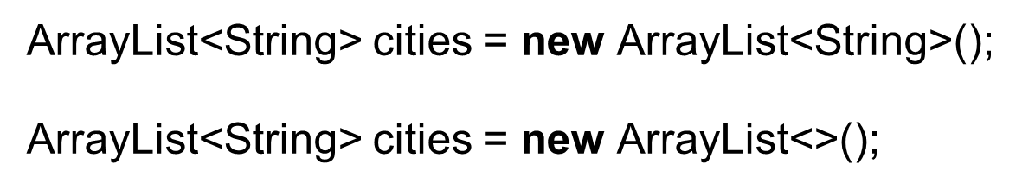
Generic Type
ArrayList is known as a generic class with a generic type E. You can specify a concrete type to replace E when creating an ArrayList. For example, the following statement creates an ArrayList and assigns its reference to variable cities. This ArrayList object can be used to store strings.
TestArrayList
Run

Slide 45
Differences and Similarities between Arrays and ArrayList
DistinctNumbers
Run

Slide 46
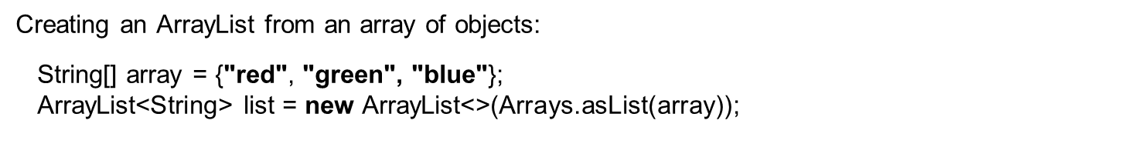

Array Lists from/to Arrays

Slide 47
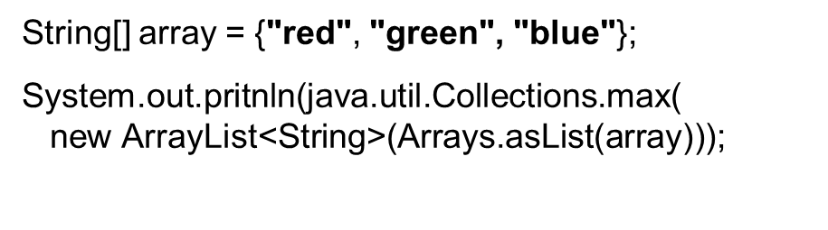
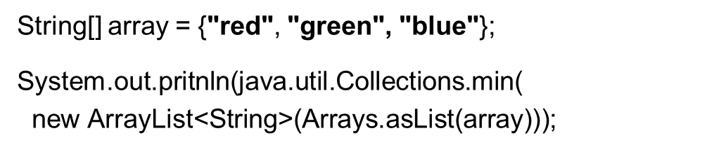
max and min in an Array List

Slide 48
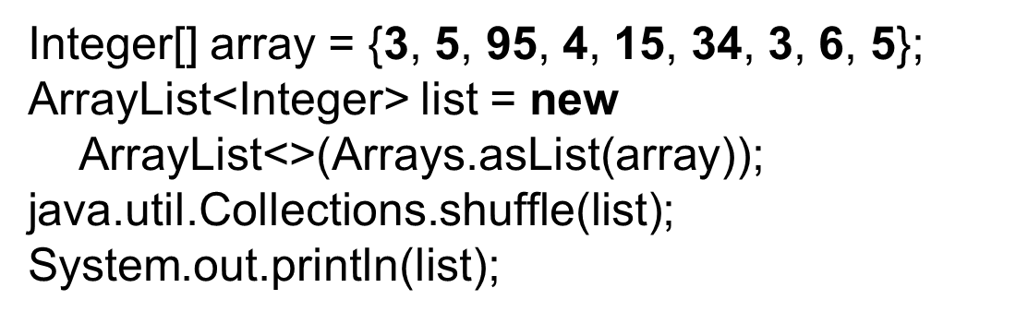
Shuffling an Array List

Slide 49

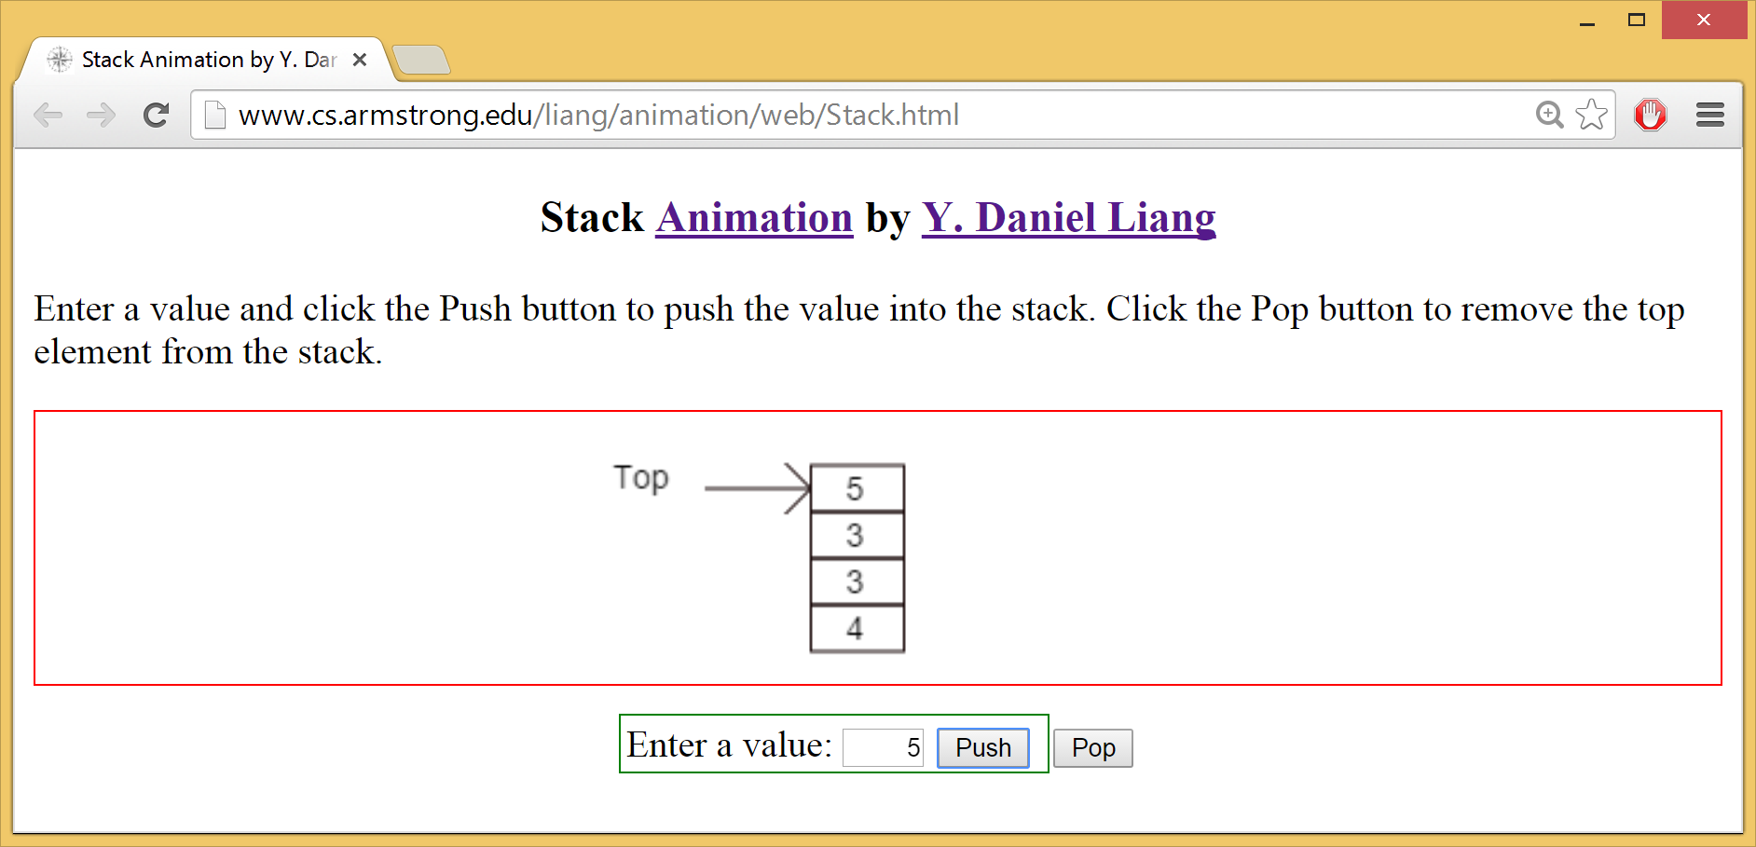
Stack Animation

Slide 50
The MyStack Classes
A stack to hold objects.
MyStack

Slide 51
The protected Modifier
The protected modifier can be applied on data and methods in a class. A protected data or a protected method in a public class can be accessed by any class in the same package or its subclasses, even if the subclasses are in a different package.
private, default, protected, public

Slide 52
Accessibility Summary

Slide 53
Visibility Modifiers

Slide 54
A Subclass Cannot Weaken the Accessibility
A subclass may override a protected method in its superclass and change its visibility to public. However, a subclass cannot weaken the accessibility of a method defined in the superclass. For example, if a method is defined as public in the superclass, it must be defined as public in the subclass.

Slide 55
Note
The modifiers are used on classes and class members (data and methods), except that the final modifier can also be used on local variables in a method. A final local variable is a constant inside a method.

Slide 56
The final Modifier
The final class cannot be extended:
final class Math {
...
}
The final variable is a constant:
final static double PI = 3.14159;
The final method cannot be overridden by its subclasses

Slide 57
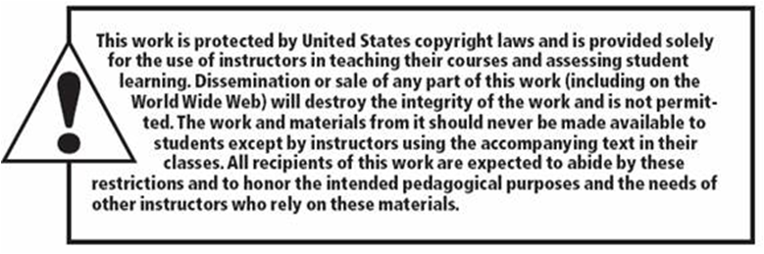
Copyright

