Slide 1
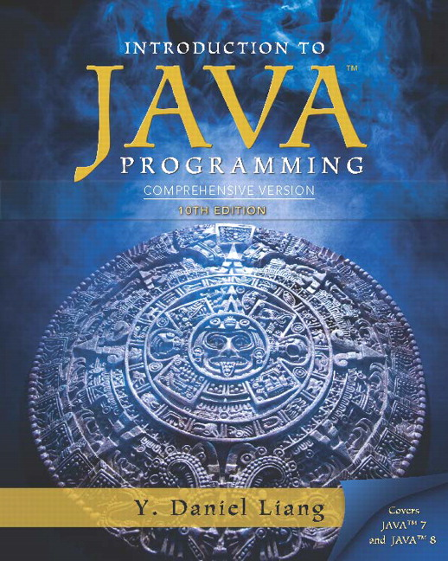
Introduction to Java Programming Comprehensive Version
Tenth Edition
Chapter 11
JavaF X Basics
Copyright © 2015 Pearson Education, Inc. All Rights Reserved
Notes:
If this PowerPoint presentation contains mathematical equations, you may need to check that your computer has the following installed:
1) MathType Plugin
2) Math Player (free versions available)
3) NVDA Reader (free versions available)

Slide 2
Motivations
Java F X is a new framework for developing Java G U I programs. The Java F X A P I is an excellent example of how the object-oriented principle is applied. This chapter serves two purposes. First, it presents the basics of Java F X programming. Second, it uses Java F X to demonstrate O O P. Specifically, this chapter introduces the framework of Java F X and discusses Java F X G U I components and their relationships.

Slide 3
Learning Objectives (1 of 2)
14.1 To distinguish between Java F X, Swing, and A W T (§14.2).
14.2 To write a simple Java F X program and understand the relationship among stages, scenes, and nodes (§14.3).
14.3 To create user interfaces using panes, U I controls, and shapes (§14.4).
14.4 To use binding properties to synchronize property values (§14.5).
14.5 To use the common properties style and rotate for nodes (§14.6).
14.6 To create colors using the Color class (§14.7).

Slide 4
Learning Objectives (2 of 2)
14.7 To create fonts using the Font class (§14.8).
14.8 To create images using the Image class and to create image views using the ImageView class (§14.9).
14.9 To layout nodes using Pane, StackPane, FlowPane, GridPane, BorderPane, H Box, and V Box (§14.10).
14.10 To display text using the Text class and create shapes using Line, Circle, Rectangle, Ellipse, Arc, Polygon, and Polyline (§14.11).
14.11 To develop the reusable GUI components ClockPane for displaying an analog clock (§14.12).

Slide 5
Java F X versus Swing and A W T
Swing and A W T are replaced by the Java F X platform for developing rich Internet applications.
When Java was introduced, the G U I classes were bundled in a library known as the Abstract Windows Toolkit (A W T). A W T is fine for developing simple graphical user interfaces, but not for developing comprehensive G U I projects. In addition, A W T is prone to platform-specific bugs. The A W T user-interface components were replaced by a more robust, versatile, and flexible library known as Swing components. Swing components are painted directly on canvases using Java code. Swing components depend less on the target platform and use less of the native G U I resource. With the release of Java 8, Swing is replaced by a completely new G U I platform known as Java F X.

Slide 6
Basic Structure of JavaF X
Application
Override the start(Stage) method
Stage, Scene, and Nodes
MyJavaFX
Run
MultipleStageDemo
Run

Slide 7
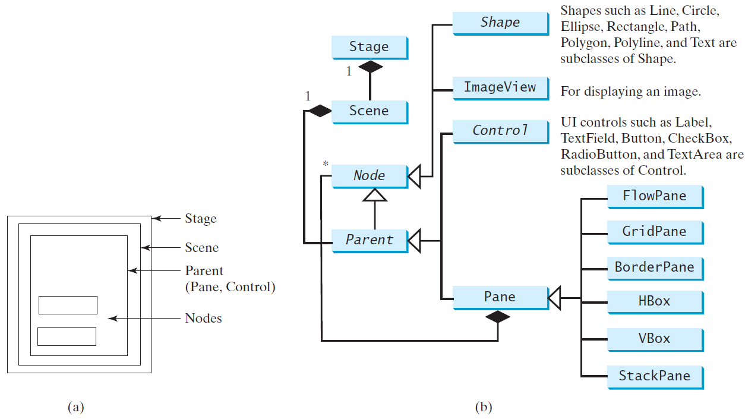
Panes, U I Controls, and Shapes
ButtonInPane
Run

Slide 8
Display a Shape
This example displays a circle in the center of the pane.
ShowCircle
Run

Slide 9
Binding Properties
JavaF X introduces a new concept called binding property that enables a target object to be bound to a source object. If the value in the source object changes, the target property is also changed automatically. The target object is simply called a binding object or a binding property.
ShowCircleCentered
Run

Slide 10
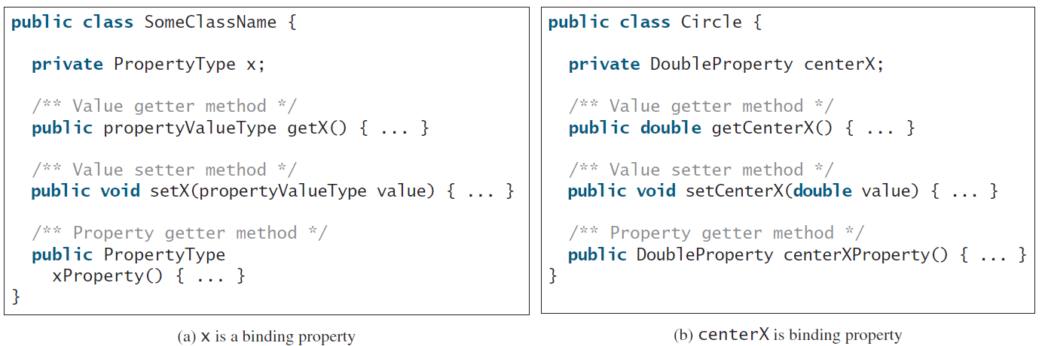
Binding Property: getter, setter, and property getter

Slide 11
Uni/Bidirectional Binding
BindingDemo
Run
BidirectionalBindingDemo
Run

Slide 12
Common Properties and Methods for Nodes
style: set a JavaF X C S S style
rotate: Rotate a node
NodeStyleRotateDemo
Run

Slide 13
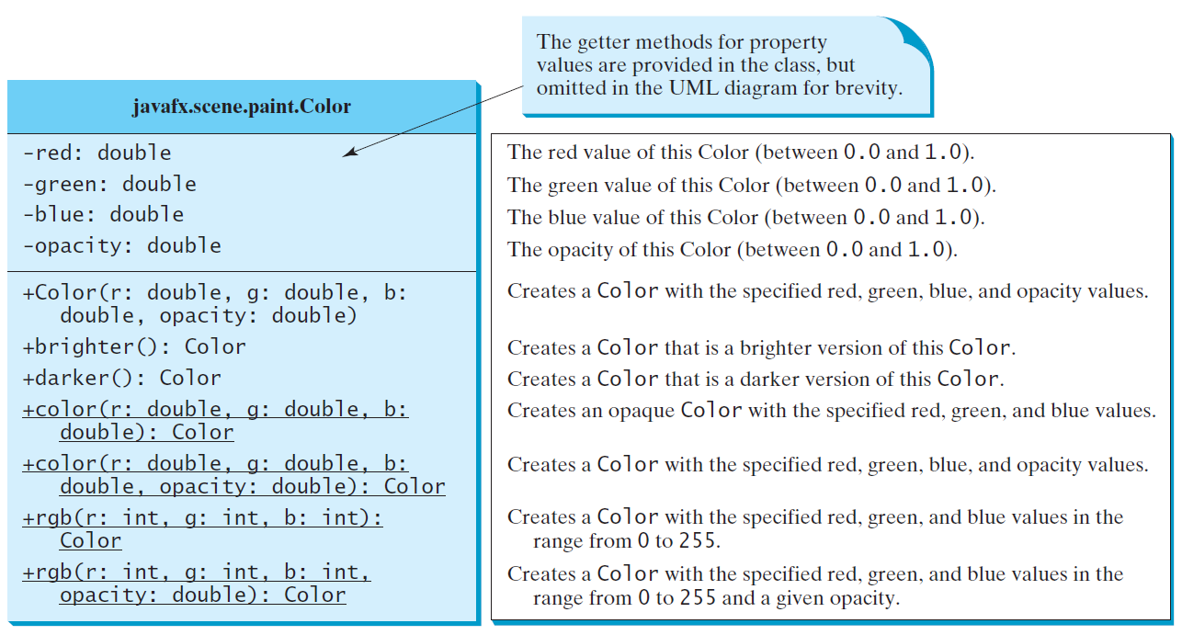
The Color Class

Slide 14
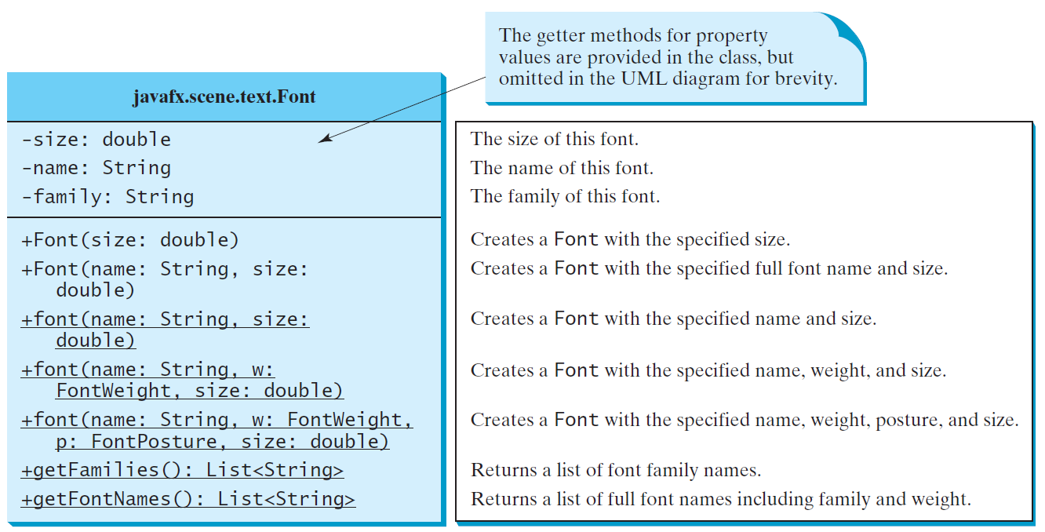
The Font Class
FontDemo
Run

Slide 15
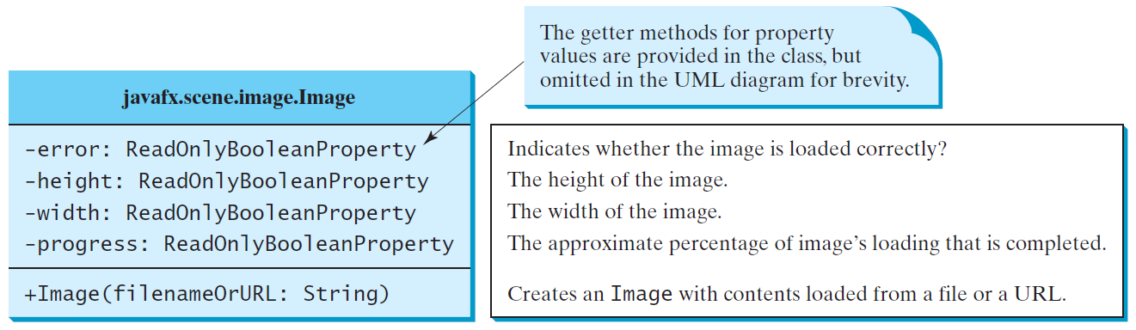
The Image Class

Slide 16
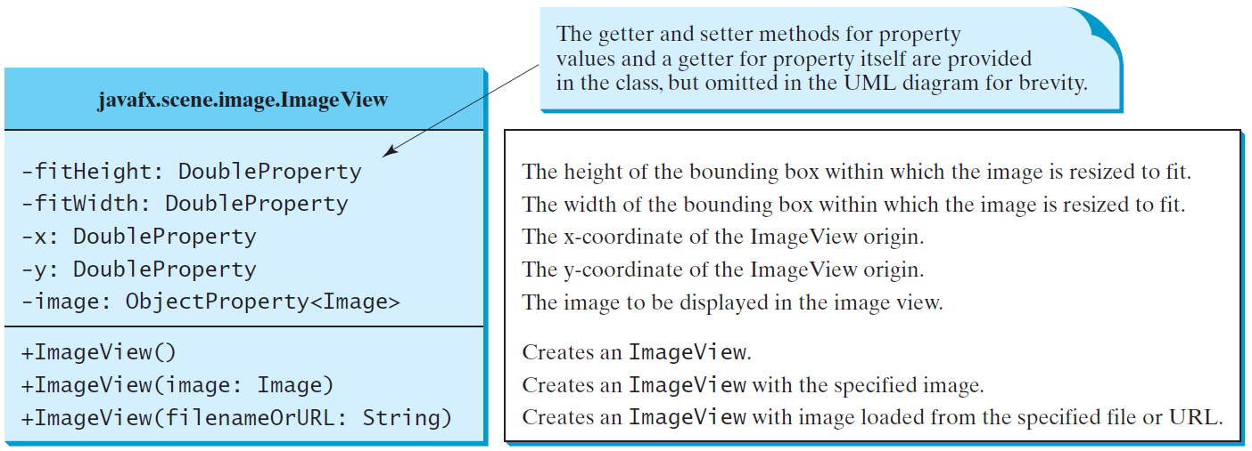
The ImageView Class
ShowImage
Run

Slide 17
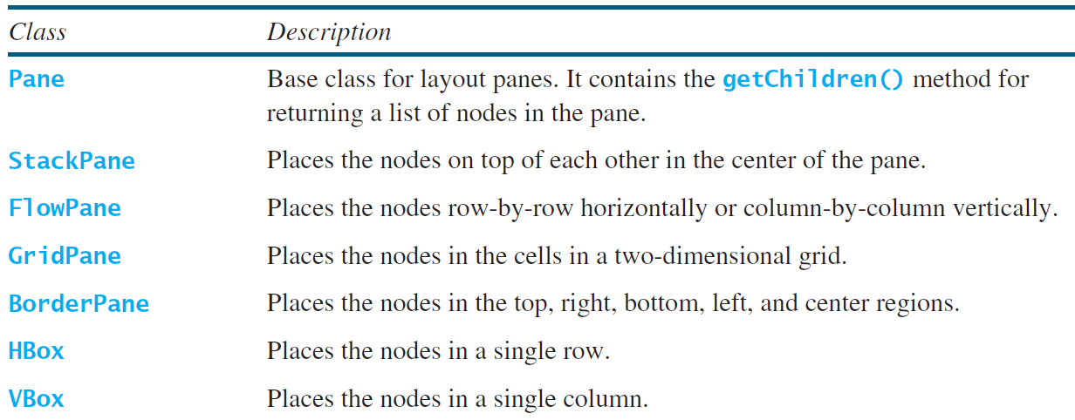
Layout Panes
JavaF X provides many types of panes for organizing nodes in a container.

Slide 18
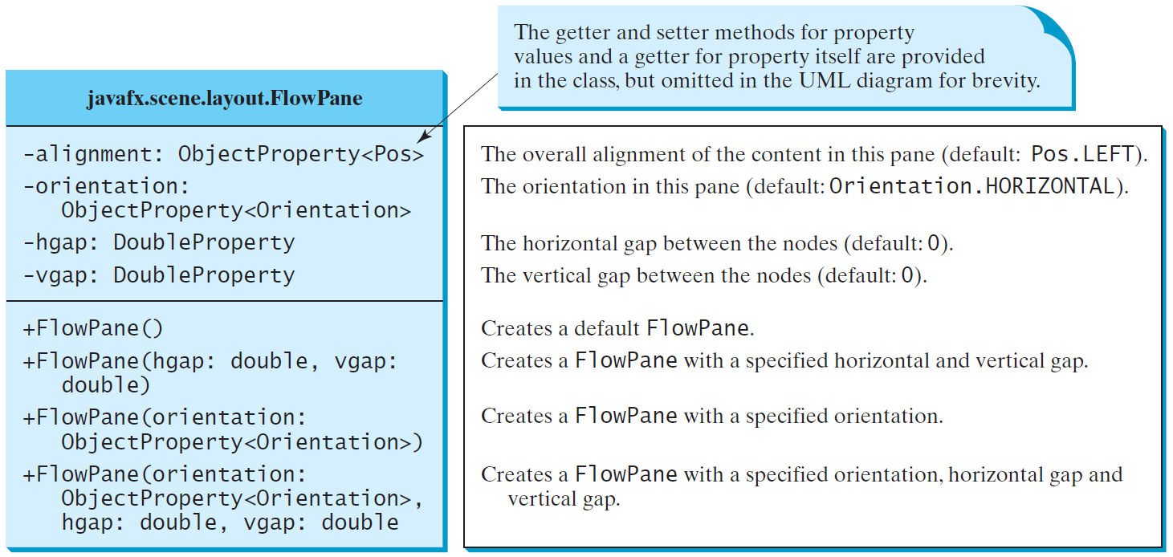
FlowPane
MultipleStageDemo
Run

Slide 19
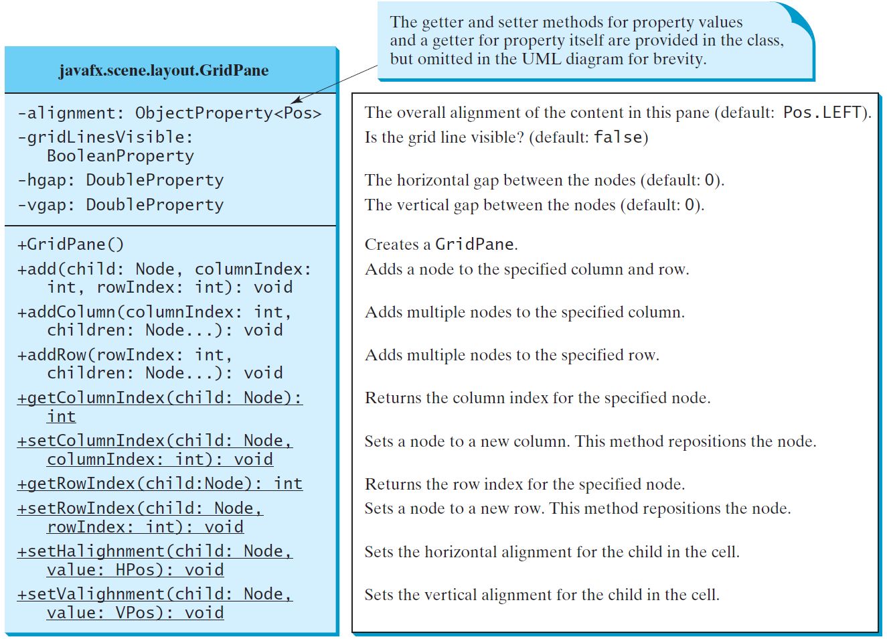
GridPane
ShowGridPane
Run

Slide 20
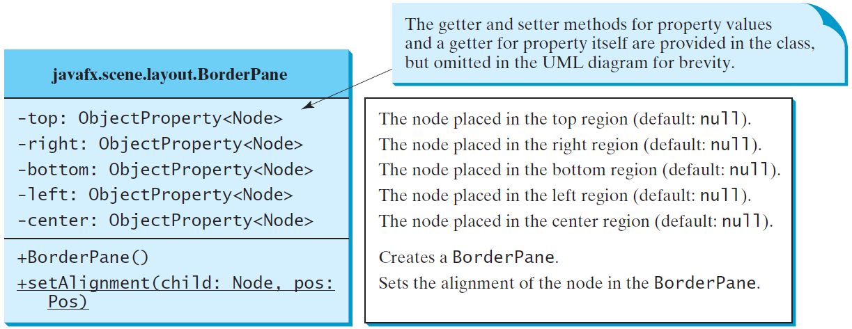
BorderPane
ShowBorderPane
Run

Slide 21
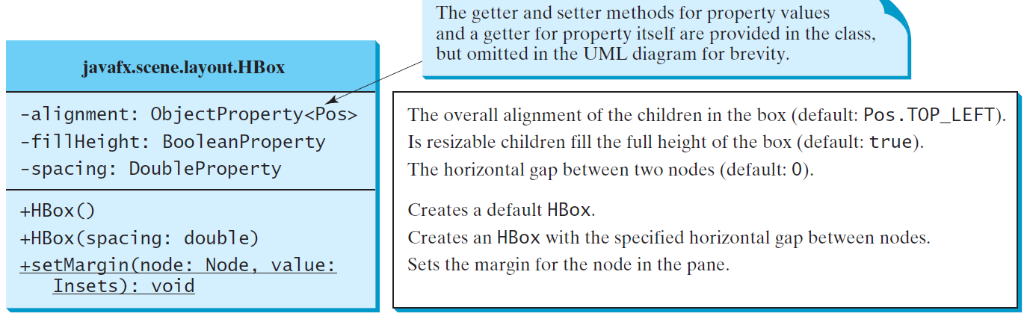
H Box

Slide 22
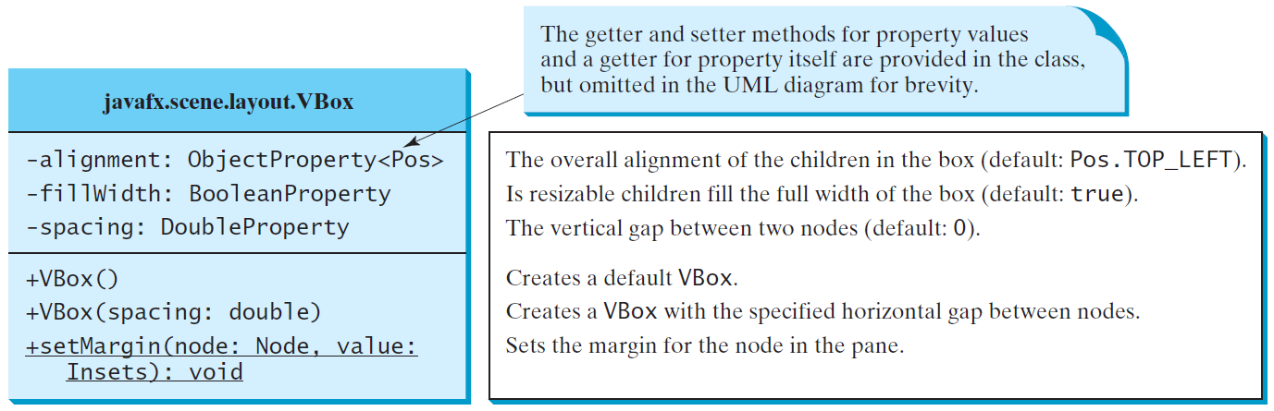
V Box
ShowHBoxVBox
Run

Slide 23
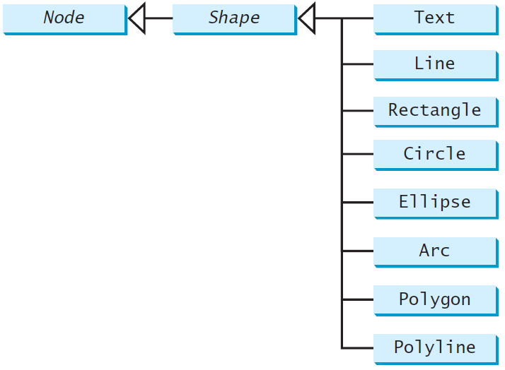
Shapes
JavaF X provides many shape classes for drawing texts, lines, circles, rectangles, ellipses, arcs, polygons, and polylines.

Slide 24
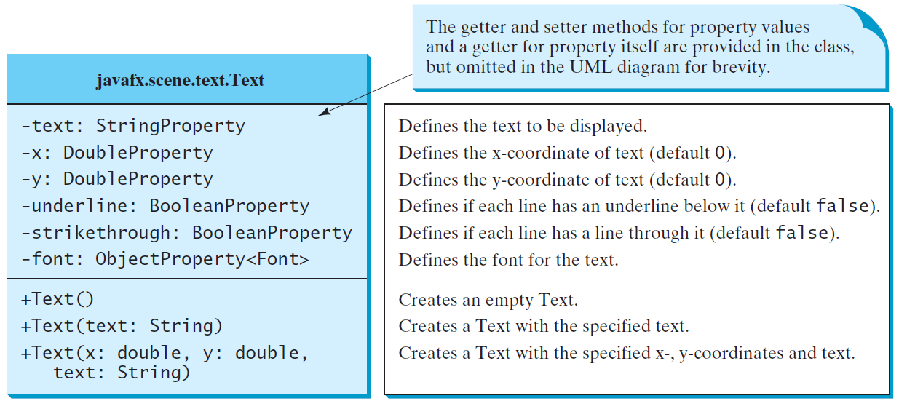
Text

Slide 25
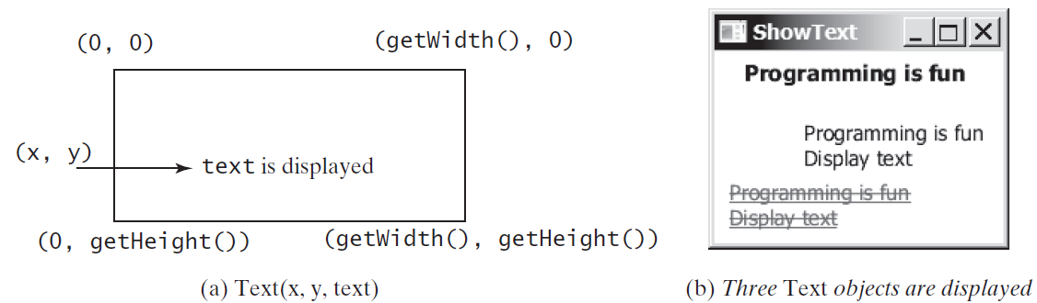
Text Example
ShowText
Run

Slide 26
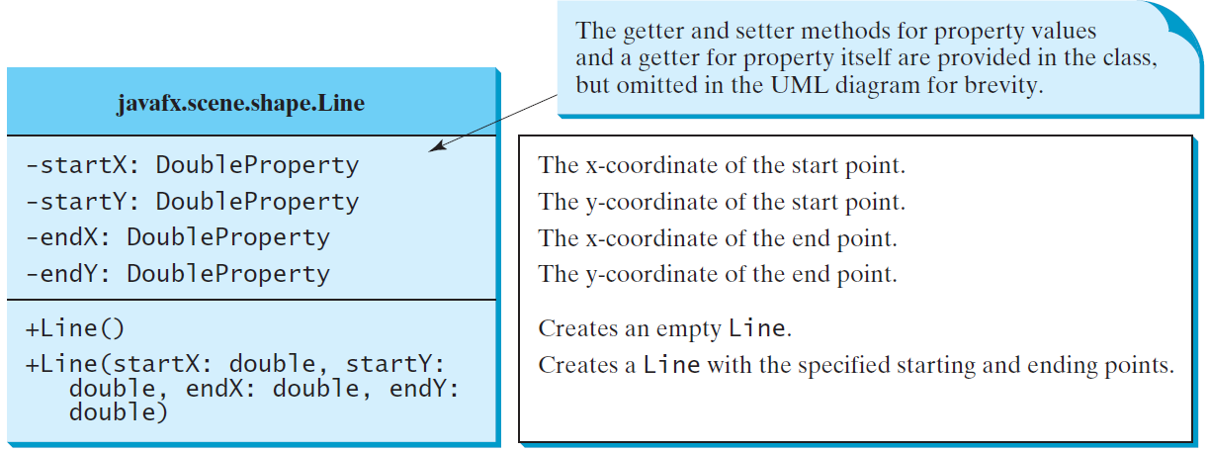
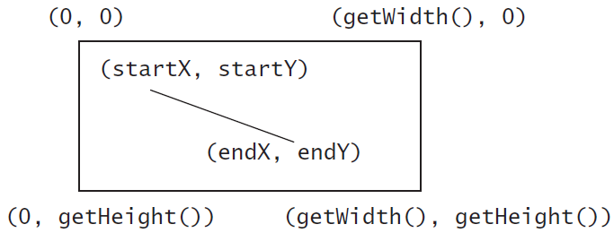
Line
ShowLine
Run

Slide 27
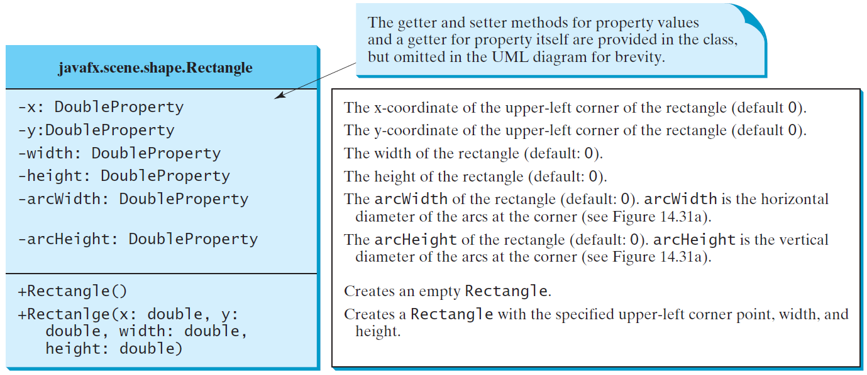
Rectangle

Slide 28
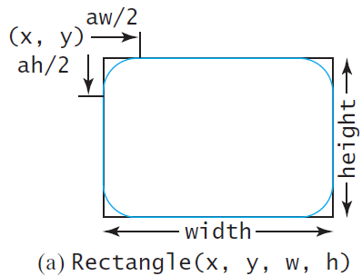
Rectangle Example
ShowRectangle
Run

Slide 29
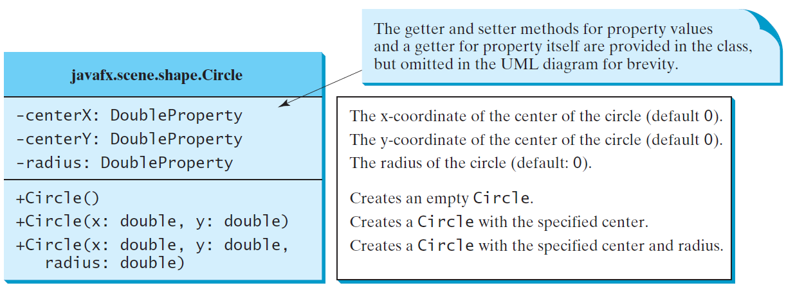
Circle

Slide 30
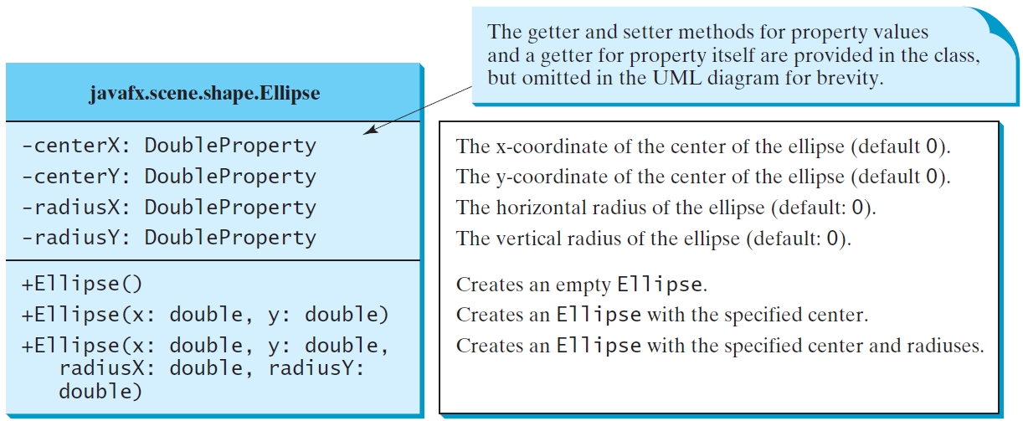
Ellipse
ShowEllipse
Run

Slide 31
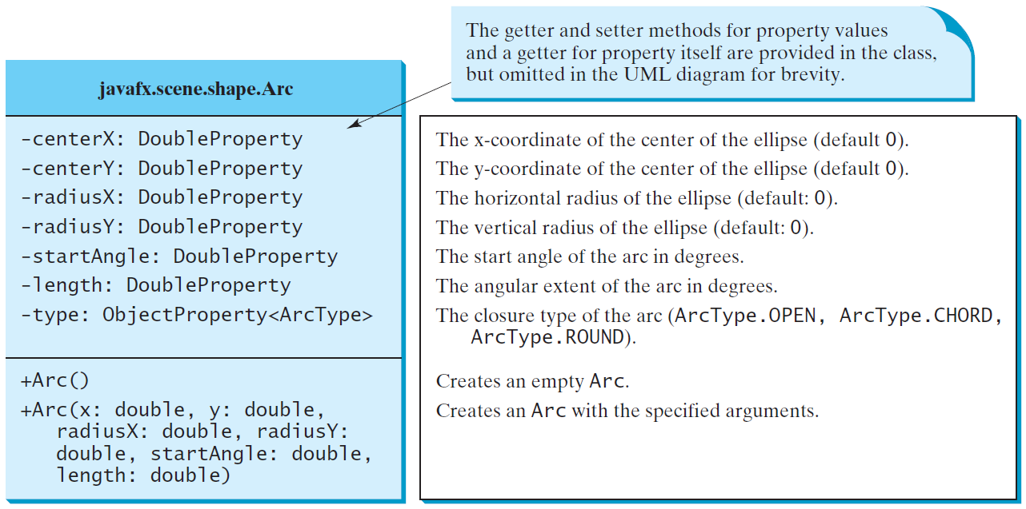
Arc

Slide 32
Arc Examples
ShowArc
Run

Slide 33
Polygon and Polyline

Slide 34
Polygon
ShowPolygon
Run

Slide 35
Case Study: The ClockPane Class
This case study develops a class that displays a clock on a pane.
ClockPane

Slide 36
Use the ClockPane Class
DisplayClock
Run

Slide 37
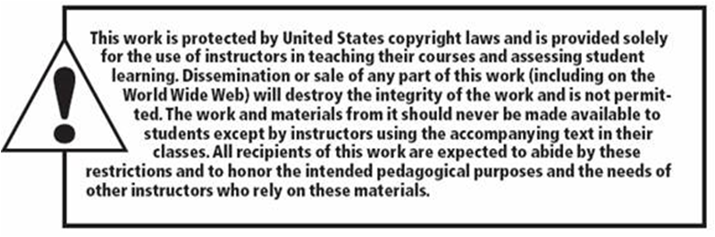
Copyright

