Slide 1
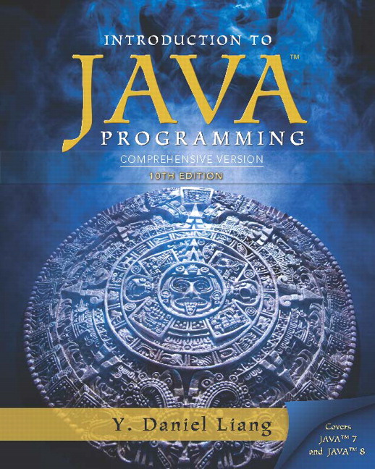
Introduction to Java Programming Comprehensive Version
Tenth Edition
Chapter 15
Event-Driven Programming and Animations
Copyright © 2015 Pearson Education, Inc. All Rights Reserved
Notes:
If this PowerPoint presentation contains mathematical equations, you may need to check that your computer has the following installed:
1) MathType Plugin
2) Math Player (free versions available)
3) NVDA Reader (free versions available)

Slide 2
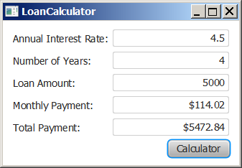
Motivations
Suppose you want to write a G U I program that lets the user enter a loan amount, annual interest rate, and number of years and click the Compute Payment button to obtain the monthly payment and total payment. How do you accomplish the task? You have to use event-driven programming to write the code to respond to the button-clicking event.
LoanCalculator
Run

Slide 3
Learning Objectives (1 of 2)
15.1 To get a taste of event-driven programming (§15.1).
15.2 To describe events, event sources, and event classes (§15.2).
15.3 To define handler classes, register handler objects with the source object, and write the code to handle events (§15.3).
15.4 To define handler classes using inner classes (§15.4).
15.5 To define handler classes using anonymous inner classes (§15.5).
15.6 To simplify event handling using lambda expressions (§15.6).

Slide 4
Learning Objectives (2 of 2)
15.7 To develop a G U I application for a loan calculator (§15.7).
15.8 To write programs to deal with MouseEvents (§15.8).
15.9 To write programs to deal with KeyEvents (§15.9).
15.10 To create listeners for processing a value change in an observable object (§15.10).
15.11 To use the Animation, PathTransition, FadeTransition, and Timeline classes to develop animations (§15.11).
15.12 To develop an animation for simulating a bouncing ball (§15.12).

Slide 5
Procedural versus Event-Driven Programming
Procedural programming is executed in procedural order.
In event-driven programming, code is executed upon activation of events.

Slide 6
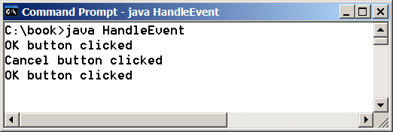
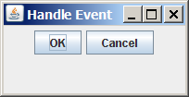
Taste of Event-Driven Programming
The example displays a button in the frame. A message is displayed on the console when a button is clicked.
HandleEvent
Run

Slide 7
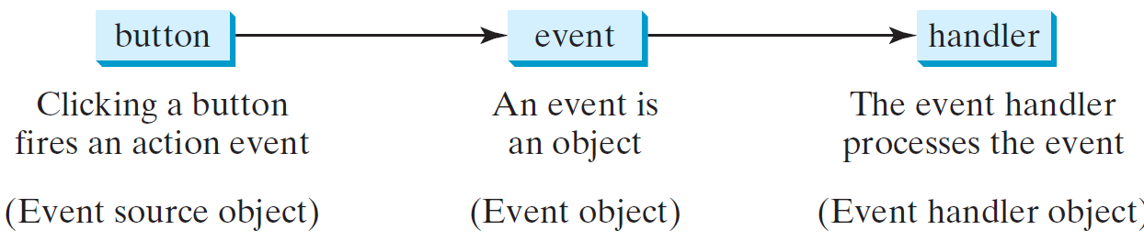
Handling G U I Events
Source object (e.g., button)
Listener object contains a method for processing the event.

Slide 8
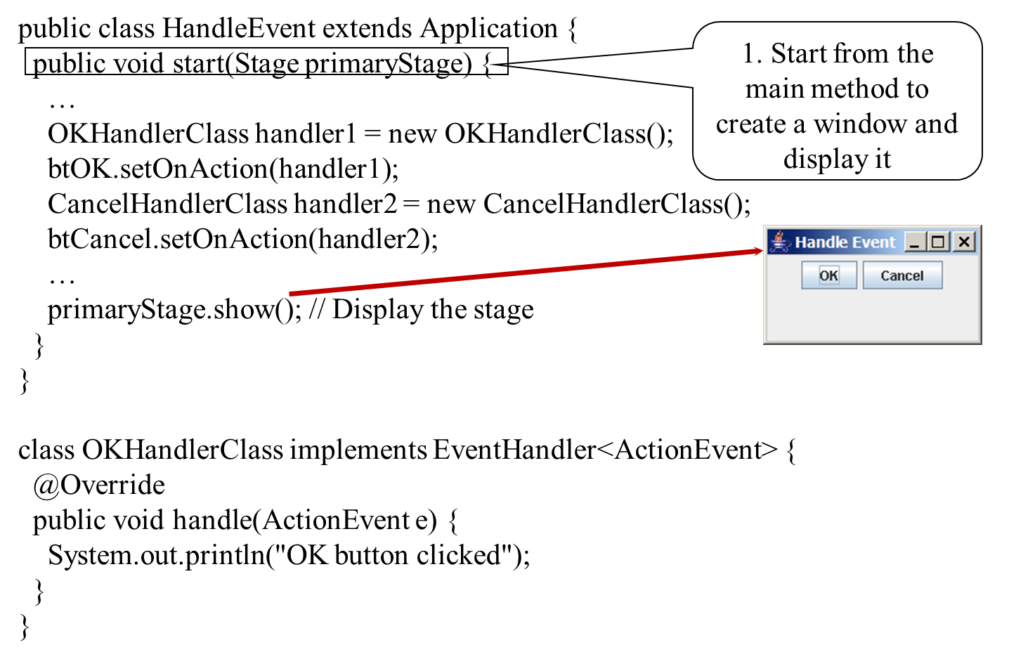
Trace Execution (1 of 3)

Slide 9
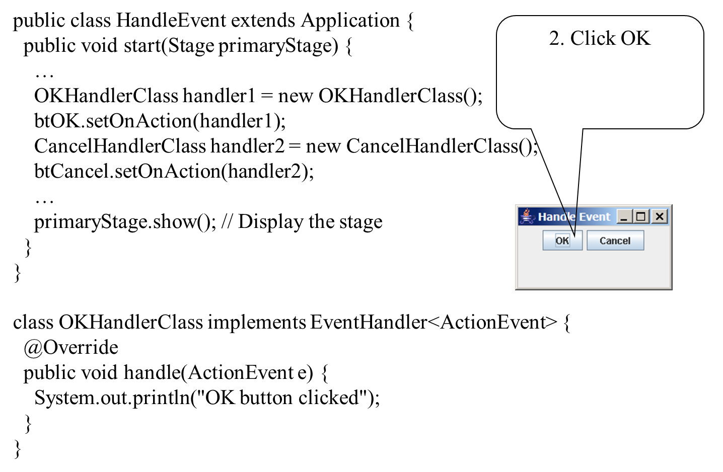
Trace Execution (2 of 3)

Slide 10
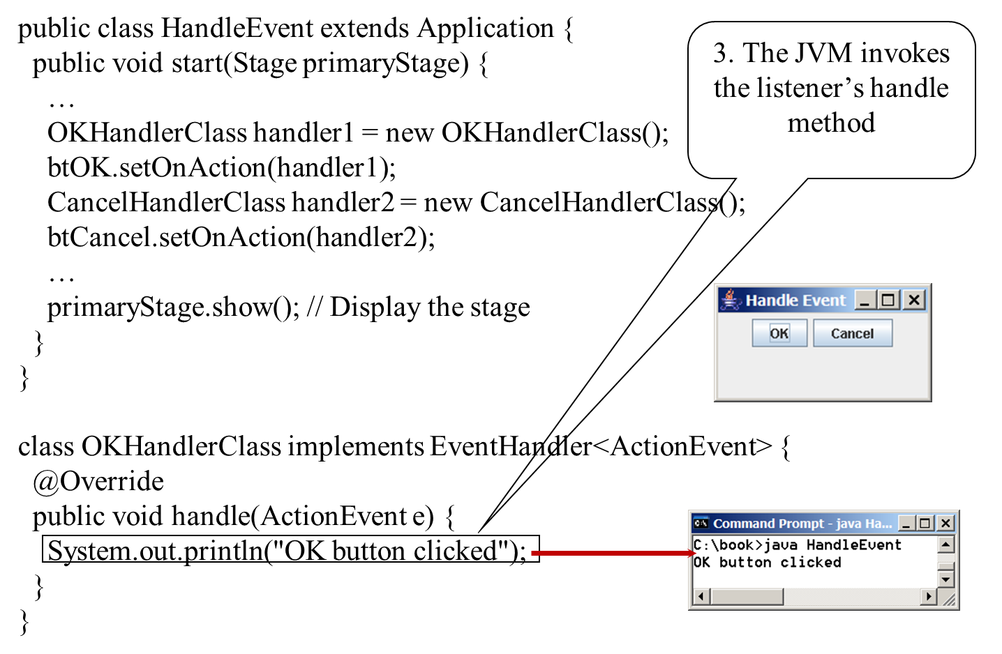
Trace Execution (3 of 3)

Slide 11
Events
An event can be defined as a type of signal to the program that something has happened.
The event is generated by external user actions such as mouse movements, mouse clicks, or keystrokes.

Slide 12
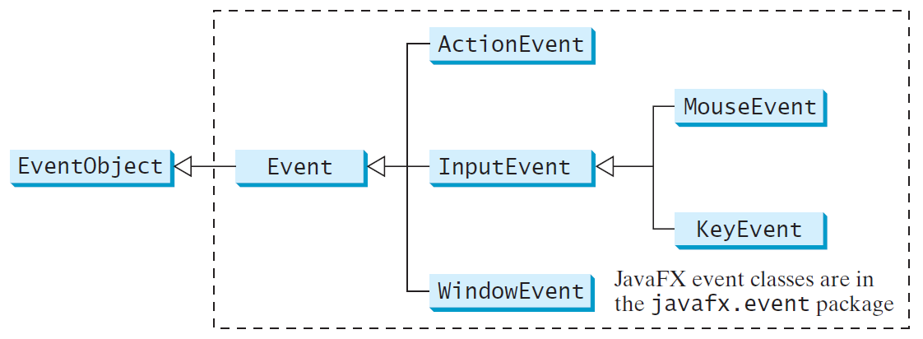
Event Classes

Slide 13
Event Information
An event object contains whatever properties are pertinent to the event. You can identify the source object of the event using the getSource() instance method in the EventObject class. The subclasses of EventObject deal with special types of events, such as button actions, window events, mouse movements, and keystrokes. Table 16.1 lists external user actions, source objects, and event types generated.

Slide 14
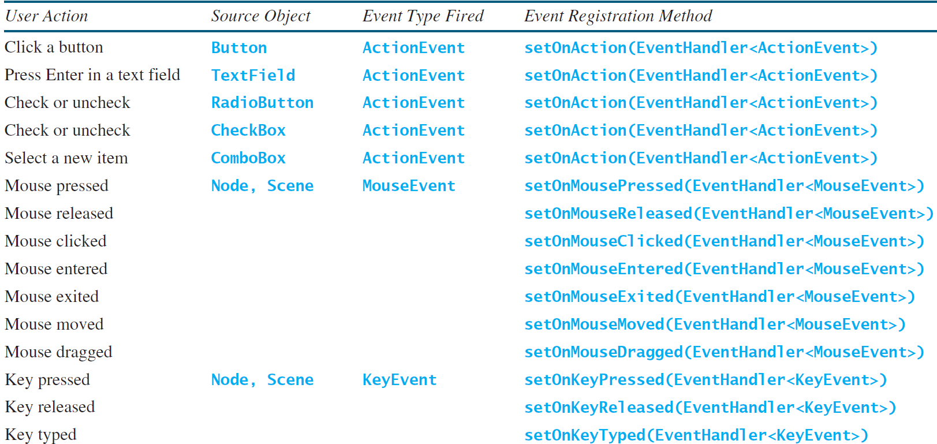
Selected User Actions and Handlers

Slide 15
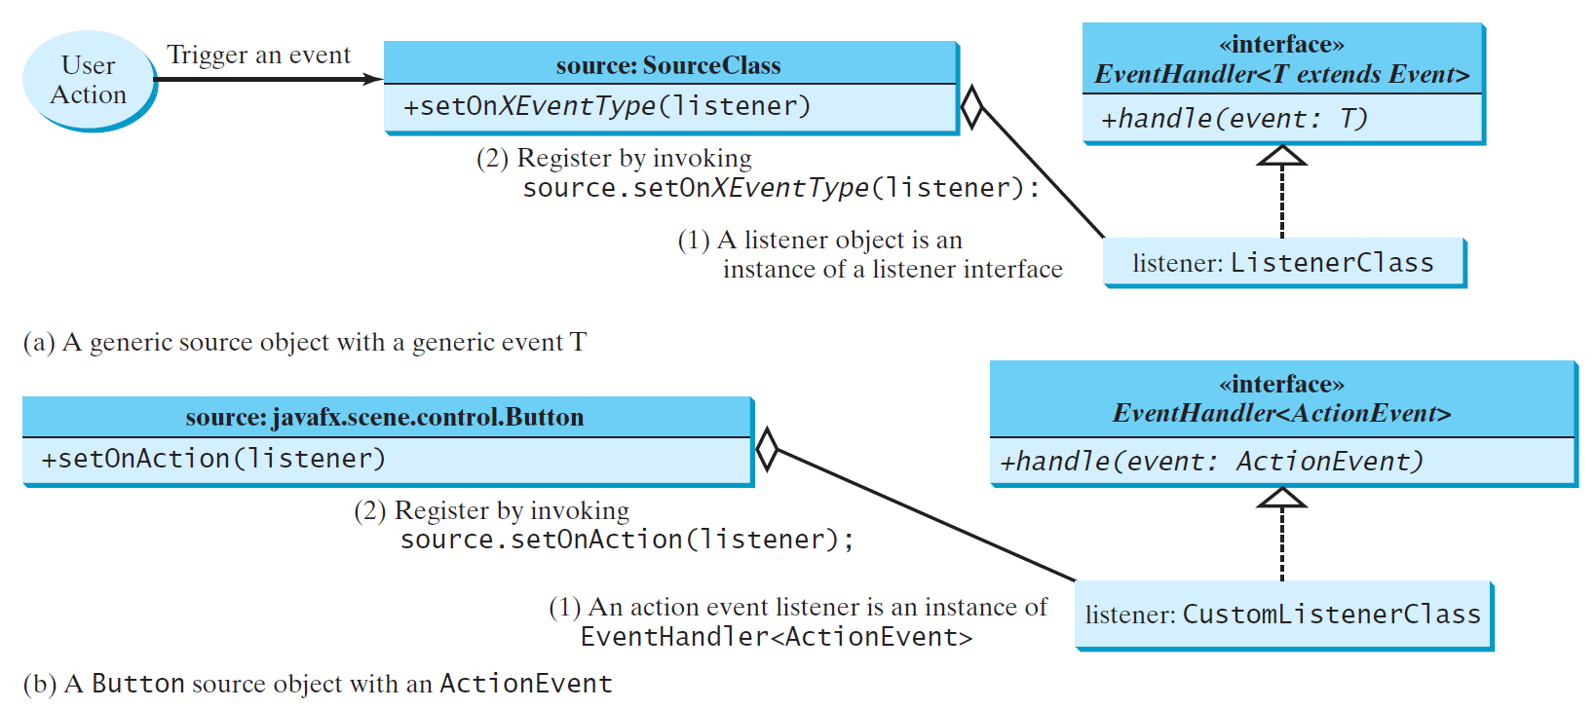
The Delegation Model

Slide 16
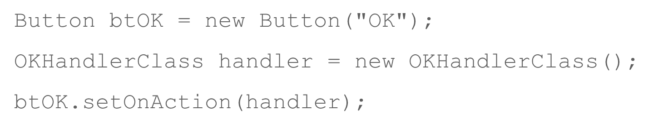
The Delegation Model: Example

Slide 17
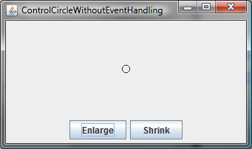
Example: First Version for ControlCircle (no listeners)
Now let us consider to write a program that uses two buttons to control the size of a circle.
ControlCircleWithoutEventHandling
Run

Slide 18
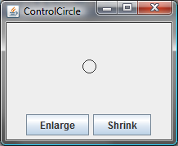
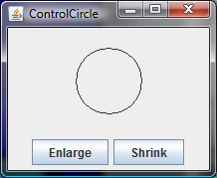
Example: Second Version for ControlCircle (with listener for Enlarge)
Now let us consider to write a program that uses two buttons to control the size of a circle.
ControlCircle
Run

Slide 19
Inner Class Listeners
A listener class is designed specifically to create a listener object for a G U I component (e.g., a button). It will not be shared by other applications. So, it is appropriate to define the listener class inside the frame class as an inner class.

Slide 20
Inner Classes (1 of 4)
Inner class: A class is a member of another class.
Advantages: In some applications, you can use an inner class to make programs simple.
An inner class can reference the data and methods defined in the outer class in which it nests, so you do not need to pass the reference of the outer class to the constructor of the inner class.
ShowInnerClass

Slide 21
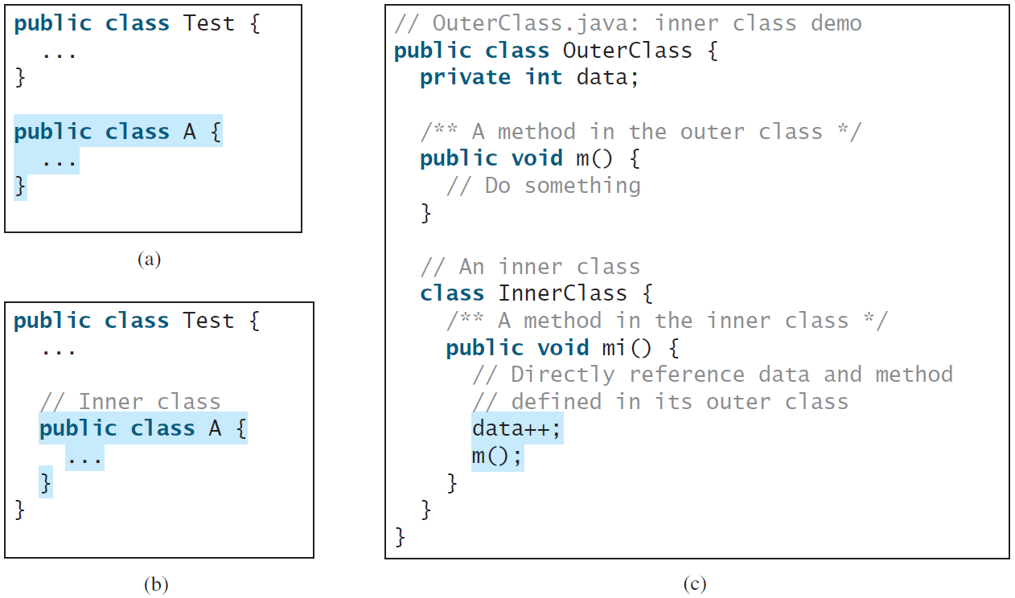
Inner Classes (2 of 4)

Slide 22
Inner Classes (3 of 4)
Inner classes can make programs simple and concise.
An inner class supports the work of its containing outer class and is compiled into a class named OuterClassName$InnerClassName.class. For example, the inner class InnerClass in OuterClass is compiled into OuterClass$InnerClass.class.

Slide 23
Inner Classes (4 of 4)
An inner class can be declared public, protected, or private subject to the same visibility rules applied to a member of the class.
An inner class can be declared static. A static inner class can be accessed using the outer class name. A static inner class cannot access nonstatic members of the outer class

Slide 24
Anonymous Inner Classes (1 of 4)
An anonymous inner class must always extend a superclass or implement an interface, but it cannot have an explicit extends or implements clause.
An anonymous inner class must implement all the abstract methods in the superclass or in the interface.
An anonymous inner class always uses the no-arg constructor from its superclass to create an instance. If an anonymous inner class implements an interface, the constructor is Object().
An anonymous inner class is compiled into a class named OuterClassName$n.class. For example, if the outer class Test has two anonymous inner classes, these two classes are compiled into Test$1.class and Test$2.class.

Slide 25
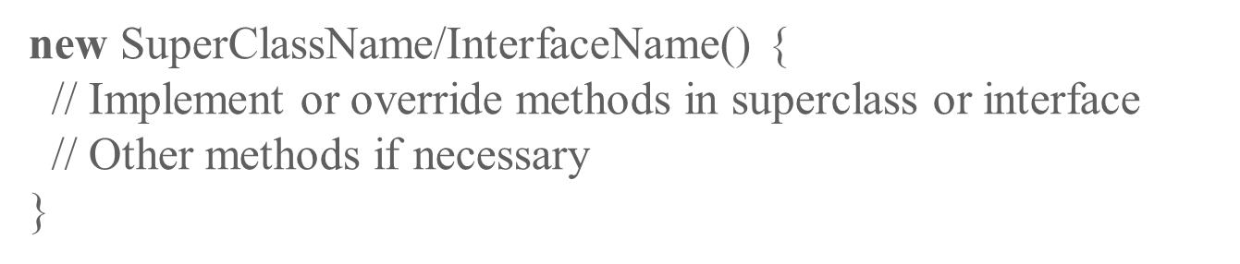
Anonymous Inner Classes (2 of 4)
Inner class listeners can be shortened using anonymous inner classes. An anonymous inner class is an inner class without a name. It combines declaring an inner class and creating an instance of the class in one step. An anonymous inner class is declared as follows:

Slide 26
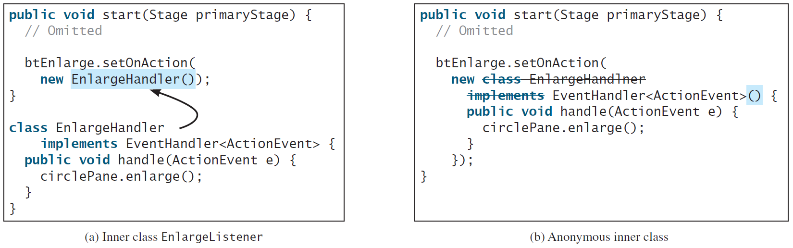
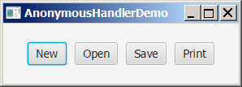
Anonymous Inner Classes (3 of 4)
/AnonymousHandlerDemo
Run

Slide 27
Anonymous Inner Classes (4 of 4)
Lambda expression is a new feature in Java 8. Lambda expressions can be viewed as an anonymous method with a concise syntax. For example, the following code in (a) can be greatly simplified using a lambda expression in (b) in three lines.

Slide 28
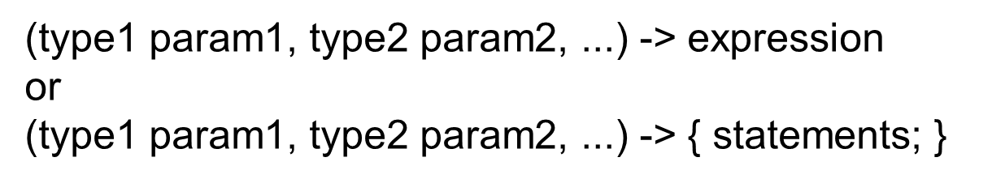
Basic Syntax for a Lambda Expression
The basic syntax for a lambda expression is either
The data type for a parameter may be explicitly declared or implicitly inferred by the compiler. The parentheses can be omitted if there is only one parameter without an explicit data type.

Slide 29
Single Abstract Method Interface (S A M)
The statements in the lambda expression is all for that method. If it contains multiple methods, the compiler will not be able to compile the lambda expression. So, for the compiler to understand lambda expressions, the interface must contain exactly one abstract method. Such an interface is known as a functional interface, or a Single Abstract Method (S A M) interface.
AnonymousHandlerDemo
Run

Slide 30
Problem: Loan Calculator
LoanCalculator
Run

Slide 31
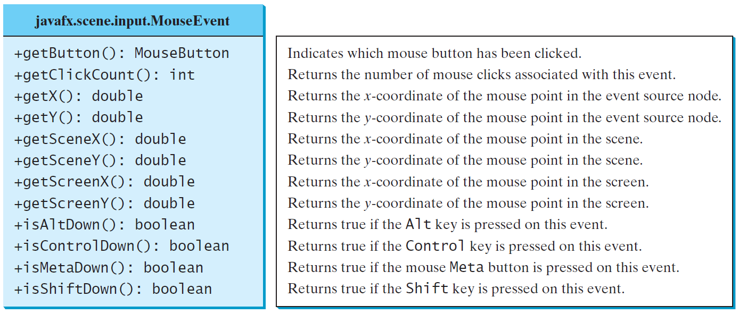
The MouseEvent Class
MouseEventDemo
Run

Slide 32
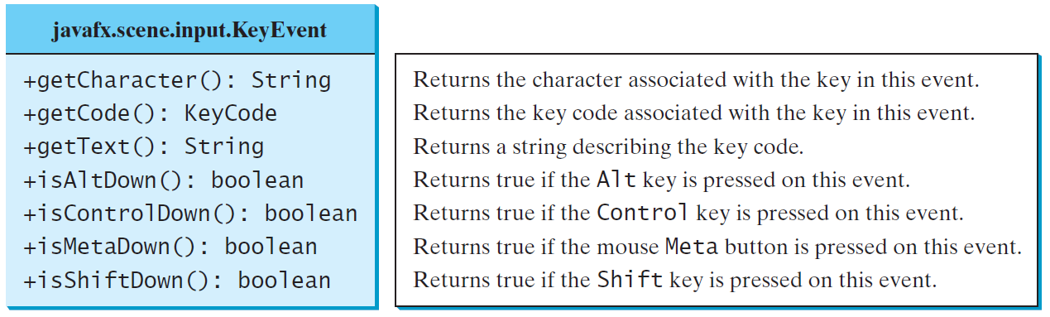
The KeyEvent Class
KeyEventDemo
Run

Slide 33
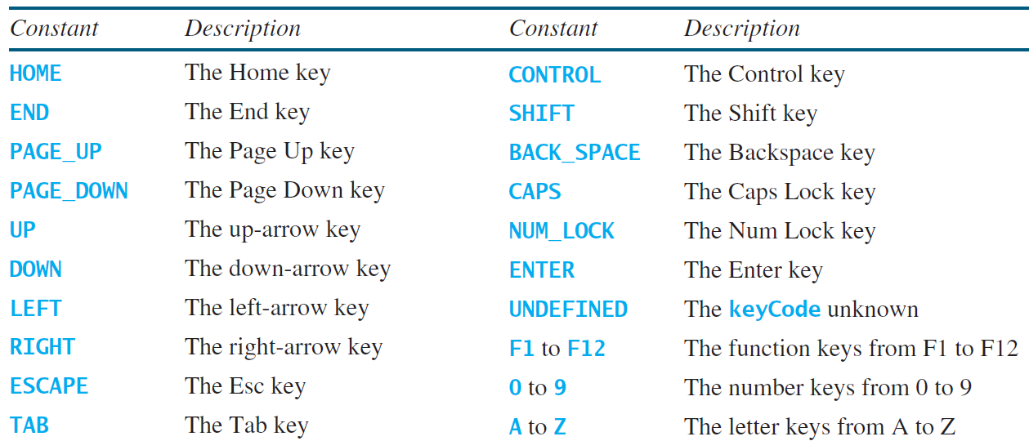
The KeyCode Constants

Slide 34
Example: Control Circle with Mouse and Key
ControlCircleWithMouseAndKey
Run

Slide 35
Listeners for Observable Objects
You can add a listener to process a value change in an observable object.
An instance of Observable is known as an observable object, which contains the addListener(InvalidationListener listener) method for adding a listener. Once the value is changed in the property, a listener is notified. The listener class should implement the InvalidationListener interface, which uses the invalidated(Observable o) method to handle the property value change. Every binding property is an instance of Observable.
ObservablePropertyDemo
Run
DisplayResizableClock
Run

Slide 36
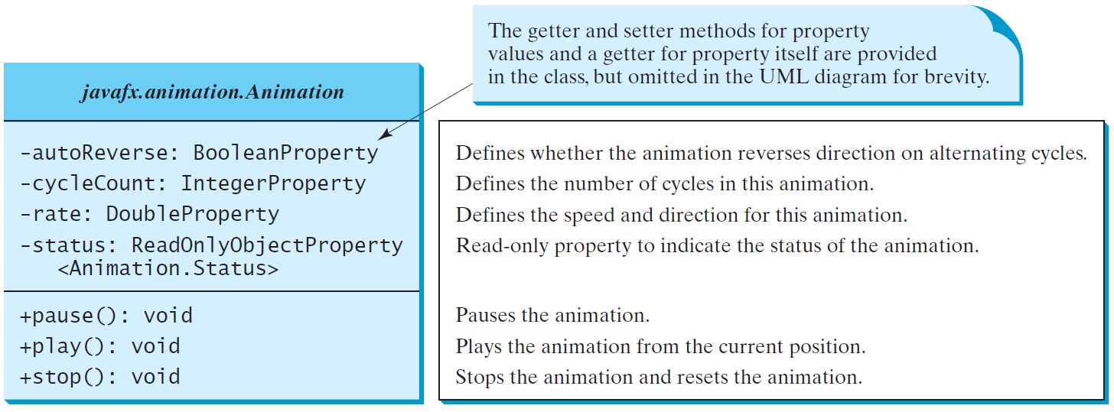
Animation
JavaF X provides the Animation class with the core functionality for all animations.

Slide 37
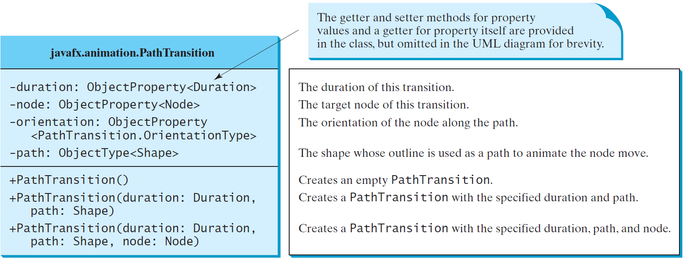
PathTransition
PathTransitionDemo
Run
FlagRisingAnimation
Run

Slide 38
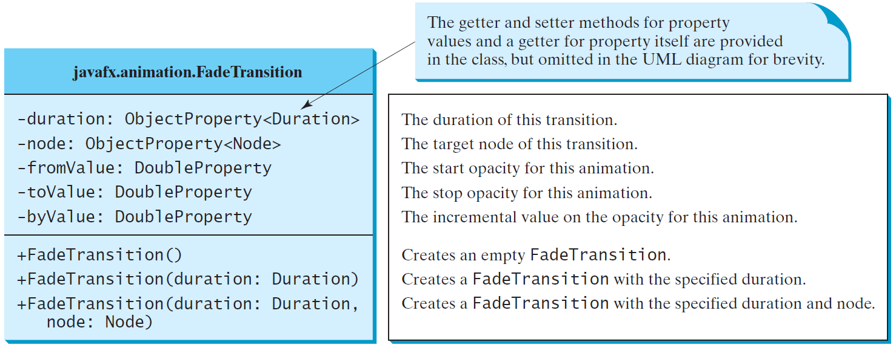
FadeTransition
The FadeTransition class animates the change of the opacity in a node over a given time.
FadeTransitionDemo
Run

Slide 39
Timeline
PathTransition and FadeTransition define specialized animations. The Timeline class can be used to program any animation using one or more KeyFrames. Each KeyFrame is executed sequentially at a specified time interval. Timeline inherits from Animation.
TimelineDemo
Run

Slide 40
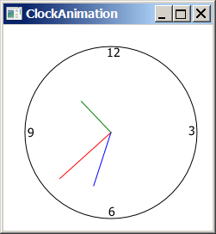
ClockAnimation
ClockAnimation
Run

Slide 41
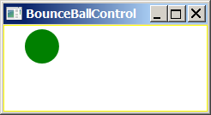
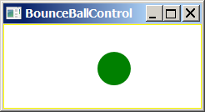
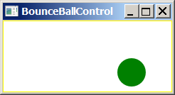
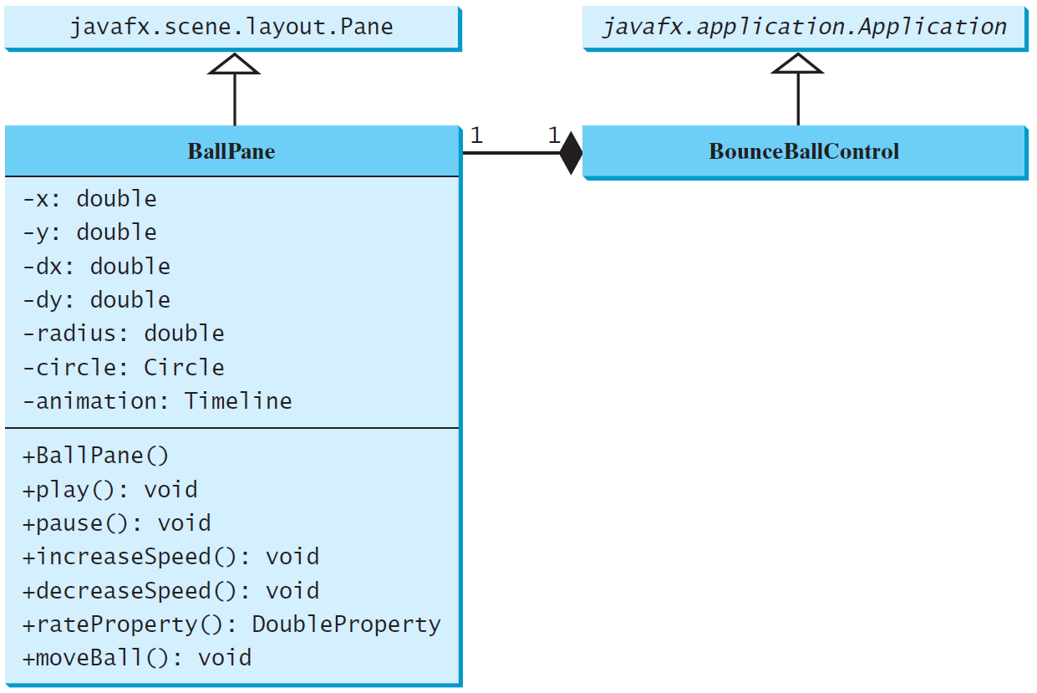
Case Study: Bouncing Ball
BallPane
BounceBallControl
Run

Slide 42

Copyright

