Slide 1
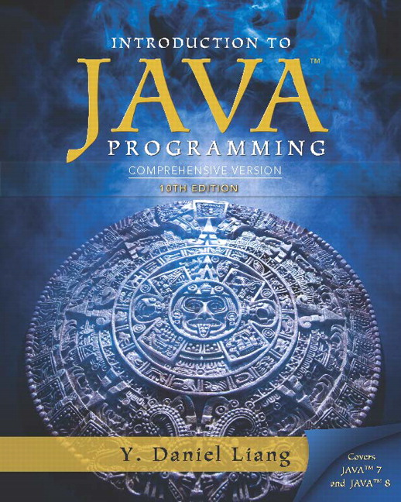
Introduction to Java Programming
Tenth Edition
Chapter 16
JavaF X U I Controls and Multimedia
Copyright © 2015 Pearson Education, Inc. All Rights Reserved
Notes:
If this PowerPoint presentation contains mathematical equations, you may need to check that your computer has the following installed:
1) MathType Plugin
2) Math Player (free versions available)
3) NVDA Reader (free versions available)

Slide 2
Motivations
A graphical user interface (G U I) makes a system user-friendly and easy to use. Creating a G U I requires creativity and knowledge of how G U I components work. Since the G U I components in Java are very flexible and versatile, you can create a wide assortment of useful user interfaces.
Previous chapters briefly introduced several G U I components. This chapter introduces the frequently used G U I components in detail.

Slide 3
Objectives (1 of 2)
To create graphical user interfaces with various user-interface controls (§§16.2–16.11).
To create a label with text and graphic using the Label class and explore properties in the abstract Labeled class (§16.2).
To create a button with text and graphic using the Button class and set a handler using the setOnAction method in the abstract ButtonBase class (§16.3).
To create a check box using the CheckBox class (§16.4).
To create a radio button using the RadioButton class and group radio buttons using a ToggleGroup (§16.5).
To enter data using the TextField class and password using the PasswordField class (§16.6).

Slide 4
Objectives (2 of 2)
To enter data in multiple lines using the TextArea class (§16.7).
To select a single item using ComboBox (§16.8).
To select a single or multiple items using ListView (§16.9).
To select a range of values using ScrollBar (§16.10).
To select a range of values using Slider and explore differences between ScrollBar and Slider (§16.11).
To develop a tic-tac-toe game (§16.12).
To view and play video and audio using the Media, MediaPlayer, and MediaView (§16.13).
To develop a case study for showing the national flag and play anthem (§16.14).

Slide 5
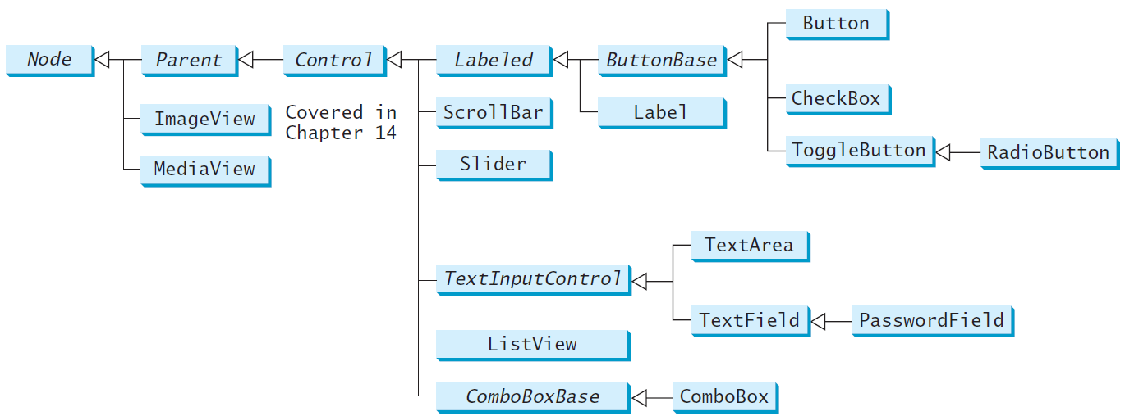
Frequently Used UI Controls
Throughout this book, the prefixes lbl, bt, chk, rb, tf, pf, ta, cbo, lv, scb, sld, and mp are used to name reference variables for Label, Button, CheckBox, RadioButton, TextField, PasswordField, TextArea, ComboBox, ListView, ScrollBar, Slider, and MediaPlayer.

Slide 6
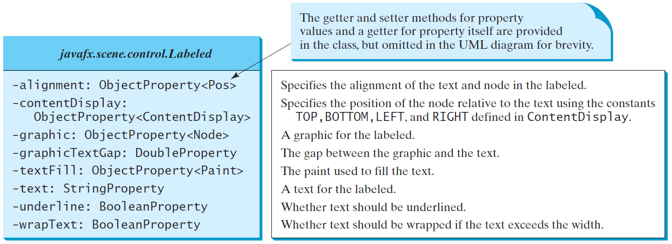
Labeled
A label is a display area for a short text, a node, or both. It is often used to label other controls (usually text fields). Labels and buttons share many common properties. These common properties are defined in the Labeled class.

Slide 7
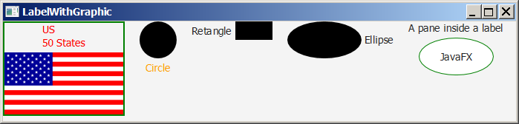
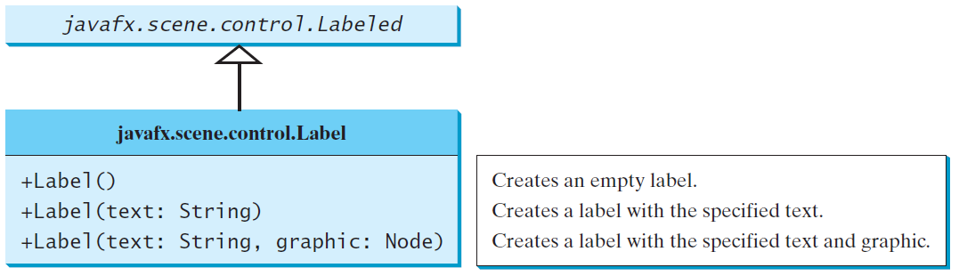
Label
The Label class defines labels.
labelWithGraphic
Run

Slide 8
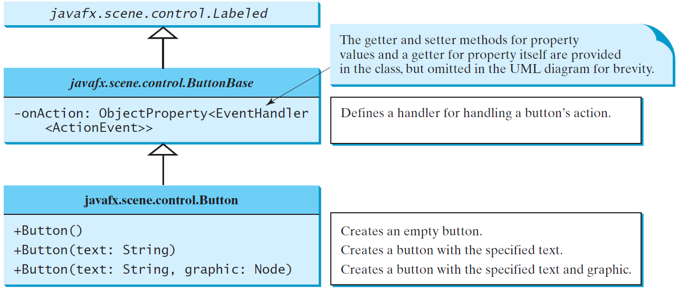
ButtonBase and Button
A button is a control that triggers an action event when clicked. Java F X provides regular buttons, toggle buttons, check box buttons, and radio buttons. The common features of these buttons are defined in ButtonBase and Labeled classes.

Slide 9
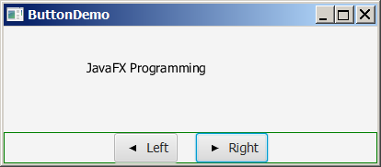
Button Example
ButtonDemo
Run

Slide 10
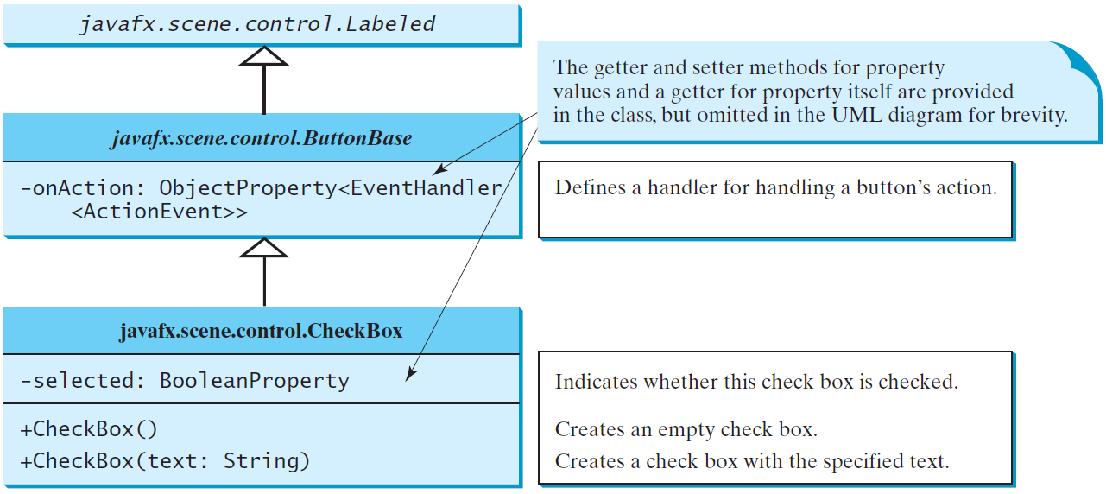
CheckBox
A CheckBox is used for the user to make a selection. Like Button, CheckBox inherits all the properties such as onAction, text, graphic, alignment, graphicTextGap, textFill, contentDisplay from ButtonBase and Labeled.

Slide 11
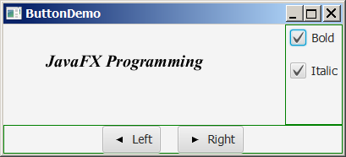
CheckBox Example
CheckBoxDemo
Run

Slide 12
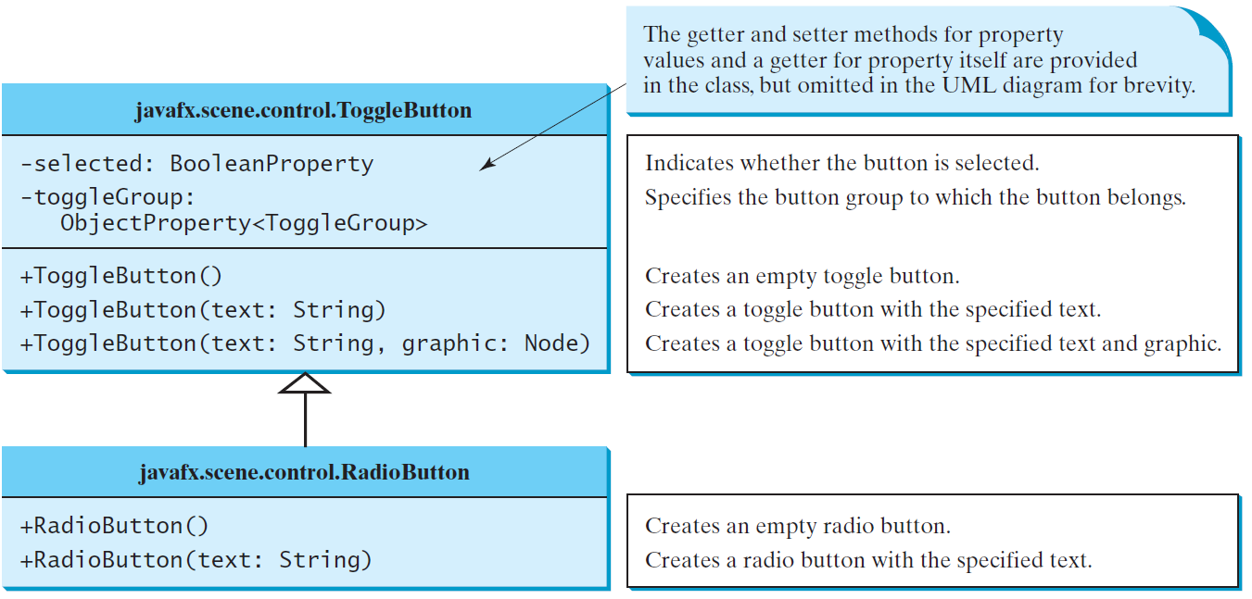
Courier New
Radio buttons, also known as option buttons, enable you to choose a single item from a group of choices. In appearance radio buttons resemble check boxes, but check boxes display a square that is either checked or blank, whereas radio buttons display a circle that is either filled (if selected) or blank (if not selected).

Slide 13
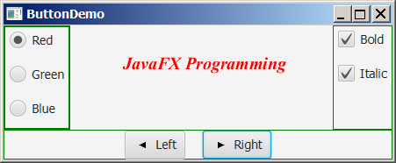
RadioButton Example
RadioButtonDemo
Run

Slide 14
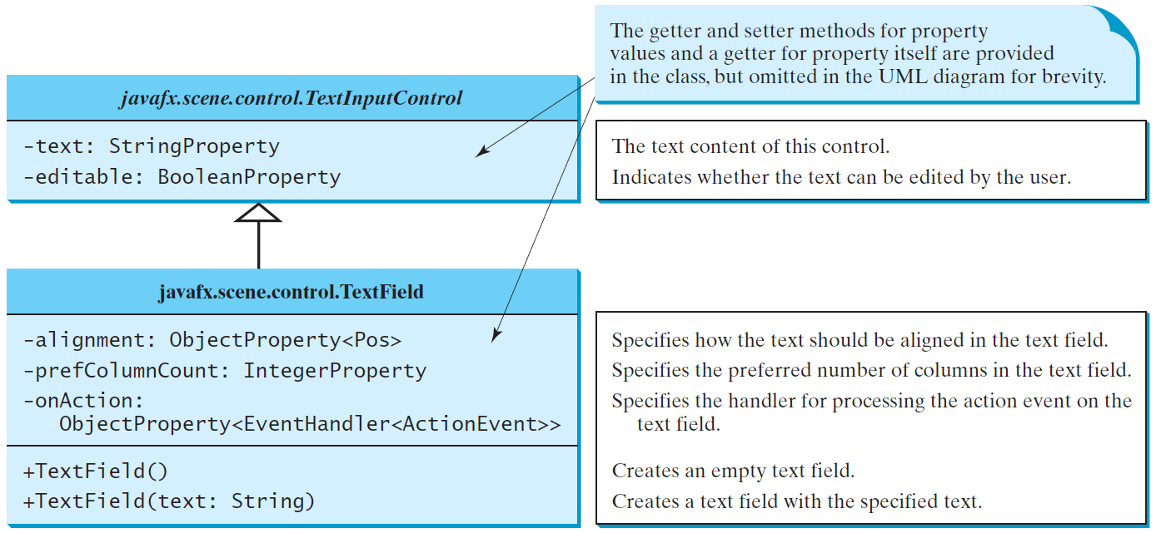
TextField
A text field can be used to enter or display a string. TextField is a subclass of TextInputControl.

Slide 15
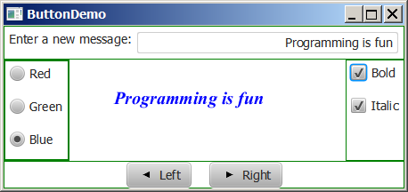
TextField Example
TextFieldDemo
Run

Slide 16
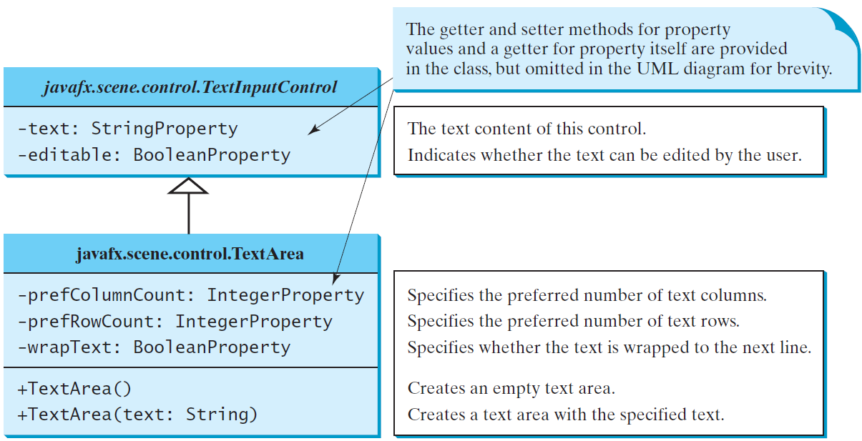
TextArea
A TextArea enables the user to enter multiple lines of text.

Slide 17
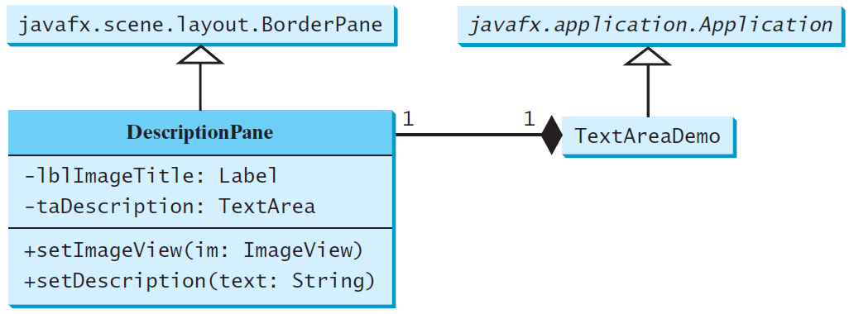
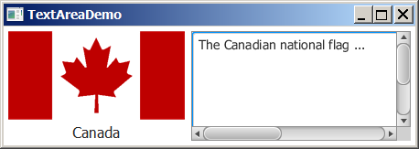
TextArea Example
DescriptionPane
TextAreaDemo
Run

Slide 18
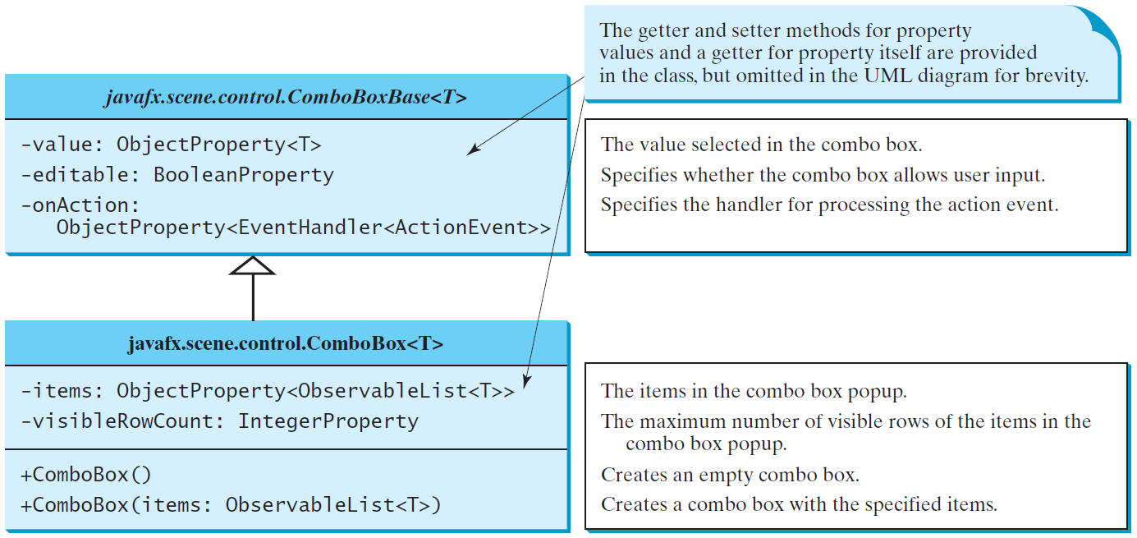
ComboBox
A combo box, also known as a choice list or drop-down list, contains a list of items from which the user can choose.

Slide 19
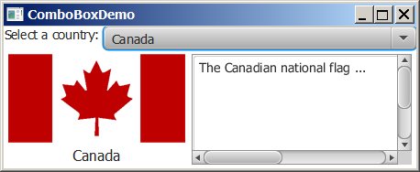
ComboBox Example
This example lets users view an image and a description of a country’s flag by selecting the country from a combo box.
ComboBoxDemo
Run

Slide 20
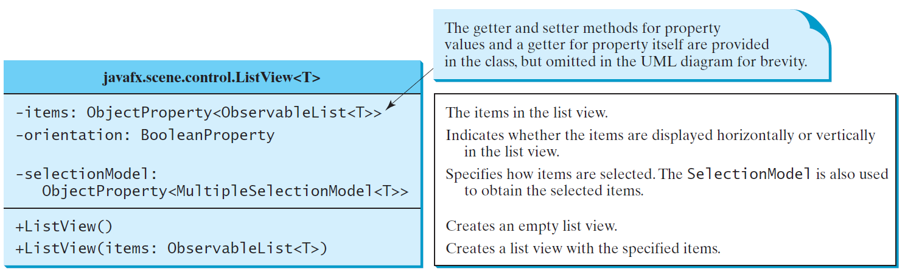
ListView
A list view is a component that performs basically the same function as a combo box, but it enables the user to choose a single value or multiple values.

Slide 21
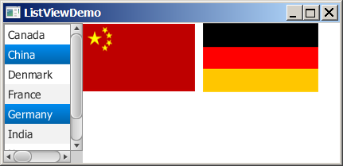
Example: Using ListView
This example gives a program that lets users select countries in a list and display the flags of the selected countries in the labels.
ListViewDemo
Run

Slide 22
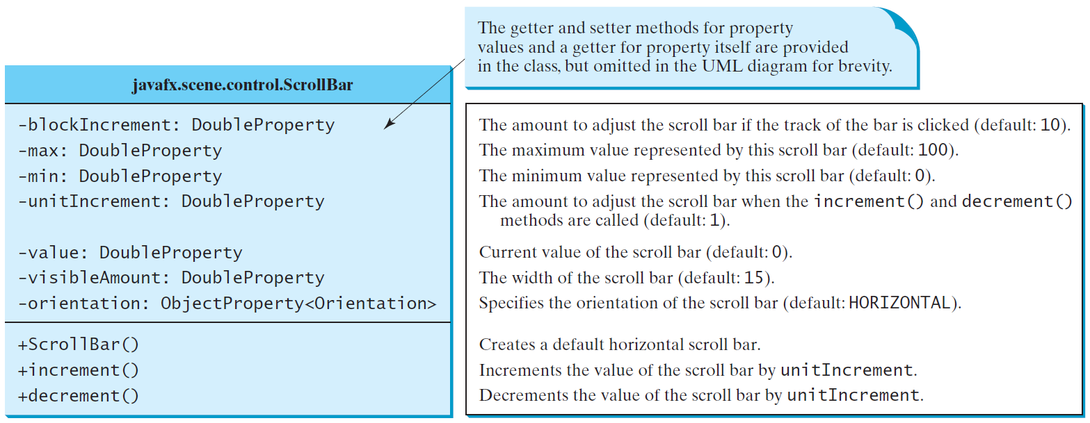
ScrollBar
A scroll bar is a control that enables the user to select from a range of values. The scrollbar appears in two styles: horizontal and vertical.

Slide 23
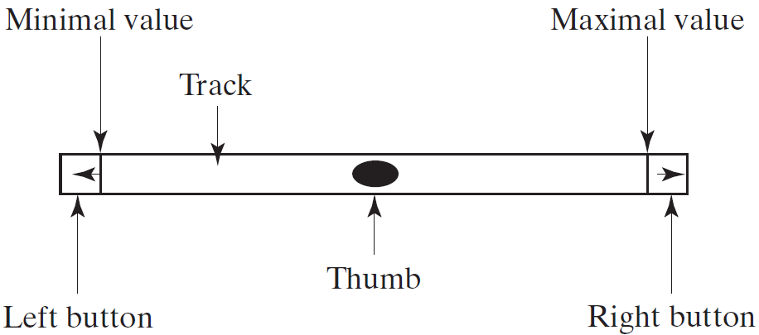
Scroll Bar Properties

Slide 24
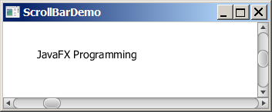
Example: Using Scrollbars
This example uses horizontal and vertical scrollbars to control a message displayed on a panel. The horizontal scrollbar is used to move the message to the left or the right, and the vertical scrollbar to move it up and down.
ScrollBarDemo
Run

Slide 25
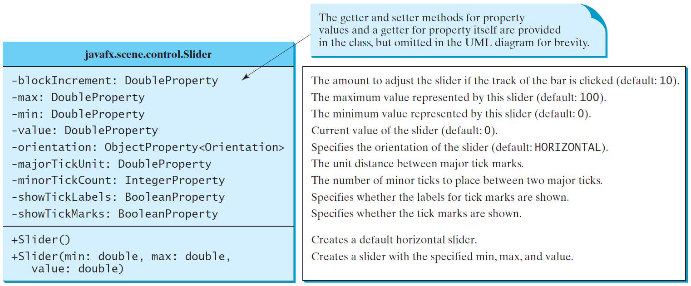
Slider
Slider is similar to ScrollBar, but Slider has more properties and can appear in many forms.

Slide 26
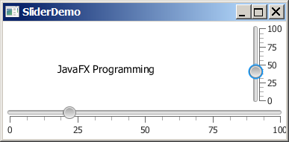
Example: Using Sliders
Rewrite the preceding program using the sliders to control a message displayed on a panel instead of using scroll bars.

Slide 27
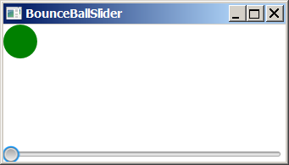
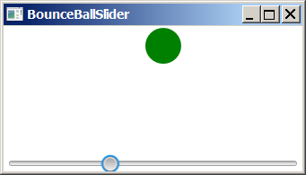
Case Study: Bounce Ball
Listing 15.17 gives a program that displays a bouncing ball. You can add a slider to control the speed of the ball movement.
SliderDemo
Run

Slide 28
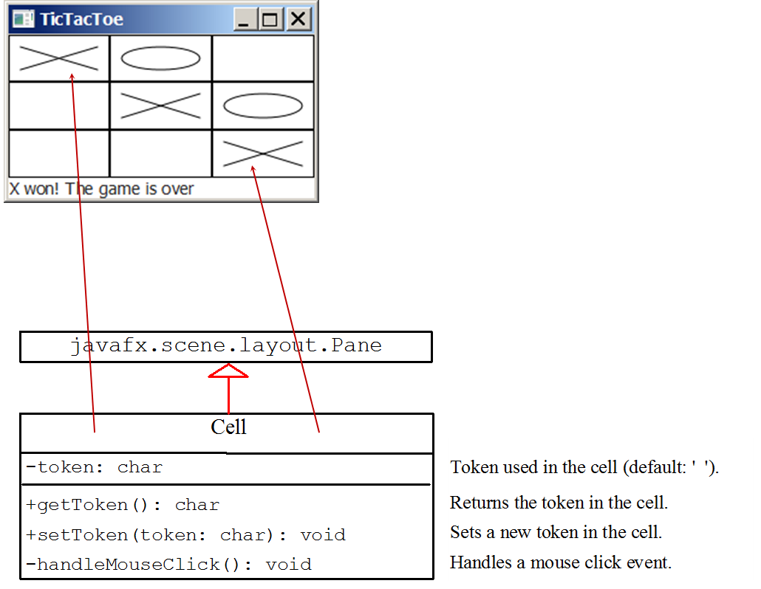
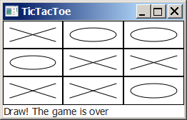
Case Study: TicTacToe (1 of 2)

Slide 29
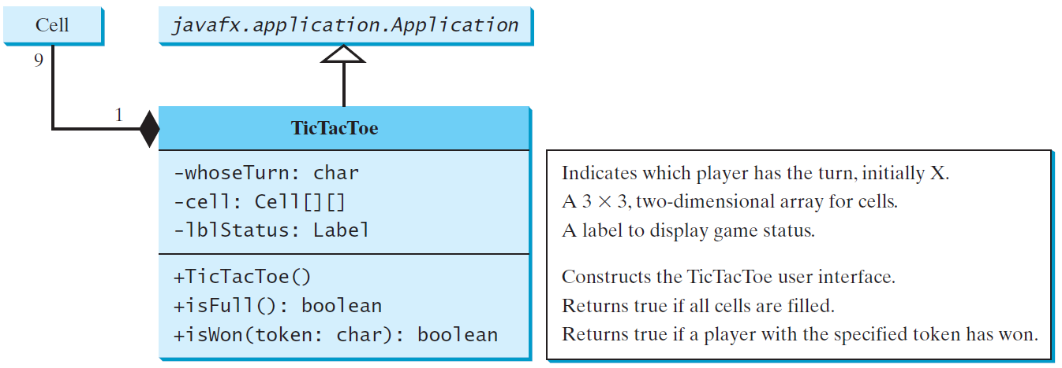
Case Study: TicTacToe (2 of 2)
TicTacToe
Run

Slide 30
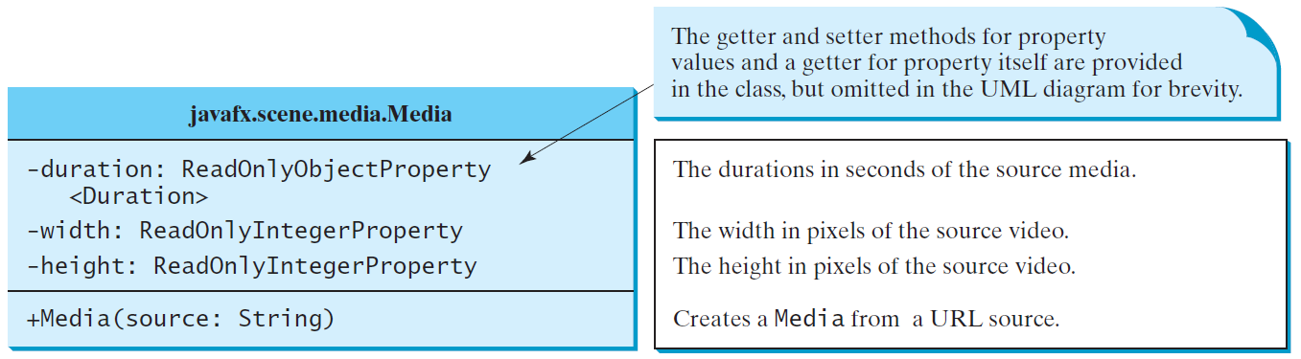
Media
You can use the Media class to obtain the source of the media, the MediaPlayer class to play and control the media, and the MediaView class to display the video.

Slide 31
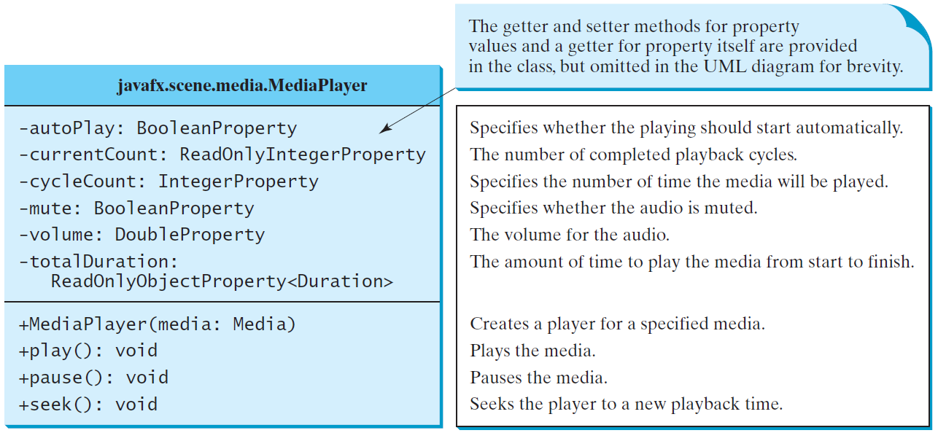
MediaPlayer
The MediaPlayer class playes and controls the media with properties such as autoPlay, currentCount, cycleCount, mute, volume, and totalDuration.

Slide 32
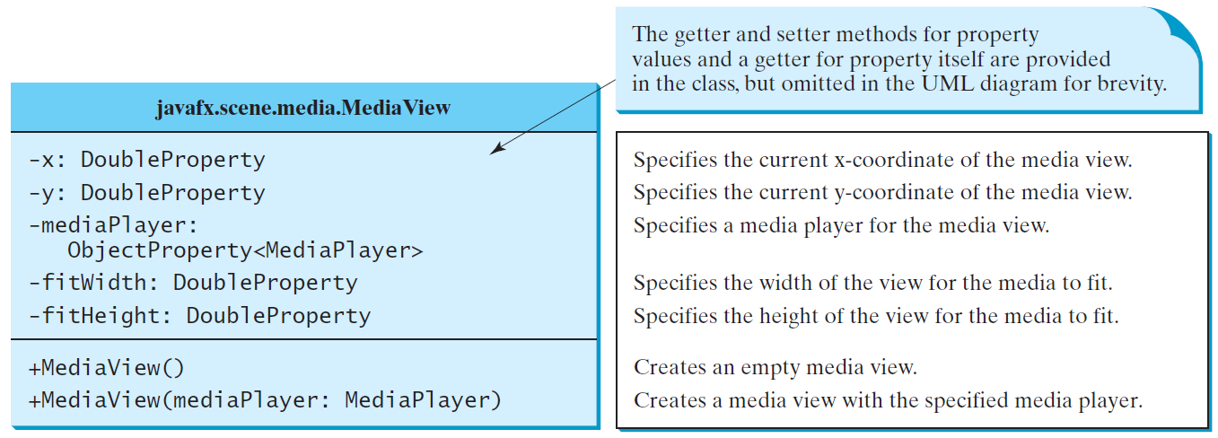
MediaView
The MediaView class is a subclass of Node that provides a view of the Media being played by a MediaPlayer. The MediaView class provides the properties for viewing the media.

Slide 33
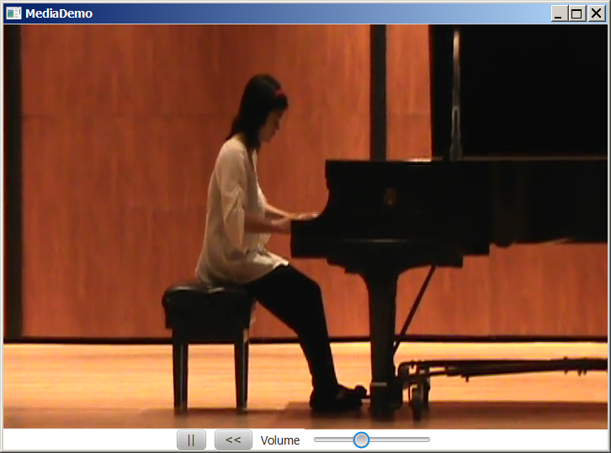
Example: Using Media
This example displays a video in a view. You can use the play/pause button to play or pause the video and use the rewind button to restart the video, and use the slider to control the volume of the audio.
MediaDemo
Run

Slide 34
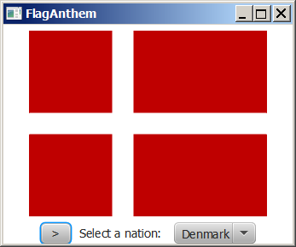
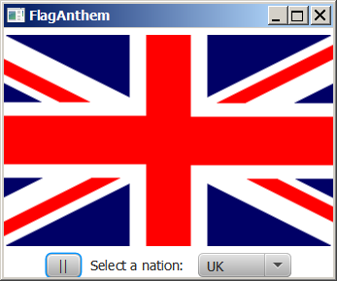
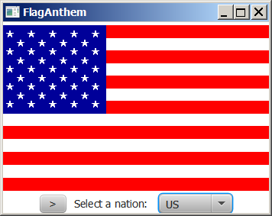
Case Study: National Flags and Anthems
This case study presents a program that displays a nation’s flag and plays its anthem.
FlagAnthem
Run

Slide 35
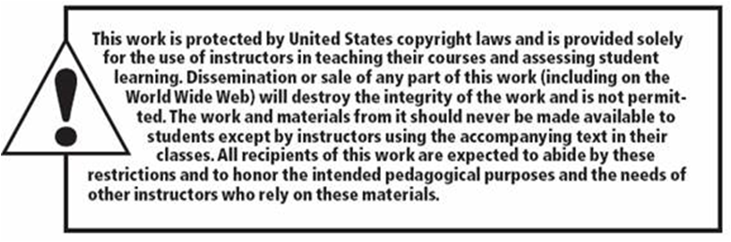
Copyright

