Slide 1
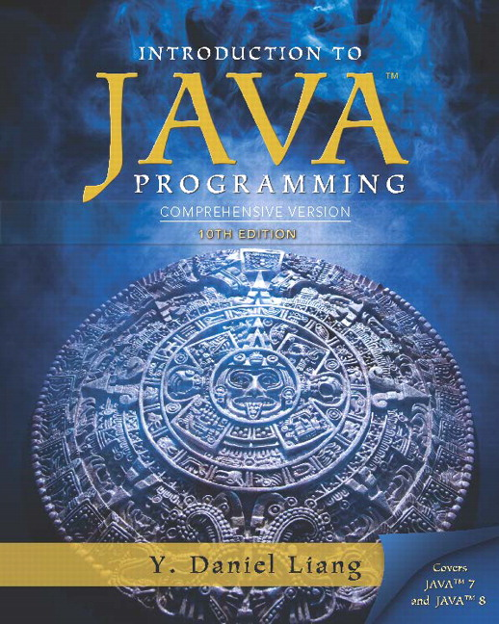
Introduction to Java Programming
Tenth Edition
Chapter 18
Recursion
Copyright © 2015 Pearson Education, Inc. All Rights Reserved
Notes:
If this PowerPoint presentation contains mathematical equations, you may need to check that your computer has the following installed:
1) MathType Plugin
2) Math Player (free versions available)
3) NVDA Reader (free versions available)

Slide 2
Motivations (1 of 2)
Suppose you want to find all the files under a directory that contains a particular word. How do you solve this problem? There are several ways to solve this problem. An intuitive solution is to use recursion by searching the files in the subdirectories recursively.

Slide 3
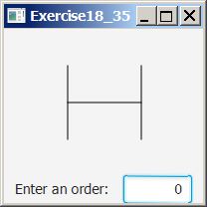
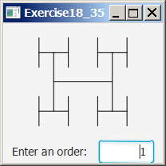
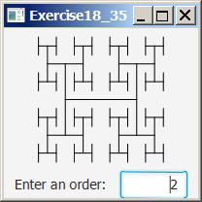
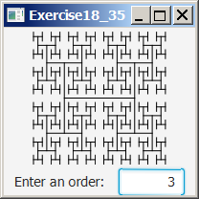
Motivations (2 of 2)
H-trees, depicted in Figure 18.1, are used in a very large-scale integration (V L S I) design as a clock distribution network for routing timing signals to all parts of a chip with equal propagation delays. How do you write a program to display H-trees? A good approach is to use recursion.

Slide 4
Objectives (1 of 2)
To describe what a recursive method is and the benefits of using recursion (§18.1).
To develop recursive methods for recursive mathematical functions (§§18.2–18.3).
To explain how recursive method calls are handled in a call stack (§§18.2–18.3).
To solve problems using recursion (§18.4).
To use an overloaded helper method to derive a recursive method (§18.5).
To implement a selection sort using recursion (§18.5.1).

Slide 5
Objectives (2 of 2)
To implement a binary search using recursion (§18.5.2).
To get the directory size using recursion (§18.6).
To solve the Tower of Hanoi problem using recursion (§18.7).
To draw fractals using recursion (§18.8).
To discover the relationship and difference between recursion and iteration (§18.9).
To know tail-recursive methods and why they are desirable (§18.10).

Slide 6
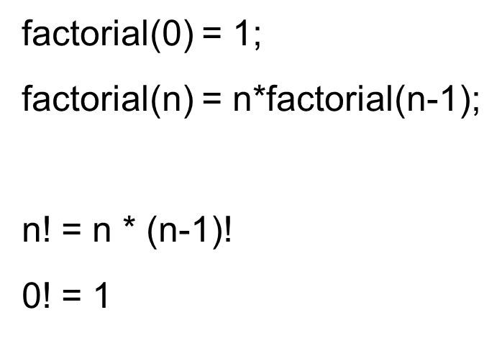
Computing Factorial (1 of 11)
ComputeFactorial
Run

Slide 7
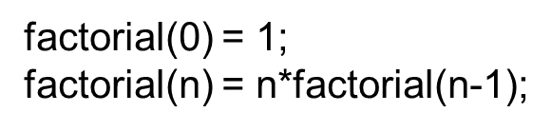
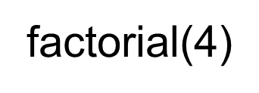
Computing Factorial (2 of 11)

Slide 8
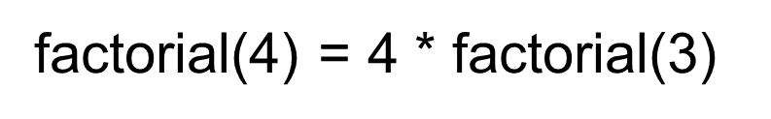
Computing Factorial (3 of 11)

Slide 9
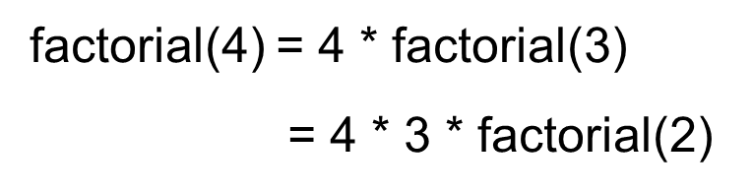
Computing Factorial (4 of 11)

Slide 10
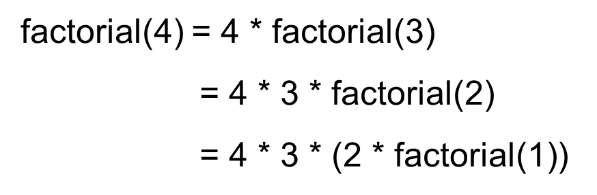
Computing Factorial (5 of 11)

Slide 11
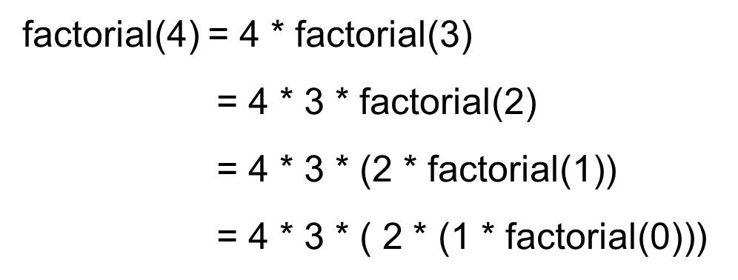
Computing Factorial (6 of 11)

Slide 12
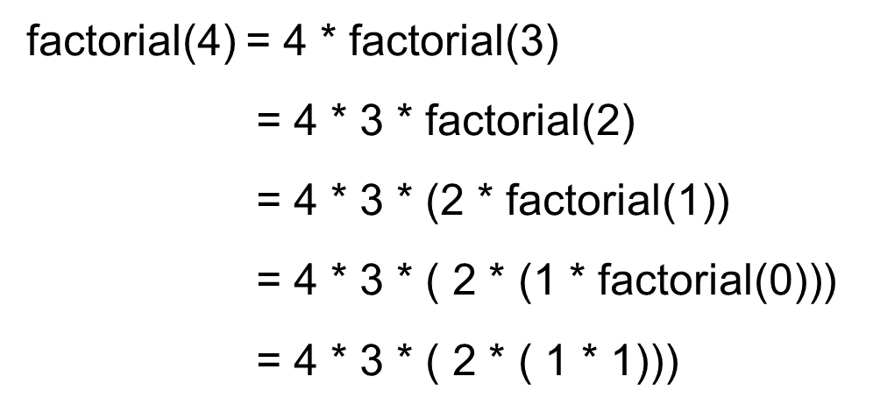
Computing Factorial (7 of 11)

Slide 13
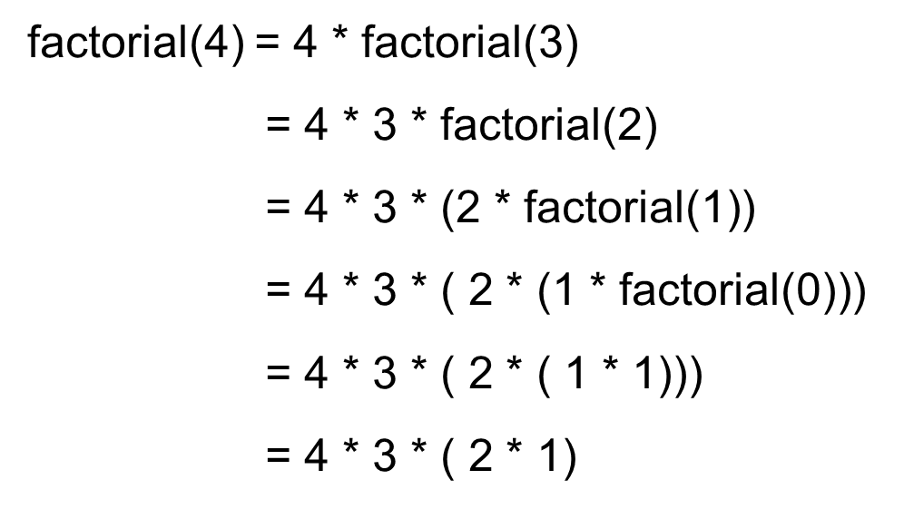
Computing Factorial (8 of 11)

Slide 14
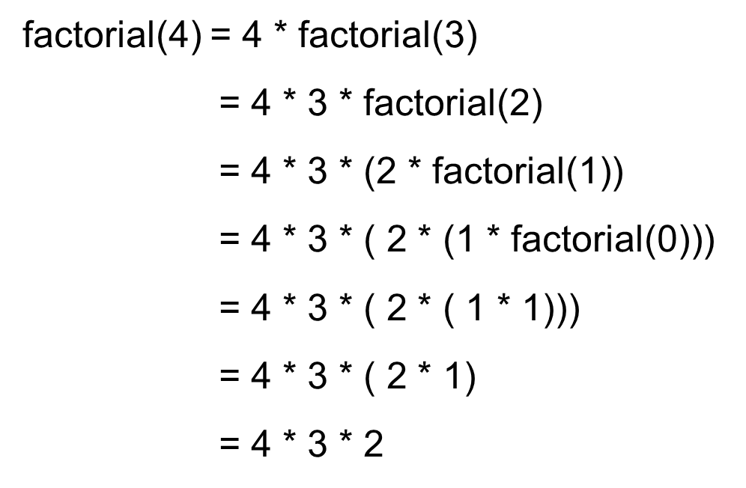
Computing Factorial (9 of 11)

Slide 15
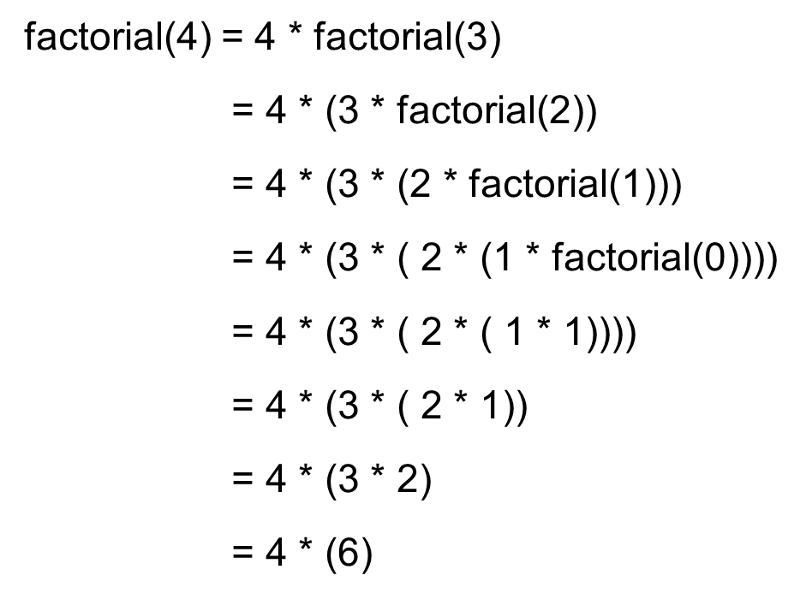
Computing Factorial (10 of 11)

Slide 16
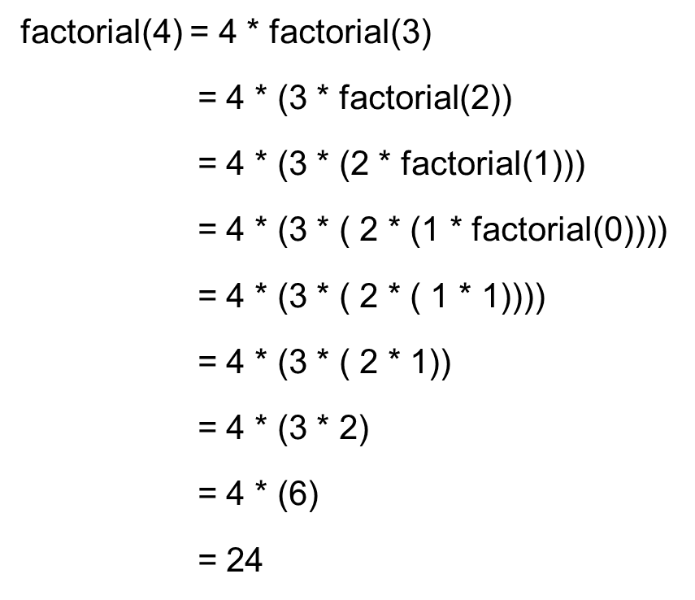
Computing Factorial (11 of 11)

Slide 17
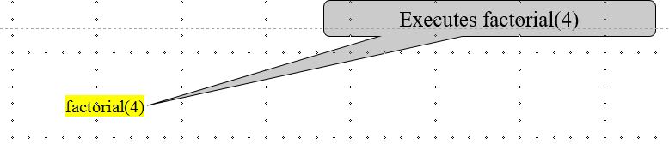
Trace Recursive factorial (1 of 11)

Slide 18
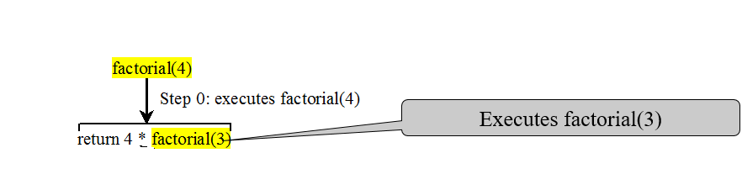
Trace Recursive factorial (2 of 11)

Slide 19
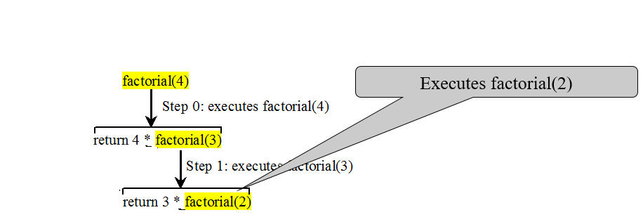
Trace Recursive factorial (3 of 11)

Slide 20
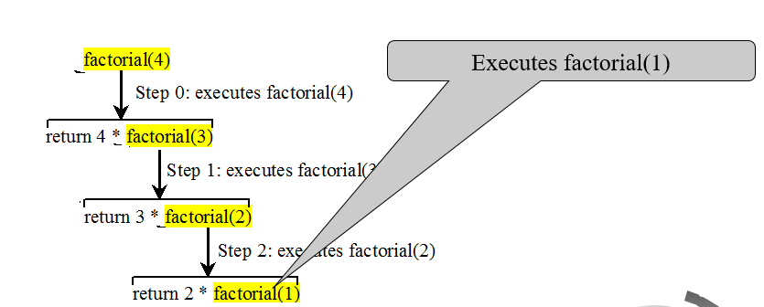
Trace Recursive factorial (4 of 11)

Slide 21
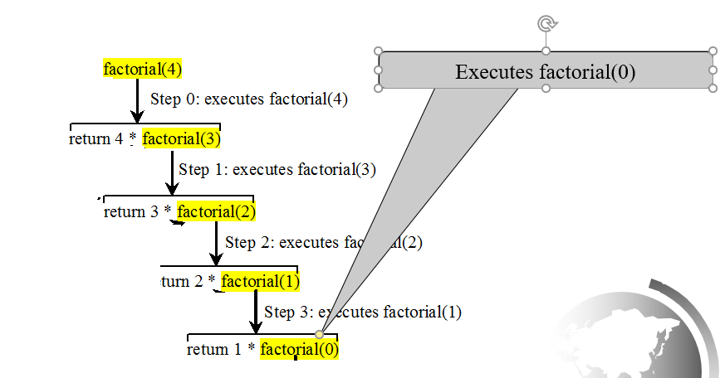
Trace Recursive factorial (5 of 11)

Slide 22
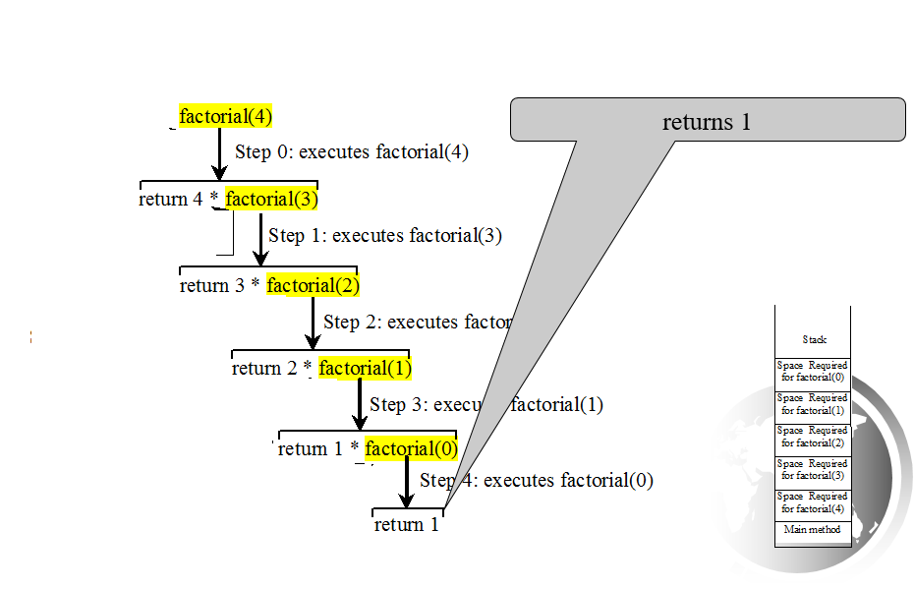
Trace Recursive factorial (6 of 11)

Slide 23
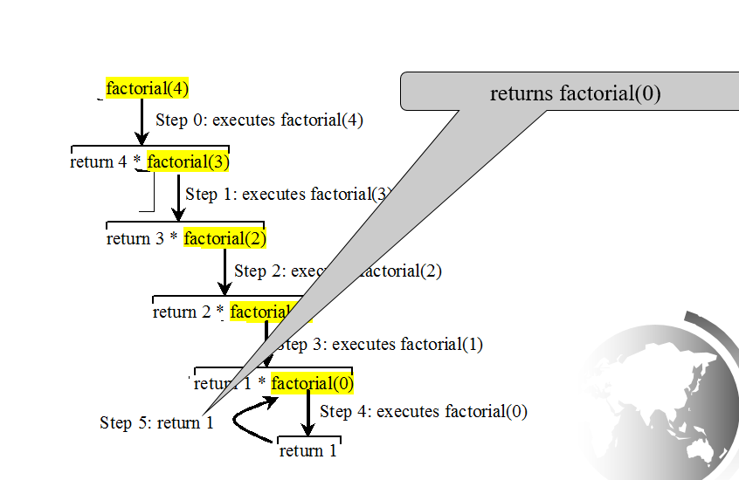
Trace Recursive factorial (7 of 11)

Slide 24
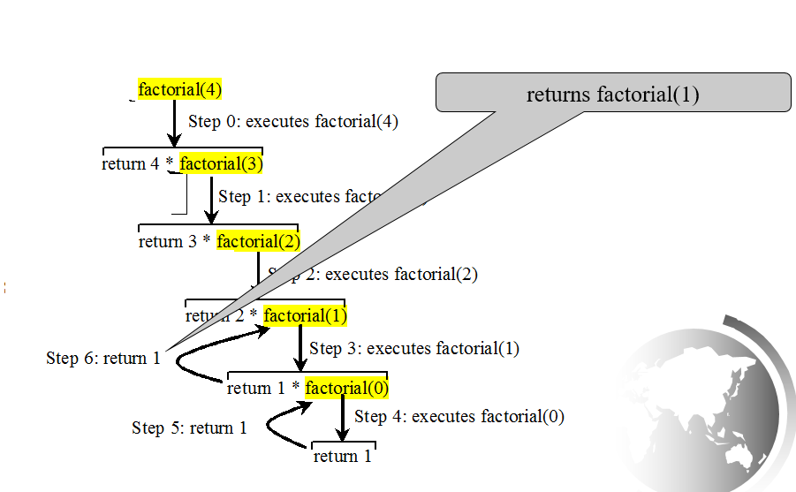
Trace Recursive factorial (8 of 11)

Slide 25
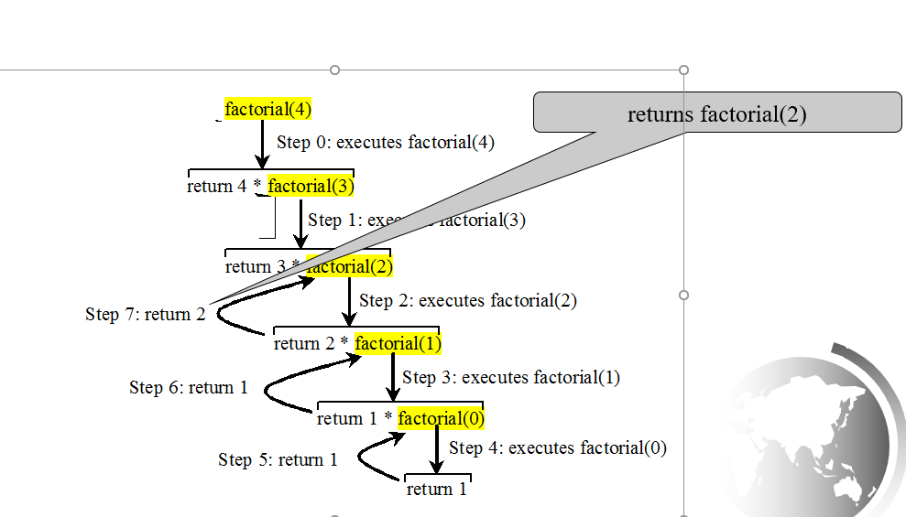
Trace Recursive factorial (9 of 11)

Slide 26
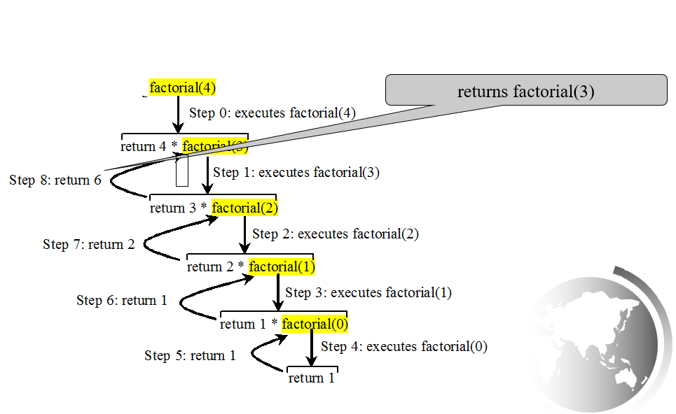
Trace Recursive factorial (10 of 11)

Slide 27
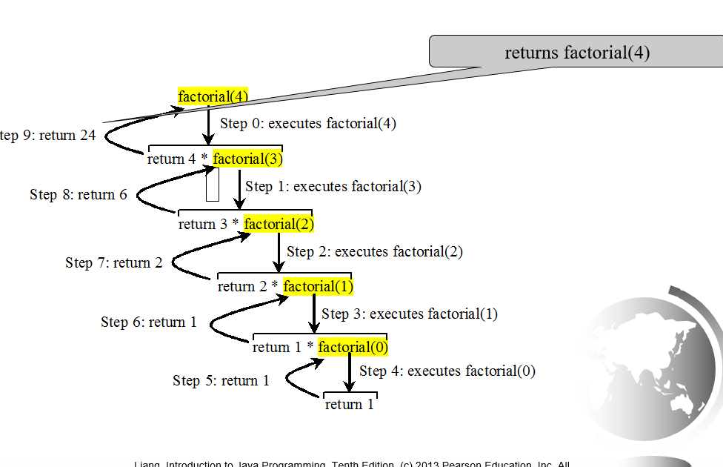
Trace Recursive factorial (11 of 11)

Slide 28
factorial(4) Stack Trace

Slide 29
Other Examples

Slide 30
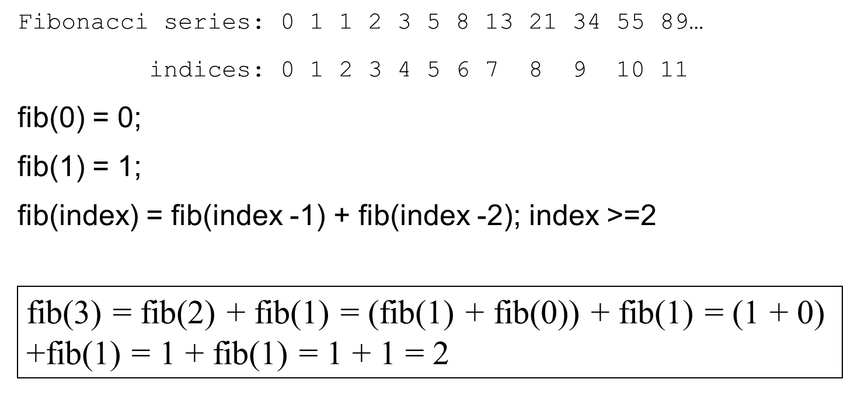
Fibonacci Numbers
ComputeFibonacci
Run

Slide 31
Fibonnaci Numbers

Slide 32
Characteristics of Recursion
All recursive methods have the following characteristics:
One or more base cases (the simplest case) are used to stop recursion.
Every recursive call reduces the original problem, bringing it increasingly closer to a base case until it becomes that case.
In general, to solve a problem using recursion, you break it into subproblems. If a subproblem resembles the original problem, you can apply the same approach to solve the subproblem recursively. This subproblem is almost the same as the original problem in nature with a smaller size

Slide 33
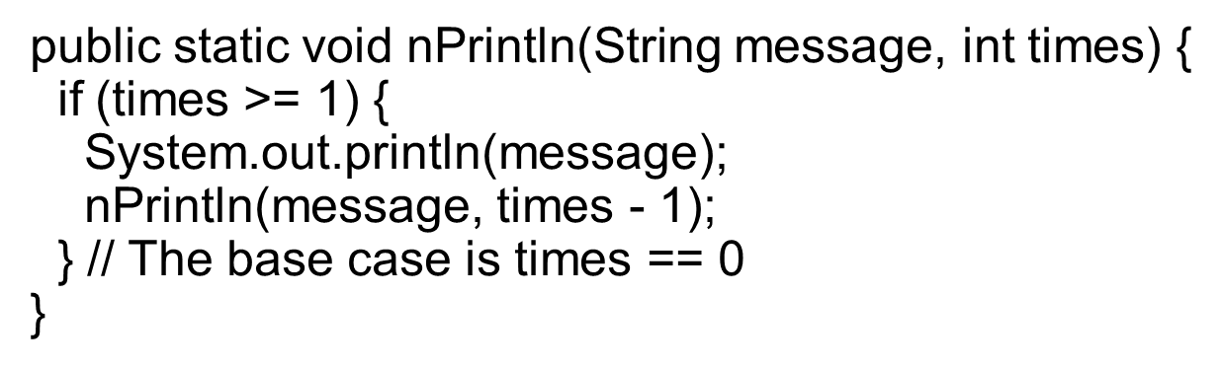
Problem Solving Using Recursion
Let us consider a simple problem of printing a message for n times. You can break the problem into two subproblems: one is to print the message one time and the other is to print the message for n-1 times. The second problem is the same as the original problem with a smaller size. The base case for the problem is n==0. You can solve this problem using recursion as follows:

Slide 34
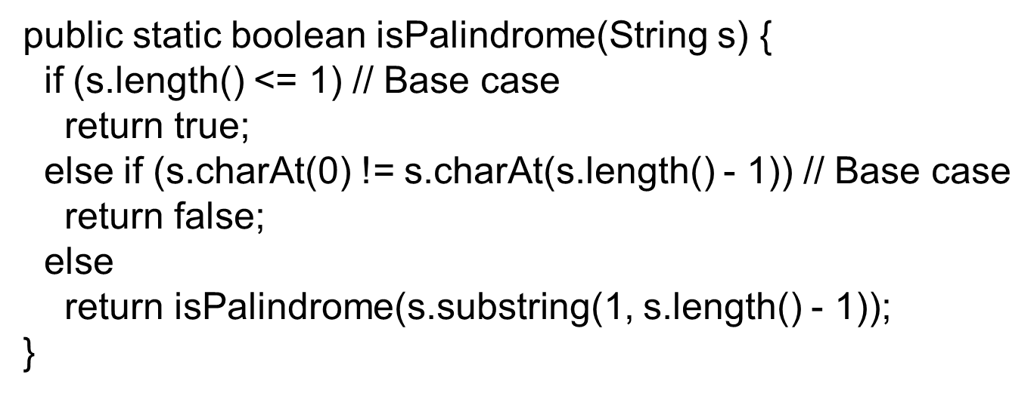
Think Recursively
Many of the problems presented in the early chapters can be solved using recursion if you think recursively. For example, the palindrome problem can be solved recursively as follows:

Slide 35
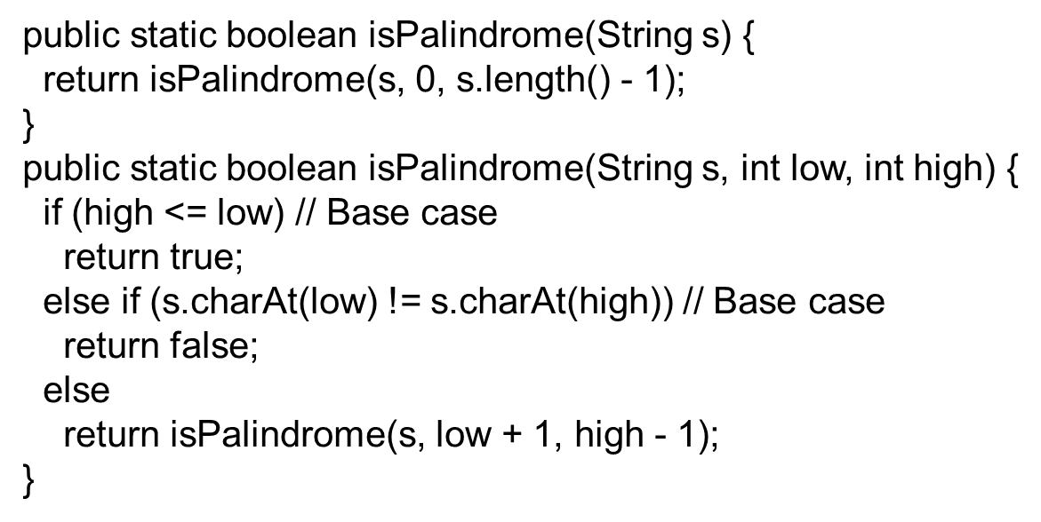
Recursive Helper Methods
The preceding recursive isPalindrome method is not efficient, because it creates a new string for every recursive call. To avoid creating new strings, use a helper method:

Slide 36
Recursive Selection Sort
Find the smallest number in the list and swaps it with the first number.
Ignore the first number and sort the remaining smaller list recursively.
RecursiveSelectionSort

Slide 37
Recursive Binary Search
Case 1: If the key is less than the middle element, recursively search the key in the first half of the array.
Case 2: If the key is equal to the middle element, the search ends with a match.
Case 3: If the key is greater than the middle element, recursively search the key in the second half of the array.
RecursiveBinarySearch

Slide 38
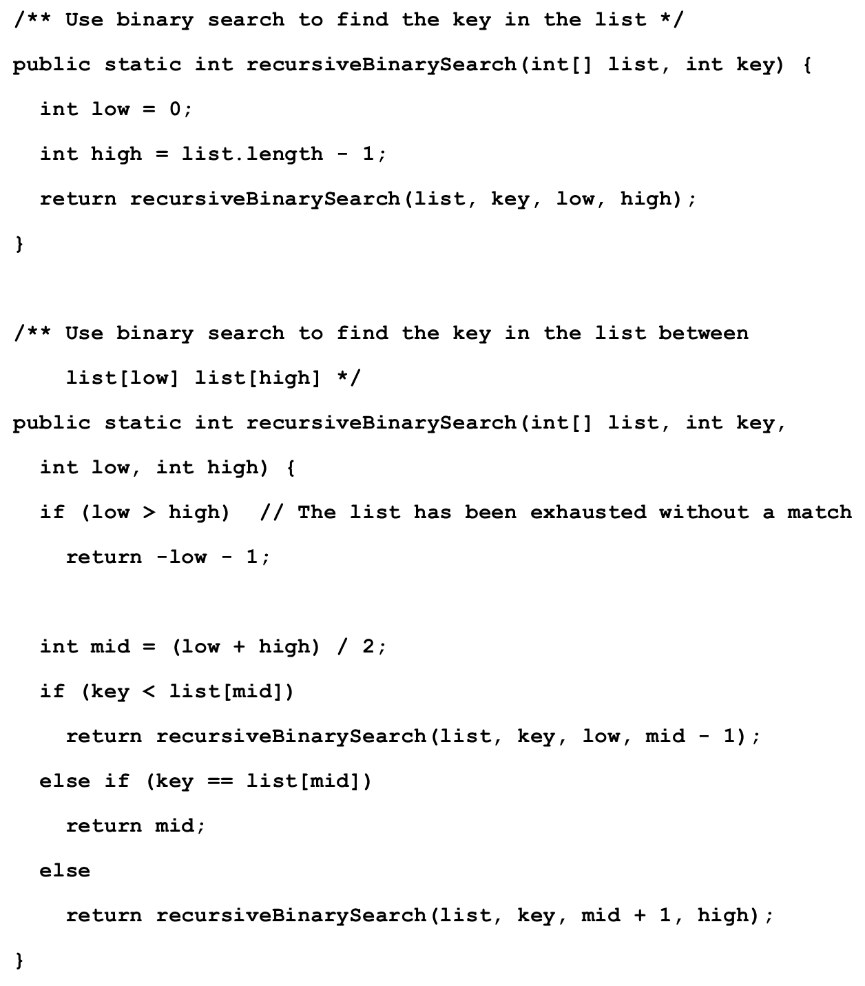
Recursive Implementation

Slide 39
Directory Size (1 of 2)
The preceding examples can easily be solved without using recursion. This section presents a problem that is difficult to solve without using recursion. The problem is to find the size of a directory. The size of a directory is the sum of the sizes of all files in the directory. A directory may contain subdirectories. Suppose a directory contains files , , ..., , and subdirectories , , ..., , as shown below.

Slide 40
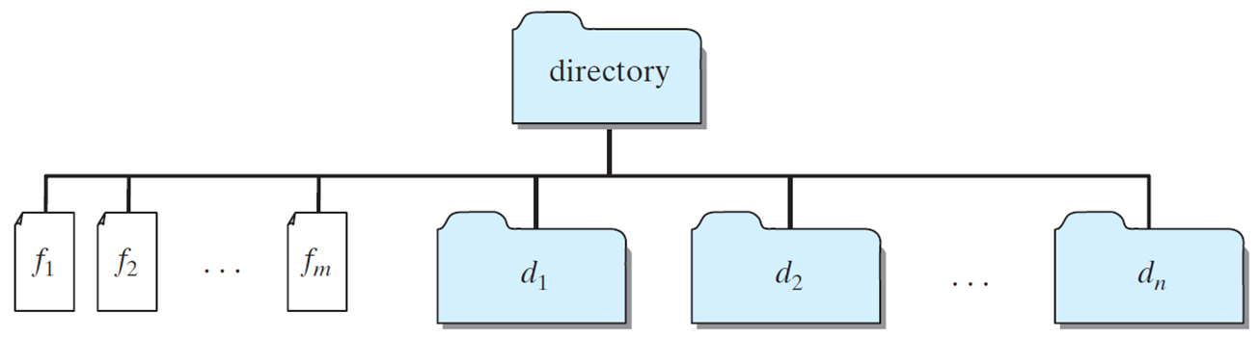
Directory Size (2 of 2)
The size of the directory can be defined recursively as follows:
DirectorySize
Run

Slide 41
Tower of Hanoi (1 of 2)
There are n disks labeled 1, 2, 3, . . ., n, and three towers labeled A, B, and C.
No disk can be on top of a smaller disk at any time.
All the disks are initially placed on tower A.
Only one disk can be moved at a time, and it must be the top disk on the tower.

Slide 42
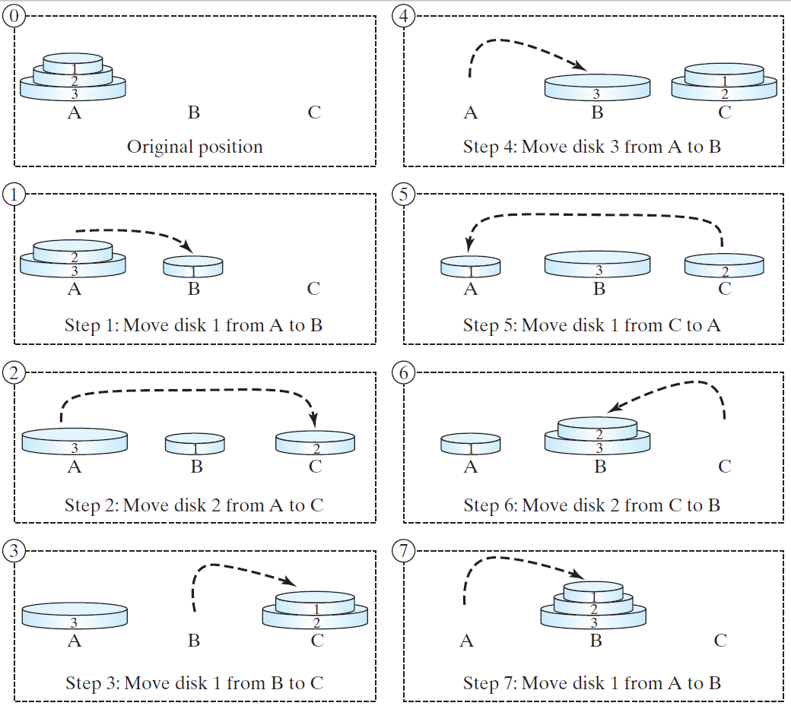
Tower of Hanoi (2 of 2)

Slide 43
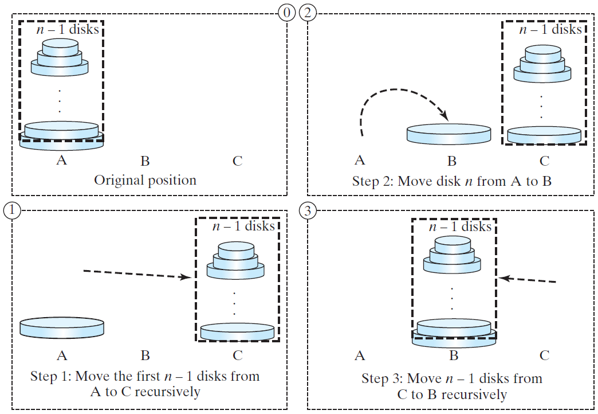
Solution to Tower of Hanoi (1 of 2)
The Tower of Hanoi problem can be decomposed into three subproblems.

Slide 44
Solution to Tower of Hanoi (2 of 2)
Move the first n − 1 disks from A to C with the assistance of tower B.
Move disk n from A to B.
Move n − 1 disks from C to B with the assistance of tower A.
TowerOfHanoi
Run

Slide 45
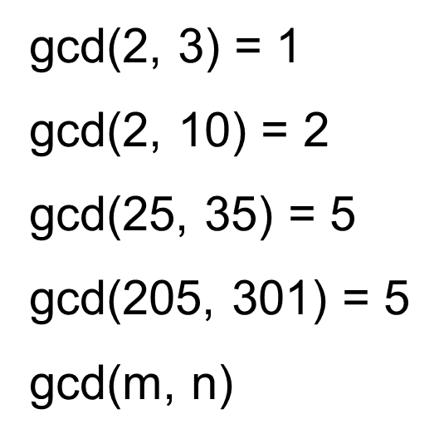
Exercise 18.3 G C D
Approach 1: Brute-force, start from min(n, m) down to 1, to check if a number is common divisor for both m and n, if so, it is the greatest common divisor.
Approach 2: Euclid’s algorithm
Approach 3: Recursive method

Slide 46
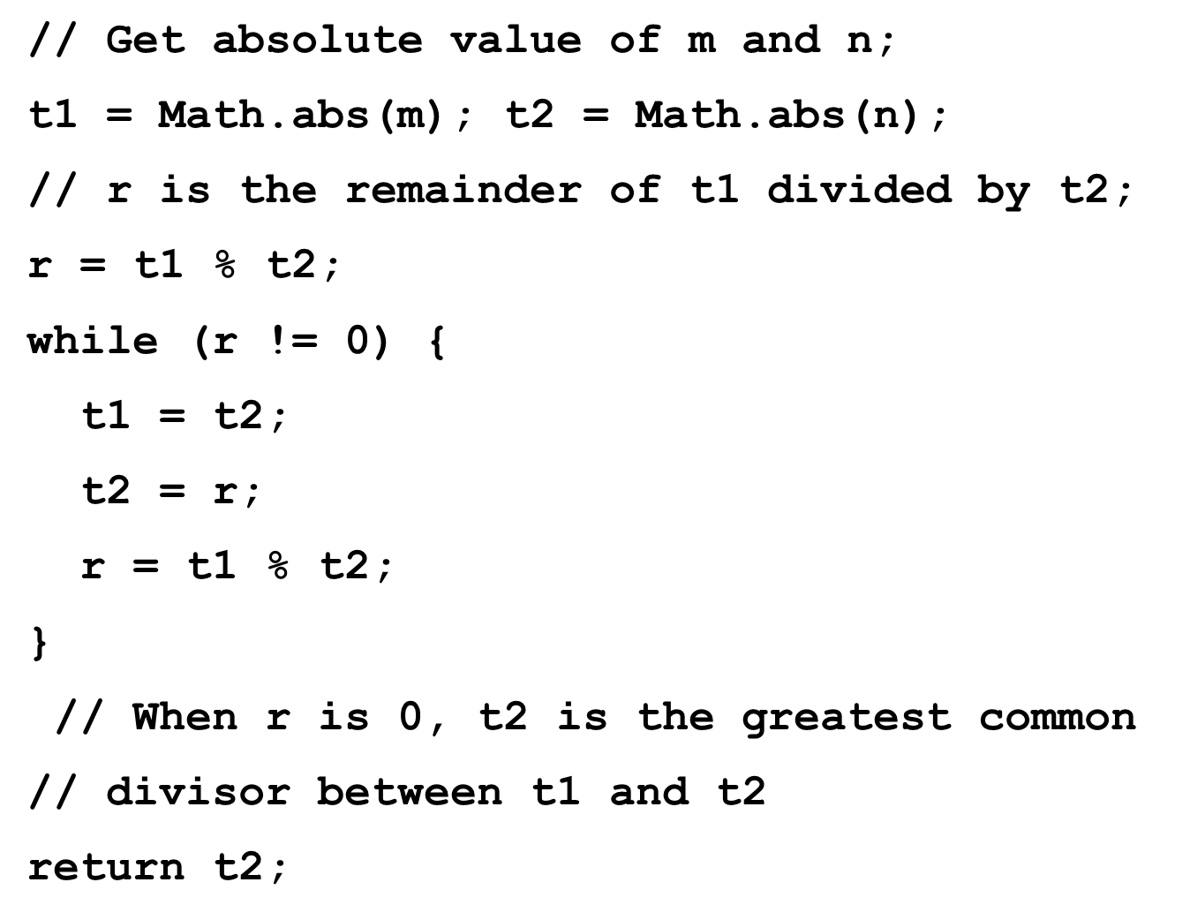
Approach 2: Euclid’s algorithm

Slide 47
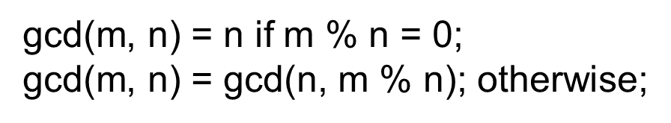
Approach 3: Recursive Method

Slide 48
Fractals?
A fractal is a geometrical figure just like triangles, circles, and rectangles, but fractals can be divided into parts, each of which is a reduced-size copy of the whole. There are many interesting examples of fractals. This section introduces a simple fractal, called Sierpinski triangle, named after a famous Polish mathematician.

Slide 49
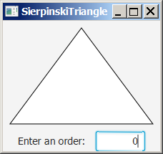
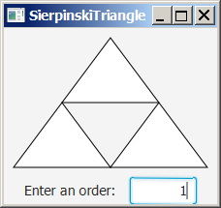
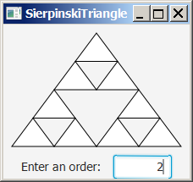
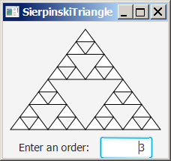
Sierpinski Triangle
It begins with an equilateral triangle, which is considered to be the Sierpinski fractal of order (or level) 0, as shown in Figure (a).
Connect the midpoints of the sides of the triangle of order 0 to create a Sierpinski triangle of order 1, as shown in Figure (b).
Leave the center triangle intact. Connect the midpoints of the sides of the three other triangles to create a Sierpinski of order 2, as shown in Figure (c).
You can repeat the same process recursively to create a Sierpinski triangle of order 3, 4, ..., and so on, as shown in Figure (d).

Slide 50
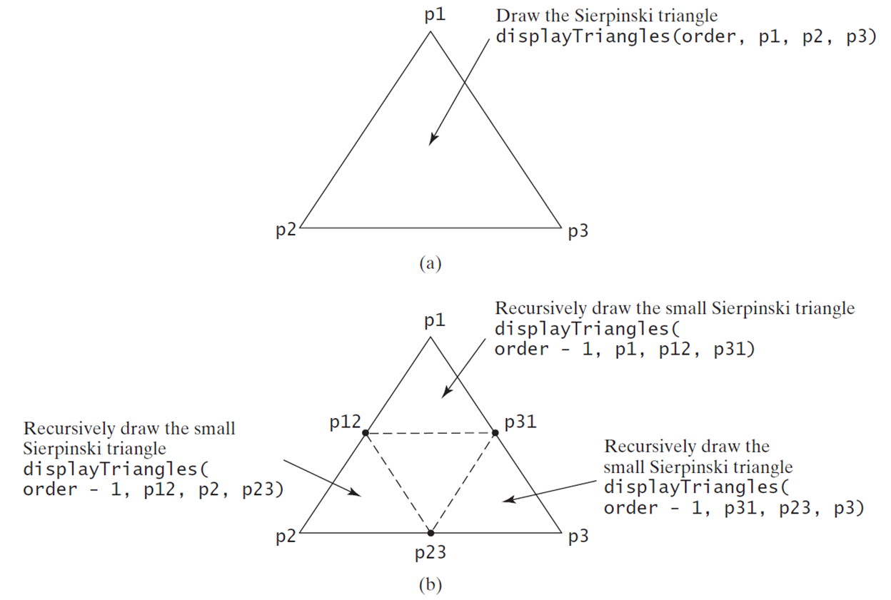
Sierpinski Triangle Solution
SierpinskiTriangle
Run

Slide 51
Recursion Versus. Iteration
Recursion is an alternative form of program control. It is essentially repetition without a loop.
Recursion bears substantial overhead. Each time the program calls a method, the system must assign space for all of the method’s local variables and parameters. This can consume considerable memory and requires extra time to manage the additional space.

Slide 52
Advantages of Using Recursion
Recursion is good for solving the problems that are inherently recursive.

Slide 53
Tail Recursion
A recursive method is said to be tail recursive if there are no pending operations to be performed on return from a recursive call.
Non-tail recursive
ComputeFactorial
Tail recursive
ComputeFactorialTailRecursion

Slide 54

Copyright

