Slide 1
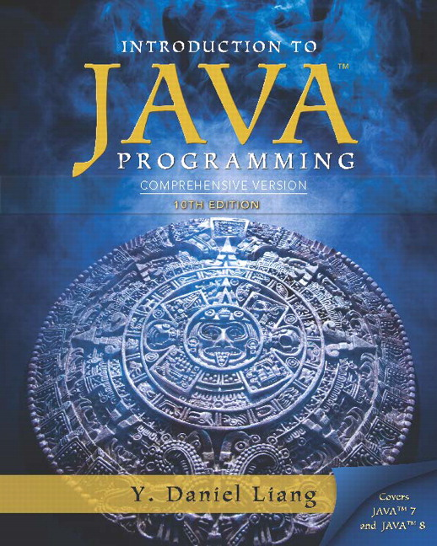
Introduction to Java Programming
Tenth Edition
Chapter 19
Generics
Copyright © 2015 Pearson Education, Inc. All Rights Reserved
Notes:
If this PowerPoint presentation contains mathematical equations, you may need to check that your computer has the following installed:
1) MathType Plugin
2) Math Player (free versions available)
3) NVDA Reader (free versions available)

Slide 2
Objectives (1 of 2)
To know the benefits of generics (§19.1).
To use generic classes and interfaces (§19.2).
To declare generic classes and interfaces (§19.3).
To understand why generic types can improve reliability and readability (§19.3).
To declare and use generic methods and bounded generic types (§19.4).
To use raw types for backward compatibility (§19.5).
To know wildcard types and understand why they are necessary (§19.6).

Slide 3
Objectives (2 of 2)
To convert legacy code using J D K 1.5 generics (§19.7).
To understand that generic type information is erased by the compiler and all instances of a generic class share the same runtime class file (§19.8).
To know certain restrictions on generic types caused by type erasure (§19.8).
To design and implement generic matrix classes (§19.9).

Slide 4
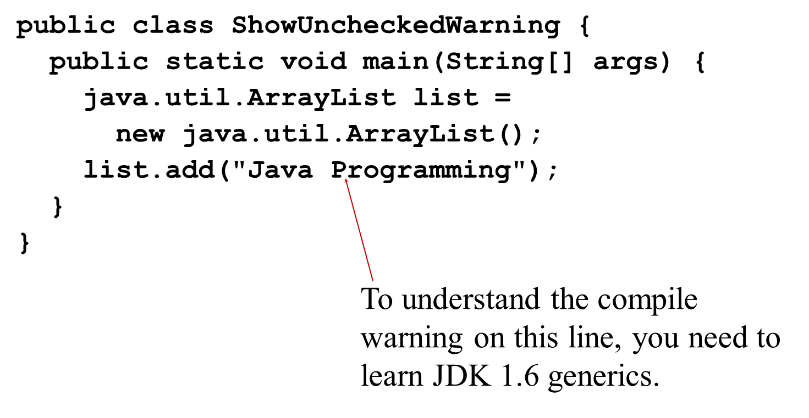
Why Do You Get a Warning?

Slide 5
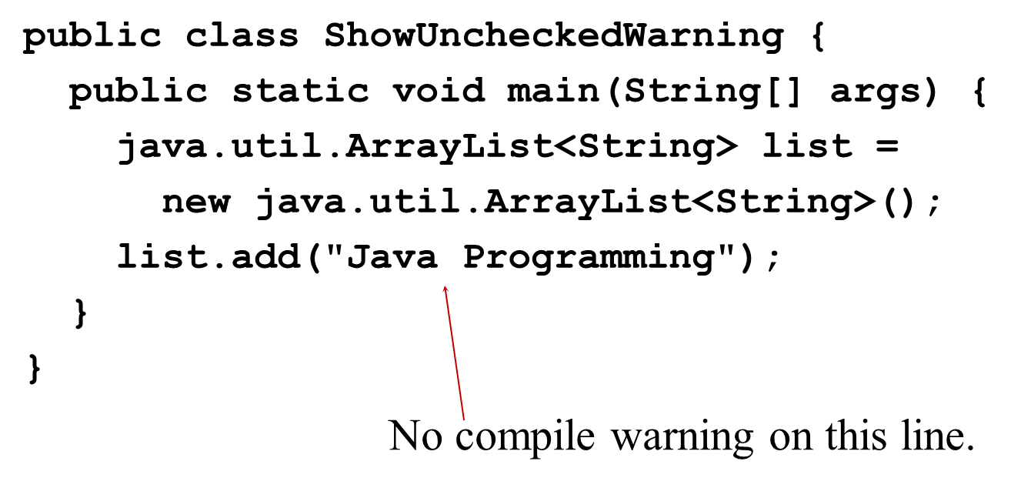
Fix the Warning

Slide 6
What is Generics?
Generics is the capability to parameterize types. With this capability, you can define a class or a method with generic types that can be substituted using concrete types by the compiler. For example, you may define a generic stack class that stores the elements of a generic type. From this generic class, you may create a stack object for holding strings and a stack object for holding numbers. Here, strings and numbers are concrete types that replace the generic type.

Slide 7
Why Generics?
The key benefit of generics is to enable errors to be detected at compile time rather than at runtime. A generic class or method permits you to specify allowable types of objects that the class or method may work with. If you attempt to use the class or method with an incompatible object, a compile error occurs.

Slide 8
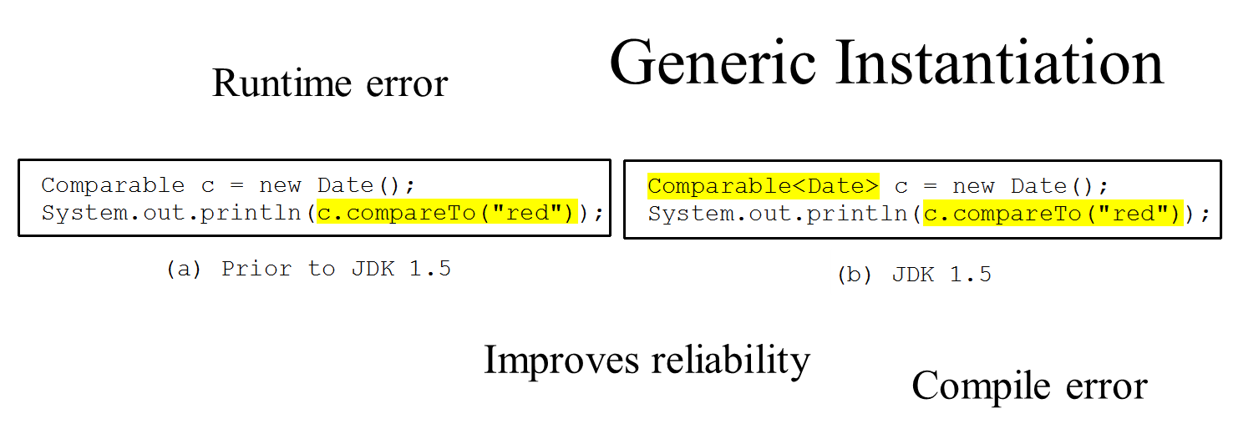
Generic Type

Slide 9
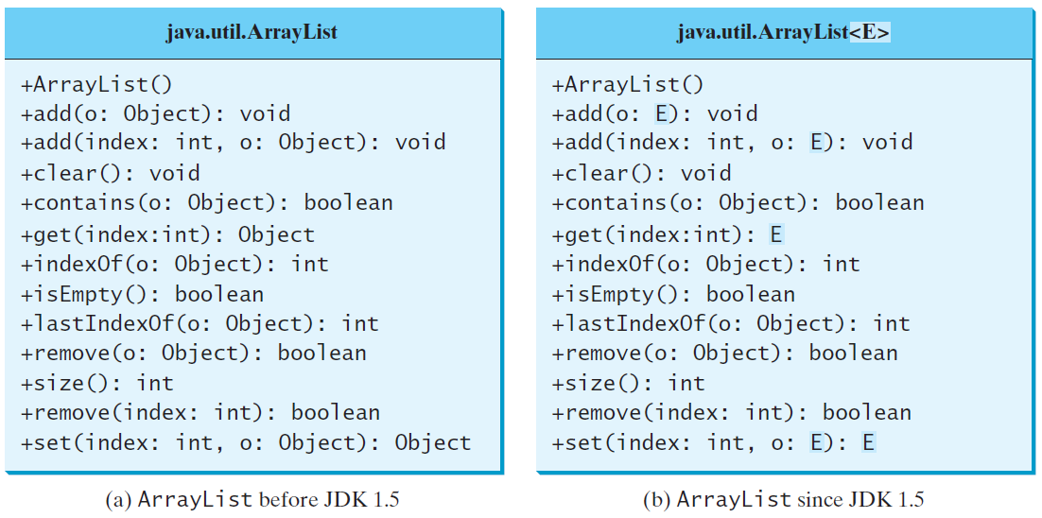
Generic ArrayList in J D K 1.5

Slide 10
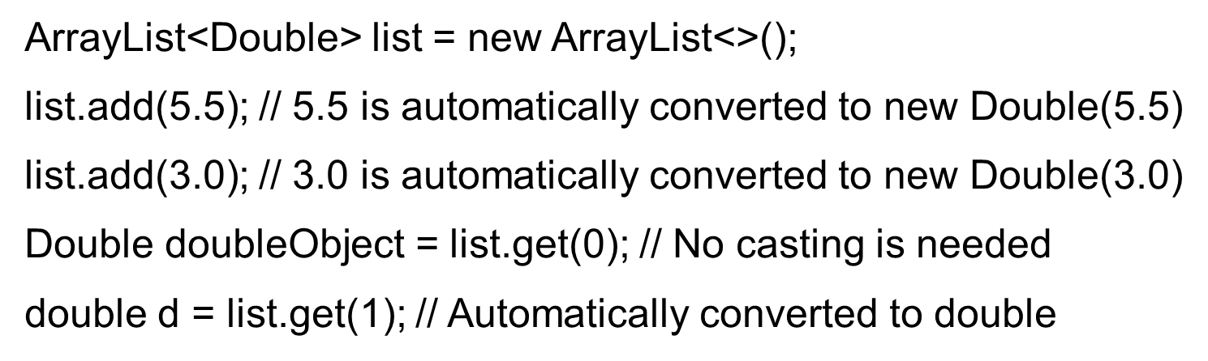
No Casting Needed

Slide 11
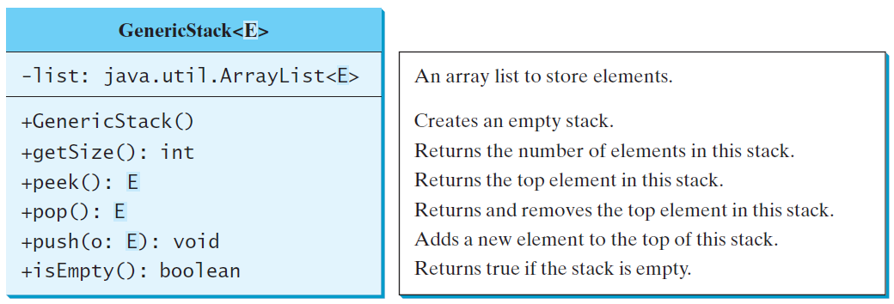
Declaring Generic Classes and Interfaces
GenericStack

Slide 12
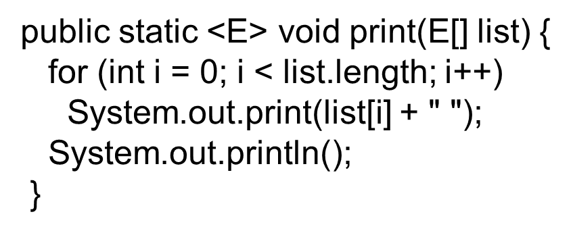
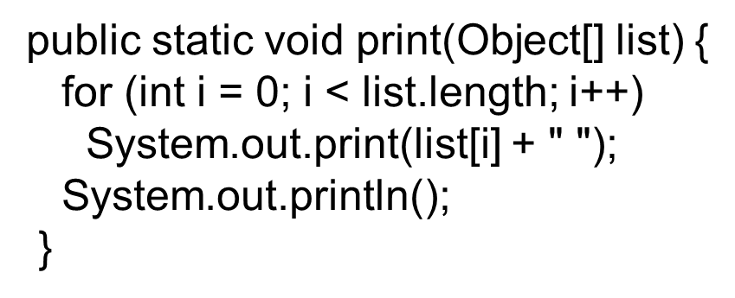
Generic Methods

Slide 13
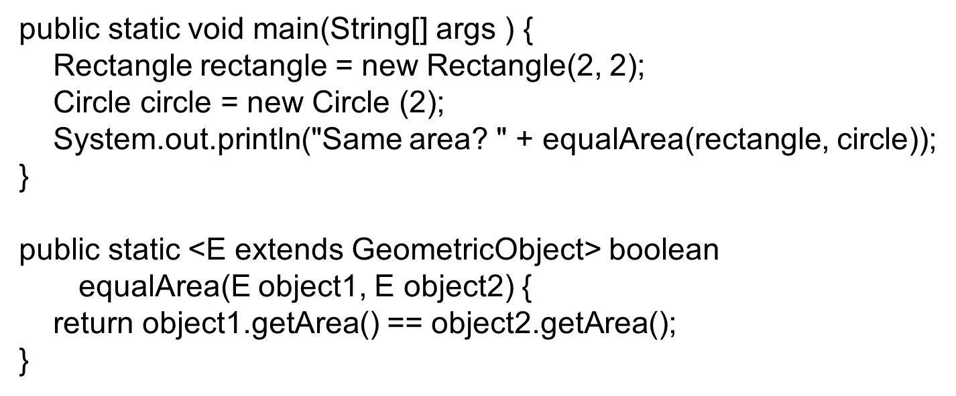
Bounded Generic Type

Slide 14
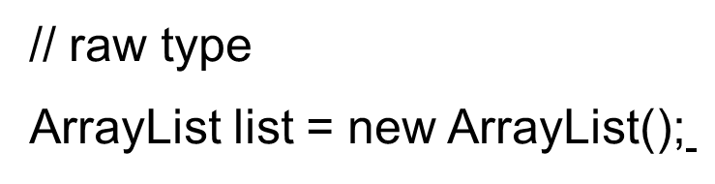
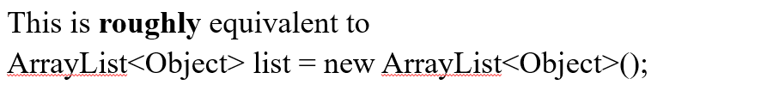
Raw Type and Backward Compatibility

Slide 15
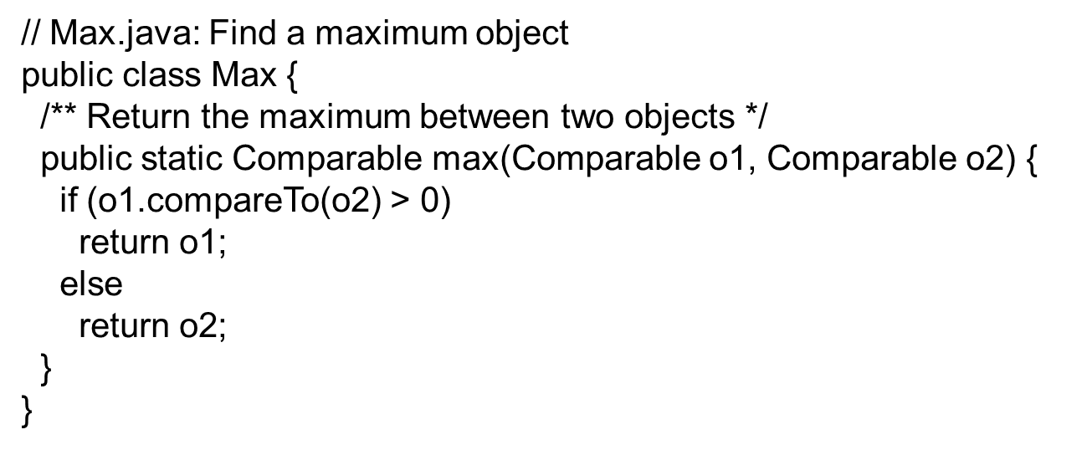
Raw Type is Unsafe
Runtime Error:
Max.max("Welcome", 23);

Slide 16
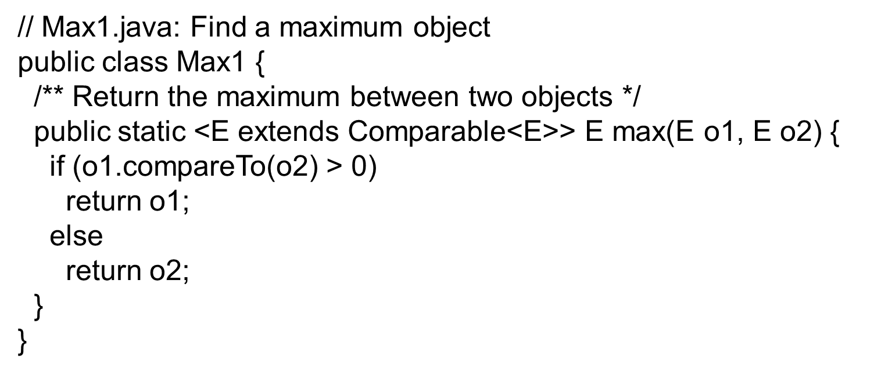
Make it Safe
Max.max("Welcome", 23);

Slide 17
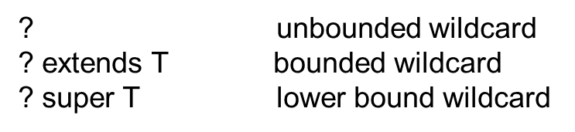
Wildcards
Why wildcards are necessary? See this example.
WildCardNeedDemo
AnyWildCardDemo
SuperWildCardDemo

Slide 18
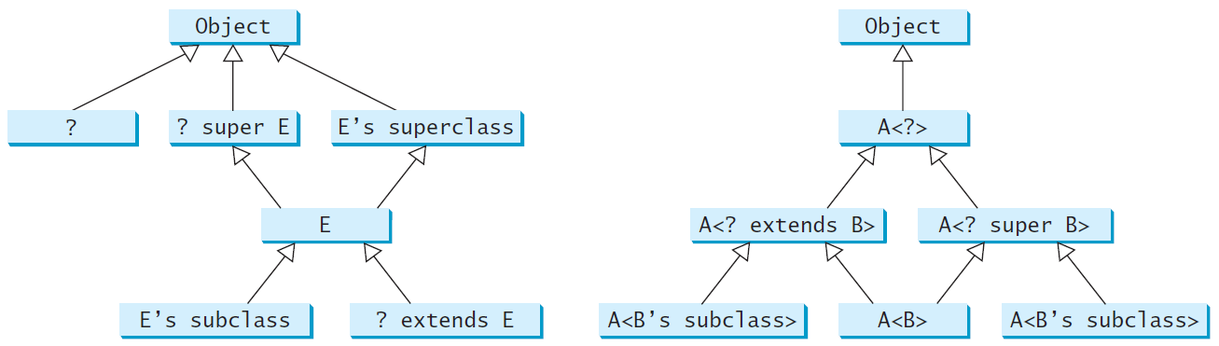
Generic Types and Wildcard Types

Slide 19
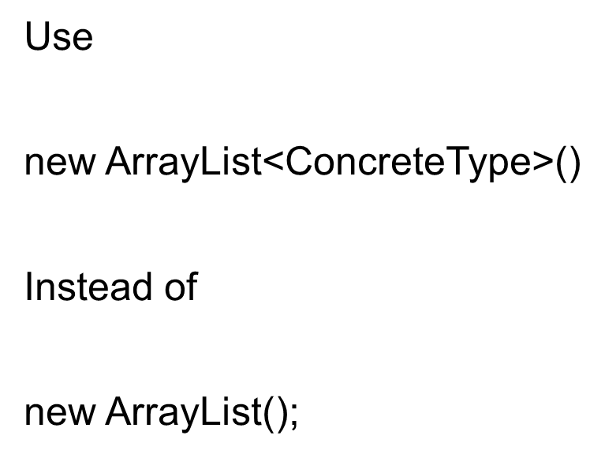
Avoiding Unsafe Raw Types
TestArrayListNew
Run

Slide 20
Erasure and Restrictions on Generics
Generics are implemented using an approach called type erasure. The compiler uses the generic type information to compile the code, but erases it afterwards. So the generic information is not available at run time. This approach enables the generic code to be backward-compatible with the legacy code that uses raw types.

Slide 21
Compile Time Checking
For example, the compiler checks whether generics is used correctly for the following code in (a) and translates it into the equivalent code in (b) for runtime use. The code in (b) uses the raw type.

Slide 22
Important Facts
It is important to note that a generic class is shared by all its instances regardless of its actual generic type.
Although
are two types, but there is only one class GenericStack loaded into the J V M.

Slide 23
Restrictions on Generics
Restriction 1: Cannot Create an Instance of a Generic Type.
Restriction 2: Generic Array Creation is Not Allowed.
Restriction 3: A Generic Type Parameter of a Class Is Not Allowed in a Static Context.
Restriction 4: Exception Classes Cannot be Generic.

Slide 24
Designing Generic Matrix Classes
Objective: This example gives a generic class for matrix arithmetic. This class implements matrix addition and multiplication common for all types of matrices.
GenericMatrix

Slide 25
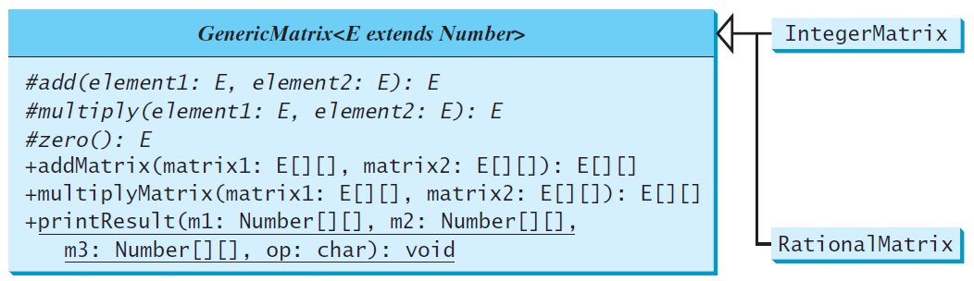
U M L Diagram

Slide 26
Source Code
Objective: This example gives two programs that utilize the GenericMatrix class for integer matrix arithmetic and rational matrix arithmetic.
IntegerMatrix
TestIntegerMatrix
Run
RationalMatrix
TestRationalMatrix
Run

Slide 27
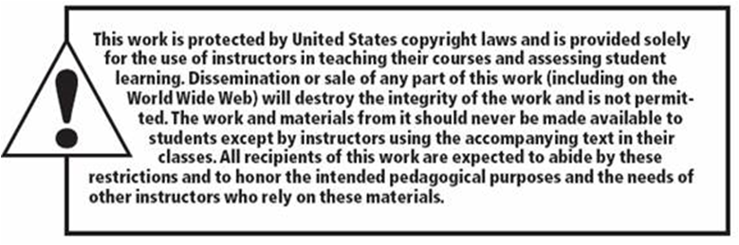
Copyright

