Slide 1
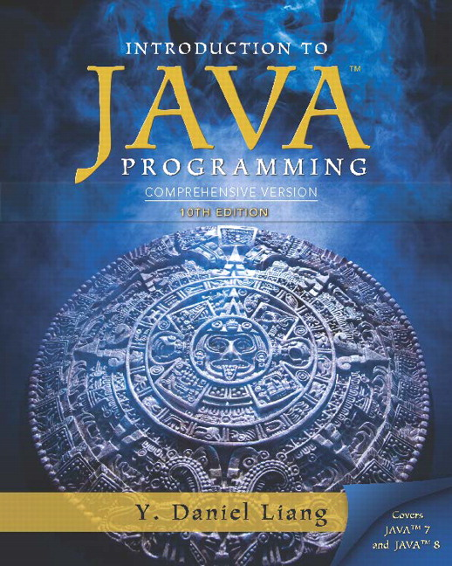
Introduction to Java Programming
Tenth Edition
Chapter 21
Sets and Maps
Copyright © 2015 Pearson Education, Inc. All Rights Reserved
Notes:
If this PowerPoint presentation contains mathematical equations, you may need to check that your computer has the following installed:
1) MathType Plugin
2) Math Player (free versions available)
3) NVDA Reader (free versions available)

Slide 2
Objectives (1 of 2)
To store unordered, nonduplicate elements using a set (§21.2).
To explore how and when to use HashSet (§21.2.1), LinkedHashSet (§21.2.2), or TreeSet (§21.2.3) to store elements.
To compare performance of sets and lists (§21.3).
To use sets to develop a program that counts the keywords in a Java source file (§21.4).
To tell the differences between Collection and Map and describe when and how to use HashMap, LinkedHashMap, and TreeMap to store values associated with keys (§21.5).

Slide 3
Objectives (2 of 2)
To use maps to develop a program that counts the occurrence of the words in a text (§21.6).
To obtain singleton sets, lists, and maps, and unmodifiable sets, lists, and maps, using the static methods in the Collections class (§21.7).

Slide 4
Motivations
The “No-Fly” list is a list, created and maintained by the U.S. government’s Terrorist Screening Center, of people who are not permitted to board a commercial aircraft for travel in or out of the United States. Suppose we need to write a program that checks whether a person is on the No-Fly list. You can use a list to store names in the No-Fly list. However, a more efficient data structure for this application is a set.
Suppose your program also needs to store detailed information about terrorists in the No-Fly list. The detailed information such as gender, height, weight, and nationality can be retrieved using the name as the key. A map is an efficient data structure for such a task.

Slide 5
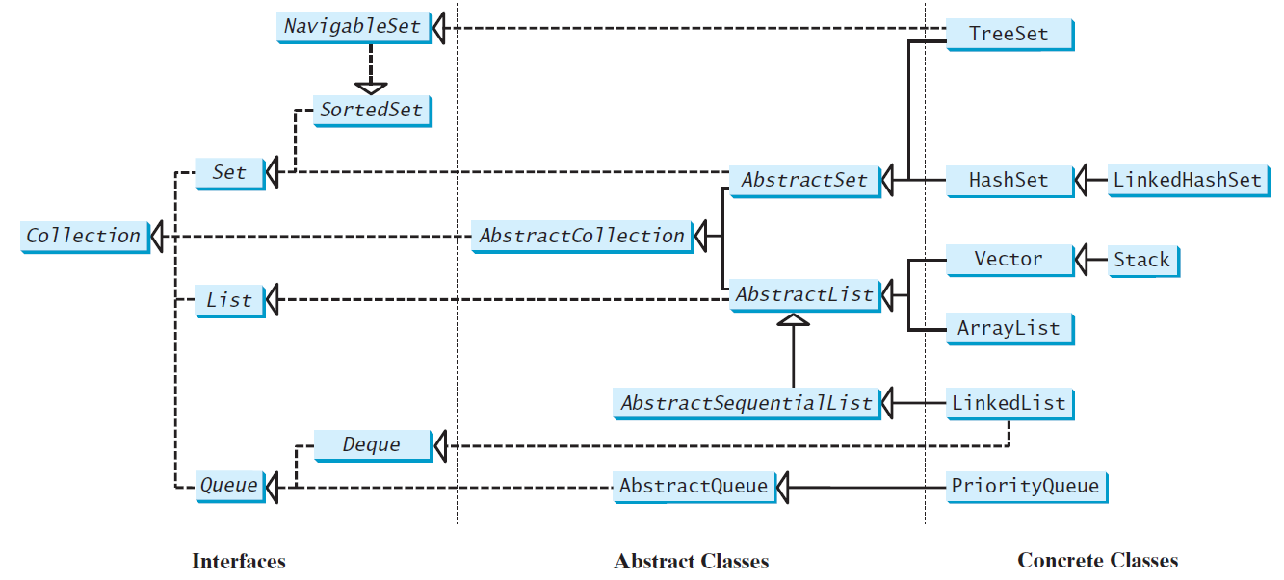
Review of Java Collection Framework Hierarchy
Set and List are subinterfaces of Collection.

Slide 6
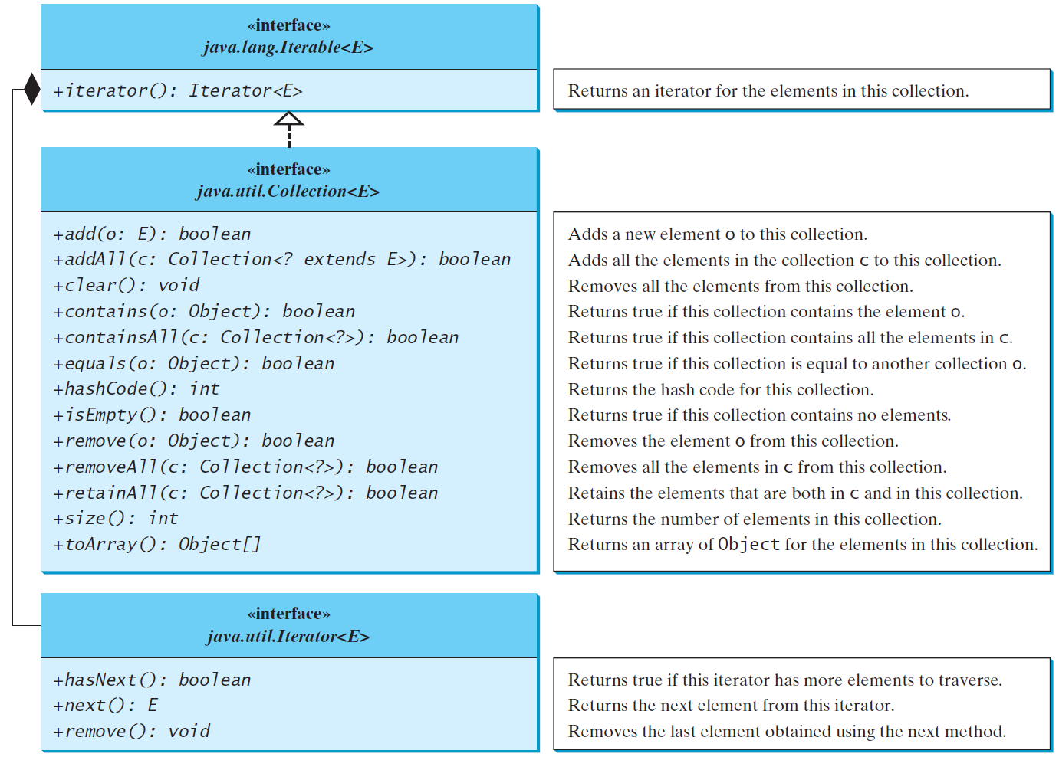
Review of Java Collection Framework Hierarchy
The Collection interface is the root interface for manipulating a collection of objects

Slide 7
The Set Interface
The Set interface extends the Collection interface. It does not introduce new methods or constants, but it stipulates that an instance of Set contains no duplicate elements. The concrete classes that implement Set must ensure that no duplicate elements can be added to the set. That is no two elements e1 and e2 can be in the set such that e1.equals(e2) is true.

Slide 8
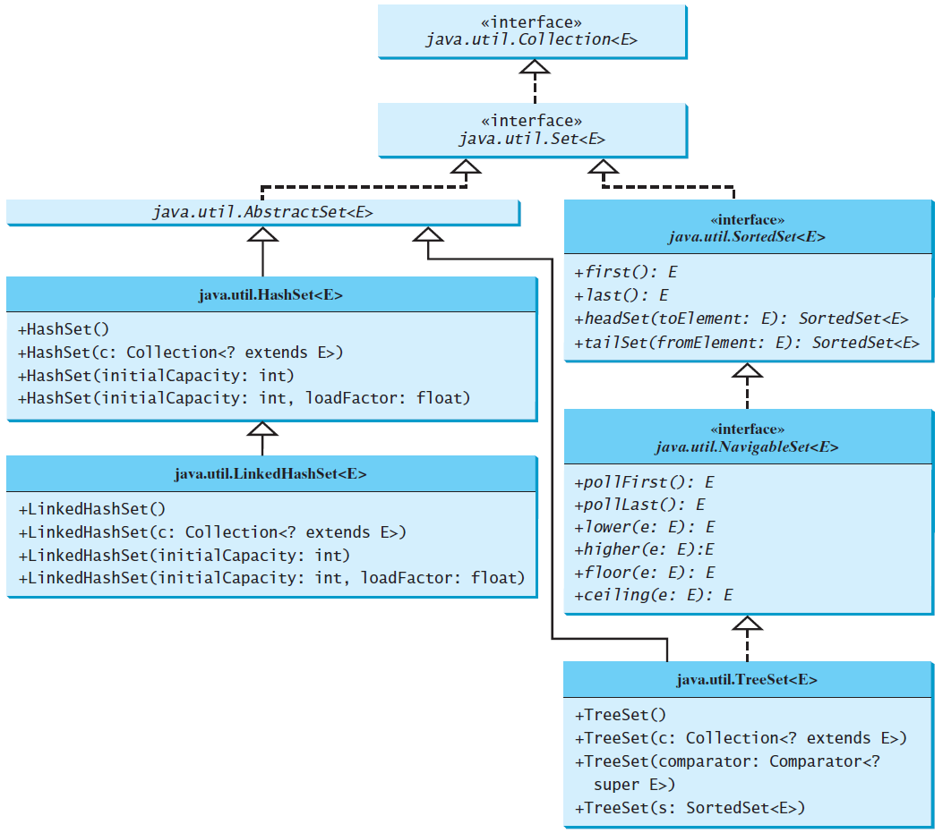
The Set Interface Hierarchy

Slide 9
The AbstractSet Class
The AbstractSet class is a convenience class that extends AbstractCollection and implements Set. The AbstractSet class provides concrete implementations for the equals method and the hashCode method. The hash code of a set is the sum of the hash code of all the elements in the set. Since the size method and iterator method are not implemented in the AbstractSet class, AbstractSet is an abstract class.

Slide 10
The HashSet Class
The HashSet class is a concrete class that implements Set. It can be used to store duplicate-free elements. For efficiency, objects added to a hash set need to implement the hashCode method in a manner that properly disperses the hash code.

Slide 11
Example: Using HashSet and Iterator
This example creates a hash set filled with strings, and uses an iterator to traverse the elements in the list.
TestHashSet
Run

Slide 12
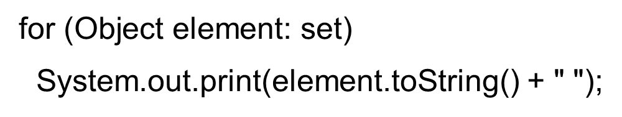
TIP: For-Each Loop
You can simplify the code in Lines 21-26 using a J D K 1.5 enhanced for loop without using an iterator, as follows:

Slide 13
Example: Using LinkedHashSet
This example creates a hash set filled with strings, and uses an iterator to traverse the elements in the list.
TestLinkedHashSet
Run

Slide 14
The SortedSet Interface and the TreeSet Class (1 of 2)
SortedSet is a subinterface of Set, which guarantees that the elements in the set are sorted. TreeSet is a concrete class that implements the SortedSet interface. You can use an iterator to traverse the elements in the sorted order. The elements can be sorted in two ways.

Slide 15
The SortedSet Interface and the TreeSet Class (2 of 2)
One way is to use the Comparable interface.
The other way is to specify a comparator for the elements in the set if the class for the elements does not implement the Comparable interface, or you don’t want to use the compareTo method in the class that implements the Comparable interface. This approach is referred to as order by comparator.

Slide 16
Example: Using TreeSet to Sort Elements in a Set
This example creates a hash set filled with strings, and then creates a tree set for the same strings. The strings are sorted in the tree set using the compareTo method in the Comparable interface. The example also creates a tree set of geometric objects. The geometric objects are sorted using the compare method in the Comparator interface.
TestTreeSet
Run

Slide 17
Example: The Using Comparator to Sort Elements in a Set
Write a program that demonstrates how to sort elements in a tree set using the Comparator interface. The example creates a tree set of geometric objects. The geometric objects are sorted using the compare method in the Comparator interface.
TestTreeSetWithComparator
Run

Slide 18
Performance of Sets and Lists
TestTreeSetWithComparator
Run

Slide 19
Case Study: Counting Keywords
This section presents an application that counts the number of the keywords in a Java source file.
CountKeywords
Run

Slide 20
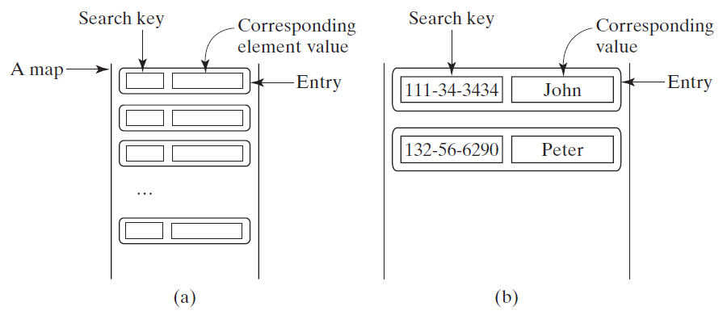
The Map Interface
The Map interface maps keys to the elements. The keys are like indexes. In List, the indexes are integer. In Map, the keys can be any objects.

Slide 21
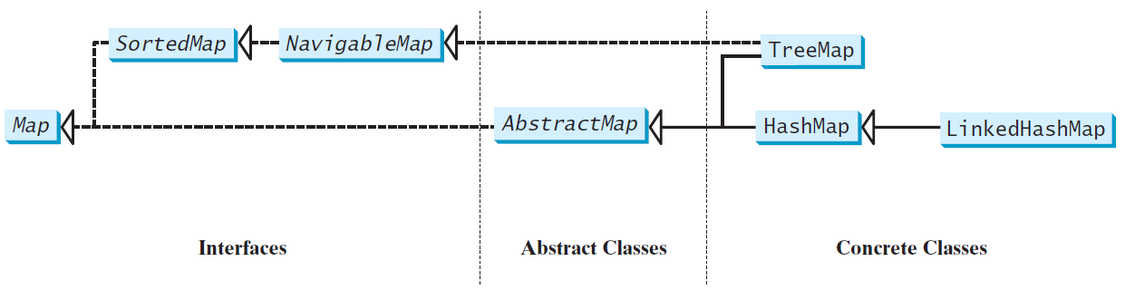
Map Interface and Class Hierarchy
An instance of Map represents a group of objects, each of which is associated with a key. You can get the object from a map using a key, and you have to use a key to put the object into the map.

Slide 22
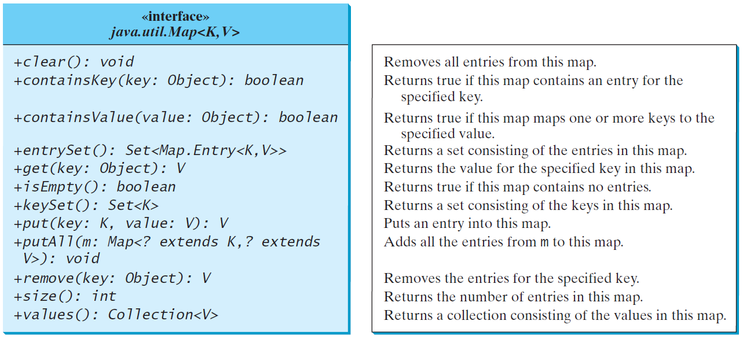
The Map Interface UML Diagram

Slide 23
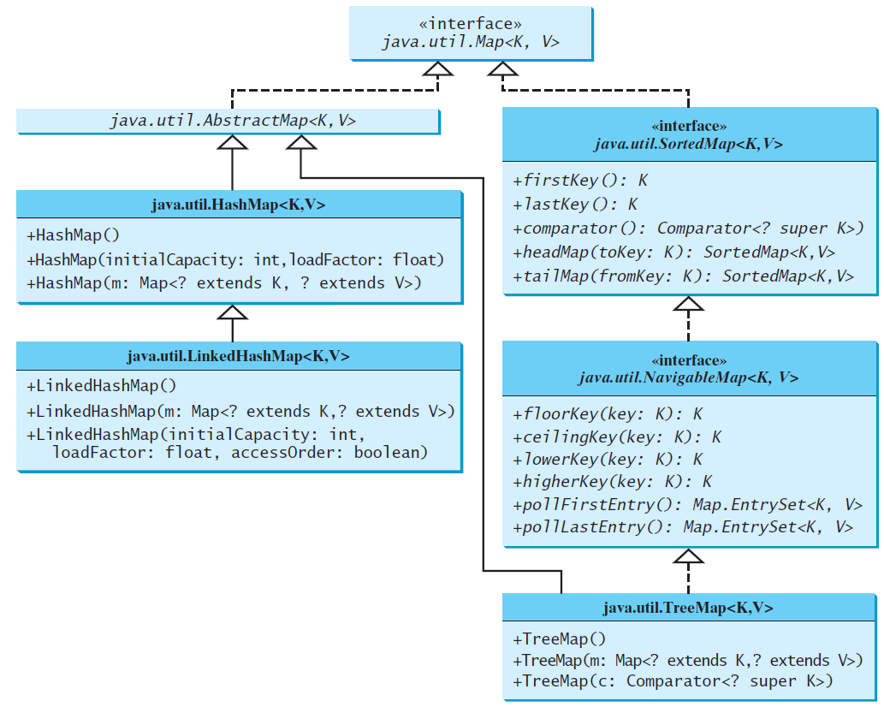
Concrete Map Classes

Slide 24
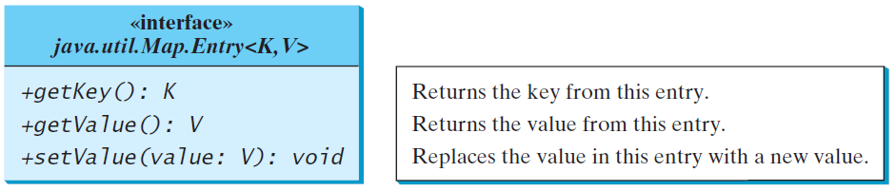
Entry

Slide 25
HashMap and TreeMap
The HashMap and TreeMap classes are two concrete implementations of the Map interface. The HashMap class is efficient for locating a value, inserting a mapping, and deleting a mapping. The TreeMap class, implementing SortedMap, is efficient for traversing the keys in a sorted order.

Slide 26
LinkedHashMap
LinkedHashMap was introduced in JDK 1.4. It extends HashMap with a linked list implementation that supports an ordering of the entries in the map. The entries in a HashMap are not ordered, but the entries in a LinkedHashMap can be retrieved in the order in which they were inserted into the map (known as the insertion order), or the order in which they were last accessed, from least recently accessed to most recently (access order). The no-arg constructor constructs a LinkedHashMap with the insertion order. To construct a LinkedHashMap with the access order, use the LinkedHashMap(initialCapacity, loadFactor, true).

Slide 27
Example: Using HashMap and TreeMap
This example creates a hash map that maps borrowers to mortgages. The program first creates a hash map with the borrower’s name as its key and mortgage as its value. The program then creates a tree map from the hash map, and displays the mappings in ascending order of the keys.
TestMap
Run

Slide 28
Case Study: Counting the Occurrences of Words in a Text
This program counts the occurrences of words in a text and displays the words and their occurrences in ascending order of the words. The program uses a hash map to store a pair consisting of a word and its count. For each word, check whether it is already a key in the map. If not, add the key and value 1 to the map. Otherwise, increase the value for the word (key) by 1 in the map. To sort the map, convert it to a tree map.
CountOccurrenceOfWords
Run

Slide 29
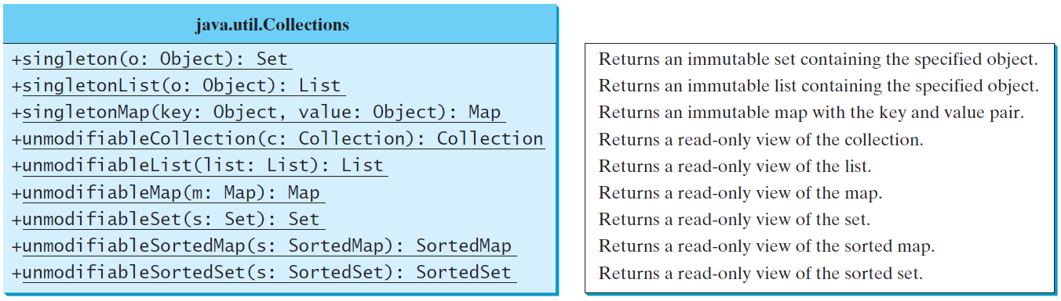
The Singleton and Unmodiable Collections

Slide 30

Copyright

