Slide 1
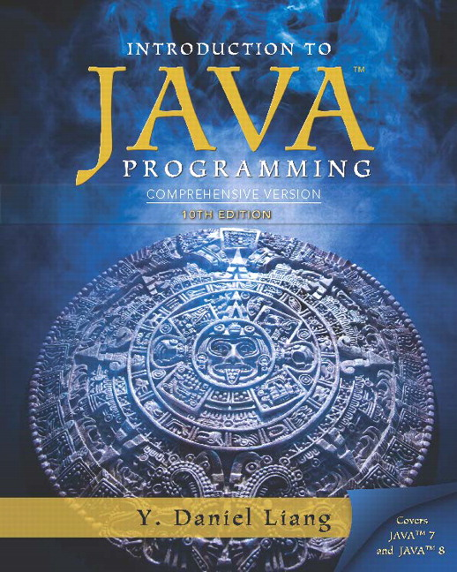
Introduction to Java Programming
Tenth Edition
Chapter 23
Sorting
Copyright © 2015 Pearson Education, Inc. All Rights Reserved
Notes:
If this PowerPoint presentation contains mathematical equations, you may need to check that your computer has the following installed:
1) MathType Plugin
2) Math Player (free versions available)
3) NVDA Reader (free versions available)

Slide 2
Objectives (1 of 2)
To study and analyze time complexity of various sorting algorithms (§§23.2–23.7).
To design, implement, and analyze insertion sort (§23.2).
To design, implement, and analyze bubble sort (§23.3).
To design, implement, and analyze merge sort (§23.4).
To design, implement, and analyze quick sort (§23.5).
To design and implement a binary heap (§23.6).
To design, implement, and analyze heap sort (§23.7).

Slide 3
Objectives (2 of 2)
To design, implement, and analyze bucket sort and radix sort (§23.8).
To design, implement, and analyze external sort for files that have a large amount of data (§23.9).

Slide 4
Why Study Sorting?
Sorting is a classic subject in computer science. There are three reasons for studying sorting algorithms.
First, sorting algorithms illustrate many creative approaches to problem solving and these approaches can be applied to solve other problems.
Second, sorting algorithms are good for practicing fundamental programming techniques using selection statements, loops, methods, and arrays.
Third, sorting algorithms are excellent examples to demonstrate algorithm performance.

Slide 5
What Data To Sort?
The data to be sorted might be integers, doubles, characters, or objects. §7.8, “Sorting Arrays,” presented selection sort and insertion sort for numeric values. The selection sort algorithm was extended to sort an array of objects in §11.5.7, “Example: Sorting an Array of Objects.” The Java A P I contains several overloaded sort methods for sorting primitive type values and objects in the java.util.Arrays and java.util.Collections class. For simplicity, this section assumes:
data to be sorted are integers,
data are sorted in ascending order, and
data are stored in an array. The programs can be easily modified to sort other types of data, to sort in descending order, or to sort data in an ArrayList or a LinkedList.

Slide 6
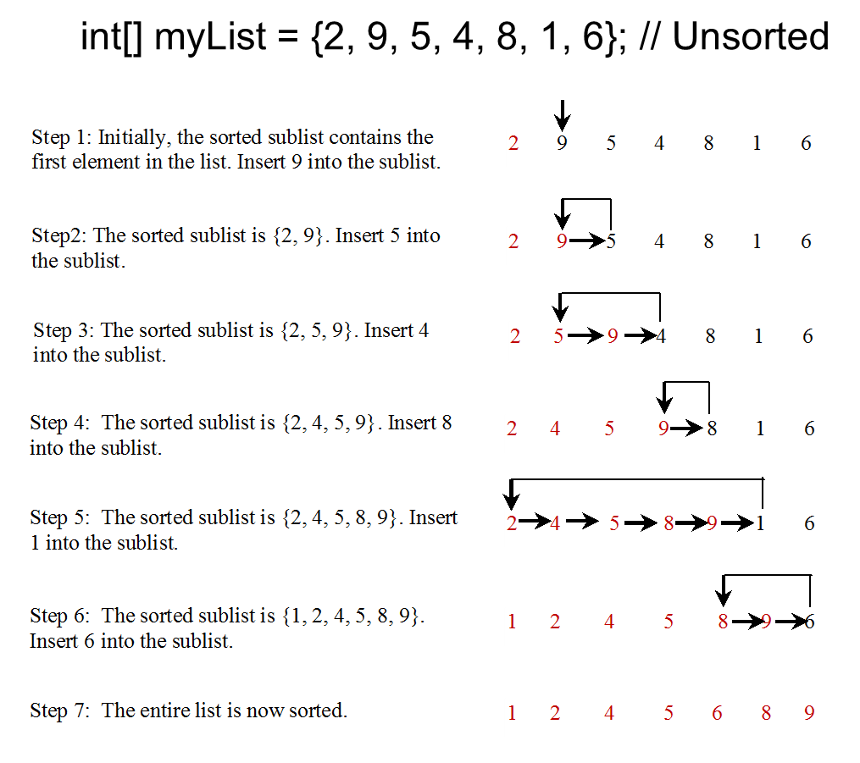
Insertion Sort (1 of 2)
The insertion sort algorithm sorts a list of values by repeatedly inserting an unsorted element into a sorted sublist until the whole list is sorted.

Slide 7

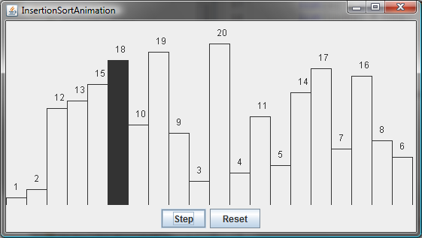
Insertion Sort Animation

Slide 8
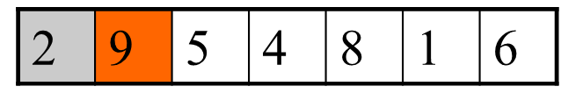
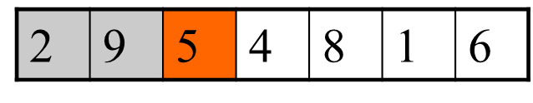
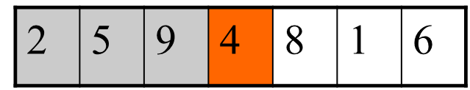
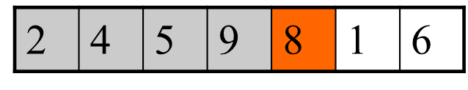
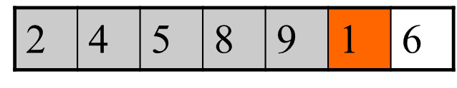
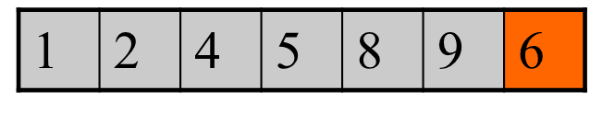
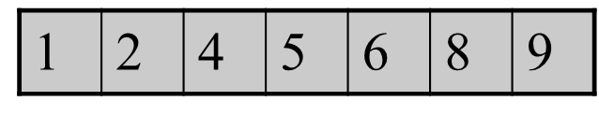
Insertion Sort (2 of 2)

Slide 9
How to Insert?
The insertion sort algorithm sorts a list of values by repeatedly inserting an unsorted element into a sorted sublist until the whole list is sorted.

Slide 10
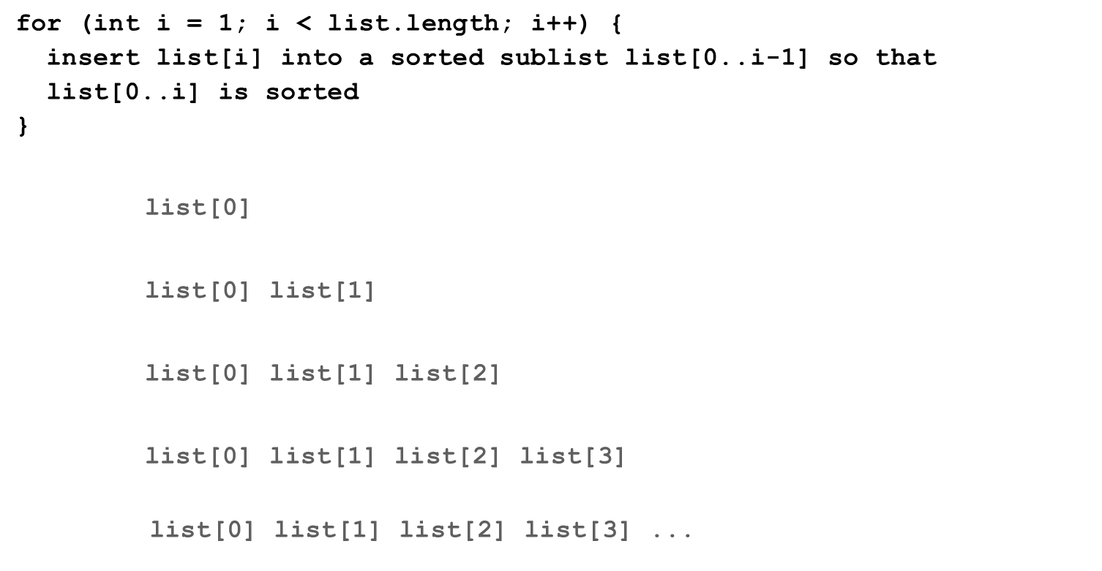
From Idea to Solution (1 of 2)

Slide 11
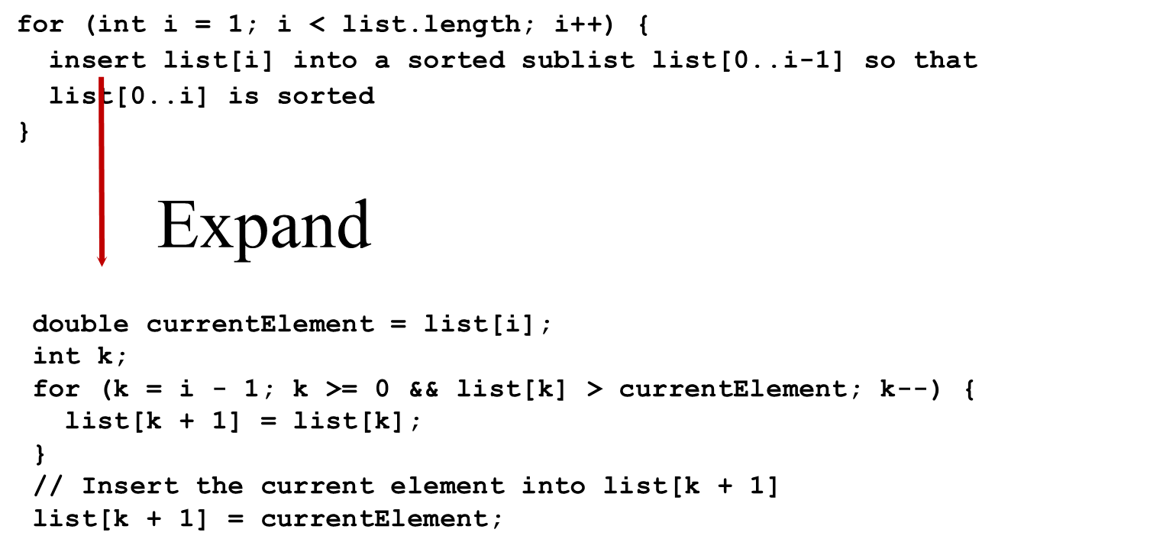
From Idea to Solution (2 of 2)
InsertSort
Run

Slide 12
Bubble Sort
Bubble sort time:
BubbleSort
Run

Slide 13

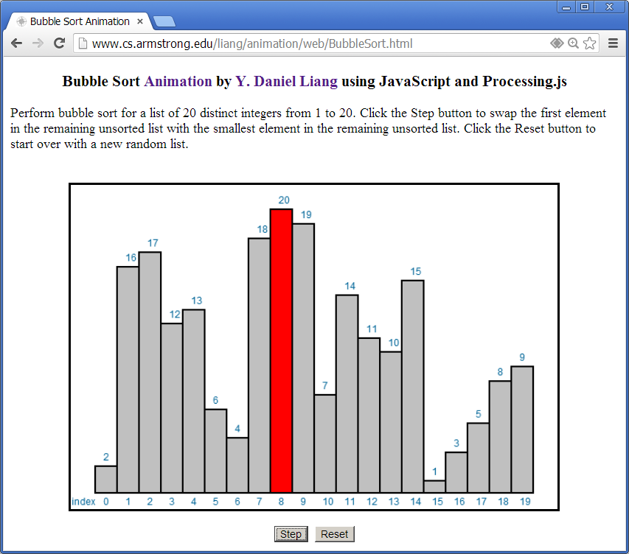
Bubble Sort Animation

Slide 14
Merge Sort (1 of 2)
MergeSort
Run

Slide 15
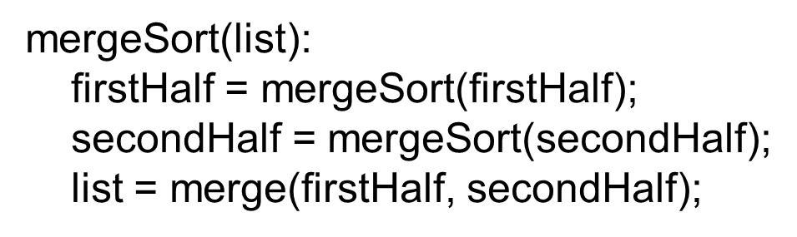
Merge Sort (2 of 2)

Slide 16

Merge Two Sorted Lists

Slide 17
Merge Sort Time (1 of 2)
Let
denote the time required for sorting an array of n
elements using merge sort. Without loss of generality, assume n is a power of 2. The merge sort algorithm splits the array into two subarrays, sorts the subarrays using the same algorithm recursively, and then merges the subarrays. So,

Slide 18
Merge Sort Time (2 of 2)
The first
is the time for sorting the first half of the
array and the second
is the time for sorting
the second half. To merge two subarrays, it takes at most n-1 comparisons to compare the elements from the two subarrays and n moves to move elements to the temporary array. So, the total time is 2n-1. Therefore,

Slide 19
Quick Sort (1 of 2)
Quick sort, developed by C. A. R. Hoare (1962), works as follows: The algorithm selects an element, called the pivot, in the array. Divide the array into two parts such that all the elements in the first part are less than or equal to the pivot and all the elements in the second part are greater than the pivot. Recursively apply the quick sort algorithm to the first part and then the second part.

Slide 20
Quick Sort (2 of 2)

Slide 21
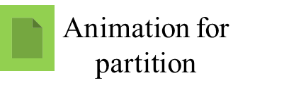
Partition
QuickSort
Run

Slide 22
Quick Sort Time
To partition an array of n elements, it takes n-1 comparisons and n moves in the worst case. So, the time required for
partition is

Slide 23
Worst-Case Time
In the worst case, each time the pivot divides the array into one big subarray with the other empty. The size of the big subarray is one less than the one before divided. The
algorithm requires

Slide 24
Best-Case Time
In the best case, each time the pivot divides the array into two parts of about the same size. Let T(n) denote the time required for sorting an array of elements using quick sort. So,

Slide 25
Average-Case Time
On the average, each time the pivot will not divide the array into two parts of the same size nor one empty part. Statistically, the sizes of the two parts are very close. So the
average time is
The exact average-case
analysis is beyond the scope of this book.

Slide 26
Heap
Heap is a useful data structure for designing efficient sorting algorithms and priority queues. A heap is a binary tree with the following properties:
It is a complete binary tree.
Each node is greater than or equal to any of its children.

Slide 27
Complete Binary Tree
A binary tree is complete if every level of the tree is full except that the last level may not be full and all the leaves on the last level are placed left-most. For example, in the following figure, the binary trees in (a) and (b) are complete, but the binary trees in (c) and (d) are not complete. Further, the binary tree in (a) is a heap, but the binary tree in (b) is not a heap, because the root (39) is less than its right child (42).

Slide 28
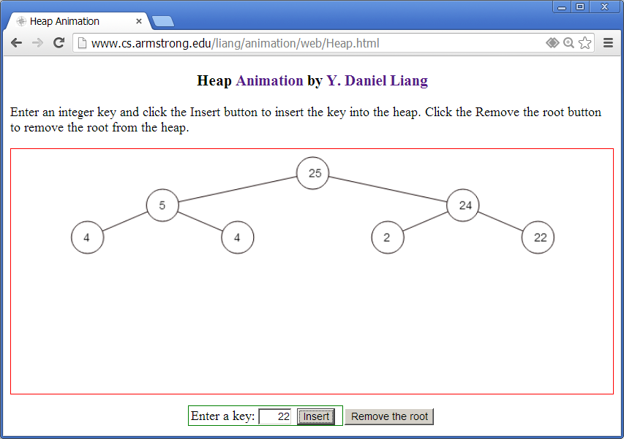
See How a Heap Works

Slide 29
Representing a Heap
For a node at position i, its left child is at position 2i+1 and its right child is at position 2i+2, and its parent is at index
For example, the node for element 39 is at
position 4, so its left child (element 14) is at 9 (2*4+1), its right child (element 33) is at 10 (2*4+2), and its parent
(element 42) is at 1

Slide 30
Adding Elements to the Heap
Adding 3, 5, 1, 19, 11, and 22 to a heap, initially empty

Slide 31
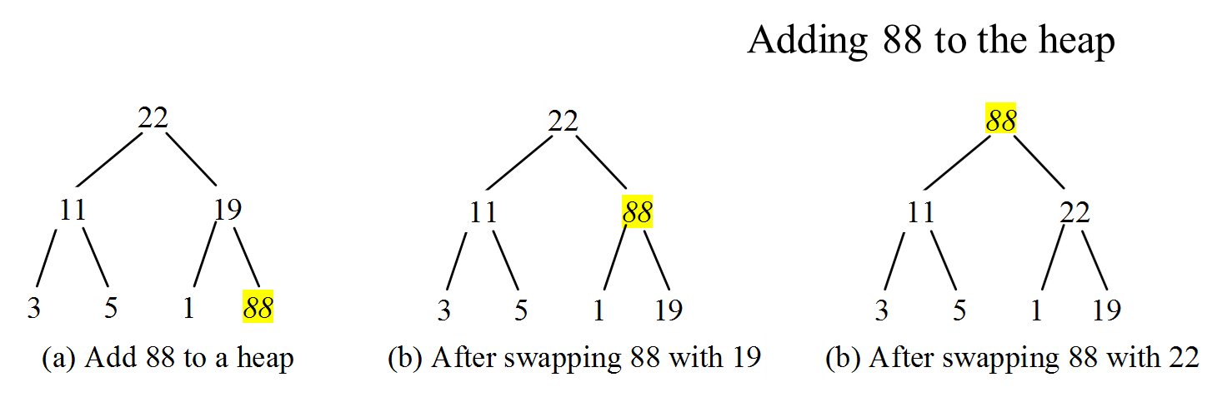
Rebuild The Heap After Adding A New Node

Slide 32
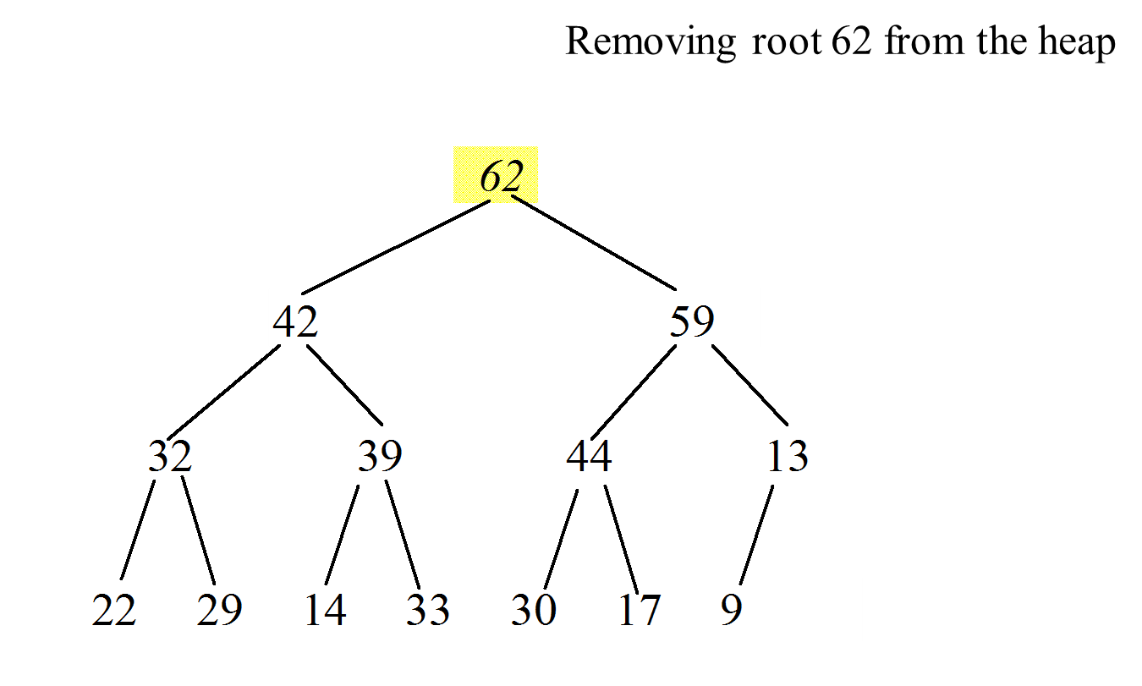
Removing the Root and Rebuild the Tree (1 of 5)

Slide 33
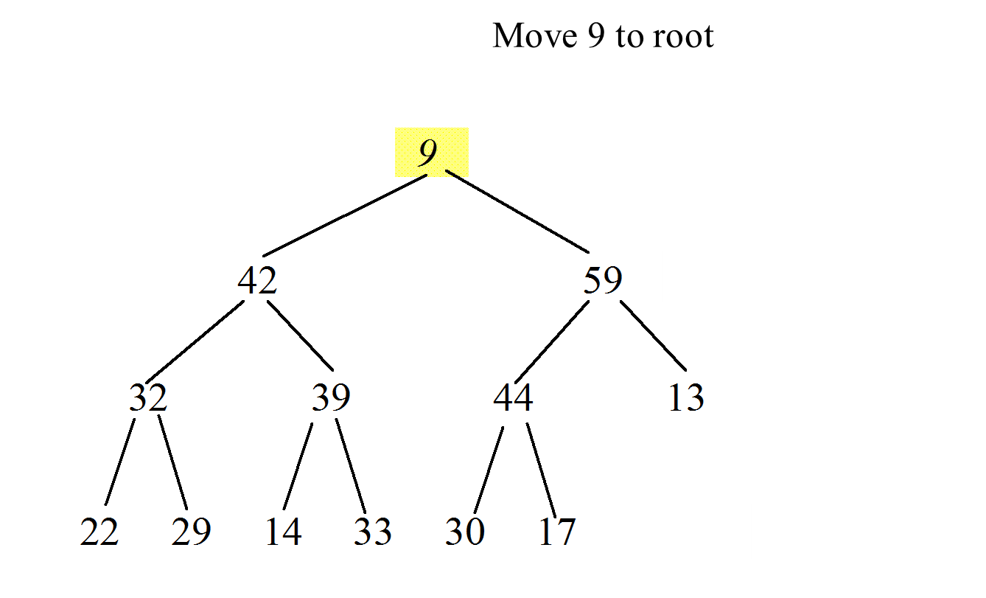
Removing the Root and Rebuild the Tree (2 of 5)

Slide 34
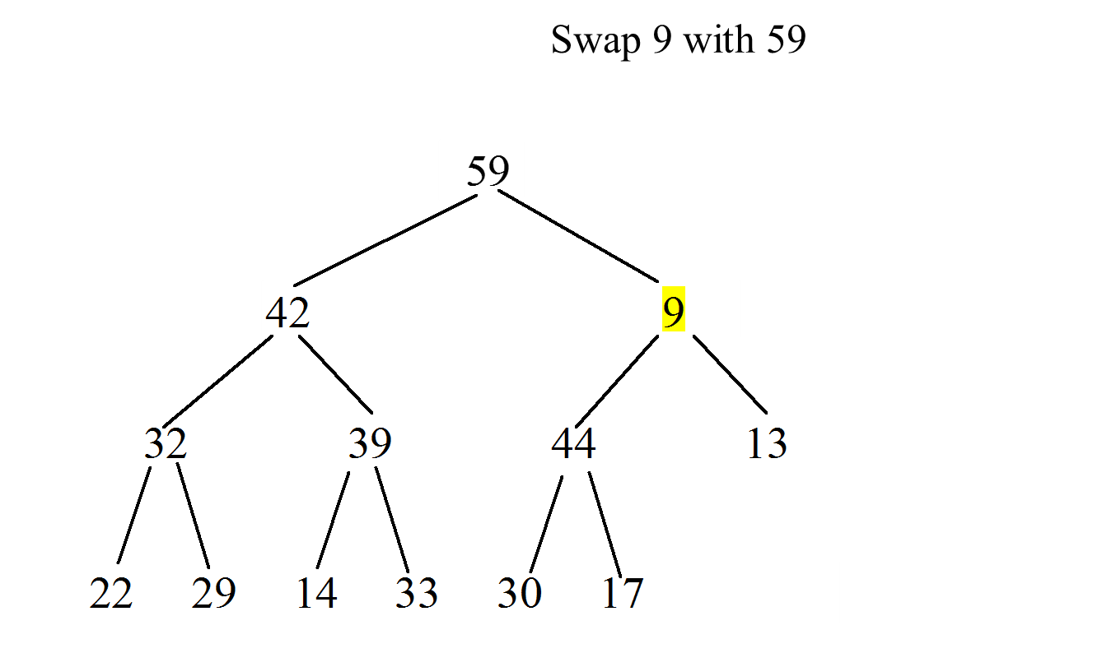
Removing the Root and Rebuild the Tree (3 of 5)

Slide 35
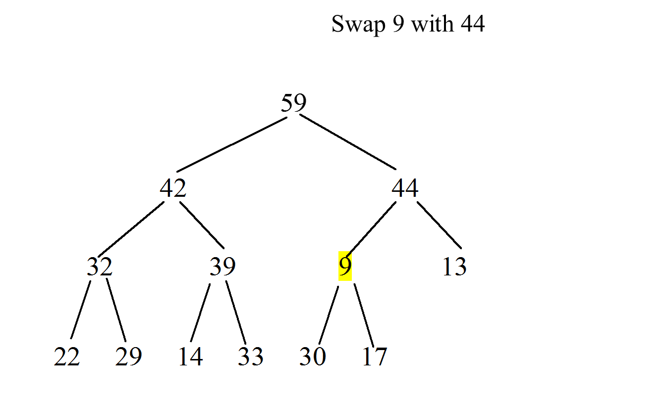
Removing the Root and Rebuild the Tree (4 of 5)

Slide 36
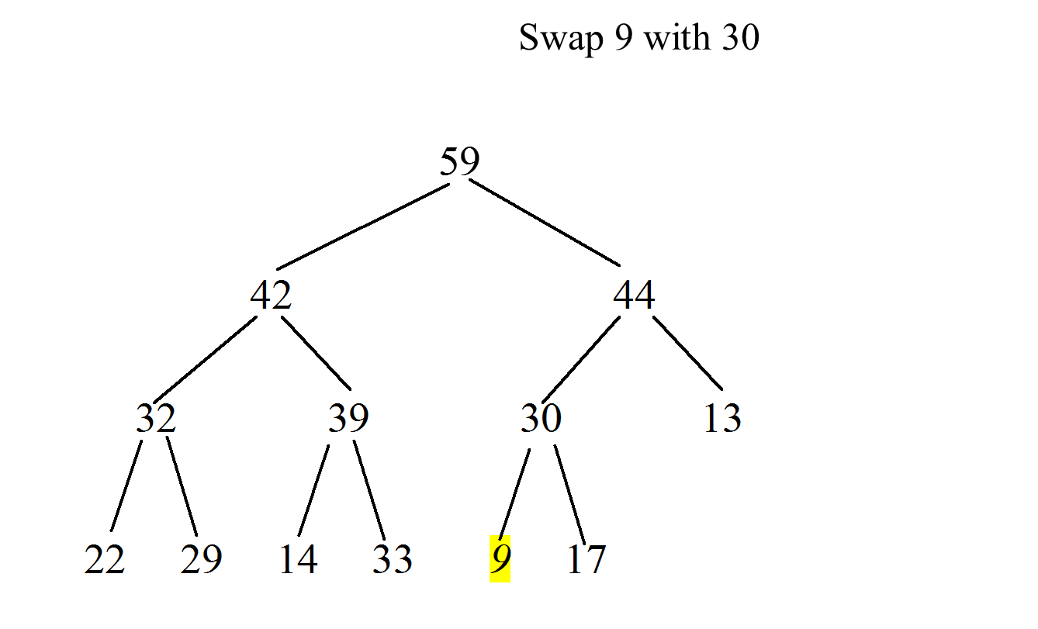
Removing the Root and Rebuild the Tree (5 of 5)

Slide 37
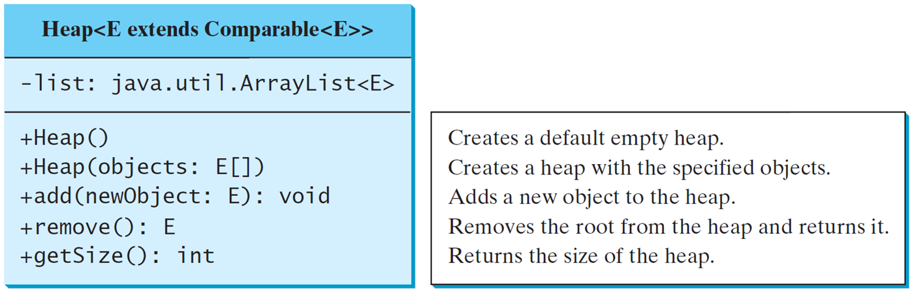
The Heap Class
Heap

Slide 38
Heap Sort
HeapSort
Run

Slide 39
Heap Sort Time
Let h denote the height for a heap of n elements. Since a heap is a complete binary tree, the first level has 1 node, the second level has 2 nodes, the kth level has
and the hth level has at least one node and at most
nodes. Therefore,

Slide 40
Bucket Sort and Radix Sort
All sort algorithms discussed so far are general sorting algorithms that work for any types of keys (e.g., integers, strings, and any comparable objects). These algorithms sort the elements by comparing their keys. The lower bound for general sorting algorithms is O(nlogn). So, no sorting algorithms based on comparisons can perform better than O(nlogn). However, if the keys are small integers, you can use bucket sort without having to compare the keys.

Slide 41
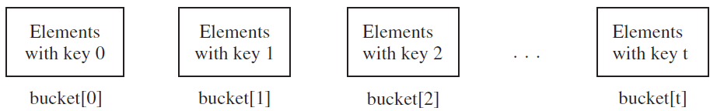
Bucket Sort
The bucket sort algorithm works as follows. Assume the keys are in the range from 0 to N-1. We need N buckets labeled 0, 1, ..., and N-1. If an element’s key is i, the element is put into the bucket i. Each bucket holds the elements with the same key value. You can use an ArrayList to implement a bucket.

Slide 42
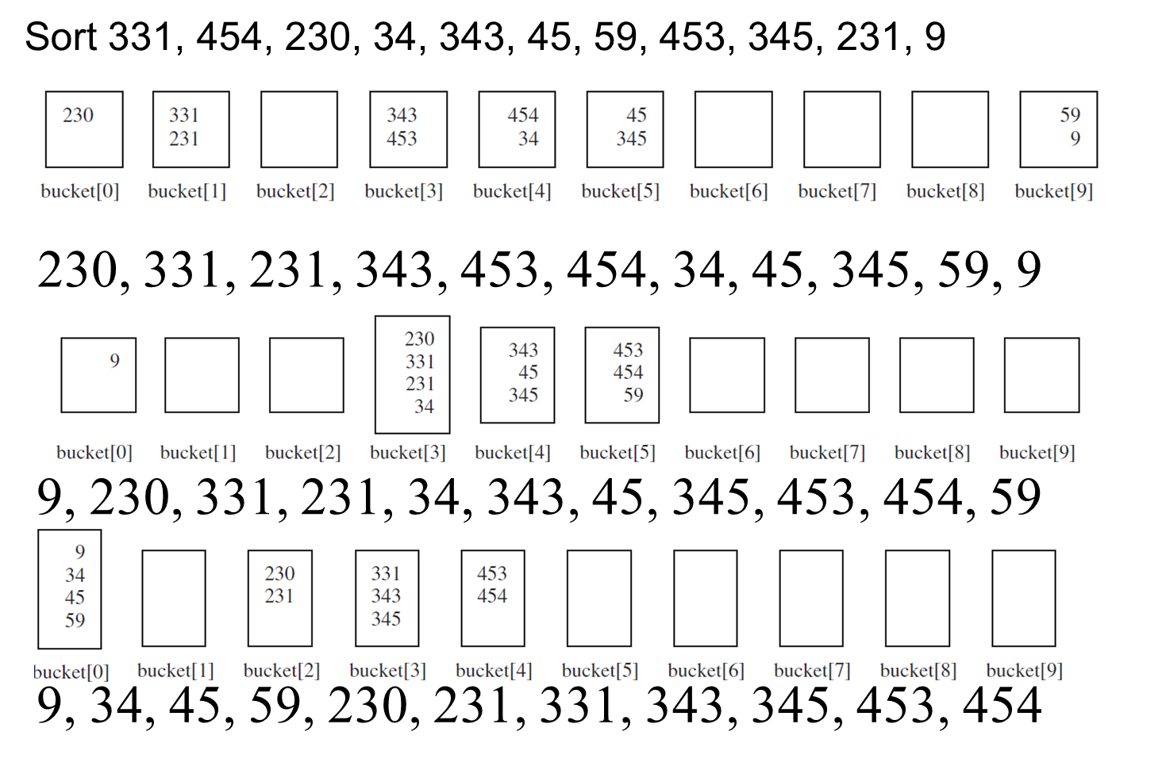
Radix Sort

Slide 43

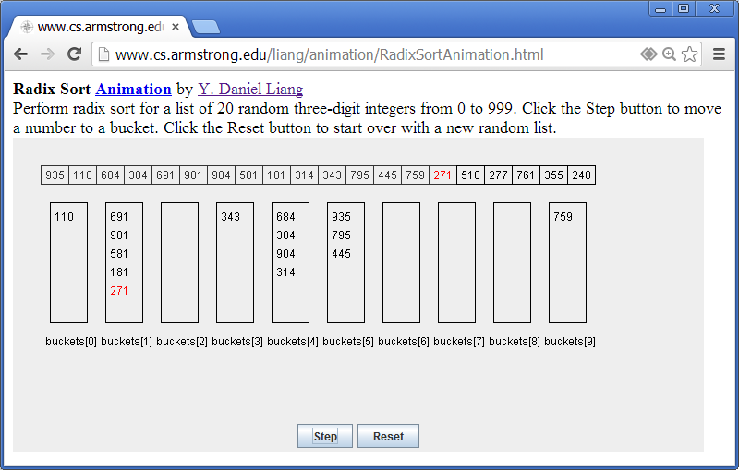
Radix Sort Animation

Slide 44
External Sort
All the sort algorithms discussed in the preceding sections assume that all data to be sorted is available at one time in internal memory such as an array. To sort data stored in an external file, you may first bring data to the memory, then sort it internally. However, if the file is too large, all data in the file cannot be brought to memory at one time.
CreateLargeFile
Run
SortLargeFile
Run

Slide 45
Phase I
Repeatedly bring data from the file to an array, sort the array using an internal sorting algorithm, and output the data from the array to a temporary file.

Slide 46
Phase II
Merge a pair of sorted segments (e.g., S1 with S2, S3 with S4, ..., and so on) into a larger sorted segment and save the new segment into a new temporary file. Continue the same process until one sorted segment results.

Slide 47
Implementing Phase II (1 of 2)
Each merge step merges two sorted segments to form a new segment. The new segment doubles the number elements. So the number of segments is reduced by half after each merge step. A segment is too large to be brought to an array in memory. To implement a merge step, copy half number of segments from file f1.dat to a temporary file f2.dat. Then merge the first remaining segment in f1.dat with the first segment in f2.dat into a temporary file named f3.dat.

Slide 48
Implementing Phase II (2 of 2)

Slide 49

Copyright

