Slide 1

Introduction to Java Programming
Tenth Edition
Chapter 25
Binary Search Trees
Copyright © 2015 Pearson Education, Inc. All Rights Reserved
Notes:
If this PowerPoint presentation contains mathematical equations, you may need to check that your computer has the following installed:
1) MathType Plugin
2) Math Player (free versions available)
3) NVDA Reader (free versions available)

Slide 2
Objectives
To design and implement a binary search tree (§25.2).
To represent binary trees using linked data structures (§25.2.1).
To search an element in binary search tree (§25.2.2).
To insert an element into a binary search tree (§25.2.3).
To traverse elements in a binary tree (§25.2.4).
To delete elements from a binary search tree (§25.3).
To display binary tree graphically (§25.4).
To create iterators for traversing a binary tree (§25.5).
To implement Huffman coding for compressing data using a binary tree (§25.6).

Slide 3
Binary Trees
A list, stack, or queue is a linear structure that consists of a sequence of elements. A binary tree is a hierarchical structure. It is either empty or consists of an element, called the root, and two distinct binary trees, called the left subtree and right subtree.

Slide 4

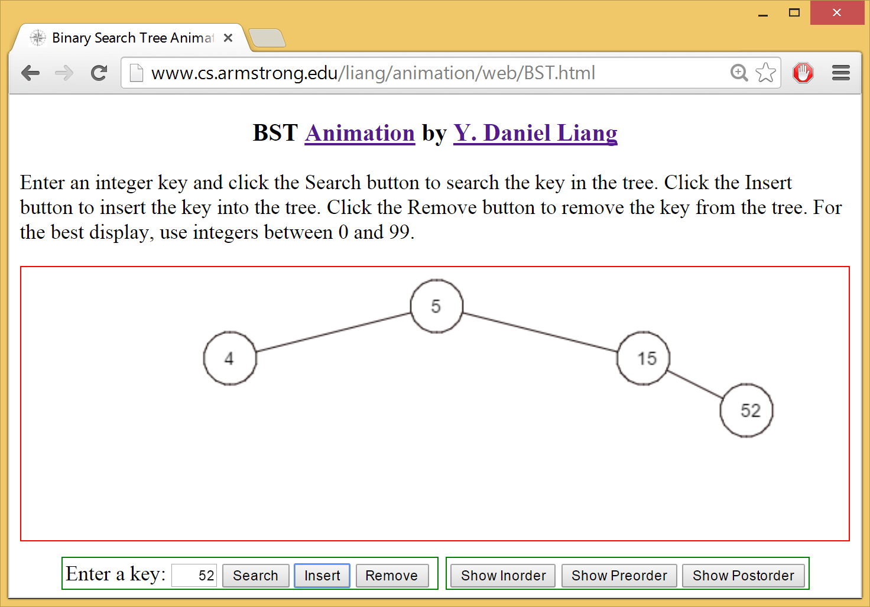
See How a Binary Search Tree Works

Slide 5
Binary Tree Terms
The root of left (right) subtree of a node is called a left (right) child of the node. A node without children is called a leaf. A special type of binary tree called a binary search tree is often useful. A binary search tree (with no duplicate elements) has the property that for every node in the tree the value of any node in its left subtree is less than the value of the node and the value of any node in its right subtree is greater than the value of the node. The binary trees in Figure 25.1 are all binary search trees. This section is concerned with binary search trees.

Slide 6
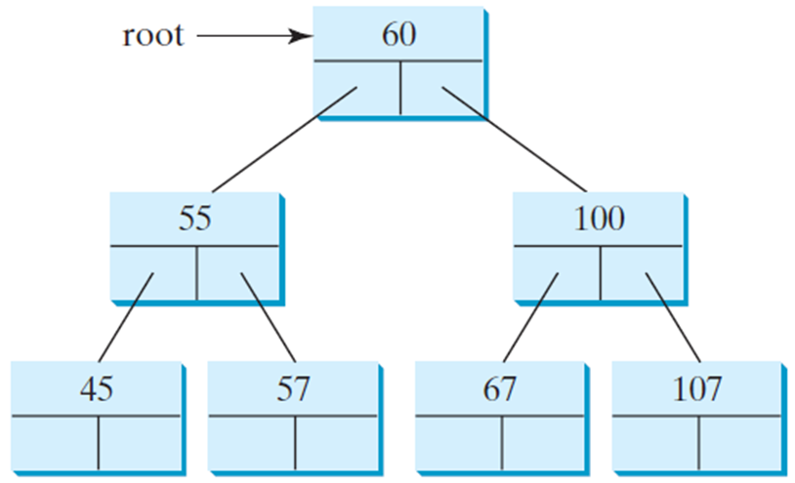
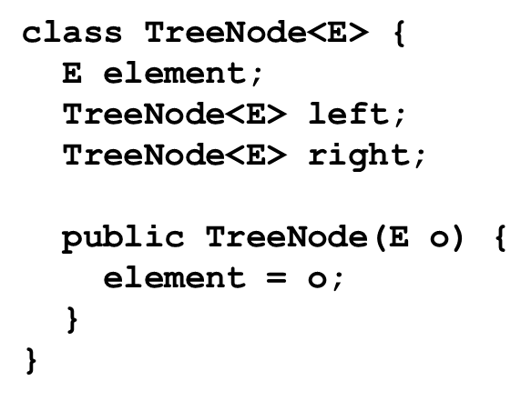
Representing Binary Trees
A binary tree can be represented using a set of linked nodes. Each node contains a value and two links named left and right that reference the left child and right child, respectively, as shown in Figure 25.2.

Slide 7
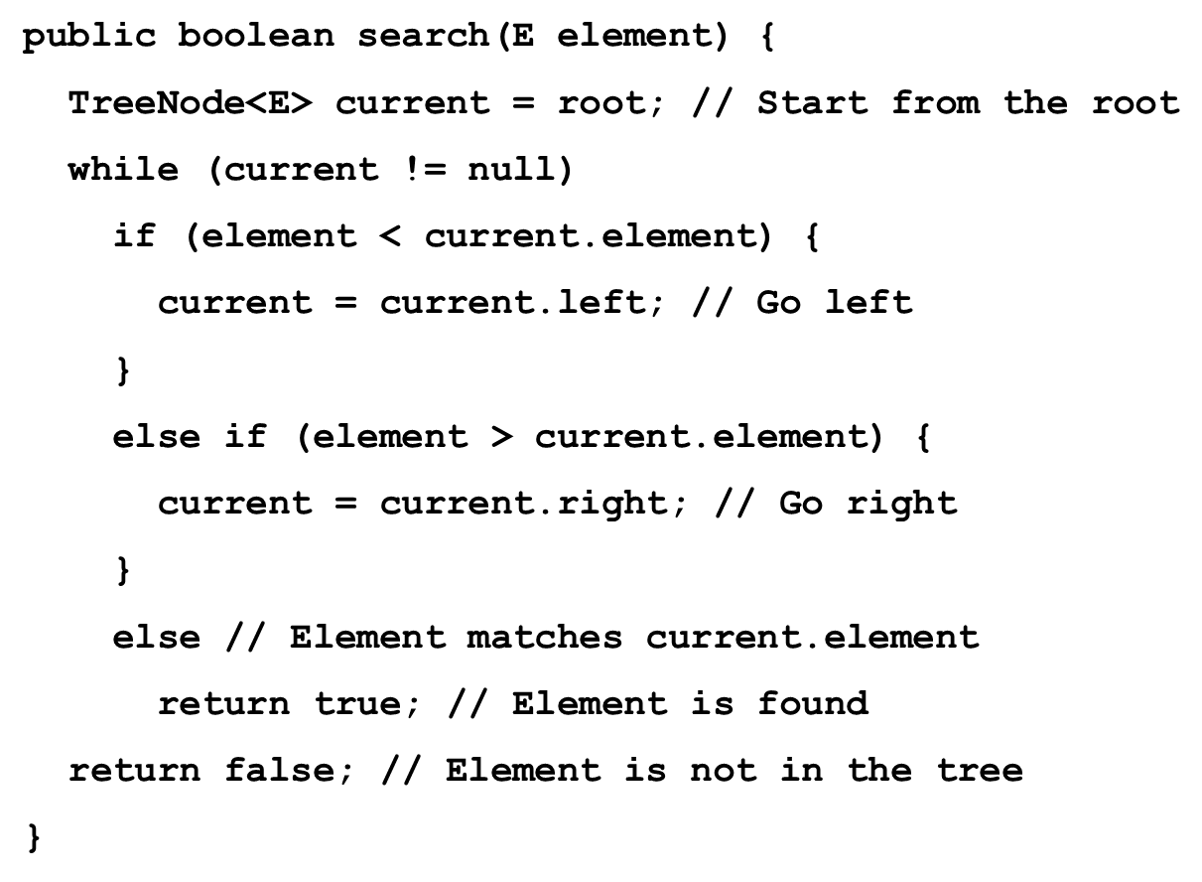
Searching an Element in a Binary Search Tree

Slide 8
Inserting an Element to a Binary Search Tree
If a binary tree is empty, create a root node with the new element. Otherwise, locate the parent node for the new element node. If the new element is less than the parent element, the node for the new element becomes the left child of the parent. If the new element is greater than the parent element, the node for the new element becomes the right child of the parent. Here is the algorithm:

Slide 9
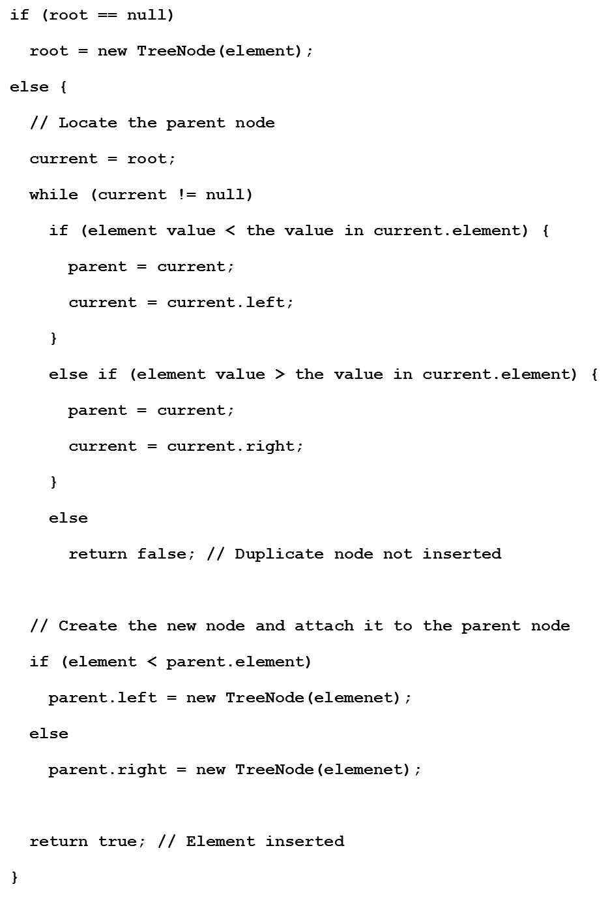
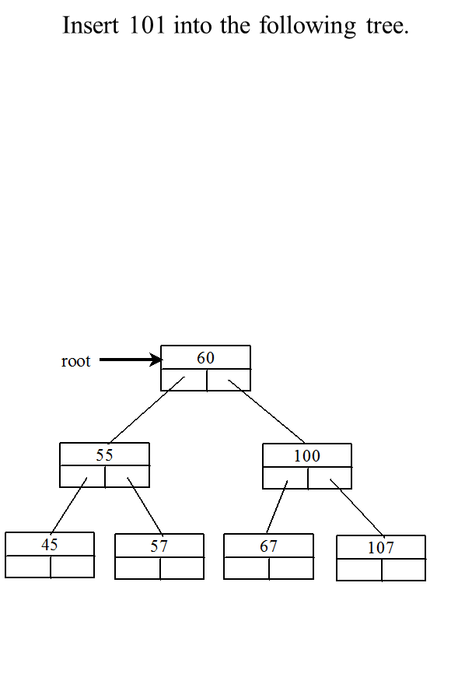
Inserting an Element to a Binary Tree (1 of 21)

Slide 10
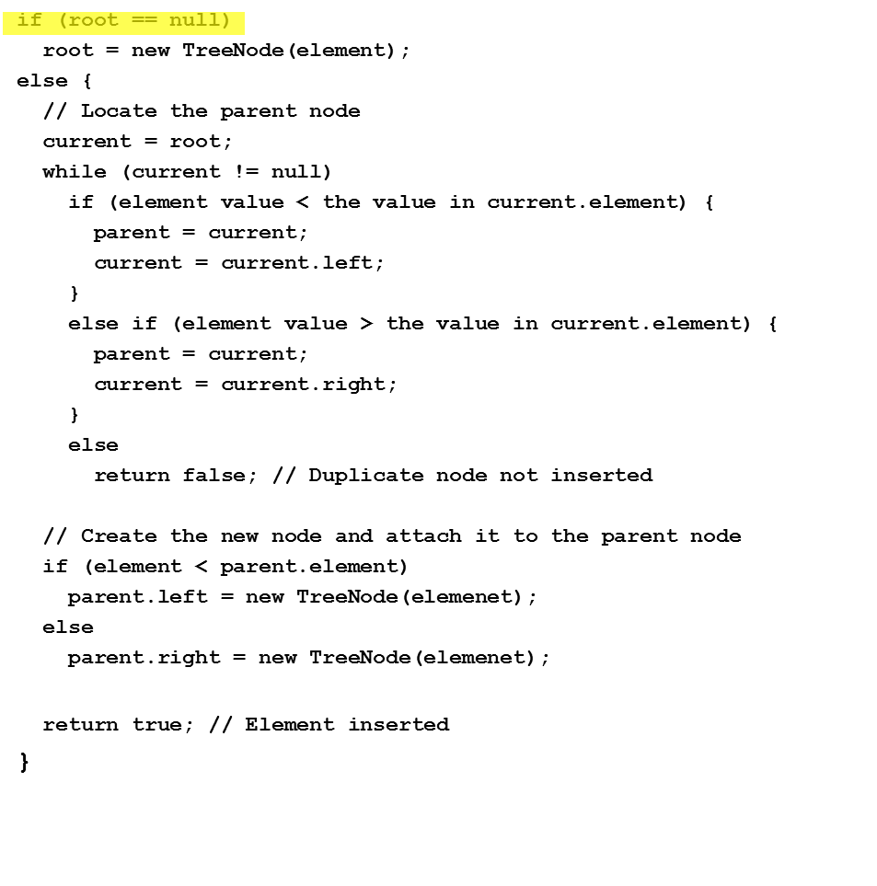
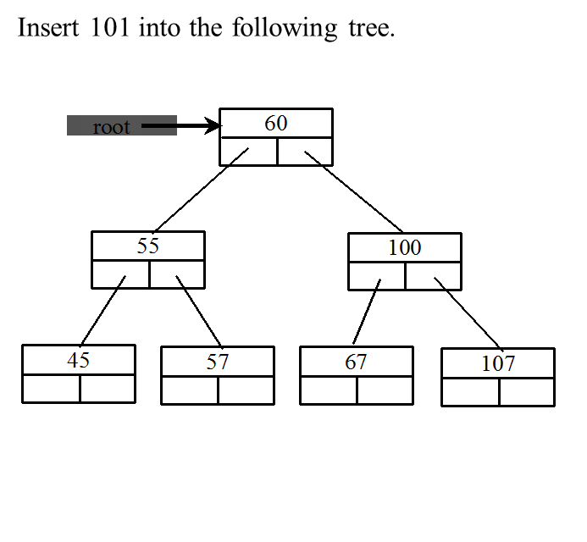
Inserting an Element to a Binary Tree (2 of 21)

Slide 11
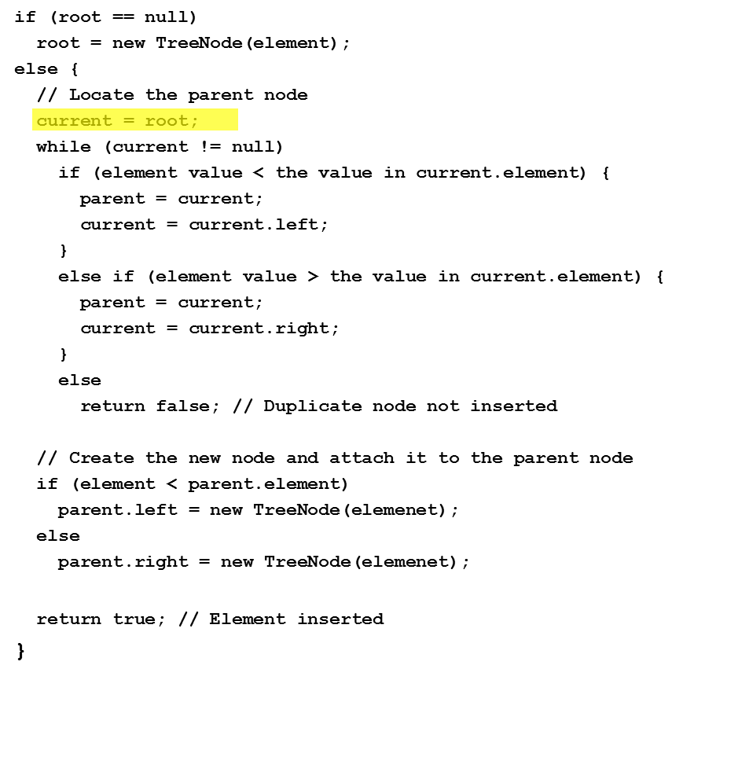
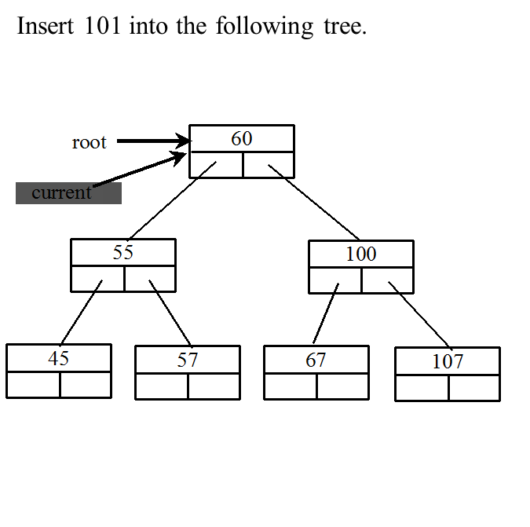
Inserting an Element to a Binary Tree (3 of 21)

Slide 12
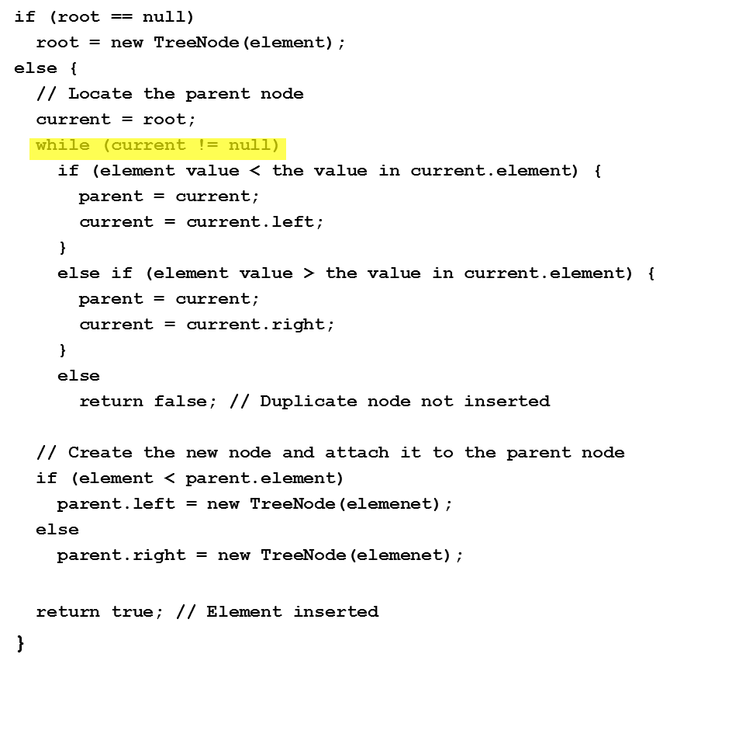
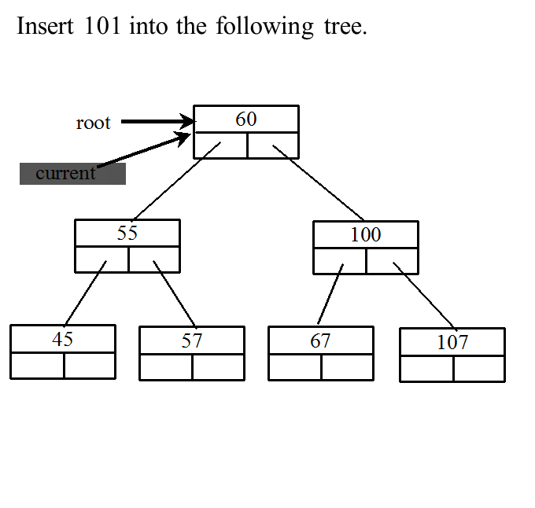
Inserting an Element to a Binary Tree (4 of 21)

Slide 13
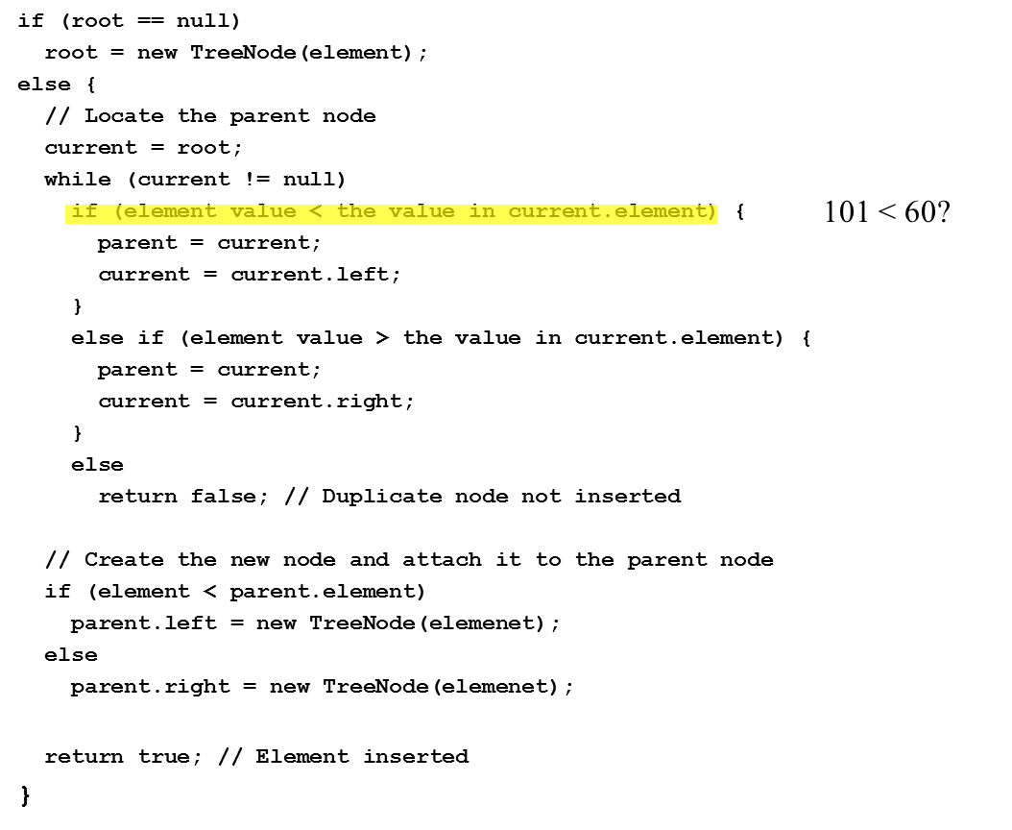
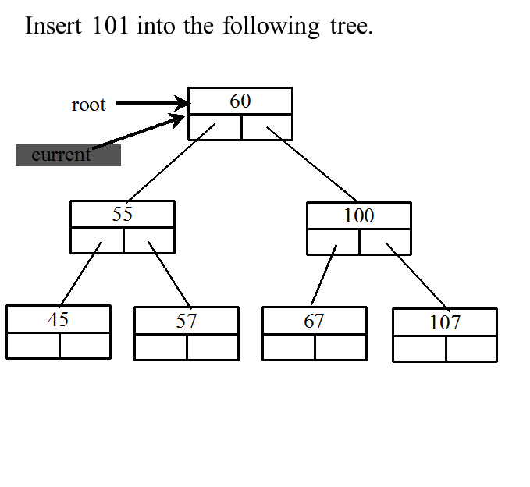
Inserting an Element to a Binary Tree (5 of 21)

Slide 14
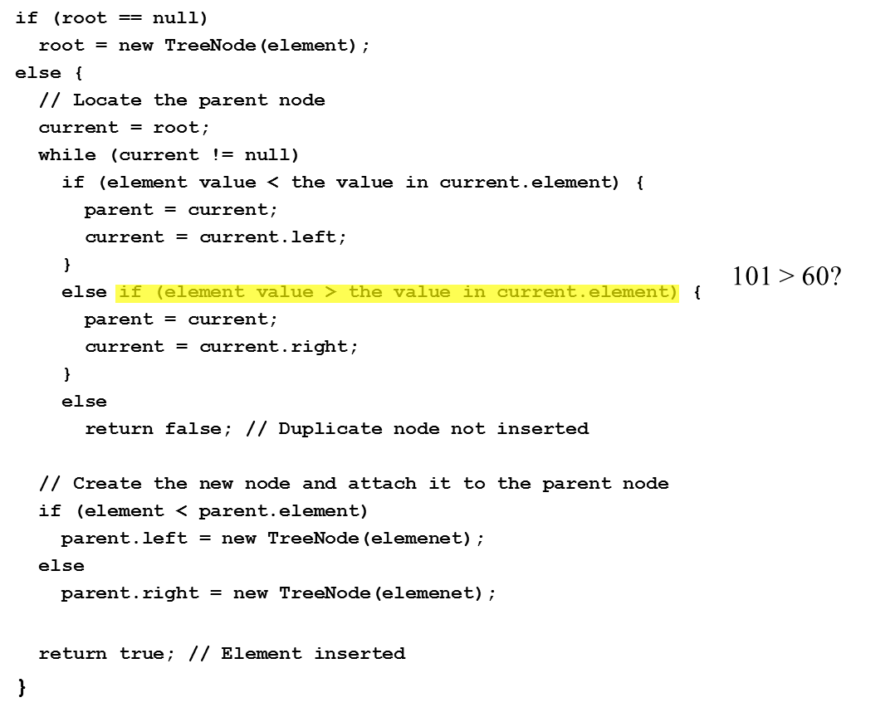
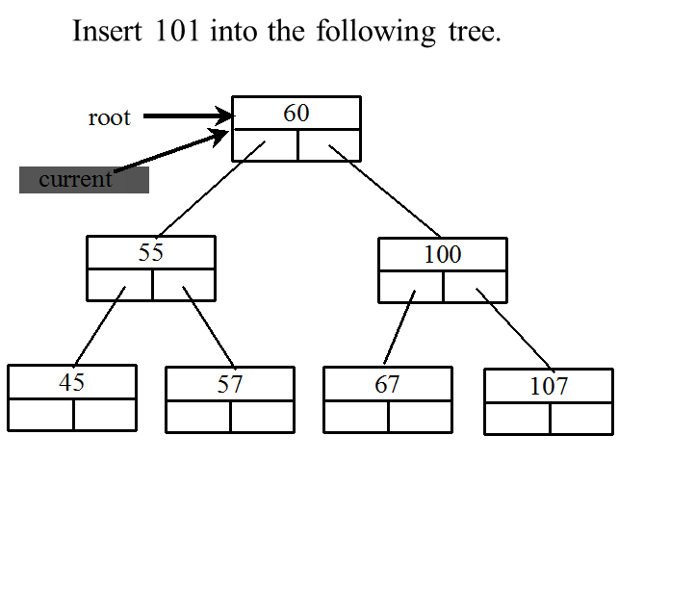
Inserting an Element to a Binary Tree (6 of 21)

Slide 15
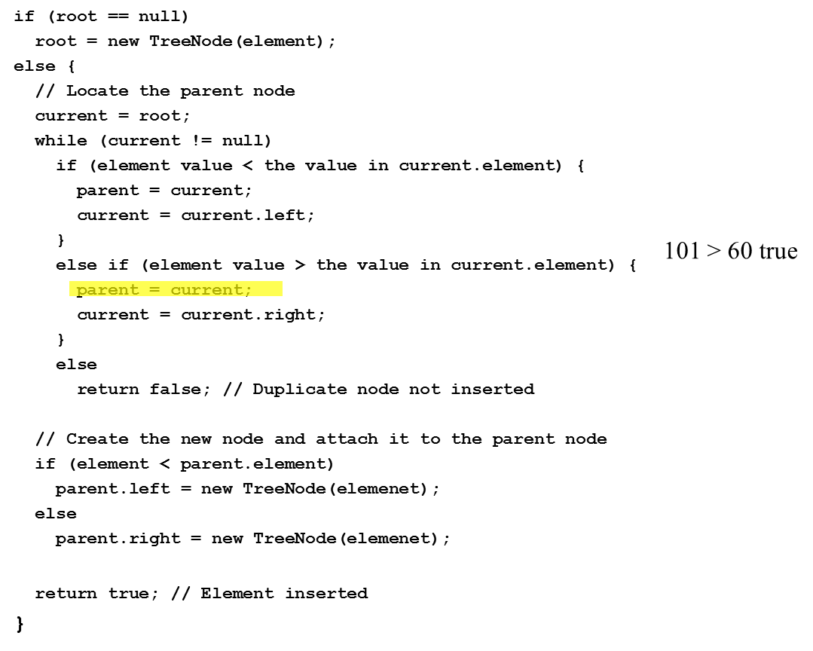
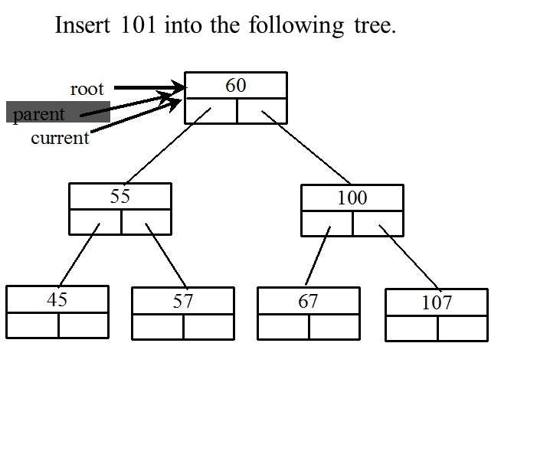
Inserting an Element to a Binary Tree (7 of 21)

Slide 16
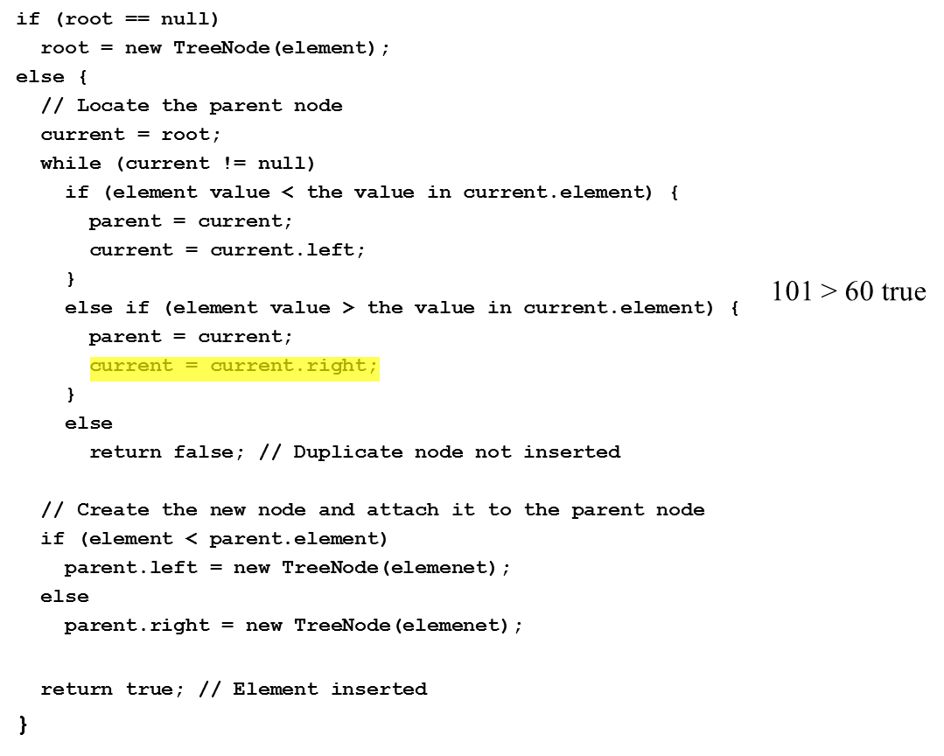
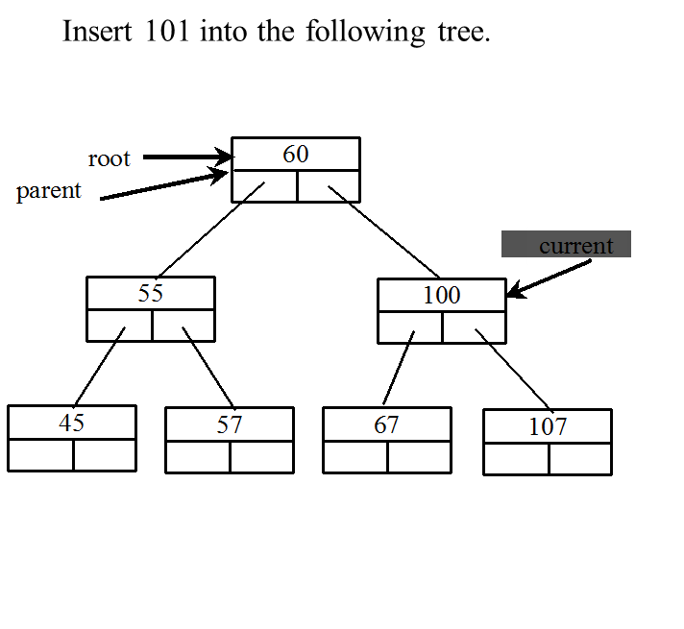
Inserting an Element to a Binary Tree (8 of 21)

Slide 17
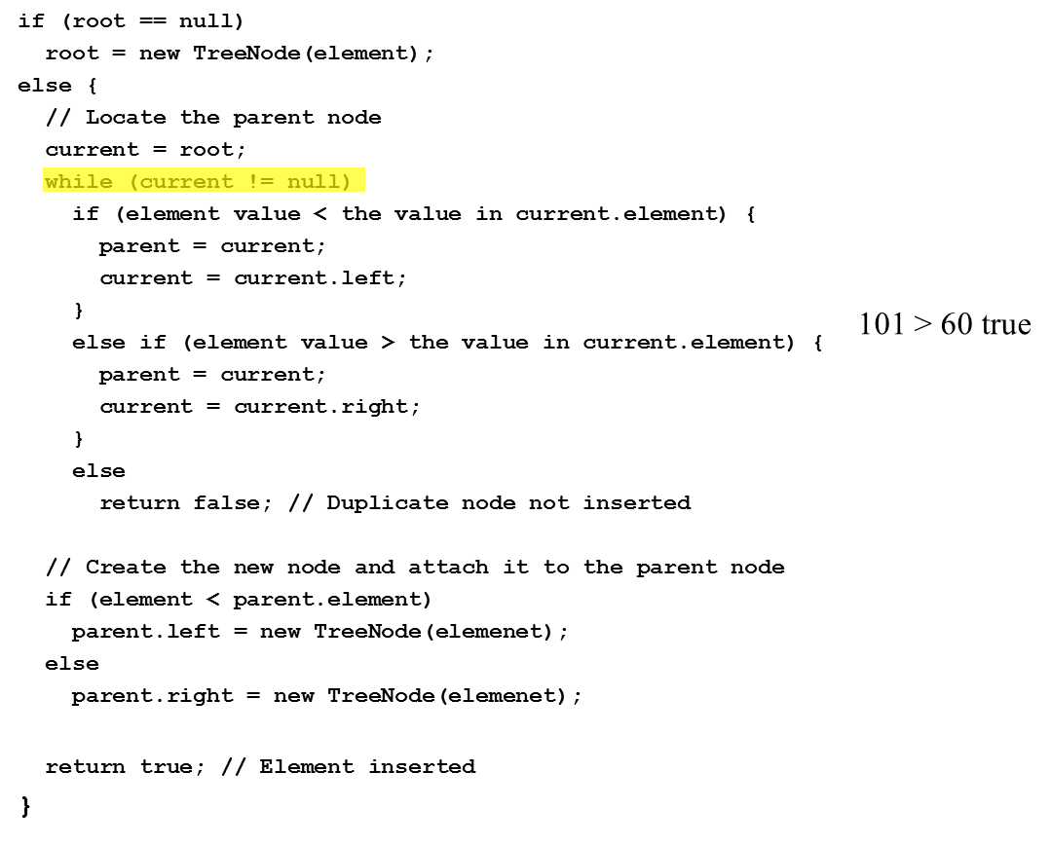
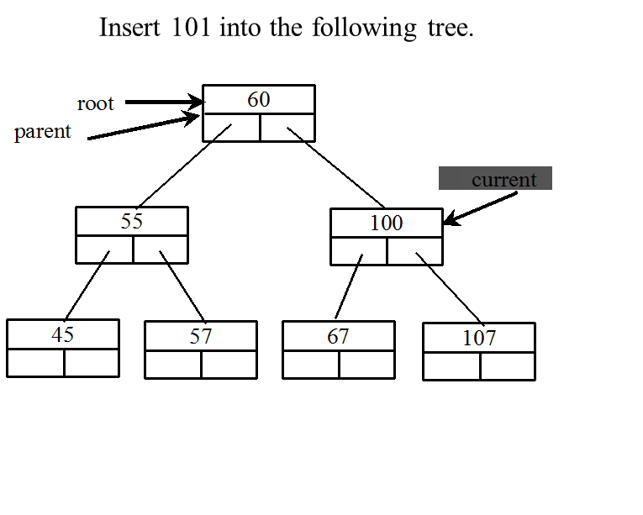
Inserting an Element to a Binary Tree (9 of 21)

Slide 18
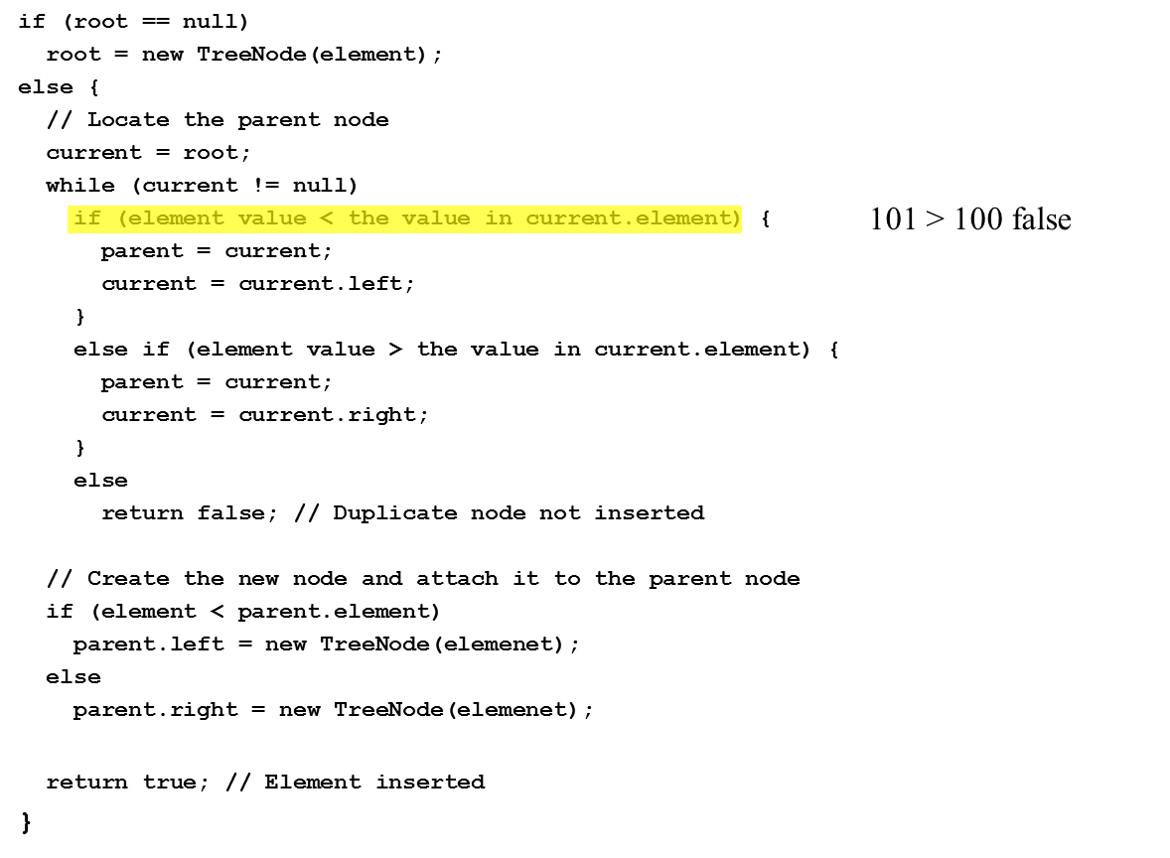
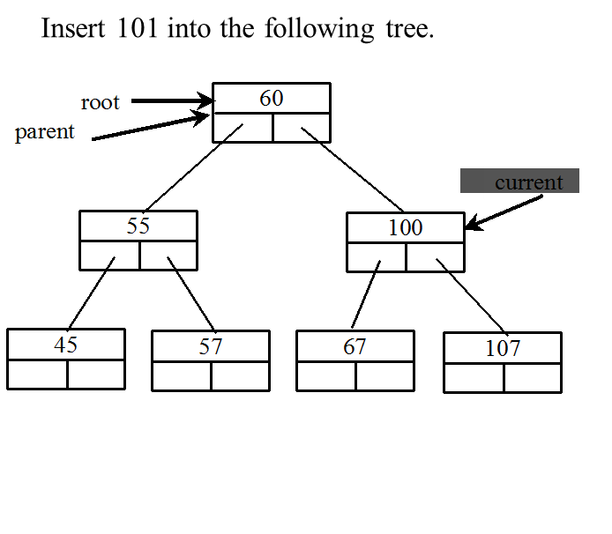
Inserting an Element to a Binary Tree (10 of 21)

Slide 19
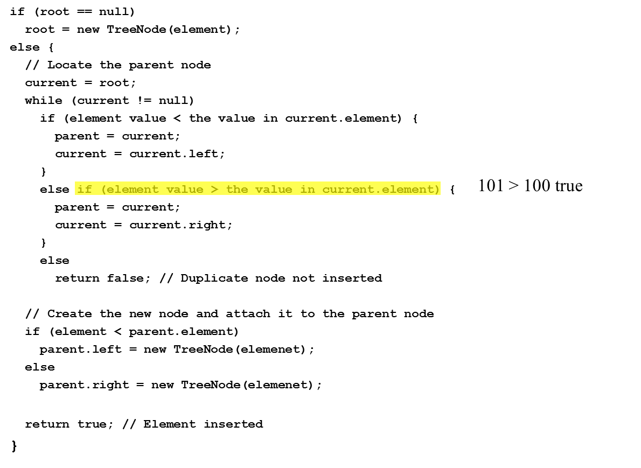
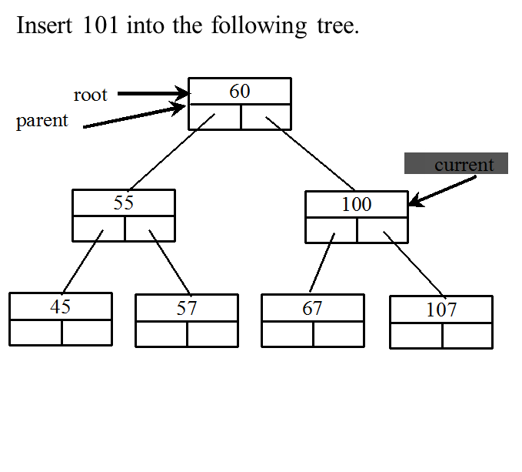
Inserting an Element to a Binary Tree (11 of 21)

Slide 20
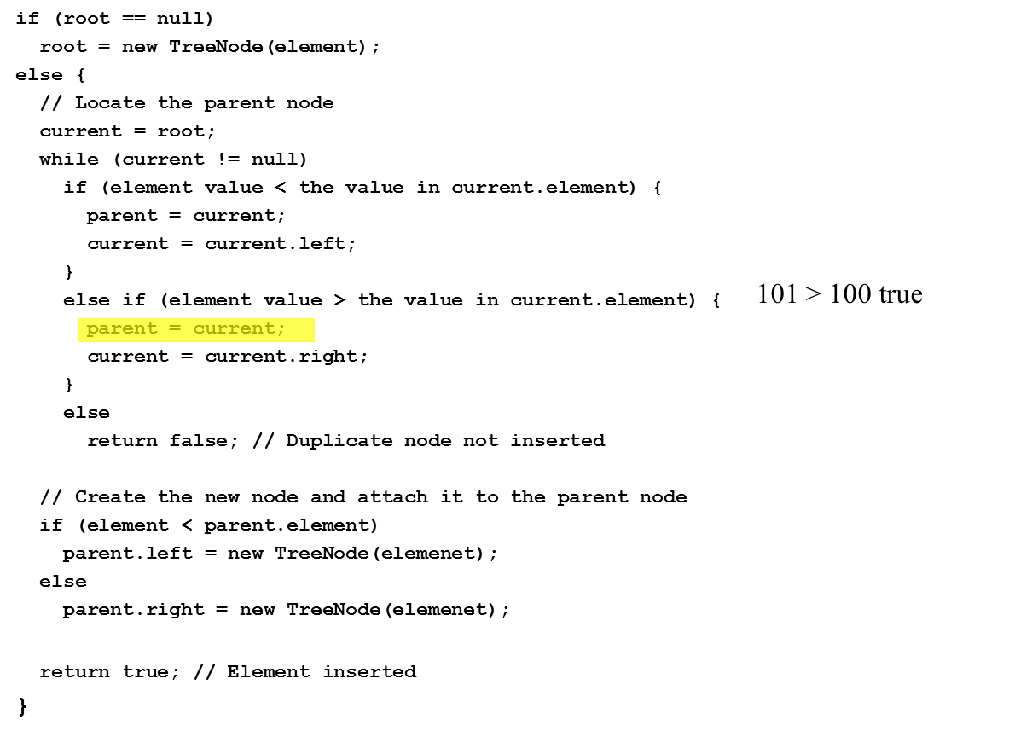
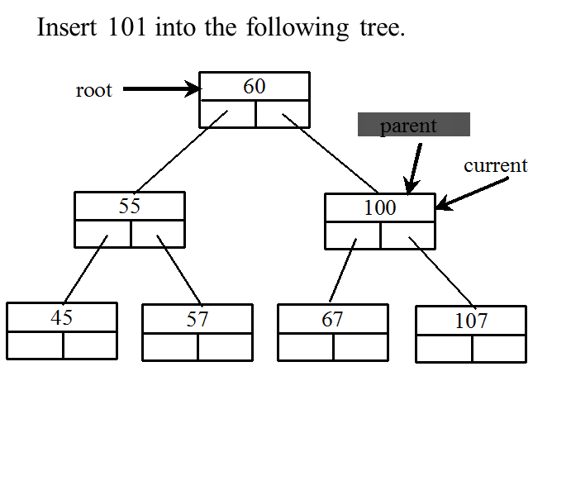
Inserting an Element to a Binary Tree (12 of 21)

Slide 21
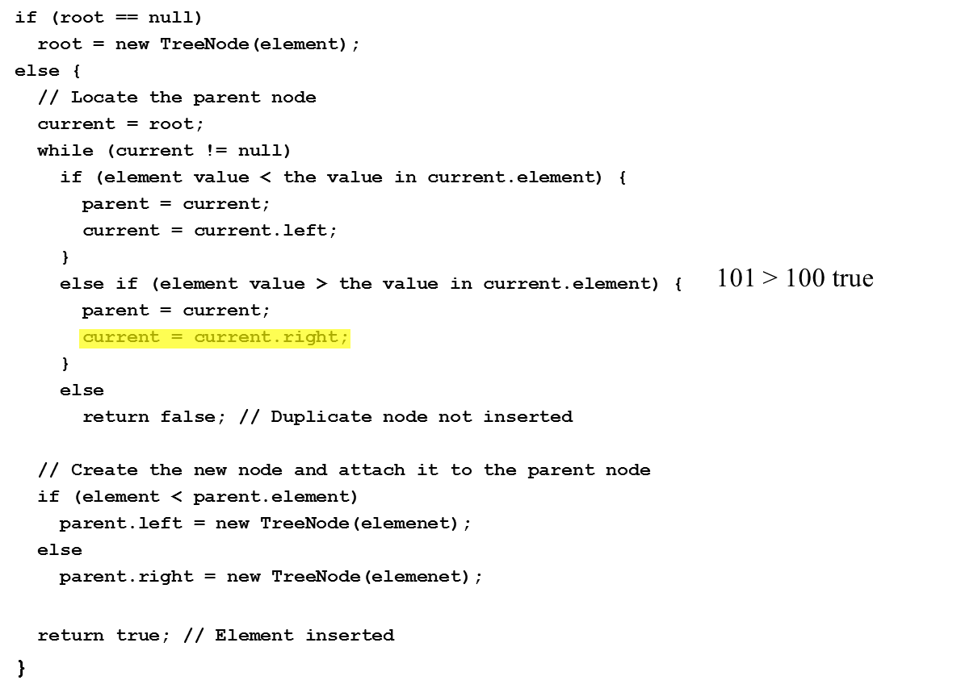
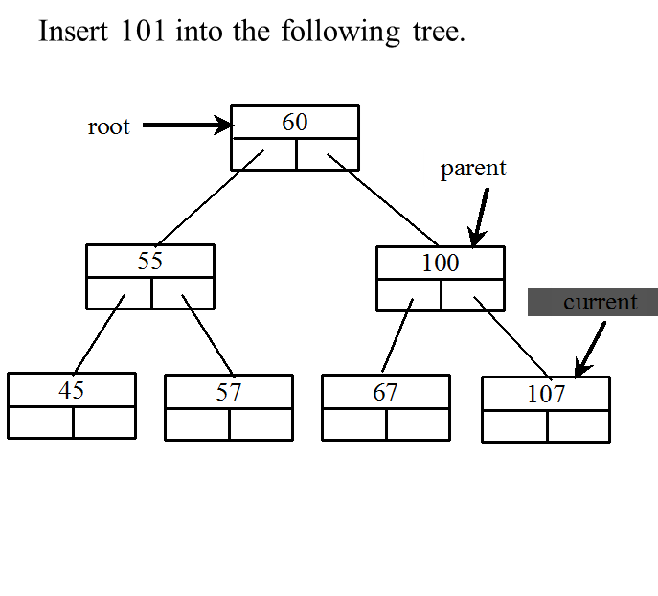
Inserting an Element to a Binary Tree (13 of 21)

Slide 22
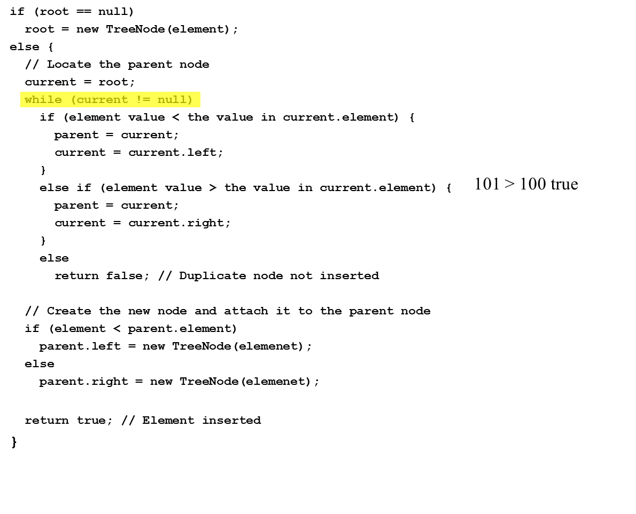
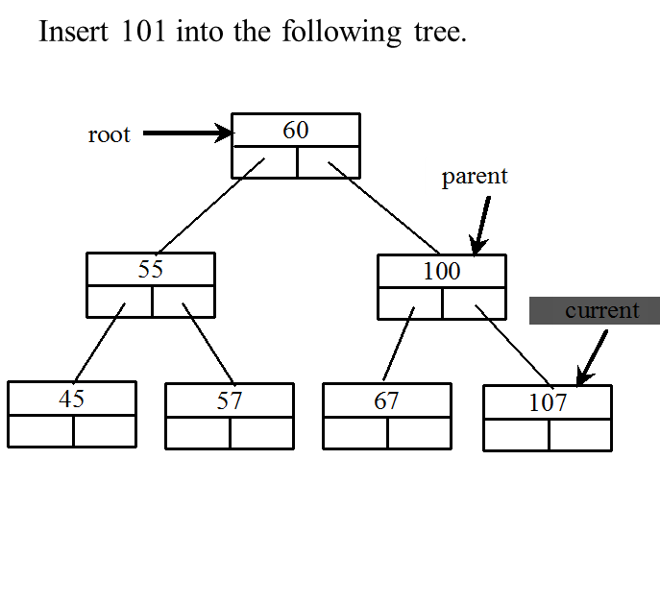
Inserting an Element to a Binary Tree (14 of 21)

Slide 23
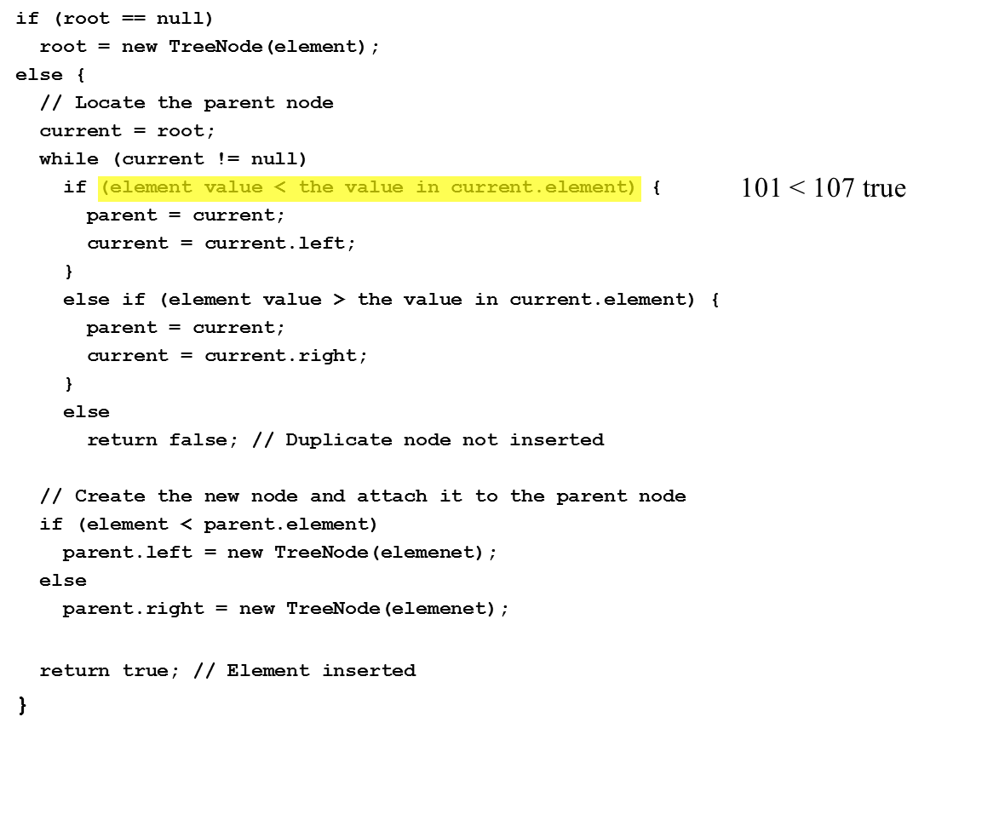
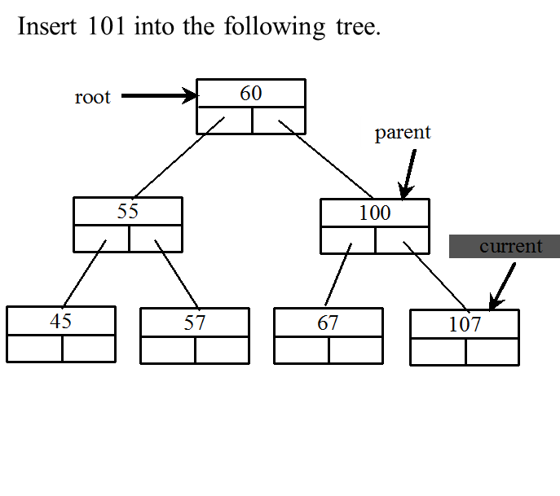
Inserting an Element to a Binary Tree (15 of 21)

Slide 24
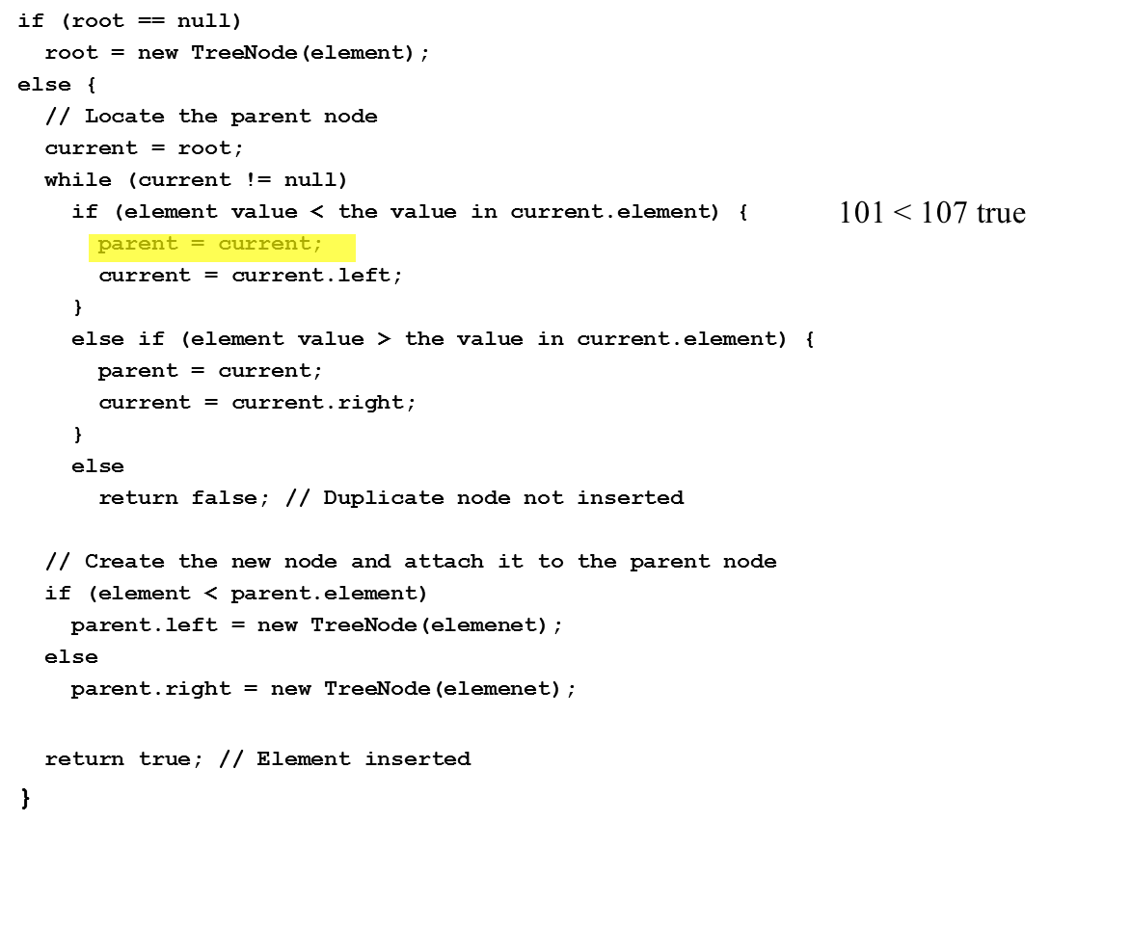
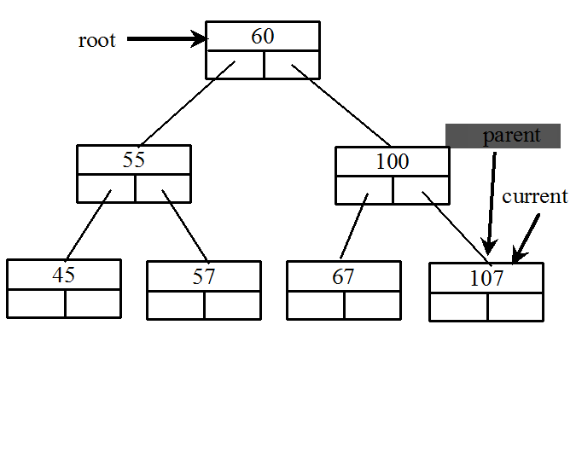
Inserting an Element to a Binary Tree (16 of 21)

Slide 25
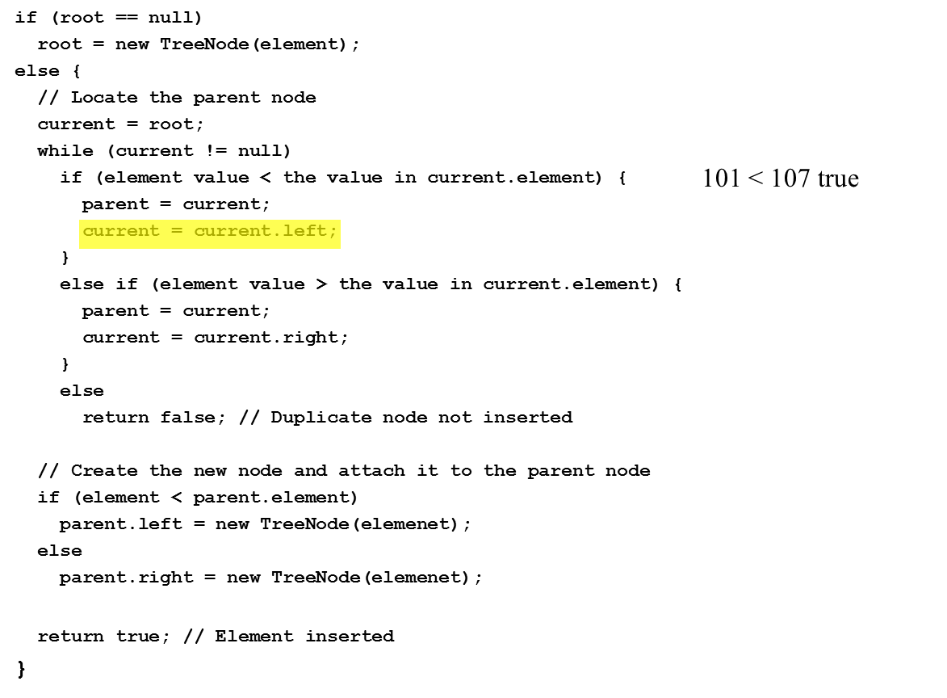
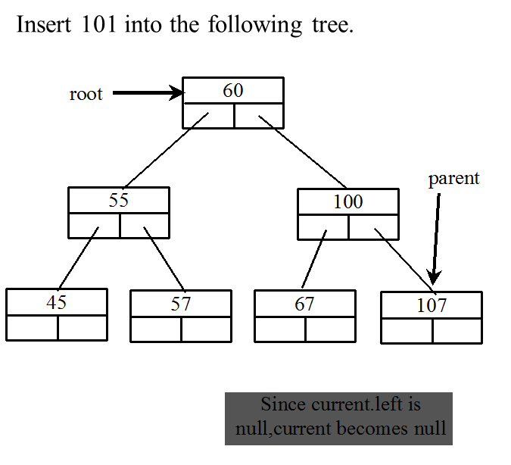
Inserting an Element to a Binary Tree (17 of 21)

Slide 26
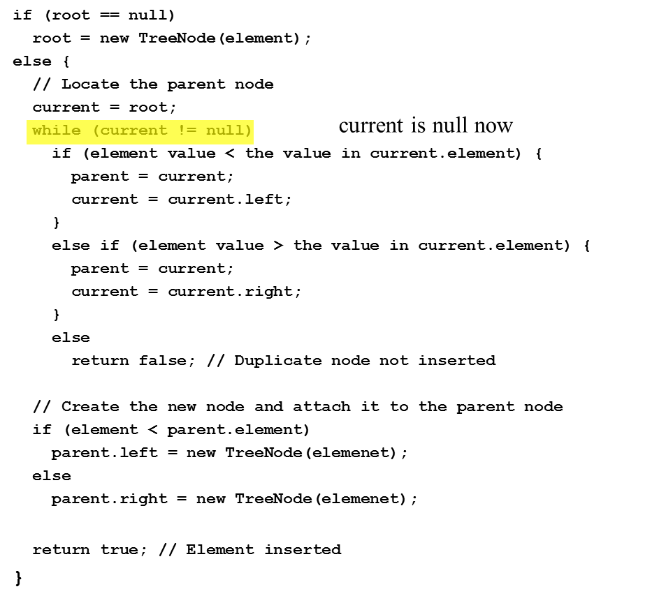
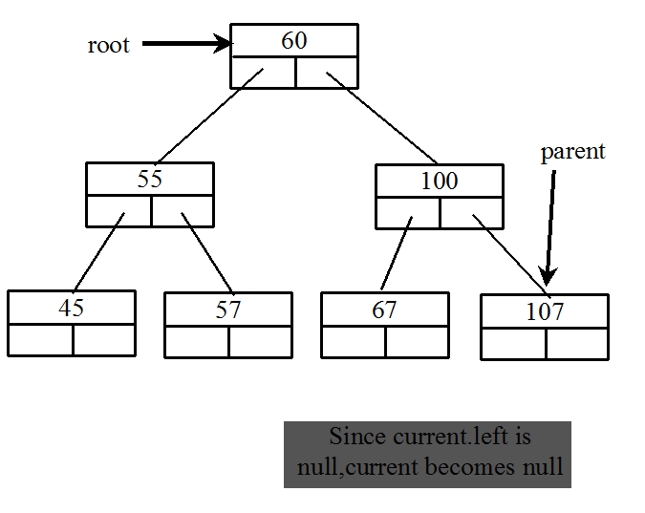
Inserting an Element to a Binary Tree (18 of 21)

Slide 27
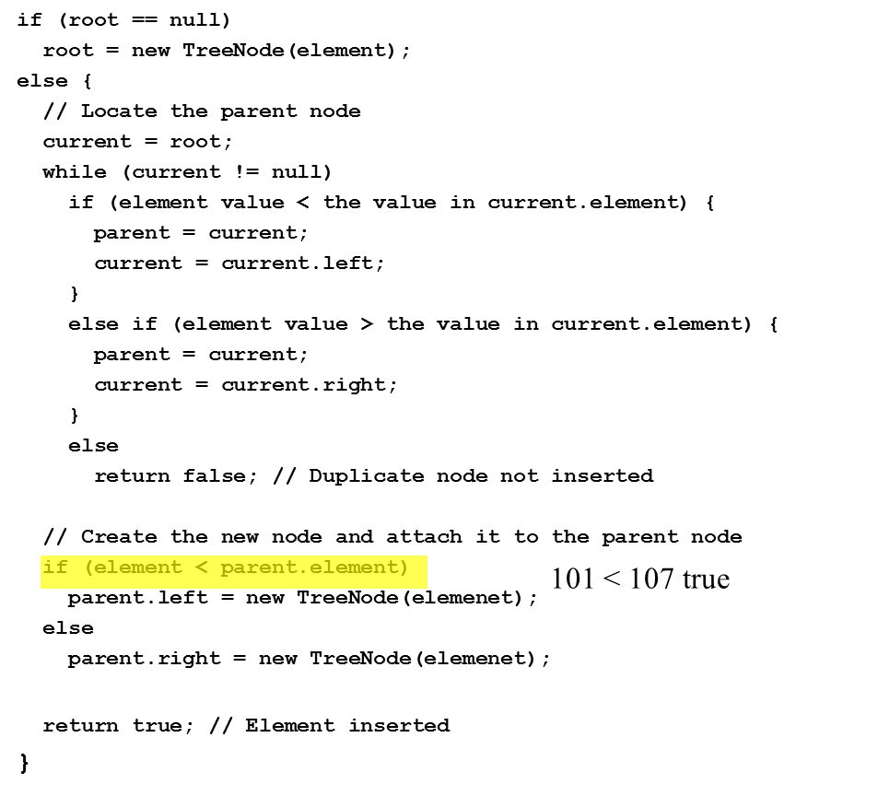
Inserting an Element to a Binary Tree (19 of 21)

Slide 28
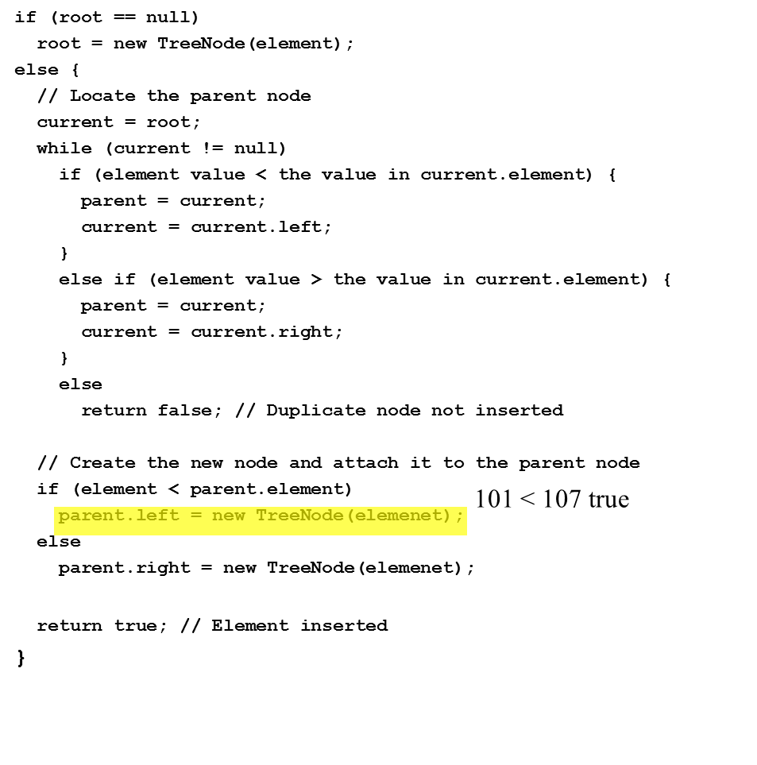
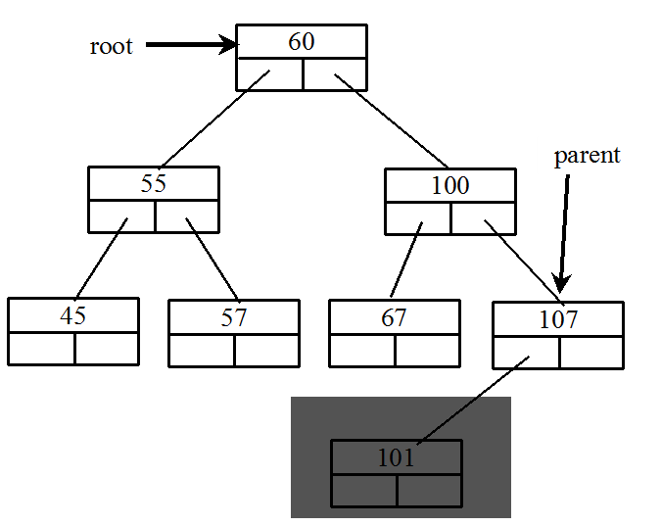
Inserting an Element to a Binary Tree (20 of 21)

Slide 29
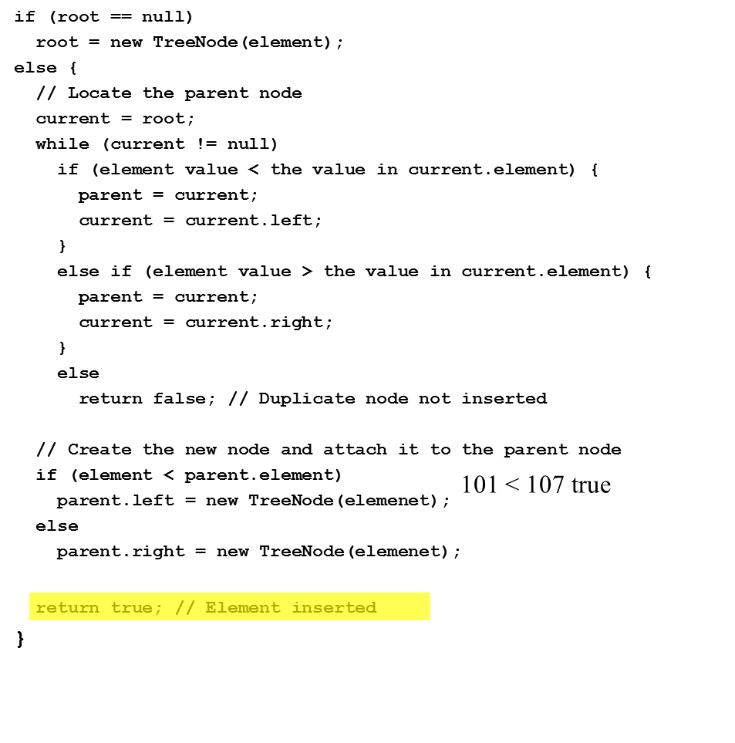
Inserting an Element to a Binary Tree (21 of 21)

Slide 30
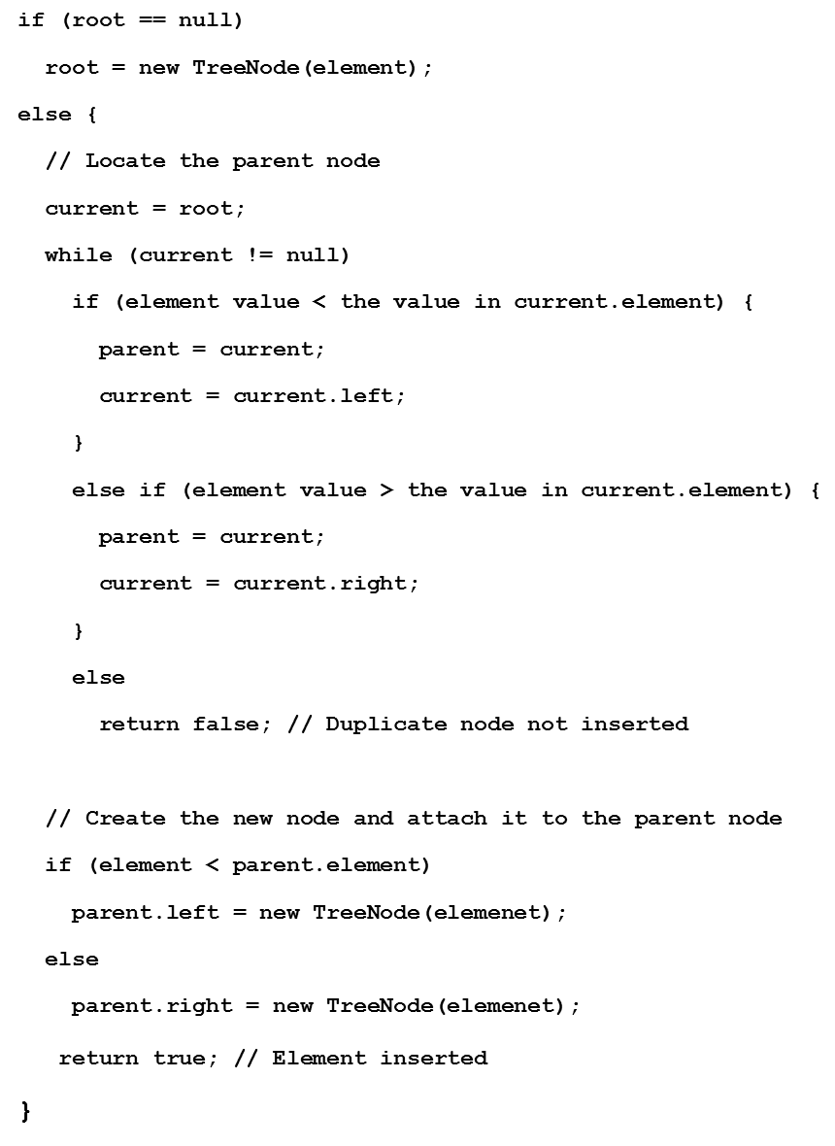
Inserting 59 into the Tree

Slide 31
Tree Traversal (1 of 2)
Tree traversal is the process of visiting each node in the tree exactly once. There are several ways to traverse a tree. This section presents inorder, preorder, postorder, depth-first, and breadth-first traversals.
The inorder traversal is to visit the left subtree of the current node first recursively, then the current node itself, and finally the right subtree of the current node recursively.
The postorder traversal is to visit the left subtree of the current node first, then the right subtree of the current node, and finally the current node itself.

Slide 32
Tree Traversal (2 of 2)
The preorder traversal is to visit the current node first, then the left subtree of the current node recursively, and finally the right subtree of the current node recursively.
The breadth-first traversal is to visit the nodes level by level. First visit the root, then all children of the root from left to right, then grandchildren of the root from left to right, and so on.
For example, in the tree in Figure 25.2, the inorder is 45 55 57 59 60 67 100 101 107. The postorder is 45 59 57 55 67 101 107 100 60. The preorder is 60 55 45 57 59 100 67 107 101. The breadth-first traversal is 60 55 100 45 57 67 107 59 101.

Slide 33
The Tree Interface
The Tree interface defines common operations for trees.
Tree

Slide 34
The B S T Class
Let’s define the binary tree class, named B S T with A concrete B S T class can be defined to extend AbstractTree.
BST

Slide 35
Example: Using Binary Trees
Write a program that creates a binary tree using B S T. Add strings into the binary tree and traverse the tree in inorder, postorder, and preorder.
TestBST
Run

Slide 36
Tree After Insertions
Inorder: Adam, Daniel George, Jones, Michael, Peter, Tom
Postorder: Daniel Adam, Jones, Peter, Tom, Michael, George
Preorder: George, Adam, Daniel, Michael, Jones, Tom, Peter

Slide 37
Deleting Elements in a Binary Search Tree (1 of 6)
To delete an element from a binary tree, you need to first locate the node that contains the element and also its parent node. Let current point to the node that contains the element in the binary tree and parent point to the parent of the current node. The current node may be a left child or a right child of the parent node. There are two cases to consider:

Slide 38
Deleting Elements in a Binary Search Tree (2 of 6)
Case 1: The current node does not have a left child, as shown in this figure (a). Simply connect the parent with the right child of the current node, as shown in this figure (b).

Slide 39
Deleting Elements in a Binary Search Tree (3 of 6)
For example, to delete node 10 in Figure 25.9a. Connect the parent of node 10 with the right child of node 10, as shown in Figure 25.9b.

Slide 40
Deleting Elements in a Binary Search Tree (4 of 6)
Case 2: The current node has a left child. Let rightMost point to the node that contains the largest element in the left subtree of the current node and parentOfRightMost point to the parent node of the rightMost node, as shown in Figure 25.10a. Note that the rightMost node cannot have a right child, but may have a left child. Replace the element value in the current node with the one in the rightMost node, connect the parentOfRightMost node with the left child of the rightMost node, and delete the rightMost node, as shown in Figure 25.10b.

Slide 41
Deleting Elements in a Binary Search Tree (5 of 6)
Case 2 diagram

Slide 42
Deleting Elements in a Binary Search Tree (6 of 6)
Case 2 example, delete 20

Slide 43
Examples (1 of 3)

Slide 44
Examples (2 of 3)

Slide 45
Examples (3 of 3)
TestBSTDelete
Run

Slide 46
Binary Tree Time Complexity
It is obvious that the time complexity for the inorder, preorder, and postorder is O(n), since each node is traversed only once. The time complexity for search, insertion and deletion is the height of the tree. In the worst case, the height of the tree is O(n).

Slide 47
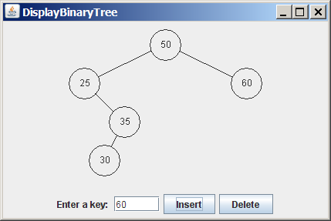
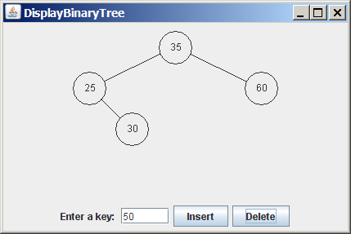
Tree Visualization
BTView
BSTAnimation
Run

Slide 48
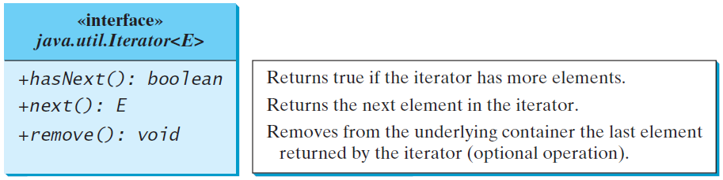
Iterators
An iterator is an object that provides a uniform way for traversing the elements in a container such as a set, list, binary tree, etc.
TestBSTWithIterator
Run

Slide 49
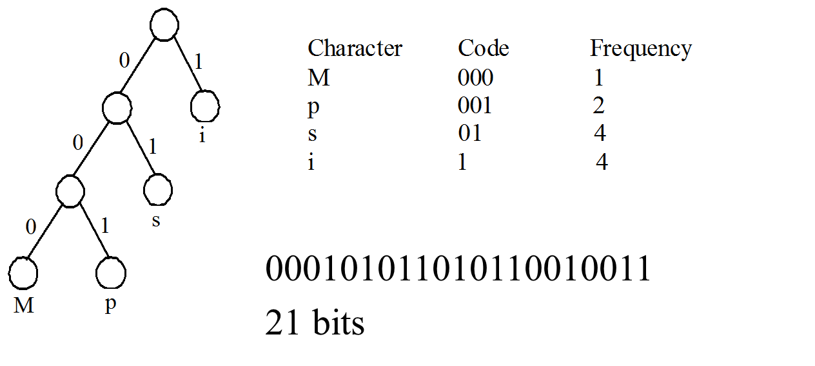
Data Compression: Huffman Coding
In A S C II, every character is encoded in 8 bits. Huffman coding compresses data by using fewer bits to encode more frequently occurring characters. The codes for characters are constructed based on the occurrence of characters in the text using a binary tree, called the Huffman coding tree.
Mississippi

Slide 50
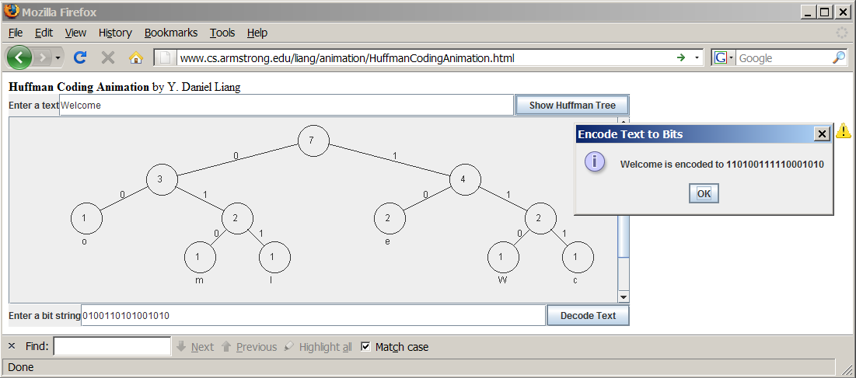
See How a Binary Tree Works
www.cs.armstrong.edu/liang/animation/HuffmanCodingAnimation.html

Slide 51
Constructing Huffman Tree (1 of 3)
To construct a Huffman coding tree, use a greedy algorithm as follows:
Begin with a forest of trees. Each tree contains a node for a character. The weight of the node is the frequency of the character in the text.
Repeat this step until there is only one tree: Choose two trees with the smallest weight and create a new node as their parent. The weight of the new tree is the sum of the weight of the subtrees.

Slide 52

Constructing Huffman Tree (2 of 3)

Slide 53
Constructing Huffman Tree (3 of 3)
HuffmanCode
Run

Slide 54

Copyright

