Slide 1

Introduction to Java Programming
Tenth Edition
Chapter 26
A V L Trees
Copyright © 2015 Pearson Education, Inc. All Rights Reserved
Notes:
If this PowerPoint presentation contains mathematical equations, you may need to check that your computer has the following installed:
1) MathType Plugin
2) Math Player (free versions available)
3) NVDA Reader (free versions available)

Slide 2
Objectives
To know what an A V L tree is (§26.1).
To understand how to rebalance a tree using the L L rotation, L R rotation, R R rotation, and R L rotation (§26.2).
To know how to design the A V L Tree class (§26.3).
To insert elements into an A V L tree (§26.4).
To implement node rebalancing (§26.5).
To delete elements from an A V L tree (§26.6).
To implement the A V L Tree class (§26.7).
To test the A V L Tree class (§26.8).
To analyze the complexity of search, insert, and delete operations in A V L trees (§26.9).

Slide 3
Why A V L Tree?
The search, insertion, and deletion time for a binary tree is dependent on the height of the tree. In the worst case, the height is O(n). If a tree is perfectly balanced, i.e., a complete binary tree, its height is . Can we maintain a perfectly balanced tree? Yes. But it will be costly to do so. The compromise is to maintain a well-balanced tree, i.e., the heights of two subtrees for every node are about the same.

Slide 4
What is an A V L Tree?
AVL trees are well-balanced. A V L trees were invented by two Russian computer scientists G. M. Adelson-Velsky and E. M. Landis in 1962. In an A V L tree, the difference between the heights of two subtrees for every node is 0 or 1. It can be shown that the maximum height of an A V L tree is O(logn).

Slide 5
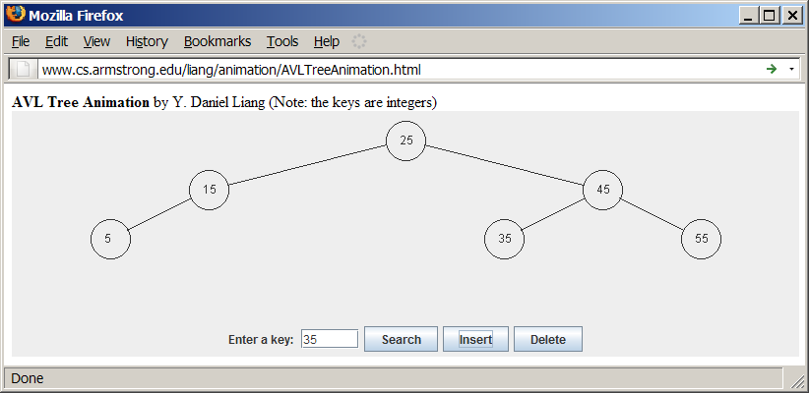
A V L Tree Animation

Slide 6
Balance Factor/Left-Heavy/Right-Heavy
The process for inserting or deleting an element in an A V L tree is the same as in a regular binary search tree. The difference is that you may have to rebalance the tree after an insertion or deletion operation. The balance factor of a node is the height of its right subtree minus the height of its left subtree. A node is said to be balanced if its balance factor is -1, 0, or 1. A node is said to be left-heavy if its balance factor is -1. A node is said to be right-heavy if its balance factor is +1.

Slide 7
Balancing Trees
If a node is not balanced after an insertion or deletion operation, you need to rebalance it. The process of rebalancing a node is called a rotation. There are four possible rotations.

Slide 8
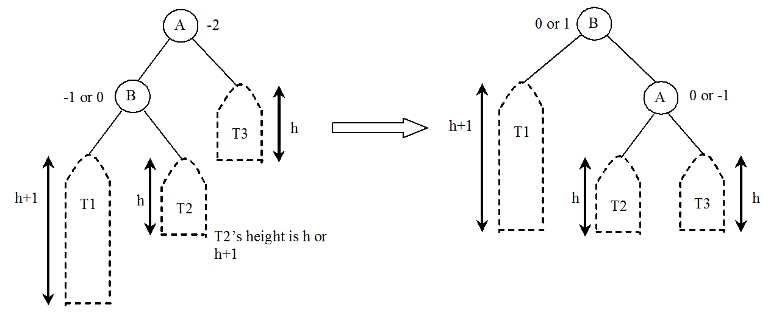
L L Imbalance and L L Rotation
LL Rotation: An LL imbalance occurs at a node A such that A has a balance factor -2 and a left child B with a balance factor -1 or 0. This type of imbalance can be fixed by performing a single right rotation at A.

Slide 9
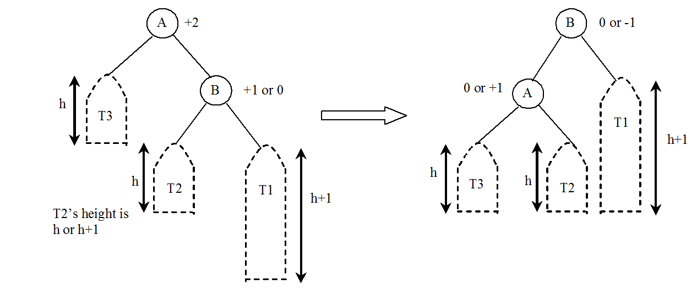
R R Imbalance and R R Rotation
R R Rotation: An R R imbalance occurs at a node A such that A has a balance factor +2 and a right child B with a balance factor +1 or 0. This type of imbalance can be fixed by performing a single left rotation at A.

Slide 10
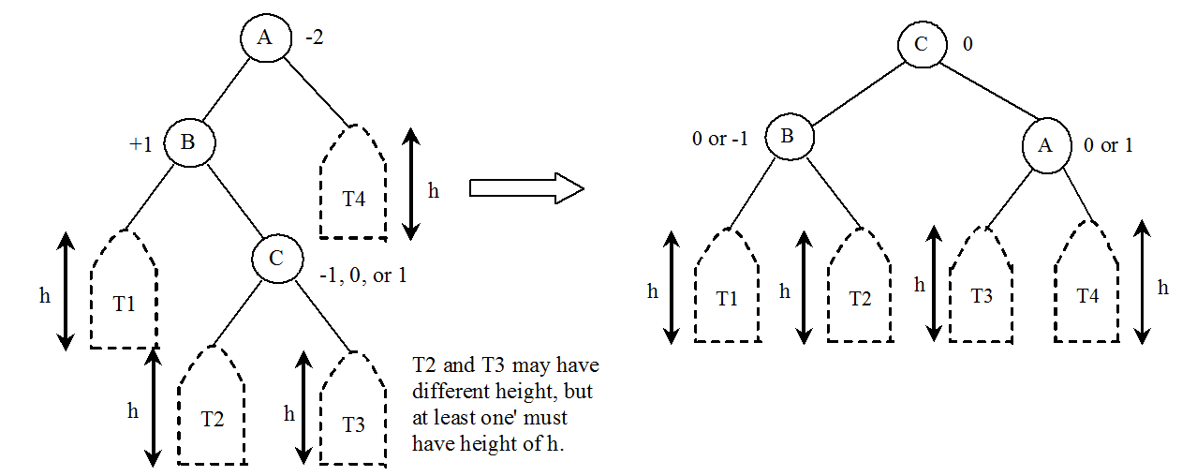
L R Imbalance and L R Rotation
LR Rotation: An LR imbalance occurs at a node A such that A has a balance factor -2 and a left child B with a balance factor +1. Assume B’s right child is C. This type of imbalance can be fixed by performing a double rotation (first a single left rotation at B and then a single right rotation at A).

Slide 11
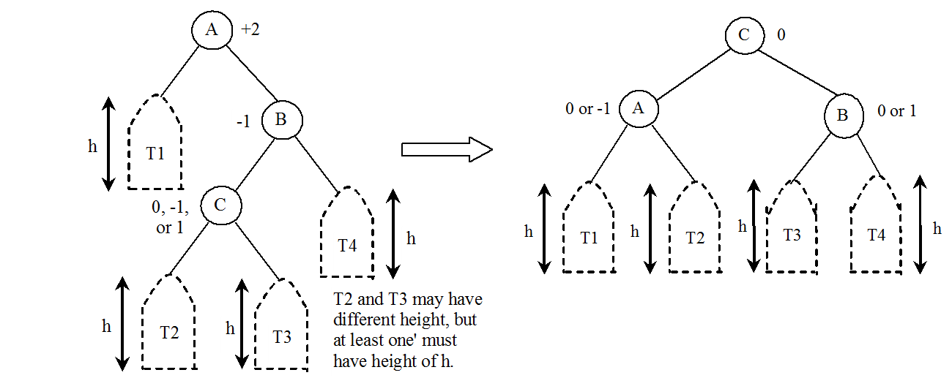
R L Imbalance and R L Rotation
R L Rotation: An R L imbalance occurs at a node A such that A has a balance factor +2 and a right child B with a balance factor -1. Assume B’s left child is C. This type of imbalance can be fixed by performing a double rotation (first a single right rotation at B and then a single left rotation at A).

Slide 12
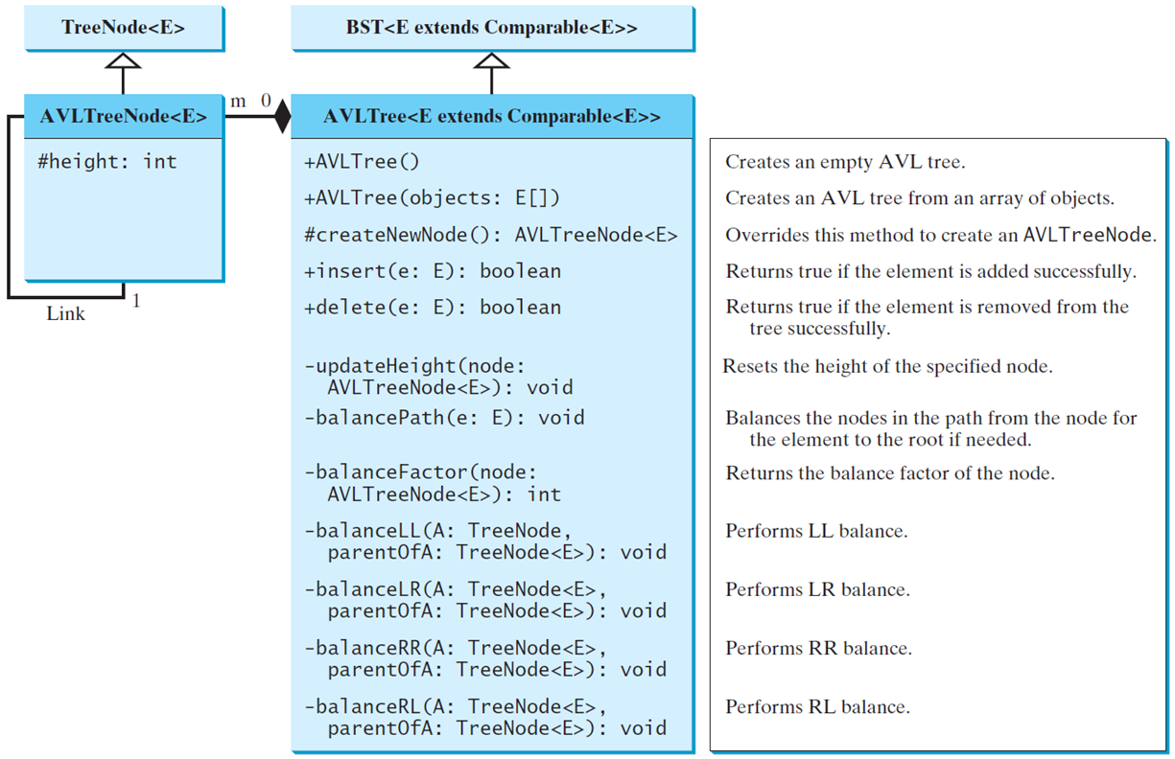
Designing Classes for AVL Trees
An A V L tree is a binary tree. So you can define the A V LTree class to extend the B S T class.
AVLTree
TestAVLTree
Run

Slide 13

Copyright

