Slide 1
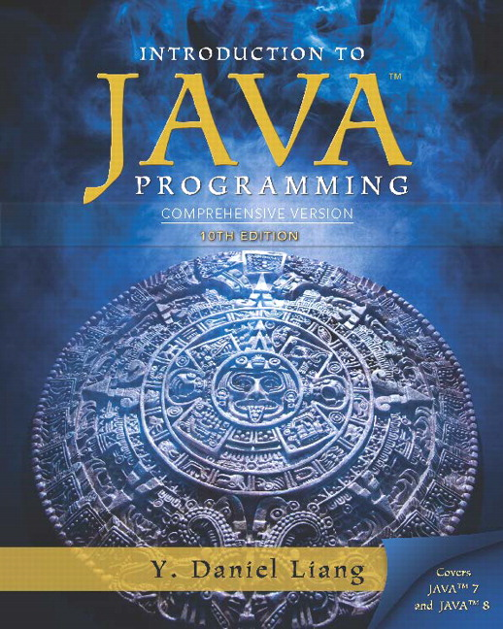
Introduction to Java Programming
Tenth Edition
Chapter 28
Graphs and Applications
Copyright © 2015 Pearson Education, Inc. All Rights Reserved
Notes:
If this PowerPoint presentation contains mathematical equations, you may need to check that your computer has the following installed:
1) MathType Plugin
2) Math Player (free versions available)
3) NVDA Reader (free versions available)

Slide 2
Objectives (1 of 2)
To describe the graph terminologies: vertices, edges, simple graphs, weighted/unweighted graphs, and directed/undirected graphs (§28.2).
To represent vertices and edges using lists, edge arrays, edge objects, adjacency matrices, and adjacency lists (§28.3).
To model real-world problems using graphs and explain the Seven Bridges of Königsberg problem (§28.1).
To model graphs using the Graph interface, the AbstractGraph class, and the UnweightedGraph class (§28.4).

Slide 3
Objectives (2 of 2)
To display graphs visually (§28.5).
To represent the traversal of a graph using the AbstractGraph.Tree class (§28.6).
To design and implement depth-first search (§28.7).
To solve the connected-circle problem using depth-first search (§28.8).
To design and implement breadth-first search (§28.9).
To solve the nine-tail problem using breadth-first search (§28.10).

Slide 4
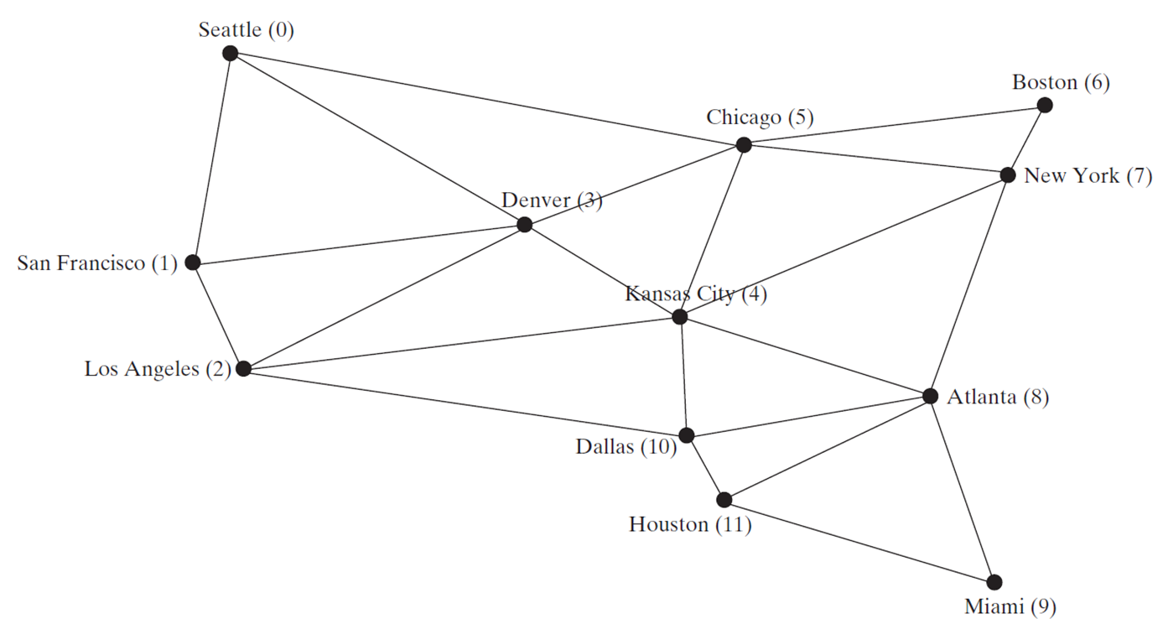
Modeling Using Graphs

Slide 5

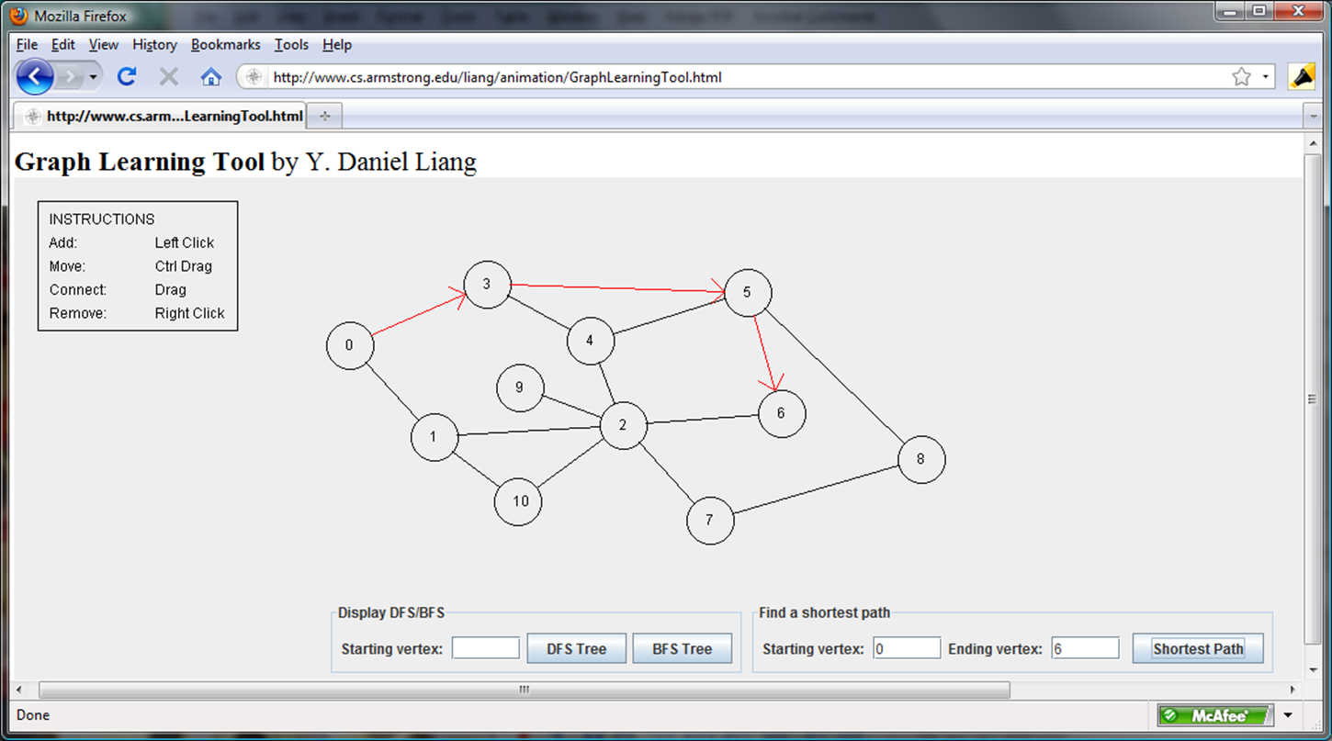
Graph Animation

Slide 6
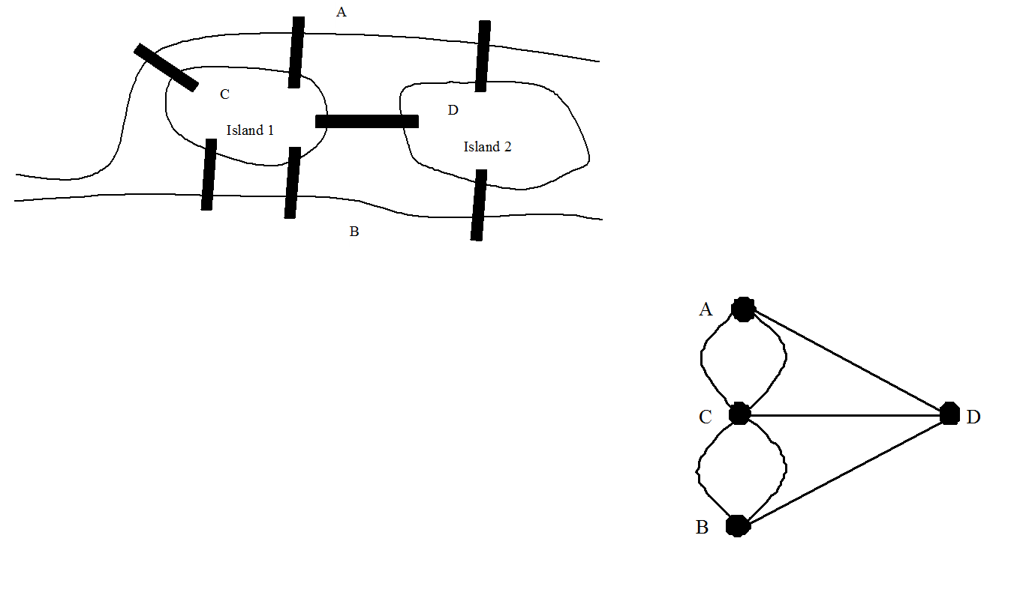
Seven Bridges of Königsberg

Slide 7
Basic Graph Terminologies (1 of 2)
What is a graph? G=(V, E)
Define a graph
Directed versus. undirected graphs
Weighted versus. unweighted graphs
Adjacent vertices
Incident
Degree
Neighbor
loop

Slide 8
Directed Versus Undirected Graph

Slide 9
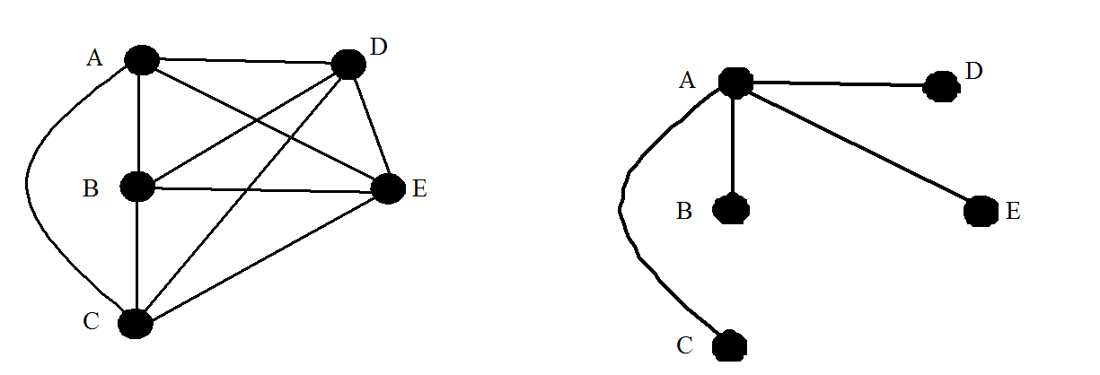
Basic Graph Terminologies (2 of 2)
Parallel edge
Simple graph
Complete graph
Spanning tree

Slide 10
Representing Graphs
Representing Vertices
Representing Edges: Edge Array
Representing Edges: Edge Objects
Representing Edges: Adjacency Matrices
Representing Edges: Adjacency Lists

Slide 11
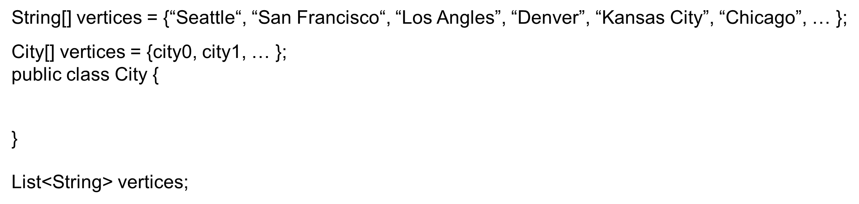
Representing Vertices

Slide 12
Representing Edges: Edge Array

Slide 13
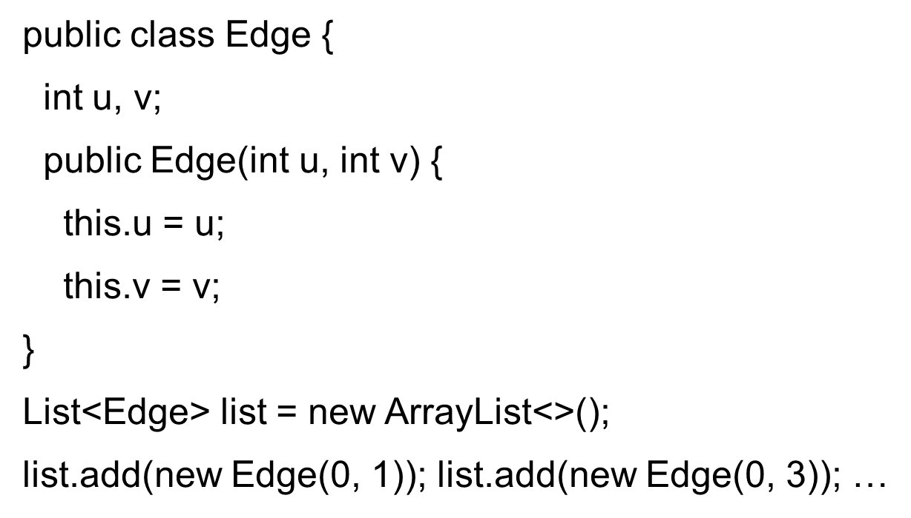
Representing Edges: Edge Object

Slide 14
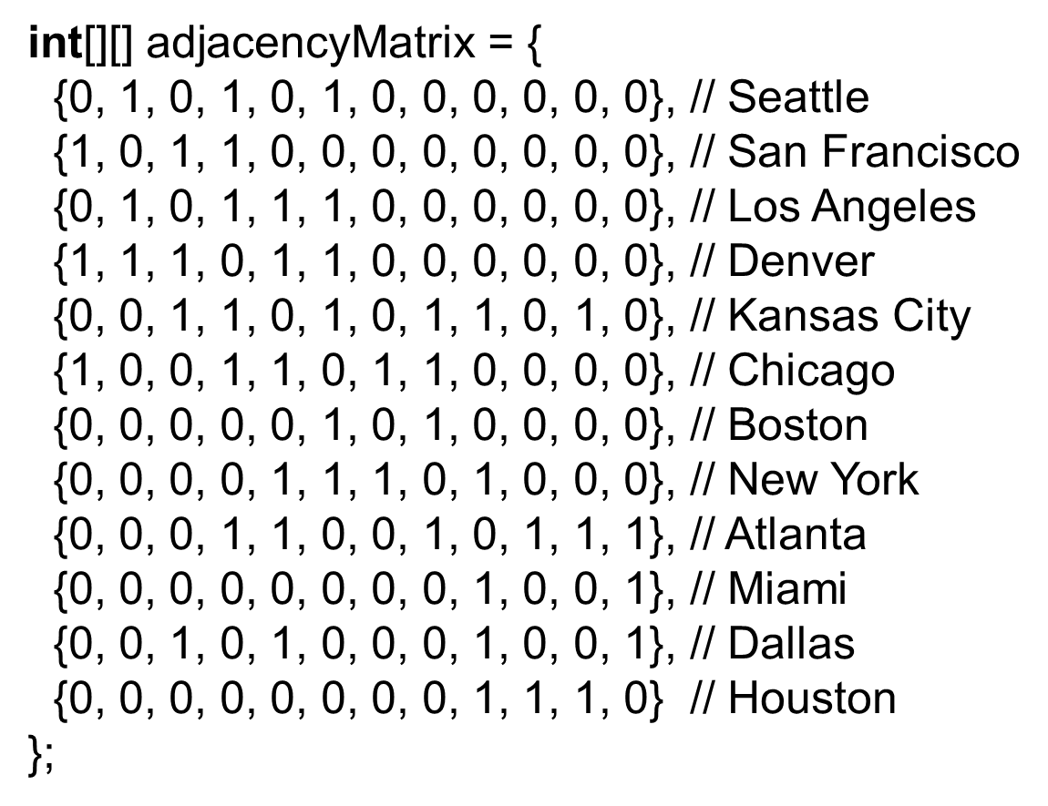
Representing Edges: Adjacency Matrix

Slide 15
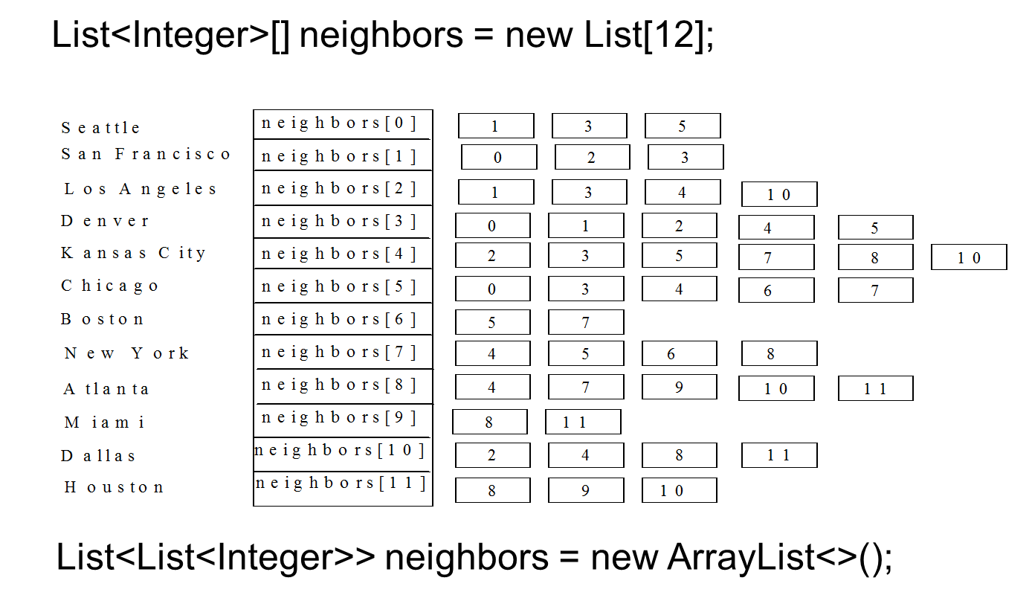
Representing Edges: Adjacency Vertex List

Slide 16
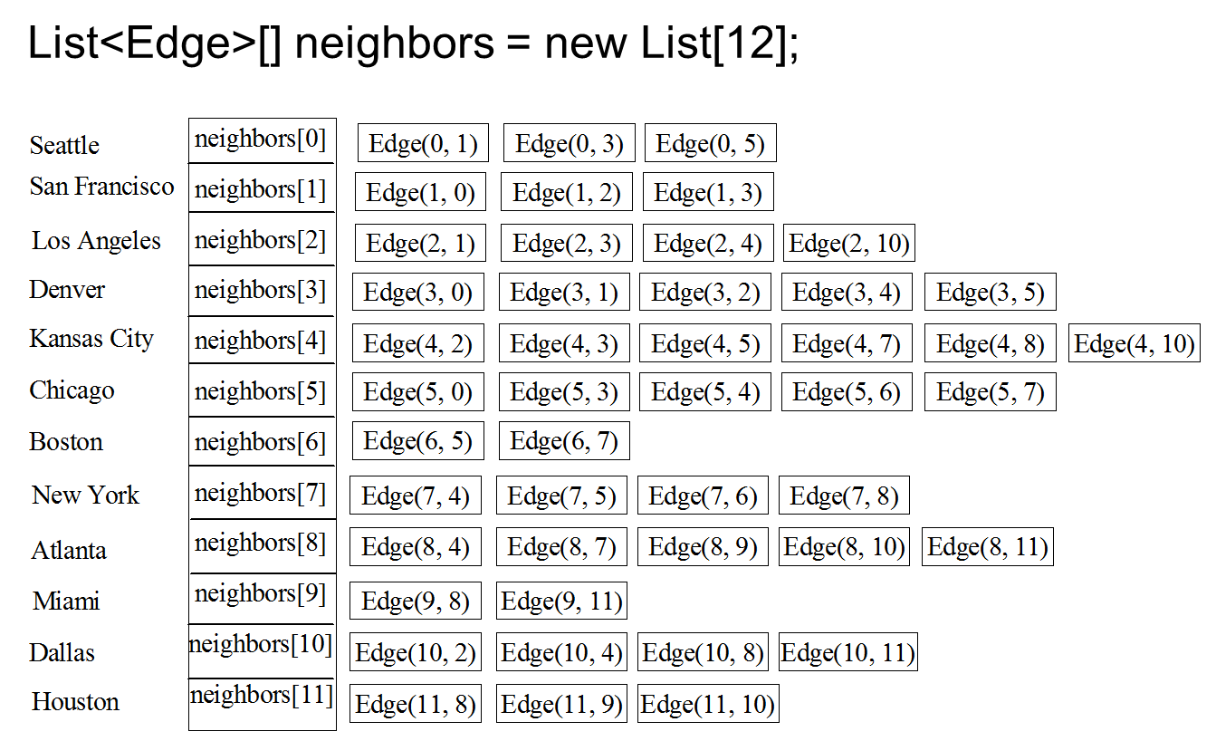
Representing Edges: Adjacency Edge List

Slide 17
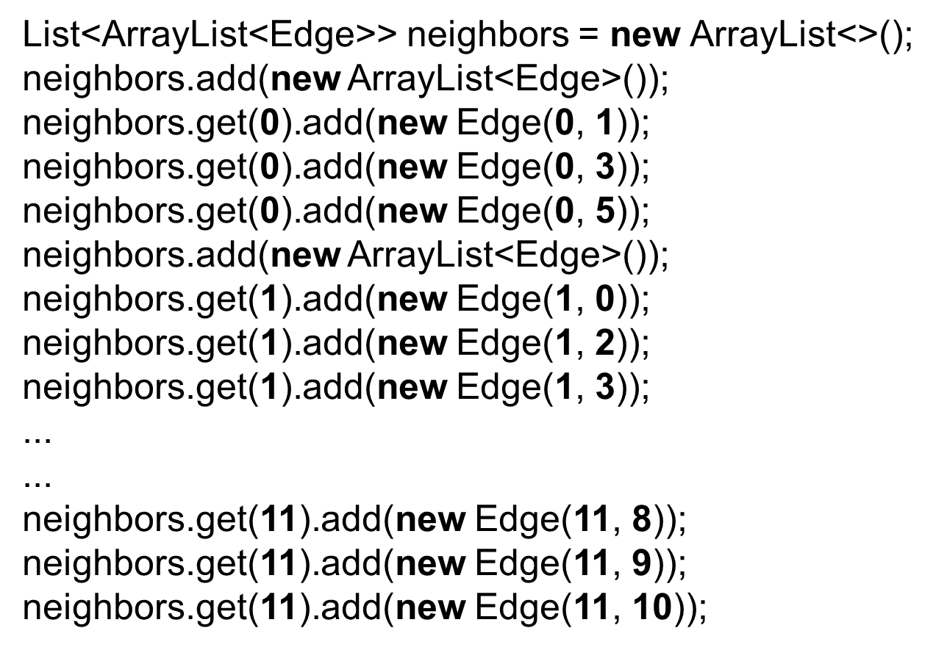
Representing Adjacency Edge List Using ArrayList

Slide 18
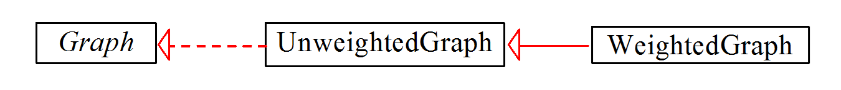
Modeling Graphs (1 of 2)

Slide 19
Modeling Graphs (2 of 2)
Graph
UnweightedGraph
TestGraph
Run

Slide 20
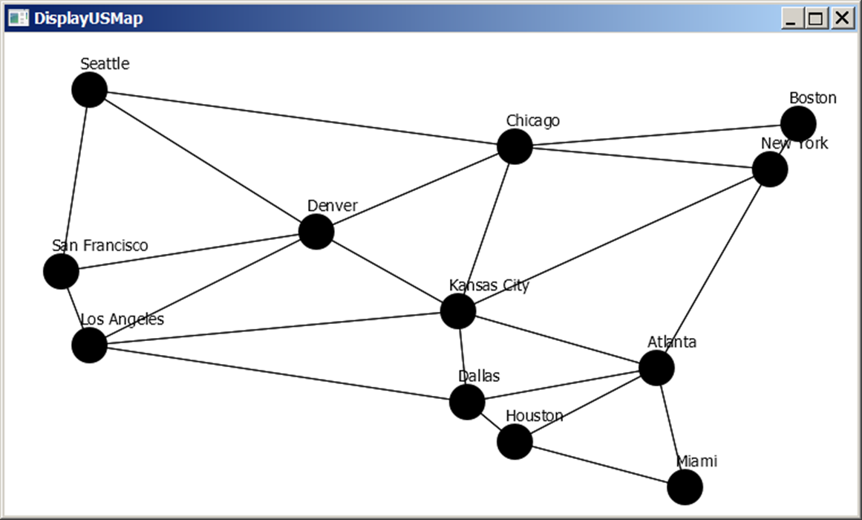
Graph Visualization
GraphView
Displayable
DisplayUSMap
Run

Slide 21
Graph Traversals
Depth-first search and breadth-first search
Both traversals result in a spanning tree, which can be modeled using a class.

Slide 22
Depth-First Search (1 of 2)
The depth-first search of a graph is like the depth-first search of a tree discussed in §25.2.3, “Tree Traversal.” In the case of a tree, the search starts from the root. In a graph, the search can start from any vertex.

Slide 23
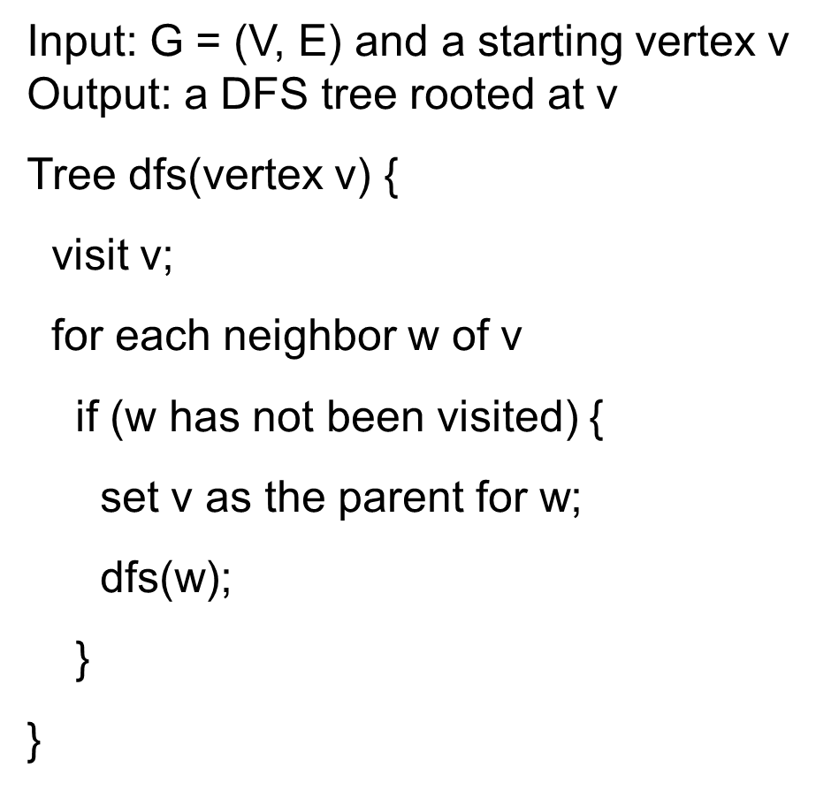
Depth-First Search (2 of 2)

Slide 24
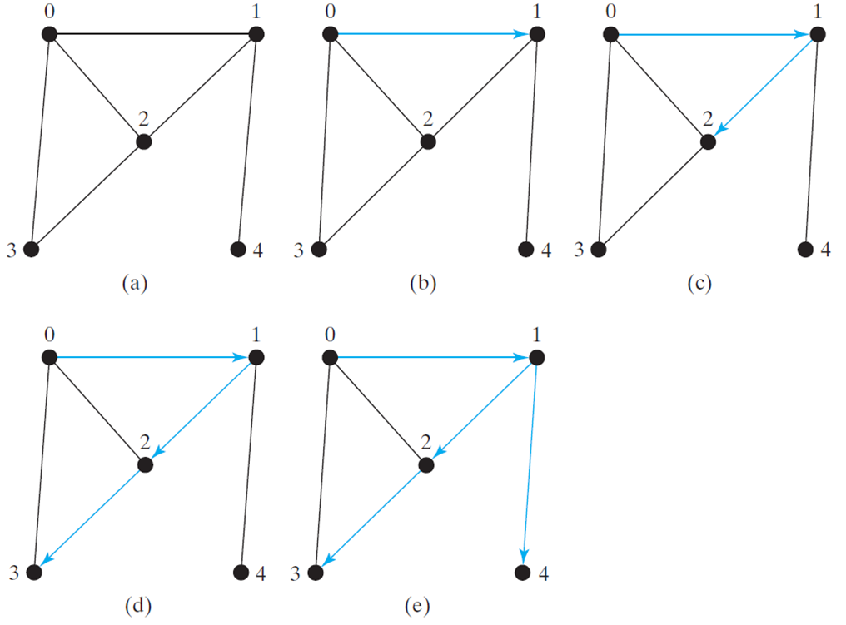
Depth-First Search Example (1 of 2)

Slide 25
Depth-First Search Example (2 of 2)
TestDFS
Run

Slide 26
Applications of the DFS
Detecting whether a graph is connected. Search the graph starting from any vertex. If the number of vertices searched is the same as the number of vertices in the graph, the graph is connected. Otherwise, the graph is not connected.
Detecting whether there is a path between two vertices.
Finding a path between two vertices.
Finding all connected components. A connected component is a maximal connected subgraph in which every pair of vertices are connected by a path.

Slide 27
Applications of the D F S
Detecting whether there is a cycle in the graph.
Finding a cycle in the graph.

Slide 28
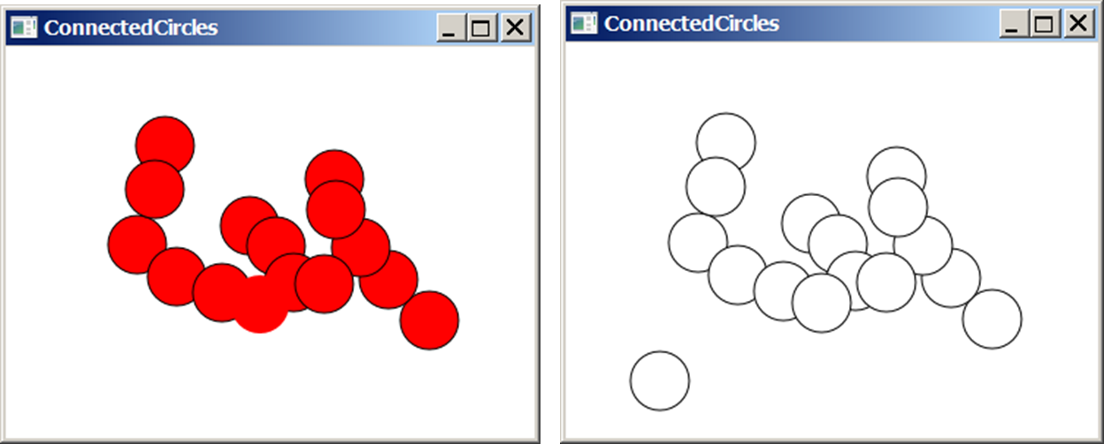
The Connected Circles Problem
TestDFS
Run

Slide 29
Breadth-First Search
The breadth-first traversal of a graph is like the breadth-first traversal of a tree discussed in §25.2.3, “Tree Traversal.” With breadth-first traversal of a tree, the nodes are visited level by level. First the root is visited, then all the children of the root, then the grandchildren of the root from left to right, and so on.

Slide 30
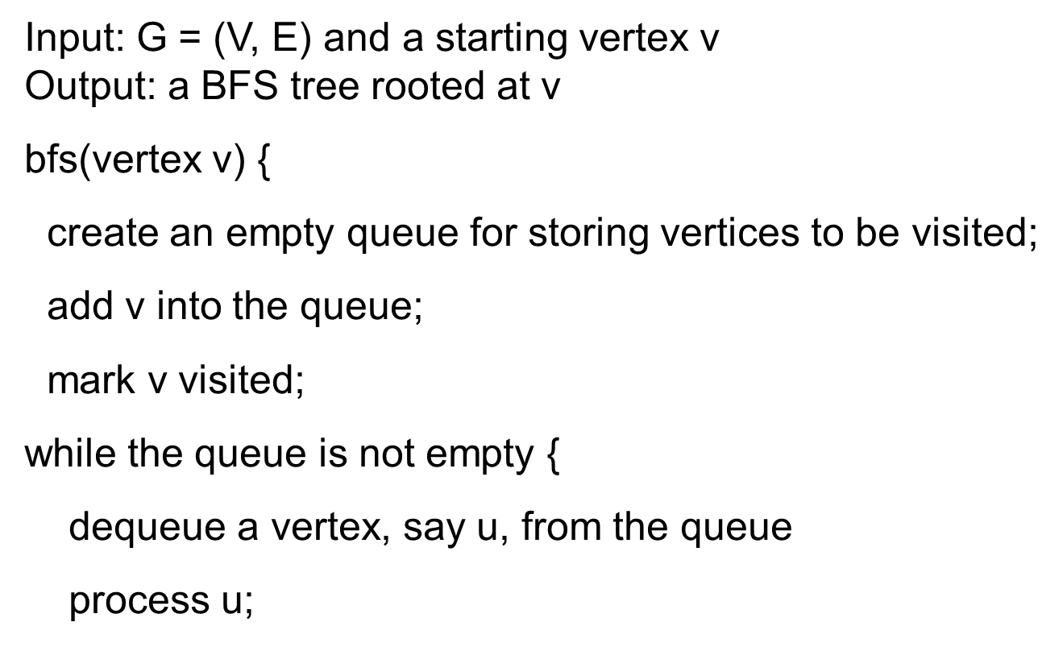
Breadth-First Search Algorithm (1 of 2)

Slide 31
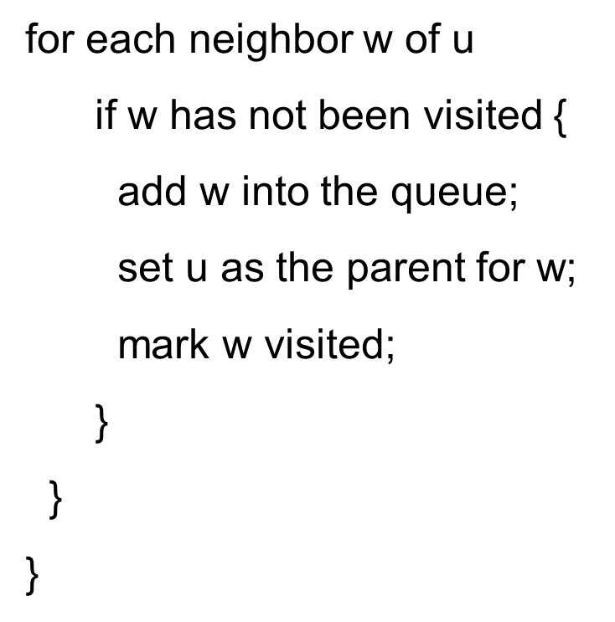
Breadth-First Search Algorithm (2 of 2)

Slide 32
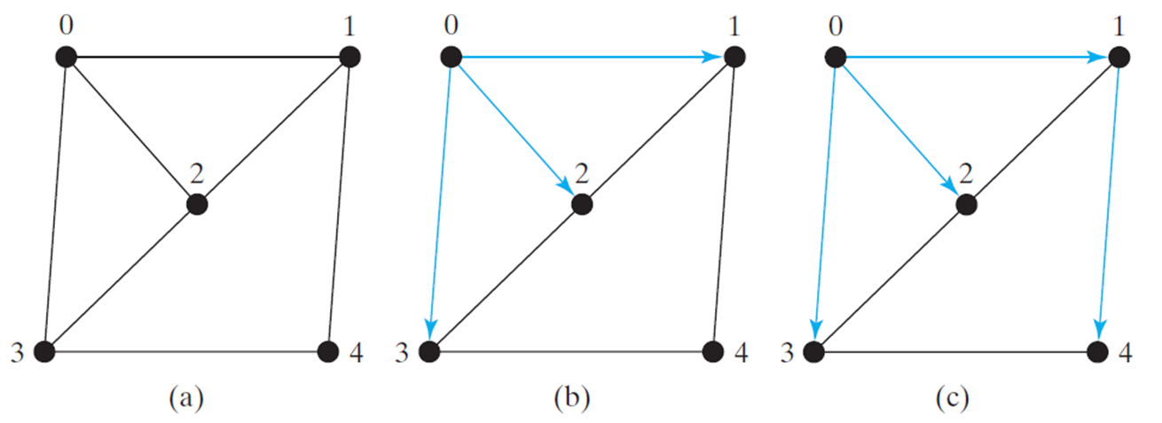
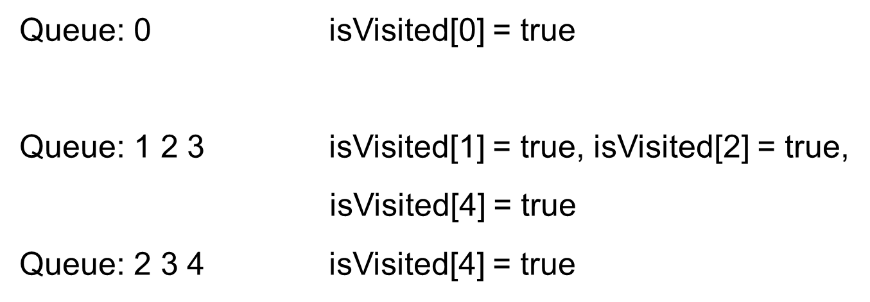
Breadth-First Search Algorithm Example (1 of 2)

Slide 33
Breadth-First Search Algorithm Example (2 of 2)
TestBFS
Run

Slide 34
Applications of the B F S (1 of 2)
Detecting whether a graph is connected. A graph is connected if there is a path between any two vertices in the graph.
Detecting whether there is a path between two vertices.
Finding a shortest path between two vertices. You can prove that the path between the root and any node in the B F S tree is the shortest path between the root and the node.
Finding all connected components. A connected component is a maximal connected subgraph in which every pair of vertices are connected by a path.

Slide 35
Applications of the B F S (2 of 2)
Detecting whether there is a cycle in the graph.
Finding a cycle in the graph.
Testing whether a graph is bipartite. A graph is bipartite if the vertices of the graph can be divided into two disjoint sets such that no edges exist between vertices in the same set.

Slide 36
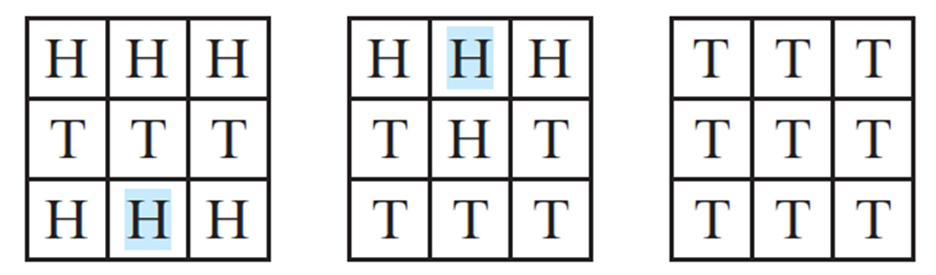
The Nine Tail Problem
The problem is stated as follows. Nine coins are placed in a three by three matrix with some face up and some face down. A legal move is to take any coin that is face up and reverse it, together with the coins adjacent to it (this does not include coins that are diagonally adjacent). Your task is to find the minimum number of the moves that lead to all coins face down.

Slide 37
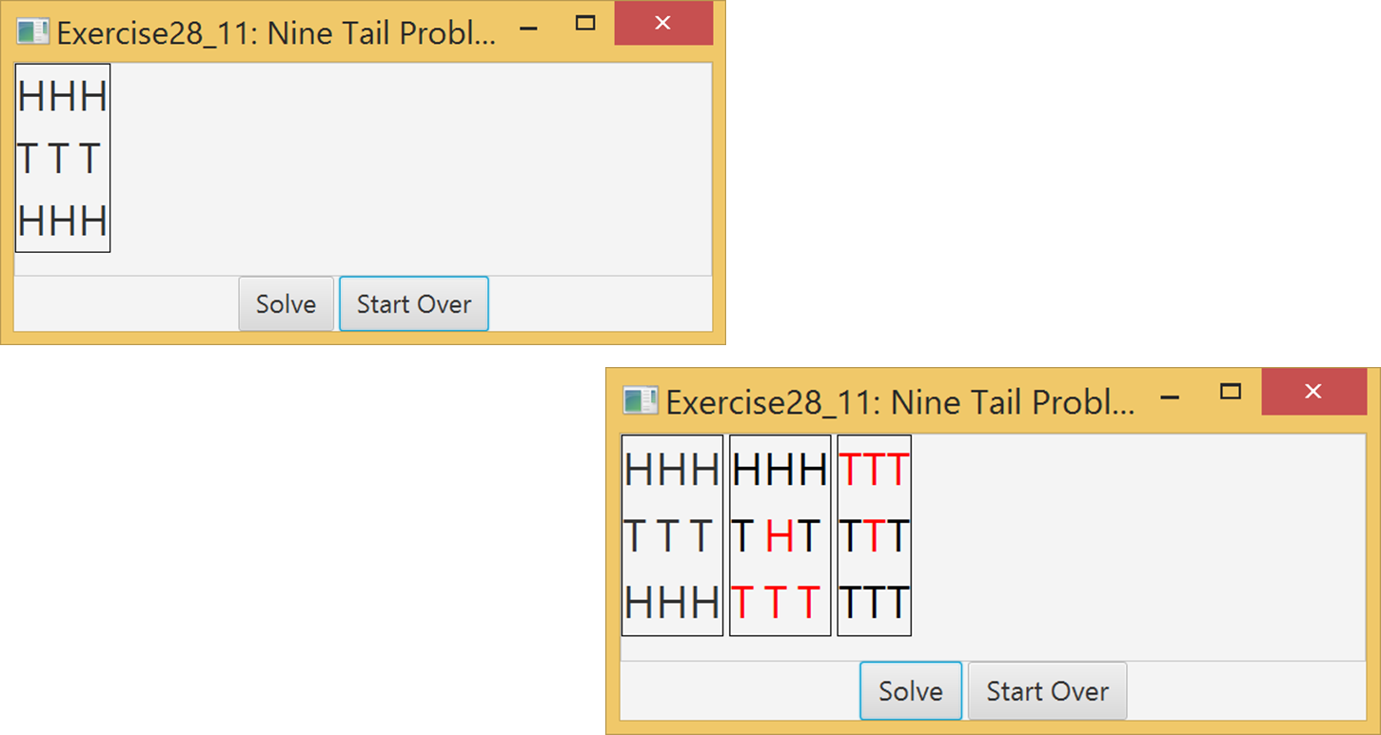
Nine Tail GUI Demo
Nine Tail GUI

Slide 38
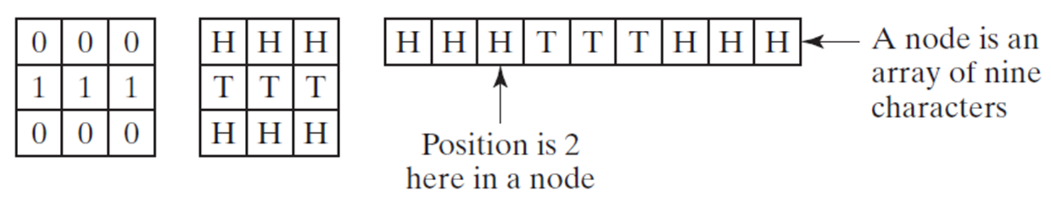
Representing Nine Coins

Slide 39
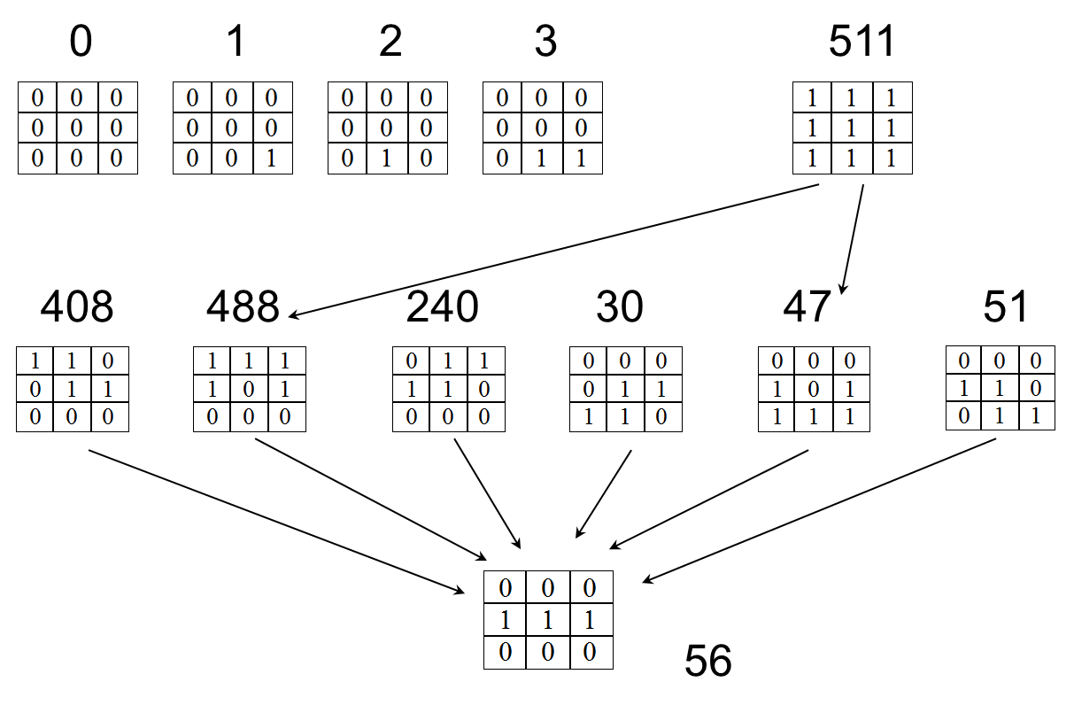
Model the Nine Tail Problem

Slide 40
NineTailModel
NineTailModel
NineTail
Run

Slide 41

Copyright

