Slide 1
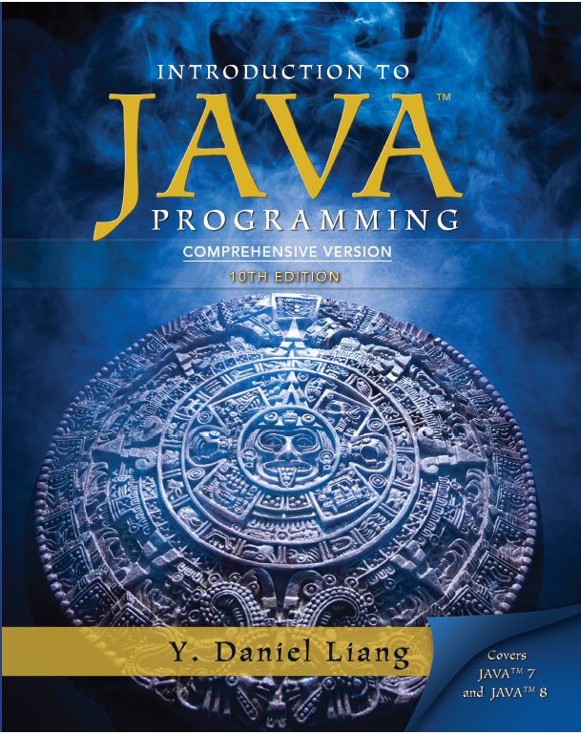
Introduction to Java Programming
Tenth Edition
Chapter 29
Weighted Graphs and Applications
Copyright © 2015 Pearson Education, Inc. All Rights Reserved

Slide 2
Objectives (1 of 2)
29.1 To represent weighted edges using adjacency matrices and adjacency lists (§29.2).
29.2 To model weighted graphs using the WeightedGraph class that extends the AbstractGraph class (§29.3).
29.3 To design and implement the algorithm for finding a minimum spanning tree (§29.4).
29.4 To define the M S T class that extends the Tree class (§29.4).

Slide 3
Objectives (2 of 2)
29.5 To design and implement the algorithm for finding single-source shortest paths (§29.5).
29.6 To define the ShortestPathTree class that extends the Tree class (§29.5).
29.7 To solve the weighted nine tail problem using the shortest-path algorithm (§29.6).

Slide 4
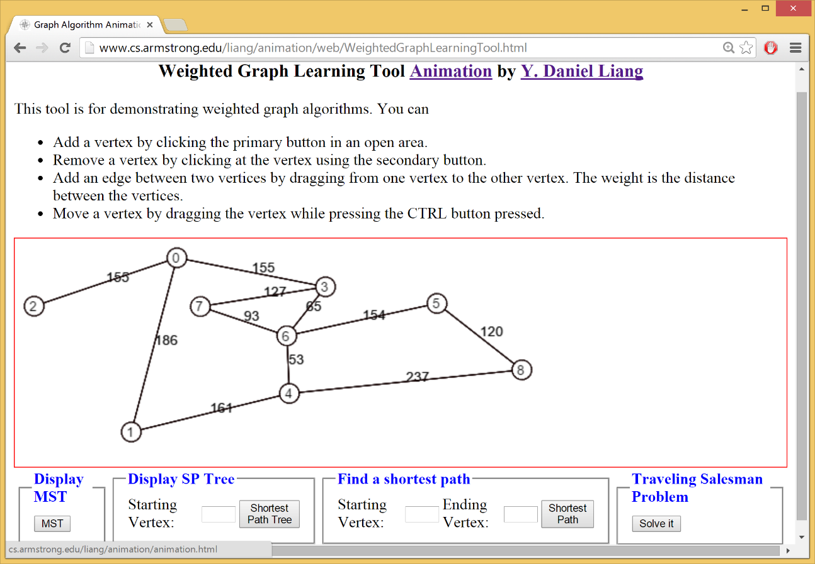
Weighted Graph Animation

Slide 5
Representing Weighted Graphs
Representing Weighted Edges: Edge Array
Weighted Adjacency Matrices
Adjacency Lists

Slide 6
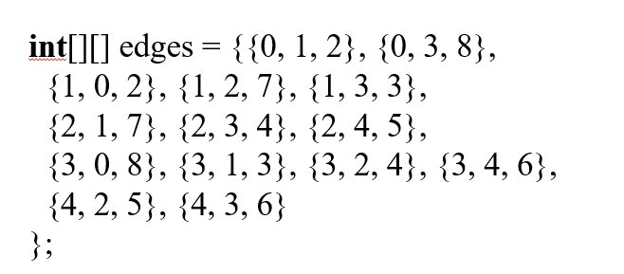
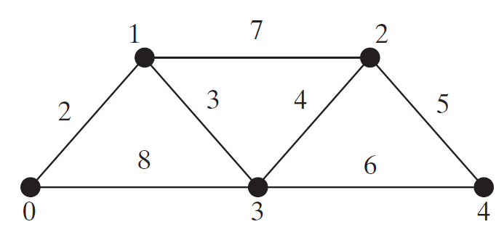
Representing Weighted Edges: Edge Array (1 of 2)

Slide 7
Representing Weighted Edges: Edge Array (2 of 2)

Slide 8
Edge Adjacency Lists (1 of 3)
WeightedEdge

Slide 9
Edge Adjacency Lists (2 of 3)
For flexibility, we will use an array list rather than a fixed-sized array to represent list as follows:

Slide 10
Edge Adjacency Lists (3 of 3)
WeightedGraph
TestWeightedGraph
Run

Slide 11
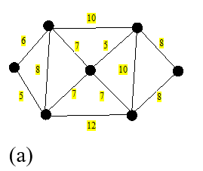
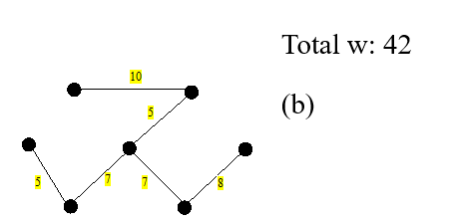
Minimum Spanning Trees (1 of 2)
A graph may have many spanning trees. Suppose that the edges are weighted. A minimum spanning tree is a spanning tree with the minimum total weights. For example, the trees in Figures (b), (c), (d) are spanning trees for the graph in Figure (a). The trees in Figures (c) and (d) are minimum spanning trees.

Slide 12
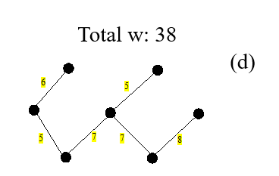
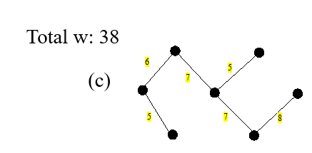
Minimum Spanning Trees (2 of 2)

Slide 13
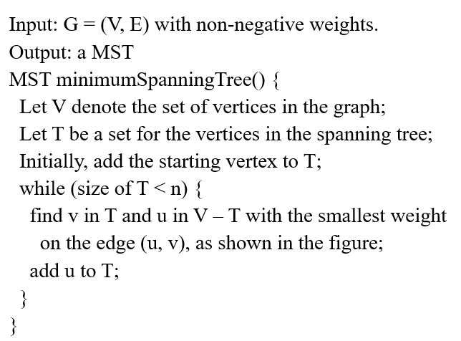
Prim’s Minimum Spanning Tree Algorithm
Find a vertex in V-T that has the smallest weighted edge connecting to a vertex in T.

Slide 14
Minimum Spanning Tree Algorithm

Slide 15
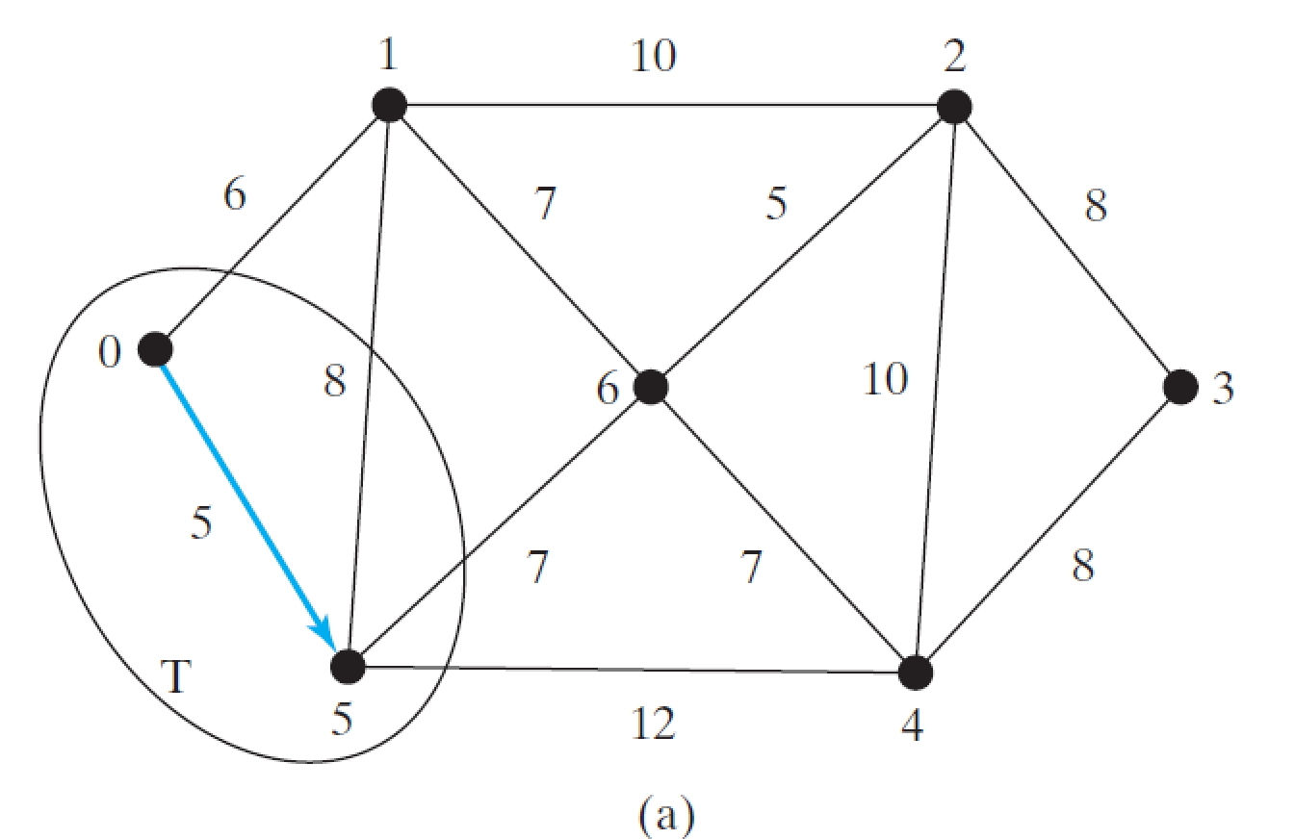
Minimum Spanning Tree Algorithm Example (1 of 6)

Slide 16
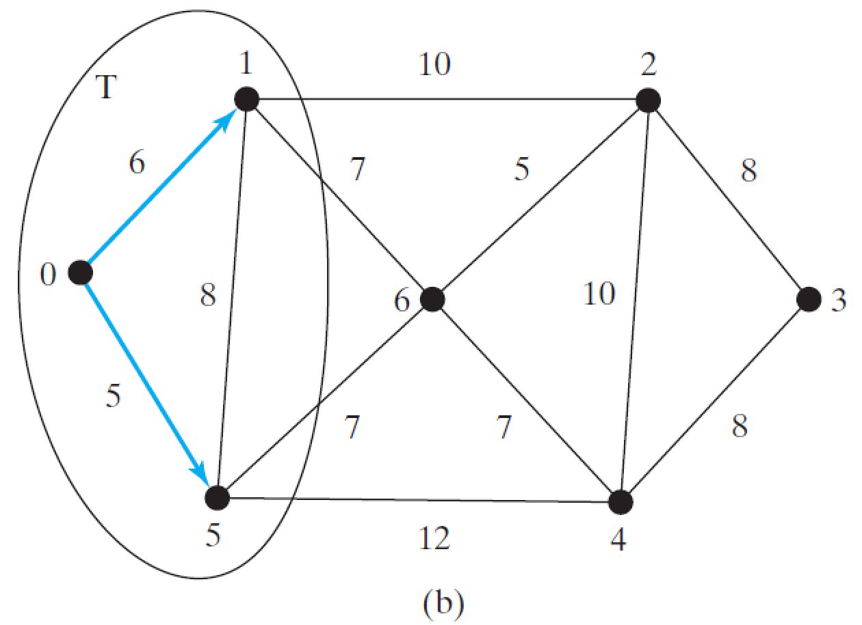
Minimum Spanning Tree Algorithm Example (2 of 6)

Slide 17
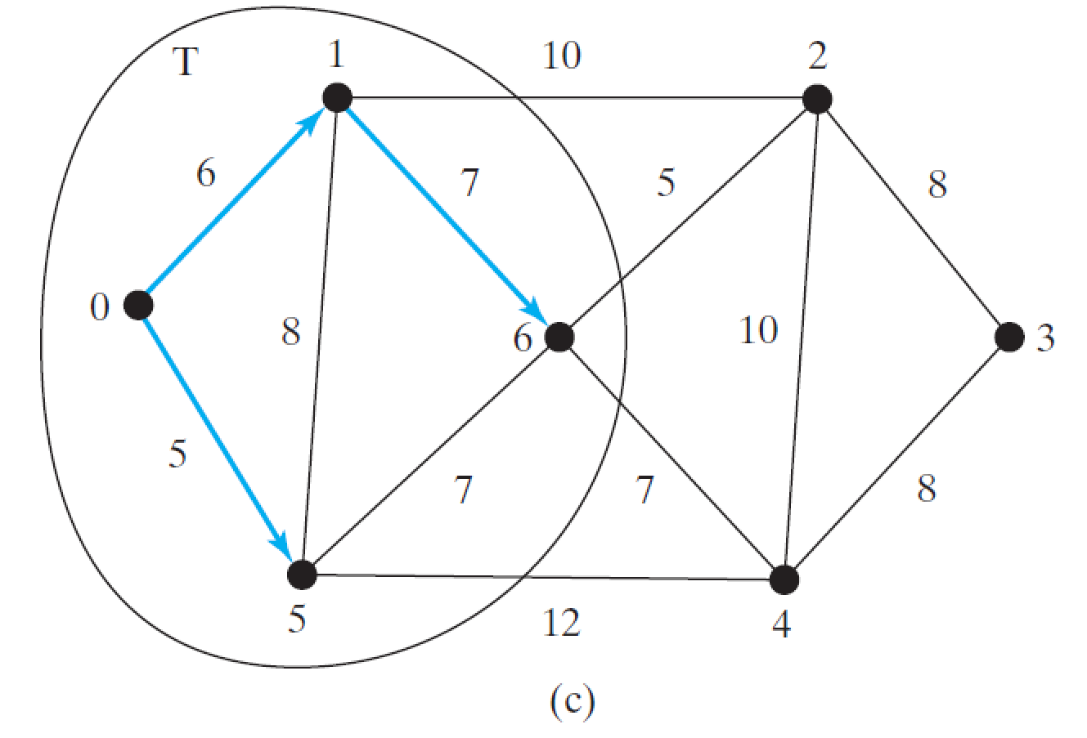
Minimum Spanning Tree Algorithm Example (3 of 6)

Slide 18
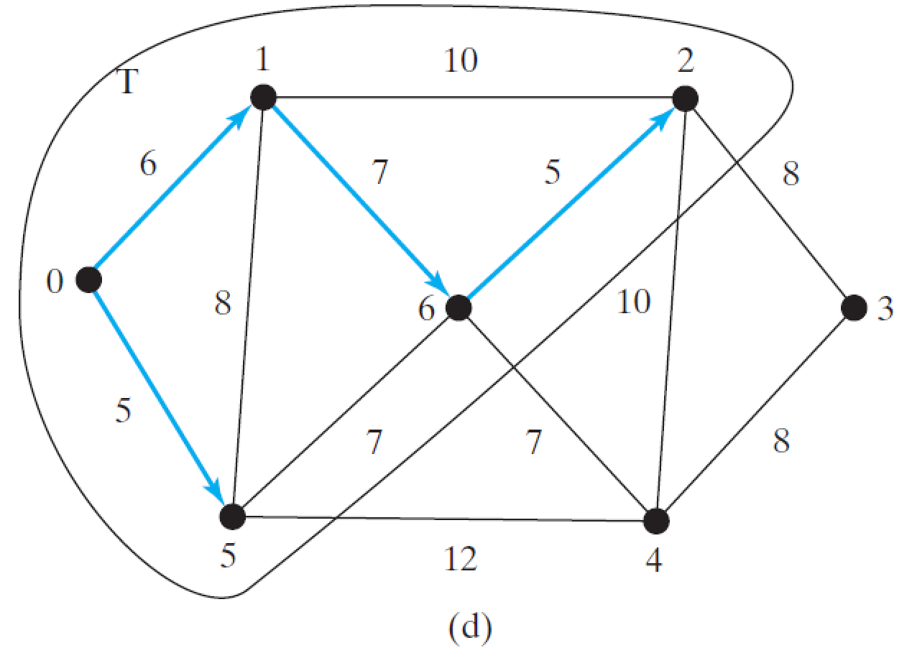
Minimum Spanning Tree Algorithm Example (4 of 6)

Slide 19
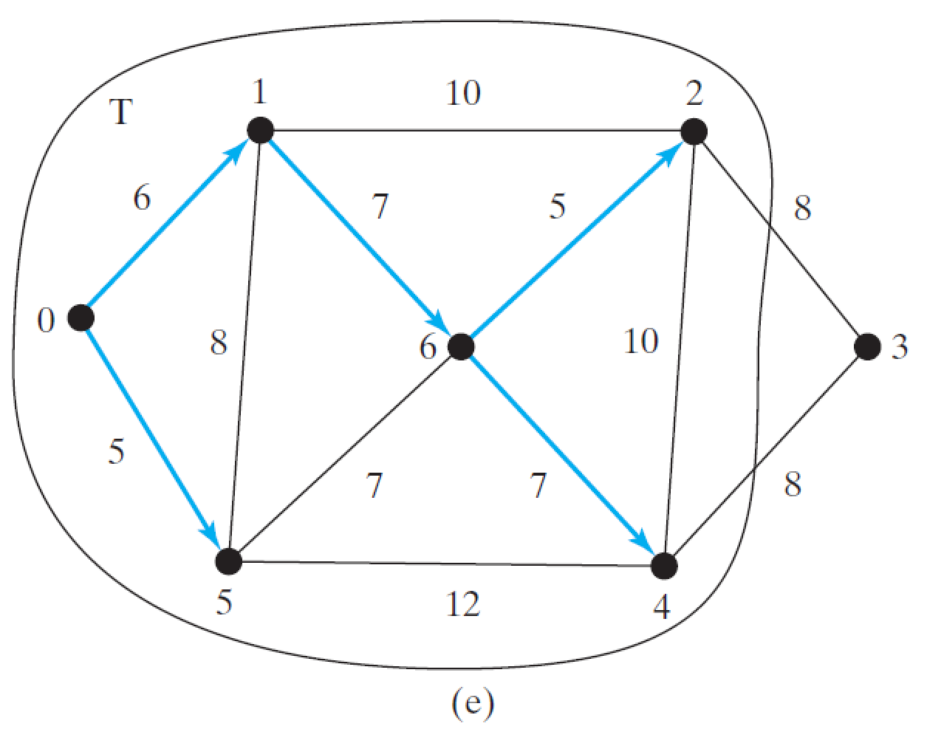
Minimum Spanning Tree Algorithm Example (5 of 6)

Slide 20
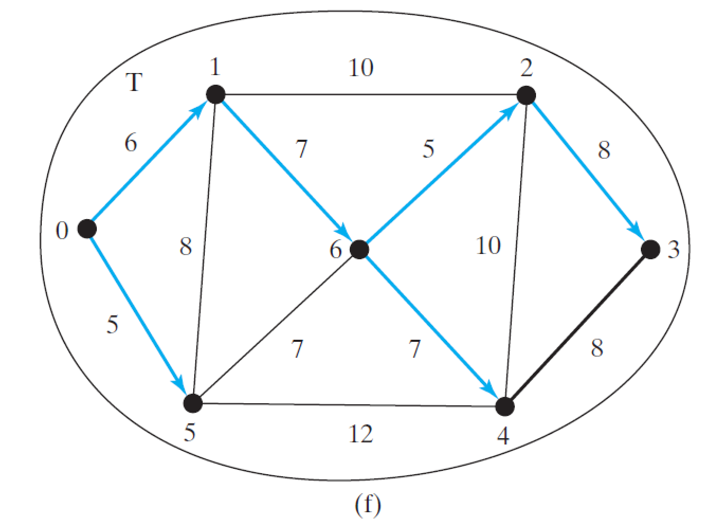
Minimum Spanning Tree Algorithm Example (6 of 6)

Slide 21
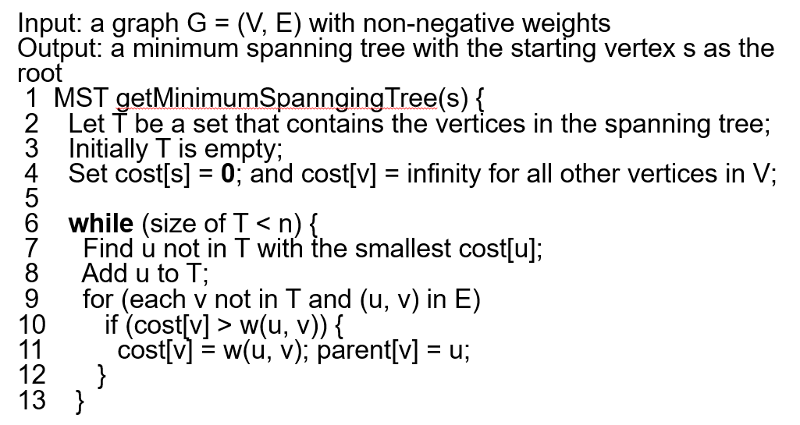
Refined Version of Prim’s Minimum Spanning Tree Algorithm

Slide 22
Implementing M S T Algorithm

Slide 23
Time Complexity 1
Note that testing whether a vertex i is in T by invoking T.conatins(i) takes O(n) time, since T is a list. Therefore, the overall time complexity for this implemention is O(n³). Interested readers may see Programming Exercise 29.20 for improving the implementation and reduce the complexity to O(n²).

Slide 24
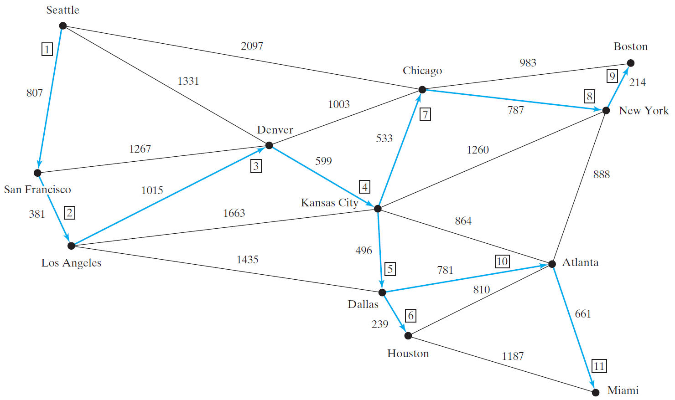
Test M S T
TestMinimumSpanningTree
Run

Slide 25
Shortest Path
§29.1 introduced the problem of finding the shortest distance between two cities for the graph in Figure 29.1. The answer to this problem is to find a shortest path between two vertices in the graph.

Slide 26
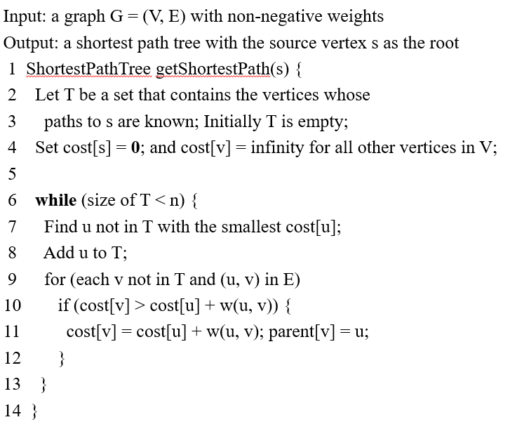
Single Source Shortest Path Algorithm (1 of 3)

Slide 27
Single Source Shortest Path Algorithm (2 of 3)
Before moving u to T

Slide 28
Single Source Shortest Path Algorithm (3 of 3)
After moving u to T

Slide 29
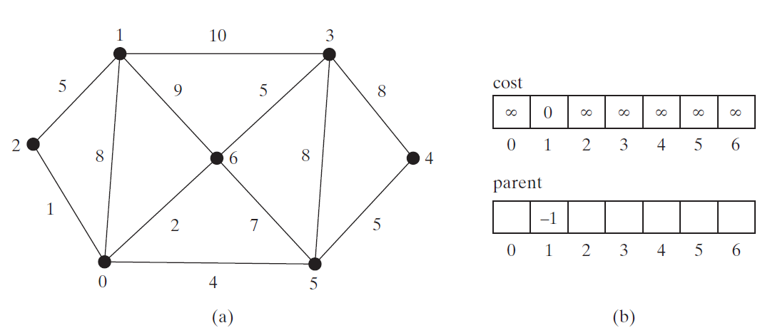
SP Algorithm Example (Step 0)

Slide 30
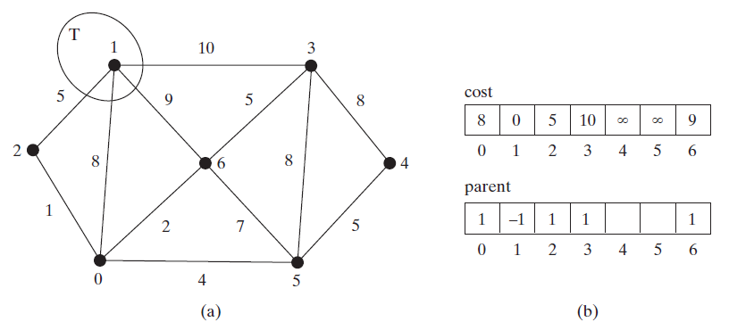
SP Algorithm Example (Step 1)

Slide 31
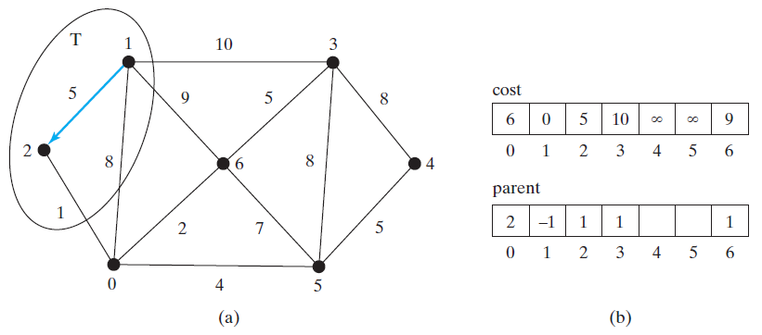
SP Algorithm Example (Step 2)

Slide 32
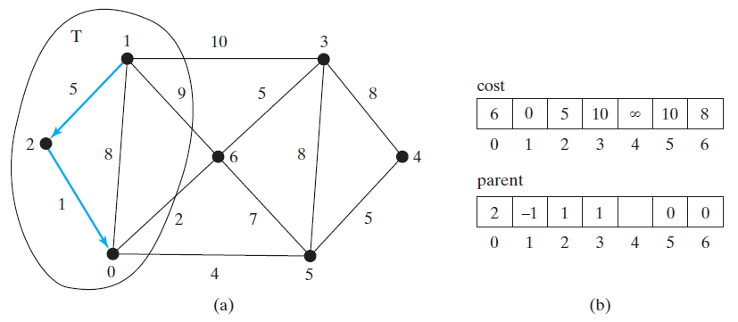
SP Algorithm Example (Step 3)

Slide 33
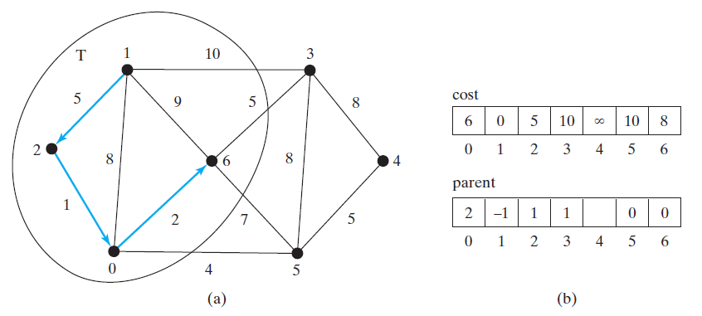
SP Algorithm Example (Step 4)

Slide 34
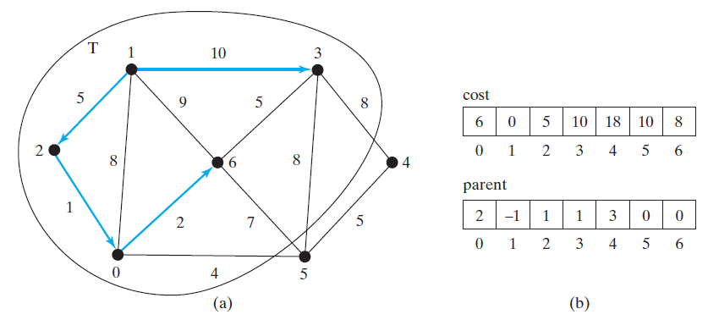
SP Algorithm Example (Step 5)

Slide 35
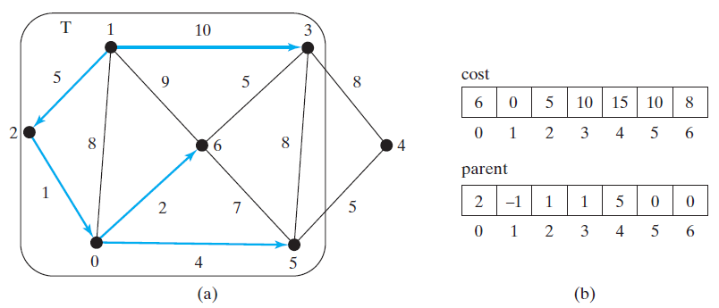
SP Algorithm Example (Step 6)

Slide 36
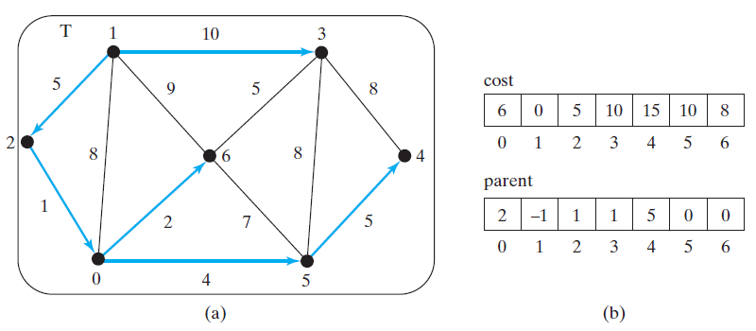
SP Algorithm Example (Step 7)

Slide 37
SP Algorithm Implementation
TestShortestPath
Run

Slide 38
Time Complexity 2
Same as the Prim’s MST, O(n^3) and can be reduced to O(n^2).

Slide 39
SP Algorithm Example

Slide 40
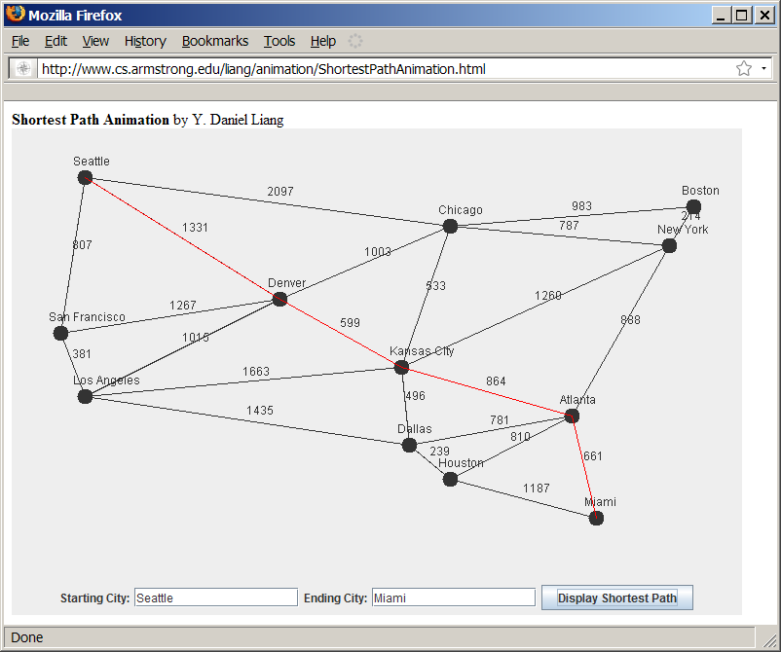
Shortest Path Animation
www.cs.armstrong.edu/liang/animation/ShortestPathAnimation.html

Slide 41
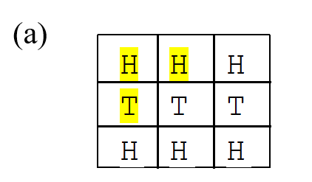
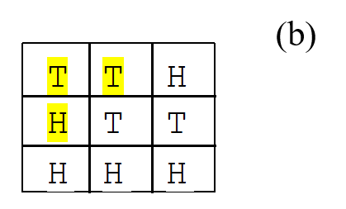
The Weighted Nine Tail Problem
The nine tail problem is to find the minimum number of the moves that lead to all coins face down. Each move flips a head coin and its neighbors. The weighted nine tail problem assigns the number of the flips as a weight on each move. For example, you can move from the coins in (a) to (b) by flipping the three coins. So the weight for this move is 3.

Slide 42
WeightedNineTailModel
NineTailModel
WeightedNineTailModel
WeightedNineTail
Run

Slide 43

Copyright

