Slide 1
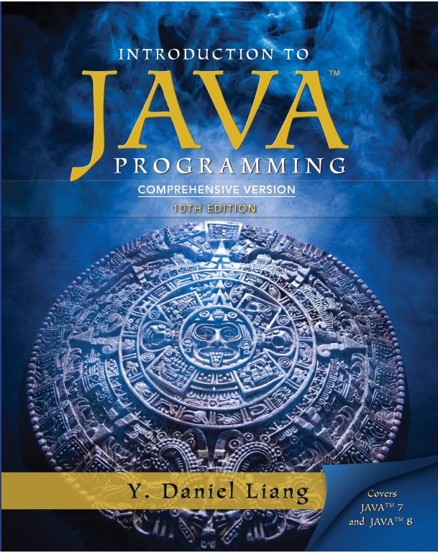
Introduction to Java Programming
Tenth Edition
Chapter 31
Networking
Copyright © 2013 Pearson Education, Inc. All Rights Reserved

Slide 2
Objectives (1 of 2)
31.1 To explain terms: T C P, I P, domain name, domain name server, stream-based communications, and packet-based communications (§31.2).
31.2 To create servers using server sockets (§31.2.1) and clients using client sockets (§31.2.2).
31.3 To implement Java networking programs using stream sockets (§31.2.3).
31.4 To develop an example of a client/server application (§31.2.4).

Slide 3
Objectives (2 of 2)
31.5 To obtain Internet addresses using the InetAddress class (§31.3).
31.6 To develop servers for multiple clients (§31.4).
31.7 To send and receive objects on a network (§31.5).
31.8 To develop an interactive tic-tac-toe game played on the Internet (§31.6).

Slide 4
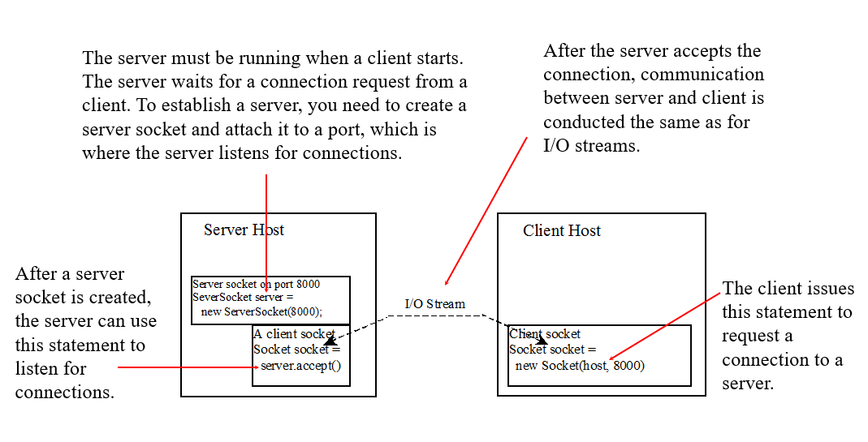
Client/Server Communications

Slide 5
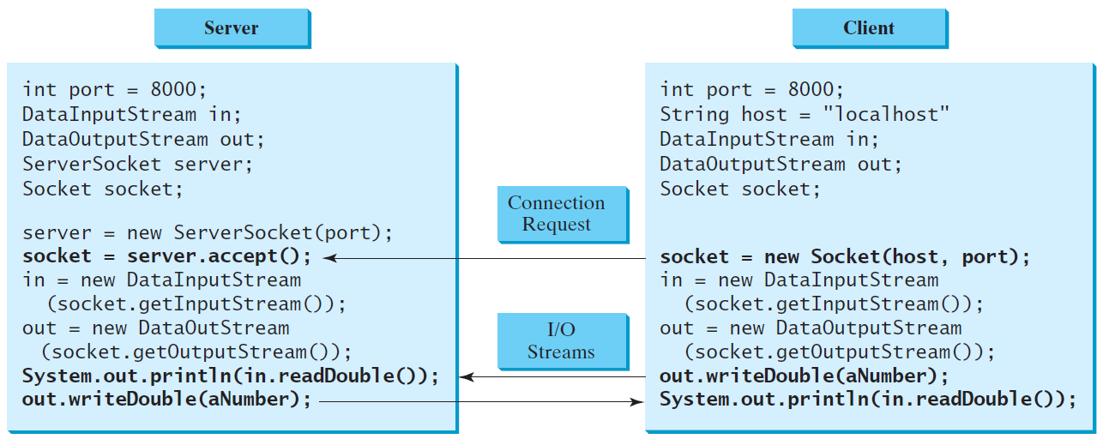
Data Transmission through Sockets

Slide 6
A Client/Server Example (1 of 3)
Problem: Write a client to send data to a server. The server receives the data, uses it to produce a result, and then sends the result back to the client. The client displays the result on the console. In this example, the data sent from the client is the radius of a circle, and the result produced by the server is the area of the circle.

Slide 7
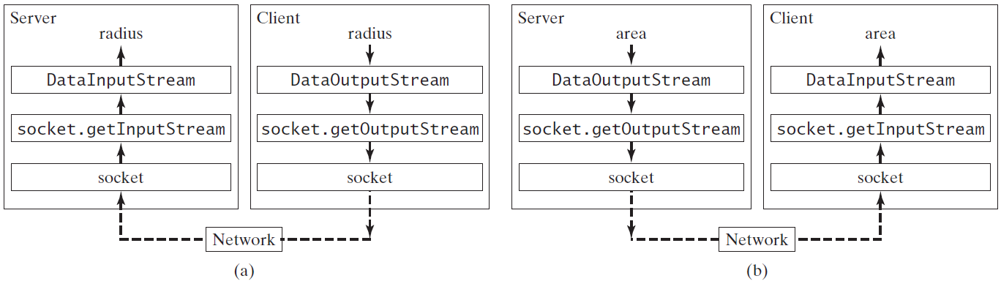
A Client/Server Example (2 of 3)

Slide 8
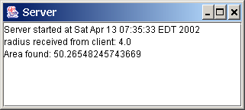
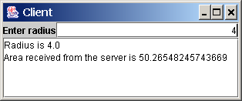
A Client/Server Example (3 of 3)
Note: Start the server, then the client.
Server
Client
Start Server
Start Client

Slide 9
The InetAddress Class (1 of 2)
Occasionally, you would like to know who is connecting to the server. You can use the InetAddress class to find the client's host name and IP address. The InetAddress class models an IP address. You can use the statement shown below to create an instance of InetAddress for the client on a socket.

Slide 10
The InetAddress Class (2 of 2)
Next, you can display the client's host name and IP address, as follows:

Slide 11
Serving Multiple Clients (1 of 2)
Multiple clients are quite often connected to a single server at the same time. Typically, a server runs constantly on a server computer, and clients from all over the Internet may want to connect to it. You can use threads to handle the server's multiple clients simultaneously. Simply create a thread for each connection. Here is how the server handles the establishment of a connection:

Slide 12
Serving Multiple Clients (2 of 2)
The server socket can have many connections. Each iteration of the while loop creates a new connection. Whenever a connection is established, a new thread is created to handle communication between the server and the new client; and this allows multiple connections to run at the same time.

Slide 13
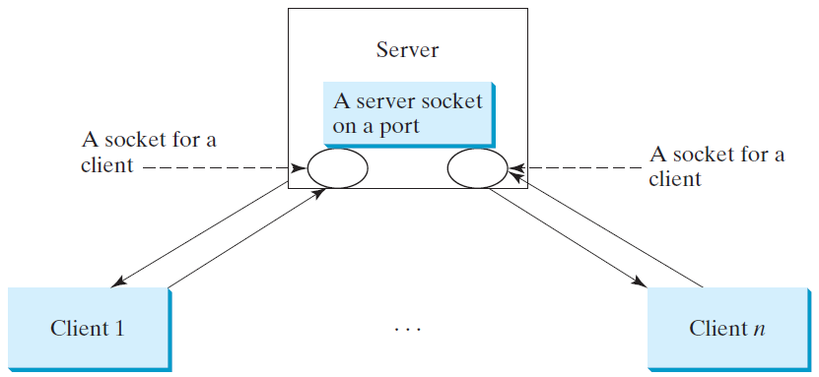
Example: Serving Multiple Clients
Note: Start the server first, then start multiple clients.
MultiThreadServer
Start Server
Start Client

Slide 14
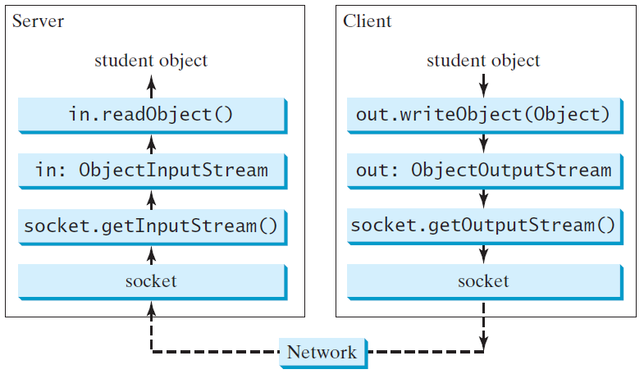
Example: Passing Objects in Network Programs
Write a program that collects student information from a client and send them to a server. Passing student information in an object.
StudentAddres Class
StudentServer
StudentClient
Start Server
Start Client
Note: Start the server first, then the client.

Slide 15
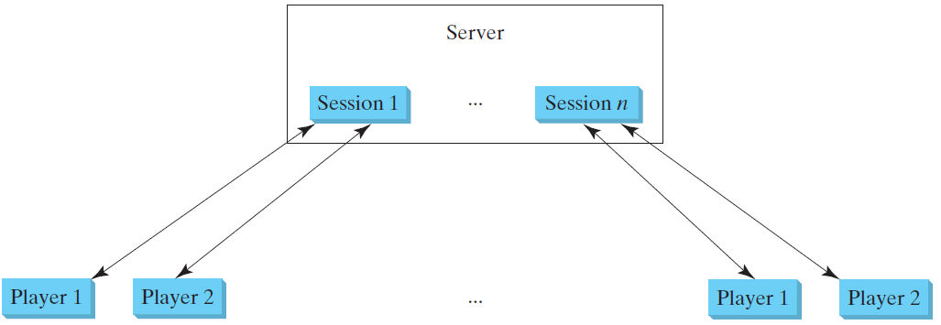
Case Studies: Distributed TicTacToe Games
TicTacToeServer
Run
TicTacToeClient
Run

Slide 16
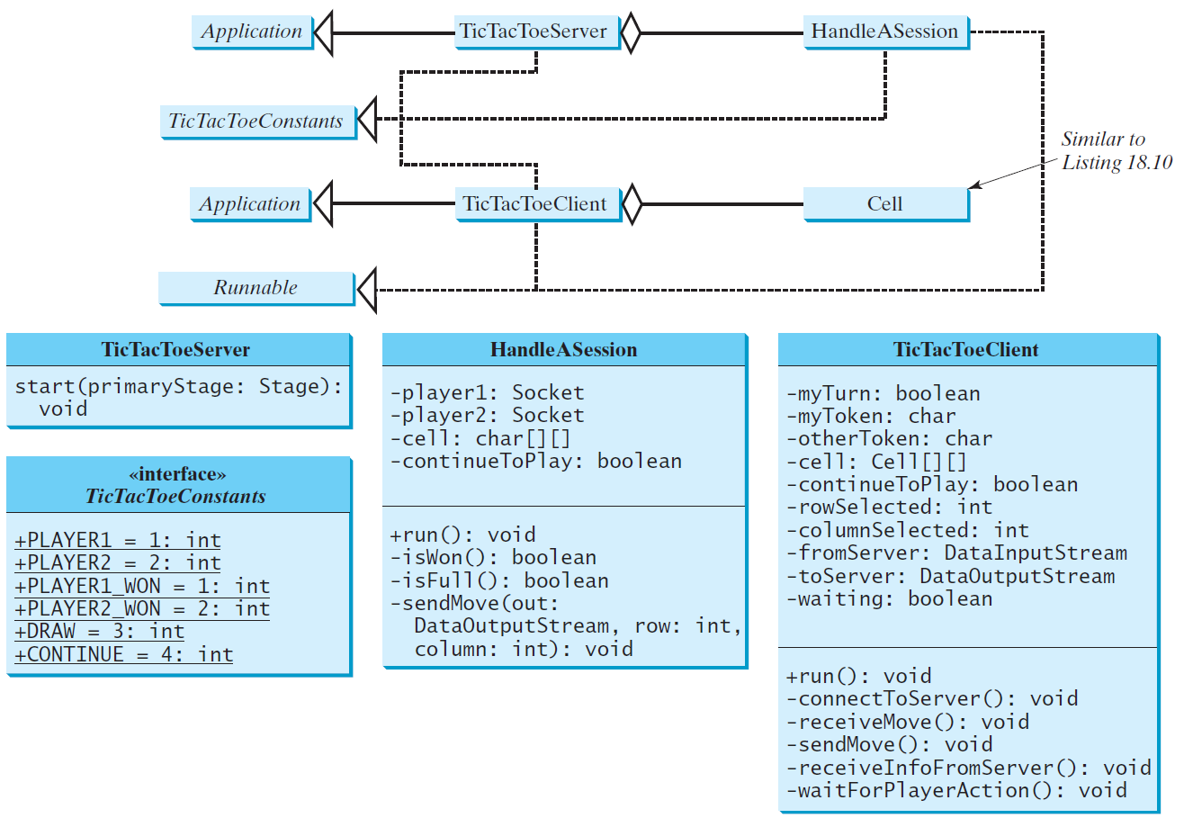
Distributed TicTacToe

Slide 17
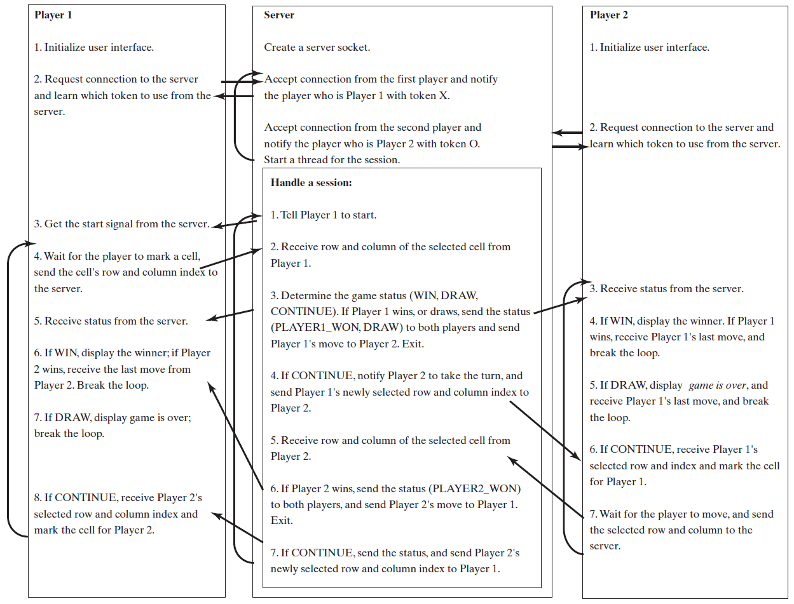
Distributed TicTacToe Game

Slide 18
DatagramPacket
The DatagramPacket class represents a datagram packet. Datagram packets are used to implement a connectionless packet delivery service. Each message is routed from one machine to another based solely on information contained within the packet.

Slide 19
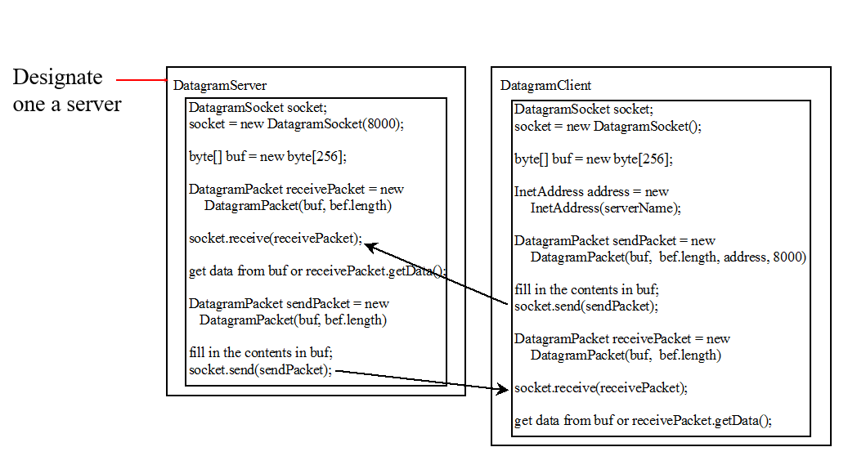
Datagram Programming
Datagram programming is different from stream socket programming in the sense that there is no concept of a ServerSocket for datagrams. Both client and server use DatagramSocket to send and receive packets.

Slide 20
Example: A Client/Server Example (1 of 2)
Section 31.2 presents a client program and a server program using socket streams. The client sends radius to a server. The server receives the data, uses them to find the area, and then sends the area to the client. Rewrite the program using datagram sockets.
Note: Start the server, then the client.

Slide 21
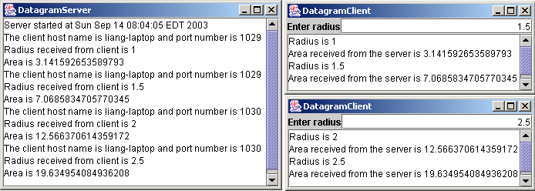
Example: A Client/Server Example (2 of 2)
DatagramServer
DatagramClient
Run
Run

Slide 22
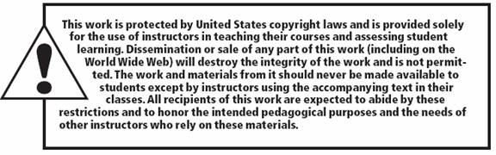
Copyright

