Slide 1
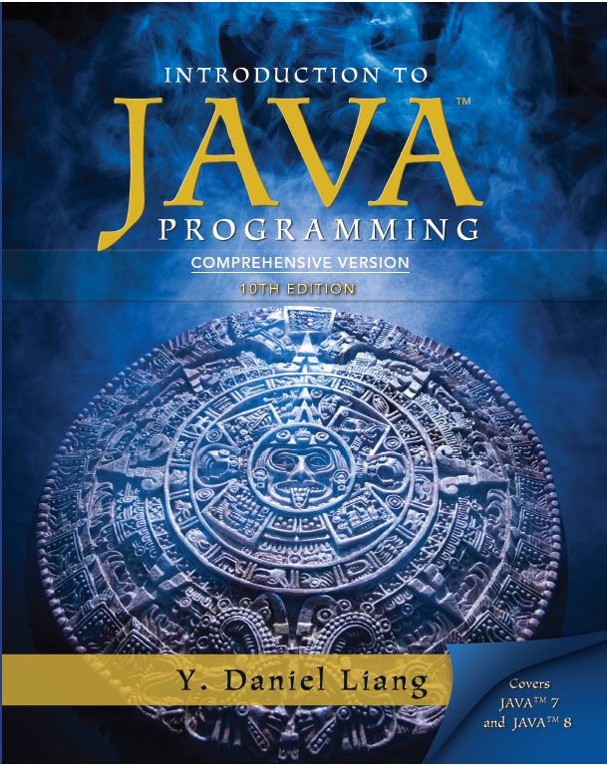
Introduction to Java Programming
Tenth Edition
Chapter 32
Java Database Programming
Copyright © 2013 Pearson Education, Inc. All Rights Reserved

Slide 2
Objectives (1 of 2)
32.1 To understand the concept of database and database management systems (§32.2).
32.2 To understand the relational data model: relational data structures, constraints, and languages (§32.2).
32.3 To use SQL to create and drop tables, and to retrieve and modify data (§32.3).
32.4 To learn how to load a driver, connect to a database, execute statements, and process result sets using JDBC (§32.4).

Slide 3
Objectives (2 of 2)
32.5 To use prepared statements to execute precompiled SQL statements (§32.5).
32.6 To use callable statements to execute stored SQL procedures and functions (§32.6).
32.7 To explore database metadata using the DatabaseMetaData and ResultSetMetaData interfaces (§32.7).

Slide 4
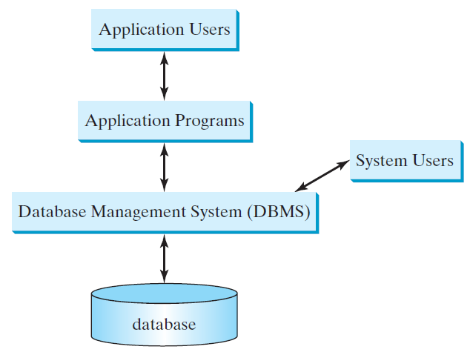
What is a Database System?

Slide 5
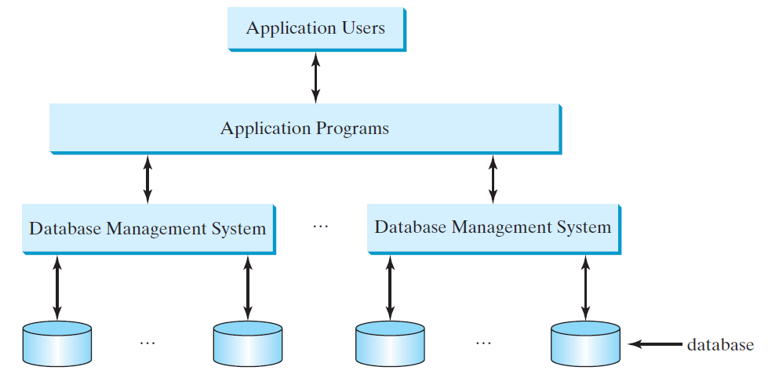
Database Application Systems

Slide 6
Rational Database and Relational Data Model
Most of today’s database systems are relational database systems, based on the relational data model. A relational data model has three key A relational data model has three key components: structure, integrity and languages.
Structure defines the representation of the data.
Integrity imposes constraints on the data.
Language provides the means for accessing and manipulating data.

Slide 7
Relational Structure
A relational database consists of a set of relations. A relation has two things in one: a schema and an instance of the schema. The schema defines the relation and an instance is the content of the relation at a given time. An instance of a relation is nothing more than a table with rows and named columns. For convenience with no confusion, we refer instances of relations as just relations or tables.

Slide 8
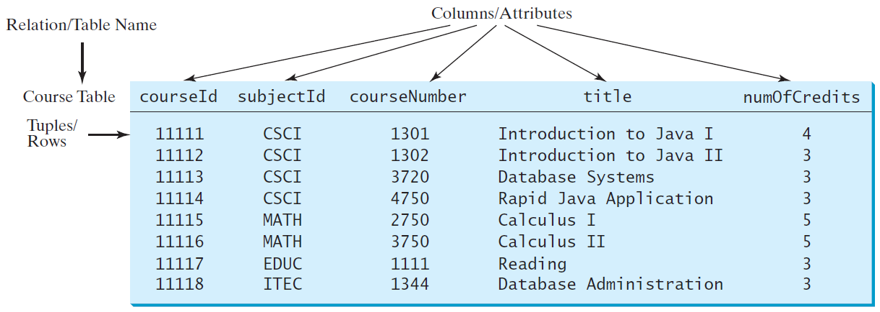
Course Table

Slide 9
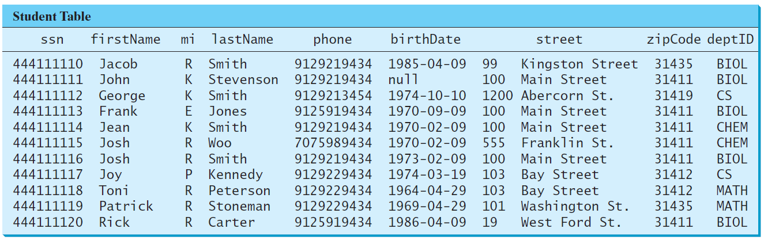
Student Table

Slide 10
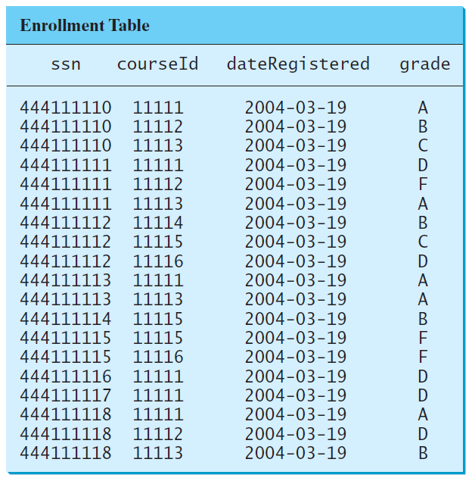
Enrollment Table

Slide 11
Table vs. File
NOTE:
A table or a relation is not same as a file. Most of the relational database systems store multiple tables in a file.

Slide 12
Integrity Constraints
An integrity constraint imposes a condition that all legal instances of the relations must satisfy. In general, there are three types of constraints: domain constraint, primary key constraint, and foreign key constraint. Domain constraints and primary key constraints are known as intra-relational constraints, meaning that a constraint involves only one relation. The foreign key constraint is known as inter-relational, meaning that a constraint involves more than one relation.

Slide 13
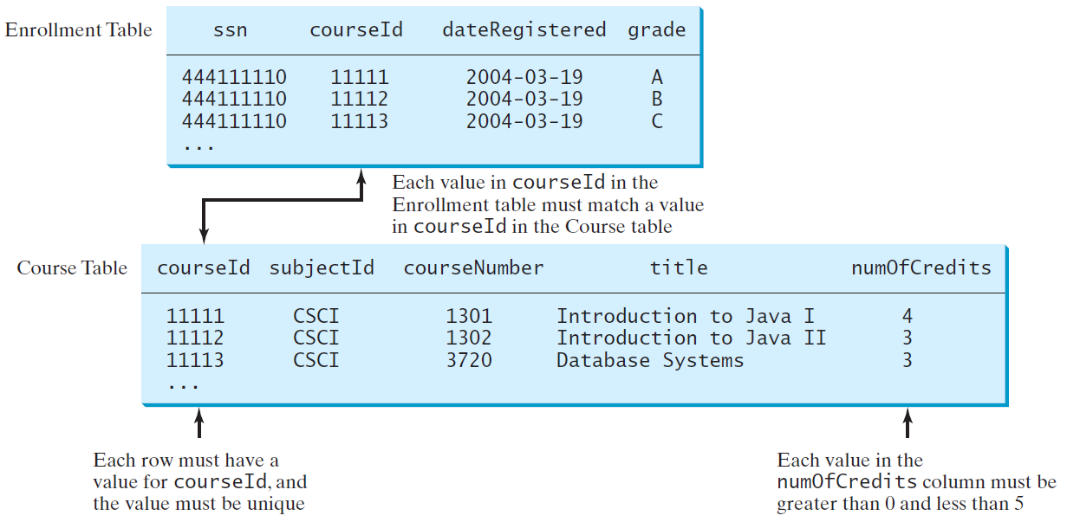
Domain Constraints

Slide 14
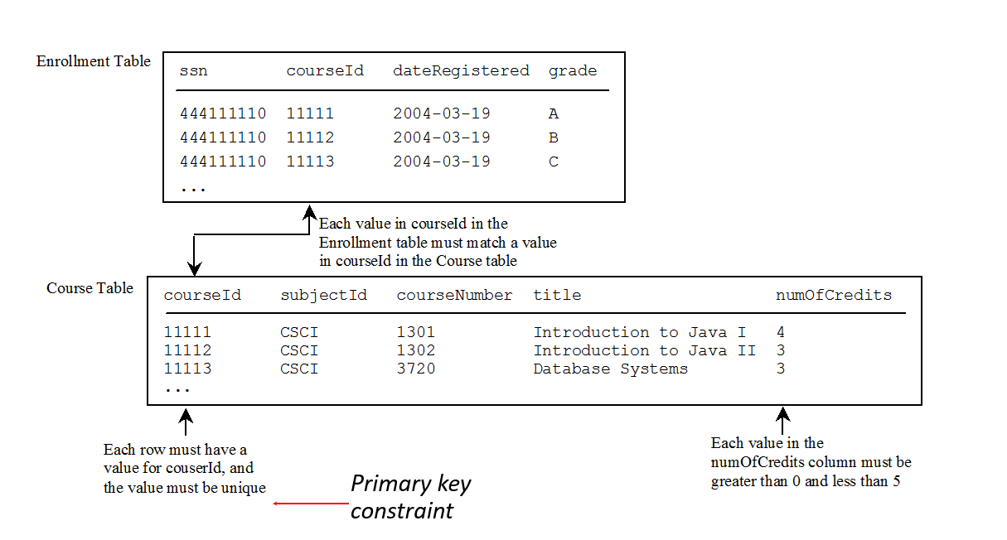
Primary Key Constraints

Slide 15
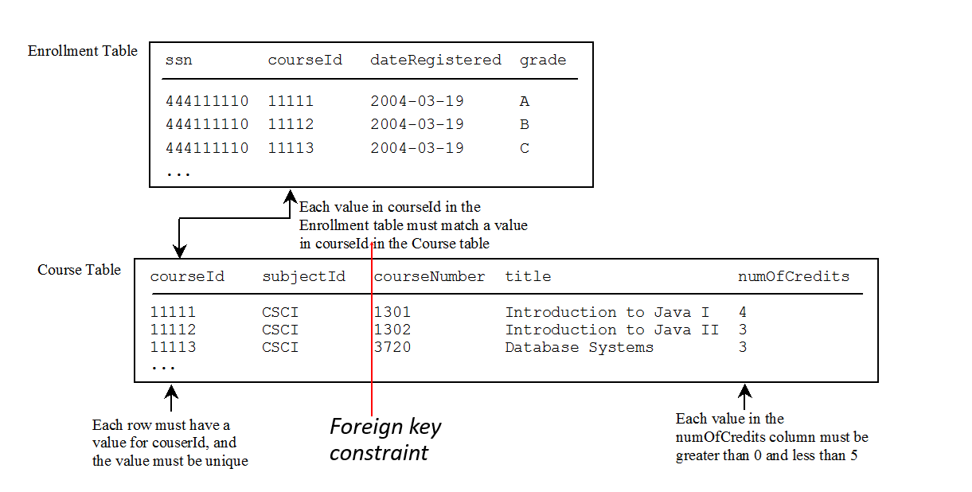
Foreign Key Constraints

Slide 16
Domain Constraints
Domain constraints specify the permissible values for an attribute. Domains can be specified using standard data types such as integers, floating-point numbers, fixed-length strings, and variant-length strings. The standard data type specifies a broad range of values. Additional constraints can be specified to narrow the ranges. You can also specify whether an attribute can be null.

Slide 17
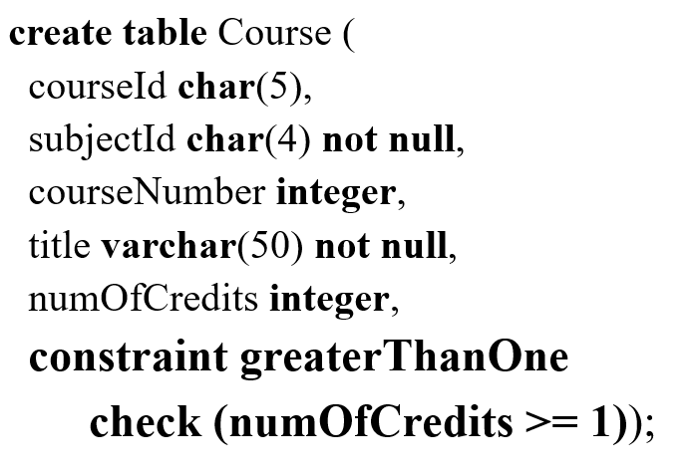
Domain Constraints Example

Slide 18
Superkey
A superkey is an attribute or a set of attributes that uniquely identify the relation. That is, no two tuples have the same values on the superkey. By definition, a relation consists of a set of distinct tuples. The set of all attributes in the relation forms a superkey.

Slide 19
Key and Candidate Key
A key K is a minimal superkey, meaning that any proper subset of K is not a superkey. It is possible that a relation has several keys. In this case, each of the keys is called a candidate key.

Slide 20
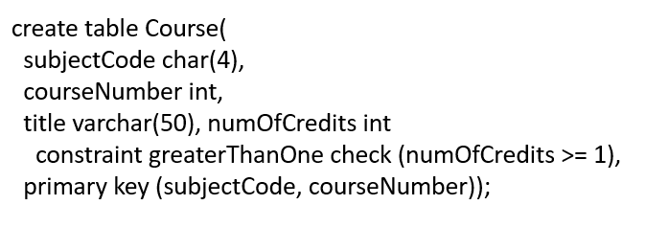
Primary Key
The primary key is one of the candidate keys designated by the database designer. The primary key is often used to identify tuples in a relation.

Slide 21
Primary Key
The primary key is one of the candidate keys designated by the database designer. The primary key is often used to identify tuples in a relation.

Slide 22
Primary Key Constraints
The primary key constraint specifies that the primary key value of a tuple cannot be null and no two tuples in the relation can have the same value on the primary key. The D B M S enforces the primary key constraint. For example, if you attempt to insert a record with the same primary key as an existing record in the table, the DBMS would report an error and reject the operation.

Slide 23
Foreign Key Constraints
In a relational database, data are related. Tuples in a relation are related and tuples in different relations are related through their common attributes. Informally speaking, the common attributes are foreign keys. The foreign key constraints define the relationships among relations.

Slide 24
Foreign Key Constraints Formal Definition
Formally, a set of attributes FK is a foreign key in a relation R that references relation T if it satisfies the following two rules:
The attributes in FK have the same domain as the primary key in T.
A non-null value on FK in R must match a primary key value in T.

Slide 25
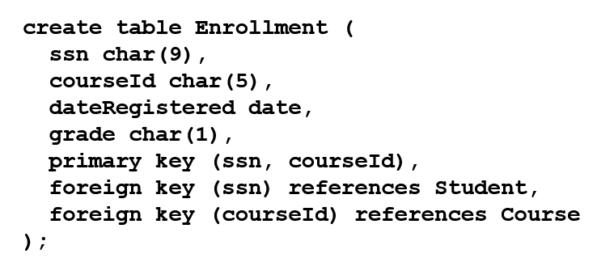
Foreign Key Example

Slide 26
Foreign Key Discussion (1 of 4)
A foreign key is not necessarily the primary key or part of the primary in the relation. For example, subjectCode is a foreign key in the Course table that references the Subject table, but it is not the primary key in Course. departmentCode is a foreign key in the Subject table that references Department, but it is not the primary key in Subject.

Slide 27
Foreign Key Discussion (2 of 4)
The referencing relation and the referenced relation may be the same table. For example, supervisorId is a foreign key in Faculty that references facultyId in Faculty.

Slide 28
Foreign Key Discussion (3 of 4)
The foreign key is not necessary to have the same name as its referenced primary key as long as they have the same domain. For example, headId is a foreign key in Department that references facultyId in Faculty.

Slide 29
Foreign Key Discussion (4 of 4)
A relation may have more than one foreign key. For example, headId and collegeCode are both foreign keys in Department.

Slide 30
S Q L
Structured Query Language, pronounced S-Q-L, or Sequel
To access or write applications for database systems, you need to use the Structured Query Language (S Q L). S Q L is the universal language for accessing relational database systems. Application programs may allow users to access database without directly using S Q L, but these applications themselves must use S Q L to access the database.

Slide 31
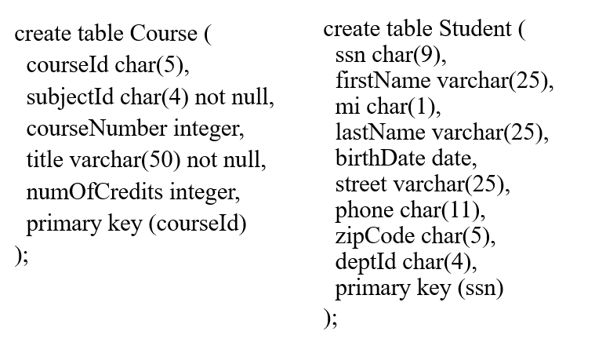
Examples of simple SQL statements (1 of 7)
Create Table

Slide 32

Examples of simple SQL statements (2 of 7)
Drop Table

Slide 33
Examples of simple SQL statements (3 of 7)
Describe Table

Slide 34
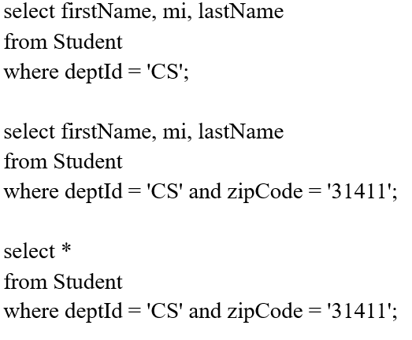
Examples of simple SQL statements (4 of 7)
Select

Slide 35

Examples of simple SQL statements (5 of 7)
Insert

Slide 36
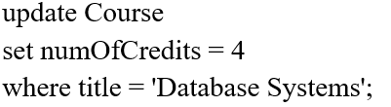
Examples of simple SQL statements (6 of 7)
Update

Slide 37

Examples of simple SQL statements (7 of 7)
Delete

Slide 38
Why Java for Database Programming?
First, Java is platform independent. You can develop platform-independent database applications using S Q L and Java for any relational database systems.
Second, the support for accessing database systems from Java is built into Java A P I, so you can create database applications using all Java code with a common interface.
Third, Java is taught in almost every university either as the first programming language or as the second programming language.

Slide 39
Database Applications Using Java
G U I
Client/Server
Server-Side programming

Slide 40
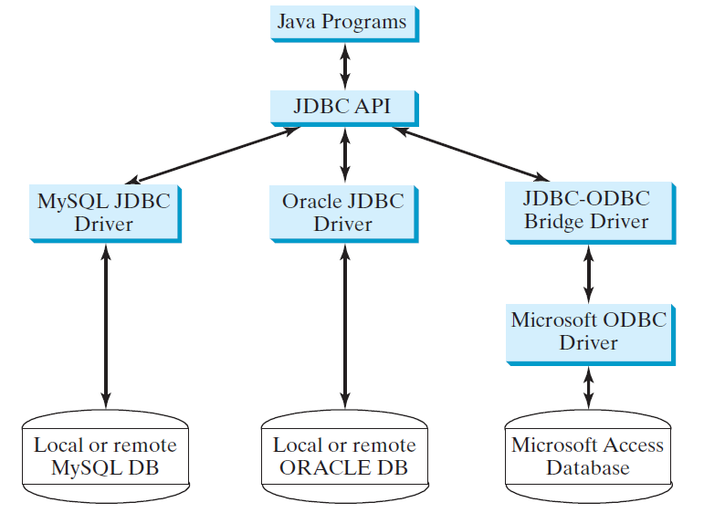
The Architecture of J D B C

Slide 41
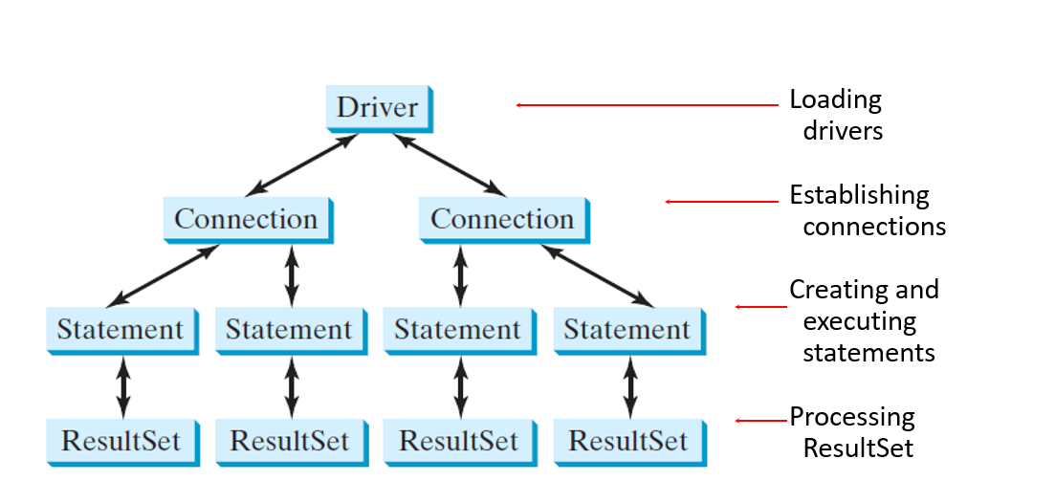
The J D B C Interfaces

Slide 42
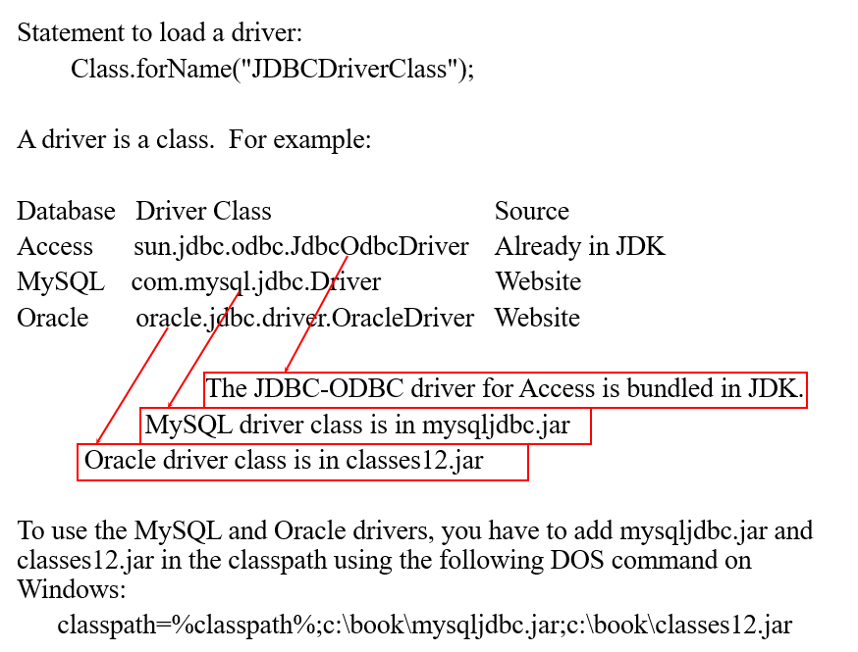
Developing J D B C Programs (1 of 4)
Loading Drivers

Slide 43
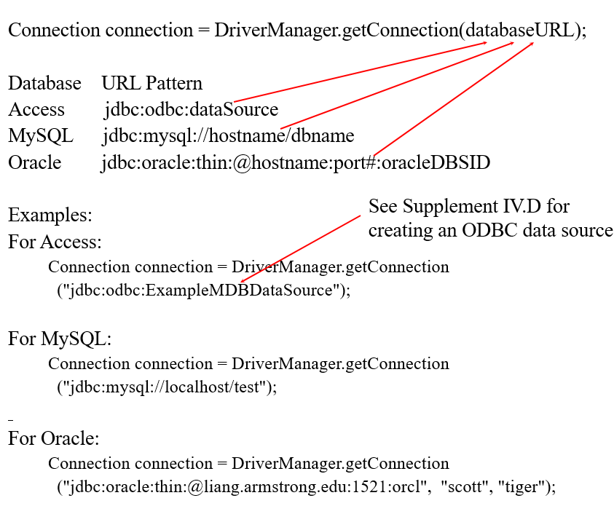
Developing J D B C Programs (2 of 4)
Establishing connections

Slide 44
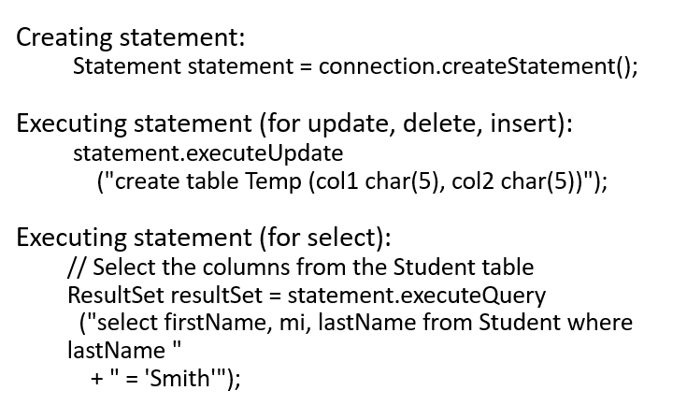
Developing J D B C Programs (3 of 4)
Creating and executing statements

Slide 45
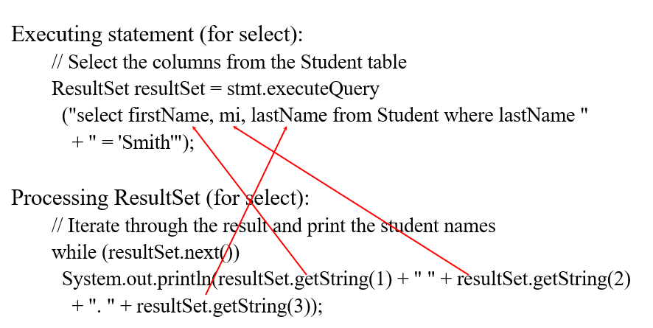
Developing J D B C Programs (4 of 4)
Processing result set

Slide 46
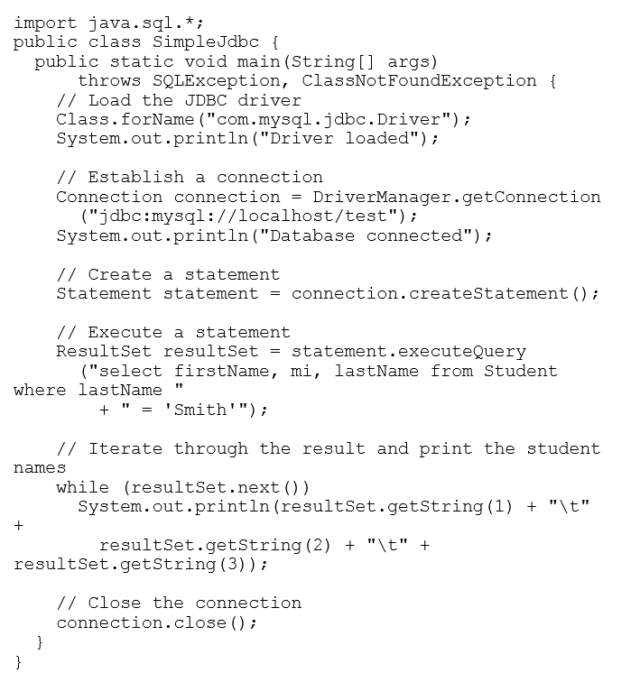
Simple J D B C Example
SimpleJdbc
Run

Slide 47
Creating O D B C Data Source
Please follow the steps in Supplement on the Companion Website to create an O D B C data source on Windows.

Slide 48
Example: Accessing Database from JavaF X
This example demonstrates connecting to a database from a Java applet. The applet lets the user enter the S S N and the course I D to find a student’s grade.
NOTE: To run this program from here, you need:
To have a MyS Q L database setup just like the one in the text.
Set MyS Q L J D B C driver in the classpath.
FindGrade
Run

Slide 49
Processing Statements
Once a connection to a particular database is established, it can be used to send S Q L statements from your program to the database. J D B C provides the Statement, PreparedStatement, and CallableStatement interfaces to facilitate sending statements to a database for execution and receiving execution results from the database.

Slide 50
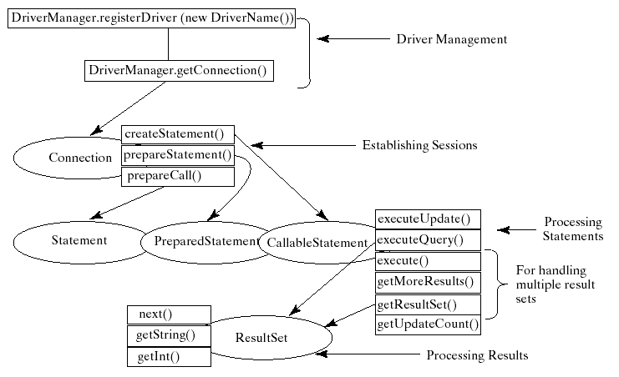
Processing Statements Diagram

Slide 51
The execute, executeQuery, and executeUpdate Methods (1 of 2)
The methods for executing S Q L statements are execute, executeQuery, and executeUpdate, each of which accepts a string containing a S Q L statement as an argument. This string is passed to the database for execution. The execute method should be used if the execution produces multiple result sets, multiple update counts, or a combination of result sets and update counts.

Slide 52
The execute, executeQuery, and executeUpdate Methods (2 of 2)
The executeQuery method should be used if the execution produces a single result set, such as the S Q L select statement. The executeUpdate method should be used if the statement results in a single update count or no update count, such as a S Q L INSERT, DELETE, UPDATE, or D D L statement.

Slide 53
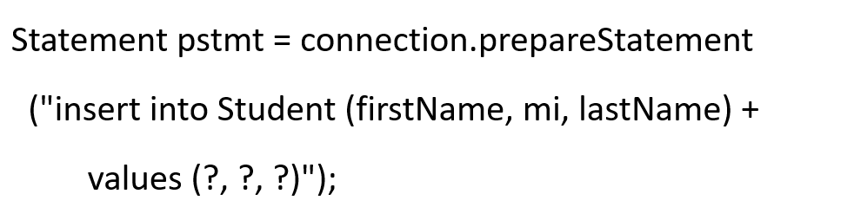
PreparedStatement
The PreparedStatement interface is designed to execute dynamic S Q L statements and S Q L-stored procedures with I N parameters. These S Q L statements and stored procedures are precompiled for efficient use when repeatedly executed.

Slide 54
Example:Using PreparedStatement to Execute Dynamic S Q L Statements
This example rewrites the preceding example using PreparedStatement.
FindGradeUsingPreparedStatement
Run

Slide 55
Retrieving Database Metadata
Database metadata is the information that describes database itself. J D B C provides the DatabaseMetaData interface for obtaining database wide information and the ResultSetMetaData interface for obtaining the information on the specific ResultSet.

Slide 56
DatabaseMetadata
The DatabaseMetaData interface provides more than 100 methods for getting database metadata concerning the database as a whole. These methods can be divided into three groups: for retrieving general information, for finding database capabilities, and for getting object descriptions.

Slide 57
General Information
The general information includes the U R L, username, product name, product version, driver name, driver version, available functions, available data types and so on.

Slide 58
Obtaining Database Capabilities
The examples of the database capabilities are whether the database supports the GROUP BY operator, the ALTER TABLE command with add column option, supports entry-level or full ANSI92 S Q L grammar.

Slide 59
Obtaining Object Descriptions
The examples of the database objects are tables, views, and procedures.

Slide 60
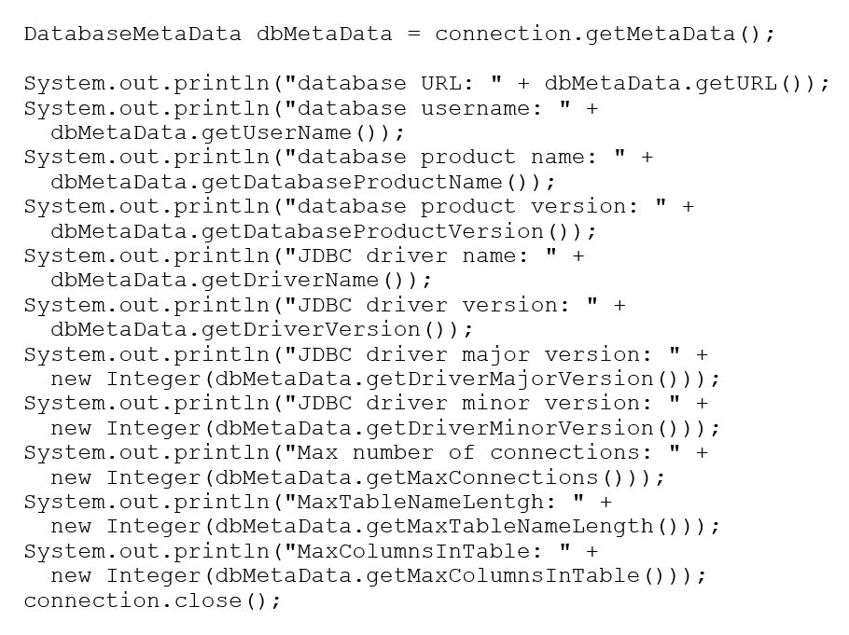
Examples

Slide 61
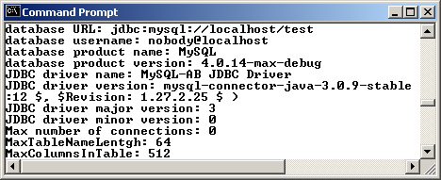
Sample Run

Slide 62

Copyright

