Slide 1
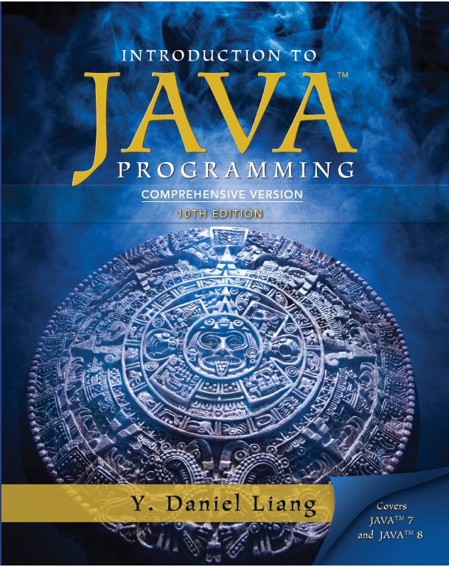
Introduction to Java Programming
Tenth Edition
Chapter 33
JavaServer Face
Slides in the presentation contain hyperlinks. JAWS user should be able to get a list of links by using INSERT+F7
Copyright © 2013 Pearson Education, Inc. All Rights Reserved

Slide 2
Objectives (1 of 2)
33.1 To explain what J S F is (§33.1).
33.2 To create a J S F page using NetBeans (§33.2).
33.3 To create a J S F managed bean (§33.2).
33.4 To use J S F expressions in a facelet (§33.2).
33.5 To use J S F G U I components (§33.3).
33.6 To obtain and process input from a form (§33.4).

Slide 3
Objectives (2 of 2)
33.7 To track sessions in application, session, view, and request scope (§33.5).
33.8 To validate input using the J S F validators (§33.6).
33.9 To bind database with facelets (§33.7).

Slide 4
What is J S F?
J S F completely separates Web U I from Java code so the application developed using J S F is easy to debug and maintain.

Slide 5
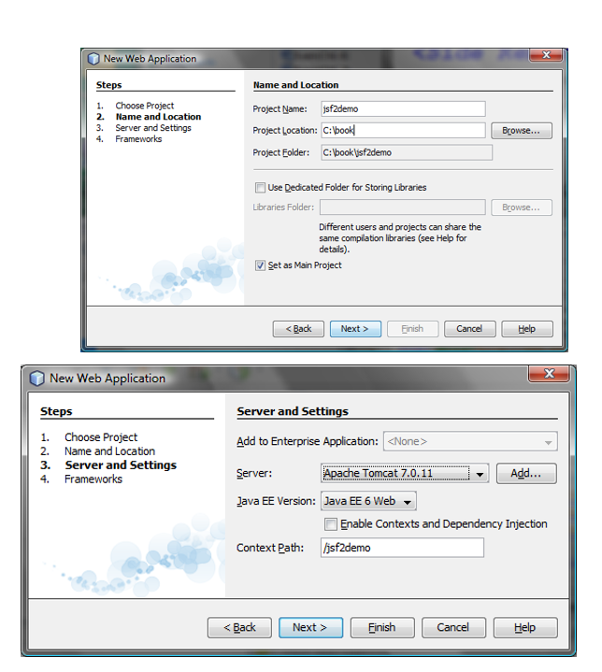
Creating a J S F Project (1 of 2)
Create a Web project with JavaServer Faces.

Slide 6
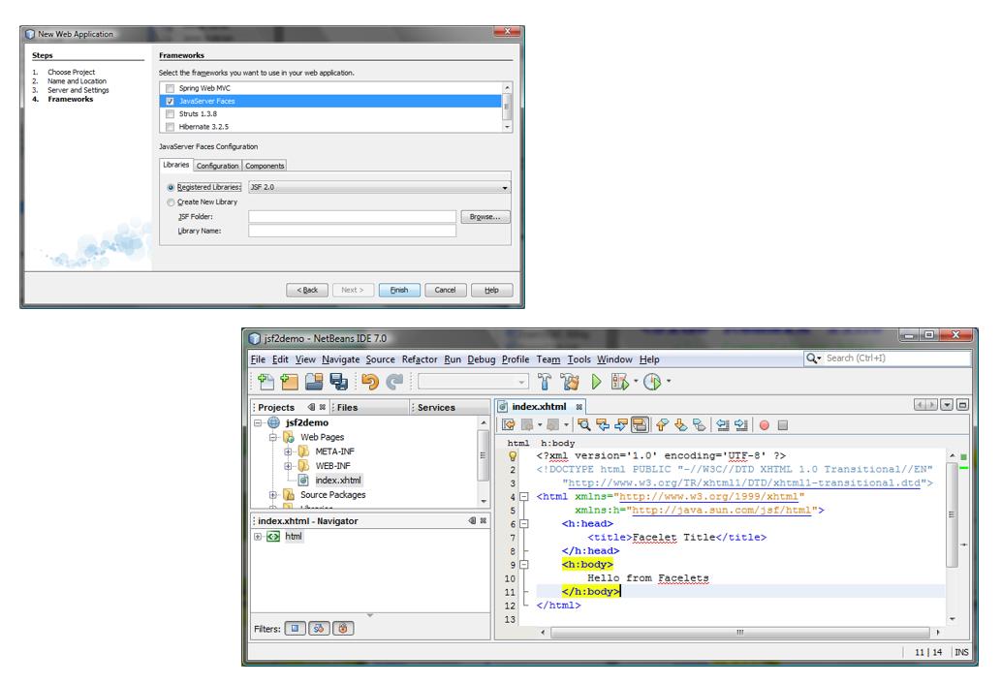
Creating a J S F Project (2 of 2)

Slide 7
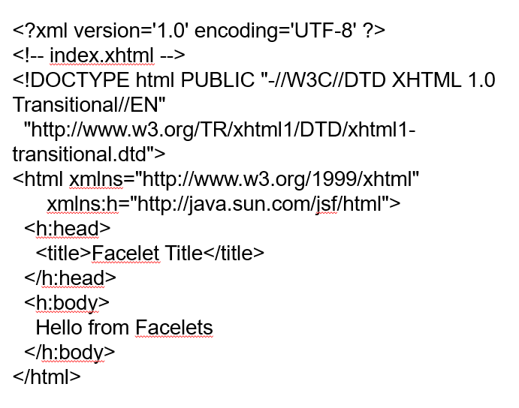
A Basic J S F Page

Slide 8
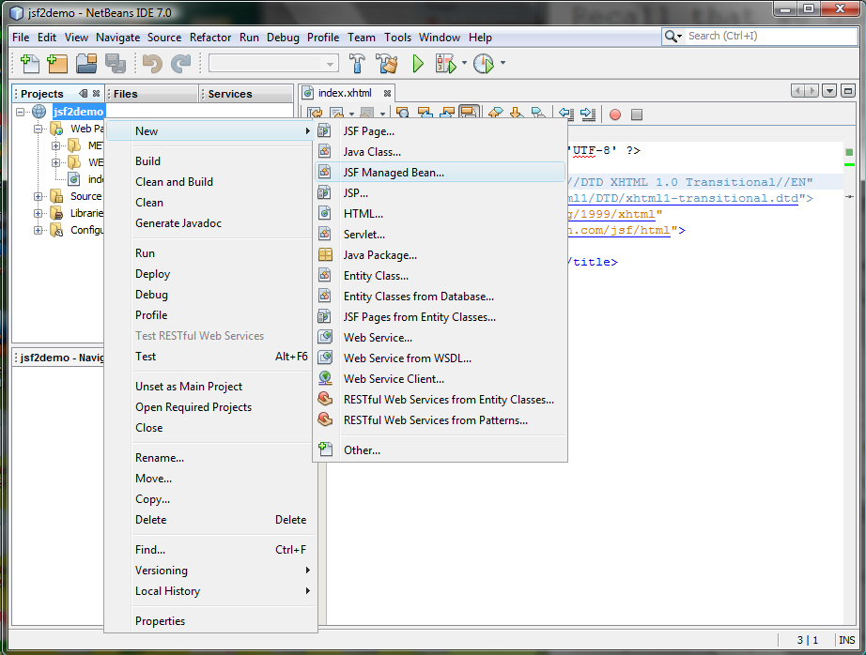
Managed JavaBeans for J S F (1 of 2)

Slide 9
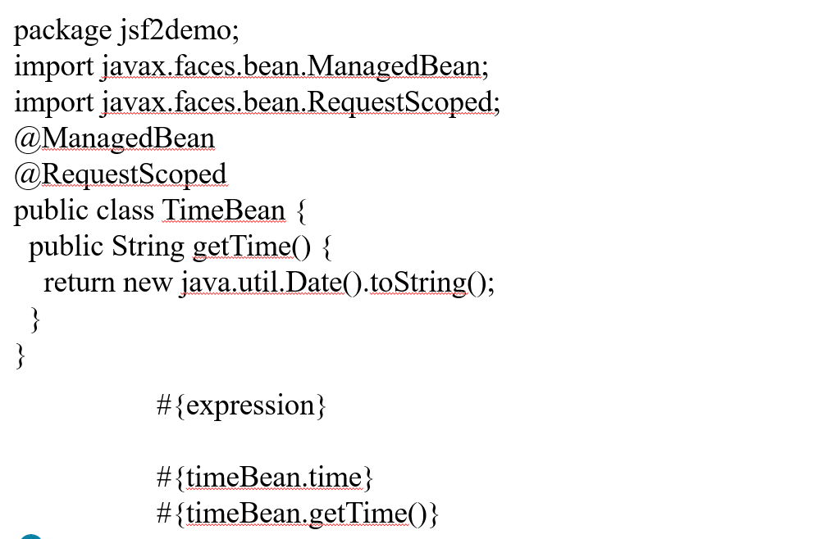
Managed JavaBeans for J S F (2 of 2)

Slide 10
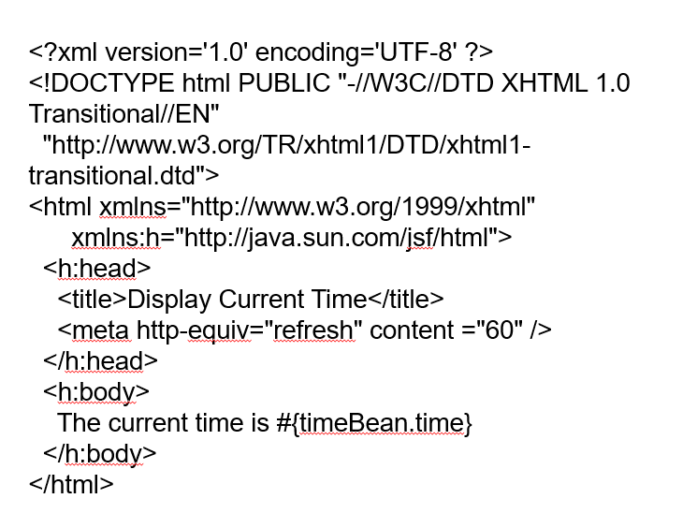
Listing 33.3 CurrentTime.xhtml

Slide 11
J S F G U I Components

Slide 12
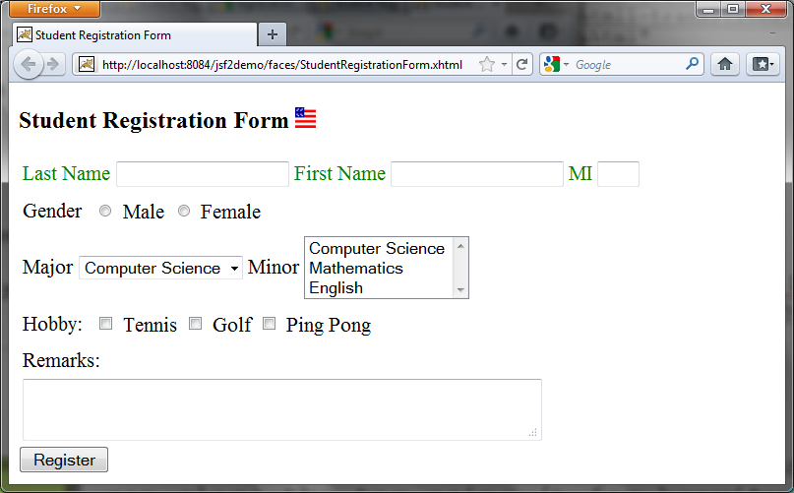
J S F U I Containers

Slide 13
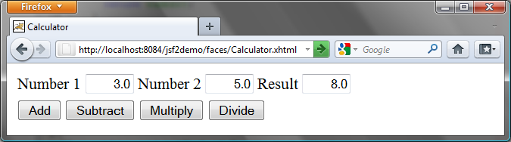
33.5 Case Study: Calculator

Slide 14
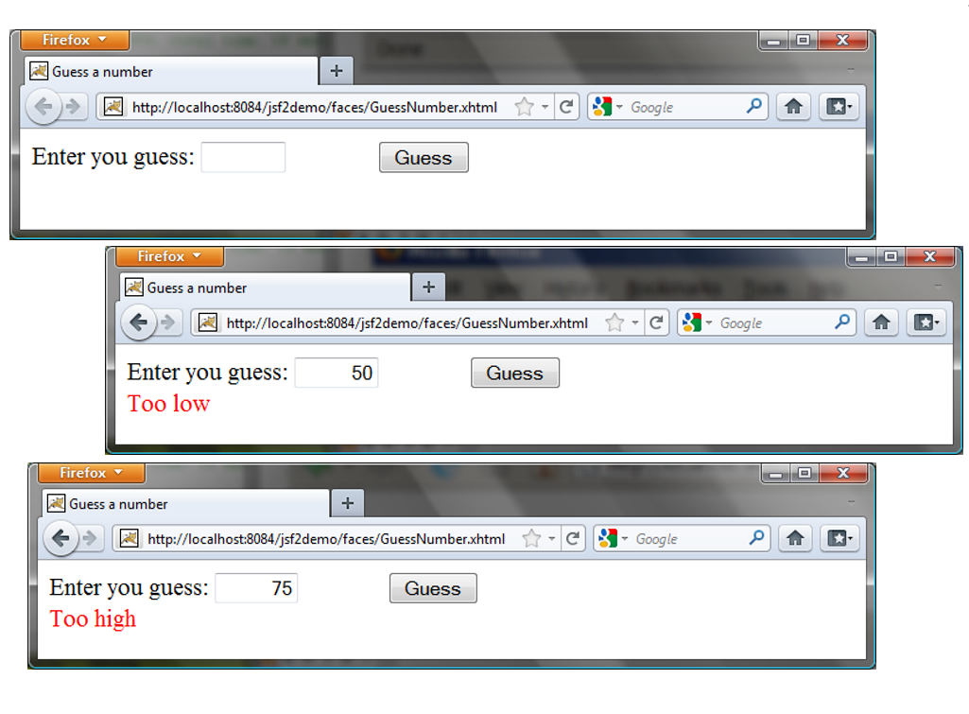
33.6 Session Tracking

Slide 15
33.7 Validating Input

Slide 16


