Slide 1
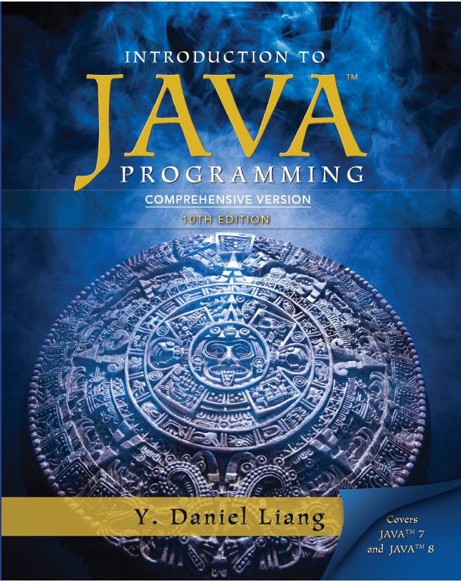
Introduction to Java Programming
Tenth Edition
Chapter 34
Advanced JavaF X
Copyright © 2015 Pearson Education, Inc. All Rights Reserved

Slide 2
Objectives (1 of 2)
34.1 To specify styles for U I nodes using JavaF X C S S (§34.2).
34.2 To simplify creating JavaF X nodes using the builder classes (§34.3).
34.3 To create quadratic curve, cubic curve, and path using the QuadCurve, CubicCurve, and Path classes (§34.4).
34.4 To translation, rotation, and scaling to perform coordinate transformations for nodes (§34.5).
34.5 To define a shape’s border using various types of strokes (§34.6).

Slide 3
Objectives (2 of 2)
34.6 To create menus using the Menu, MenuItem, CheckMenuItem, and RadioMemuItem classes (§34.7).
34.7 To create context menus using the ContextMenu class (§34.8).
34.8 To use SplitPane to create adjustable horizontal and vertical panes (§34.9).
34.9 To create tab panes using the TabPane control (§34.10).
34.10 To create and display tables using the TableView and TableColumn classes (§34.11).

Slide 4
JavaF X C S S
A JavaFX style property is defined with a prefix –fx- to distinquish it from a property in CSS. All the available JavaFX properties are defined in http://docs.oracle.com/javafx/2/api/javafx/scene/doc-files/cssref.html. Listing 34.1 gives an example of a style sheet .

Slide 5
Style Class and Style I D
A style sheet uses the style class or style id to define styles. Multiple style classes can be applied to a single node and a style id to a unique node. The syntax .styleclass defines a style class. The syntax #styleid defines a style id.
mystyle.css
StyleSheetDemo
Run

Slide 6
Builder Classes
The builder classes can be used to simplify creating JavaFX nodes. JavaFX provides a builder class for every node. Using the builder class can sometimes simplify coding. It is particularly useful when creating multiple objects of the same type with common properties.
BuilderClassDemo
Run

Slide 7
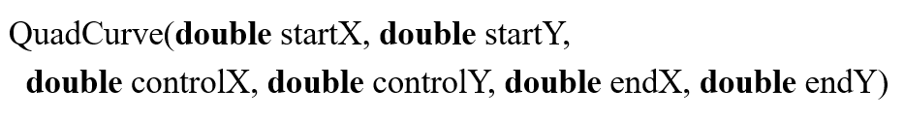
QuadCurve (1 of 2)
A quadratic curve is mathematically defined as a quadratic polynomial. To create a QuadCurve, use its no-arg constructor or the following constructor:

Slide 8
QuadCurve (2 of 2)

Slide 9
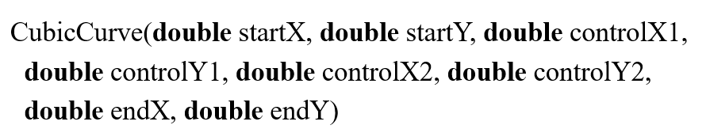
CubicCurve (1 of 2)
A cubic curve is mathematically defined as a cubic polynomial. To create a CubicCurve, use its no-arg constructor or the following constructor:

Slide 10
CubicCurve (2 of 2)
CurveDemo
Run

Slide 11
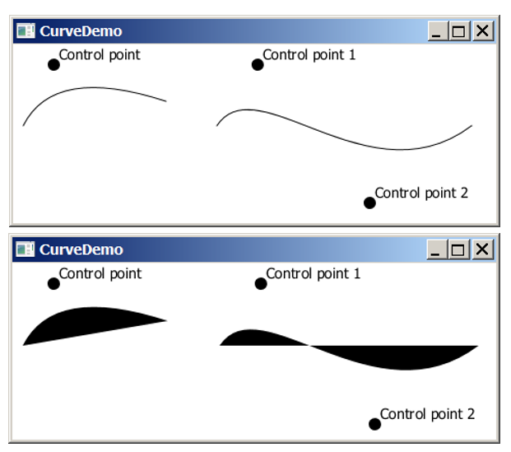
Curve Demo
CurveDemo
Run

Slide 12
Path (1 of 2)
The Path class models an arbitrary geometric path. A path is constructed by adding path elements into the path. The PathElement is the root class for the path elements MoveTo, HLineTo, VLineTo, LineTo, ArcTo, QuadCurveTo, CubicCurveTo, and ClosePath.
PathDemo
Run

Slide 13
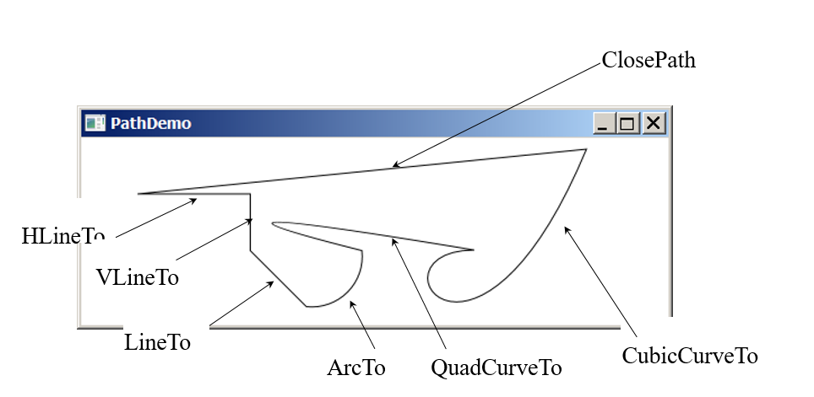
Path (2 of 2)
PathDemo
Run

Slide 14
Coordinate Transformations
JavaF X supports coordinate transformations using translation, rotation, and scaling.

Slide 15
Translations
You can use the setTranslateX(double x), setTranslateY(double y), and setTranslateZ(double z)methods in the Node class to translate the coordinates for a node.
TransitionDemo
Run

Slide 16
Rotations
You can use the rotate(double theta) method in the Node class to rotate a node by theta degrees from its pivot point clockwise, where theta is a double value in degrees. The pivot point is automatically computed based on the bounds of the node.
RotationDemo
Run

Slide 17
Scaling (1 of 2)
You can use the setScaleX(double sx), setScaleY(double sy) , and setScaleY(double sy) methods in the Node class to specify a scaling factor. The node will appear larger or smaller depending on the scaling factor. Scaling alters the coordinate space of the node such that each unit of distance along the axis is multiplied by the scale factor. As with rotation transformations, scaling transformations are applied to enlarge or shrink the node around the pivot point.
For a node of the rectangle shape, the pivot point is the center of the rectangle.

Slide 18
Scaling (2 of 2)
ScaleDemo
Run

Slide 19
Strokes

Slide 20

strokeType
The setStrokeType(type) method sets a type for the stroke. The type defines whether the stroke is inside, outside, or in the center of the border using the constants StrokeType.INSIDE, StrokeType.CENTERED (default), or StrokeType.OUTSIDE,

Slide 21
strokeLineCap
The setStrokeType(type) method sets a type for the stroke. The type defines whether the stroke is inside, outside, or in the center of the border using the constants StrokeType.INSIDE, StrokeType.CENTERED (default), or StrokeType.OUTSIDE,

Slide 22

strokeLineJoin
The setStrokeLineJoin method defines the decoration applied where path segments meet. You can specify three types of line join using the constants StrokeLineJoin.MITER (default), StrokeLineJoin.BEVEL, and StrokeLineJoin.ROUND.

Slide 23
strokeDashArray
The Shape class has a property named strokeDashArray of the ObservableList<Double> type. This property is used to define a dashed pattern for the stroke. Alternate numbers in the list specify the lengths of the opaque and transparent segments of the dashes.

Slide 24
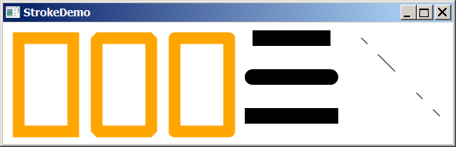
Stroke Demo
StrokeDemo
Run

Slide 25
Menu
Menus make selection easier and are widely used in window applications. JavaF X provides five classes that implement menus: MenuBar, Menu, MenuItem, CheckMenuItem, and RadioButtonMenuItem.
MenuBar is a top-level menu component used to hold the menus. A menu consists of menu items that the user can select (or toggle on or off). A menu item can be an instance of MenuItem, CheckMenuItem, or RadioButtonMenuItem. Menu items can be associated with nodes and keyboard accelerators.

Slide 26
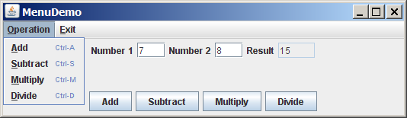
Creating Menus
MenuDemo
Run

Slide 27
Context Menu
A context menu, also known as a popup menu, is like a regular menu, but does not have a menu bar and can float anywhere on the screen. Creating a context menu is similar to creating a regular menu. First, you create an instance of ContextMenu, then you can add MenuItem, CheckMenuItem, and RadioMenuItem to the context menu.

Slide 28
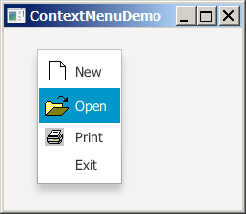
Creating Context Menus
ContextMenuDemo
Run

Slide 29
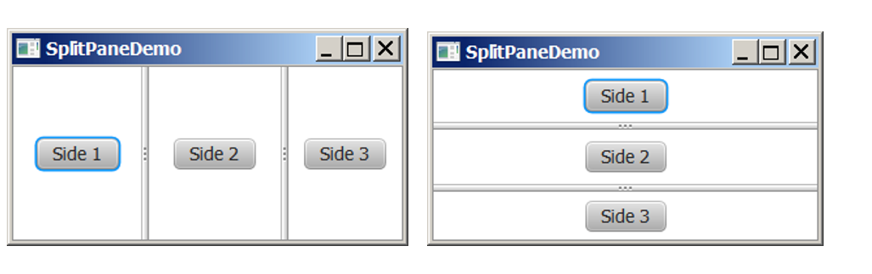
SplitPane
The SplitPane class can be used to display multiple panes and allow the user to adjust the size of the panes.

Slide 30
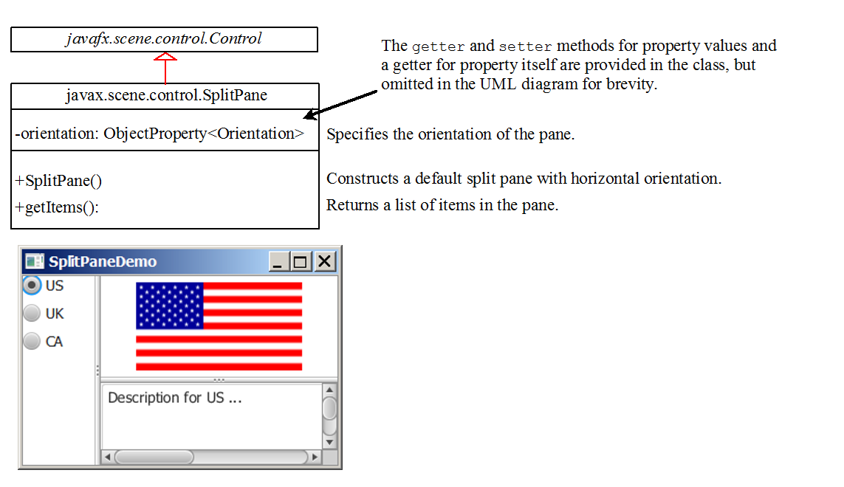
Using SplitPane
SplitPaneDemo
Run

Slide 31
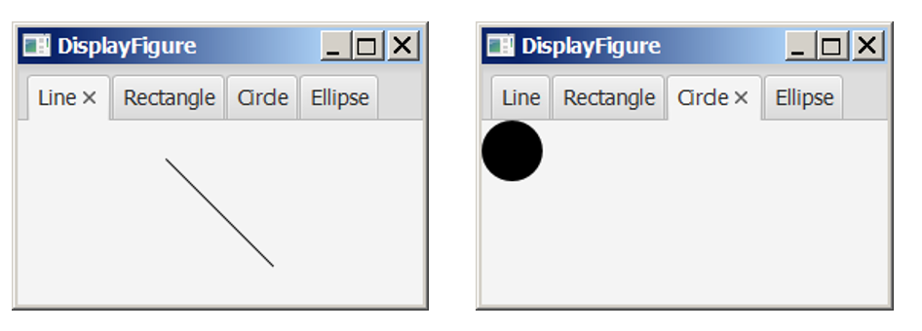
TabPane
The TabPane class can be used to display multiple panes with tabs.

Slide 32
The TabPane Class

Slide 33
The Tab Class
TabPaneDemo
Run

Slide 34
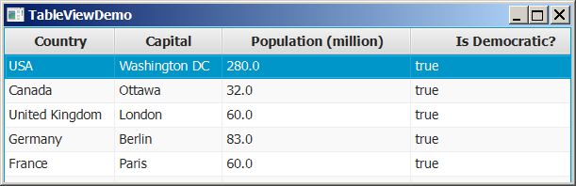
TableView
You can display tables using the TableView class.
TableviewDemo
Run

Slide 35
The TableView Class

Slide 36
The TableColumn Class

Slide 37
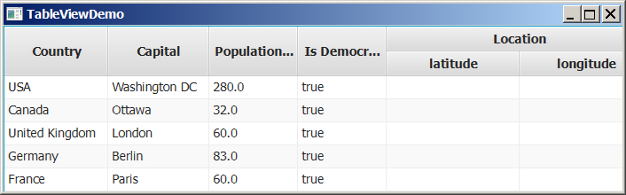
Add New Row
You can display tables using the TableView class.
AddNewRowDemo
Run

Slide 38

Copyright

