Slide 1
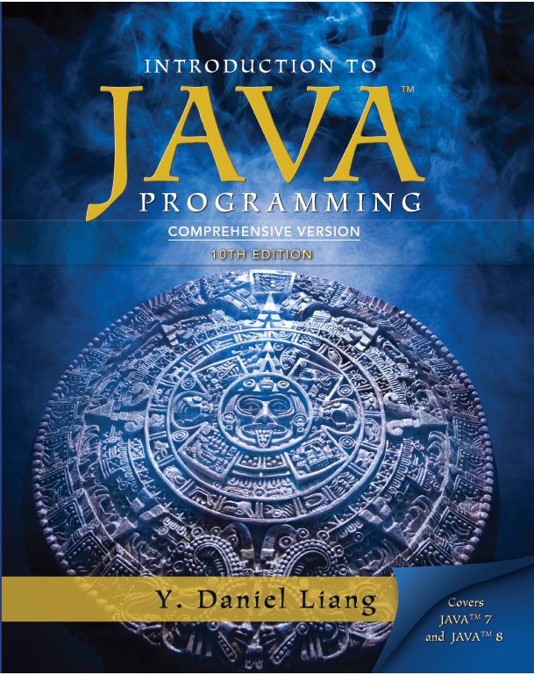
Introduction to Java Programming
Tenth Edition
Chapter 35
Advanced Java Database Programming
Copyright © 2013 Pearson Education, Inc. All Rights Reserved

Slide 2
Objectives
35.1 To create a universal S Q L client for accessing local or remote database (§35.2).
35.2 To execute S Q L statements in a batch mode (§35.3).
35.3 To process updatable and scrollable result sets (§35.4).
35.4 To simplify Java database programming using RowSet (§35.5).
35.5 To store and retrieve images in J D B C (§35.6).

Slide 3
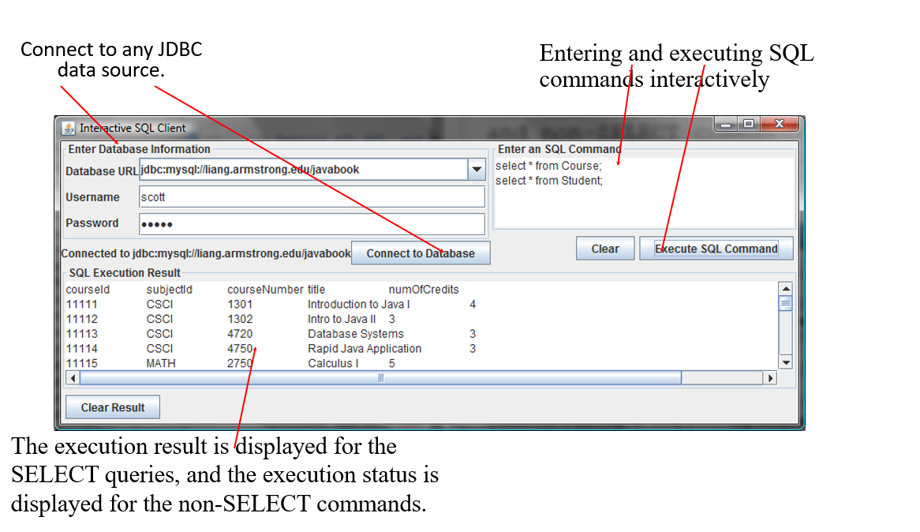
Example: Creating an Interactive S Q L Client
SQLClient
Run

Slide 4
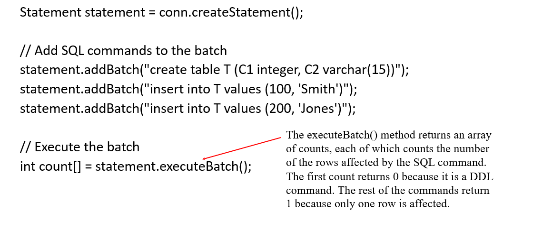
Batch Updates
To improve performance, JDBC 2 introduced the batch update for processing nonselect SQL commands. A batch update consists of a sequence of nonselect SQL commands. These commands are collected in a batch and submitted to the database all together.

Slide 5
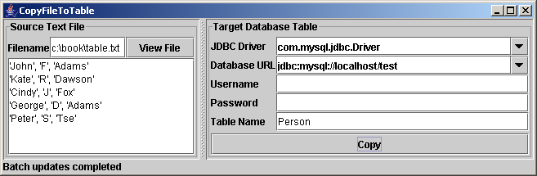
Example: Copying Text Files to Table
Write a program that gets data from a text file and copies the data to a table. The text file consists of the lines, each of which corresponds to a row in the table. The fields in a row are separated by commas. The string values in a row are enclosed in single quotes. You can view the text file by clicking the View File button and copy the text to the table by clicking the Copy button. The table must already be defined in the database.
CopyFileToTable
Run

Slide 6
Scrollable and Updateable Result Set
The result sets used in the preceding examples are read sequentially. A result set maintains a cursor pointing to its current row of data. Initially the cursor is positioned before the first row. The next() method moves the cursor forward to the next row. This is known as sequential forward reading. It is the only way of processing the rows in a result set that is supported by JDBC 1.
With JDBC 2, you can scroll the rows both forward and backward and move the cursor to a desired location using the first, last, next, previous, absolute, or relative method. Additionally, you can insert, delete, or update a row in the result set and have the changes automatically reflected in the database.

Slide 7
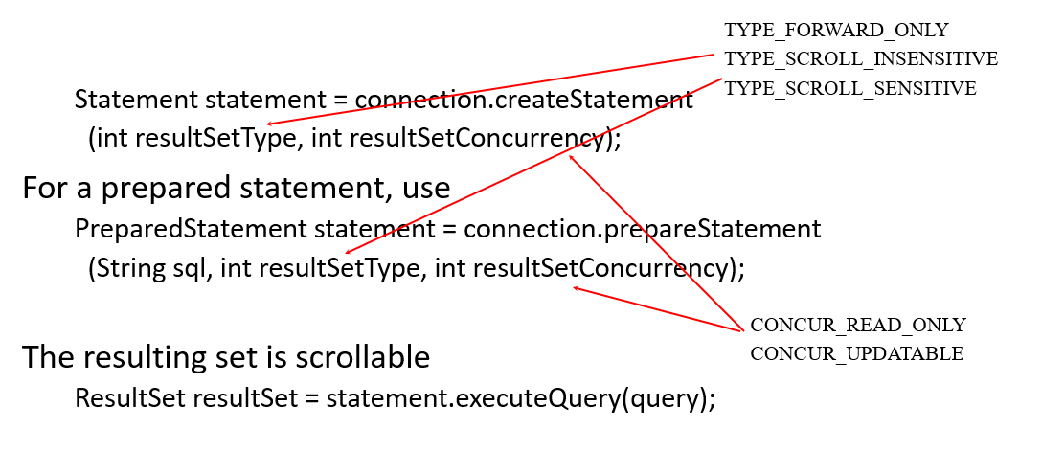
Creating Scrollable Statements
To obtain a scrollable or updateable result set, you must first create a statement with an appropriate type and concurrency mode. For a static statement, use
ScrollUpdateResultSet
Run

Slide 8
RowSet: JdbcRowSet and CachedRowSet
JDBC 2 introduced a new RowSet interface that can be used to simplify database programming. The RowSet interface extends java.sql.ResultSet with additional capabilities that allow a RowSet instance to be configured to connect to a JDBC url, username, password, set a SQL command, execute the command, and retrieve the execution result.

Slide 9
S Q L B L O B and C L O B Types (1 of 2)
B L O B
Database can store not only numbers and strings, but also images. S Q L 3 introduced a new data type B L O B (Binary Large OBject) for storing binary data, which can be used to store images.
C L O B
Another new S Q L 3 type is C L O B (Character Large OBject) for storing a large text in the character format. J D B C 2 introduced the interfaces java.sql.Blob and java.sql.Clob to support mapping for these new S Q L types.

Slide 10
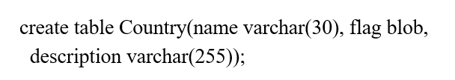
SQL BLOB and CLOB Types (2 of 2)
J B D C 2 also added new methods, such as getBlob, setBinaryStream, getClob, setBlob, and setClob, in the interfaces ResultSet and PreparedStatement to access S Q L B L O B, and C L O B values.
To store an image into a cell in a table, the corresponding column for the cell must be of the B L O B type. For example, the following S Q L statement creates a table whose type for the flag column is B L O B.

Slide 11

Storing and Retrieving Images in J D B C (1 of 2)
To insert a record with images to a table, define a prepared statement like this one:
Images are usually stored in files. You may first get an instance of InputStream for an image file and then use the setBinaryStream method to associate the input stream with a cell in the table, as follows:

Slide 12
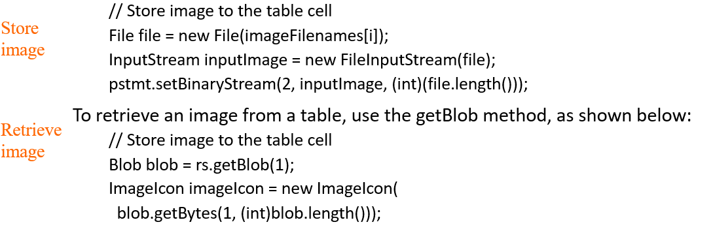
Storing and Retrieving Images in J D B C (2 of 2)

Slide 13
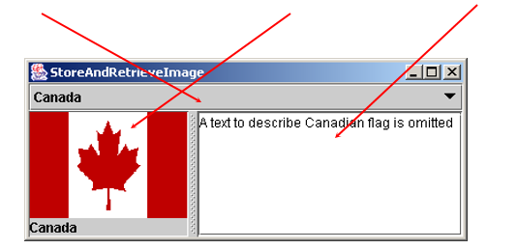
Example: Scrolling and Updating Table
In this example, you will create a table, populate it with data, including images, and retrieve and display images. The table is named Country. Each record in the table consists of three fields: name, flag, and description. Flag is an image field. The program first creates the table and stores data to it. Then the program retrieves the country names from the table and adds them to a combo box. When the user selects a name from the combo box, the country’s flag and description are displayed.
StoreAndRetrieveImage
Run

Slide 14
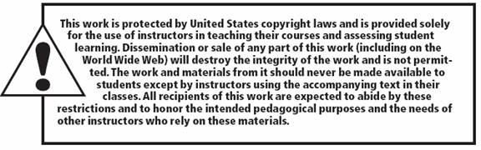
Copyright

