Slide 1
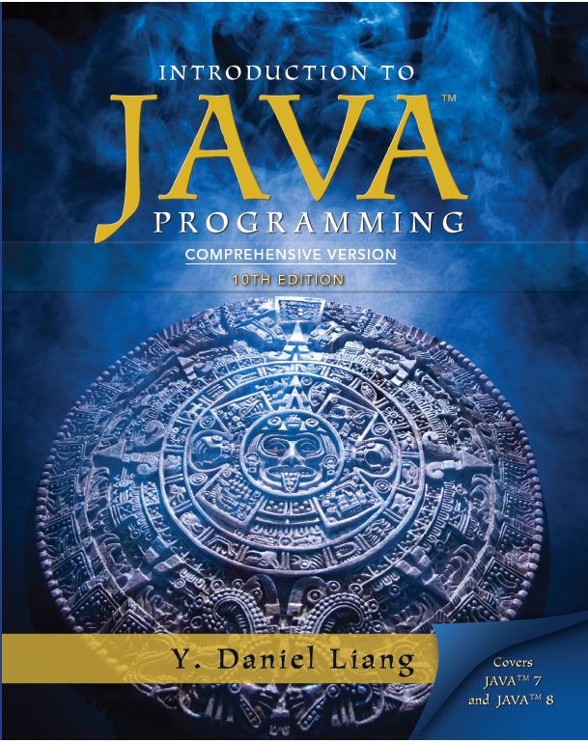
Introduction to Java Programming
Tenth Edition
Chapter 38
JavaServer Page
Copyright © 2013 Pearson Education, Inc. All Rights Reserved

Slide 2
Objectives (1 of 2)
38.1 To create a simple J S P page (§38.2).
38.2 To explain how a J S P page is processed (§38.3).
38.3 To use J S P constructs to code J S P script (§38.4).
38.4 To use predefined variables and directives in J S P (§§38.5-38.6).

Slide 3
Objectives (2 of 2)
38.5 To use JavaBeans components in J S P (§38.7-38.9).
38.6 To develop database applications using J S P (§38.7-38.9).
38.7 To forward requests from a J S P page to another (§38.10).

Slide 4
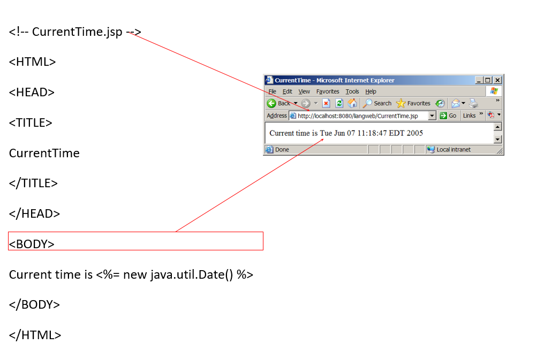
A Simple J S P
Run

Slide 5
How Is a J S P Processed?

Slide 6
J S P Constructs (1 of 3)
There are three types of scripting constructs you can use to insert Java code into the resultant servlet. They are expressions, scriptlets, and declarations.
Expression
A J S P expression is used to insert a Java expression directly into the output. It has the following form:
The expression is evaluated, converted into a string, and sent to the output stream of the servlet.

Slide 7
J S P Constructs (2 of 3)
There are three types of scripting constructs you can use to insert Java code into the resultant servlet. They are expressions, scriptlets, and declarations.
Scriplet
A JSP scriptlet enables you to insert a Java statement into the servlet’s jspService method, which is invoked by the service method. A JSP scriptlet has the following form:

Slide 8
J S P Constructs (3 of 3)
There are three types of scripting constructs you can use to insert Java code into the resultant servlet. They are expressions, scriptlets, and declarations.
Declaration
A JSP declaration is for declaring methods or fields into the servlet. It has the following form:

Slide 9
J S P Comment
H T M L comments have the following form:
If you don’t want the comment appear in the resultant H T M L file, use the following comment in J S P:

Slide 10
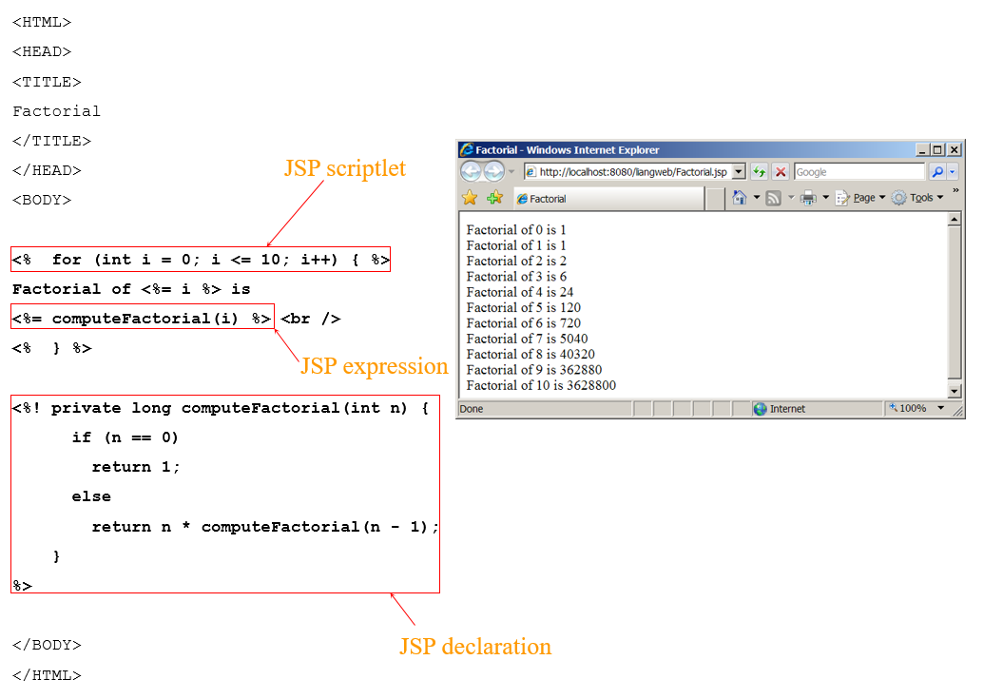
Listing 38.1 Computing Factorials
Run

Slide 11
J S P Predefined Variables (1 of 8)
You can use variables in J S P. For convenience, J S P provides eight predefined variables from the servlet environment that can be used with J S P expressions and scriptlets. These variables are also known as J S P implicit objects.
Request
Represents the client’s request, which is an instance of HttpServletRequest. You can use it to access request parameters, H T T P headers such as cookies, hostname, etc.

Slide 12
J S P Predefined Variables (2 of 8)
You can use variables in J S P. For convenience, J S P provides eight predefined variables from the servlet environment that can be used with J S P expressions and scriptlets. These variables are also known as J S P implicit objects.
Response
Represents the servlet’s response, which is an instance of HttpServletResponse. You can use it to set response type and send output to the client.

Slide 13
J S P Predefined Variables (3 of 8)
You can use variables in J S P. For convenience, J S P provides eight predefined variables from the servlet environment that can be used with J S P expressions and scriptlets. These variables are also known as J S P implicit objects.
Out
Represents the character output stream, which is an instance of PrintWriter obtained from response.getWriter(). You can use it to send character content to the client.

Slide 14
J S P Predefined Variables (4 of 8)
You can use variables in J S P. For convenience, J S P provides eight predefined variables from the servlet environment that can be used with J S P expressions and scriptlets. These variables are also known as J S P implicit objects.
Session
Represents the HttpSession object associated with the request, obtained from request.getSession().

Slide 15
J S P Predefined Variables (5 of 8)
You can use variables in J S P. For convenience, J S P provides eight predefined variables from the servlet environment that can be used with J S P expressions and scriptlets. These variables are also known as J S P implicit objects.
Application
Represents the ServletContext object for storing persistent data for all clients. The difference between session and application is that session is tied to one client, but application is for all clients to share persistent data.

Slide 16
J S P Predefined Variables (6 of 8)
You can use variables in J S P. For convenience, J S P provides eight predefined variables from the servlet environment that can be used with J S P expressions and scriptlets. These variables are also known as J S P implicit objects.
Config
Represents the ServletConfig object for the page.

Slide 17
J S P Predefined Variables (7 of 8)
You can use variables in J S P. For convenience, J S P provides eight predefined variables from the servlet environment that can be used with J S P expressions and scriptlets. These variables are also known as J S P implicit objects.
Pagecontext
Represents the PageContext object. PageContext is a new class introduced in J S P to give a central point of access to many page attributes.

Slide 18
J S P Predefined Variables (8 of 8)
You can use variables in J S P. For convenience, J S P provides eight predefined variables from the servlet environment that can be used with J S P expressions and scriptlets. These variables are also known as J S P implicit objects.
Page
Page is an alternative to this.

Slide 19
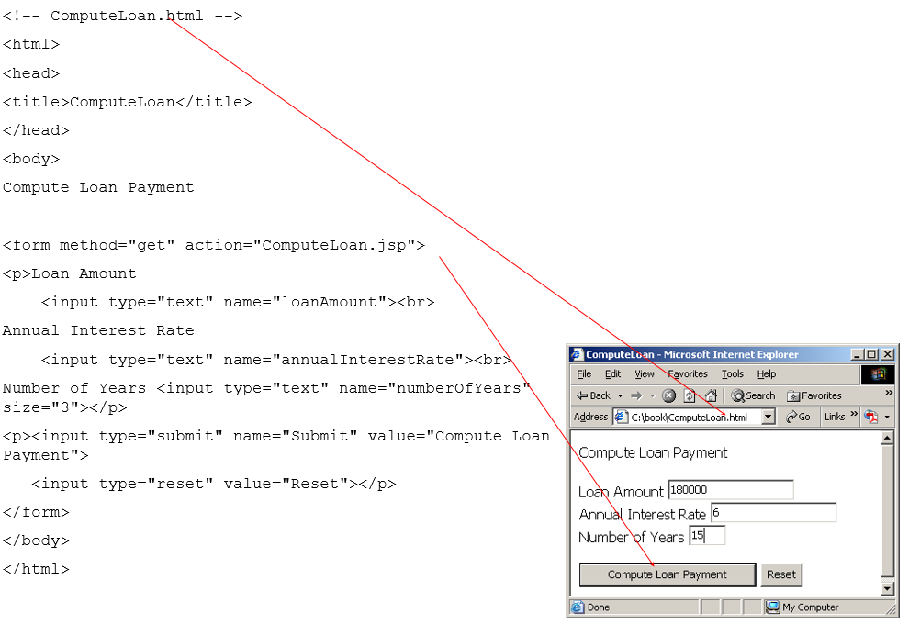
Example 38.2 Computing Loan (1 of 2)
Write an H T M L page that prompts the user to enter loan amount, annual interest rate, and number of years. Clicking the Compute Loan Payment button invokes a J S P to compute and display the monthly and total loan payment.
Run

Slide 20
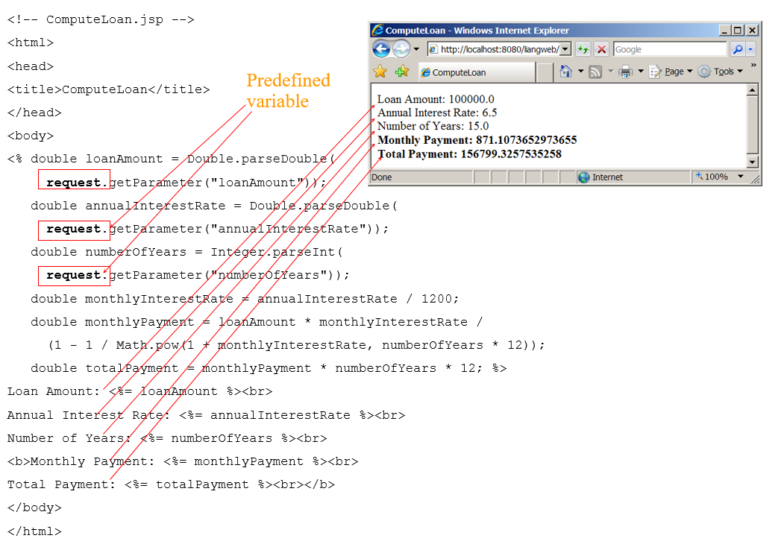
Example 38.2 Computing Loan (2 of 2)

Slide 21
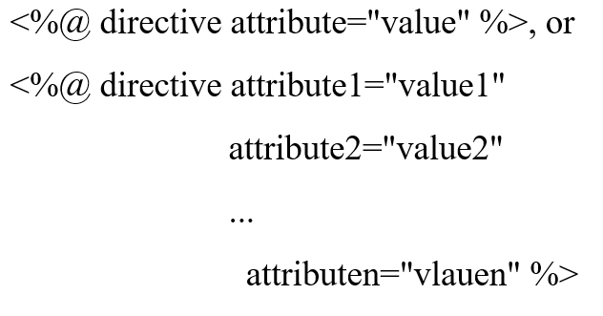
J S P Directives
A J S P directive is a statement that gives the J S P engine information about the J S P page. For example, if your J S P page uses a Java class from a package other than the java.lang package, you have to use a directive to import this package. The general syntax for a J S P directive is as follows:

Slide 22
Three J S P Directives (1 of 3)
Three possible directives are the following: page, include, and tablib.
Page
page lets you provide information for the page, such as importing classes and setting up content type. The page directive can appear anywhere in the J S P file.

Slide 23
Three J S P Directives (2 of 3)
Three possible directives are the following: page, include, and tablib.
Include
include lets you insert a file to the servlet when the page is translated to a servlet. The include directive must be placed where you want the file to be inserted.

Slide 24
Three J S P Directives (3 of 3)
Three possible directives are the following: page, include, and tablib.
Tablib
tablib lets you define custom tags.

Slide 25
Attributes for page Directives (1 of 7)
Import
Specifies one or more packages to be imported for this page. For example, the directive

Slide 26
Attributes for page Directives (2 of 7)
contentType
Specifies the M I M E type for the resultant J S P page. By default, the content type is text/html for J S P. The default content type for servlets is text/plain.

Slide 27
Attributes for page Directives (3 of 7)
Session
Specifies a boolean value to indicate whether the page is part of the session. By default, session is true.

Slide 28
Attributes for page Directives (4 of 7)
Buffer
Specifies the output stream buffer size. By default, it is 8KB. For example, the directive
specifies that the output buffer size is 10KB. The directive
specifies that a buffer is not used.

Slide 29
Attributes for page Directives (5 of 7)
autoFlush
Specifies a boolean value to indicate whether the output buffer should be automatically flushed when it is full or whether an exception should be raised when the buffer overflows. By default, this attribute is true. In this case, the buffer attribute cannot be none.

Slide 30
Attributes for page Directives (6 of 7)
isThreadSafe
Specifies a boolean value to indicate whether the page can be accessed simultaneously without data corruption. By default, it is true. If it is set to false, the J S P page will be translated to a servlet that implements the SingleThreadModel interface.

Slide 31
Attributes for page Directives (7 of 7)
errorPage
errorPage specifies a J S P page that is processed when an exception occurs in the current page. For example, the directive
specifies that HandleError.jsp is processed when an exception occurs.
isErrorPage
isErrorPage specifies a boolean value to indicate whether the page can be used as an error page. By default, this attribute is false.

Slide 32
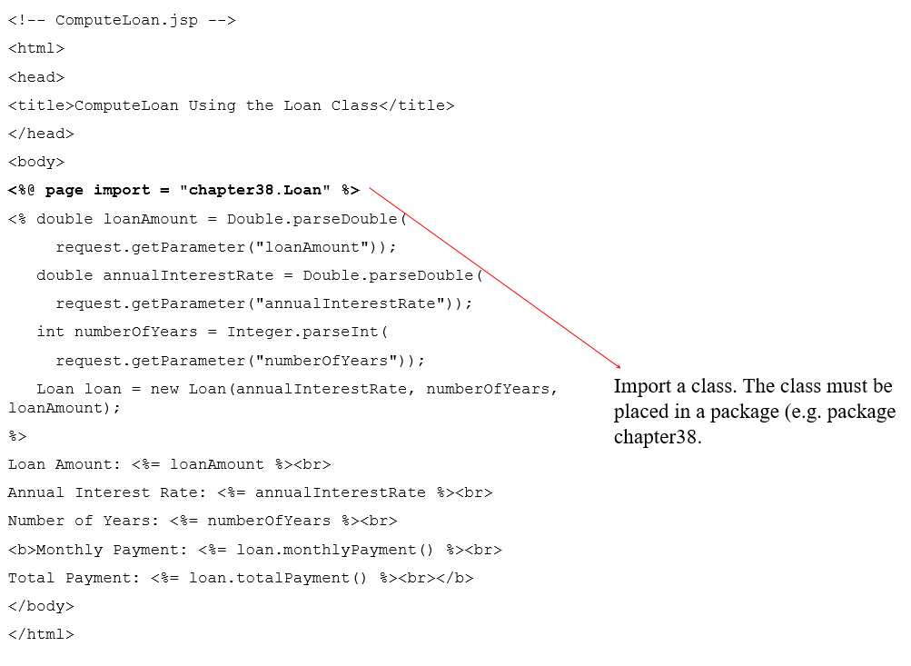
Example: Computing Loan Using the Loan Class
Use the Loan class to simplify Example 38.2. You can create an object of Loan class and use its monthlyPayment() and totalPayment() methods to compute the monthly payment and total payment.

Slide 33
JavaBeans Component in J S P
Recall that a class is a JavaBeans component if it has the following three features:
The class is public.
The class has a public constructor with no arguments.
The class is serializable. (This requirement is not necessary in J S P.)

Slide 34
Using JavaBeans in J S P
To create an instance for a JavaBeans component, use the following syntax:
This syntax is equivalent to
except that the scope attribute specifies the scope of the object.

Slide 35
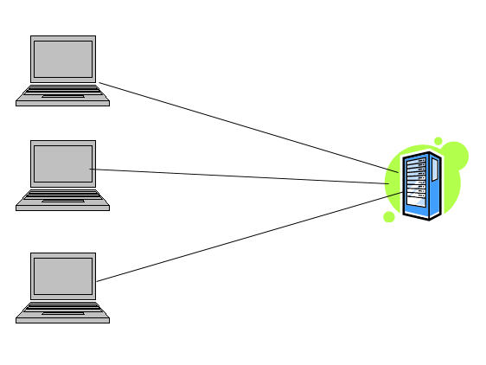
Scope Attributes (1 of 4)
Application
Specifies that the object is bound to the application. The object can be shared by all sessions of the application.

Slide 36

Scope Attributes (2 of 4)
Session
Specifies that the object is bound to the client’s session. Recall that a client’s session is automatically created between a Web browser and Web server. When a client from the same browser accesses two servlets or two J S P pages on the same server, the session is the same.

Slide 37
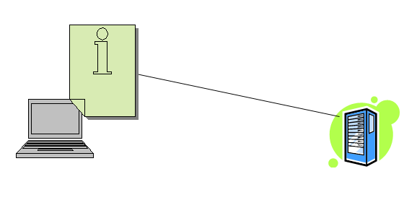
Scope Attributes (3 of 4)
Page
The default scope, which specifies that the object is bound to the page.

Slide 38
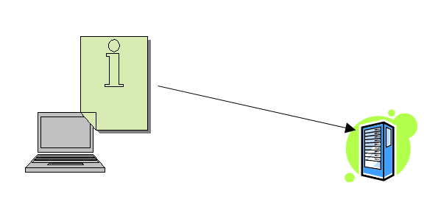
Scope Attributes (4 of 4)
Request
Specifies that the object is bound to the client’s request.

Slide 39
How Does J S P Find an Object
When
is processed, the J S P engine first searches for the object of the class with the same id and scope. If found, the preexisting bean is used; otherwise, a new bean is created.

Slide 40
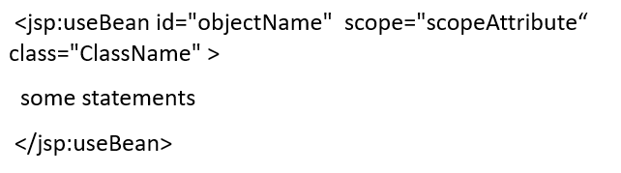
Another Syntax for Creating a Bean
Here is another syntax for creating a bean using the following statement:
The statements are executed when the bean is created. If the bean with the same id and className already exists, the statements are not executed.

Slide 41
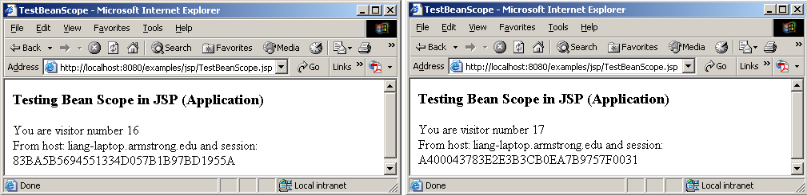
Example: Testing Bean Scope (1 of 2)
This example creates a JavaBeans component named Count and uses it to count the number of visits to a page.
Run

Slide 42
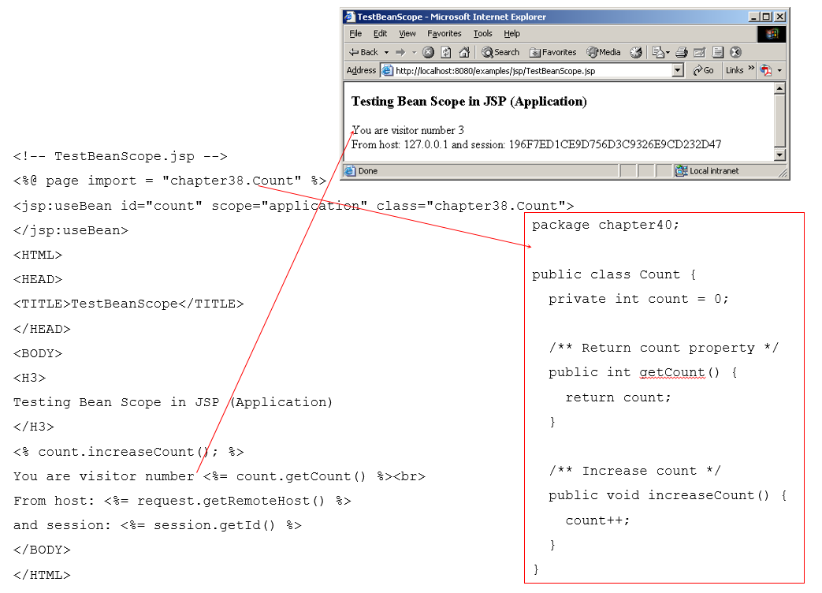
Example: Testing Bean Scope (2 of 2)

Slide 43
Getting and Setting Properties (1 of 2)
By convention, a JavaBeans component provides the get and set methods for reading and modifying its private properties. You can get the property in J S P using the following syntax:
This is equivalent to

Slide 44
Getting and Setting Properties (2 of 2)
You can set the property in JSP using the following syntax:
This is equivalent to

Slide 45
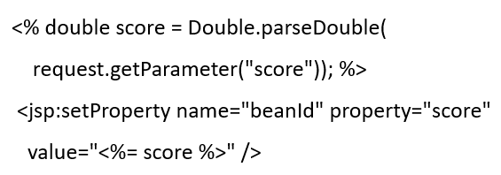
Associating Properties with Input Parameters (1 of 2)
Often properties are associated with input parameters. Suppose you want to get the value of the input parameter named score and set it to the JavaBeans property named score. You may write the following code:

Slide 46
Associating Properties with Input Parameters (2 of 2)
This is cumbersome. JSP provides a convenient syntax that can be used to simplify it as follows:
Instead of using the value attribute, you use the param attribute to name an input parameter. The value of this parameter is set to the property.

Slide 47
Associating All Properties
Often the bean property and the parameter have the same name. You can use the following convenient statement to associate all the bean properties in beanId with the parameters that match the property names.

Slide 48
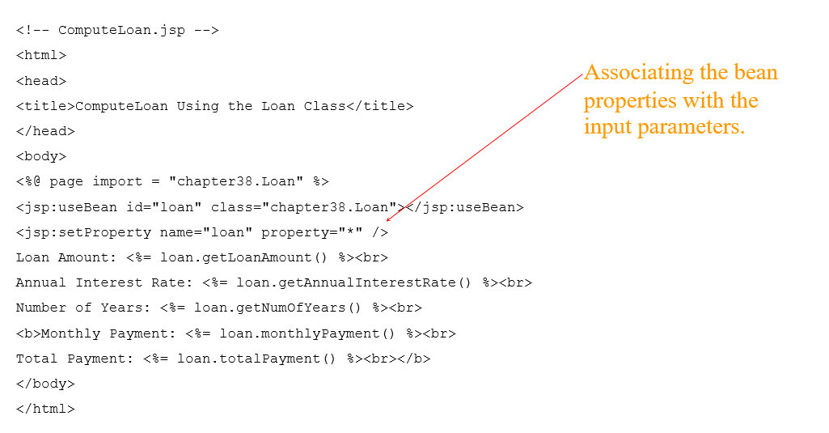
Example: Computing Loan Using JavaBeans
Use JavaBeans to simplify Example 38.3 by associating the bean properties with the input parameters.

Slide 49
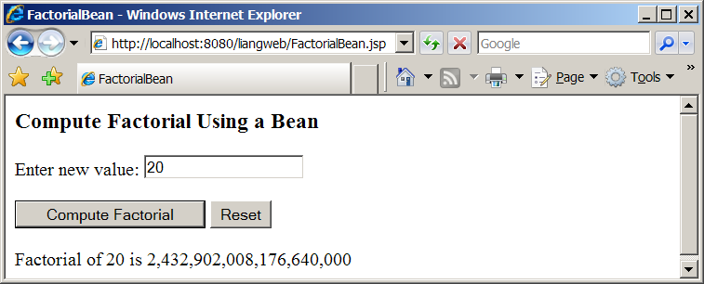
Example: Computing Factorials Using JavaBeans (1 of 3)
Create a JavaBeans component named FactorialBean and use it to compute the factorial of an input number in a J S P page named FactorialBean.jsp.
Run

Slide 50
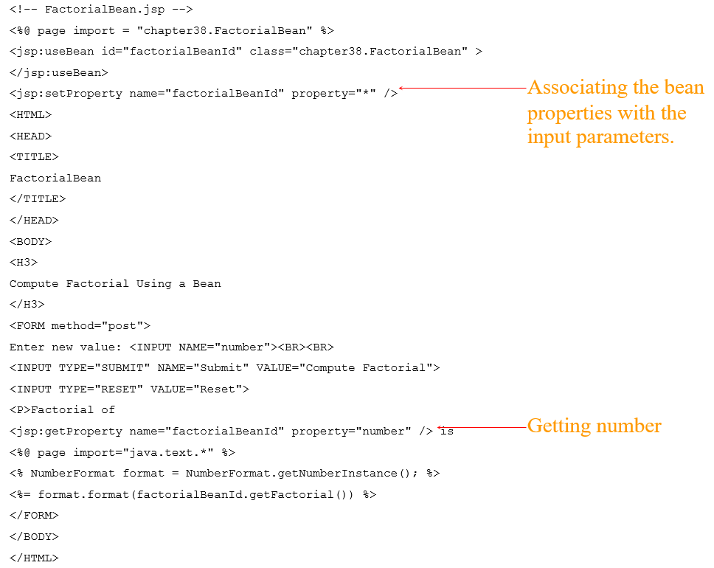
Example: Computing Factorials Using JavaBeans (2 of 3)

Slide 51
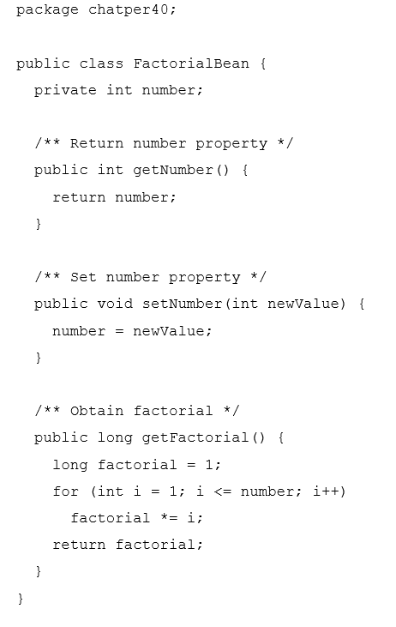
Example: Computing Factorials Using JavaBeans (3 of 3)

Slide 52
Design Guide
Mixing a lot of Java code with H T M L in a J S P page makes the code difficult to read and to maintain. You should move the Java code to a .java file as much as you can.

Slide 53
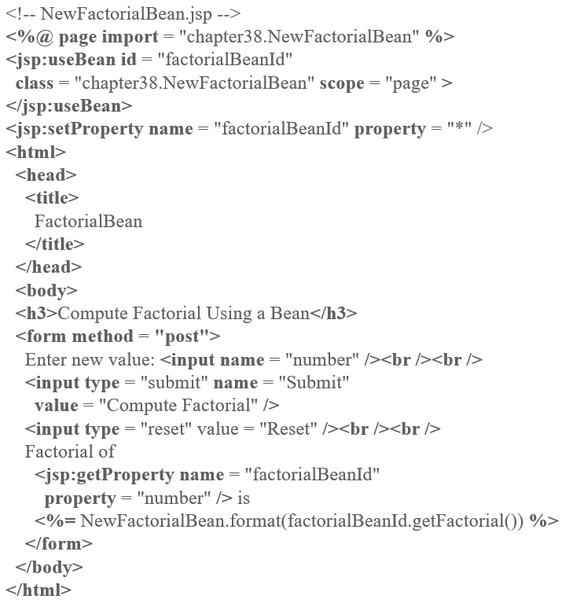
NewFactorialBean

Slide 54
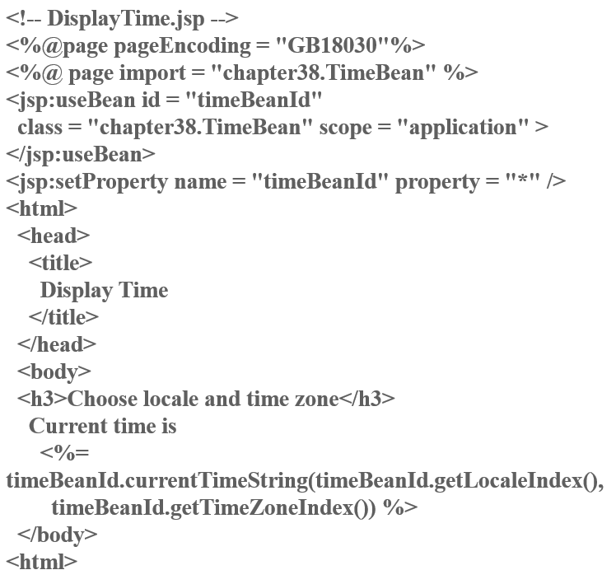
TimeBean

Slide 55
Forwarding Requests from JavaServer Pages
Web applications developed using J S P generally consist of many pages linked together. J S P provides a forwarding tag in the following syntax that can be used to forward a page to another page.

Slide 56
Example: Browsing Database Tables (1 of 2)
This example creates a J S P database application that browses tables. When you start the application, the first page prompts the user to enter the J D B C driver, U R L, username, and password for a database. After you login to the database, you can select a table to browse. Upon clicking the Browse Table Content button, the table content is displayed.

Slide 57
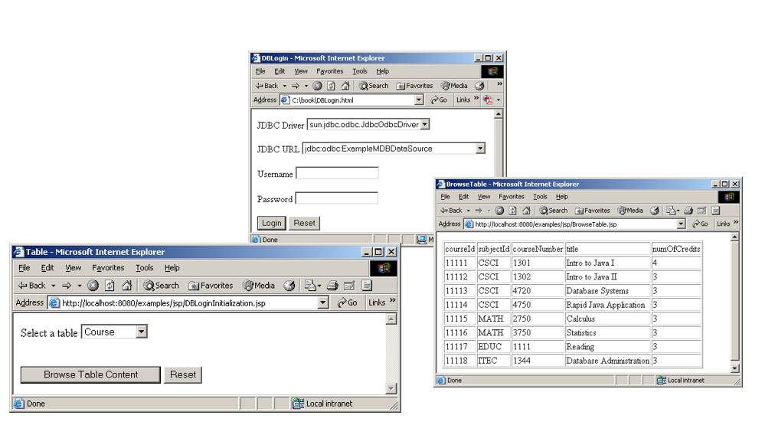
Example: Browsing Database Tables (2 of 2)
Run

Slide 58

Copyright

