Slide 1

Introduction to Java Programming
Tenth Edition
Chapter 41
Red Black Trees
Copyright © 2015 Pearson Education, Inc. All Rights Reserved

Slide 2
Objectives (1 of 2)
41.1 To know what a red-black tree is (§41.1).
41.2 To convert a red-black tree to a 2-4 tree and vice versa (§41.2).
41.3 To design the RBTree class that extends the BinaryTree class (§41.3).
41.4 To insert an element in a red-black tree and resolve the double red problem if necessary (§41.4).

Slide 3
Objectives (2 of 2)
41.5 To insert an element from a red-black tree and resolve the double black problem if necessary (§41.5).
41.6 To implement and test the RBTree class (§§41.6-41.7).
41.7 To compare the performance of AVL trees, 2-4 trees, and RBTree (§41.8).

Slide 4
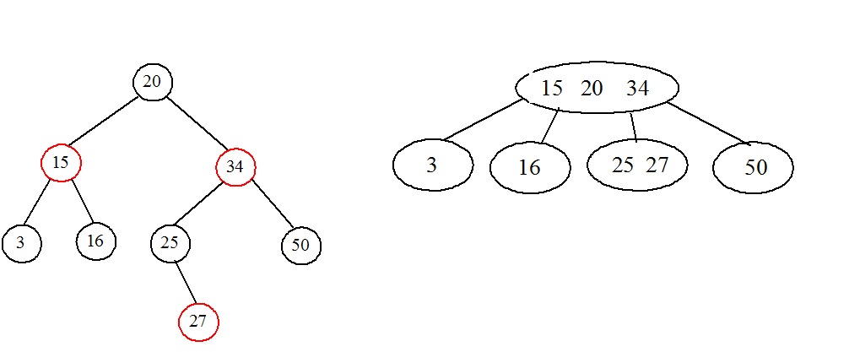
What is a Red Black Tree? (1 of 2)
A red-black tree is a binary search tree, which is derived from a 2-4 tree. A red-black tree corresponds to a 2-4 tree. Each node in a red-black tree has a color attribute red or black.

Slide 5
What is a Red Black Tree? (2 of 2)
A node is called external if its left or right subtree is empty. Note that a leaf node is external, but an external node is not necessarily a leaf node. For example, node 25 is external, but it is not a leaf. The black depth of a node is defined as the number of black nodes in a path from the node to the root. For example, the black depth of node 25 is 2 and the black depth of node 27 is 2.

Slide 6
Properties
A red-black tree has the following properties:
The root is black.
Two adjacent nodes cannot be both red.
All external nodes have the same black depth.

Slide 7
Conversion between Red-Black Trees and 2-4 Trees
To convert a red-black tree to a 2-4 tree, simply merge any red nodes with its parent to create a 3-node or a 4-node.
To convert a 2-4 tree to a red-black tree, perform the transformations for each node :

Slide 8
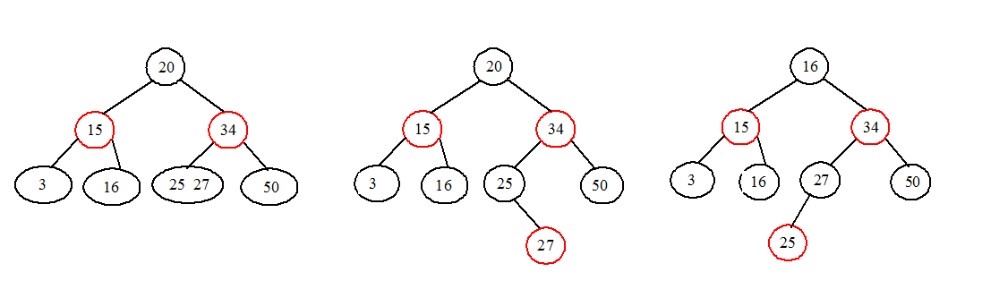
Conversion Not Unique
The conversion from a 2-4 tree to a red-black tree is not unique.

Slide 9
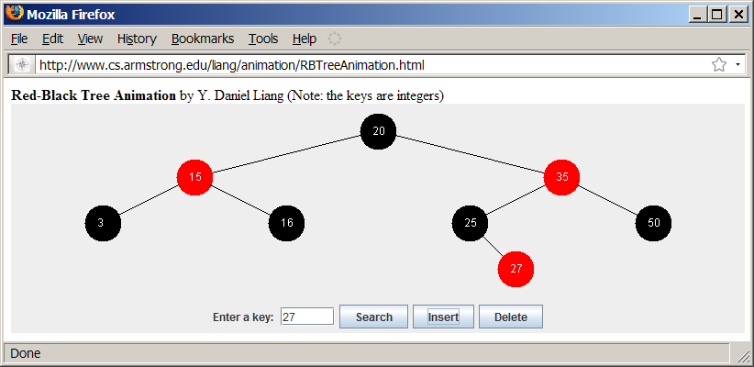
2-4 Tree Animation
http://www.cs.armstrong.edu/liang/animation/RBTreeAnimation.html

Slide 10
Designing Classes for Red Black Trees
RBTree
TestRBTree
Run

Slide 11
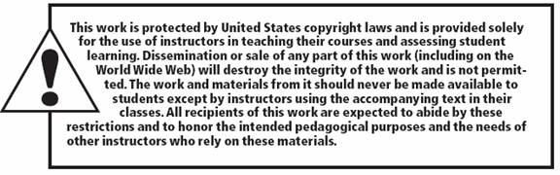
Copyright

